Slide 1
Haematopoiesis and blood cells
Dr Amit Patel
MRC Chain-Florey Clinical Research Fellow, MRC Clinical Sciences Centre,
Imperial College London
Specialist Registrar in Haematology & Intensive Care Medicine, Hammersmith Hospital, Imperial College Healthcare NHS Trust

Slide 2
Learning outcomes
Explain the origin and function of red cells, neutrophils and platelets
State the approximate intravascular life span of red cells, neutrophils and platelets
Explain the function of monocytes, eosinophils and lymphocytes
List the main physiological factors that influence the rate of red cell production

Slide 3
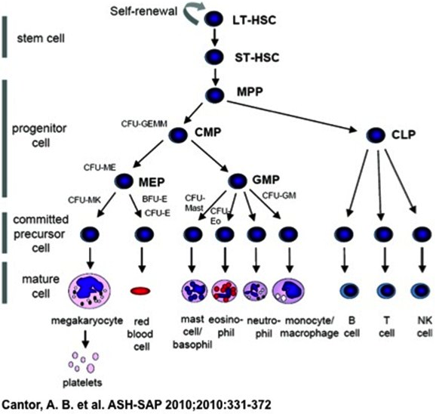
Explain the origin (function and approximate intravascular life span) of red cells, neutrophils and platelets

Slide 4
Explain the origin (function) and approximate intravascular life span of red cells, neutrophils and platelets
Haematopoietic stem cell
Common myeloid progenitor
Megakaryocyte
Erythrocyte
Multi-lymphoid progenitor
NK cells
T cells
Granulocyte-monocyte
B cells
Multi-potent progenitors
7-10 days
120 days
Neutrophil
6-10 hours
variable
Eosinophil
6 hours
Monocyte
several days
Doulatov, et al. Cell Stem Cell, 2012;10:120-136
Notes:
Blood cells of all types originate in the bone marrow
They are ultimately derived from haemopoietic stem cells
The multi-potent progenitors gives rise to multi-lymphoid progenitor and common myeloid progenitor, from which red cells, granulocytes, monocytes and platelets are derived

Slide 5
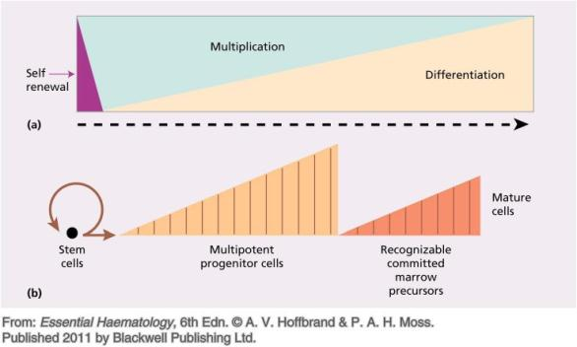
Adult stem cells and progenitors
 | Stem cell | Progenitor Cell
Self-renewal | Unlimited | Limited
Potential | Multi-potent | Oligo- or uni-potent
Self renewal | Yes | No
Maximum population | Required before division | Division population independt
Hierarchy
Toti-potent (fertilised egg)
Pluri-potent (embryonic cell)
Multi-potent (haematopoietic)
Notes:
Many properties are shared by adult stem cells and progenitor cells. But still, controversy remains because embryonic stem cells are true stem cells in that they are pluripotent and show unlimited capacity for self-renewal. In contrast, many cells termed adult stem cells would be better defined as progenitor cells, as their capacities for unlimited self-renewal and plasticity have not been comprehensively demonstrated.
Progenitor cells are found in adult organisms and they act as a repair system for the body. They replenish special cells, but also maintain the blood, skin and intestinal tissues. They can also be found in developing embryonic pancreatic tissue.

Slide 6
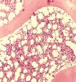
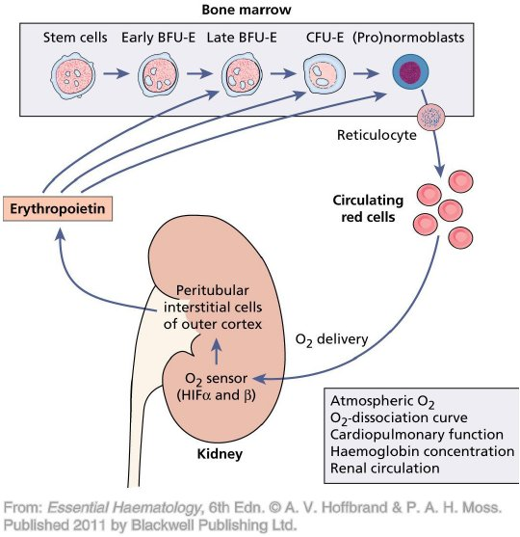
List the main physiological factors that influence the rate of red cell production
Oxygen delivery to the renal peritubular interstitial cells responsible for 90% of erythropoietin (EPO) production
Hypoxia induces hypoxia inducible factors (HIFs) alpha and beta, which stimulate EPO secretion
EPO is make on demand; not stored
Von Hippel Lindau (VHL) breaks down HIF
10% contribution of EPO from liver and intestine
Notes:
90% renal
10% liver and intestinal

Slide 7
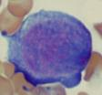
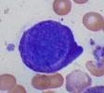
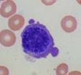
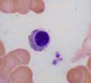
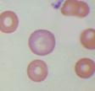
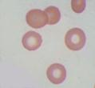
Explain the origin, function and approximate intravascular life span of red cells (neutrophils and platelets)
Main function is oxygen transport
  Also transports carbon dioxide
Erythrocyte intravascular survival is about 120 days
Erythrocyte destroyed by phagocytic cells of the spleen
Proerythroblast
Early erythroblast
Intermediate erythroblast
Late erythroblast
Polychromatic erythrocyte
Mature erythrocyte
Bain BJ, 2010, Haematology: A Core Curriculum, Imperial College Press.
Notes:
The multipotent haemopoietic stem cell can also give rise to a myeloblast, which in turn can give rise to granulocytes and monocytes
Cytokines such as G-CSF, M-CSF and GM-CSF are needed
The multipotent myeloid stem cell/ precursor can give rise to a proerythroblast
This in turn gives rise to erythroblasts and then erythrocytes or red cells

Slide 8

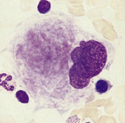
Explain the origin, function and approximate intravascular life span of (red cells, neutrophils) platelets
Vessel constriction
Platelets have a role in primary haemostasis
Platelets contribute phospholipid, which promotes blood coagulation
Platelets survive for 7 – 10 days
Formation of an unstable platelet plug
Platelet adhesion & aggregation
Stabilisation of the plug with fibrin
Blood coagulation
Dissolution of clot and vessel repair
Fibrinolysis
© Wiley-Blackwell, from Bain, Clark and Wilkins, Bone Marrow Pathology, 4th Edn, 2010

Slide 9
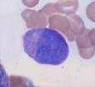
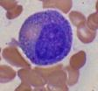
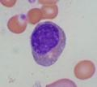
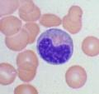
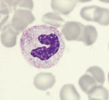
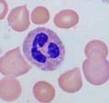


Explain the origin, function and approximate intravascular life span of (red cells) neutrophils (and platelets)
Main function is defence against infection
  phagocytoses and kills micro-organisms
Neutrophil intravascular survival is 6–10 hours before migrating to tissues
Myeloblast
Promyelocyte
Myelocyte
Metamyelocyte
Band form
Neutrophil
-blast ➔ Pro- -cyte ➔ -cyte ➔ Meta- - cyte ➔ Mature cell
Bain BJ, 2010, Haematology: A Core Curriculum, Imperial College Press.

Slide 10
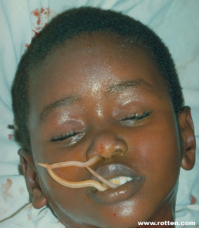
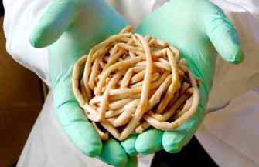

Explain the function of (monocytes) eosinophils (and lymphocytes)
Main function is immunity against parasitic infection
A myeloblast can also give rise to eosinophil granulocytes
The eosinophil spends around 6 hours in the circulation
Ascaris lumbricoides
© Wiley-Blackwell, from Bain, Blood Cells, 4th Edn, 2006

Slide 11

Explain the function of basophils
A myeloblast can also give rise to basophil granulocytes
Basophils have a role in allergic responses
© Wiley-Blackwell, from Bain, Blood Cells, 4th Edn, 2006

Slide 12
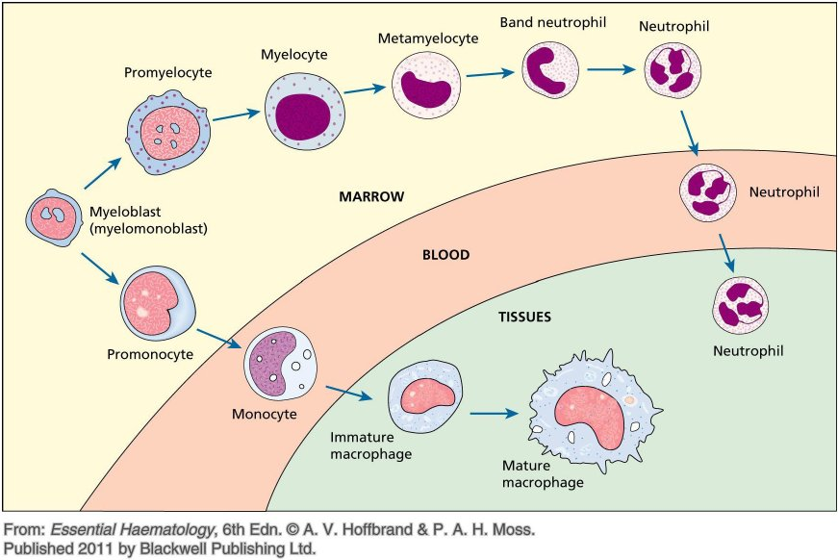
The origin of monocytes

Slide 13
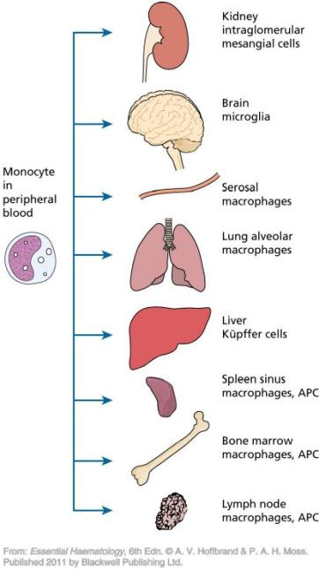


Explain the function of monocytes (eosinophils and lymphocytes
Multi-potent progenitors can give rise to monocyte precursors and thence monocytes
Monocytes spend several days in the circulation
Monocytes migrate to tissues where they develop into macrophages and other specialized cells that have a phagocytic and scavenging function
Macrophages also store and release iron
© Wiley-Blackwell, from Bain, Clark and Wilkins, Bone Marrow Pathology, 4th Edn, 2010
© Wiley-Blackwell, from Bain, Blood Cells, 4th Edn, 2006

Slide 14


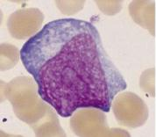
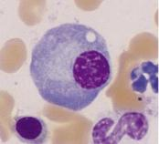
Explain the function of (monocytes, eosinophils) lymphocytes
Main function is immunity by making antibodies (humoral function) and killing infected cells (cellular function)
The lymphoid stem cell gives rise to T cells, B cells and natural killer cells
Lymphocytes recirculate to lymph nodes and other tissues and then back to the blood stream
Intravascular life span is very variable
© Wiley-Blackwell, from Bain, Blood Cells, 4th Edn, 2006

Slide 15
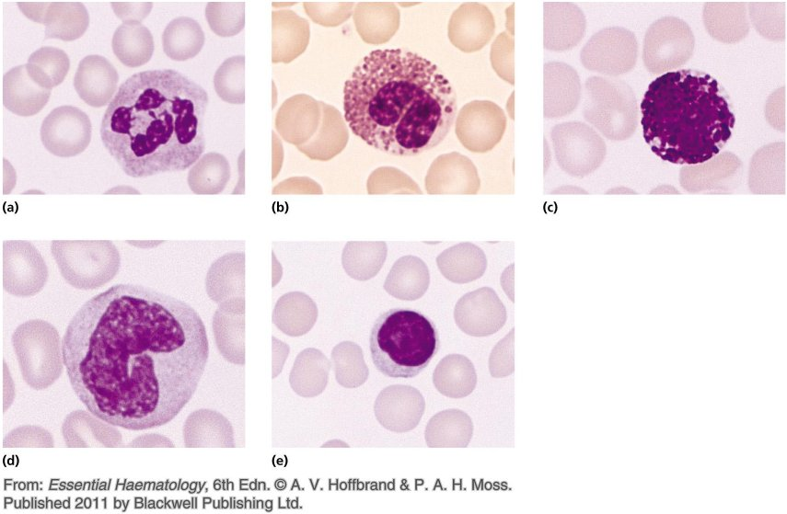
Please match the cell type to the microscope picture
Neutrophil
Eosinophil
Basophil
Monocyte
Lymphocyte
Erythrocyte
Platelet

Slide 16
The language of haematology and peripheral blood microscopy
Dr Amit Patel
MRC Chain-Florey Clinical Research Fellow, MRC Clinical Sciences Centre,
Imperial College London
Specialist Registrar in Haematology & Intensive Care Medicine, Hammersmith Hospital, Imperial College Healthcare NHS Trust

Slide 17
Terminology
All disciplines use a specialized language, employing precisely defined terms
In haematology, specialized language is used to describe blood films and counts
You need to know what the words mean and what the clinical significance might be
Red cell morphology
White cell morphology

Slide 18
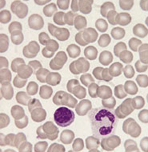
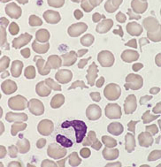
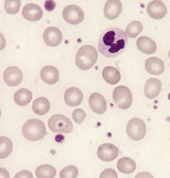
Greater variation in red cell shape or size than normal
Normal
Poikilocytosis
Anisocytosis
variation in shape
variation in size
© Wiley-Blackwell, from Bain, Blood Cells, 4th Edn, 2006

Slide 19
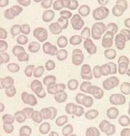
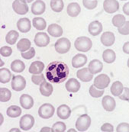



Variation in red cell size: most cells too small or too large
Normal (normocytic)
Microcytosis
Macrocytosis
normal size
smaller than normal
larger than normal
Round
Oval
Polychromatic
© Wiley-Blackwell, from Bain, Blood Cells, 4th Edn, 2006

Slide 20
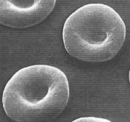
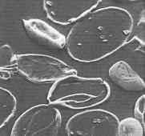
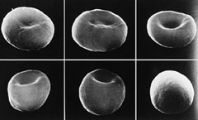
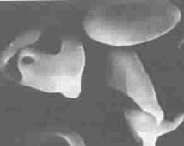

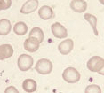

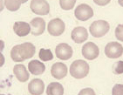
Hypochromia and hyperchromia
Normal
Hypochromia
Hyperchromia
(spherocytes)
Hyperchromia
(irregularly contracted cells)
Nagel et al. 2003, Blood Rev, 17, 167.
© Wiley-Blackwell, from Bain, Blood Cells, 4th Edn, 2006
© Elsevier, from Bain, Bates, Laffan and Lewis, Practical Haematology, 11th Edn, 2012
Notes:
Hypochromia
Normal red cells have about a third of the diameter that is pale
This is a result of the disk shape of the red cell; the centre has less haemoglobin and is therefore paler
Hypochromia means that the cells have a larger area of central pallor than normal
This results from a lower haemoglobin content and concentration and a flatter cell
Red cells that show hypochromia are described as hypochromic
Hypochromia and microcytosis often go together
Hyperchromia
Hyperchromia means that cells lack central pallor
This can occur because they are thicker than normal or because their shape is abnormal
Cells showing hyperchromia can be described as hyperchromatic or hyperchromic
Hyperchromia has many causes since many abnormally shaped cells lack the central thinner area
However there are only two important types, spherocytes and irregularly contracted cells
Spherocytes are cells that are approximately spherical in shape
They therefore have a round, regular outline and lack central pallor
They result from the loss of cell membrane without the loss of an equivalent amount of cytoplasm so the cell is forced to round up
Spherocytes in hereditary spherocytosis – can you spot them?
Irregularly contracted cells are irregular in outline but are smaller than normal cells and have lost their central pallor
They usually result from oxidant damage to the cell membrane and to the haemoglobin

Slide 21


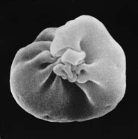
Polychromasia: blue tinge to the cytoplasm of a red cell
Detecting polychromasia or increased numbers of reticulocytes gives you similar information
Polychromasia
Red cell is dying young
Qualitative estimate of reticulocytes in the circulation
Reticulocytes
Detect young cells with a reticulocyte stain
Qualitative and quantitative (more accurate)
This exposes living red cells to methylene blue, which precipitates as a network or ‘reticulum’
© Wiley-Blackwell, from Bain, Blood Cells, 4th Edn, 2006
Notes:
However, identification of reticulocytes is more reliable so they can be counted

Slide 22
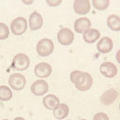
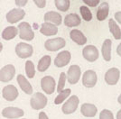
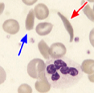
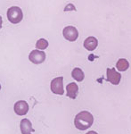

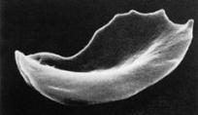
Poikilocytes also come in different shapes!
Target cells
Elliptocytes
Sickle cells
Fragments
Accumulation of haemoglobin in the centre of the area of central pallor
Occur in obstructive jaundice, liver disease, haemoglobinopathies and hyposplenism
Fragments or schistocytes are small pieces of red cells
The indicate that a red cell has fragmented
They occur in hereditary elliptocytosis and in iron deficiency (pencil cells)
They result from the polymerization of haemoglobin S when it is present in a high concentration
© Wiley-Blackwell, from Bain, Blood Cells, 4th Edn, 2006
© Springer-Verlag, Berlin, from Bessis, Living Blood Cells and Their Ultrastructure, trans Weed RI, 1973.
© Wiley-Blackwell, from Bain, Leukaemia Diagnosis, 4th Edn, 2010

Slide 23
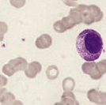
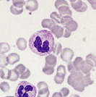
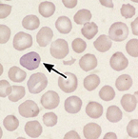
Clumping of red cells
Red cell inclusions
Rouleaux
Agglutinates
Howell-Jolly body
Rouleaux are stacks of red cells
The resemble a pile of coins
They result from alterations in plasma proteins
Red cell agglutinates differ from rouleaux in that they are irregular clumps, rather than tidy stacks
They usually result from antibody on the surface of the cells
A nuclear remnant. The commonest cause is lack of splenic function (hyposplenism)
© Wiley-Blackwell, from Bain, Blood Cells, 4th Edn, 2006

Slide 24
Describing increased or reduced cells
-cytosis = increased
-penia = reduced
Leuco- = white cell
Neutro- = neutrophil
Lympho- = lymphocyte
Thrombo- = platelet
Erythro- = red cell
Leucocytosis
Leucopenia
Neutrophilia
Neutropenia
Lymphocytosis
Lymphopenia
Thrombocytosis
Thrombocytopenia
Erythrocytosis
Reticulocytosis

Slide 25
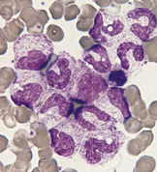
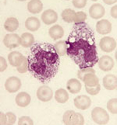
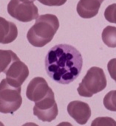
Abnormal neutrophils
Left shift
Toxic granulation
Hypersegmented
An increase in non-segmented neutrophils or neutrophil precursors in the blood
Causes: infection, inflammation and tissue necrosis, pregnancy (norm)
>5 lobes
Causes: lack of vitamin B12 or folic acid
Myeloblast
Promyelocyte
Myelocyte
Metamyelocyte
Band form
Neutrophil
Bain BJ, 2010, Haematology: A Core Curriculum, Imperial College Press.
© Wiley-Blackwell, from Bain, Blood Cells, 4th Edn, 2006

Slide 26


Atypical lymphocyte or mononuclear cell
Often describes the abnormal cells present in infectious mononucleosis (‘glandular fever’)
© Wiley-Blackwell, from Bain, Blood Cells, 4th Edn, 2006

Slide 27
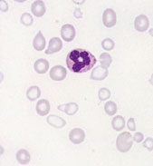
Case
Which of the following abnormalities are present?
  Anaemia
  Anisocytosis
  Poikilocytosis
  Hypochromia
  Hyperchromia
  Thrombocytopenia
© Wiley-Blackwell, from Bain, Blood Cells, 4th Edn, 2006

Slide 28


Case
Here are examples of hyperchromia: spherocytes and irregularly contracted cells
Can you guess which is which?
A
B
© Wiley-Blackwell, from Bain, Blood Cells, 4th Edn, 2006

Slide 29
Full blood count parameters
What is a normal…
Dr Amit Patel
MRC Chain-Florey Clinical Research Fellow, MRC Clinical Sciences Centre,
Imperial College London
Specialist Registrar in Haematology & Intensive Care Medicine, Hammersmith Hospital, Imperial College Healthcare NHS Trust

Slide 30
How is a normal or reference range determined?
Samples are collected from healthy volunteers with defined characteristics
They are analysed using the instrument and techniques that will be used for patient samples
The data are analysed by an appropriate technique
Notes:
In order to interpret blood counts it is necessary to know what is normal. This is usually done by reference to either a normal range or a reference range. A reference range is more strictly defined than a normal range but both represent the range of test results which would be expected in healthy people of the same age and sex (and, if relevant, of the same ethnic origin) as the person being investigated.

Slide 31
Ideal and non-ideal tests
sick
well
Excellent
sick
well
Poor
sick
well
The best you might hope for in practice

Slide 32
What is normal?
‘Normal’ is affected by
Age
Gender
Ethnic origin
Physiological status
Altitude
Nutrition
Cigarette smoking, alcohol intake

Slide 33
What is an appropriate statistical technique?
Data with a normal (Gaussian) distribution can be analysed by determining the mean and standard deviation and taking mean ± 2SD as the 95% range
Data with a different distribution must be analysed by an alternative method
Caveats
Not all results within the normal range are normal
Not all results outside the reference range are abnormal

Slide 34
A patient’s full blood count (FBC)

Slide 35
What is a FBC?
Abbreviation (units) | Meaning | Definition
WBC (x 10⁹/l) | white cell count | the number of white cells in a given volume of blood
RBC (x 10¹²/l) | red cell count | the number of red cells in a given volume of blood
Hb (g/dl or g/l) | haemoglobin | haemoglobin concentration
PCV (l/l) | packed cell volume | the proportion of a column of centrifuged blood occupied by red cells
Hct (l/l) | haematocrit | equivalent to the PCV
MCV (fl) | mean cell volume | the average size of the red cells
MCH (pg) | mean cell haemoglobin | the average amount of haemoglobin in a red cell
MCHC (g/l or g/dl) | mean cell haemoglobin concentration | the average concentration of haemoglobin red cell
Plts (x 10⁹/l) | platelet count | the number of platelets in a given volume of blood

Slide 36
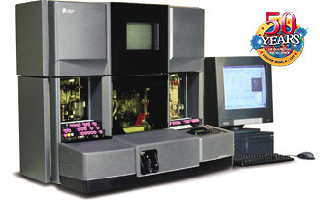
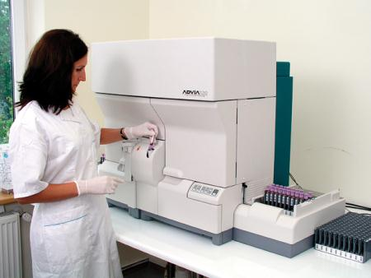
The WBC, RBC and platelet count
Current instruments look like this
Notes:
Initially counted visually, using a microscope and a diluted sample of blood
Now counted in large automated instruments, by enumerating electronic impulses generated when cells flow between a light source and a sensor or when cells flow through an electrical field

Slide 37

Measuring haemoglobin (Hb)
Initially measured in a spectrometer, by converting haemoglobin to a stable form and measuring light absorption at a specific wave length
Now measured by an automated instrument but the principle is the same
The spectrum of light absorbance of haemoglobin (as cyanmethaemoglobin) in a spectrophotometer

Slide 38


Packed cell volume (PCV) or haematocrit (Hct)
Initially measured by centrifuging a blood sample
microhaematocrit technique
Campbell P and Green A. N Engl J Med 2006;355:2452-2466
Notes:
This test is called a packed cell volume (PCV) or a haematocrit (Hct). Some haematologists use these two terms interchangeably while others used PCV to refer to a measurement made after centrifugation and Hct for an estimate made by an automated instrument. This measurement is expressed as a decimal percentage, i.e. as litres/litre (e.g. 0.45).

Slide 39

Mean cell volume (MCV)
Divide the total volume of red cells in a sample by the number of red cells in a sample
Now determined indirectly by light scattering or by interruption of an electrical field
A histogram of red cell size with cell size being determined by interruption of an electrical field
Formula for MCV
MCV (fl) = PCV (l/l) x 1000
RBC (x 10⁻¹²/l)
e.g., 0.45 x 1000 = 90
5
MCV = 96.9 fl

Slide 40




Mean cell volume (MCV)
Light microscopy
Light scattering
Normal
Low
High
© Wiley-Blackwell, from Bain, Blood Cells, 4th Edn, 2006

Slide 41
Mean cell haemoglobin (MCH)
The amount of haemoglobin in a given volume of blood divided by the number of red cells in the same volume
Thus, the absolute amount or weight of Hb per red cell
Formula for the MCH
MCH (pg) = Hb (g/l)
RBC (x 10⁻¹²/l)
e.g., 123 = 23.3 pg
5.2
Notes:
The average weight of haemoglobin in a red blood cell is measured by the MCH. MCH values usually rise or fall as the MCV is increased or decreased.

Slide 42
Mean cell haemoglobin concentration (MCHC)
The amount of haemoglobin in a given volume of blood divided by the proportion of the sample represented by the red cells
Thus, the concentration of Hb per red cell
Measured electronically, most accurately on the basis of light scattering
Formula for the MCHC
MCHC (g/dl) = Hb (g/l)
PCV (l/l)
Normal
Severe thalassaemia
Hereditary spherocytosis

Slide 43






MCH correlates with MCV, and MCHC with shape and colour
MCHC is the mean concentration of haemoglobin in a red cell
MCHC correlates with the colour and shape of red cells
MCH is the mean absolute amount or weight of haemoglobin in a red cell
MCH correlates with MCV
Normal
Reduced MCH
Normal MCHC
Reduced MCH Reduced MCHC
© Springer-Verlag, Berlin, from Bessis, Living Blood Cells and Their Ultrastructure, trans Weed RI, 1973
© Elsevier, from Bain, Bates, Laffan and Lewis, Practical Haematology, 11th Edn, 2012
© Wiley-Blackwell, from Bain, Blood Cells, 4th Edn, 2006
Notes:
The average weight of haemoglobin in a red blood cell is measured by the MCH. MCH values usually rise or fall as the MCV is increased or decreased.
MCH is increased in macrocytic anaemia and is decreased in microcytic anaemia and iron deficiency anaemia.
The MCHC measures the average concentration of haemoglobin in a red blood cell.
The MCHC categorizes red blood cells according to their concentration of haemoglobin. Cells with a normal concentration of haemoglobin are called normochromic; cells with a lower than normal concentration are called hypochromic. There is a physical limit to the amount of haemoglobin that can fit in a cell.
MCHC relates to the colour of the cells. When examined under a microscope, normal red blood cells that contain a normal amount of haemoglobin stain pinkish red with a paler area in the centre. These normochromic cells have a normal MCHC. Cells with too little haemoglobin are lighter in colour with a larger pale area in the centre. These
hypochromic cells have a low MCHC.
MCHC is increased in some cases of hereditary spherocytosis and is decreased in iron deficiency anaemia.

Slide 44

Case
Does this patient have a high or low MCV?
What is the cell that is arrowed?
What is wrong with the neutrophil?
© Wiley-Blackwell, from Bain, Blood Cells, 4th Edn, 2006

Slide 45
Anaemia
Dr Amit Patel
MRC Chain-Florey Clinical Research Fellow, MRC Clinical Sciences Centre,
Imperial College London
Specialist Registrar in Haematology & Intensive Care Medicine, Hammersmith Hospital, Imperial College Healthcare NHS Trust

Slide 46
Learning outcomes
Explain the term anaemia
Describe the mechanisms underlying the development of anaemia
Describe the classification of anaemia on the basis of red cell size
List the common causes of microcytic, normocytic and macrocytic anaemia
List causes of haemolytic anaemia and describe how you would recognise a haemolytic anaemia

Slide 47



Anaemia
Polycythaemia
© Wiley-Blackwell, from Bain, Blood Cells, 4th Edn, 2006

Slide 48
Explain the term anaemia
A reduction in the amount of haemoglobin in a given volume of blood below what would be expected in comparison with a healthy subject of the same age and gender
  Usually due to a reduction of the absolute amount of haemoglobin in the blood stream
  Occasionally from an increase in the volume of plasma
    In a healthy person, anaemia cannot persist as excess fluid is excreted
The RBC and the PCV/Hct are usually also reduced

Slide 49
Describe the mechanisms underlying the development of anaemia
Reduced production of red cells
Reduced survival of red cells (haemolysis)
Increased pooling of red cells in an enlarged spleen
Increased loss of blood from the body
Dilution from increased plasma volume (transient)
Try to distinguish the mechanism of anaemia from the cause
Sometimes neither the mechanism of the anaemia or a specific cause is immediately apparent
Classification on the basis of cell size can help to suggest specific causes
Notes:
We need to distinguish the mechanism of anaemia from the cause
The mechanism of the anaemia might be reduced synthesis of haemoglobin in the bone marrow
The cause of this could be either a condition causing reduced synthesis of haem or one causing reduced synthesis of globin
Sometimes neither the mechanism of the anaemia or the specific cause is immediately apparent
Classification on the basis of cell size can help to suggest specific causes

Slide 50
Describe the classification of anaemia on the basis of red cell size
Microcytic (usually also hypochromic)
Normocytic (usually also normochromic)
Macrocytic (usually also normochromic)
Anaemia
Normocytic anaemia
Macrocytic anaemia
Microcytic anaemia

Slide 51
List the common mechanisms of microcytic, normocytic and macrocytic anaemia
Microcytic
Defect in haem synthesis
Defect in globin synthesis (thalassaemia)
Normocytic
Reduced production of red cells
Pooling (hypersplenism)
Blood loss
Dilution from increased plasma volume (transient)
Macrocytic
abnormal haematopoiesis
  megaloblastic erythropoiesis
  delay in maturation of the nucleus while the cytoplasm continues to mature with cell grow
Premature release of cells from the bone marrow
  Young red cells are about 20% larger than mature cells
  An increased proportion of young red cells (reticulocytes) increases MCV
Notes:
Young red cells are about 20% larger than mature red cells so if there is an increased proportion of young red cells (reticulocytes) in the circulation, the average cells size (MCV) will be increased

Slide 52
List the common causes of microcytic, normocytic and macrocytic anaemia
Microcytic
  Iron deficiency
  Anaemia of chronic disease
  Defect in α chain synthesis (α thalassaemia)
  Defect in β chain synthesis (β thalassaemia)
Normocytic
Peptic ulcer, oesophageal varices, trauma
Early stages of iron deficiency or anaemia of chronic disease
Renal failure
Bone marrow failure or suppression
Bone marrow infiltration
Hypersplenism, e.g. portal cirrhosis
Macrocytic
Lack of vitamin B12 or folic acid
Use of drugs interfering with DNA synthesis
Liver disease and ethanol toxicity
Recent major blood loss with adequate iron stores (reticulocytes increased)
Haemolytic anaemia (reticulocytes increased)

Slide 53
Reduced red cell survival: classifying haemolytic anaemia
intrinsic abnormality of the red cells
extrinsic factors acting on normal red cells
Intravascular
  occurs if there is very acute damage to the red cell
Extravascular haemolysis
  occurs when defective red cells are removed by the spleen
Often haemolysis is partly intravascular and partly extravascular
Inherited
  abnormalities in the cell membrane, the haemoglobin or the enzymes in the red cell
Acquired
  extrinsic factors, e.g., micro-organisms, chemicals or drugs that damage the red cell
Extrinsic factors can interact with red cells that have an intrinsic abnormality

Slide 54
List causes of haemolytic anaemia (and describe how you would recognise a haemolytic anaemia)

Slide 55
List causes of haemolytic anaemia (and describe how you would recognise a haemolytic anaemia)
Site of defect | Examples
Inherited
Membrane | Hereditary spherocytosis
Haemoglobin | Sickle cell anaemia
Glycolytic pathway | Pyruvate kinase deficiency
Pentose shunt | Glucose-6 phosphate dehydrogenase deficiency
Acquired
Membrane – immune | Autoimmune haemolytic anaemia
Whole red cell – mechanical | Microangiopathic haemolytic anaemia
Whole red cell – oxidant | Drugs and chemicals
Whole red cell – microbiological | Malaria

Slide 56

Increased bilirubin
Reduced haptoglobin, then free haemoglobin is filtered by the kidney

Slide 57



(List causes of haemolytic anaemia) and describe how you would recognise a haemolytic anaemia
Normochromic and usually either normocytic or macrocytic anaemia
Evidence of morphologically abnormal red cells
Evidence of increased red cell breakdown
  Jaundice (increased unconjugated hyperbilirubinaemia)
    Pigment gallstones
  Increased lactate dehydrogenase (LDH)
Evidence of increased bone marrow activity
  Increased reticulocytes
  Polychromasia
© Wiley-Blackwell, from Bain, Leukaemia Diagnosis, 4th Edn, 2010
© Wiley-Blackwell, from Bain, Interactive Haematology Imagebank, 2nd Edn, 2012
Notes:
All you need to know is
How to suspect or recognize haemolytic anaemia
The features of a few common and important causes of haemolytic anaemia

Slide 58


Hereditary spherocytosis - extravascular haemolysis
Chronic compensated haemolysis
inherited intrinsic defect of the red cell membrane
After entering the circulation the cells lose membrane in the spleen
  become spherocytic
    Red cells become less flexible
    removed prematurely by the spleen
    prone to haemolyse when osmotic pressure is reduced
Treatment is splenectomy
  risky, so only done in severe cases
Risk of folic acid deficiency
  Need a good diet
  Daily folic acid
This test is not often needed
© Wiley-Blackwell, from Bain, Blood Cells, 4th Edn, 2006
© Wiley-Blackwell, from Bain, Interactive Haematology Imagebank, 2nd Edn, 2012

Slide 59






Glucose-6-phosphate dehydrogenase (G6PD) deficiency
Enzyme in the pentose phosphate shunt that protects against oxidant damage
Intrinsic oxidants (e.g., in blood stream during infection)
Extrinsic oxidants (e.g., broad beans, chemicals [naphthalene], or drugs [dapsone, primaquine]
G6PD gene on the X chromosome
  Hemizygous males (occasionally homozygous females) affected
Intermittent, severe intravascular haemolysis as a result of oxidant stress
Episodes of intravascular haemolysis associated with the appearance of considerable numbers of irregularly contracted cells
Haemoglobin is denatured and forms round inclusions known as Heinz bodies, which can be detected by a specific test
Acute haemolysis sometimes requires blood transfusion
Thereafter, prevention is important
Irregularly contracted cells
Heinz bodies
Spleen removes Heinz bodies, leaving a defect in the cell
www.rustwholesale.com
www.seasonalchef.com/bestbuys051003.htm
© Wiley-Blackwell, from Bain, Blood Cells, 4th Edn, 2006
© Wiley-Blackwell, from Bain, Interactive Haematology Imagebank, 1st Edn, 1999
© Wiley-Blackwell, from Amare et al. (1972), British Journal of Haematology, 23, 215.
Notes:
Mothballs advertised as 100% pure naphthalene

Slide 60

Autoimmune haemolytic anaemia: anaemia and spherocytosis
Autoantibodies directed to red cell antigens
Immunoglobulin bound to the red cell membrane is recognized by splenic macrophages, which remove parts of the red cell membrane, leading to spherocytosis
The spherocytes are less flexible than normal red cells
The combination of cell rigidity and recognition of antibody and complement on the red cell surface by splenic macrophages leads to removal of cells from the circulation by the spleen
Diagnosis:
  spherocytes and an increased reticulocyte count
  Detecting immunoglobulin on the red cell surface
  Detecting antibodies to red cell antigens or other autoantibodies in the plasma
Treatment
  Corticosteroids and other immunosuppressive agents
  Splenectomy for severe cases
© Wiley-Blackwell, from Bain, Blood Cells, 4th Edn, 2006

Slide 61

Case
What is wrong with the red cells?
Are they spherocytes?
What has the patient been eating?
© Wiley-Blackwell, from Bain, Blood Cells, 4th Edn, 2006

Slide 62

Case
List the abnormalities in this blood film identified by the arrows
© Wiley-Blackwell, from Bain, Blood Cells, 4th Edn, 2006

Slide 63




Case
Why are all these patients suspected of having a haemolytic anaemia?
© Wiley-Blackwell, from Bain, Blood Cells, 4th Edn, 2006

Slide 64
Polycythaemia
Dr Amit Patel
MRC Chain-Florey Clinical Research Fellow, MRC Clinical Sciences Centre,
Imperial College London
Specialist Registrar in Haematology & Intensive Care Medicine, Hammersmith Hospital, Imperial College Healthcare NHS Trust

Slide 65

Polycythaemia: too many red cells in the circulation
The Hb, RBC and PCV/Hct are all increased compared with normal subjects of the same age and gender
Virchow’s triad
Blood constituents
Blood vessel
Blood flow
‘thick blood’ or hyperviscosity can lead to vascular obstruction
Polycythaemia
Normal
true polycythaemia refers to an increase in the number of circulating red cells
‘pseudopolycythaemia’ or ‘apparent polycythaemia’ refers to a decrease in plasma volume that increases Hb, RBC, PCV/Hct
Campbell P and Green A. N Engl J Med 2006;355:2452-2466
Notes:
Figure 1. Laboratory Features of Polycythemia Vera, Essential Thrombocythemia, and Idiopathic Myelofibrosis. Polycythemia vera is characterized by an increased hematocrit in the peripheral blood (test tube on left); a hypercellular marrow with increased numbers of erythroid, megakaryocytic, and granulocytic precursor cells; and a variable increase in the number of reticulin fibers. Essential thrombocythemia is characterized by an increase in the number of platelets in the peripheral blood and an increased number of megakaryocytes in the marrow, which tend to cluster together and have hyperlobated nuclei. Idiopathic myelofibrosis is characterized by the presence of immature red and white cells (a so-called leukoerythroblastic blood film) and "teardrop" red cells, disordered cellular architecture, dysplastic megakaryocytes, new bone formation in the marrow, and the formation of collagen fibers.

Slide 66
Explain the possible mechanisms underlying polycythaemia
Type of polycythaemia | Example
Physiological | Newborn baby
Appropriate erythropoietin secretion | Altitude, e.g., Himalayas or Andes Hypoxia, e.g., cyanotic heart disease, severe chronic lung disease
Inappropriate erythropoietin secretion or adminstration | Erythropoietin abuse by athletes, e.g., ‘blood doping’ Erythropoietin secreted by renal cysts or tumours, or other tumours
Erythropoietin-independent | Polycythaemia vera
If there is no physiological need for a high haemoglobin, or if hyperviscosity is extreme, blood can be removed to thin the blood
If there is intrinsic bone marrow disease, drugs can be used to reduce bone marrow production of red cells

Slide 67


Consequences of polycythaemia
To increase [Hb] by 1 g/dl, 4 ml/kg of PRC is given IV
PRC unit volume = 282 ml (± 32 ml)
Thus, 1 unit of PRC will increase [Hb] by 1 g/dl in a ~70 kg patient
Polycythaemia from over-transfusion
Small adult female with haematuria and anaemia
  Hb of 6.3 g/dl
8 units of blood were transfused; patient’s Hb rose to 20.5 g/dl and she became hypertensive
She required daily venesection for 3 days
http://www.shotuk.org/home/

Slide 68
Achieved learning objectives
Explain the origin and function of red cells, neutrophils and platelets
State the approximate intravascular life span of red cells, neutrophils and platelets
Explain the function of monocytes, eosinophils and lymphocytes
List the main physiological factors that influence the rate of red cell production
Explain the term anaemia
Describe the mechanisms underlying the development of anaemia
Describe the classification of anaemia on the basis of red cell size
List the common causes of microcytic, normocytic and macrocytic anaemia
List causes of haemolytic anaemia and describe how you would recognise a haemolytic anaemia
Explain the possible mechanisms underlying polycythaemia

Slide 69

Thank you – Any final questions?
Additional Interactive Resources:
Haematology Imagebank on the Intranet
CAL and practical classes
Dr Amit Patel
MRC Chain-Florey Clinical Research Fellow, MRC Clinical Sciences Centre,
Imperial College London
Specialist Registrar in Haematology & Intensive Care Medicine, Hammersmith Hospital, Imperial College Healthcare NHS Trust

