Slide 1
GE: Haematology
4 February 2013
Haemostasis: Professor David Lane
Abnormalities of haemostasis
- Professor Mike Laffan
Department of Haematology
Hammersmith Hospital Campus
(d.lane@imperial.ac.uk; m.laffan@imperial.ac.uk)

Slide 2
Learning Objectives
The student should be able to:
Assess the significance of bleeding symptoms.
Describe with examples, the clinical features of abnormal bleeding due to defects of primary haemostasis and coagulation disorders and explain why they are different.
Describe the uses and limitations of laboratory tests to assess haemostasis
Explain the inheritance of haemophilia and von Willebrand disease
Describe the principles of management of disorders of
Haemostasis.

Slide 3
Abnormal Haemostasis
What is abnormal bleeding?
Why do people have abnormal haemostasis?
Genetics of hereditary bleeding disorders
Laboratory detection/prediction of abnormal haemostasis
Treatment of bleeding disorders

Slide 4
Minor bleeding symptoms are common
Easy bruising 12%
Gum bleeding 7%
Frequent nosebleeds 5%
Bleeding after tooth extraction 2.5%
Post operative bleeding 1.4%
In women
Menorrhagia 23%
Post partum bleeding 6%
Family history 44%

Slide 5
History and Bleeding after tonsillectomy
non bleeding
%(228)
Known bleeding disorder
%(31)
24
36
39
4
4.9
3.6
2.7
67
68
69
47
39
30
22
Easy bruising
Frequent bruising
Epistaxes
>10mins
Bruises >1 site
Large bruises
Haematomata
Nosek-Cenkowska 1991

Slide 6
A significant bleeding history: elements
Epistaxis not stopped by 10 mins compression or requiring medical attention/transfusion.
Cutaneous haemorrhage or bruising without apparent trauma (esp. multiple/large).
Prolonged (>15 mins) bleeding from trivial wounds, or in oral cavity or recurring spontaneously in 7 days after wound. Spontaneous GI bleeding leading to anaemia.
Menorrhagia requiring treatment or leading to anaemia, not due to structural lesions of the uterus.
Heavy, prolonged or recurrent bleeding after surgery or dental extractions.
Sadler 2005

Slide 7
Why do people bleed?

Slide 8
Haemostatic Plug Formation: An Overview
Response to injury
Vessel constriction
Formation of an unstable platelet plug
-platelet adhesion
-platelet aggregation
Stabilisation of the plug with fibrin
-blood coagulation
Dissolution of clot and vessel repair
-fibrinolysis

Slide 9
Abnormal Haemostasis
Lack of coagulation factor(s)
Failure of production: congenital and acquired
Increased consumption/clearance
Defective function of coagulation factor(s)
Genetic defect
Acquired defect – drugs, synthetic defect, inhibition

Slide 10
Haemostatic Plug Formation: An Overview
Response to injury
Vessel constriction
Formation of an unstable platelet plug
-platelet adhesion
-platelet aggregation
Stabilisation of the plug with fibrin
-blood coagulation
Dissolution of clot and vessel repair
-fibrinolysis
Primary
haemostasis

Slide 11
Defects of primary haemostasis

Slide 12
Platelet adhesion
platelet
Von
Willebrand
factor
Endothelial
cells
or
platelet
GlpIb
GlpIa
collagen
Release of ADP
&
thromboxane
Platelet aggregation
GlpIIb/IIIa
platelet
platelet
platelet
Fibrinogen
+
Ca2+

Slide 13
lumen
platelet
platelet
platelet
platelet
platelet
platelet
Collagen
Tissue Factor
Primary Haemostasis: platelet plug
Notes:
Consider damaged vessel. 2 crucial molecules exposed. Forget TF.

Slide 14
lumen
platelet
platelet
platelet
Collagen
Tissue Factor
VWD: failure of primary haemostasis
Notes:
Consider damaged vessel. 2 crucial molecules exposed. Forget TF.

Slide 15
Bleeding in disorders of primary haemostasis
Typical primary haemostasis bleeding:
Immediate
Prolonged bleeding from cuts
Epistaxes
Gum bleeding
Menorrhagia
Easy bruising
Prolonged bleeding after trauma or surgery
Thrombocytopenia – Petechiae
Severe VWD – haemophilia-like bleeding

Slide 16
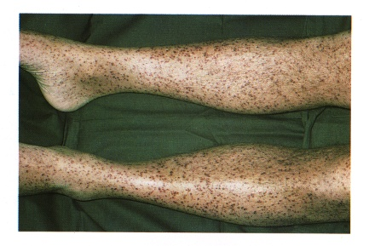
Purpura and petechiae

Slide 17
Tests for disorders of primary haemostasis
Platelet count
Bleeding time (PFA100 in lab)
Platelet aggregation
Assays of von Willebrand Factor
Clinical observation

Slide 18
Disorders of Primary Haemostasis
Platelets
Low numbers: “thrombocytopenia”
Bone marrow failure eg: leukaemia, B12 deficiency
Accelerated clearance eg: immune (ITP), DIC.

Slide 19
Auto-Immune Thrombocytopenic Purpura (auto-ITP)
Y
antiplatelet
autoantibodies
Y
Y

Slide 20
Auto-Immune Thrombocytopenic Purpura (auto-ITP)
Y
antiplatelet
autoantibodies
Y
Y
.
.
.
sensitised
platelet
Y
.
.
Y
.

Slide 21
Auto-Immune Thrombocytopenic Purpura (auto-ITP)
Y
antiplatelet
autoantibodies
Macrophage
(Spleen)
Y
Y
v
.
.
.
v
sensitised
platelet
Y
.
.
Y
.
.
.
sensitised
platelet
Y
.
v
.
.
.
.
.
Y
Y
Y
v
v
ITP is a very common cause
of thrombocytopenia
v

Slide 22
Mechanisms (and causes) of Thrombocytopenia
1. Failure of platelet production by megakaryocytes
2. Shortened half life of platelets (eg: ITP)
3. Increased pooling of platelets in an enlarged spleen
(hypersplenism) + shortened half life

Slide 23
Disorders of Primary Haemostasis
Platelets
Low numbers: “thrombocytopenia”
Bone marrow failure eg: leukaemia, B12 deficiency
Accelerated clearance eg: immune (ITP), DIC.
Pooling and destruction in an enlarged spleen
Impaired function
Hereditary absence of glycoproteins or storage granules

Slide 24
Hereditary Platelet defects
Microtubules &
actomyosin
Surface glycoproteins:
GpIa
GpIIb/IIIa
GpIb
X
X
Glycogen
X
Dense granules:
ADP
ATP
Serotonin
Ca2+
Phospholipid
membrane
α granules:
growth factors
fibrinogen
factor V
vWF
Open cannalicular
system
(Receptor
for
thrombin)
mitochondrion
Glanzmann’s thrombasthenia
Bernard Soulier syndrome
Storage Pool disease

Slide 25
Disorders of Primary Haemostasis
Platelets
Low numbers: “thrombocytopenia”
Bone marrow failure eg: leukaemia, B12 deficiency
Accelerated clearance eg: immune (ITP), DIC.
Pooling and destruction in an enlarged spleen
Impaired function
Hereditary absence of glycoproteins or storage granules
Acquired due to drugs: aspirin, NSAIDs, clopidogrel

Slide 26
Disorders of Primary Haemostasis
Platelets
Von Willebrand Factor
Von Willebrand disease
Hereditary decrease of quantity +/ function (common)
Complex multimeric protein – many defective variants
Acquired due to antibody (rare)

Slide 27
Disorders of Primary Haemostasis
Platelets
Von Willebrand Factor
The vessel wall
Inherited (rare) Hereditary haemorrhagic telangiectasia, Ehlers-Danlos syndrome and other connective tissue disorders

Slide 28
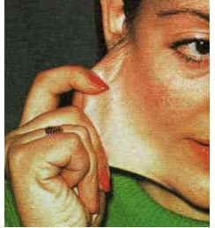
Ehlers Danlos syndrome
Notes:
Blue sclera, especially seen in females.Atypical ears: prominent “winged”, small, round, lobeless, lobe attached to face, ears with different shapes: kidney shape, “Dumbo ears”, “Mr. Spock ears”, soft ears, with bent helix. Abnormal nose: with a lump in the union of the bone and the cartilage, nasal septum deviation,

Slide 29
Disorders of Primary Haemostasis
Platelets
Von Willebrand Factor
The vessel wall
Inherited (rare) Hereditary haemorrhagic telangiectasia Ehlers-Danlos syndrome and other connective tissue disorders
Acquired: Scurvy, Steroid therapy, Aging (senile purpura), Vasculitis

Slide 30
Disorders of Primary Haemostasis
Summary
Platelets
Thrombocytopenia
Platelet function defects
Drugs
Von Willebrand Factor
Von Willebrand disease
The vessel wall
Hereditary vascular disorders
Scurvy, steroids, age

Slide 31
Defects of coagulation (secondary haemostasis)

Slide 32
Haemostatic Plug Formation: An Overview
Response to injury
Vessel constriction
Formation of an unstable platelet plug
-platelet adhesion
-platelet aggregation
Stabilisation of the plug with fibrin
-blood coagulation
Dissolution of clot and vessel repair
-fibrinolysis
Secondary
haemostasis

Slide 33
Blood coagulation
XII
XIIa
XI
XIa
Tissue factor
VIIa
(vessel damage)
Ca
2+
IX
IXa
VIIa
EXTRINSIC
PATHWAY
INTRINSIC
PATHWAY
VIIIa
Ca
2+
Pl
Ca ²⁺
X
Xa
X
Va
Pl
Ca
2+
COMMON
PATHWAY
Prothrombin
thrombin (IIa)
Fibrinogen
Fibrin
thrombin
XIIIa
XIII
Crosslinked
fibrin

Slide 34
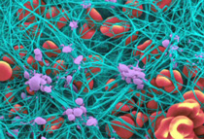
Fibrin mesh binds and stabilises platelet plug and other cells

Slide 35
Disorders of coagulation
The role of the coagulation cascade is to generate a burst of thrombin which will convert fibrinogen to fibrin
Deficiency of any coagulation factor results in a failure of thrombin generation and hence fibrin formation

Slide 36
Thrombin generation by the coagulation cascade
Normal
Haemophilia
Factor VIII <1%
TF trigger
Notes:
We can visualise the process of coagulation by measuring thrombin generation over time. This is often called the thrombogram and looks like this…

Slide 37
lumen
Haemostasis: fibrin clot stabilising platelet plug
Notes:
Consider damaged vessel. 2 crucial molecules exposed. Forget TF.

Slide 38
lumen
Haemophilia: failure to generate fibrin to stabilise platelet plug
Notes:
Consider damaged vessel. 2 crucial molecules exposed. Forget TF.

Slide 39
Coagulation and secondary haemostasis
The primary platelet plug is sufficient for small vessel injury
In larger vessels it will fall apart
Fibrin formation stabilises the platelet plug

Slide 40
Disorders of Coagulation
Deficiency of coagulation factor production
Hereditary
Factor VIII/IX: haemophilia A/B

Slide 41
Coagulation factor deficiencies are not all the same
Factor VIII and IX (Haemophilia)
Severe but compatible with life
Spontaneous joint and muscle bleeding
Prothrombin (Factor II)
Lethal
Factor XI
Bleed after trauma but not spontaneously
Factor XII
No excess bleeding at all

Slide 42
Asymptomatic
Blood coagulation
XII
XIIa
Mild
XI
XIa
Tissue factor
VIIa
(vessel damage)
Ca
2+
IX
IXa
VIIa
EXTRINSIC
PATHWAY
INTRINSIC
PATHWAY
VIIIa
Severe
Ca
2+
Pl
Ca ²⁺
X
Xa
X
Va
Pl
Lethal
Ca
2+
COMMON
PATHWAY
Prothrombin
thrombin (IIa)
Fibrinogen
Fibrin
thrombin
XIIIa
XIII
Crosslinked
fibrin

Slide 43
Disorders of Coagulation
Deficiency of coagulation factor production
Hereditary failure of production
Factor VIII/IX: haemophilia A/B
Acquired
Liver disease
Dilution
Anticoagulant drugs – warfarin

Slide 44
Acquired coagulation disorders (1)
More common in hospital practice
Liver failure – decreased production
Most coagulation factors are synthesized in the liver
Dilution
Red cell transfusions no longer contain plasma
Major transfusions require plasma as well as rbc and platelets
Warfarin
Inhibits synthesis of II, VII, IX and X

Slide 45
Disorders of Coagulation
Deficiency of coagulation factor production
Hereditary failure of production
Factor VIII/IX: haemophilia A/B
Acquired
Liver disease
Dilution
Anticoagulant drugs – warfarin
Increased consumption
Acquired
Disseminated intravascular coagulation (DIC)
Immune - autoantibodies

Slide 46
Acquired coagulation disorders (2)
Consumption
Disseminated intravascular coagulation
increased consumption
Generalised activation of coagulation – Tissue factor
Associated with sepsis, major tissue damage, inflammation
Consumes and depletes coagulation factors
Platelets consumed
Activation of fibrinolysis depletes fibrinogen
Deposition of fibrin in vessels causes organ failure

Slide 47
Bleeding in coagulation disorders
superficial cuts do not bleed (platelets)
bruising is common, nosebleeds are rare
spontaneous bleeding is deep, into muscles
and joints
bleeding after trauma may be delayed and is prolonged
frequently restarts after stopping

Slide 48
Taking blood samples is usually safe

Slide 49
Haemarthrosis – hallmark of haemophilia

Slide 51
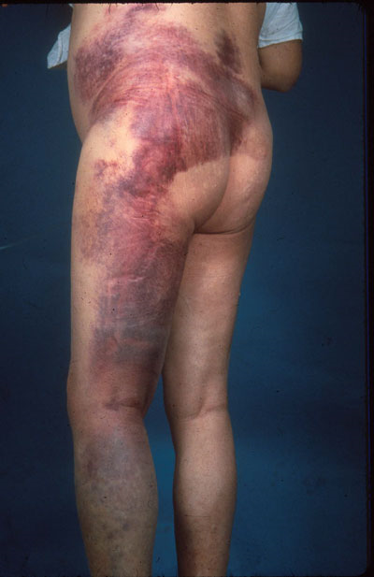
Intramuscular injections should be avoided

Slide 52
Do not mistake bleeding disorders for NAI

Slide 53
How dangerous is haemophilia?
Carol Birch 1937

Slide 54
How dangerous is warfarin?
By depleting Vitamin K
Warfarin reduces levels of II, VII, IX and X
Also reduces Protein C and Protein S
Net effect is anticoagulant
Anticoagulant effect is best measured using the INR (international normalised ratio) which is calculated from the prothrombin time:

Slide 55
Warfarin Monitoring
INR (International Normalised Ratio)
ISI = International Sensitivity Index
Indicates sensitivity of particular thromboplastin for warfarin
Unanticoagulated normal INR = 1.0

Slide 56
Optimising Intensity of oral anticoagulation
Target INR
Recurrence
Haemorrhage
2.0-3.0
2%
4%
3.0-4.0
2%
22%
Hull et al 1982

Slide 57
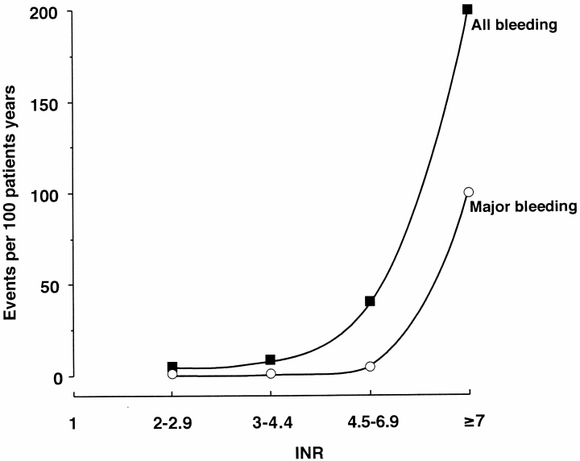
Bleeding risk vs. INR
Makris 2001

Slide 58
Some rough numbers
Approx 1% of the population take warfarin
Major haemorrhage 2% pa and increases over 70
1% mortality from AAICH in the elderly.
AAICH 5 per 100000 2004
4.4 1999
0.8 1988
10-25% of ICH admissions are warfarin-associated (maybe one a month for a regional neurosurgery centre)
Notes:
Possibly goes up to 10%pa in 75 year olds. (must be less than this – refer to Linkins Ann Int Med 139:893 (2003)
Maybe 2000 deaths a year from AAICH in UK.
Mean age of AAICH is in the 70’s

Slide 59
Anticoagulation: stratified risk
Haemorrhage (%pa)
Risk Modifier
Minor
Major
Fatal
Overall
6.2
1.1
0.25
Age (<50)
6.9
0
0
Age (50-69)
5.0
0.7
0
Age (≥70)
7.5
2.2
0.7
Arterial disease
9.8
2.2
0.45
Time <90days
9.2
1.6
0.18
Target <2.8
6.8
1.2
0.22
Palareti 1996

Slide 60
Clinical Distinction Between Bleeding due to Platelet and
Coagulation Defects
Platelet/Vascular
Superficial bleeding
into skin, mucosal
membranes
Bleeding immediate
after injury
Coagulation
Bleeding into deep
tissues, muscles,
joints
Delayed, but severe
bleeding after
injury. Bleeding
often prolonged
This is a simplistic distinction. Note that
either defect can be life threatening

Slide 61
Tests for coagulation disorders
Screening tests (‘clotting screen’)
Prothrombin time (PT)
Activated partial thromboplastin time (APTT)
Full blood count (platelets)
Factor assays (for Factor VIII etc)
Tests for inhibitors

Slide 62
HMWK
APTT
CONTACT
PK
XII
XI
VIIa
PT
TF
VIII
IX
V
X
TT
IIa
II
Fibrinogen
Fibrin

Slide 63
PROLONGED APTT in HAEMOPHILIA
Contact
APTT
(intrinsic)
XII
PT
(extrinsic)
XI
VIIa
VIII
IX
TF
PT 10.6s (9.6-11.6)
APTT 85s (26-32)
TT 16s (15-19)
V
X
II
Fibrinogen
Fibrin

Slide 64
Bleeding disorders not detected by
routine clotting tests
Mild factor deficiencies
von Willebrand disease
Factor XIII deficiency (cross linking)
Platelet disorders
Excessive fibrinolysis
Vessel wall disorders
Metabolic disorders (e.g. uraemia)
(Thrombotic disorders)

Slide 65
Haemostatic Plug Formation: An Overview
Response to injury
Vessel constriction
Formation of an unstable platelet plug
-platelet adhesion
-platelet aggregation
Stabilisation of the plug with fibrin
-blood coagulation
Dissolution of clot and vessel repair
-fibrinolysis
Fibrinolysis

Slide 66
Disorders of Fibrinolysis
Disorders of fibrinolysis can cause abnormal bleeding but are rare
Hereditary
antiplasmin deficiency
Acquired
drugs such as tPA
Disseminated intravascular coagulation

Slide 67
Genetics of common bleeding disorders

Slide 68
Haemophilia: a sex linked recessive disorder
XY
XX
XX
XY
100%
95%
50%
120%
XY
XX
XX
XY
1%
65%
60%
110%
Unaffected female
Carrier female
Unaffected male
Affected male

Slide 69
Von Willebrand disease: an autosomal
dominant disorder
Unaffected female
Affected female
Unaffected male
Affected male

Slide 70
Genetics of common bleeding disorders
Haemophilia
Sex linked recessive (SLR)
Von Willebrand disease
Autosomal dominant (AD)
All the rest (V, X etc.)
Autosomal recessive (AR)
And therefore much less common

Slide 71
Principles of treatment

Slide 72
Treatment of abnormal haemostasis
Failure of production/function
Give missing factor/platelets
Prophylactic
Therapeutic
Stop drugs
Immune destruction
Immunosuppression (eg prednisolone)
Splenectomy for ITP
Increased consumption
Treat cause
Replace as necessary

Slide 73
Factor replacement therapy
Principles of Treatment of Haemostatic
Disorders Causing Bleeding
Plasma
Contains all coagulation factors
Cryoprecipitate
Rich in Fibrinogen, FVIII, VWF, Factor XIII
Factor concentrates
Concentrates available for all factors except factor V.
Recombinant forms of FVIII and FIX are available.
Platelet replacement therapy
Pooled platelet concentrates available

Slide 74
Using factor replacement therapy
factor
level (%)
100
75
50
25
0
VIII
IX
0
12
24
24
36
48
96
60
time (hours)

Slide 75
Additional haemostatic treatments
DDAVP
Tranexamic acid
Fibrin glue/spray

Slide 76
Desmopressin (DDAVP)
Vasopressin derivative
2-5 fold rise in VWF-VIII (VIII>vWF)
Releases endogenous stores -
Hence only useful in mild disorders
Dose
Peak response
0.3µg/kg i.v
30-60 mins
300µg i.n.
60-90 mins

Slide 77
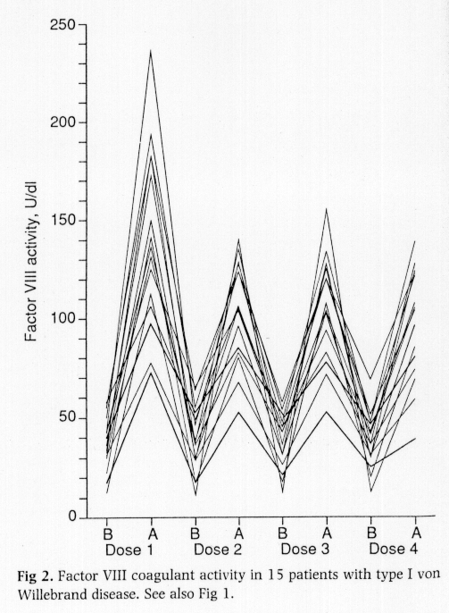
Repeated DDAVP doses and Factor VIII
Mannucci 1992

Slide 78
Tranexamic acid
Inhibits fibrinolysis
Widely distributed – crosses placenta
Low concentration in breast milk
Useful adjunctive therapy.
Intravenous: 0.5g tds
Oral: 1.5g tds
Mouthwash: 1g (10ml 5%) qds

Slide 79
Haemostasis and Thrombosis: a Balance
Normal haemostasis: a state of equilibrium
Fibrinolytic factors,
anticoagulant proteins
Coagulation factors,
platelets

Slide 80
Bleeding
Coagulation factors,
platelets
Fibrinolytic
factors,
anticoagulant
proteins

Slide 81
Thrombosis
Fibrinolytic factors,
anticoagulant proteins
Coagulation
factors,
platelets

