Slide 1
The Future of Genomic Medicine: facts and fiction
Dr Jess Buxton
Imperial College London

Slide 2
The future: fiction?
Designer babies chosen for ‘brains and beauty’?
DNA technology used to determine social class?

Slide 3
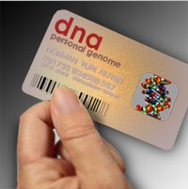
The future: fact?
Personalised healthcare based on genetic information

Slide 4
What we know now:
Chromosome abnormalities that cause congenital conditions
Genetic mutations identified for many monogenic diseases
Currently offered in UK:
- antenatal screening for all pregnant women
- genetic tests/counselling for families affected by monogenic diseases
- newborn screening programmes
The entire DNA sequence of the ‘reference’ human genome
Extensive genetic variation identified – both single bp changes and structural variants
Some common and rare genetic variants that affect risk of complex disease

Slide 5
What we don’t (yet) know:
What all DNA of human genome codes for
Causes of some rare monogenic diseases
Genetic variants that affect different drug responses
Most of DNA variants that affect risk of complex disease
How genetic and environmental factors interact to affect risk of complex disease
But what if we did?

Slide 6
Outline
Advances in genomic medicine
‘Next generation’ DNA sequencing
Finding the causes of monogenic disease
Pharmacogenetics
Risk of common, complex diseases
Personalised healthcare
Direct-to-consumer genetic testing
Ethical issues
Future perspectives
Embryo testing
Preimplantation genetic diagnosis (PGD)
Uses and limitations
Ethical issues
Notes:
During this lecture I aim to try and disentangle genetic facts from fiction, and hype from genuine hope – by focussing on 3 high profile areas of genetic technology: PGD, or embryo testing; pharmacogenetics - different responses to treatment and different disease ‘sub-types’; and the potential for personalised healthcare based on genetic ‘profiles’. Will look briefly at ethics as well as science.

Slide 7
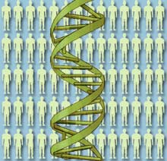
Advances in genomic medicine
Technology
Knowledge

Slide 8
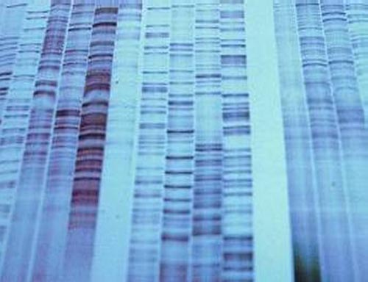
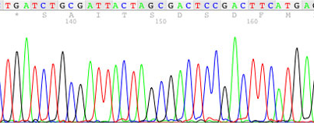
Advances in genomic medicine: DNA sequencing
Since 1970s, speed and efficiency of DNA sequencing technology has increased exponentially
Notes:
First ‘reference’ human genome sequence took 10 years to produce, can now be done in a few weeks (though analysis takes months), for fraction of the cost – still few £1000

Slide 9
The cost of DNA sequencing
Entire human genome is made up of 2.9 billion base-pairs of DNA
First human genome cost $3 billion to sequence
Now around $10,000
‘$1000 genome’ very soon?
(‘From ‘What lies within’, The Economist, 12/8/10)
Notes:
Genomics technology has increased by 10-fold over the last 5 years (compared to, eg, other fast-moving technologies such as computing – 1.5 x)

Slide 10
Applications of NGS
‘Next-generation’ sequencing (NGS) mainly used so far to:
- Identify genetic changes in cancer cells (to develop more targeted therapies)
- Identify novel gene mutations in monogenic disease using whole exome sequencing (WES) – ie. just protein-coding genes

Slide 11
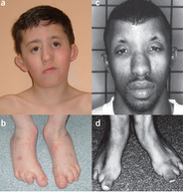
Miller syndrome
Multiple malformation syndrome
Characteristic facial features, including ‘cupped’ ears
Absent toes
Caused by mutations in DHODH gene (Ng et al 2010):

Slide 12
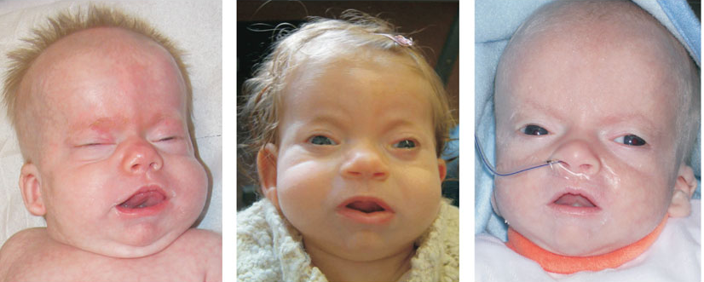
Schinzel-Giedion syndrome
Severe mental retardation
Multiple congenital abnormalities
Characteristic facial features
Life-limiting
Caused by mutations in SETBP1 gene (Hoischen et al, 2010)
Notes:
Both genes identified by sequencing exomes of just 4 individuals

Slide 13
Advances in genomic medicine: pharmacogenetics
Studying the genetic basis for the difference between individuals in response to drugs:
“right drug, right dose, right patient”
Notes:
Will only work if patients take medicines as directed…

Slide 14
Pharmacogenetics : getting the dose right
Variants in TPMT gene affect metabolism of 6-mercaptopurine
NIGMS website
Notes:
TMPT catalyses methylation of thiopurine drugs such as 6-mercaptopurine. People with low activity of this enzyme at risk of bone marrow toxicity - estimated that 5% of all thiopurine therapies fail for this reason

Slide 15
Pharmacogenetics example 2: getting the drug right
Maturity onset diabetes of the young (MODY):
Usually childhood onset
Monogenic disease
Some types can be treated with oral sulfonylurea drugs
Type 1 diabetes:
Usually childhood onset
Autoimmune disease
Must be treated with daily insulin injections
Can be misdiagnosed
Notes:
This is also an example of the importance of identifying disease ‘sub-types’, another step towards personalised medicine. Another example are the treatable forms of monogenic forms of obesity, eg. Leptin deficiency can be treated with leptin injections.

Slide 16
Advances in genomic medicine: Risk of common disease
Many genetic variants that affect risk of common, complex traits and diseases identified through:
Genome Wide Association Studies = GWAS
Eg. Type 2 diabetes, schizophrenia, obesity, blood pressure.....

Slide 17
Published GWAS, 2005 – 6/2011
951
Total Number of Publications
Calendar Quarter
NHGRI GWA Catalog
www.genome.gov/GWAStudies

Slide 18
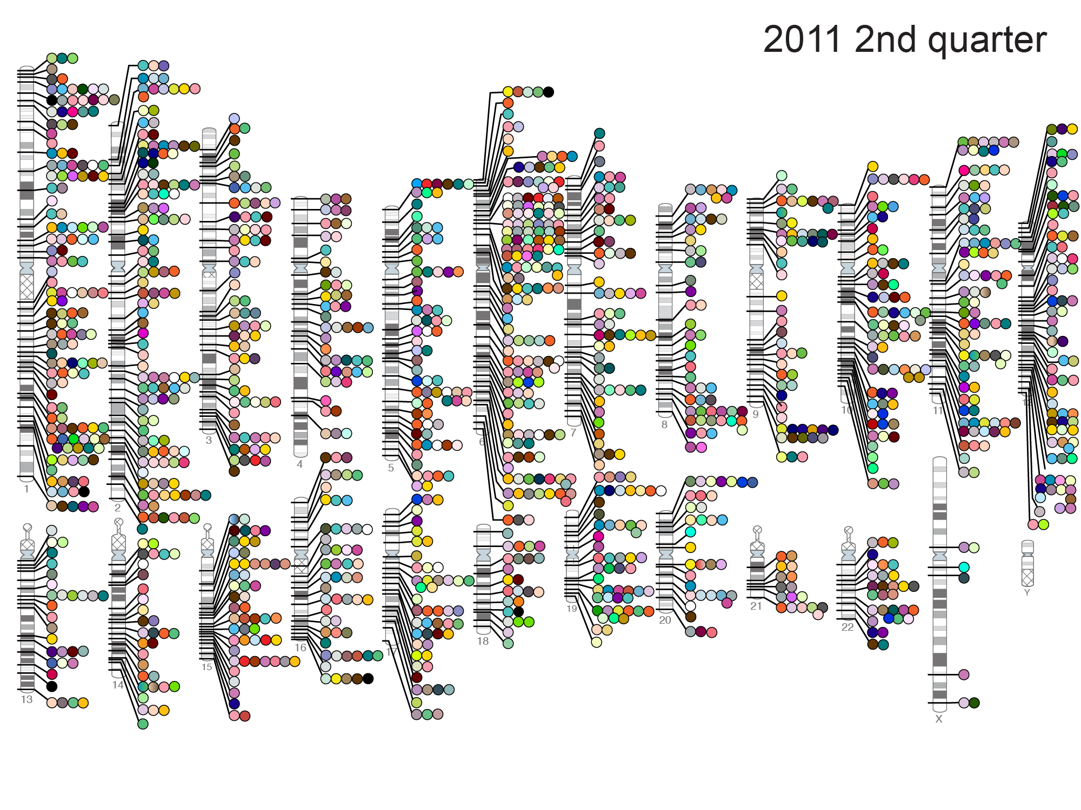
Published Genome-Wide Associations through 06/2011,
1,449 published GWA at p≤5x10⁻⁸ for 237 traits
NHGRI GWA Catalog
www.genome.gov/GWAStudies
GWAStudies

Slide 20
Selling genetic information
Some companies already offering disease-specific tests directly to consumers

Slide 21
Direct to consumer (DTC) genetic tests
For monogenic disease
Can provide carrier status information
Can detect rare serious conditions in newborn
Essential that service includes genetic counselling
For complex disease
Often have limited clinical utility
May cause undue alarm
May offer false reassurance
Data privacy concerns

Slide 22
DTC genetic tests for monogenic disease
To determine carrier status of recessive disease, eg. Tay Sachs; cystic fibrosis
To determine risk of later onset disease, eg. hereditary breast cancer
To determine presence of serious, treatable disease in newborn, eg. MCAD deficiency (part of newborn screening in UK since 2009)
Notes:
In UK, carrier testing offered via genetic services for families/populations at high risk (eg. relatives of CF child for CF, Ashkenazi Jewish population for Tay-Sachs)
Medium chain acyl CoA dehydrogenase (MCAD) deficiency is an autosomal recessive disorder of beta-oxidation of fatty acids, which occurs in approximately 1 in 20,000 live births. MCADD generally presents clinically between the second month and second year of life – can be fatal if undiagnosed, as body cannot combat hypoglycaemia by producing glucose via fatty acid metabolism
DTC tests for monogenic disease have generally met demand for tests before they become part of mainstream medicine, eg. MCAD before newborn screening in US/UK – not all states in US offer it even now.

Slide 23
Predicting risk of common disease: type 2 diabetes (T2D)
T2D currently affects 285 million adults worldwide, predicted to rise to 439 million by 2030 (Shaw et al. 2010)
Caused by complex interaction of non-genetic (eg diet) and genetic factors: sibling relative risk is ~3 in Europeans
38 confirmed T2D genes so far, which explain just ~10% of estimated genetic contribution (Voight et al. 2010)
Strongest associations are with variants in the TCF7L2 gene
Notes:
Sibling relative risk is the increased fold risk for people with an affected sibling, compared to the population risk

Slide 24
DTC genetic test for type 2 diabetes
Text from website of a DTC genetic test company:
“At this time we provide this information on all [15] variants for individuals of European descent.
Information for 8 out of the 15 variants is provided for East Asians. For African Americans we provide information on TCF7L2, the individually strongest genetic risk factor”.

Slide 25
TCF7L2 risk variant (‘T’ allele) for type 2 diabetes: expected outcome of 1000 tests
 | TT (100) | TC (350) | CC (550)
Will develop disease (60) | 27 | 19 | 14*
Will not develop disease (940) | 73** | 331** | 536
*False reassurance (ie people who have no copies of the risk variant but will still develop the disease)
**False alarm (ie. people who have at least one copy of the risk variant but will never develop the disease)
Notes:
The information on this slide is based on known frequencies of the T and C allele of a particular variant at the TCF7L2 locus associated with increased risk of T2D – remember this is the ‘best’ T2D gene - and an estimated 6% prevalence of T2D in Europeans (including undiagnosed).
Note that out of every 1000 people tested, 14 people who tested negative for this variant would develop T2D anyway. Perhaps even more worryingly, over 400 people would be told they were at increased risk, yet would never develop T2D. Just over half would receive a correct risk prediction – only slightly better than tossing a coin!

Slide 26
DTC genetic tests for common disease: concerns
Tests of dubious clinical benefit may be offered
Test results may cause false alarm/provide false reassurance
Complex results may not be explained fully, or with appropriate genetic counselling
Data protection (especially if company ceases trading)

Slide 27
DTC genetic tests for common disease: benefits?
Even if the information provided by some commercial genetic tests is of limited clinical value, it may still spur some customers to make lifestyle changes…..

Slide 28
The future: Genetic profiles for all?

Slide 29
Personal genomes
Individual genetic
tests for variants
associated with:
Monogenic disease
Drug response
Disease ‘sub-type’
Future risk of
common disease
Whole genome sequencing:
All variants (common and rare) identified in one analysis
May one day all be replaced by

Slide 30
Personalised medicine: ethical issues
Commercial genetic testing for disease risk based on incomplete information
Right ‘not to know’ (particularly children)
Protection of data, right to ‘genetic privacy’
Equality of access to genetic information

Slide 31
Embryo testing (PGD)

Slide 32
PGD – genetic testing of embryos
What is PGD?
PGD (preimplantation genetic diagnosis) is a genetic test carried out on IVF embryos, usually to ensure that only embryos free from a particular genetic condition are returned to the woman's womb
Who uses it?
PGD is an option for some families at risk of having a child affected by a serious genetic condition, offered as an alternative to prenatal testing

Slide 33
PGD: a brief history
July 1990: First twin girls born after PGD, at Hammersmith Hospital
Licensed on a case-by-case basis in the UK
Dec 2009: study of 581 PGD babies showed procedure had no effect on pregnancy outcome (up to age of two months)
Just a few 1000 babies born after PGD worldwide (compared to over 5 million IVF babies)
Notes:
Alan Handyside and Robert Winston published first PGD pregnancies in Nature April 1990 – female embryos chosen to avoid X-linked diseases, adrenoleukodystrophy and X-linked mental retardation. by carrying out test for Y-chromosome. Despite relatively small number of babies born using this technique in past 20 years, has generated enormous amount of media coverage/controversy

Slide 34
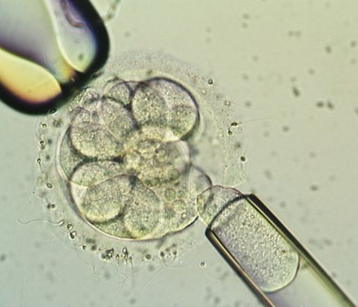
PGD: genetic testing of IVF embryos
Notes:
The most commonly used method for carrying out PGD is known as blastomere biopsy, which involves growing IVF embryos for three days, at which point they consist of eight cells. At this stage, all eight cells are identical, and all are ‘totipotent’ that is, they still have the ability to develop into any body part or tissue.

Slide 35
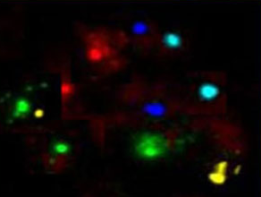
PGD: types of genetic test
Fluorescent in situ hybridisation (FISH) – to detect chromosomal conditions, eg. Down syndrome
Polymerase chain reaction (PCR) and DNA sequencing – to detect mutations in single genes
Notes:
If FISH is used then normal IVF can be used for embryos, but if PCR amplification then ICSI (direct injection of a single sperm) is used, to minimise contamination by sperm DNA.

Slide 36
PGD: Ethical issues
PGD (like all IVF procedures) involves discarding unused embryos
Disability rights arguments
‘Slippery slope’ – designer babies?
Eugenics

Slide 37
PGD: what is permitted in UK?
✓
✓
✓
✓
✗
Severe early onset genetic disease, eg. Tay Sachs
Severe late onset conditions, eg. Huntington disease
Disease with incomplete penetrance, eg. hereditary breast cancer (BRCA1/2 mutations)
To choose a tissue-matched baby that can provide umbilical cord blood to treat a sick sibling
To choose a boy/girl for non-medical reasons
Notes:
PGD licensed on a case-by-case basis, currently by HFEA. Social sex selection is not permitted in UK, but IS allowed in other countries, eg. Northern Cyprus, US.

Slide 38
PGD for hereditary breast cancer
PGD for BRCA1 mutation to avoid risk of hereditary cancer in baby provoked ‘slippery slope’ concerns
Notes:
Birth of baby born following PGD to select embryos free from BRCA1 mutation reignited controversy over ‘designer’ babies last year – baby’s father’s mum, aunt, sister and grandmother had all been affected. (BRCA1 mutation carriers have up to an 80% lifetime risk of developing breast/ovarian cancer, often at a young age <40)

Slide 39
PGD for ‘saviour siblings’
PGD can be used to select an embryo that is both free from disease, and HLA tissue-matched for a sibling affected by a disease that may be treatable using stem cells from umbilical cord blood.

Slide 40
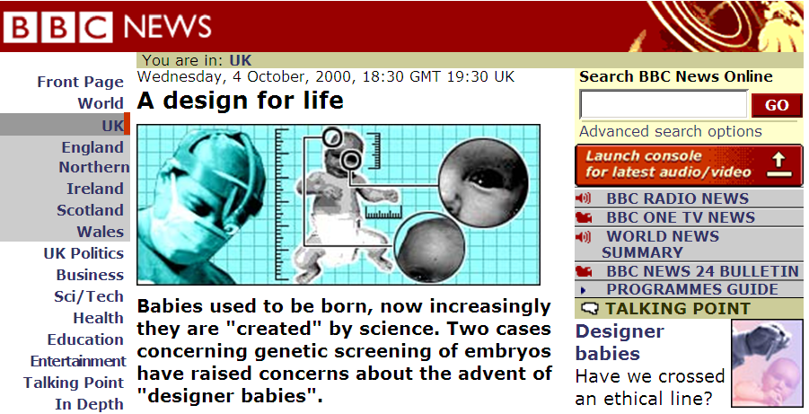
Saviour siblings: ethical issues
Nash case sparked concerns over ‘commodification’ of children

Slide 41
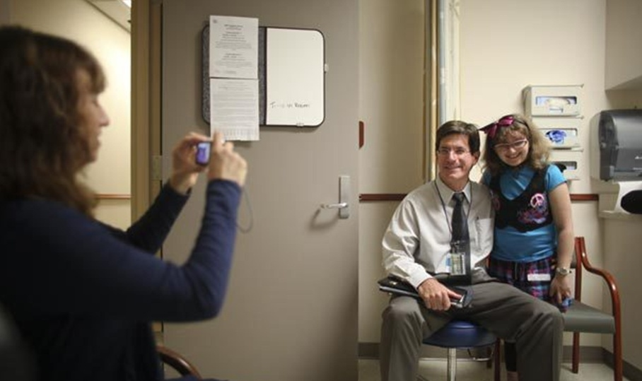
The first child with a ‘saviour sibling’ selected using PGD: 10 years later…
Lisa Nash, left, snaps a photo of her daughter, Molly, 16, right, and her doctor, John Wagner. (Seattle Times, 28/9/10)

Slide 42
Limitations of PGD
It requires use of in vitro fertilisation (IVF): physically and emotionally demanding - and expensive
Only suitable for diseases where genetic/chromosome abnormality is known
Can only select for traits that are present/absent in embryos obtained (can’t ‘design’!)

Slide 43
Summary
PGD likely to remain an important reproductive option for a small number of families affected by serious genetic disease
Pharmacogenetics and identification of disease ‘sub-types’ should reduce side effects and increase efficacy of treatments
Some companies are already offering genetic tests direct to consumers that have limited clinical utility at present
Technological advances may one day mean that everyone’s genome is sequenced as part of routine healthcare
Personalised medicine based on genetic information raises concerns over privacy, autonomy and equality of access, but also has the potential to transform healthcare

Slide 44
Find out more
House of Lords Science and Technology Committee: Genomic Medicine Inquiry
An assessment of genome technologies and their actual and potential impact on clinical practice in the post-genome era
http://www.parliament.uk/business/committees/committees-archive/lords-s-t-select/genomic/
A Common Framework of Principles for direct-to-consumer genetic testing services
http://www.hgc.gov.uk/Client/Content.asp?ContentId=816
Medical profiling and online medicine: the ethics of 'personalised healthcare' in a consumer age
http://www.nuffieldbioethics.org/personalised-healthcare-0
BioNews – online news and comment on developments in human genetics and assisted reproduction
http://www.bionews.org.uk/
Blogs, eg: Genetic Future -how Genes affect your future and the future of society
http://www.genetic-future.com/
j.buxton@imperial.ac.uk

