Slide 1
GENETICS 4: Cancer in families and individuals
Alistair Reid
Imperial College Centre for Haematology
a.reid@imperial.ac.uk

Slide 2
Introduction to cancer in families and individuals
Key concepts of oncology genetics
Types of genetic changes
Sporadic v’s familial cancer
Role of inherited mutations in breast and colorectal cancer
Role of chromosomal markers in pathogenesis and management of leukemia
Haematopoietic system
Chronic myeloid leukemia (CML)
Acute promyelocytic leukamia (APML)
Pharmacogenomics (colorectal and lung cancers and CML)

Slide 3
Learning objectives
Explain the difference between somatic and germline mutations
Understand why genetic changes cause cancer and describe the 2 main classes of cancer gene
Understand the contribution of chromosome rearrangements to the formation of gene fusions and their contribution to oncogenesis.
Discuss how inherited mutations in BRCA1 and BRCA2 genes influence risk of breast and ovarian cancer
Outline how defects in cell division or DNA repair influence risk of colorectal cancer
Explain, using an example, how chromosome translocations are used to quantify residual disease in some leukaemias.
Explain with examples what is meant by a “pharmacogenomic marker”

Slide 4
Some facts about cancer
One in three people will develop cancer during their lifetime
One in eight people will die from cancer
Cancer can develop at any age, but three-quarters of cases occur in people aged 60 or older
Encompasses >100 different diseases from most of the cell types and organs of the body

Slide 5


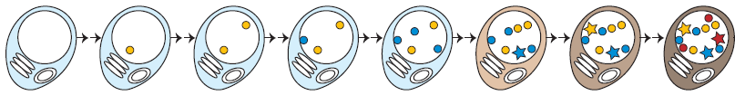
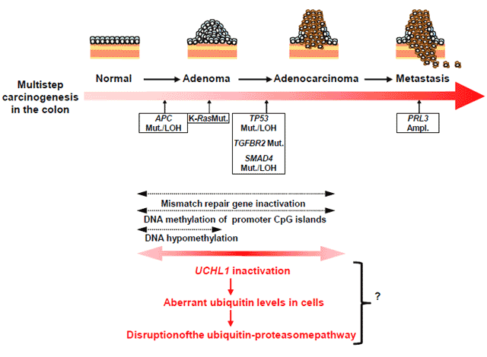
Cancer is a “genetic” disease
Cancer is driven by an accumulation of genetic changes that lead to altered levels of transcription or aberrant gene transcripts.
Age
in situ
invasive
metastatic
For the majority of cancers these aberrations are diverse and numerous and only a fraction have been discovered so far!

Slide 6
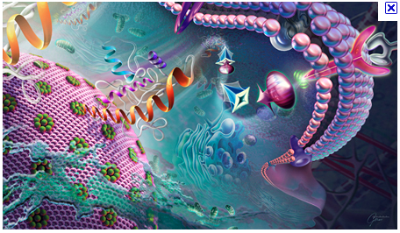
Altered levels of transcription or aberrant gene transcripts causes cancer because the resulting protein changes activate signal transduction pathways that confer a selective advantage to the cell.
Commonly affected pathways include those that control cell cycle, proliferation, apoptosis, and adhesion

Slide 7
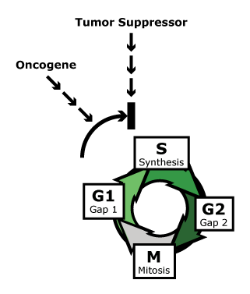
There are 2 classes of cancer gene:
Oncogenes and Tumor Suppressors
X
deletion/inactivation
activation/amplification
Normal oncogene functions
Growth and proliferation
eg
Growth factors
Transcription factors
Tyrosine kinases
Normal functions of TS genes
Regulating cell division
DNA damage checkpoints
(damage=no division)
Apoptosis
DNA repair
Notes:
NB- this slide is animated

Slide 8
Ways in which cancer genes can be altered
Type of genetic abnormality (“hit”) | Tumour Supressor | Oncogene
mutation in promotor | ✔✔ (reduces transcription) | ✔✔ (increases transcription)
mutation in coding region | ✔✔ (truncates or inactivates protein) Main inherited type | ✔ (increased activity or novel protein)
Genomic deletion or whole chromosome loss | ✔✔ (removes all or part of gene = transcriptional reduction)
Genomic amplification or whole chromosome gain |  | ✔✔ Increases gene copy number (and therefore transcription)
Gene fusion via chromosome rearrangement |  | ✔✔ (Novel protein)
May take several hits to initiate tumour, one of which, occasionally may be inherited
Lesions accumulate during disease progression

Slide 9
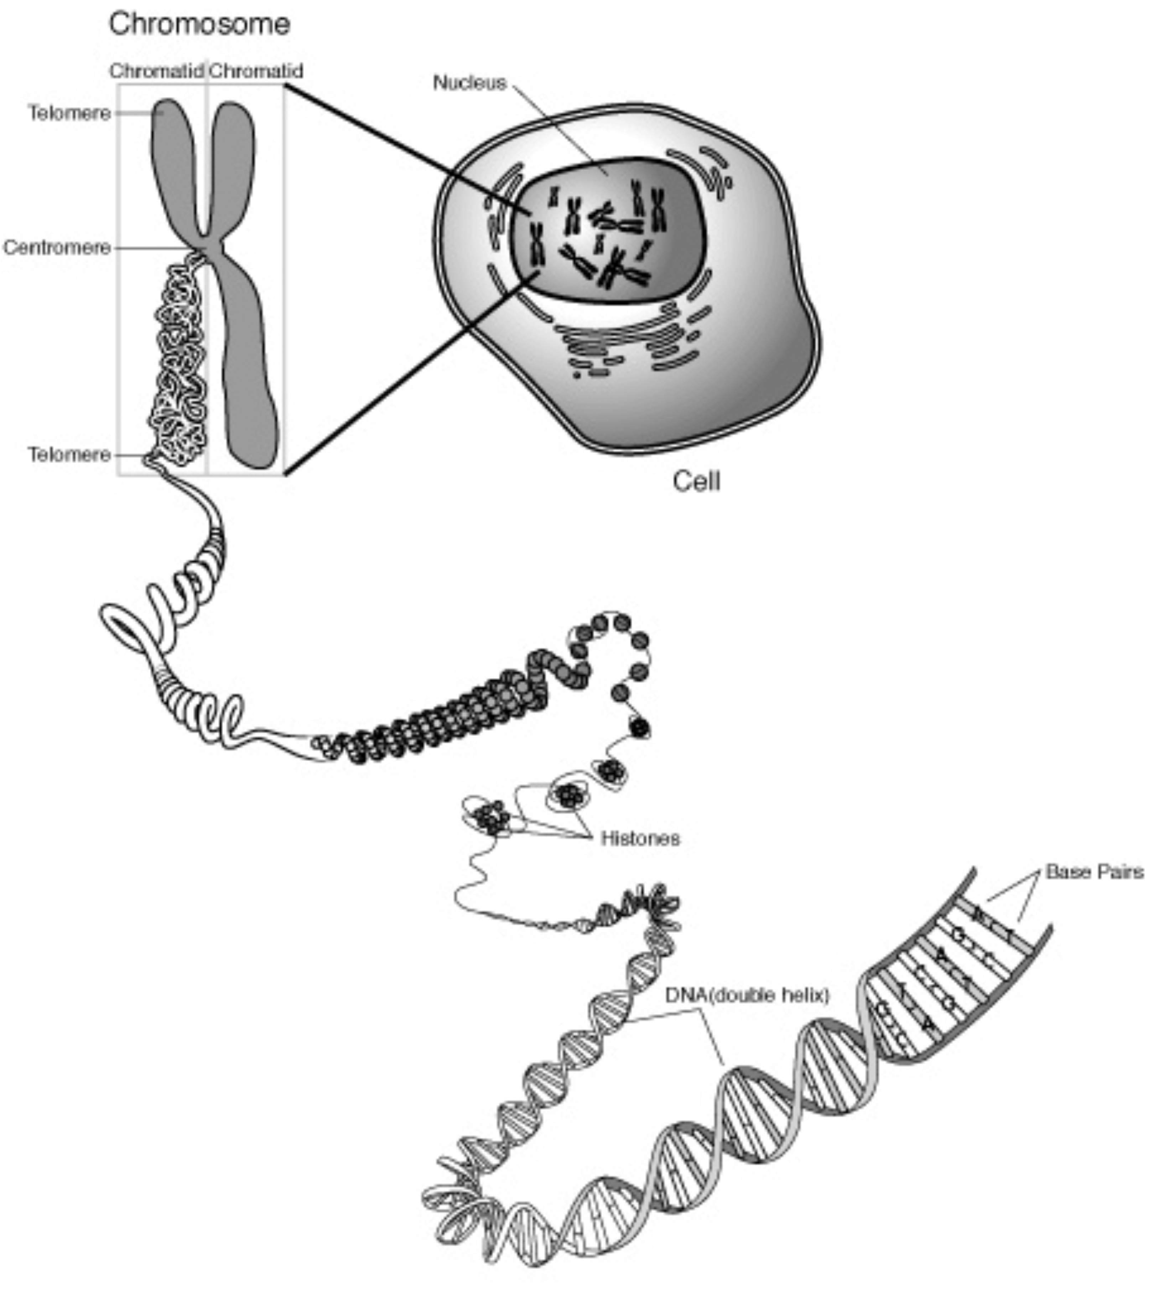
Techniques of different resolution are used to
detect different types of abnormalities
“Cytogenetic” changes
Global, microscopy-based,
low resolution
“Molecular” changes
targetted, biochemistry based, high resolution
translocation
Mutations, other small intragenic sequence changes and transcript
quantification
deletion
duplication

Slide 10
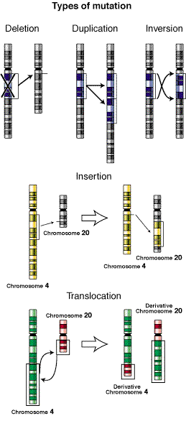
Cytogenetic changes:
How do chromosome rearrangements cause cancer?
Gene copy number change is brought about by:
Gene fusion is brought about by:
Eg:
loss
gain
Gene fusions occur at the DNA junction of chromosome rearrangements (translocations or inversion):
Gene A
New “fusion” gene “A-B”
Gene B

Slide 11
“Molecular” changes:
How do point mutations affect protein structure?
No change!
1 amino acid change!
Truncated protein

Slide 12
Most TS genes require inactivation of both copies to cause malignancy
In a few inactivation of one copy is sufficient
Most TS genes require damage to both alleles for tumorigenic effect
A few TS genes require damage to only one
X
Hit 2
(often a deletion)
X
X
Hit 1
(often a mutation)
Hit 1
Allele A
Allele B
Allele A
Allele B
Hit1 reduces transcript/protein level but is insufficient to cause a phenotypic effect.
Requires inactivation of second allele (hit 2) causing total loss of transcription for malignant phenotype to be conferred.
“2-hit model”
Single hit causes reduction in transcription and in level of protein product which for these genes is sufficient to have a biological effect via “haploinsufficiency”-

Slide 13
Loss of Heterozygosity (LOH)
Mat
Pat
Maternal
Paternal
LOH has several related meanings/uses:
1) A historical method of (i) assessing the stability of cancer genomes and (ii) looking for the location of TS genes
2) Another term for deletion
3) Unmasking of the mutated copy of a TS gene (ie hit 2)
In summary!
LOH describes a region of apparent homozygosity, probably a deletion, in cancer tissue that may mark the location of a TS gene.
genes
DELETION (causes LOH)
Hit 1
Chromosome 3
Genes
Allele A
Allele B
Mutated TS
Deleted

Slide 14
99% of cancers are sporadic (non-inherited)
1% have an inherited (“germline”) component
The vast majority of cancer cases (approx 99%) are sporadic caused entirely by acquired changes in somatic tissue (“somatic mutations”)
1% of cases of cancer are initiated by the inheritance from one parent (or occasionally both) of a mutation in “germline” tissue, usually in a tumour suppressor “(hit 1”)

Slide 15
In inherited cancer syndromes, risk of cancer is “high” but not necessarily 100%
Why?
In most inherited cancers, additional somatic changes are still required (albeit fewer than would be required for sporadic cancers), most importantly the inactivation of the second allele.
The syndromes are therefore described as conferring a “high risk” of cancer- ie it may not be 100% likely that the additional hit(s) required will occur over the persons lifetime, but the chances are far higher than in individuals who are wild-type (non-mutated).
Most inherited cancer genes are 2-hit tumour suppressors
X
X
Hit 2
SOMATIC
Hit 1
GERMLINE
Allele A
Allele B

Slide 16
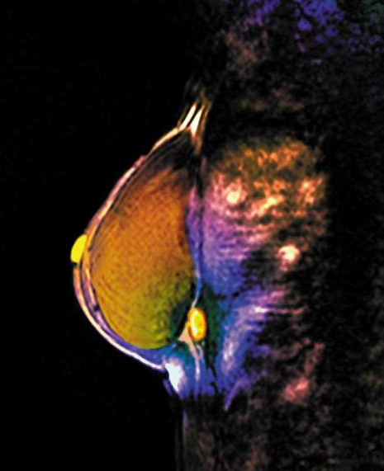
Inherited predisposition to breast and ovarian cancer
2-4% of breast cancer cases are caused by germline mutation of BRCA1 or BRCA2 genes (“hit 1”)
60% risk of developing breast cancer by age of 90, and earlier average age of onset
Inactivation of second allele is usually via somatic deletion
Also confer increased risk of ovarian cancer
BRCA2 mutations also predispose to breast cancer in men
MRI
Notes:
NCI overview
http://www.cancer.gov/cancertopics/factsheet/Risk/BRCA

Slide 17
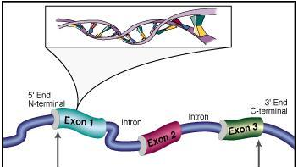
Inherited predisposition to breast and ovarian cancer:
Patho-genetic mechanism
Hundreds of different types of inherited mutations in the BRCA1/2 genes have been reported involving most exons of the genes, including point mutations, several base pair deletions, whole exon deletions and amplifications. They usually result in a truncated non-functional protein.

Slide 18
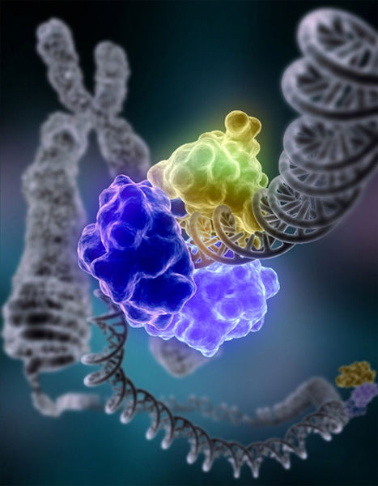
Inherited predisposition to breast and ovarian cancer:
Patho-genetic mechanism continued
Normal function of BRCA1 and BRCA2 is DNA repair, specifically a process called homologous recombination. A truncated/non-functional protein causes impaired DNA repair, so mistakes or damage go uncorrected. Impaired DNA repair is a common theme in cancer.

Slide 19
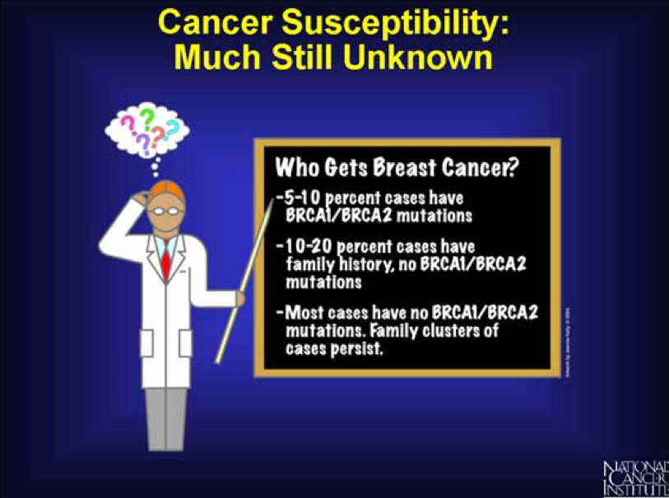
2-4% of Breast Cancer patients have BCRCA1/2 mutations
10-20% of cases have some evidence of family history with no BRCA1/2 mutations (causal gene(s) not yet identified!)

Slide 20
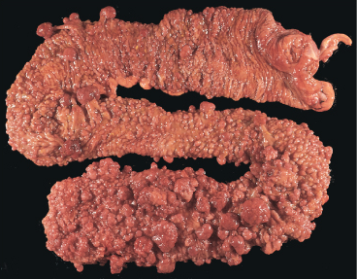
Inherited predisposition to colorectal cancer:
There 2 most common syndromes are caused by inheritance of one mutated allele of a TS gene. They differ in etiology, mechanism, and clinical presentation:
1) FAP (familial adenomatous polyposis)
Characterised by the growth of 1000s of intestinal polyps, one
or more of which is likely to become cancerous
>1% of all colorectal cancers
Mutation of APC (adenomatous polyposis coli) gene
APC controls cell division
Virtually 100% lifetime risk of cancer
2) Hereditary non-polyposis colorectal cancer (HNPCC or Lynch syndrome)
3% of all cases,
Most common inherited form (90% of familial cases)
Mutation of MLH1 or MSH2 (DNA “mismatch repair” genes)
Lifetime risk of cancer 80%
Notes:
Nice overview of FAP
http://cancer.stanford.edu/information/geneticsAndCancer/types/fap.html
Nice overview of HNPCC with some info on diagnosis
http://cancer.stanford.edu/information/geneticsAndCancer/types/hpncc.html
Other familial colon cancers
http://cancer.stanford.edu/information/geneticsAndCancer/types/occs.html

Slide 21
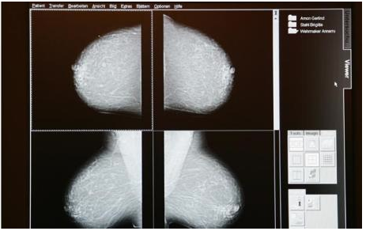
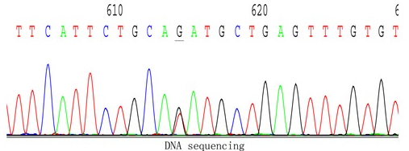
Patient management for inherited
cancer syndromes
if positive family history:
If mutation- positive
Genetic screening/genetic counseling
Surveillance
prophylactic surgery
chemoprevention

Slide 22
Sporadic malignancy:
Acquired chromosome abnormalities and oncogenic fusion genes as disease markers in patient management

Slide 23

Most cancer genomes have “cytogenetic” changes in addition to molecular mutations
As with molecular abnormalities these can be causal (“driver”) or accumulate during disease progression
translocation
deletion
duplication

Slide 24
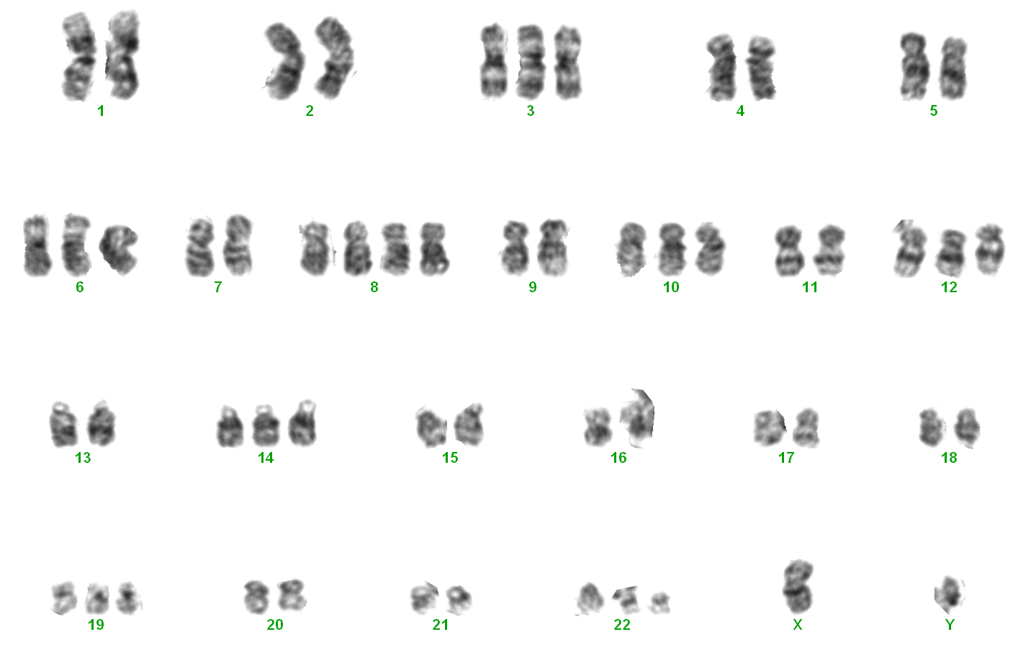
Cytogenetics and leukaemia
Our knowledge of contribution of gross chromosomal rearrangements to cancer pathogenesis comes from “cytogenetic” investigations of malignant tissue
This knowledge is most extensive in haematological malignancies (leukaemias and lymphomas) for 2 main reasons
Generally leukaemic genomes are more stable than those of solid tumours – therefore easier to pinpoint pathogenetic changes driving disease
Relative ease of performing cytogenetics on haematopoeic circulating cells
Karyotyped G-banded metaphase
(abnormal)

Slide 25
Chronic Myeloid Leukaemia
A clonal myeloproliferative disorder of the pluripotent haematopoeic stem cell leading to an overproduction of mature granulocytes
1 to 2 cases per 100,000
15% of all adult leukaemias
Triphasic - indolent chronic
phase, accelerated and terminal
acute stage
Consistent pathogenomic marker is a translocation between chromosomes 9 and 22 resulting in a fusion gene called BCR-ABL1

Slide 26
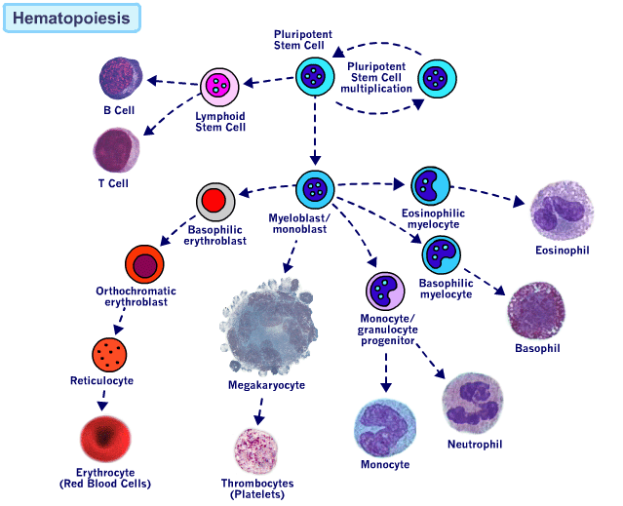
Haemopoietic system and CML
CML target cell
Overproduced
in CML

Slide 27
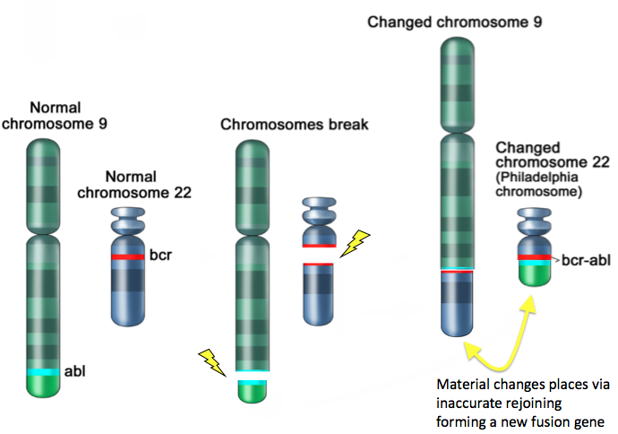
translocation t(9;22) in CML gives rise to the BCR-ABL1 gene fusion

Slide 28
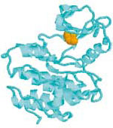
BCR-ABL1 fusion - the molecular hallmark of CML
BCR-> ABL1->
BCR-ABL1 fusion gene
(resides on the Philadelphia chromosome)
//
BCR-ABL1 mRNA
Daley GQ, Van Etten RA, Baltimore D. Induction of chronic myelogenous leukemia in mice by the P210bcr/abl gene of the Philadelphia chromosome. Science. 1990
Bcr-Abl1 protein
tyrosine kinase

Slide 29
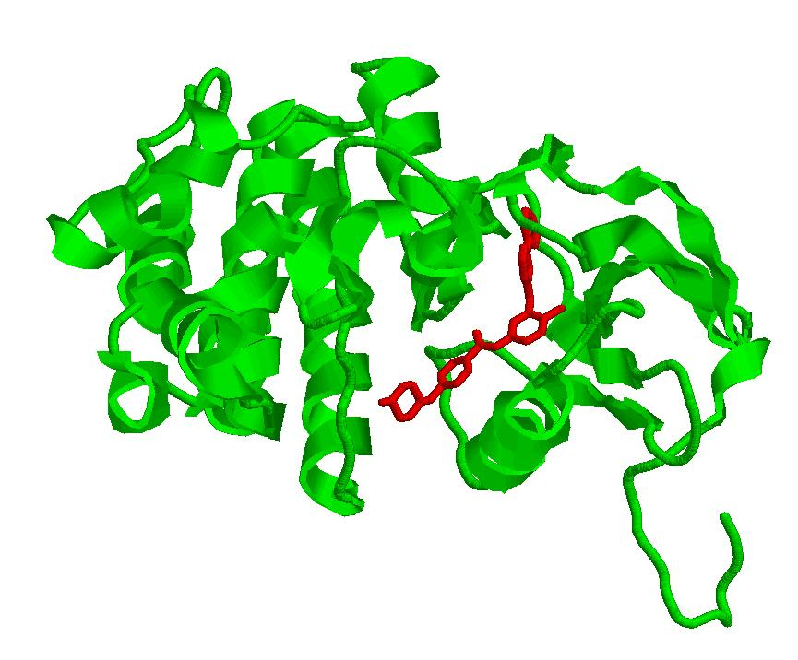
Targeted molecular therapy for CML:
Imatinib (Glivec) – an effective tyrosine kinase inhibitor (TKI)
BCR-ABL1
imatinib blocking the ATP binding pocket

Slide 30
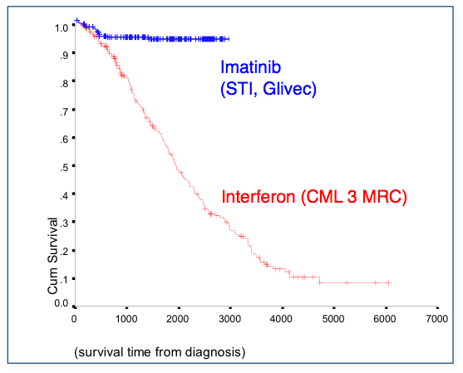
CML therapy: conventional v’s tyrosine kinase inhibitor (TKI)
Imatinib
(STI, Glivec)
Interferon (CML 3 MRC)
But: 20-30% patients on imatinib lose their response and require a second line TKI therefore monitoring is important for disease management

Slide 31
Sensitivities of the genetic methods used to detect leukaemia in responding and relapsing patients
Method Target Tissue Sensitivity (%)
(Minimum threshold)
Conventional
cytogenetics
Fluorescent
in-situ hybridisation
(FISH)
Quantitative
polymerase chain
reaction (PCR)
Ph
Chromosome
Juxtaposition of
BCR and ABL
BCR-ABL mRNA
BM
PB/BM
PB/BM
1-10
0.2-5
.001-.0001

Slide 32
Conventional cytogenetic analysis (G-banding)
Up to 30 metaphases analysed.
Advantage – robust clinical correlations, detects additional abnormalities (disease progression)
Disadvantage- relatively low sensitivity, time consuming, only analyse dividing cells, 3-5% failure rate

Slide 33
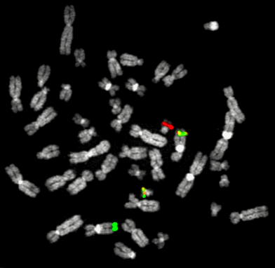
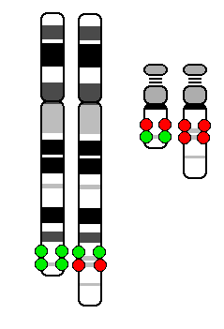
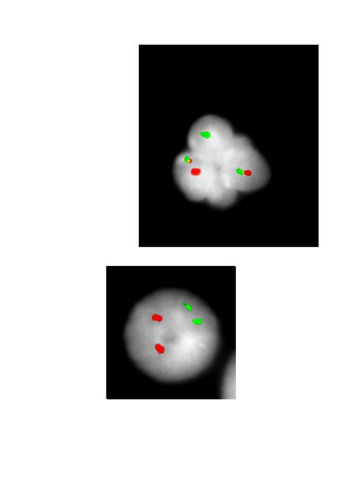
Standard dual-colour BCR/ABL fluorescent in situ hybridisation (FISH) signal pattern in CML patient with t(9;22)
9
22
22
der(9)
BCR-ABL1 positive
der(22)
der(22)
der(9)
9
BCR-ABL1 negative
BCR
ABL1
The entire genes are labelled with a fluorescent tags which are seen to fuse on the abnormal chromosomes of positive cells

Slide 34
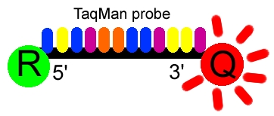
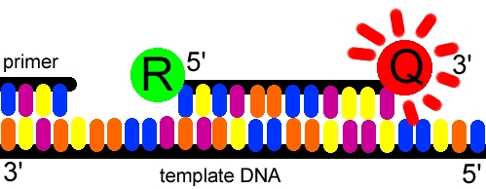
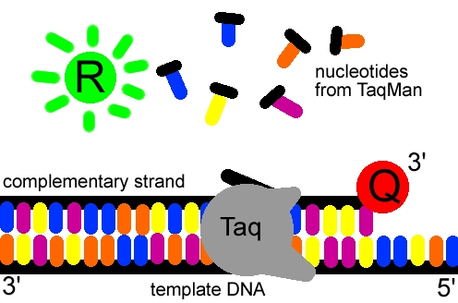
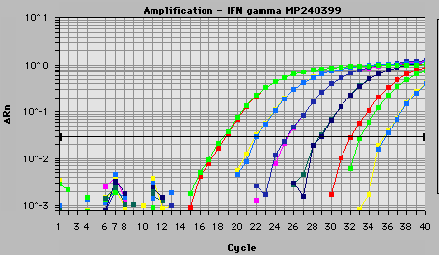
Real-time quantitative RT-PCR (RT-qPCR)
The amount of BCR-ABL1 mRNA in a peripheral blood sample is quantified very precisely in a biochemical assay called a polymerase chain reaction (PCR)
BCR-ABL exon junction
BCR-> ABL->
BCR-ABL1 fusion gene
//
BCR-ABL1 mRNA
In a PCR assay the novel fusion junction of BCR-ABL mRNA is synthesised in-vitro in a quantity-dependent manner
newly synthesised sequence is measured using a fluorescent dye which correlates directly to amount of transcript in starting sample

Slide 35
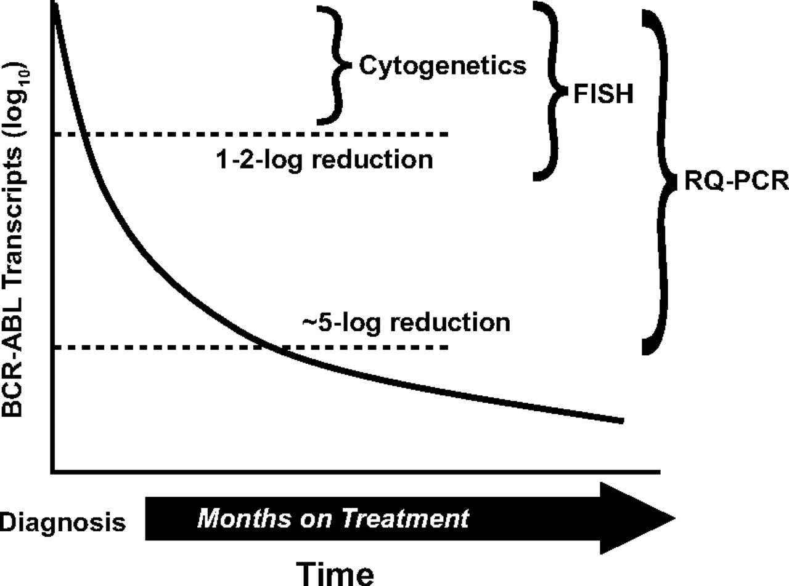
Laboratory monitoring of CML:
Disease burden is reduced over time

Slide 36
Why quantify residual disease in CML?
Cytogenetic response in first 12-18 months accurately defines response to TKI and helps guide clinical management
Absence of cytogenetic response by 12 months – change of therapy indicated
Degree of cytogenetic response over
time is predictive of survival
Loss of major molecular response (i.e. 3 log reduction measured by PCR) is an indicator of therapy resistance and imminent relapse- change of therapy indicated!

Slide 37
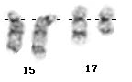
Acute promyelocytic leukemia (APML/AML-M3)
Abnormal accumulation of immature granulocytes called promyelocytes
Characterized by a chromosomal translocation involving the retinoic acid receptor alpha (RARα or RARA) gene on chromosome 17 and the promyelocytic leukemia gene (PML) on chromosome 15, a translocation denoted as t(15;17)(q22;q12)
normal
abnormal
normal
abnormal

Slide 38
Acute promyelocytic leukemia (APML/AML-M3)
Pathogenesis and treatment
RARα is a member of the nuclear family of receptors; its ligand, retinoic acid is a form of Vitamin A and acts as a regulator of DNA transcription
The translocation product is the PML-RARα fusion protein – binds too strongly to DNA via enhanced interaction with co-repressor molecules, blocking transcription (“dominant negative mutant”)
APML responds to all trans retinoic acid (ATRA) therapy, a vitamin A derivative. ATRA binds, degrades and cleaves PML-RARα dissociating co-repressors allowing normal transcription and cell differentiation
ATRA is not the same as other chemotherapy- it does not kill cells. It is effective when taken continuously (often with arsenic trioxide) but residual stem cells remain
Like CML, APML is monitored by cytogenetics and/or FISH and/or RQ-PCR

Slide 39

Pharmacogenomics and cancer
Pharmacogenomics is an emerging branch of pharmacology which deals with the influence of genetic variation on drug response
In cancer treatment, pharmacogenomic tests are used to identify which patients are most likely to respond to certain cancer drugs based on the presence or absence of particular somatic mutations.
Examples include:
KRAS test with cetuximab for colorectal cancer
KRAS mutation = less likelihood of response
EGFR test with gefitinib for nonsmall-cell lung cancer
EGFR mutation = greater likelihood of response
BCR-ABL1 “T315I” test with dasatinib for chronic myeloid leukaemia
BCR-ABL1 T315I mutation = unlikely to respond
Notes:
http://atlasgeneticsoncology.org/index.html

Slide 40
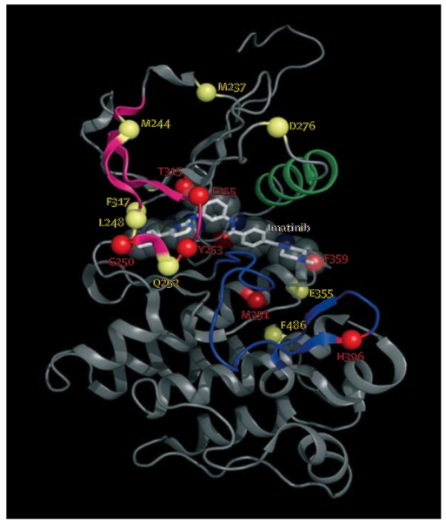
T315 mutation in BCR-ABL confers resistance to most currently available tyrosine kinase inhibitors

Slide 41
Summary
Cancer caused by abnormalities of tumour suppressors or oncogenes
TS genes usually require “2 hits” the second of which is often a deletion (manifesting as LOH)
Usually sporadic but can be inherited – some genetic causes with obvious mendelian inheritance are well characterised
Somatic abnormalities, particularly those involving a novel fusion gene can be used to monitor therapy (if successful therapy available)
Certain somatic abnormalities confer resistance or response to new targeted therapies – “Pharmagogenomics”

Slide 42
Questions?
a.reid@imperial.ac.uk
Revision notes on next 2 slides:

Slide 43
GENETICS 4 - Cancer in families and individuals;
Introduction to main concepts of cancer genetics
Cancer is driven by an accumulation of genetic changes that lead to altered levels of transcription or aberrant gene transcripts. Altered levels of transcription or aberrant gene transcripts causes cancer because the resulting protein changes activate signal transduction pathways that confer a selective advantage to the cell. Commonly affected pathways include those that control cell cycle, proliferation, apoptosis, and adhesion
There are 2 classes of cancer gene: Oncogenes and Tumor Suppressors. In a normal situation, oncogenes promote cell growth/division while tumour supressors tightly regulate it. Genetic changes cause cancer by decreasing expression of a TS gene or increasing expression of an oncogene. TS genes are usually involved in regulating cell cycle, proliferation, etc. DNA repair genes are also classed as tumour supressors because when they are knocked out DNA fidelity is compromised therefore it is much more likely that there will be further oncogenic damage.
Most TS genes require inactivation of both alleles to cause malignancy.
Common ways in which genes can be altered are via point mutation, chromosome loss/gain and chromosome rearrangements.
Familial and sporadic cancer
99% of cancers are sporadic (non-inherited); only 1% have an inherited (“germline”) component.
In familial cancer a mutation in a tumour suppressor gene is inherited in the germ line. Additional somatic (non-inherited) aberrations are usually required. In sporadic cancers, all genetic aberrations are somatic.
Mutations in the genes BRCA1 and BRCA2 confer increased susceptibility to breast (and ovarian) cancer. These genes are normally involved in DNA repair.
http://www.cancer.gov/cancertopics/factsheet/Risk/BRCA
Problems with repair of DNA damage can give rise to hereditary nonpolyposis colon cancer (or Lynch syndrome).
http://www.ncbi.nlm.nih.gov/bookshelf/br.fcgi?book=gene&part=hnpcc

Slide 44
There is an animation of mismatch repair here:
http://www.hhmi.org/biointeractive/cancer/mismatch_repair.html
Abnormalities of the cell cycle caused by mutations in the APC gene are also associated with colon cancer.
Cytogenetics, fusion genes and leukaemia
There can be gross changes in cytogenetic “karyotype” in cancer and the pattern of these changes seen can be used to assess prognosis or to determine the proportion of residual cells in leukaemia.
Some leukaemias have characteristic marker chromosomes:
eg. The Philadelphia chromosome is a marker of chronic myeloid leukaemia (CML). It is the product of a translocation between chromosomes 9 and 22. Its presence can be monitored to assess success of therapy and to detect relapse.
http://www.nature.com/scitable/topicpage/Chromosome-Abnormalities-and-Cancer-Cytogenetics-879
The translocation in CML gives rise to a novel gene “BCR-ABL1” caused by fusion of BCR and ABL1 genes, producing a novel oncogenic protein, an activated tyrosine kinase. Inhibiting the protein (eg via imatinib) is an effective means of therapy. Monitoring post-treatment can be carried out at the microscopic level by counting the number of cells in a sample that are positive for the translocation or by molecular quantification of the proportion of BCR-ABL1 mRNA transcript in a patient’s blood sample.
Another leukaemia with a consistent novel fusion gene is Acute Promyelocytic Leukaemia (APML), associated with fusion of PML and RARA genes via a translocation between chromosomes 15 and 17. Patients normally respond to all trans retinoic acid, a vitamin A derivative.
Pharmacogenomics
Pharmacogenomics is an emerging branch of pharmacology which deals with the influence of genetic variation on drug response. In cancer treatment, pharmacogenomic tests are used to identify which patients are most likely to respond to certain cancer drugs based on the presence of particular somatic mutations.
Examples include:
KRAS test with cetuximab for colorectal cancer
EGFR test with gefitinib for nonsmall-cell lung cancer
BCR-ABL1 T315I test with dasatinib for chrinic myeloid leukaemia

