Slide 1
The genetic basis of disease
Dr Andrew Walley
Dept of Molecular Genetics and Genomics
National Heart and Lung Institute

Slide 2
Learning Objectives
Explain with examples the concept of aneuploidy
Draw a diagram showing possible meiotic products from a balanced translocation
Describe how 3 different chromosome aberrations lead to Down syndrome
Explain why sex determination is not solely based on sex chromosome karyotype
Explain the classification of congenital defects. Explain how non-genetic factors lead to congenital abnormalities
Give two examples of inborn errors of metabolism currently included in UK national neonatal screening programmes, including clinical features and therapeutic management of each condition

Slide 3
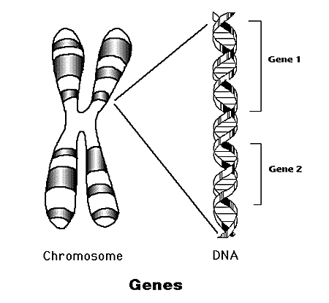
Inheritance
How are physical characteristics inherited?
DNA Sequence
Gene
Chromosome
Genome

Slide 4
Chromosome Numbers
From one parent you inherit:
Twenty-two autosomes
One sex chromosome (X or Y)
This is the haploid number (23)
You inherit one set of chromosomes from each parent:
The total number of chromosomes is 46
This is the diploid number

Slide 5
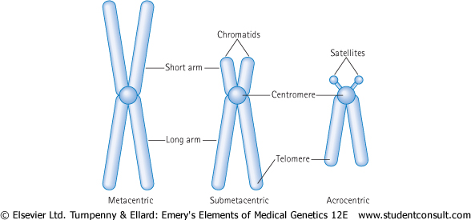
The Chromosome

Slide 6
Human Karyotype
46,XY - M
46,XX - F
DIPLOID
46 chromosomes
Somatic cells
HAPLOID
23 chromosomes
Gametes
Visualised by staining with Giemsa

Slide 7
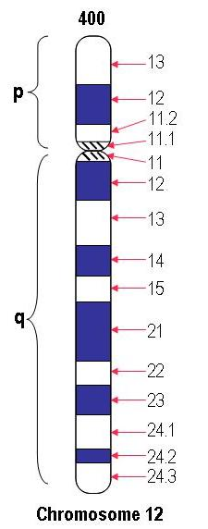
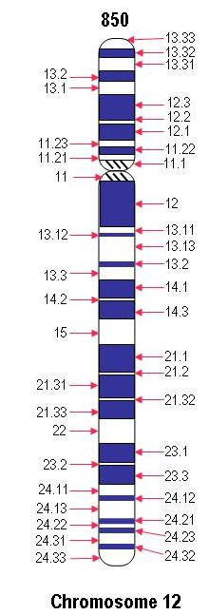
Chromosome Banding Nomenclature
Bands are labelled according to the chromosome
number, short (p) or long (q) arm and numbered out
from the centromere
= 12q21
= 12p13.2

Slide 8
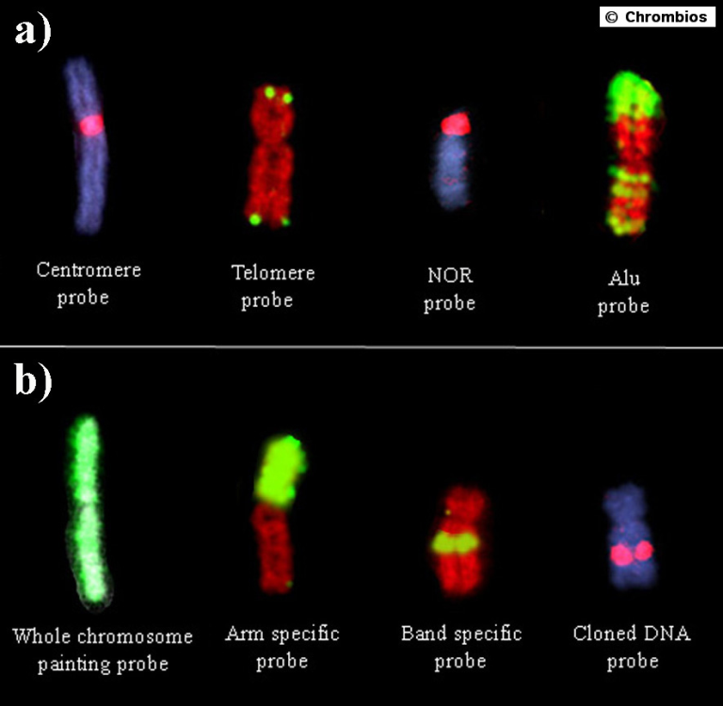
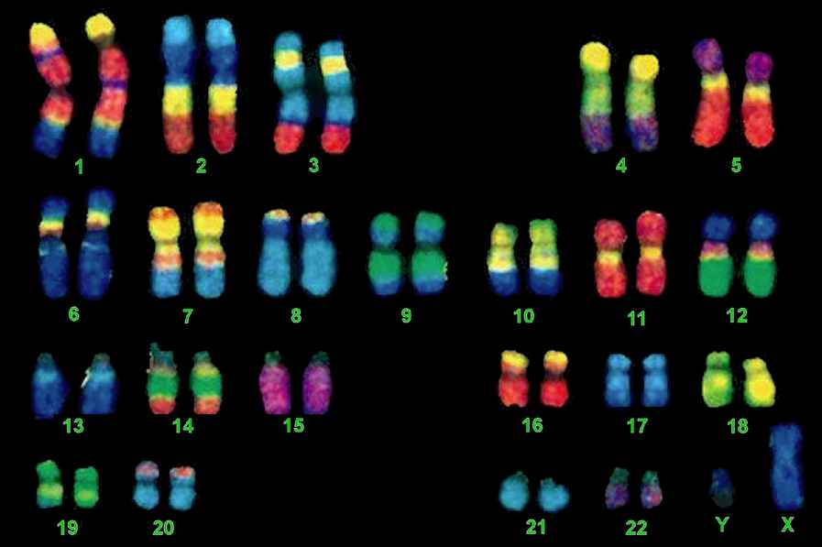
Visualising Chromosomes
False colour specific banding patterns
FISH probes
Notes:
NOR is the nucleolar organizer region on every p-arm of a chromosome

Slide 9
Chromosome Abnormalities

Slide 10
Chromosome abnormalities
Numerical – aneuploidy, loss or gain
Structural – translocations, deletions, insertions, inversions, rings
Mosaicism – different cell lines
Chromosome abnormalities are present in:
60% of early spontaneous miscarriages
4-5% of still births
7.5% of all conceptions, 0.6% of live births

Slide 11
Autosomal Aneuploidy

Slide 12
What is aneuploidy?
Numerical abnormalities involving the loss or gain of one or more chromosomes
Monosomy - loss of a chromosome is almost always lethal
Trisomy - gain of one chromosome can be tolerated
Tetrasomy - gain of two chromosomes can be tolerated
Notes:
NB euploidy is having an integral number of complete sets of chromosomes, i.e. haploid or diploid numbers of chromosomes are euploid

Slide 13
Dosage Compensation
Loss of a chromosome gives a reduction of 50% of all fully expressed gene products
Gain of one chromosome gives an increase of 33% of all fully expressed gene products

Slide 14
Chromosomal Translocations
Parental Chromosomes
e.g. 4 and 20
or
or
or
Normal
25%
Balanced
25%
Unbalanced
50%
Notes:
Please note that unaffected chromosomes are not shown here for clarity purposes.

Slide 15
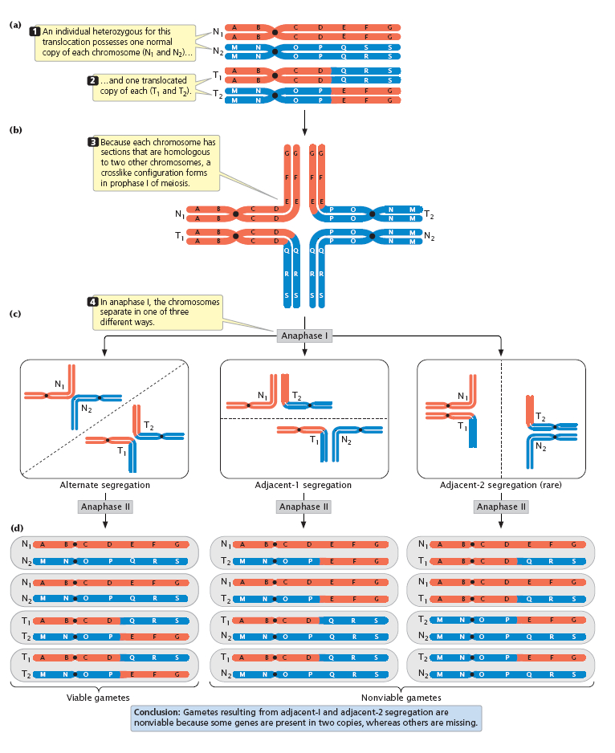
Meiosis in a balanced translocation carrier
http://www.nature.com/scitable
Notes:
(b) This structure is known as a quadrivalent
Full URL is http://www.nature.com/scitable/content/chromosomal-translocations-35454
And is linked from this page http://www.nature.com/scitable/topicpage/human-chromosome-translocations-and-cancer-23487

Slide 16
Cytogenetics report from
Regional Genetics Service
Each chr 3 is normal
One chr 2 is normal
One chr 2 is a derivative (der)
der (2) was inherited from father
who has a balanced reciprocal
translocation
Trisomy 3 (p24.2→pter)
Monosomy subtelomeric Chr 2
3
3
2
der(2)
3
3
46,XX,der(2)t(2;3)(p25.3;p24.2)pat

Slide 17
Trisomy

Slide 18
Trisomy 21: Down syndrome
Described by Langdon Down in 1866
Lejeunne found chromosomal defect in 1959
Overall incidence at birth is approx 1 in 650 to 1 in 700
Strong association between incidence and advancing maternal age

Slide 19
Increasing risk of Down syndrome with maternal age
Risk of Down’s rises significantly from the age of 30 and rises very rapidly over the age of 40

Slide 20
Clinical Features of Down syndrome
Newborn period - severe hypotonia, sleepy, excess nuchal skin
Craniofacial - macroglossia, small ears, epicanthic folds, upward sloping palpebral fissures, Brushfield spots
Limbs – single palmar crease, wide gap between first and second toes
Cardiac - Atrial and Ventral septal defects
Other - short stature, duodenal atresia
Notes:
Nuchal is back of neck
Macroglossia is the unusual enlargement (hypertrophy) of the tongue.
Palpebral fissue is the gap between upper and lower eyelids
Brushfield spots are characteristic white spots in iris
Atresia is a condition in which a body orifice or passage in the body is abnormally closed or absent

Slide 21
Natural history of Down’s
IQ scores ranging from 25-75
Most children are happy and affectionate
Relatively advanced social skills
Adult height around 150 cm
Cardiac anomaly causes early death in 20%
Increased risks of leukaemia and Alzheimer’s

Slide 22
Trisomy 21
95% of all Down cases
90% maternal origin of extra chromosome
Non-disjunction in meiosis I (75%) or II (25%)
MEIOSIS
I
Non-disjunction
MEIOSIS
II
Disomic gametes
Nullisomic gametes

Slide 23
Translocations
4% of all Down cases
Robertsonian Translocation - breakage of acrocentric chromosomes (13,14,15,21,22) and fusion of their long arms (1:1000 incidence)
2/3 de novo translocation in child
1/3 of parents are carriers of translocation
High risk of further Down syndrome babies
13q21q and 14q21q - 10% risk of Down
21q21q - all offspring will have Down

Slide 24
Mosaicism
1% of all Down cases
Children less severely affected
Caused by mitotic non-disjunction
1 cell zygote
1st mitotic division
2nd mitotic division
non-disjunction
4 cell zygote
Normal disomy
trisomy
monosomy
(33% mosaicism)

Slide 25
Monosomy

Slide 26
Monosomy X: Turner’s syndrome
1 in 3000 live female births
Generalised oedema and swelling in neck region can be detected in 2nd trimester (nuchal translucency)
Can look normal at birth or have oedematous extremities
Normal intelligence

Slide 27
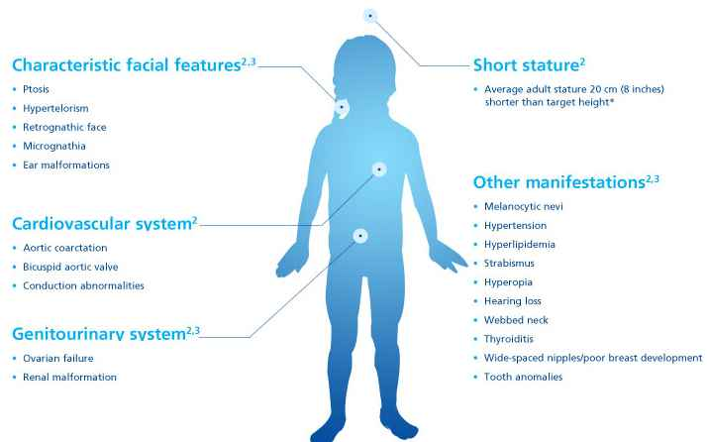
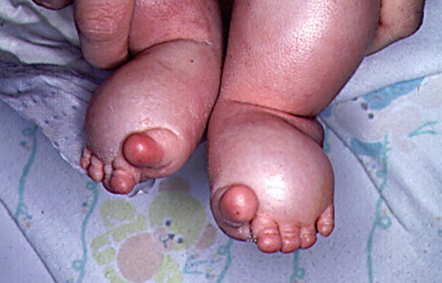
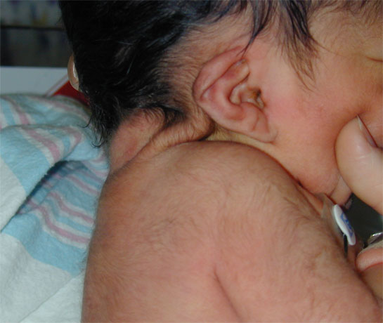
Turner’s syndrome (45,X)
Notes:
Lymphoedema and nail dysplasia picture is from http://geneticdisorderslyles03.weebly.com/turner-syndrome.html
“Webbed neck” is due to accumulation of fluid in the lymph nodes in the neck in utero (cystic hygroma), which typically then resolves prior to birth leaving loose folds of skin in the neck region. Photo is from http://newborns.stanford.edu/PhotoGallery/Turners1.html

Slide 28
Turner’s syndrome (45,X)
In adults:
short stature - 145 cm without GH treatment
ovarian failure - primary amenorrhoea and infertility
Treatment -oestrogen replacement for secondary sexual characteristics and prevention of osteoporosis
80% due to loss of X or Y chromosome by e.g. non-disjunction in paternal meiosis
Also ring chromosome, single arm deletion, mosaicism

Slide 29
Sex Chromosome Aneuploidy

Slide 30
Dosage Compensation
Loss of a chromosome gives a reduction of 50% of all fully expressed gene products
Gain of one chromosome gives an increase of 33% of all fully expressed gene products
However, for sex chromosomes, only one X is required so the other is randomly switched off in females (X-inactivation)

Slide 31
Polysomy X in females
1:1000 have 47,XXX karyotype
10-20 point decrease in IQ
No physical abnormalities
95% have an extra maternal X arising in meiosis I
Normal fertility
48,XXXX and 49,XXXXX karyotypes show mental retardation

Slide 32
Polysomy X in males
Klinefelter’s syndrome (47,XXY)
1 in 1000 male live births
clumsiness, verbal learning disability ↓10-20 pts
taller than average (long lower limbs)
30% - moderately severe gynaecomastia
all infertile
increased risk of leg ulcers, osteoporosis and breast carcinoma in adult life
X chromosome from either Male or Female
48,XXXY and 49,XXXXY are rare

Slide 33
Chromosomal Sex and Gender
Females are X,X
Males are X,Y
However, it is possible to be chromosomally one gender and phenotypically the opposite.

Slide 34
SRY gene activated at 6 wks post-conception
signalling the development of the testes

Slide 35
Sex determination
XX males
Translocation of the SRY male determining gene from Y chromosome to an X chromosome. Phenotypically male, testes develop, but sterile because some genes on Y chromosome needed for spermatogenesis.
XY females
Mutation or deletion of SRY gene leads to female who is infertile

Slide 36
Congenital Abnormalities

Slide 37
Congenital abnormalities
Congenital abnormalities are apparent at birth in 1 in 50 of all newborn infants
20-25% of all deaths during perinatal period and childhood up to the age of 10 years
Genetic factors contribute to about 40% of all congenital abnormalities

Slide 38
Classification of Congenital Abnormalities or Birth Defects
Malformation
A primary structural defect e.g. atrial septal defects, cleft lip.
Usually involves a single organ showing multifactorial inheritance.
ASD

Slide 39
Classification of Congenital Abnormalities or Birth Defects
Disruption
A secondary abnormal structure of an organ or tissue e.g. amniotic band causing digital amputation
Caused by ischaemia, infection, trauma. Not genetic, but genetic factors can predispose.

Slide 40
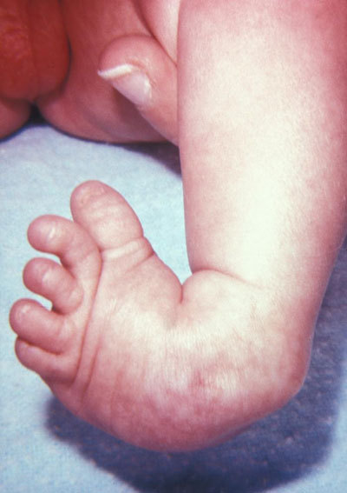
Classification of Congenital Abnormalities or Birth Defects
Deformation
An abnormal mechanical force distorting a structure e.g. club foot, hip dislocation.
Occurs late in pregnancy and has a good prognosis as the underlying structure is normal.

Slide 41
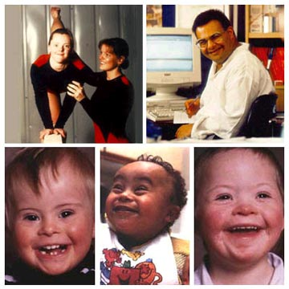
Classification of Congenital Abnormalities or Birth Defects
Syndrome
A consistent pattern of abnormalities with a specific underlying cause, e.g. Down syndrome.
Chromosomal abnormalities

Slide 42
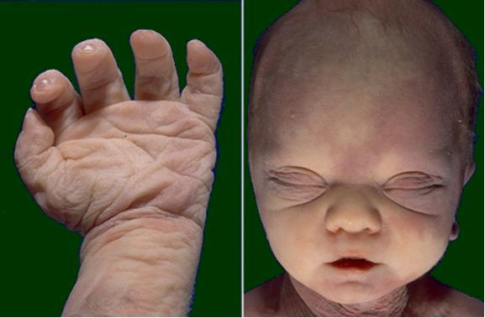
Classification of Congenital Abnormalities or Birth Defects
Sequence
Multiple abnormalities initiated by primary factor e.g reduced amniotic fluid leads to Potter sequence.
Could have genetic component as initial factor.
Not a syndrome as multiple causes give same primary factor with differing outcomes

Slide 43
Classification of Congenital Abnormalities or Birth Defects
Dysplasia
An abnormal organisation of cells into tissue
e.g. Thanatophoric Dysplasia
Caused by a single gene defect (FGFR3)
High recurrence risk for siblings/ offspring
1:60,000 incidence
Short flat bones, small thorax, large head

Slide 44
Classification of Congenital Abnormalities or Birth Defects
Association
An unexplained but non-random occurrence of abnormalities. Cause is typically unknown.
e.g. VATER/VACTERL association.
Vertebral, Anal, Tracheo-Esophageal, Renal
Vertebral, Anal, Cardiac, Tracheo-Esophageal, Renal, Limb
Classification is not mutually exclusive
e.g. a primary malformation of kidneys can lead to Potters sequence
Notes:
From OMIM – http://www.omim.org
VATER is a mnemonically useful acronym for the nonrandom association of vertebral defects (V), anal atresia (A), tracheoesophageal fistula with esophageal atresia (TE), and radial or renal dysplasia (R). This combination of associated defects was pointed out by Quan and Smith (1972). Nearly all cases have been sporadic.
VACTERL is sometimes used as it includes cardiac and limb anomalies in the range of abnormalities considered part of the association
See Solomon (2011) Orphanet J Rare Dis 6:56 for review
N.B. Differential diagnosis is very important

Slide 45
The UK Newborn Screening Programme

Slide 46
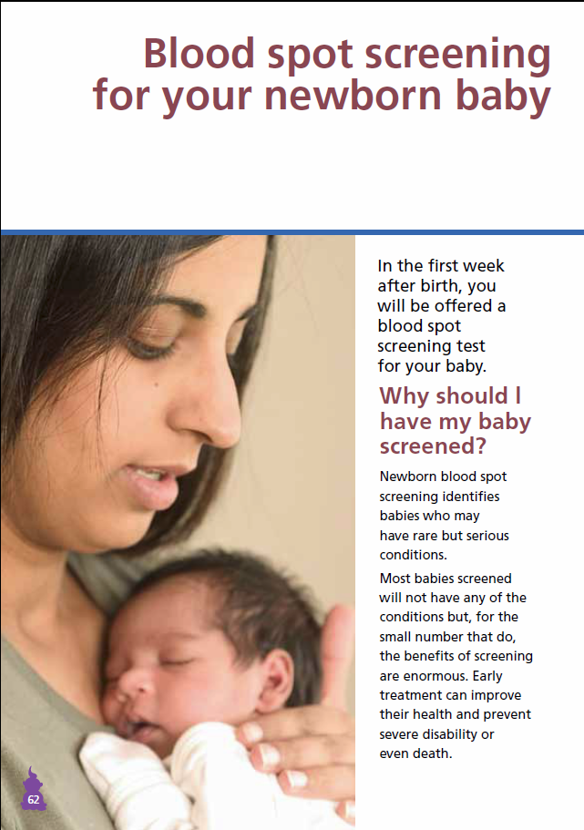
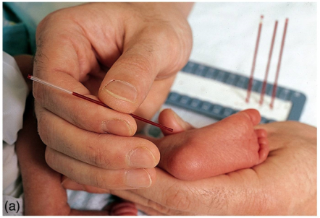
UK Newborn Screening
Screen newborns for
Phenylketonuria
Congenital Hypothyroidism
Sickle Cell Disease
Cystic Fibrosis
Medium-Chain Acyl-CoA Dehydrogenase Deficiency
http://newbornbloodspot.screening.nhs.uk/

Slide 47
Phenylketonuria

Slide 48
Phenylketonuria (PKU)
Severe mental retardation and convulsions
Blond hair/blue eyes; eczema
Phenylalanine hydroxylase deficiency
Phenylalanine accumulates and is converted to phenylpyruvic acid - excreted in urine
Tyrosine deficiency - reduced melanin

Slide 49
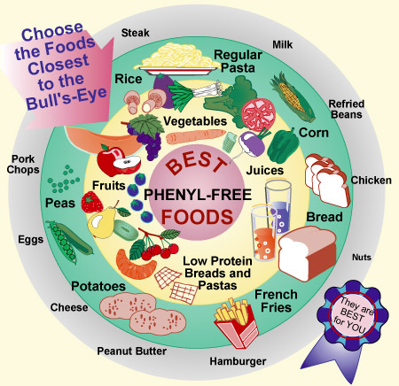
Treatment for PKU
Early detection - no mental retardation
Newborn screening for elevated levels of phenylalanine in blood
Remove phenylalanine from diet
Difficult diet
Aspartame => phenylalanine
Pregnancy requires strict diet

Slide 50
MCAD Deficiency

Slide 51
MCAD Deficiency
MCAD is Medium-Chain Acyl-CoA Dehydrogenase
MCAD gene is called ACADM
Commonest disorder of fatty-acid oxidation
Episodic hypoketotic hypoglycaemia
Commonly presents > 3 months
Can present as coma, metabolic acidosis, encephalopathy
Sudden death can occur, with a 25% mortality rate in undiagnosed cases

Slide 52
MCAD Deficiency Management
Frequency of 1:8000 to 1:15000 births
Early detection using bloodspot now routine
Maintenance of adequate calorie intake to prevent switch to fatty acid oxidation
Avoidance of fasting (<12 hrs in adults), which can be difficult in children who become ill – teaspoon of honey or glucose drip

Slide 53
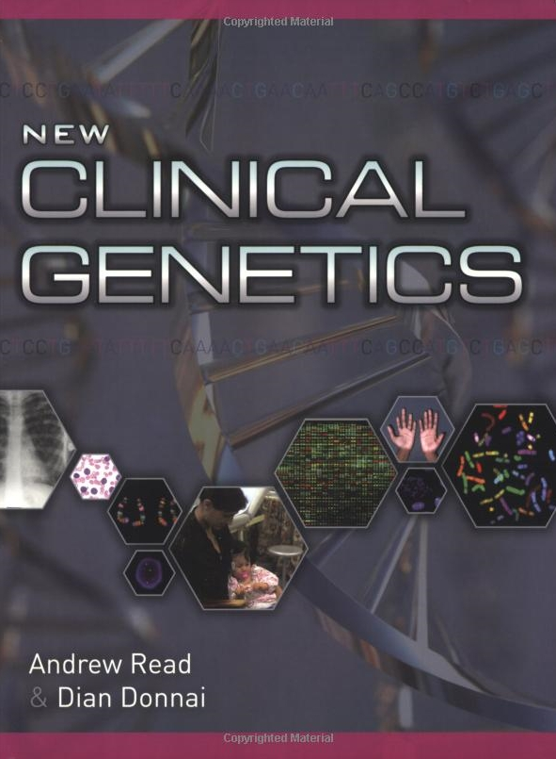
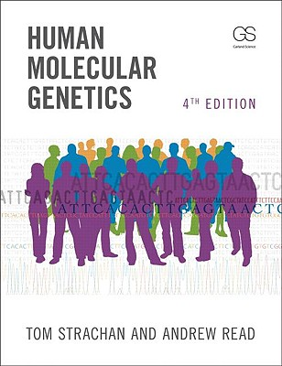
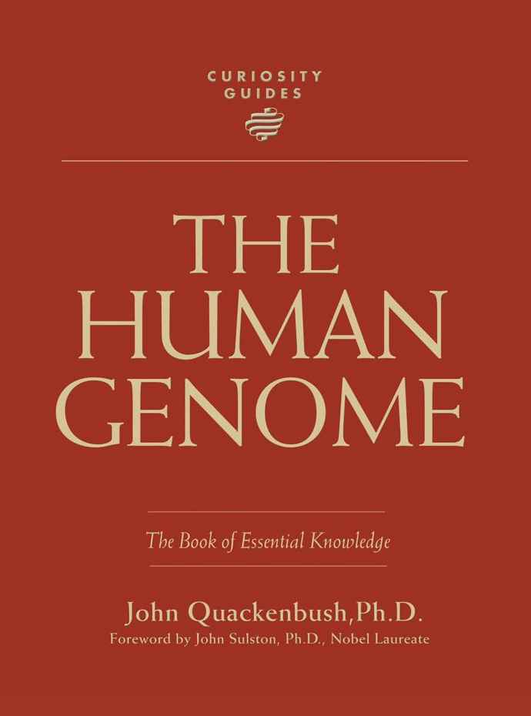
Suggested References

Slide 55
The DNA Packing Problem

Slide 56
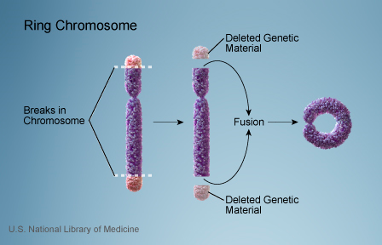
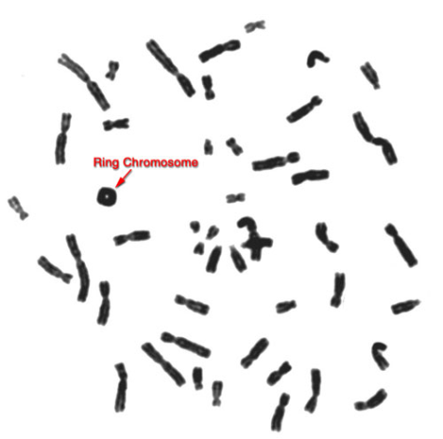
Ring Chromosome
Breaks occur at the ends of the two arms of a chromosome and the sticky ends are then joined and the fragments lost
Often unstable at mitosis and so mosaicism is frequent
Some cells have the ring and the rest are monosomic

Slide 57
Phenylketonuria
DIET
THYROXINE
1
2
PHENYLALANINE
TYROSINE
DOPA
3
PHENYLPYRUVIC
ACID IN URINE
HOMOGENTISIC
ACID IN URINE
MELANIN
4
1 - PKU
2 - THYROXINE
DEFICIENCY
ACETOACETIC ACID
3 - ALBINISM
4 - ALKAPTONURIA
C0₂ + H₂0
Notes:
DOPA = dihydroxyphenylalanine

Slide 58
MCAD Function
VLCAD
LCAD
MCAD
SCAD
SBCAD
Acetyl CoA
TCA Cycle
NADH
Oxidative
Phosphorylation
FADH2
Oxidative
Phosphorylation
http://blobs.org

