Slide 1
CMS: Cell Behaviour II The cytoskeleton
Dr Sohag Saleh

Slide 2
Learning objectives
Highlight the major differences between the three main cytoskeletal proteins
Understand the functional roles of microtubules and describe the drugs that target these structures
Understand how intermediate filaments are assembled and describe their classification system
Describe the functional roles of intermediate filaments with relation to their involvement in disease
Describe the structure and function of actin and associated proteins

Slide 3
The cytoskeleton
Microtubules
Composition & structure
Function
Pharmacology
Intermediate filaments
Background
Assembly
Disorders
Actin
Composition & structure
Assembly
Actin binding proteins

Slide 4
Introduction
Microtubules
Polymers have ~ 25 nM diameter
Stiffest of the three cytoskeletal proteins
Form polarised polymers
Have complex ‘dynamic instability’
Can easily switch between ‘growth’ & ‘shrinking’ states and can reorganise rapidly
Architecture determined by discrete organising units
Intermediate filaments
Polymers have ~ 10 nM diameter
Least stiff of the three proteins
Not polarised
Have no enzymatic activity
Higher tensile strength than compressive strength
Can be assembled or stiffen in response to mechanical stress
Actin
Polymers have ~ 7 nM diameter
Less rigid than microtubules but able to form stable structures with other proteins
Form polarised polymers
Constantly elongate at the plus end and need to be ‘capped’
Assembled and disassembled in response to local signalling

Slide 5
Microtubules
Composition & structure
A polymer of globular tubulin arranged in a hollow cylindrical tube with a diameter of ~25 nM
There are two main types of tubulin (α & β) of around ~ 450 a.a. in length and they display polarity
The α-tubulin contains an irreversible nucleotide-binding domain. The β-tubulin contains a reversible nucleotide-binding domains (E-site)
Each tubulin subunit is made up of a strongly bound α and β- tubulin heterodimer
Longitudinal contacts link the subunits into a linear protofilament
Lateral interactions between protofilaments (usually 13) form the microtubules
Microtubules are polar with +ve and -ve ends
25 nM
α- tubulin
β- tubulin
GTP
GDP
α
β
Tubulin (heterodimer)
α
β
Protofilament
α
β
α
β
α
β
β
α
β
β
β
α
α
β
β
α
α
β
α
α
β
β
α
α
β
α
β
β
α
β
α
α
β
β
α
α
β
β
α
β
α
T.S.
α
β
β
β
α
α
α
β
α
β
α
β
β
α
α
β
α
β
α
α
β
α
β
β
α
α
β
α
β
β
α
α
β
α
β
β
α
α
β
α
β
β
α

Slide 6
Microtubule dynamic instability
T
Dynamic instability
Tubulin is a GTPase
As the tubulin molecules incorporate into the growing strand there is not always sufficient time for GTP hydrolysis to occur
In the ‘T-form’ the microtubule continues to grow
If GTP hydrolysis occurs prior to tubulin addition microtubule shrinkage occurs
When shrinkage occurs this is known as ‘catastrophe’
If however, the rate of tubulin addition returns to the more rapid state, the strand begins to grow again and this is known as ‘rescue’
D
T
T
D
T
T
D
T
T
D
T
α
β
α
β
α
α
β
β
α
β
α
α
β
β
α
β
α
α
β
β
α
β
α
β
T
D
T
T
D
T
T
D
T
T
T
D
α
β
α
α
β
α
β
β
α
α
β
α
β
β
α
α
β
α
β
β
α
α
β
β
T
T
T
T
α
α
α
β
β
α
β
β
T
T
T
T
α
α
α
β
β
α
β
β
D
D
D
D
α
α
α
β
β
α
β
β

Slide 7
Microtubule function
Neurones (permanent)
Provide structural support and means of transport
Microtubules are oriented with their + end towards the axon terminal
Kinesin molecules transport ‘cargo’ (e.g. vesicles) to the nerve terminal (anterograde transport)
Cytosolic dyneins are responsible for retrograde transport
Cilia & Flagella (permanent)
Have the same structure (flagella are longer and less numerous per cell) with a central bundle of microtubules (axoneme)
Axonemes have a 9+2 structure: nine microtubule doublets surrounding 2 singlets
Axonemal dynein, found within the doublets, is responsible for ‘beating’ & movement
- +
Kinesin
Dynein
Axoneme
T.S.

Slide 8
Microtubule function
kinesin
The mitotic spindle
The mitotic spindle consists of different families of microtubules and grows outwardly from the centrosome
The centrosome is a microtubule organising centre (MTOC) composed of two centrioles
The MTOCs align towards opposite poles and microtubules radiate towards the nucleus
When the growing microtubules ‘meet’ towards the middle the motor proteins push the centrosomes in opposing directions
Upon binding to the centromere, sister chromatids are pulled apart by ‘catastrophe’ at the plus ends
centrosome
dynein

Slide 9
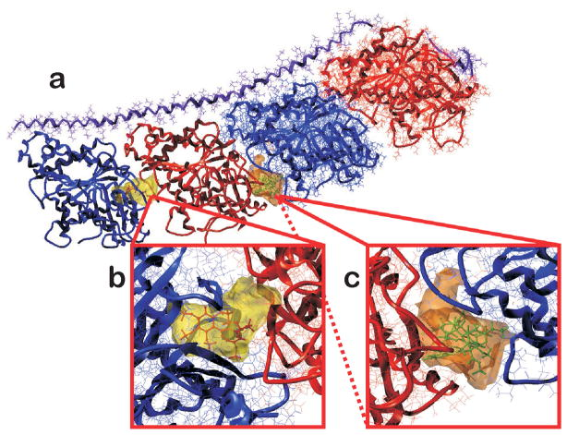
Microtubule pharmacology
Colchicine
Used in the treatment of gout
Binds close to the ATP-binding pocket of β-tubulin fixing it in a curved configuration
Vinca alkaloids
Used to treat various cancers
Has a binding site between the heterodimers thereby inhibiting assembly
Griseofulvin
Used in the treatment of fungal infections
Similar mechanism to colchicine but different locus of action
Paclitaxel
An adjunct for ovarian and breast cancer
Binds to β-tubulin tightly and prevents disassembly
Shares binding site with griseofulvin
The tubulin protein with colchicine and vinblastine binding sites at interfaces between the α and β subunits.
The α subunits are shown in red and β subunits shown in blue;
b) inset shows the colchicine binding pocket at the intra-dimeric interface of the αβ-subunit;
c) inset shows the vinblastine binding site at the inter-dimeric interface between αβ-subunits
From Tripathi & Kellogg (2010) Proteins.78(4): 825–842.

Slide 10
Practice SBAs
Which one of the following molecules is responsible for retrograde transportation along microtubules?
ATP
GTP
Kinesin
Axonemal dynein
Cytosolic dynein
Which of the following drugs binds closely to the ATP binding pocket of β-tubulin
Vinblastine
Vincristine
Colchicine
Griseofulvin
Paclitaxel

Slide 11
The cytoskeleton
Microtubules
Composition & structure
Tubulin dimers form hollow tubes.
Dynamic instability due to GTP hydrolysis
Function
Neurofilaments: Structure & Transport
Flagella: Movement
Mitotic spindle: division
Pharmacology
Griseofulvin: fungal infections
Vinca alkaloids: cancer
Intermediate filaments
Background
Assembly
Disorders
Actin
Composition & structure
Assembly
Actin binding proteins

Slide 12
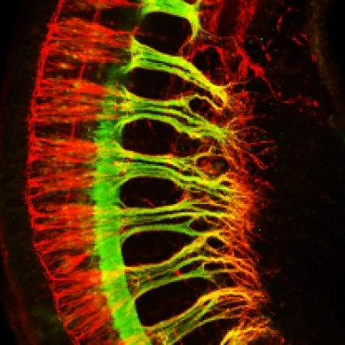
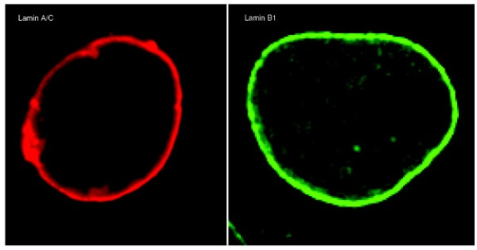
Intermediate filaments
General
Polymers that have a diameter of ~10 nM
Encoded by ~70 different genes. The proteins that make up IF fall in to 5 different categories based on sequence & structure:
Types I & II: Acidic & basic keratins, respectively
Type III: Vimentin, desmin, GFAP & peripherin
Type IV: Neurofilaments & internexin (standard), filensin & phakinin (non-standard)
Type V: nuclear lamins
Can be used to distinguish one cell type from another and can be considered as ‘cytoskeletal identity cards’
Immunofluorescence staining of keratin in liver carcinoma cells
From Moll et al (2008) Histochem Cell Biol.129(6): 705–733.
Vimentin staining in Xenopus melanophores
From Chang et al (2009) J Cell Sci.15; 122(16): 2914–2923.
Growing sensory (red, neurofilament staining) and motor axons (green, Hb9::eGFP) in the brachial plexus of the forelimb of a mouse E10.5 embryo
From Jones (2011) PLoS Biol. 2011 9(2): e1001023.
Immunofluorescence staining of lamin in U2OS and MEF cell nuclei.
From Dittmer & Misteli (2011) Genome Biol.12(5): 222.

Slide 13
Intermediate filament assembly
NH₂
COOH
Assembly
A monomer is predominantly made up of an alpha helix
Start forming by parallel coiled assembly of two monomers
Dimers then form staggered anti-parallel tetramers
Tetramers then aggregate end to end forming a protofilament
Pairs of protofilaments associate laterally to form a protofibril
Four associated protofibrils (16 protofilaments) associate coiled laterally to form the IF with a 10 nM diameter
NH₂
COOH
NH₂
COOH
COOH
NH₂
NH₂
Protofilament
COOH
COOH
Protofibril
NH₂
NH₂
COOH
COOH
NH₂

Slide 14
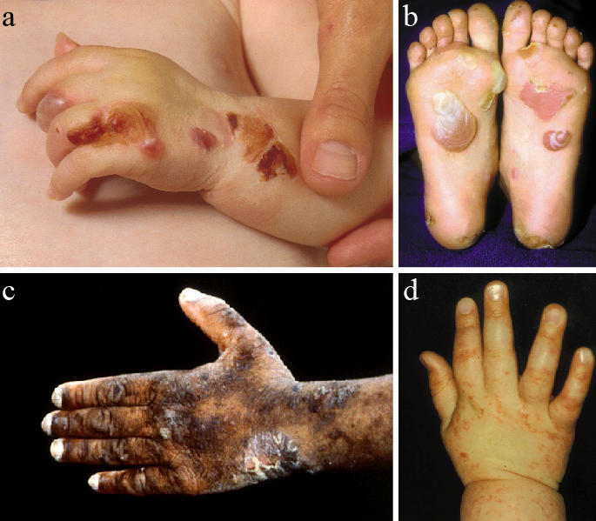
Intermediate filament disorders
Lamin Disorders (laminopathies)
Over 180 mutations associated with at least 13 known diseases
Premature aging syndromes: Hutchinson-Gilford progeria, atypical Werner syndrome
Lipodystrophies: Dunnigan-type familial partial lipodystrophy, mandibuloacral dysplasia
Myopathies/neuropathies: Emery-Driefuss muscular dystrophy, Charcot-Marie-Tooth peripheral neuropathy
Keratin (K) disorders
(EBS): rare genetic skin disorder causing blistering of the skin due to a point mutation in K5/14
Epidermolytic hyperkeratosis: fragile upper skin layers resulting from mutations in K1/K10
Clinical features of epidermolysis bullosa simplex (EBS).
From McLean & Irvine (2007) Ulster Med J. 76(2): 72–82.

Slide 15
Practice SBAs
The nuclear lamins fall into which of the intermediate filament categories?
Type I
Type II
Type III
Type IV
Type V
Which one of the following is a premature aging syndrome resulting from a laminopathy
Emery-Driefuss dystrophy
Charcot-Marie tooth syndrome
Hutchinson-Gilford progeria
Dunnigan-type familial disorder
Mandibuloacral dysplasia

Slide 16
Summary slide
Microtubules
Composition & structure
Tubulin dimers form hollow tubes.
Dynamic instability due to GTP hydrolysis
Function
Neurofilaments: Structure & Transport
Flagella: Movement
Mitotic spindle: division
Pharmacology
Griseofulvin: fungal infections
Vinca alkaloids: cancer
Intermediate filaments
Background
5 different categories
Important in cell shape and & cell stress
Assembly
Coiled-coiled dimers form protofibrils and protofilaments
Disorders
Laminopathies: 13 known rare disorders
Keratin disorders: skin disorders
Actin
Composition & structure
Assembly
Actin binding proteins

Slide 17
Actin: background
+ve (barbed) end
General
In eukaryotic cells actin is the most abundant protein
Actin exists in two forms: G-actin globular monomers and F-actin polymers
G-actin readily polymerises into F-actin and the reaction is reversible
ATP-bound G-actin is incorporated into the plus end of the filament
The polarised polymer has a fast-growing plus (barbed)
Actin is an ATPase and catalyses the hydrolysis of ATP to ADP
Net depolymerisation at the minus (pointed) end releases ADP-bound G-actin
This process in known as treadmilling and is crucial for actin motility
ATP
ADP
ATP
ATP
G-actin
ADP
ATP
ADP
ATP
ADP
ATP
ADP
ATP
ADP
ATP
ADP
-ve (pointed) end
ATP
ADP

Slide 18
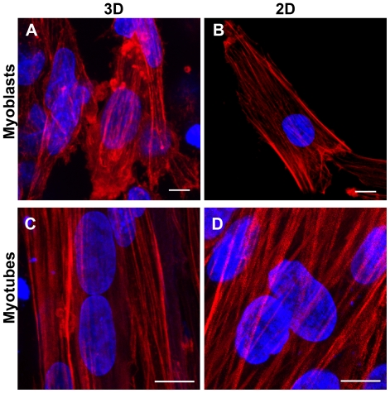
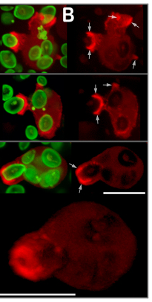
Actin: function
Function
Form the cytoskeleton that determines cell shape
Create cellular projections like microvilli and filopodia
Steady elongation is ideal for cellular motility and chemotaxis
Are responsible for phagocytosis and trigger membrane internalisation during endocytosis
Fluorescent phalloidin was used to stain the actin cytoskeleton (in red) in myoblasts (A–B) and myotubes (C–D). Nuclei were stained with DAPI (in blue).
From Chiron et al (2012) PLoS One. 7(4): e36173. .
Actin (labeled red) redistribution during protrusive phagocytosis of fluorescent zymosan (green) by human neutrophils.
From Lee et al (2011) J Cell Sci. 24(7): 1106–1114.
F-actin distribution in the two macrophage cell lines by epifluorescence microscopy. (A) Nonmotile P388D1 cells stained with rhodamine phalloidin show F-actin staining in filopodia, cell surface microvilli and the cell body.
From Correia et al (1999) J Cell Biol.146(4): 831–842.

Slide 19
Actin binding proteins
Actin binding proteins
Nucleators
The ARP2/3 (actin-related protein) complex causes nucleation and triggers branching of actin forming dendritic networks
Conformation modulators
Profilin and cofilin regulate actin dynamics enhancing actin growth and disassembly, respectively
Gelsolin and CapZ bind tightly to actin at the barbed end and act as capping proteins
Supramolecular structure organisers
The fascins, filamin and α-actinin are crosslinkers that create stable parallel bundles of actin or more disorganised bundles
Membrane anchors
Vinculin and the ERM protein family (Ezrin, Radixin, Moesin) link actin to the cell membrane (integrins & CD44 protein, respectively)

Slide 20
Practice SBAs
Which one of the following actin-binding proteins acts as an actin crosslinker?
ARP2/3
Profilin
Vinculin
Gelsolin
α-actinin
Which one of the following actin binding proteins acts as a capping protein
ARP2/3
Profilin
Vinculin
Gelsolin
α-actinin

Slide 21
Summary slide
Microtubules
Composition & structure
Tubulin dimers form hollow tubes.
Dynamic instability due to GTP hydrolysis
Function
Neurofilaments: Structure & Transport
Flagella: Movement
Mitotic spindle: division
Pharmacology
Griseofulvin: fungal infections
Vinca alkaloids: cancer
Intermediate filaments
Background
5 different categories
Important in cell shape and & cell stress
Assembly
Coiled-coiled dimers form protofibrils and protofilaments
Disorders
Laminopathies: 13 known rare disorders
Keratin disorders: skin disorders
Actin
Structure & function
Polymerise into microfilaments
Cell shape
Cell motility
Phagocytosis
Assembly
G-actin monomers & F-actin hollow tubes
Form barbed and pointed ends
Treadmilling
Actin binding proteins
Regulate actin dynamics, structure and binding

Slide 22
Learning objectives revisited
Highlight the major differences between the three main cytoskeletal proteins
Microtubules & Actin filaments polymerise to form hollow tubes with polarity. They have enzymatic activity and display dynamic instability & treadmilling.
Intermediate filaments are more heterogenous and form rods without polarity
Understand the functional roles of microtubules and describe the drugs that target these structures
Microtubules play important roles in cell integrity, intracellular transportation, cell movement & cell division
Griseofulvin is used to treat fungal infections and the Vinca alkaloids are used in the treatment of cancer

Slide 23
Learning objectives revisited
Understand how intermediate filaments are assembled and describe their classification system
Form coiled coil protofilaments that display great tensile strength
Have five different categories:
Types I & II: keratins
Type III: Vimentin & desmin
Type IV: Neurofilaments
Type V: nuclear lamins
Describe the functional roles of intermediate filaments with relation to their involvement in disease
IF have tensile strength and ‘absorb’ cellular impacts
Rare lamin disorders cause premature aging syndrome, lipodystophies & myopathies/ neuropathies
Keratin disorders affect the epidermis

Slide 24
Learning objectives revisited
Describe the structure and function of actin and associated proteins
Filamentous (F) actin is made up of globular (G) actin monomers.
Polymerisation is a dynamic process and involves ‘treadmilling’
Actin is important for maintaining cell shape, cell motility and phagocytosis
Associated protein regulate actin dynamics, structure & binding

