Slide 1
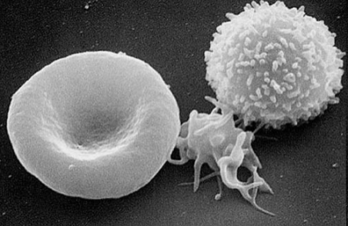
jasmina.saric@imperial.ac.uk
Section of Biomolecular Medicine
Faculty of Medicine
Blood and Blood Cells Part A

Slide 2
Learning objectives
List the main functions and components of the blood
Outline the differences in blood composition between male and female
Describe the essential features of the erythrocyte and list its major functions
Explain the major mechanisms behind anemia
Describe the major requirements, nutritional and otherwise, of normal erythropoiesis
Explain the major functions of the main hematopoietic cell populations of normal blood

Slide 3
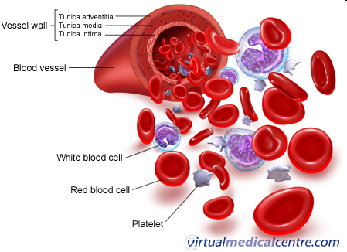
Main Functions of Blood
Transport through the body of
Oxygen and carbon dioxide
Nutrients (glucose, lipids, amino acids)
Ions (e.g., Na⁺, Ca²⁺, HCO₃⁻)
Wastes (e.g., urea, H₂O, food additives, drugs)
Hormones
Defence of the body against infections and other foreign materials
Regulation of body pH and core body temperature
Normal pH of blood: 7.35 - 7.45

Slide 4
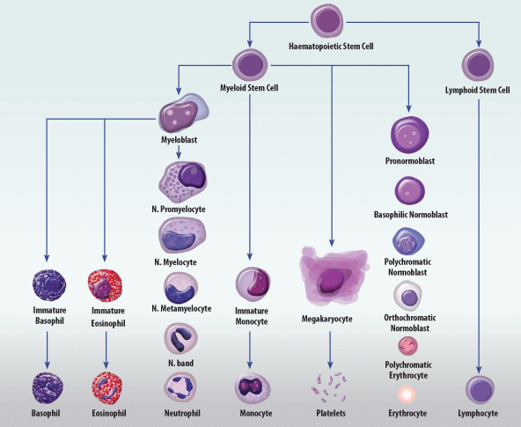
Blood Cells

Slide 5
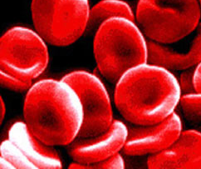
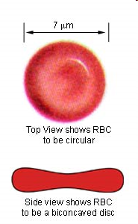
Erythrocytes
Red blood cells (RBCs)
Morphology:
Flexible biconcave discs
maximizes surface area, flexible so squeeze through capillaries
No organelles
Function: Respiratory transport O₂ and CO₂

Slide 6
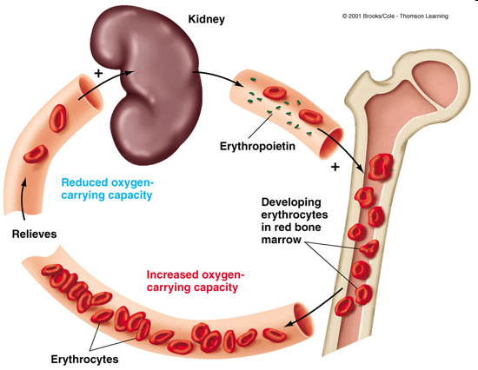
Erythropoiesis
Lifespan: 120 days
Production: Bone marrow
Removal: Phagocytic macrophages in liver and spleen
Dependent on dietary iron
Erythropoietin regulation

Slide 7
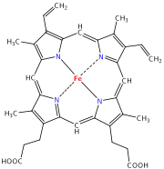
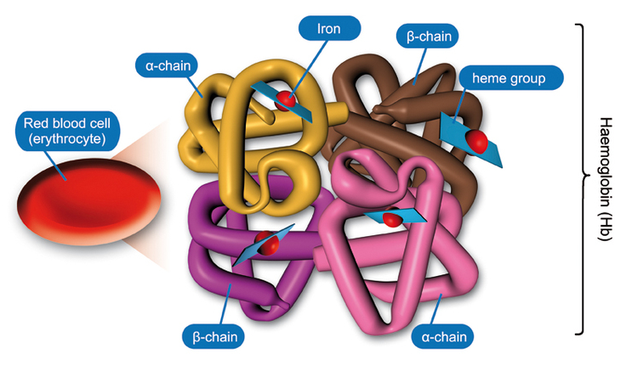
Haemoglobin and Oxygen Transport
Heme
4 subunits (α₂β₂): each a polypeptide with a haem group
Haem contains ferrous iron (Fe2+)
Iron must be in Fe²⁺ oxidation state for O₂ carriage
Oxidized form (methaemoglobin – Fe³⁺) cannot carry O₂
Also CO₂ carriage
100 mL blood: 15.8g (male)
13.7g (female)

Slide 8
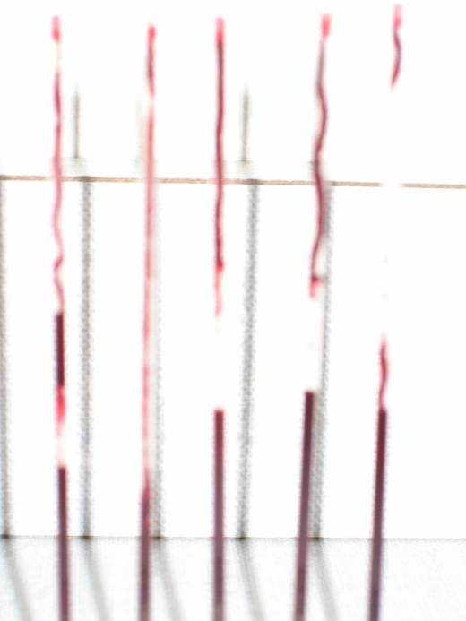
Key blood parameters
Concentration haemoglobin:
(13.5-16.5 g/dl (♂) and 11.5-14.5 g/dl (♀)
Red cell count:
5.4 x 10¹²/l (♂) and 4.8 x 10¹²/l (♀)
Haematocrit: (packed cell volume):
0.40-0.54 (♂) and 0.35-0.47 (♀)
Blood volume: Male – 5L
Female – 3.5L
Derived indices Normal
MCV (mean cell volume) 82-99fl
MCH (mean cell hemoglobin) 27-33pg
MCHC (mean cell hemoglobin concentration) 32-34g/dl

Slide 9
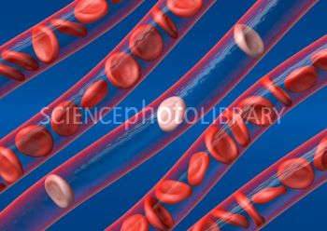
Anaemia
DEF: Decrease in erythrocyte number or
low haemoglobin concentration
Microcytic (small MCV)
= haemoglobin synthesis failure/insufficiency
Example: Iron deficiency
heme synthesis defect
most common type of anaemia overall
RBCs appear hypochromic and microcytic (paler and smaller)
due to insufficient dietary intake or absorption of iron to replace losses
menstruation (daily loss 1mg♂; 2mg♀) GIT lesions or cancers, Parasitic infestation (hookworm, schistosomiasis, whipworm)

Slide 10
Anaemia
Normocytic (normal MCV)
= overall haemoglobin levels always decreased
Examples: Acute blood loss
Aplastic anaemia (bone marrow failure)
Hemolytic anaemia (Malaria)
Macrocytic (large MCV)
= failure of DNA synthesis → restricted cell division of progenitor cells
Examples:
Folic acid deficiency -> nutritional deficiency and/or pregnancy
Vitamin B₁₂ deficiency -> nutritional deficiency or pernicious anaemia (lack of intrinsic factor due to autoimmune disease → insufficient absorption of Vitamin B₁₂)
Folic acid deficiency does not produce neurological symptoms whereas Vitamin B₁₂ deficiency does

Slide 11
Leukocytes (White blood cells)
Less numerous than erythrocytes
Have nuclei and cell organelles
Use circulation for transport
Travel near capillary wall and invade tissue space to fight infection
Divided into 2 groups:
Granulocytes: (cytoplasm filled with granules)
Basophils
Eosinophils
Neutrophils
Agranulocytes:
Lymphocytes
Monocytes

Slide 12
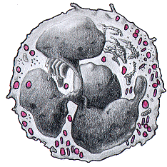
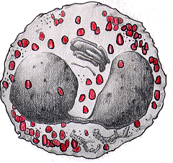
Granulocytes
Segmented nucleus
Full of cytoplasmic granules
First at site of inflammation (neutrophils)
Adhere to blood vessels in infected area and migrate to tissue
Engulf, kill and digest microorganisms
Generate reactive oxygen species and digestive enzymes

Slide 13
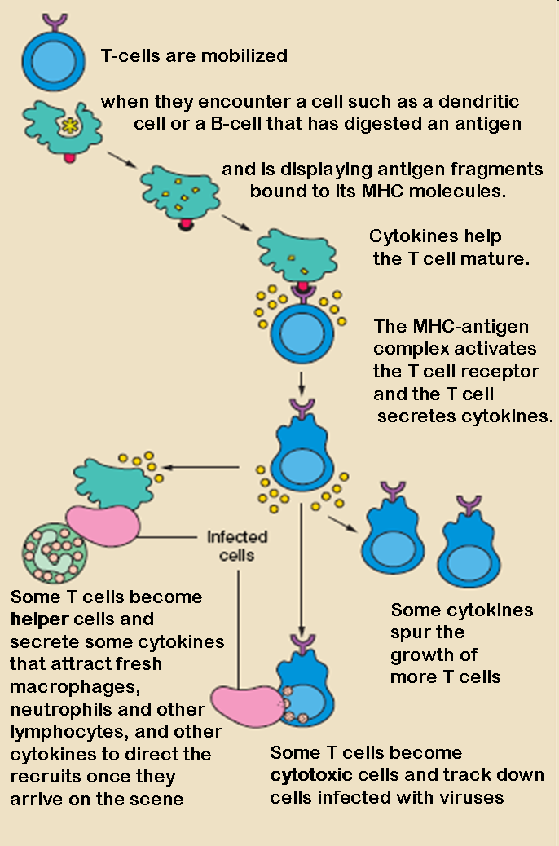
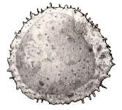
Lymphocytes
20-40% in blood
8-10um diameter
Nucleus round and large – occupies most of the cell
T lymphocytes
Cellular immunity (i.e. not antibodies)
Thymus dependent (become immunologically competent in the thymus)

Slide 14
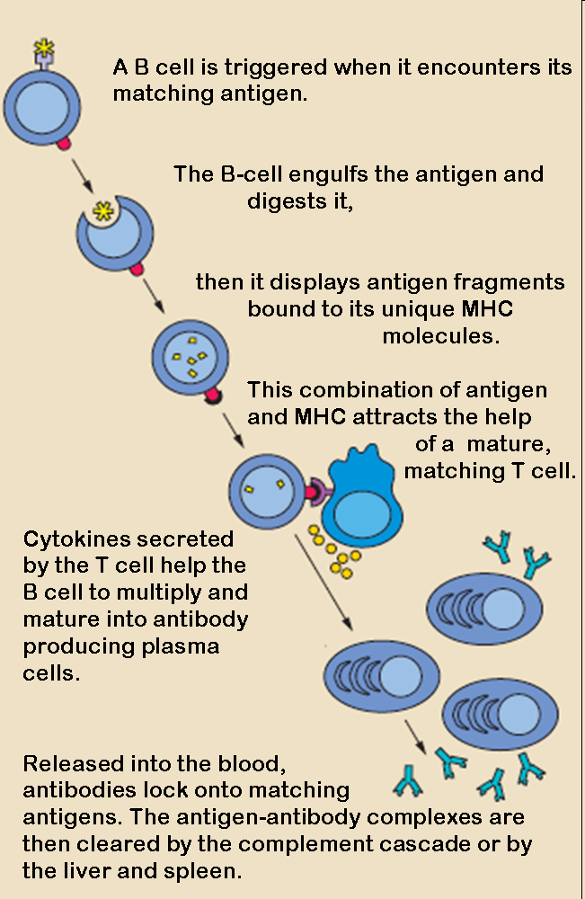
Lymphocytes - B lymphocytes
Humoral immunity
Foreign antigen → RNA synthesis → immunoglobulin (antibody) production
Immunoglobulins: IgM; IgG; IgA; IgD; IgE
Primary immune response:
First exposure, antibodies appear after lag period, IgM production, production of memory B cells
Secondary immune response:
Shorter lag period, Stronger (100-1000x), IgG prevalent, higher affinity to antigen

Slide 15
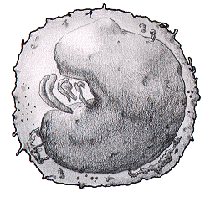
Monocytes
Appear after granulocytes
In tissue become macrophages (“big eaters”)
Engulf micro-organisms, tissue debris and dead neutrophils
Degrade foreign material and present as peptide antigen to lymphocytes
Secrete inflammatory mediators and stimulate angiogenesis (vessel growth = repair)

Slide 16
Normal leukocyte count
Total 3.5 - 10.0 x 10⁹/L
Neutrophils | 2.5 - 7.5 (40 - 75%)
Eosinophils | 0.04 - 0.4 (1 - 6%)
Basophils | 0.01 - 0.1 (<1%)
Monocytes | 0.2 - 0.8 (2 - 10%)
Lymphocytes | 1.5 - 4.0 (20 - 45%)

Slide 17
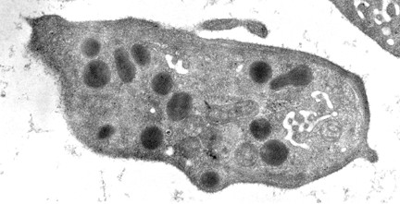
Platelets (Thrombocytes)
Derive from megakaryocytes
2 - 3 µm diameter (small)
Normal platelet count 25 x 10⁴/ml
Life span 8 - 10 days
Contain granules which are excreted when activated
Many organelles, no nucleus

Slide 18
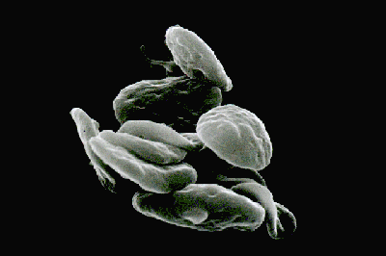
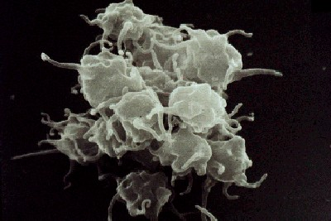
Platelets and Haemostasis
Damage to blood vessel wall exposes sub-endothelial proteins (von Willebrand factor; vWF)
vWF will recruit collagen and other clotting factors
Circulating platelets bind to collage
Release of granules promotes platelet aggregation and coagulation
Clot forms and stops bleeding
Unactivated
Activated

Slide 19
Functions of Plasma
Fluid component of blood which acts as carrier for cells and key components
Nutrients | Glucose, Lipids, Amino acids
Hormones | Thyroxine, Cortisol, Erythropoietin
Proteins | Clotting factors, Albumin, Globulins
Inorganic ions | Na, K, Ca, PO₄, HCO₃
Products of metabolism | Urea, Lactic acid

Slide 20
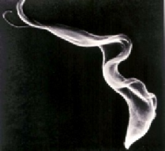
Infectious Agents Part B

Slide 21
Learning objectives
List the differences between prokaryotic and eukaryotic cells
List the 5 main types of infectious agents causing disease
Name the distinguishing feature of the different types of infectious agents
Give examples and describe the disease they cause

Slide 22
Why are we interested in infectious agents?
Top ten Global cause of death (WHO 2008)
High-income countries | Deaths in millions | % of deaths
Ischaemic heart disease | 1.42 | 15.6%
Stroke and other cerebrovascular disease | 0.79 | 8.7%
Trachea, bronchus, lung cancers | 0.54 | 5.9%
Alzheimer and other dementias | 0.37 | 4.1%
Lower respiratory infections | 0.35 | 3.8%
Chronic obstructive pulmonary disease | 0.32 | 3.5%
Colon and rectum cancers | 0.30 | 3.3%
Diabetes mellitus | 0.24 | 2.6%
Hypertensive heart disease | 0.21 | 2.3%
Breast cancer | 0.17 | 1.9%
Low-income countries | Deaths in millions | % of deaths
Lower respiratory infections | 1.05 | 11.3%
Diarrhoeal diseases | 0.76 | 8.2%
HIV/AIDS | 0.72 | 7.8%
Ischaemic heart disease | 0.57 | 6.1%
Malaria | 0.48 | 5.2%
Stroke and other cerebrovascular disease | 0.45 | 4.9%
Tuberculosis | 0.40 | 4.3%
Prematurity and low birth weight | 0.30 | 3.2%
Birth asphyxia and birth trauma | 0.27 | 2.9%
Neonatal infections | 0.24 | 2.6%

Slide 23
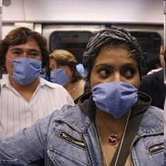
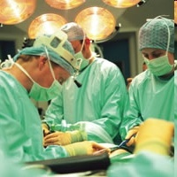
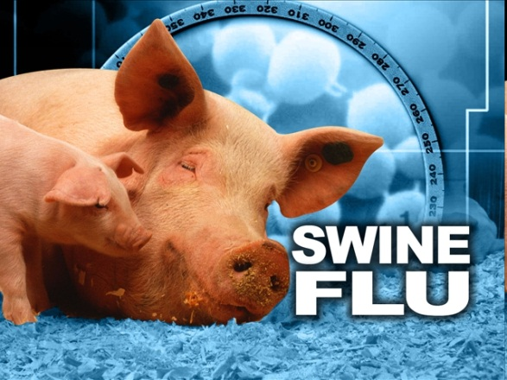
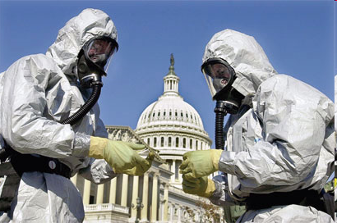
Why are we interested in infectious agents?
Global spread of infections
Hospital infections - MRSA
New and emerging infections
Bioterror - Bacillus anthracis

Slide 24
Why do they continue to cause a problem?
“It takes all the running you can do, to keep in the same place.”
- The Red Queen from Lewis Carroll’s Through the Looking Glass
“For an evolutionary system, continuing development is needed just in order to maintain its fitness relative to the systems it is co-evolving with.”
- Leigh Van Valen on the Red Queen Principle
Generation time
E. coli: 20 minutes; H. sapiens: 26 years
Point mutation rate
E. coli: 10⁻⁸-10⁻¹⁰; H. sapiens: 10⁻⁵

Slide 25
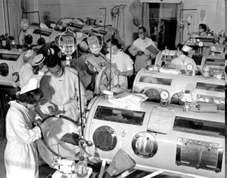
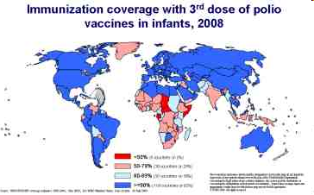
Success stories in infection control
Vaccines
1988: 350,000 cases

Slide 26
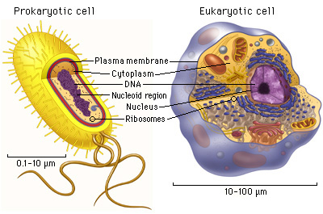
Prokaryotic cells vs. eukaryotic cells
Based on organisation of cellular structures, all living cells can be divided into two groups
Eukaryotic:
Nucleus present
Membrane enclosed organelles including ER, mitochondria, lysosomes, Golgi
Chromosomes: Haploid or diploid
Cytoskeleton
Prokaryotic:
No nucleus
No internal membranes or membranous organelles
Single copy of chromosome (haploid)

Slide 27
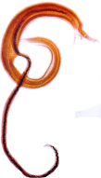
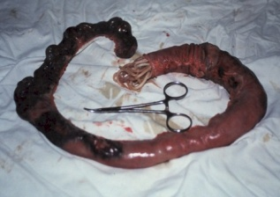
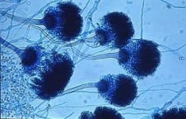
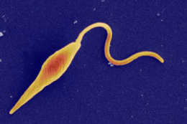
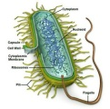
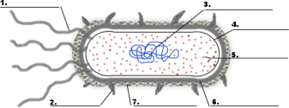
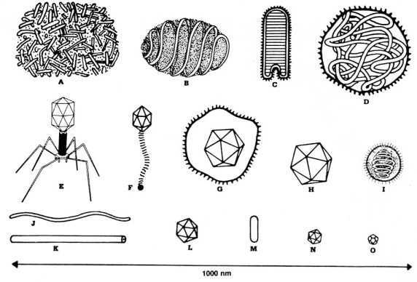
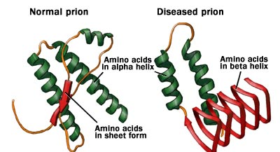
Infectious agents:
10
m 1
Fasciola hepatica
Schistosoma mansoni/
S. japonicum
and multiple
100
10
mm 1
Worms
Ascaris lumbricoides
Eukaryotes
100
10
μm 1
Fungi
Trypanosoma
brucei brucei
Protozoa
Plasmodium berghei
Leishmania major
Bacteria
Prokaryotes
100
10
nm 1
Viruses
Sub cellular Agents
Prions

Slide 28
Global Burden of Mortality
3
2.6
“The big three”
2.3
2
1.6
Deaths per year (million)
Neglected tropical diseases (NTDs)
1.3
1
534,000
0.6
280,000
0.3
65,000
60,000
51,000
48,000
14,000
10,000
6,000
0
HIV/AIDS
Malaria
Leprosi
NTD total
Hookworm
Tuberculosis
Ascariasis
Trichuriasis
Schistosomiasis
Leishmaniasis
Trypanosomiasis
Chagas disease
Hotez et.al Lancet 2009

Slide 29
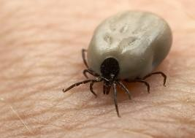
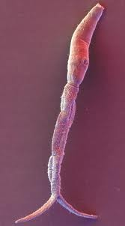
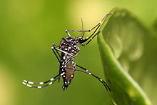
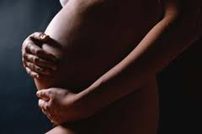
Transmission:
Direct contact
HIV/AIDS, Chlamydia, Hepatitis B
Oral and feco-oral route
Herpes simplex, Food borne trematodiases, Cholera
Percutaneous infection
Schistosomiasis, Hookworm disease
Vector-borne infection
Malaria, Dengue fever, Sleeping sickness
Vertical and horizontal transmission
Influenza A and B, Hepatitis, Syphilis

Slide 30
Viruses
Obligate parasites – not cells in their own right
Contain RNA or DNA genetic material
Make use of host cell nuclear synthetic machinery to replicate
Show host specificity but infect almost all other life forms including bacteria
Divide by budding out of host cell

Slide 31
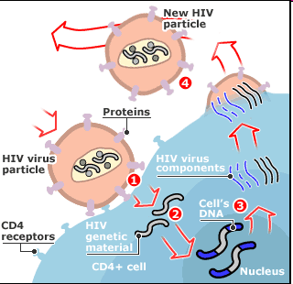
Human Immunodeficiency Virus (HIV)
34 million people live with HIV worldwide
An estimated 2.5 million people were newly infected with the virus in 2011
.
HIV is the world’s leading infectious killer
About 25 million people have died to date. An estimated 1.7 million people died of HIV/AIDS in 2011.
Combination antiretroviral therapy (ART) prevents the HIV virus from multiplying in the body
WHO 2012

Slide 32
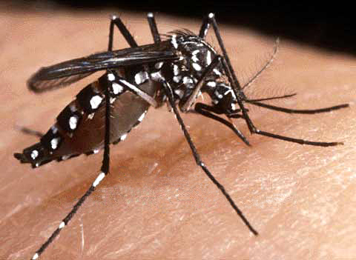
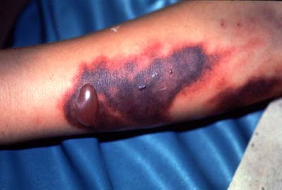
Dengue fever
The infection causes flu-like illness, and occasionally develops into a potentially lethal complication called dengue hemorrhagic fever
The global incidence of dengue has grown dramatically in recent decades; ~50% of the world's population is now at risk
Dengue is found in tropical and sub-tropical climates worldwide, mostly in urban and semi-urban areas
There is no specific treatment for dengue/ severe dengue, but early detection and access to proper medical care lowers fatality rates below 1%.
Dengue prevention and control solely depends on effective vector control measures.

Slide 33
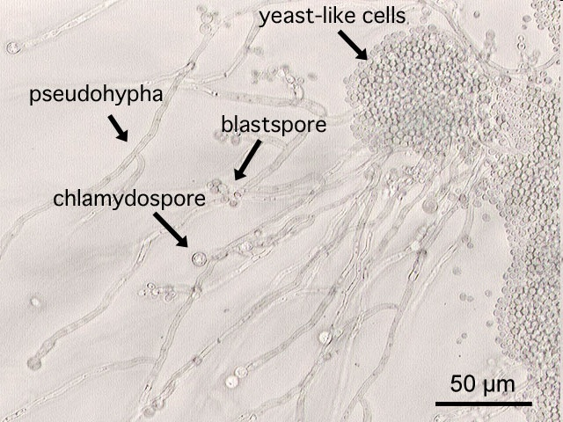
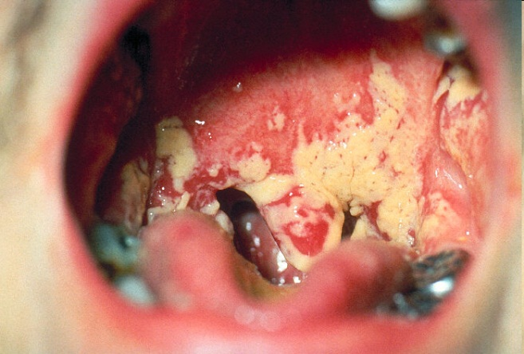
Fungi
Non-motile eukaryotic cells
Occurs as yeasts, filaments or both
Yeasts bud or divide
Cause disease by
Production of toxins
Allergens
Invasion of tissue
Cause cutaneous, mucosal (Candida albicans) and/or systemic mycoses (Aspergillus)

Slide 34
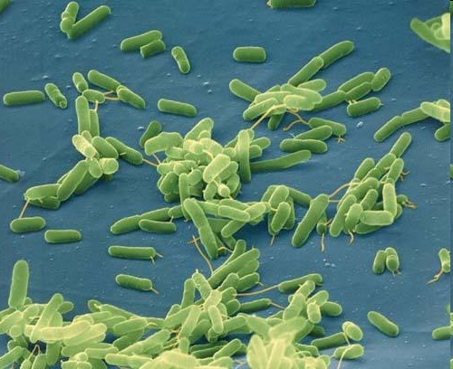
Bacteria
Fundamentally different from all other living things
- PROKARYOTES
Contain chromosomal DNA, but no nucleus (but condensations called Nucleoids)
Widely distributed in nature
Some are pathogenic
Divide by binary fission

Slide 35
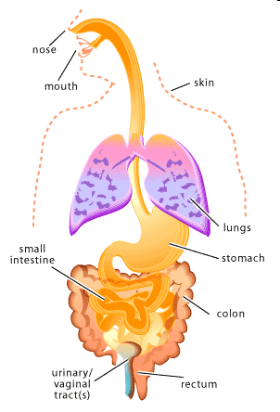
Beneficial bacteria – The microbiota
Number of human cells in the body: 10¹³
Number of bacterial cells in the body: 10¹⁴
Functions:
Protect against pathogens
Development and homoeostasis of the immune system
Control of epithelial cell proliferation and differentiation
Fermentation of non-digestible dietary fibres
Absorption of nutrients and vitamin synthesis
May cause infections in the immune-compromised
Location of normal microbial populations

Slide 36
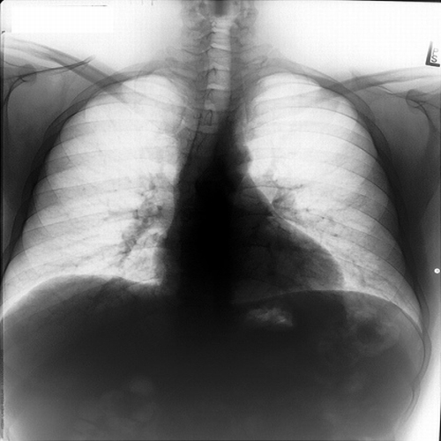
Tuberculosis
Tuberculosis (TB) is caused by bacteria (Mycobacterium tuberculosis) that most often affect the lungs.
Tuberculosis is curable and preventable.
About one-third of the world's population has latent TB.
People infected with TB bacteria have a lifetime risk of falling ill with TB of 10%. However persons with compromised immune systems have a much higher risk of falling ill.
Common symptoms of active lung TB are cough with sputum and blood at times, chest pains, weakness, weight loss, fever and night sweats.

Slide 37
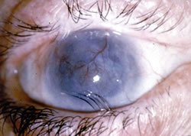
Trachoma
Caused by Chlamydia trachomatis
Ocular localised infection which spreads through contact with eye discharge
Infection often begins during infancy and can become chronic
Leading cause of infection-induced blindness
Chronic and repeated infection leads to scarring of the inside of the eyelid and inwards turning of eyelids and scarring the cornea.

Slide 38
Protozoa
Unicellular eukaryotic organisms
Include intestinal, blood and tissue parasites
Replicate in host by binary fission or by formation of trophozoites inside a cell
Many have a complex life cycle involving more than one host
Infection is often acquired by ingestion or through a vector

Slide 39
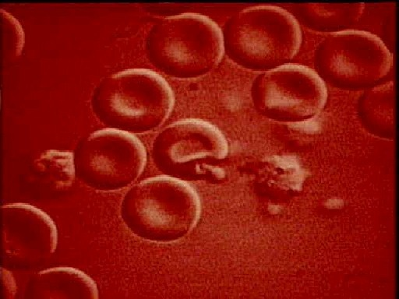
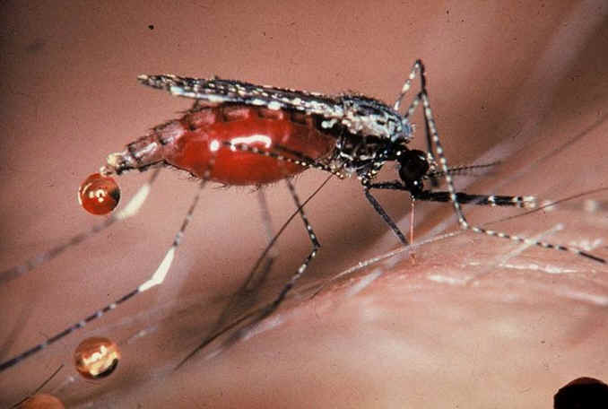
Plasmodium spp.
Malaria - Epidemiological relevance (WHO 2008)
In 2006 the disease caused ~880 Mio acute illnesses and ~ 1 Mio deaths
Significant public health problem in > 90 countries, inhabited by > 50% of the world population
90% of all cases occur in sub-Saharan Africa
High risk groups include children, pregnant women, refugees and labourers entering endemic regions
Causative agents: Plasmodium falciparum, P vivax, P ovale, P malariae

Slide 40
Pathology:
Fever - Synchronised rupture of RBC’s releasing merozoites and cell debris -> pro-inflammatory cytokines.
P falciparum P vivax and P ovale 48hr cycle (malaria tertiana) ; P malariae 72 hr (malaria quartana)
Organ dysfunction/cerebral malaria –
Sequestration of P falciparum infected
RBC in the microcirculation of vital
organs.
Lactic acidosis - Anaerobic glycolysis,
parasite end product
Anaemia - Due to rapid haemolysis of
RBC’s

Slide 41
Trypanosoma spp.
Human African Trypanosomiasis
Causative agents:
Trypanosoma brucei gambiense
T brucei rhodesiense
Epidemiological significance: WHO: 50-60 Mio people at risk and ~60,000 deaths per annum
Pathology:
Hemolymphatic stage
Meningo-Encephalitic stage

Slide 42
Helminth parasites
CLASS
Trematoda (Flukes)
Cestoda (Tapeworms)
PHYLUM
Plathelminthes (Flatworms)
Nematoda (Roundworms)
Multicellular organism with eukaryotic cell structure
Visible to the naked eye
Can have a life cycle outside the human host
Complexity of the life cycle varies from simple (all developmental stages in same host) to complex (alternation of generations in different hosts)

Slide 43
Schistosoma spp.
Causative agents: Schistosoma mansoni, S japonicum, S haematobium, S intercalatum, S mekongi
Intermediate host: Snails of the genera Bulinus, Biomphalaria, Onchomelania
Epidemiological significance: People at risk: 779 Mio; Infected: 207 Mio; Mortality: 280,000/year; Endemic in 76 countries
Chronic disease: Many infections are subclinically symptomatic (mild anaemia, malnutrition)
Acute schistosomiasis: Abdominal pain, fever, diarrhoea, fatigue, enlargement of liver and spleen

Slide 44
Soil-transmitted helminthiasis
Ascariasis
Intestinal nematodes, part of the development takes place outside the body – in the soil
Infection via contact with parasite eggs or larvae in contaminated soil
Pathology is strongly related to the parasite burden
Large worm burden can result in impaired growth and cognition
At risk: 4.5 billion people
Trichuriasis
Hookworm disease

Slide 45
Conclusions
Infectious disease crosses all boundaries within the medical curriculum and in medical practice
Effective treatment requires knowledge of the potential causative agents, its source and means of transmission, how it causes damage and how the human body reacts to it
Infectious diseases remain a major challenge to global health. Much still to be learnt about the mechanisms by which pathogens cause disease
Developing new strategies to prevent infection is a major public health priority

