Slide 1


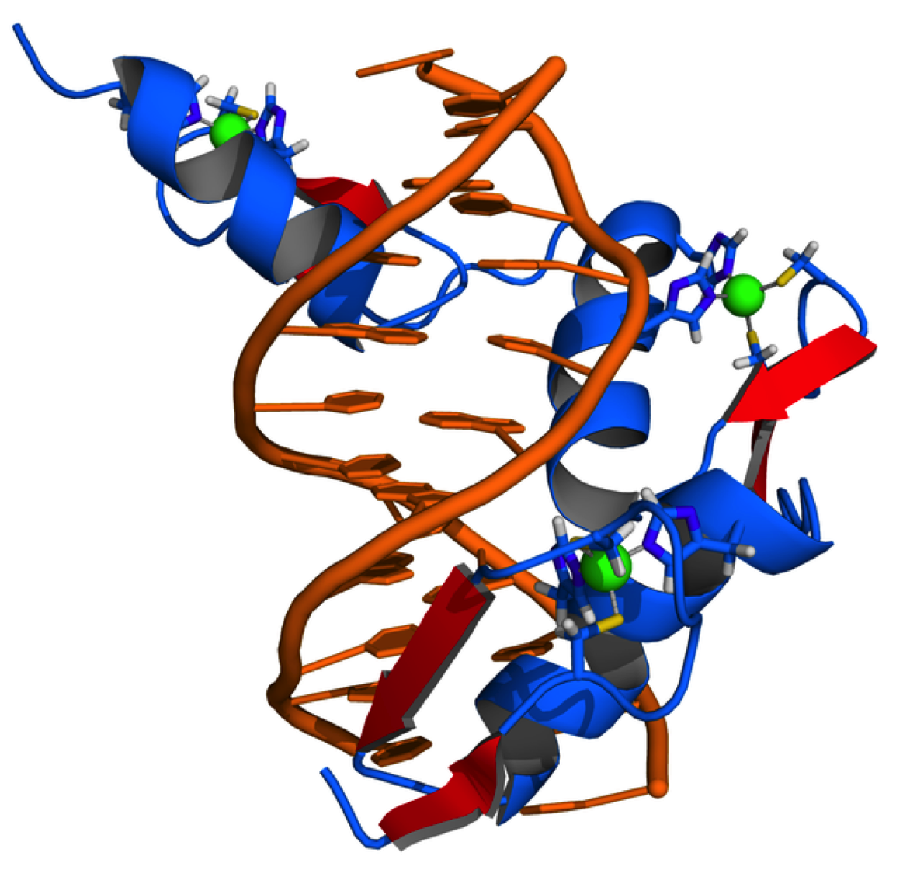
Cellular and
Molecular Science
Dr Mick Jones
Infectious Diseases & Immunity
&
MRC Clinical Sciences Centre
Genomics Laboratory
Hammersmith Hospital Campus

Slide 2
SAQ Nucleic Acids
The first exon of a gene contains the following sequence on the ‘sense strand’:
5’-GACTCGATTACTATGCGTGCTGCGTGCAGTCATTTAGCAATC-3’
Write out the sequence of the first 12 bases of the transcribed RNA. (2 marks)
Mark and label the most likely position where the ribosome will start translation of the
above sequence, once it has been used to make mRNA. (2 marks)
How many amino acids will then be encoded in the displayed sequence? (2 marks)
What 2 types of proteins are translated on the Rough Endoplasmic Reticulum (RER)?
(2 mark)
Name 2 common post-translational modifications of proteins. (2 marks)

Slide 3
Transcription: Making an RNA copy of a DNA strand
H
3. Ribonucleotide bases are joined by phosphodiester bonds. The RNA chain grows one base at a time in a 5’ ->3’ direction
1. DNA Strands unwind
2. Ribonucleotides base pair with DNA bases on one strand
RNA
P G
A
U
A
C
A
U
A
G
AOH
5’
3’
Sense DNA Strand
G
A
T
A
C
A
T
A
G
A
G
A
T
A
C
A
T
A
G
A
P G
A
U
A
C
A
U
A
G
AOH
C
T
A
T
G
T
A
T
C
T
Antisense DNA Strand
3’
5’

Slide 4
5’-GACTCGATTACTATGCGTGCTGCGTGCAGTCATTTAGCAATC-3’
Sense
5’-GACTCGATTACTATGCGTGCTGCGTGCAGTCATTTAGCAATC-3’
3’-CTGAGCTAATGATACGCACGACGCACGTCAGTAAATCGTTAG-5’ Antisense
mRNA
5’-GACUCGAUUACUAUGCGUGCUGCGUGCAGUCAUUUAGCAAUC-3’
M R A A C S H L A I

Slide 5
The first exon of a gene contains the following sequence on the ‘sense strand’:
5’-GACTCGATTACTATGCGTGCTGCGTGCAGTCATTTAGCAATC-3’
Write out the sequence of the first 12 bases of the transcribed RNA. (2 marks)
5’-GACUCGAUUACU-3’
Mark and label the most likely position where the ribosome will start translation of the
above sequence, once it has been used to make mRNA. (2 marks)
5’-GACTCGATTACTATGCGTGCTGCGTGCAGTCATTTAGCAATC-3’
5’-GACUCGAUUACUAUGCGUGCUGCGUGCAGUCAUUUAGCAAUC-3’
M R A A C S H L A I
How many amino acids will then be encoded in the displayed sequence? (2 marks)
10

Slide 6
Protein synthesis on
Rough Endoplasmic Reticulum:
secreted and transmembrane proteins
First 20 - 24 amino acids = signal sequence
(hydrophobic aas e.g. Leu, Ile, Phe, Trp, Tyr, Ala)
40S
mRNA
60S

Slide 7
Post-translational modification
- After synthesis most proteins are modified further before they are fully functional
- Only 20 amino acids – cell uses post-translational modifications (over 200) to increase diversity, including:
Proteolytic cleavage (e.g. insulin -> A and B chains)
Disulphide bond formation (e.g. insulin)
Addition of carbohydrate (Glycosylation)
Addition of phosphate (Phosphorylation)
Addition of lipid groups (Prenylation, Acylation)

Slide 8
What 2 types of proteins are translated on the Rough Endoplasmic Reticulum (RER)?
(2 mark)
Secreted and transmembrane proteins (1 mark each)
Name 2 common post-translational modifications of proteins. (2 marks)
1 mark each for any two of:
proteolytic cleavage, addition of carbohydrate (glycosylation),
disulphide bond formation; addition of phosphate (phosphorylation),
addition of lipid groups (prenylation, acylation, GPI anchors).
Others may need to be marked at the discretion of the examiners

Slide 10
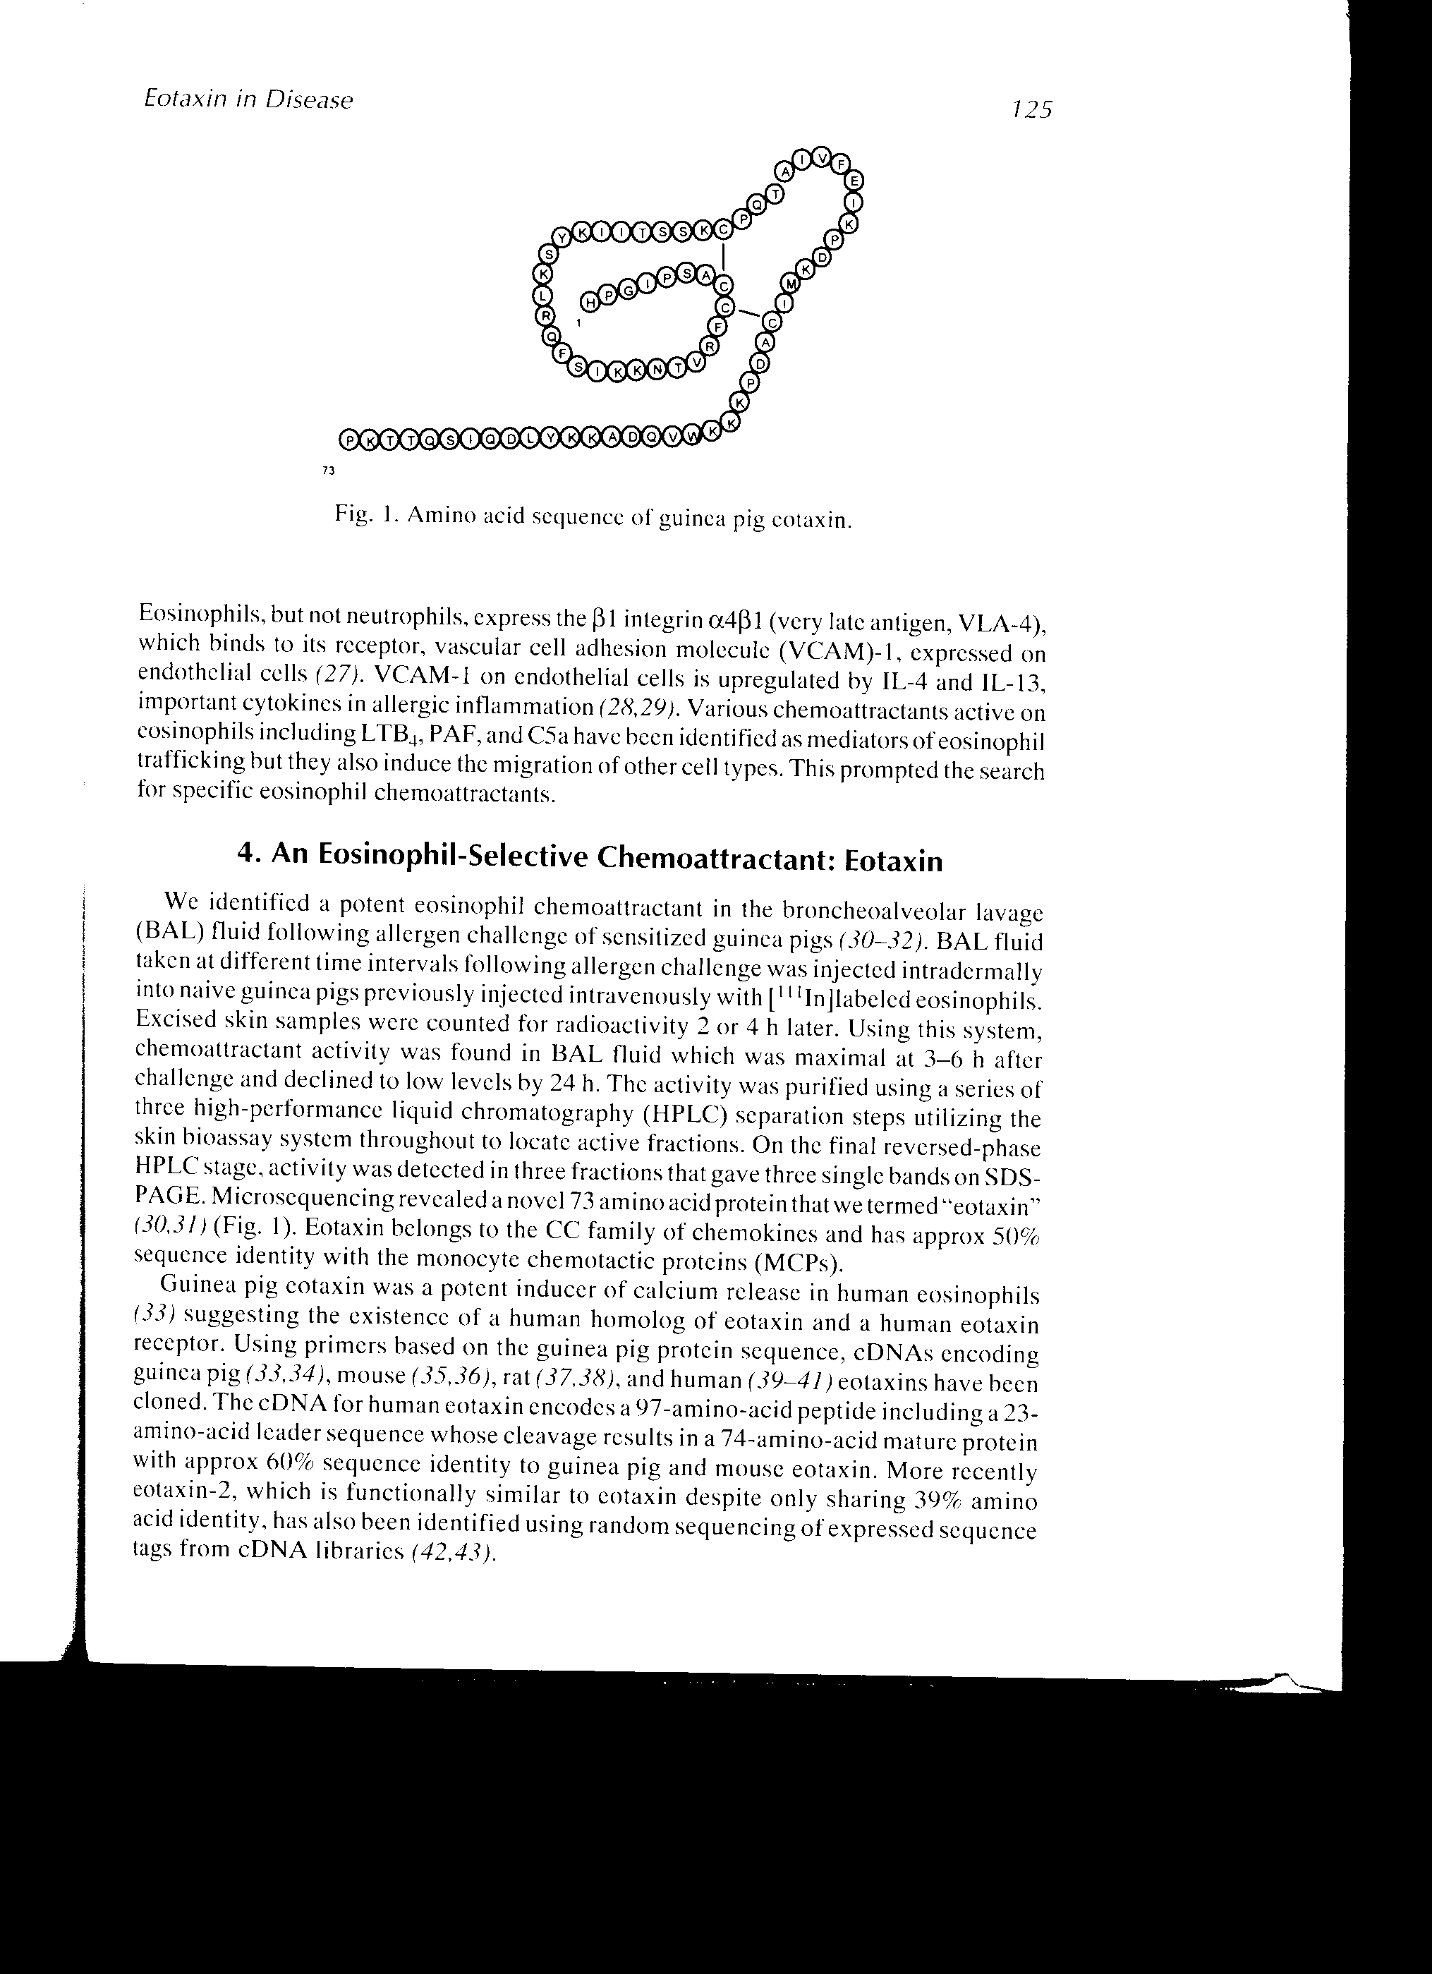
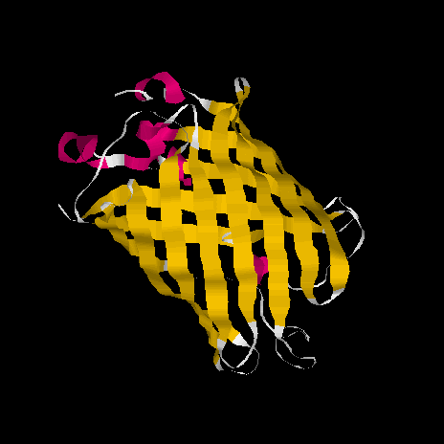
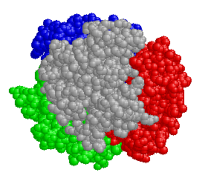
Primary Structure
Secondary Structure
Quaternary Structure
Tertiary Structure

Slide 11
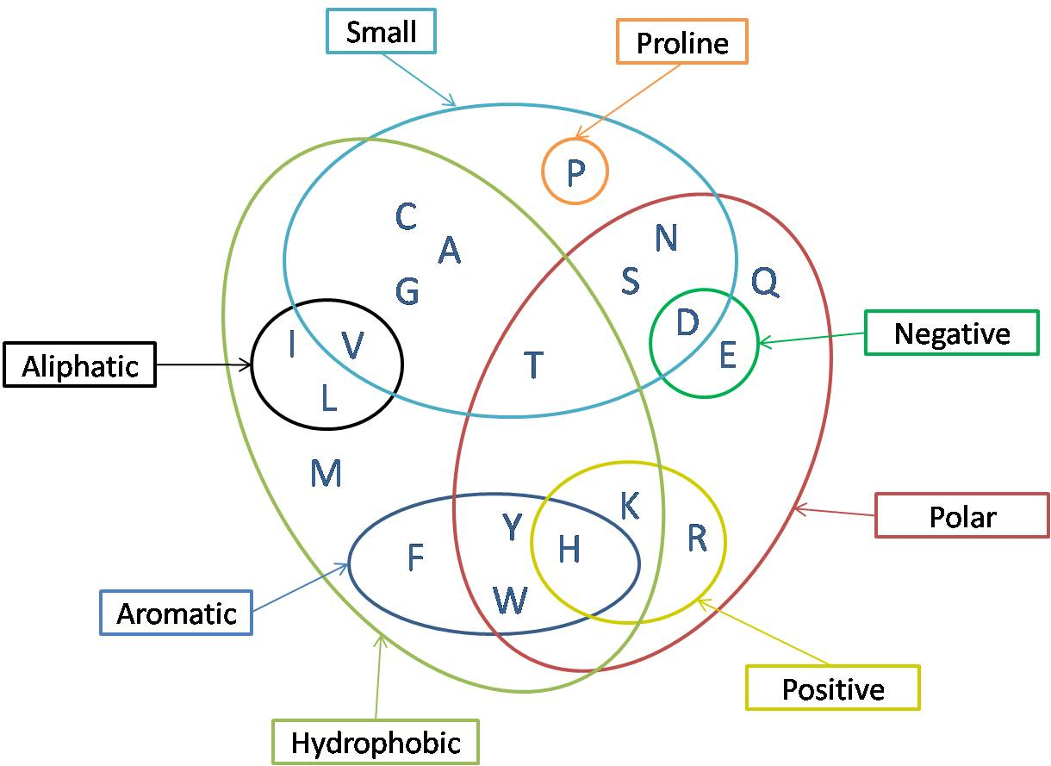

Slide 12
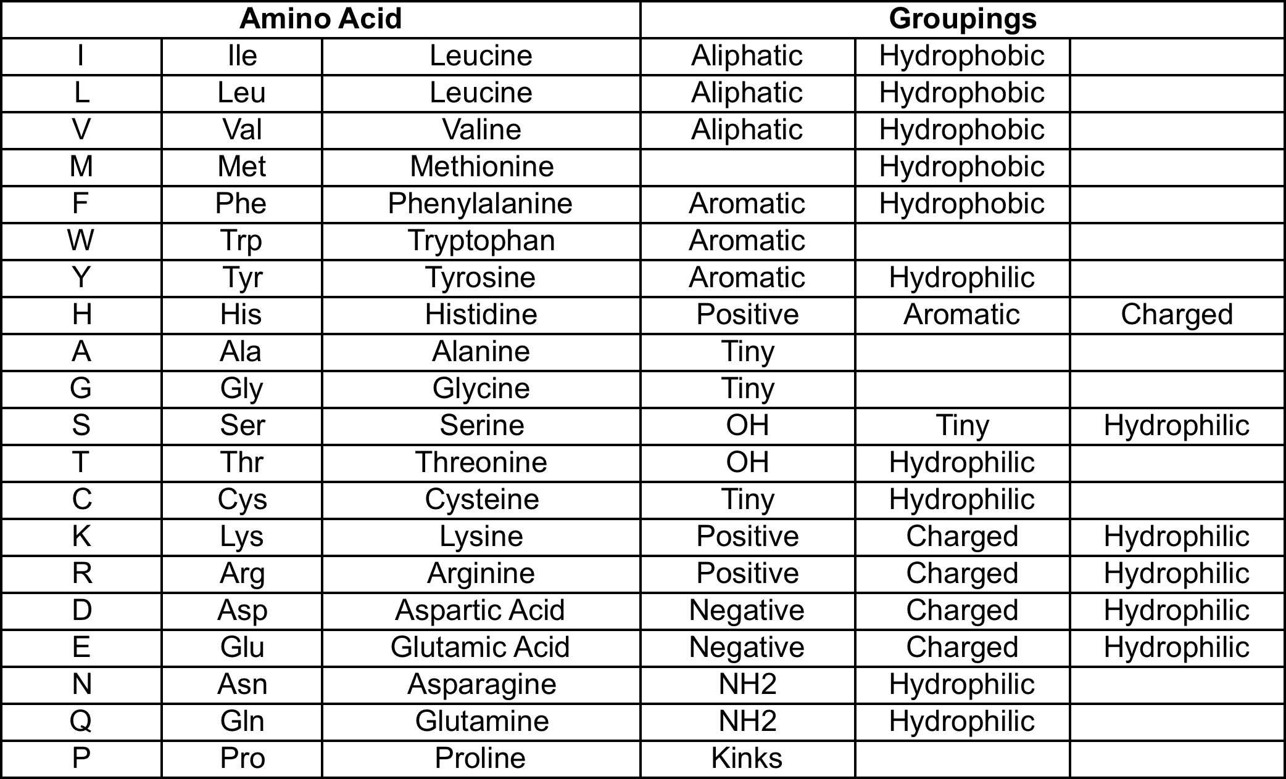

Slide 13
The Genetic Code

Slide 14
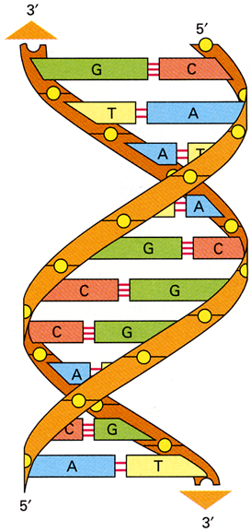
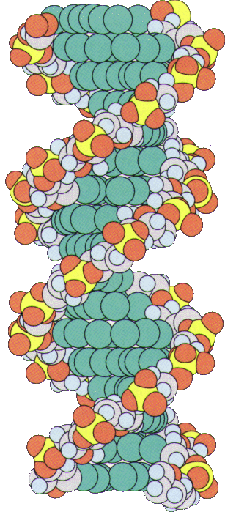
The double helix
phosphate backbone
on the outside
minor groove
DNA bases buried
on the inside
Hydrogen bonds between the bases stabilise the structure. Pairing of specific bases (Watson - Crick base pairs).
major groove

Slide 15
Sugars - deoxyribose or ribose
The sugar in DNA is deoxyribose, lacking an oxygen atom that is present in ribose, the parent compound. Ribose is the sugar in RNA.
Primes (’) are used in numbering the carbon atoms in the ribose: 1’ to 5’. The 1’ C is linked to the base; the 5’ C is linked to the phosphate.
H
H
H
H
5’
C
O
5’
C
O
HO
4’
1’
HO
4’
1’
H
3’
2’
H
H
3’
2’
H
HO
H
HO
OH
Deoxyribose
Ribose

Slide 16
DNA and RNA bases
H
There are 5 different bases; but each type of nucleic acid (DNA or RNA) contains only 4 bases
6
N
N
5
7
1
2
4
8
H
3
9
H
N
N
2 big ones (purines):
adenine (A), guanine (G)
2 small ones (pyrimidines):
cytosine (C), thymine (T)
OR: cytosine (C), uracil (U)
H
Purine ring
H
4
H
N
5
3
2
6
DNA contains A, C, G, T
RNA contains A, C, G, U
1
H
N
H
Pyrimidine ring

Slide 17
Purines
amino group
carbonyl group
H
N
H
2
O
6
N
N
H
N
N
5
7
N
1
8
N
2
H
H
H
3
4
9
H
N
N
H
N
N
N
H
2
N
N
H
amino group
Purine
Adenine
(A)
Guanine
(G)

Slide 18
Pyrimidines
amino group
carbonyl group
methyl group absent in uracil.
H
N
H
2
O
O
H
H
H
C
H
3
H
H
N
4
5
N
N
N
3
2
6
1
O
N
H
O
N
H
O
N
H
H
N
H
Pyrimidine
Cytosine
(C)
Thymine
(T)
DNA only
Uracil
(U)
RNA only

Slide 19
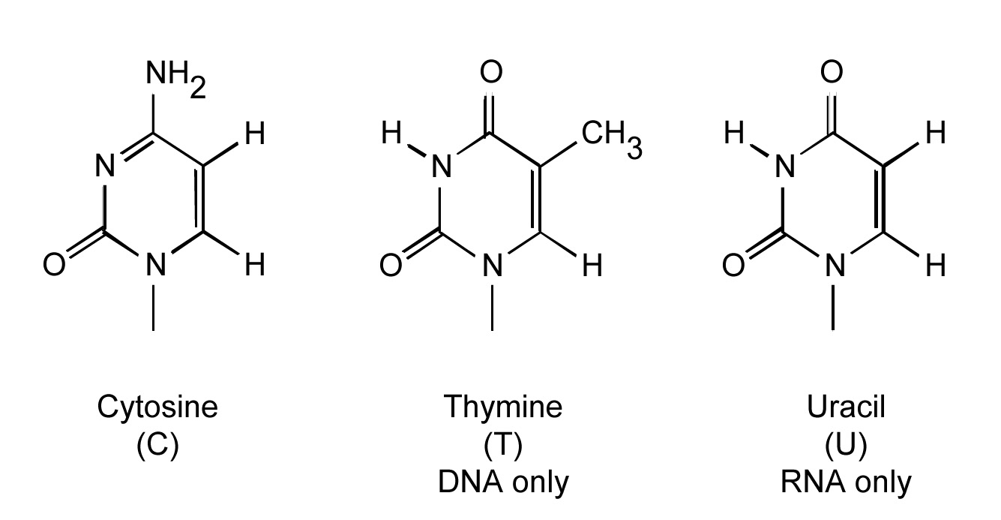
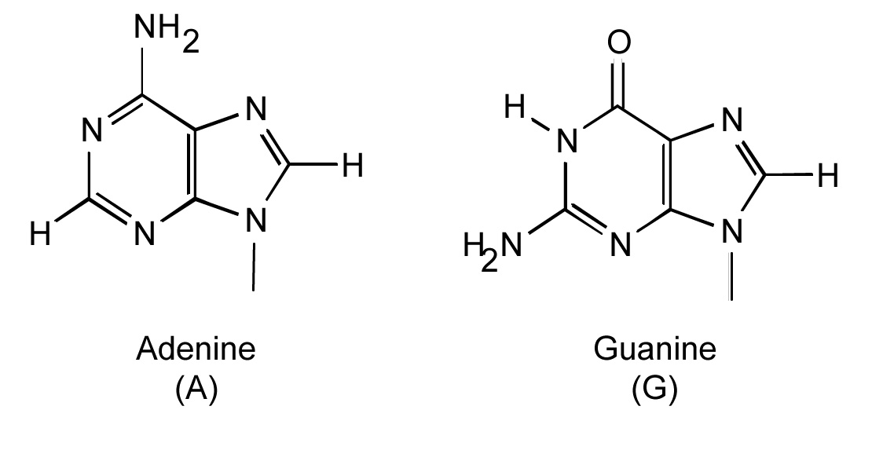

Slide 20
Nucleosides
Base + (deoxy)ribose = nucleoside
Base Nucleoside
Adenine (deoxy)adenosine
Guanine (deoxy)guanosine
cytosine (deoxy)cytidine
Uracil (deoxy)uridine
thymine (deoxy)thymidine
N
H
2
base (adenine)
N
N
9
N
N
H
O
5'
O
4'
1'
β-Glycosidic linkage
3'
2'
ribose
O
H
O
H
Adenosine

Slide 21
Nucleotides
Base + ribose + phosphate = nucleotide
Examples:
N
H
N
H
2
2
N
N
N
N
N
O
O
O
N
O
O
-
O
P
O
-
O
P
O
P
O
P
O
O
O
3'
2'
O
-
3'
2'
O
-
O
-
O
-
O
H
O
H
O
H
H
adenosine monophosphate
(AMP)
deoxycytidine triphosphate
(dCTP)

Slide 22
DNA - polymer of deoxyribonucleotide units
5' end
N
H
2
A long chain of deoxyribonucleotide units linked by phosphodiester links.
The 3’-OH of sugar of one nucleotide is linked to phosphate group, which in turn is joined to 5’-OH of adjacent sugar.
On each deoxyribose there is a base.
The chain has two ends, the 5’ end and the 3’ end. It is not symmetrical.
N
N
O
O
P
O
-
N
N
O
5'
N
H
O
2
3'
N
O
H
O
P
O
-
N
O
O
5'
O
O
3'
N
N
H
O
H
O
P
O
-
N
N
N
H
2
O
5'
O
3'
3' end
O
H
H

Slide 23
Hydrogen bonding
Watson-Crick base pairs
H
H
O
H
N
N
N
N
H
O
C
H
3
N
N
H
N
N
N
H
N
N
N
N
N
N
H
O
O
H
Adenine
(A)
Thymine
(T)
Guanine
(G)
Cytosine
(C)
2 hydrogen bonds
→ less stable
3 hydrogen bonds
→ more stable

Slide 24
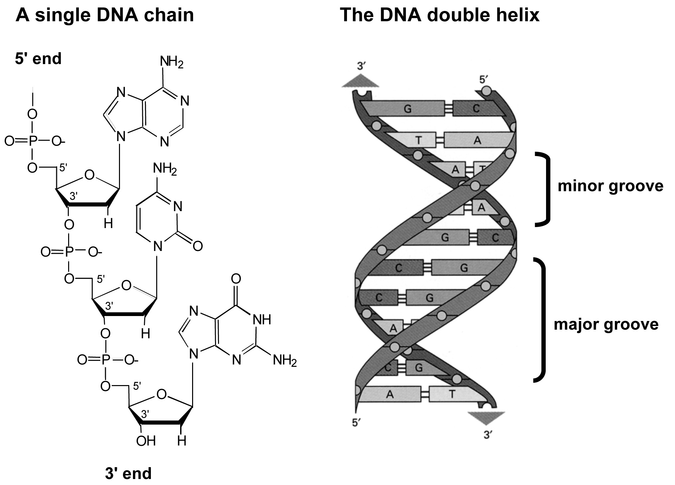

Slide 25
Semi-conservative replication
Parental DNA
DNA replication is semi-conservative. Each daughter cell inherits one old and one new strand.
new
old
old
new
Daughter molecules

Slide 26
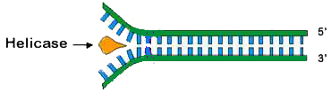
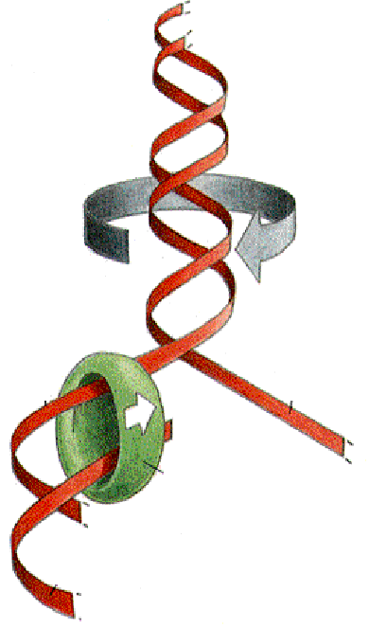
Opening of DNA helix
The DNA helix is very stable and has to be unwound before replication can occur. This is done by a DNA helicase, an anzyme that uses ATP as source of energy to break hydrogen bonds between base pairs.
DNA helix is unwound
New DNA is synthesised by
enzymes called DNA polymerases. DNA polymerases add nucleotides to the 3’ end of a growing chain.
template
DNA polymerase
new
chain

Slide 27
Enzyme reaction
N
H
2
5'
N
N
O
DNA polymerases add dNTPs to the 3’ end of a DNA molecule.
DNA (and RNA) synthesis occurs in 5’ to 3’ direction.
Energy is released by hydrolysis of the triphosphate. This drives the reaction.
N
O
P
O
N
O
5'
O
N
H
2
3'
N
O
H
O
P
O
N
O
O
5'
O
O
3'
H
H
O
N
N
H
O
O
O
N
N
H
N
2
-
3'
O
P
O
P
O
P
O
5'
O
O
-
O
-
O
-
3'
O
H
H

Slide 28
Drugs used as chain terminators I
Nucleoside analogues
N
H
O
2
H
3
C
N
N
H
N
O
N
O
H
O
H
O
O
O
H
H
N
3
H
dideoxycytosine (ddC)
azidothymidine (AZT)
Drug for HIV (zalcitabine)
Drug for HIV (Zidovudine)

Slide 29
Drugs used as chain terminators II
Nucleoside analogues
guanine base
O
N
H
2
N
N
H
N
N
N
N
H
OH
H
O
2
H
N
O
H
C
O
Drawn to show relationship to ribose
O
O
H
H
H
H
H
O
H
Acyclovir
Cytosine arabinose
Used in Chemotherapy
Drug for Herpes

Slide 30
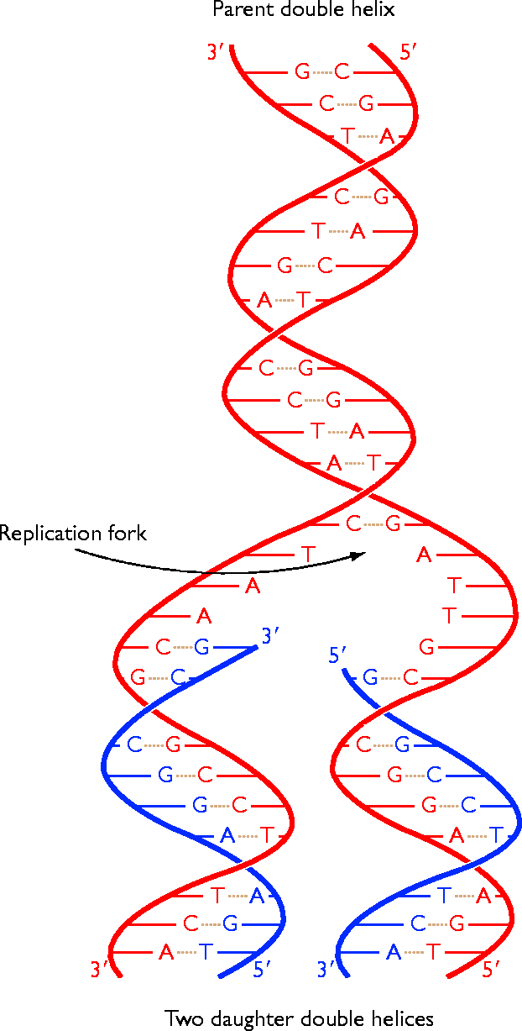
The replication fork
Replication
proceeds
in this
direction:
movement
of the fork
Replication begins at discrete
points on the DNA molecule
called origin of replication.
The site of DNA synthesis is called a replication fork: the fork moves along during the
process.
replication fork
template
strand
The two daughter molecules
are identical, each containing an old and a new strand.
new strand

Slide 31
Asymmetry of replication fork
Parental DNA helix
3’
3’
5’
5’
Newly synthesised strands
3’
5’
3’
5’
Direction of replication fork movement
The templates for the two new daughter strands have opposite orientations: 3’ to 5’ and 5’ to 3’

Slide 32
Leading and lagging strands
3’
5’
Replication fork
movement
Leading strand
5’
3’
5’
3’
Okazaki fragments
Lagging strand
3’
5’
The replication fork is asymmetric. Both strands are synthesised in a 5’-3’ direction. The leading strand is synthesised continuously, whereas the lagging strand is synthesised in short pieces termed Okazaki fragments.

Slide 33
The replication complex
Coordination between leading and lagging strands. Most of the proteins involved in DNA replication are held together as a large multi-enzyme complex. The looping of the template for the lagging strand enables a both daughter strands to be synthesised in a coordinated manner.

Slide 34
Replication Enzymes
DNA polymerase 5’ to 3’ polymerase activity
5’ to 3’ exonuclease activity (removes RNA primers and repair)
3’ to 5’ exonuclease ‘proofreading’ activity
DNA ligase seals gaps in ds DNA (Okazaki fragments)
DNA helicase unwinds double helix for replication
RNA primase synthesises RNA primer to initiate replication
Telomerases ensure integrity of linear DNA molecules

Slide 35
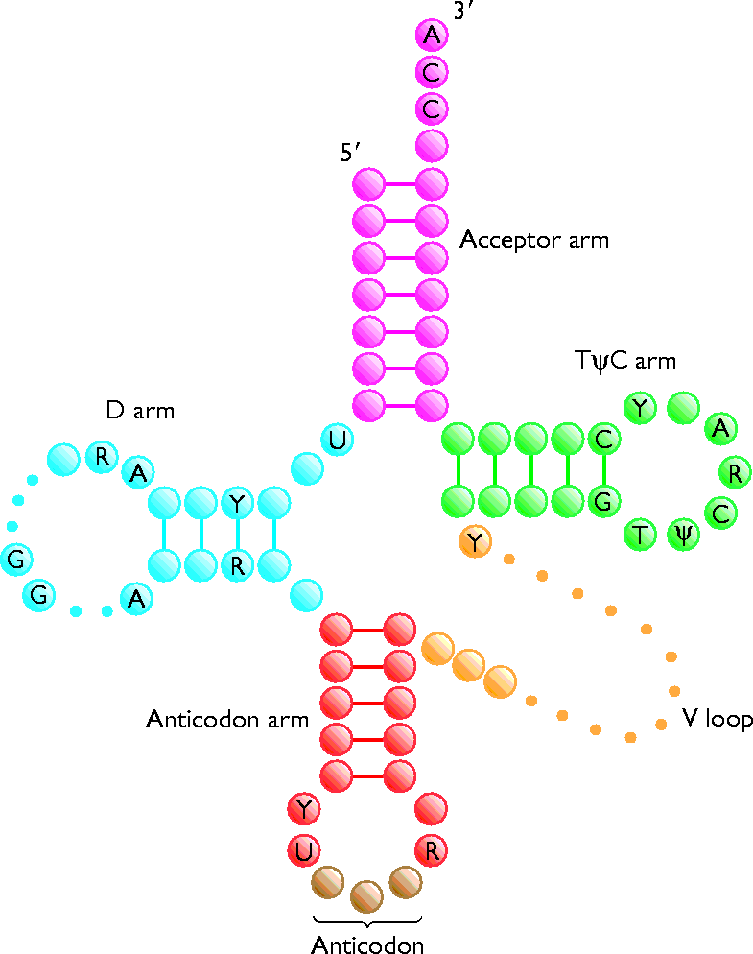
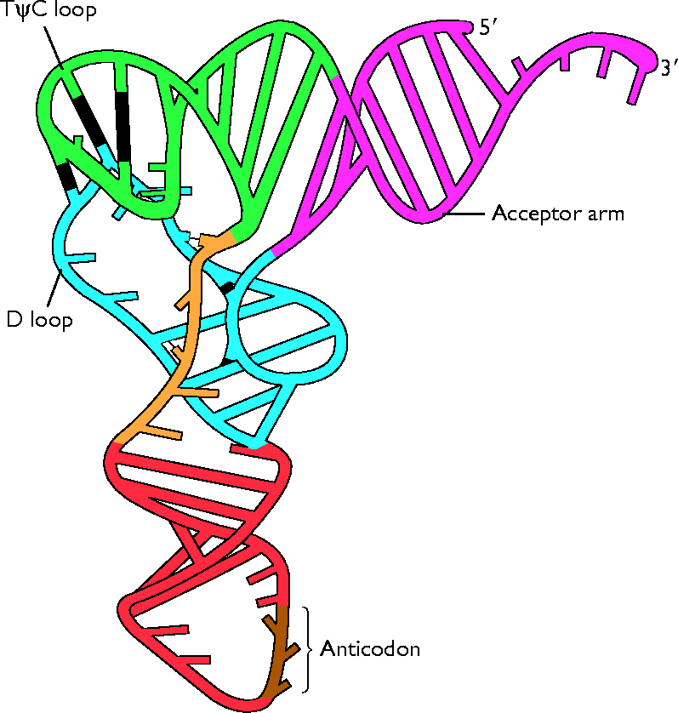
The Cloverleaf Structure

Slide 36
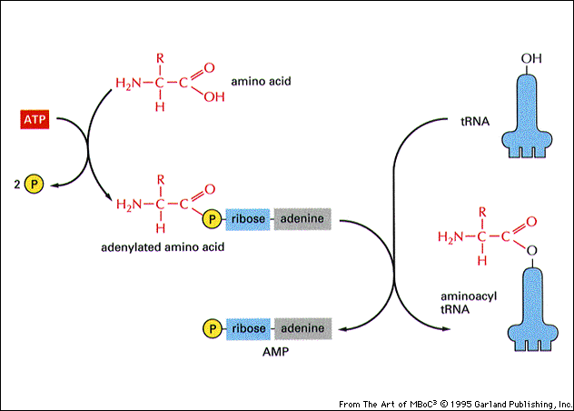
tRNA Charging

Slide 37
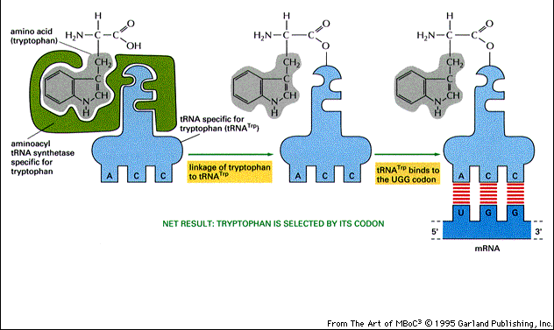
tRNA Charging Specificity

Slide 38
The Genetic Code

Slide 39
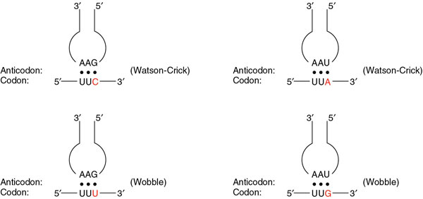
Wobble Rules
5' position in anticodon 3' position in codon
G pairs with C or U
C pairs with G
A pairs with U
U pairs with A or G
I (inosine) pairs with A, U, or C

Slide 40
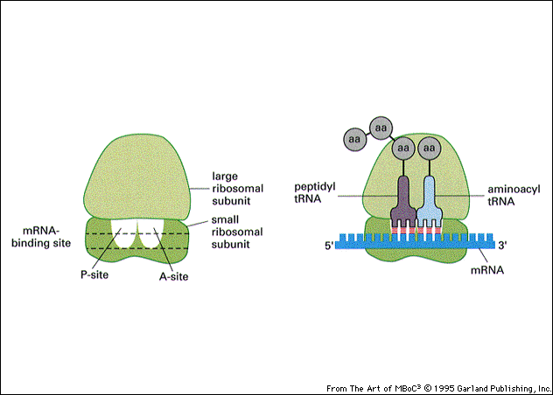

Slide 41
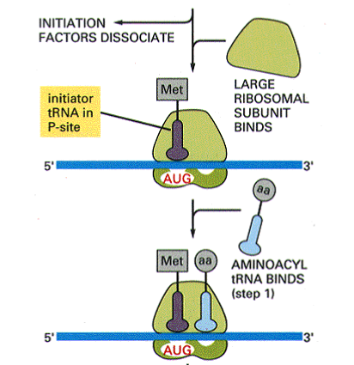
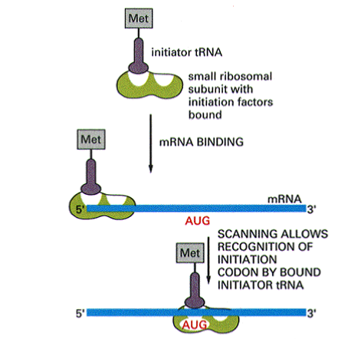
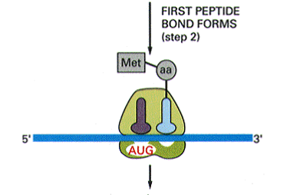

Slide 42
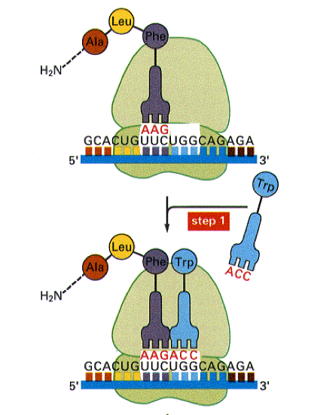
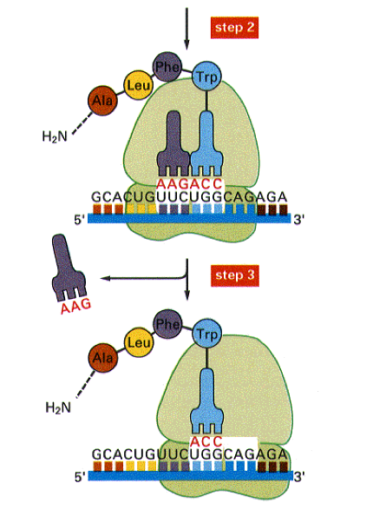

Slide 43
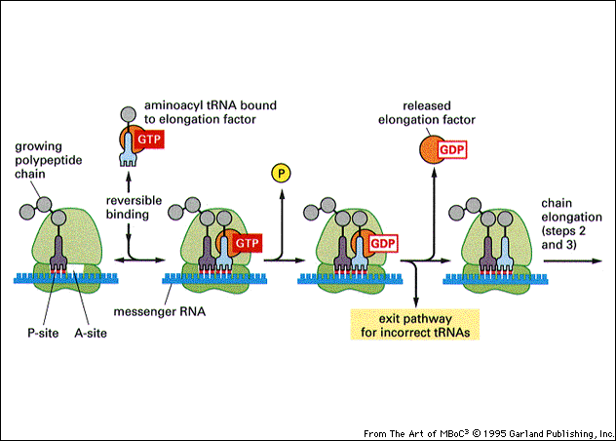

Slide 44
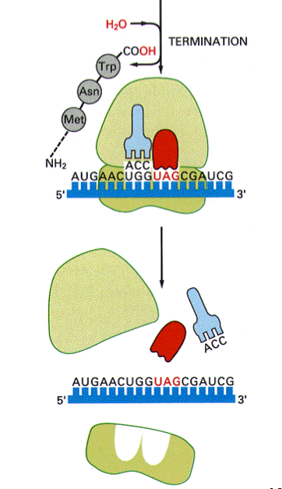
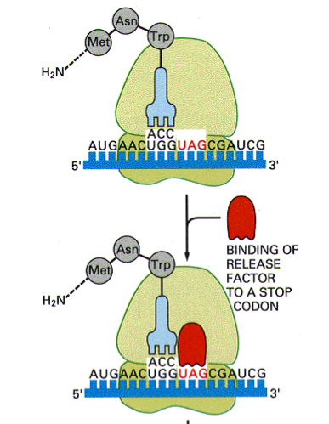

Slide 45
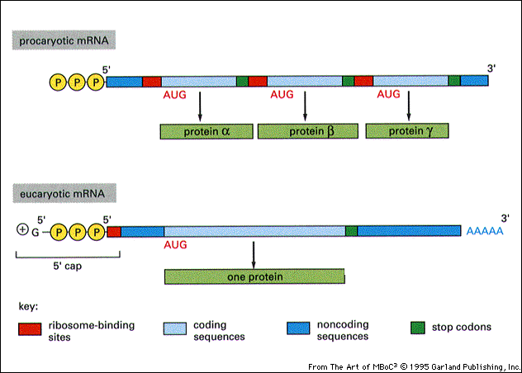

Slide 46
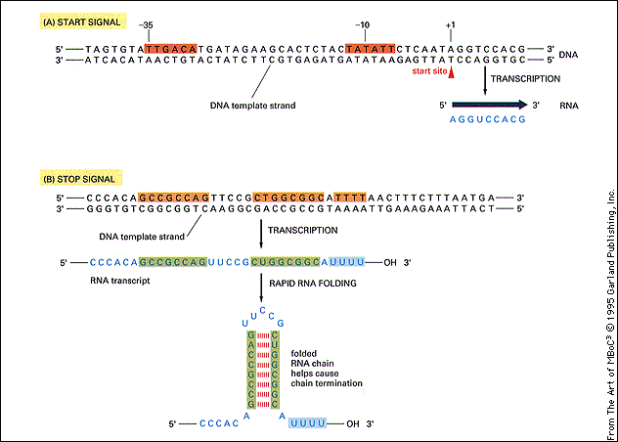

Slide 47
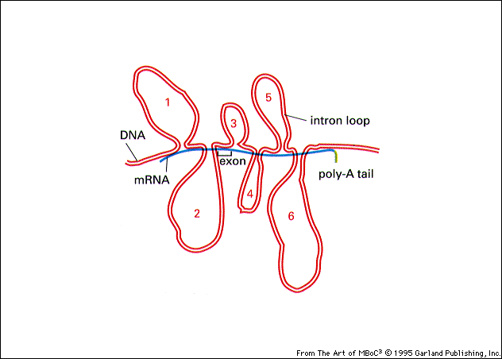

Slide 48
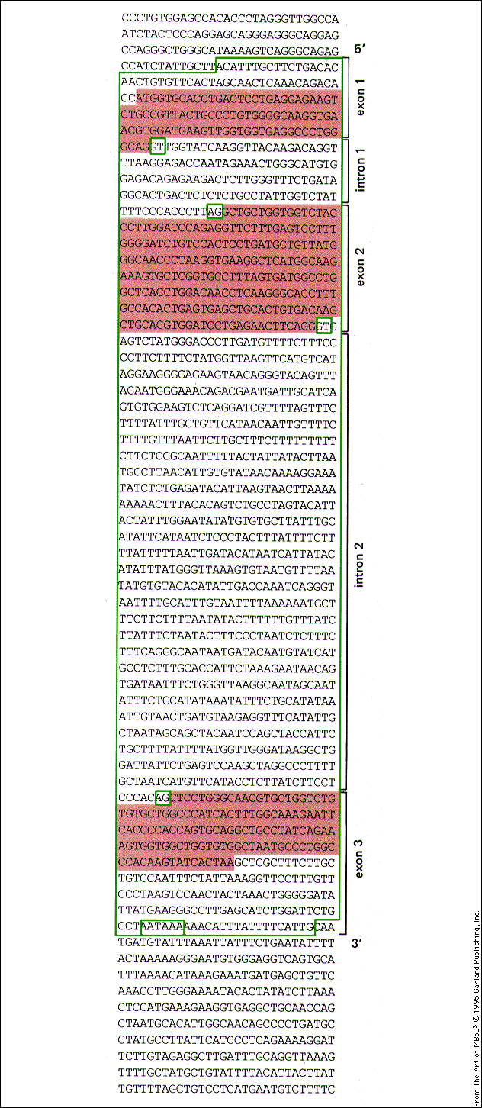

Slide 49
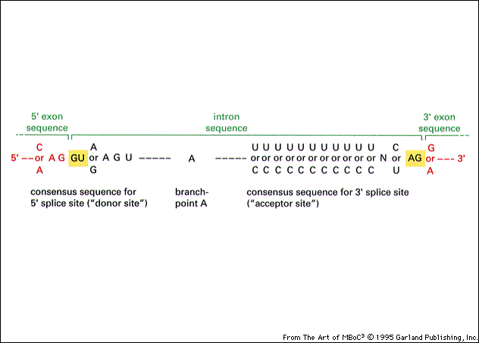

Slide 50
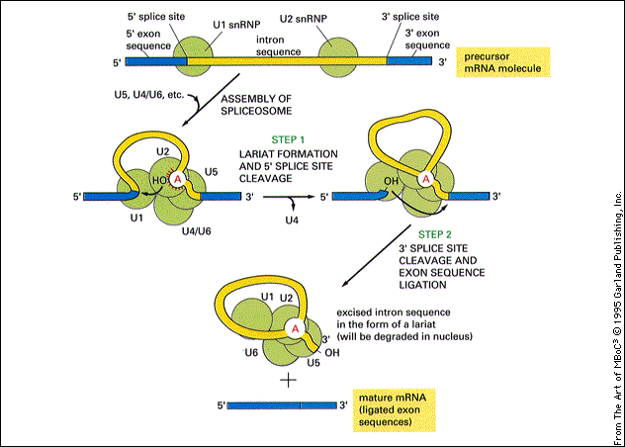

Slide 51
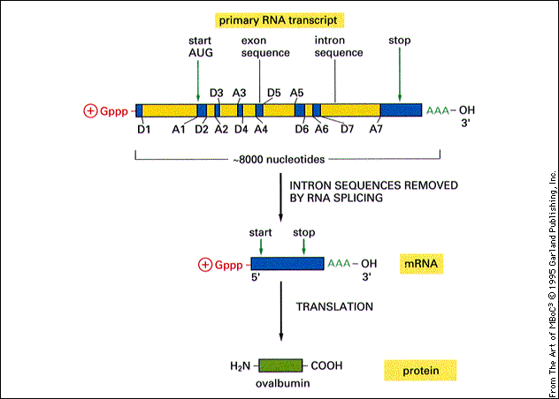
Notes:
Chicken ovalbumin mRNA is 1859 bases + poly(A) tail
Ovalbumin protein is 385 aa, ~45 kDa

Slide 52
Anatomy Of A Gene Promoter
Control the rate of transcription via transcription factor binding
Transcription Factor Binding Site(s)
TATA
Specify the initiation point for transcription by RNA Pol II

Slide 53
Anatomy Of A Gene Promoter
H
Control the rate of transcription via transcription factor binding
Transcription Factor Binding Site(s)
TATA
Specify the initiation point for transcription by RNA Pol II

Slide 54
Components of the Basal Transcription Complex
TF IID
Transcription Factor Binding Site(s)
TATA
TF II D contains TATA Binding Protein(TBP) and TBP Accessory Factors (TAF’s). On binding to DNA TF II D:-
Partially unwinds the DNA helix, widening the minor grove to allow extensive contact with bases within the DNA
This unwinding is asymmetric with respect to the TBP-TATA complex,thereby assuring transcription is unidirectional

Slide 55
Components of the Basal Transcription Complex
TF IIA
TF IIB
TF IID
Transcription Factor Binding Site(s)
TATA
Next, TFIIA and TFIIB bind. TFIIB is particularly important,
as it is able to bind to TFIID and RNA Polymerase II
TF II D contains TATA Binding Protein(TBP) and TBP Accessory Factors (TAF’s). On binding to DNA TF II D:-
Partially unwinds the DNA helix, widening the minor grove to allow extensive contact with bases within the DNA
This unwinding is asymmetric with respect to the TBP-TATA complex,thereby assuring transcription is unidirectional

Slide 56
Components of the Basal Transcription Complex
TFIIF
RNA Pol II
TF IIA
TF IIB
TF IID
Transcription Factor Binding Site(s)
TATA
Next, TFIIA and TFIIB bind. TFIIB is particularly important,
as it is able to bind to TFIID and RNA Polymerase II
RNA polymerase binds to TF IIB with TF IIF bound.
TF II D contains TATA Binding Protein(TBP) and TBP Accessory Factors (TAF’s). On binding to DNA TF II D:-
Partially unwinds the DNA helix, widening the minor grove to allow extensive contact with bases within the DNA
This unwinding is asymmetric with respect to the TBP-TATA complex,thereby assuring transcription is unidirectional

Slide 57
Components of the Basal Transcription Complex
TF IIE
TF II H
TFIIJ
TFIIF
RNA Pol II
TF IIA
TF IIB
TF IID
Transcription Factor Binding Site(s)
TATA
Next, TFIIA and TFIIB bind. TFIIB is particularly important,
as it is able to bind to TFIID and RNA Polymerase II
The final steps involve the binding of TFIIE,TF IIH and TFIIJ.
TFII H promotes further unwinding of the DNA helix to
facilitate RNA synthesis by RNA Polymerase II.
RNA polymerase binds to TF IIB with TF IIF bound.
TF II D contains TATA Binding Protein(TBP) and TBP Accessory Factors (TAF’s). On binding to DNA TF II D:-
Partially unwinds the DNA helix, widening the minor grove to allow extensive contact with bases within the DNA
This unwinding is asymmetric with respect to the TBP-TATA complex,thereby assuring transcription is unidirectional

Slide 58
H
Components of the Basal Transcription Complex
TF IIE
TF II H
TFIIJ
TFIIF
RNA Pol II
TF IIA
TF IIB
TF IID
Transcription Factor Binding Site(s)
TATA
Next, TFIIA and TFIIB bind. TFIIB is particularly important,
as it is able to bind to TFIID and RNA Polymerase II
The final steps involve the binding of TFIIE,TF IIH and TFIIJ.
TFII H promotes further unwinding of the DNA helix to
facilitate RNA synthesis by RNA Polymerase II.
RNA polymerase binds to TF IIB with TF IIF bound.
TF II D contains TATA Binding Protein(TBP) and TBP Accessory Factors (TAF’s). On binding to DNA TF II D:-
Partially unwinds the DNA helix, widening the minor grove to allow extensive contact with bases within the DNA
This unwinding is asymmetric with respect to the TBP-TATA complex,thereby assuring transcription is unidirectional
The Basal Transcription Complex allows RNA polymerase II to be phosphorylated and then engage in transcription.
In the absence of binding of other Transcription Factors this produces a Basal (low) level of transcription.

Slide 59
Transcription Factor Activity
H
TF IIE
TF II H
TFIIJ
RNA Pol II
Transcription
Factors
TF IIA
TF IIB
TF IID
Transcription Factor Binding Site(s)
TATA
SP1 5' GGGCGG 3'
AP1 5' TGAGTCA 3’
SRF 5' NNCC(A/T)6GGNN 3'
Oct 5' ATTTGCAT 3'
Pit 5' A/ TTATNCAT 3’
GR 5' AGAACAN3TGTTCT 3'
CREB /ATF 5' TGACGTCA 3'
CTF 5' GCCAAT 3'
AP2 5' CCCCAGGC 3'
C/EBP 5' TGTGGAAAG 3'
5' CCAAT 3'
Transcription factors “bend DNA” on binding. They can interact with each other and the Basal Transcription Complex to modulate transcription.

Slide 60
Gene Expression - a summary
DNA
Transcription
Nucleus
Pre-RNA processing
mRNA
Cytoplasm
mRNA
mRNA export
Translation

Slide 61
RNA polymerase I
synthesises pre-rRNA 45S – yields mature 28S, 18S and 5.8S rRNA – ribosomes
RNA polymerase II
synthesises precursors of mRNA
RNA polymerse III
synthesises tRNAs and 5S rRNA species

Slide 62
How many genes in the Human genome ?
H
The complete DNA sequence of an organism is called a “Genome”
Relative Size of Genome Number of Genes
Escherichia Coli 1 unit ~ 4,000
Fruit Fly 40 units ~20,000
Human 1000 units ~30,000
The Human genome is arranged into 46 chromosomes comprising 22 “autosomal” pairs and a pair of sex chromosomes ( X and Y)
Each nucleated cell in the Human body has the same DNA content
of a full genome
The Human genome consists of ~ 6 X10⁹ base pairs
End to End the Human Genome would be:
0.34nm X 6x10⁹ = ~2m

Slide 63
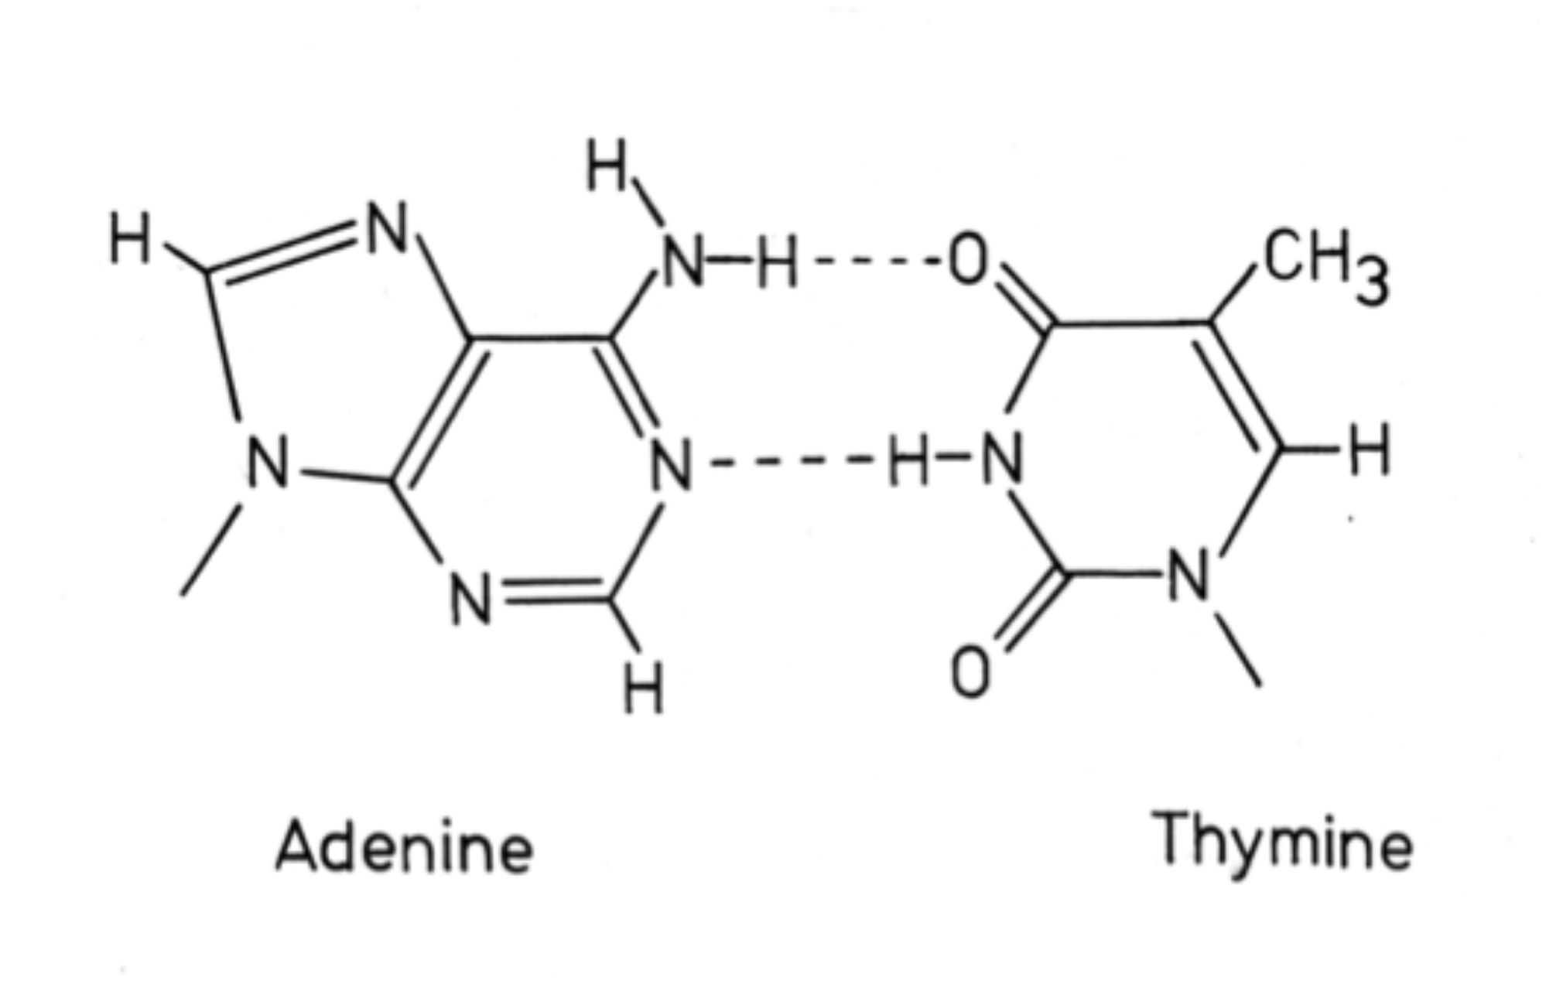
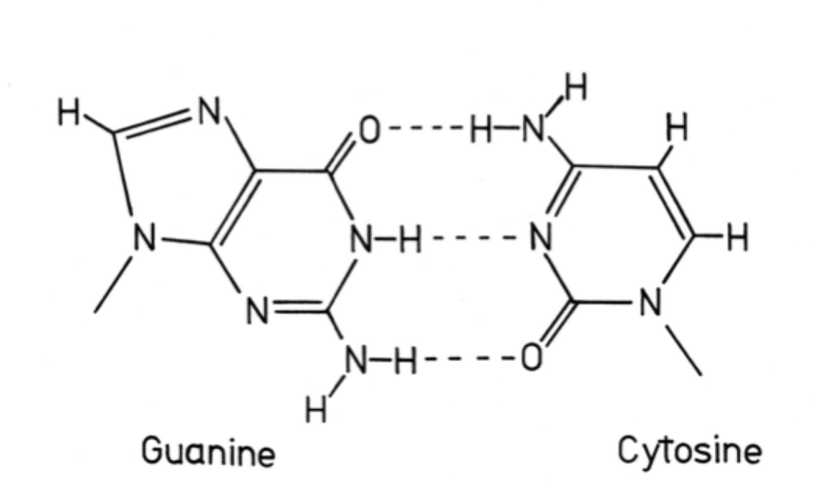
DNA Polymerase
Replication

Slide 65
PCR Cycle
Denaturation (94 - 96˚C) to
disrupt double stranded DNA
Annealing (primer dependent)
allows synthetic primers to bind
to target sites on template
DNA polymerase extension to
duplicate target sequence

Slide 66
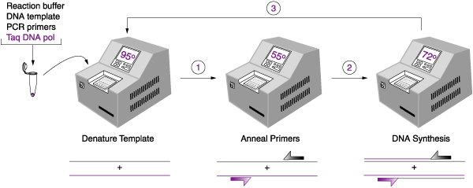
PCR Cycling

Slide 67
PCR – Gene Amplification in vitro

Slide 68
The first 4 cycles in detail

Slide 69
1.2% agarose 1x TBE gel analysis
Lane: M = 100 bp marker ladder
1 to 5 = positive DNA samples
6 = negative control DNA sample

Slide 70
POLYMERASE CHAIN REACTION (PCR)
PCR is an oligonucleotide primed double stranded DNA synthesis using a thermostable DNA polymerase
  Template – DNA extract from specimen
  DNA Polymerase (Taq from Thermus aquaticus)
  Nucleotides (dNTPs)
  Primers – 2 synthetic oligonucleotides
SIMPLE concept
EASY to do
FAST - get a result in 3 - 24 hours
SENSITIVE - analyse a single cell
Notes:
PCR developed in the late 1980s
Truly revolutionary method
NOT difficult - very simple

Slide 71
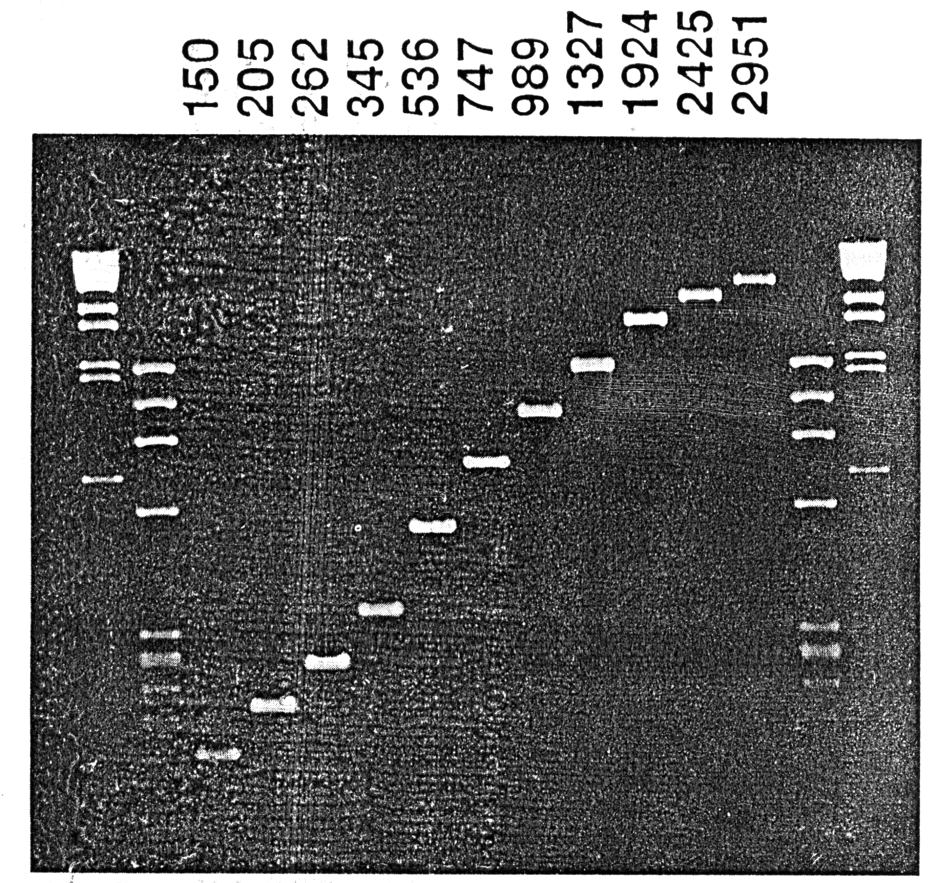
Amplification from 100 ng genomic DNA
Various size fragments from the β-globin gene

Slide 72
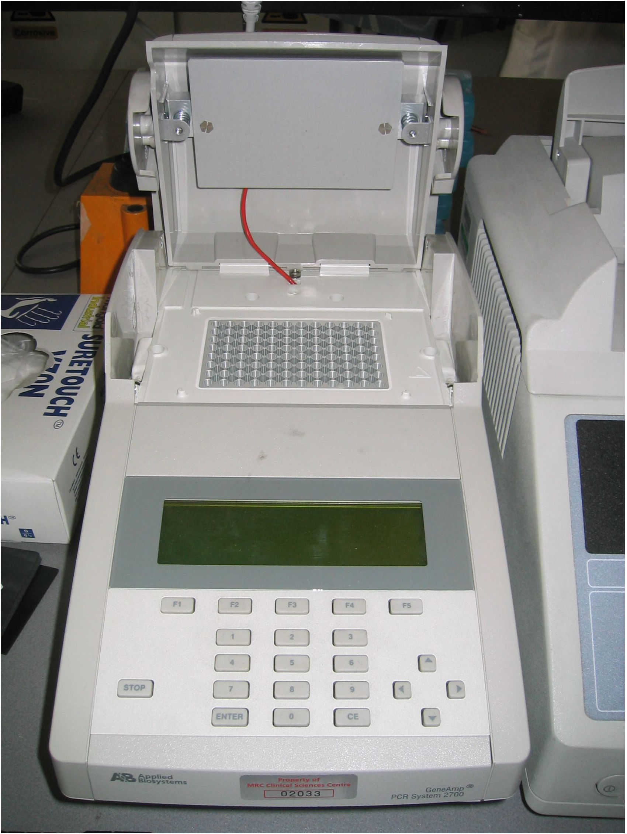
Automated Peltier Thermal Cyclers
(~£2,000 - 30,000)
Manual - water baths
(~£400)

Slide 73
DNA Purified total cellular DNA
Boiled cells (<10⁵)
Mouthwash, hair roots
Single sperm cells – haplotyping
PRIMERS Synthetically made, 18 – 30 bases in length
~50% GC content
Avoid runs of the same base (e.g. AAAA or GGGG)
Anneal to opposite strands of DNA
Direct synthesis towards each other
TARGET 90 – 20,000 base pairs in length
Ideally between 200 – 5,000 bp
Not too GC-rich (denaturation)
ACCURACY Taq DNA polymerase makes 1 error in every 5 – 10,000 bases
Not a problem when analysing product en masse
Problem analysing individual molecule (cloned PCR)

Slide 74
PRIMERS
DNA has directionality 5’---> 3’
5’-AGGCTTCAG-3’ is not the same as 3’-AGGCTTCAG-5’
5’-AGCGCGTGAG-3’ 3’-AGCATCCTAGCA-5’
5’-AGCGCGTGAGACGATAGAGATCGGCTAGATCGTAGGATCGT-3’
3’-TCGCGCACTCTGCTATCTCTAGCCGATCTAGCATCCTAGCA-5’
AGCGCGTGAG--------->
3’-TCGCGCACTCTGCTATCTCTAGCCGATCTAGCATCCTAGCA-5’
5’-AGCGCGTGAGACGATAGAGATCGGCTAGATCGTAGGATCGT-3’
<----AGCATCCTAGCA

Slide 75
PCR Parameters
    CYCLES Typically as below
    Denaturation: 94˚C, 30 seconds
    Annealing: 55˚C, 30 seconds
    (primer dependent)
Extension: 72˚C, 1 – 5 minutes
    (depends upon size of target size)
30 Cycles: >10⁶ amplification
SENSITIVE 100 ng total cellular DNA (30,000 cells)
100 cells with radioactive detection methods
Nesting - single copy with ethidium bromide staining

Slide 76
RNA as Template?
But after a reverse transcription step (converting RNA into cDNA using
the reverse transcriptase enzyme isolated from
retroviruses) you can PCR using the cDNA as template
Advantage can analyse expression of genes in particular
cells and tissues
In general choose primers in different exons, so genomic
DNA yields a larger PCR product compared to mRNA

Slide 77
SBA Questions
The name given to the DNA strand of a gene that is identical in sequence to an mRNA molecule is the:
A. Nonsense strand
B. Exonic strand
C. Sense strand
D. Intron strand
E. Antisense strand
2. Transcription Factors have the ability to:
A. Synthesise DNA
B. Repair mismatch errors in DNA
C. Usually bind to DNA upstream of the site of RNA synthesis
D. Synthesise mature mRNA
E. Splice exonic RNA into mature mRNA
3. Proteins comprise chains of amino acids.
Which of the following is a feature common to all amino acids?
A. Nitrogen containing side chain
B. Acidic side chains
C. Carboxyl group
D. Non-polar structure
E. Ability to form disulphide bonds

Slide 78
SBA Questions
The name given to the DNA strand of a gene that is identical in sequence to an mRNA molecule is the:
A. Nonsense strand
B. Exonic strand
C. Sense strand
D. Intron strand
E. Antisense strand
2. Transcription Factors have the ability to:
A. Synthesise DNA
B. Repair mismatch errors in DNA
C. Usually bind to DNA upstream of the site of RNA synthesis
D. Synthesise mature mRNA
E. Splice exonic RNA into mature mRNA
3. Proteins comprise chains of amino acids.
Which of the following is a feature common to all amino acids?
A. Nitrogen containing side chain
B. Acidic side chains
C. Carboxyl group
D. Non-polar structure
E. Ability to form disulphide bonds

Slide 79
DNA structure
A Guanine
B Ribose
C Adenosine
D 3’-deoxyguanosine
E 2’-deoxyribose
F Adenosine 5’-triphosphate
G Thymine
H Uridine
I Cytosine
J 2’-deoxyadenosine
The sugar component of DNA
A pyrimidine nucleoside present only in RNA
Forms a Watson-Crick base pair with adenine in DNA
A purine nucleoside present in DNA
5. A base present in DNA, but not in mRNA

Slide 80
DNA structure
A Guanine
B Ribose
C Adenosine
D 3’-deoxyguanosine
E 2’-deoxyribose
F Adenosine 5’-triphosphate
G Thymine
H Uridine
I Cytosine
J 2’-deoxyadenosine
The sugar component of DNA 2’-deoxyribose
A pyrimidine nucleoside present only in RNA Uridine
Forms a Watson-Crick base pair with adenine in DNA Thymine
A purine nucleoside present in DNA 2’-deoxyadenosine
5. A base present in DNA, but not in mRNA Thymine

