Slide 1
Leukaemia and lymphoma
Gerry Thomas/Robert Leonard
Molecular Pathology/Medical Oncology
Surgery and Cancer

Slide 2
Learning outcomes
Understand the differences between lymphoma, myeloma and leukaemia
Understand the diagnosis and treatment of the above
Understand the difference between acute and chronic leukaemia
Understand how targeted therapies have made a difference to treatment of leukemia

Slide 3
Types of blood cancer
Leukaemia is a disease of the white blood cells – myeloid,lymphoid; acute or chronic
Lymphoma is a disease of the lymphatic system B or T lymphocytes –
  Two types of lymphoma – Hodgkins and Non-Hodgkins
  Myeloma – disease of the plasma cells.

Slide 4
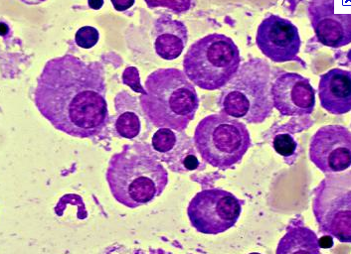
Myeloma – basic facts
More common in 65+
Monoclonal marrow proliferat’n
Paraproteinaemia
Bone pain/fractures ;renal failure; sepsis

Slide 5
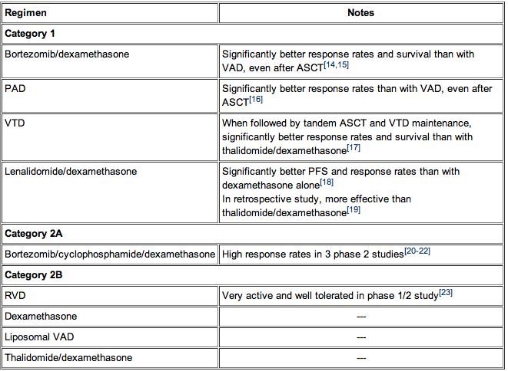
TREATMENT OF MYELOMA
Presentation-hydration;anti-calcaemia; antibiotics

Slide 6
Lymphoma – risk factors
Viruses – EBV and HIV
Immune deficiency (e.g. after transplantation)
Age – Hodgkin’s more common in those aged 15-34 and over 55 years of age, non-Hodgkin’s more common in 65+
Genetics – family history of lymphoma (Hodgkin’s or non-Hodgkin’s)

Slide 7
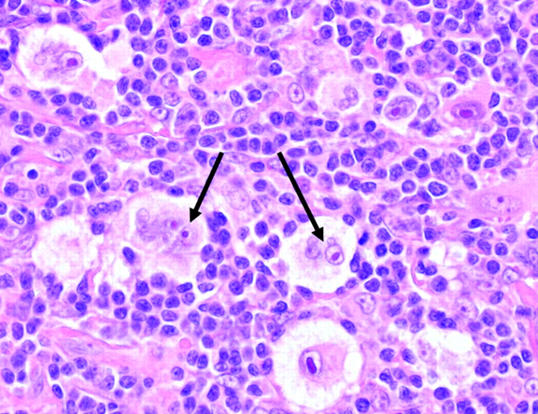
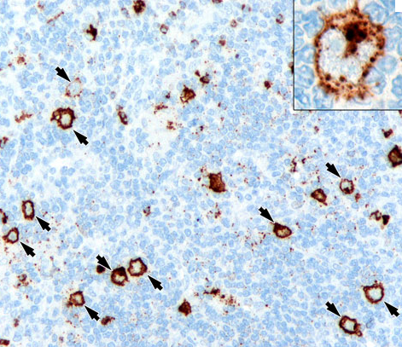
Hodgkin’s versus non-Hodgkin’s
The Reed Sternberg cell

Slide 8
Presenting symptoms
:Asymptomatic lymphadenopathy (above the diaphragm in 80% )
unexplained weight loss, fever, night sweats) are present in 40%
- "B symptoms."
the classic Pel-Ebstein fever is observed (high fever for 1-2 wk followed by an afebrile period of 1-2 wk)
Chest pain, cough, shortness of breath, or a combination of these things may be present due to a large mediastinal mass or lung involvement; rarely, hemoptysis occurs
Patients may present with pruritus
Pain at sites of nodal disease, precipitated by drinking alcohol, occurs in less than 10% of patients but is specific for Hodgkin lymphoma
Erythema nodosum on shins
Back or bone pain may rarely occur

Slide 9
Differential diagnosis
Cytomegalovirus
Infectious Mononucleosis
Lung Cancer-Small Cell)
Lymphoma, Non-Hodgkin
Sarcoidosis
Toxoplasmosis
Tuberculosis

Slide 10
Staging
Stage for prognosis and treatment planning; was very intensive to plan RT cure (Mantle for chest or inverted Y for paraaortic/pelvic nodes)
Bloods
CT scanning +/- PET
Bone marrow biopsy?

Slide 11
Staging - early
Stage I: On group of LN or one tissue
Stage II: 2 LN groups on the same side of the diaphragm
Stage III Both sides nodes
Stage IV Disseminated +/- organs
A = No constitutional symptoms
B = Fever; wgt loss; night sweats

Slide 12
Treatment and prognosis
Chemotherapy for most stages-MOPP;CMOPP;ABVD
Auto Stem Cell Tx for relapsed high risk
Radiotherapy for very early(involved field) or to sites of ‘bulky disease’ post-chemo to reduce risk of local relapse
Curability 80-95% ‘early stage’ (1-2A)
…………60-70% ‘late stage’ (3-4,any B)

Slide 13
Non Hodgkins Lymphomas
High Grade NHL
  DLBL
  Burkitts
  Tcell variants
Low Grade NHL
  Follicular B Cell
  Diffuse small B—INCL CLL
  Marginal zone variants
20 pathological varieties
Most are B lymphocytic origin

Slide 14
NHL
Chemotherapy standard for most NHL types
Watch and wait approriate for indolent advanced follicular lympomas
Potent impact of pan B antibody (‘rituximab’) added to CHOP chemo for high grade B cell
Auto SCT can convert remission>cure

Slide 15
Curbility of NHL
Depends on subtype and stage and age
Broadly about 50-60% high grade B cell curable with chemotherapy/antibody
High cure rates for early stage high or low grade
Stage 3-4 low grade rarely if ever cured but may be watched/treated 10 yrs+

Slide 16
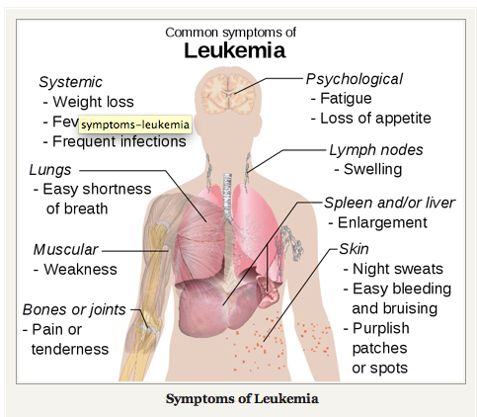

Slide 17
What is Leukaemia?
Leukaemia is cancer of the blood
5% of all cancers are cancers of the blood
In the UK approximately 60 people every day are diagnosed with a cancer of the blood
Blood cancers are the most common cancers in men and women aged 15-24
They are the main cause of cancer death in people aged 1-34 years
Data from Leukaemia Research Fund

Slide 18
What is Leukaemia?
Leukaemia means ‘white blood’
The name was given because the first cases of leukaemia recognized had a marked increase in the white cell count
Leukaemia is actually a bone marrow disease and not all patients have abnormal cells in the blood

Slide 19
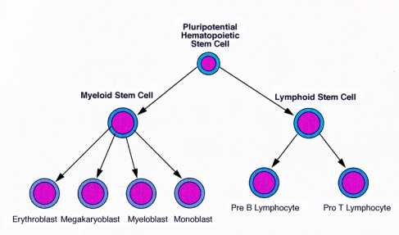
What is Leukaemia?
Leukaemia results from a series of mutations in a single lymphoid or myeloid stem cell
These mutations lead the progeny of that cell to show abnormalities in proliferation, differentiation or cell survival leading to steady expansion of the leukaemic clone
Myeloid leukaemia
Lymphoid leukaemia

Slide 20
Why is leukaemia different?
Leukaemia is different from other cancers
Most cancers exist as a solid tumour
However, it is uncommon for patients with leukaemia to have tumours (xcpt CLL)
More often they have leukaemic cells replacing normal bone marrow cells and circulating freely in the blood stream

Slide 21
Different diseases -different concepts
Leukaemias that behave in a relatively ‘benign’ manner are called chronic—that means the disease goes on for a long time
Leukaemias that behave in a ‘malignant’ manner are called acute—that means that, if not treated, the disease is very aggressive and the patient dies quite rapidly

Slide 22
Classification of leukaemia
leukaemia can be acute or chronic
Depending on the cell of origin, it can also be lymphoid or myeloid
Lymphoid can be B or T lineage
Myeloid can be any combination of granulocytic, monocytic, erythroid or megakaryocytic

Slide 23
Origin of leukaemia
Leukaemia results from a series of mutations in a single stem cell
Some mutations results from identifiable (or unidentifiable) oncogenic influences
Others are probably random errors—chance events—that occur throughout life and accumulate in individual cells
Many genetic variants which may be prognostic

Slide 24
Molecular changes in leukaemia
The important leukaemogenic mutations that have been recognized include
  Mutation in a known proto-oncogene
  Creation of a novel gene, e.g. a chimaeric or fusion gene
  Dysregulation of a gene when translocation brings it under the influence of the promoter or enhancer of another gene

Slide 25
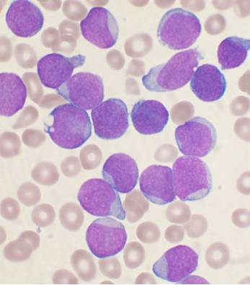
Acute Lymphoblastic Leukaemia (ALL)
ALL commonest cancer in children, but has 70% cure rate. Cure rate only 30% in adults
Adverse prognostic factors:
  male sex
  older age
  age <1 year
  high blast count
  hypodiploidy

Slide 26
Aetiology of acute leukaemia
Inherited:
  Fanconi’s Anaemia
  Bloom’s syndrome
  Klinefelter’s syndrome
  Ataxia Telangiectasia
  3-5x higher risk in identical twins
Environmental:
  ionizing radiation
  chemical carcinogens/chemotherapeutic agents
  infectious agents e.g. T-cell leukemia virus 1 in the Caribbean and Japan

Slide 27
WHO Classification of ALL
1- Acute lymphoblastic leukemia/lymphoma
Synonyms:Former Fab L1/L2
i. Precursor B – acute lymphoblastic/lymphoma Cytogenetic subtypes:
  t(12;21)(p12,q22) TEL/AML-1
  t(1;19)(q23;p13) PBX/E2A
  T(V,11)(V;q23) V/MLL
ii. Precursor T – acute lymphoblastic/lymphoma
2- Burkitt's leukaemia/lymphoma
Synonyms:Former FAB L3
3- Biphenotypic acute leukemia

Slide 28
Treatment of ALL
Therapy divided into 3 phases
  induction of remission
  consolidation/intensification
  maintenance

Slide 29
Treatment of ALL
Phase 1 – aim to kill malignant cells quickly
vincristine – vinca alkaloid that binds to tubulin promoting mitotic spindle arrest
prednisolone - corticosteroid
l-asparaginase –unlike normal cells ALL cells cannot synthesise asparagine, l- asparaginase catalyses the conversion of asparagine to aspartic acid and therefore depletes ALL cells of necessary aa
anthracycline – DNA intercalating agent

Slide 30
Treatment of ALL
Phase 2 – further reduces tumour burden and to kill cells in the CNS (by intrathecal cytarabine or by combination with radiotherapy to puncture the blood/brain barrier)
Combinations of the following- NOT INTRATHECAL!!
vincristine
cyclophosphamide – alkylating agent
cytarabine – inhbits DNA synthesis
thioguanine, mercaptopurine – inhibits purine synthesis

Slide 31
Treatment of ALL
Phase 3 – maintenance. Aim to kill any residual cells not destroyed by Phase 1 and 2 treatment
Combinations of the following
daily oral mercaptopurine
weekly oral methotrexate - antifolate
vincristine
3 years for boys, 2 for girls and adults

Slide 32
CURABILITY OF CHILDHOOD ALL
Patients younger than 1 year with acute leukemia have disease that is biologically distinct with a poor outcome
The 5-year event-free survival (EFS) varies considerably depending on risk category, <20% for patients younger than 90 days.
Overall, the cure rate for childhood acute lymphoblastic leukemia (ALL) is more than 80%.

Slide 33
LONG TERM COMPLICATIONS
Secondary malignancy
Short stature (if cranio-spinal radiation)
Cardiac damage from anthracyclines
Growth hormone deficiency
Learning disability
Cognitive defects

Slide 34
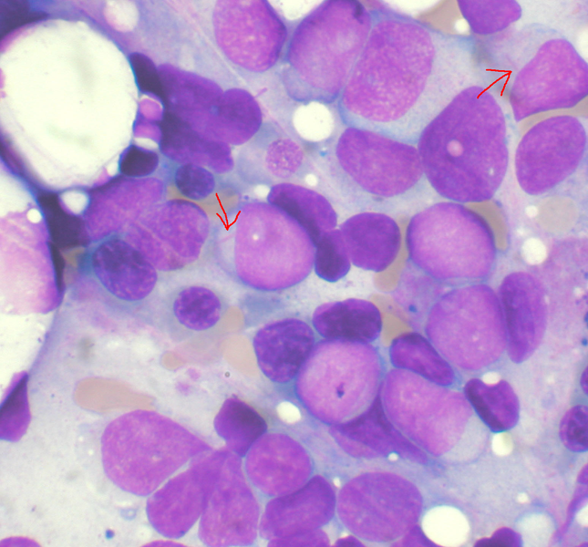
AML – clinical presentation
Normal blood cells replaced with leukaemic cells
anaemia, fatigue, weight loss, loss of appetite, bruising easily, petechiae, bone and joint pain, frequent and persistent infections
Auer Rods
Often diagnosed on a routine blood test

Slide 35
WHO Classification of AML
AML with characteristic genetic abnormalities
translocations between x-some 8 and 21 [t(8;21)] RUNX1/RUNX1T1
inversions in chromosome 16[inv(16)] CBFB/MYH11
translocations between chromosome 15 and 17 [t(15;17)] RARA;PML
Patients with AML in this category generally have a high rate of remission and a better prognosis compared to other types of AML.

Slide 36
AML – prognostic factors
Chromosomal changes
favourable - t(8;21), t(15;17), inv(16)
intermediate – various complex changes
adverse - 5, -7, del(5q), Abnormal 3q, Complex cytogenetics
FLT3 Internal tandem duplications

Slide 37
WHO Classification of AML
AML with multilineage dysplasia
  prior myelodysplastic syndrome or myeloproliferative disease
  occurs more commonly in elderly and has worse prognosis
AML – treatment related
  prior chemo or radiotherapy
  characterised by specific xsomal abnormalities
  often associated with worse prognosis
AML – NOS

Slide 38
AML – treatment
Phase 1 – chemotherapy with 2/3 agents
cytarabine
anthracycline
(6-thioguanine)
Phase 2 - Young patients
several cycles of high-dose cytarabine
allogeneic (donor) stem cell transplant
autologous stem cell transplant
Older patients
high dose cytarabine or standard dose cytarabine + anthracycline

Slide 39
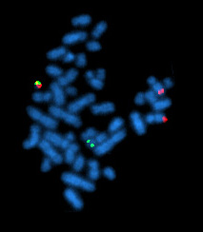
CML – clinical presentation and aetiology
Patients often asymptomatic – picked up on routine blood test
can have symptoms of malaise, low grade fever, gout, susceptibility to bruising.
diagnosis confirmed by the presence of the t(9;22)(q34;q11) translocation

Slide 40
Aetiology and treatment - CML
Found predominantly in middle age and elderly
15-20% of adult leukaemias
only well described risk factor is exposure to ioinizing radiation
patients can have CML for some time before entering a “blast crisis” when the number of lymphoblasts and myeloblasts increases

Slide 41
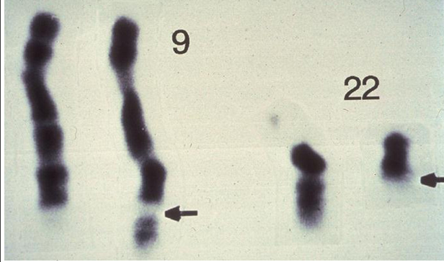
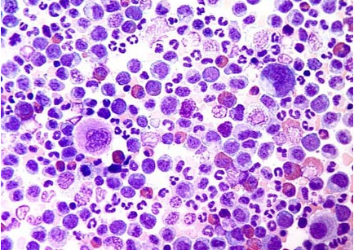
Characteristic lesion in CML
CML is an acquired abnormality due to reciprocal translocation between the long arms of chromosomes 22 and 9 [t(9;22)]. The translocation results in a shortened chromosome 22, an observation first described by Nowell and Hungerford and subsequently termed the Philadelphia (Ph1) chromosome after the city of discovery.
The Philadelphia chromosome, which is a diagnostic karyotypic abnormality for chronic myelogenous leukemia, is f the reciprocal translocation of 22q to the lower arm of 9 and 9q (c-abl to a specific breakpoint cluster region [bcr] of chromosome 22
This translocation relocates an oncogene called ABL from the long arm of chromosome 9 to a specific breakpoint cluster region (BCR) in the long arm of chromosome 22. The ABL oncogene encodes a tyrosine protein kinase. The resulting BCR/ABL fusion gene encodes a chimeric protein with strong tyrosine kinase activity.

Slide 42
Natural history and treatment aims
The goals of treatment
Hematologic remission (normal complete blood cell count [CBC] and physical examination [ie, no organomegaly])
Cytogenetic remission (normal chromosomes with 0% Ph-positive cells)
Molecular remission (negative PCR result for the mutational BCR/ABL mRNA), which is an attempt for cure/prolongation of survival

Slide 43
90% of patients with CML are diagnosed in chronic phase - lasts 2-3 years:
The major goal is to control haematological symptoms and splenomegaly. Imatinib mesylate (Glivec), is an inhibitor of BCR/ABL. Also hydroxyurea or busulfan, but it may last for longer than 9.5 years in patients who respond well to interferon-alfa therapy.
Some progress to accelerated phase. The survival in this phase is 1-1.5 years- poor control of the blood counts, new peripheral blast cells (≥15%), promyelocytes (≥30%), basophils (≥20%), and platelet counts less than 100,000 cells/μL
ASCT/MUDD and investigative options for younger patients, are in constant flux. New agents may prolong the survival of patients with CML and offer the possibility of eventual cure.

Slide 44
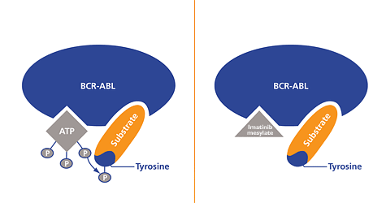
Targeted treatment for CML
Imatinib – selectively targets abl tyrosine kinase
also shows activity against mutated c-kit (AML)
But... T315I mutation in ATP binding pocket confers resistance to imatinib

Slide 45
Targeted treatment for CML
Before imatinib –
survival varied from 98 months to 42 – based on age, spleen size, blast, eosinophil, basophil and platelet count at presentation. Median 5 year survival 68% when treated with interferon and cytarabine
After imatinib –
median 5 year survival 89% - patients who responded completely to imatinib within 12 months did best

Slide 46
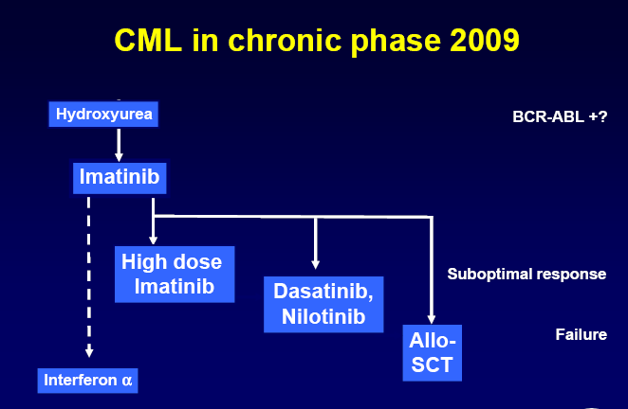

Slide 47
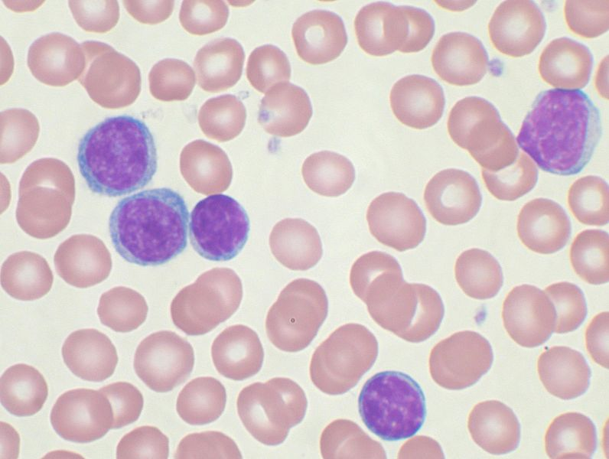
Chronic Lymphoid Leukaemia
Disease of adults – rare in those aged under 40 (79% over the age of 60)
Cell of origin – B lymphocyte
Diagnosed by high WBC – may be accompanied by swollen lymph nodes, spleen, liver, anaemia
Long term disease – 10 – 25 years

Slide 48
CLL - diagnosis
CLL is clonal, therefore there is a skewed distribution of B cells producing either lambda or kappa light chains
Atypical molecular pattern showing co-expression of CD5 and CD23 in addition to classic B cell markers CD19 and CD20

Slide 49
Aetiology - CLL
Environmental associations
farming (esp soya bean, cattle, dairy, herbicide use)
rubber manufacture
asbestos
tyre-repair
CCL4 exposure
Inherited?
low incidence of CLL in Japanese both in Japan and after emigration

Slide 50
Aetiology - CLL
Environmental associations
farming (esp soya bean, cattle, dairy, herbicide use)
rubber manufacture
asbestos
tyre-repair
CCL4 exposure
Inherited?
low incidence of CLL in Japanese both in Japan and after emigration

Slide 51
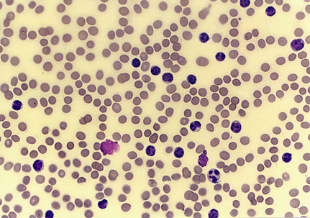
CLL
Onset is insidious, and it is not unusual for CLL to be discovered incidentally after a blood cell count is performed for another reason.
Enlarged lymph nodes are the most common presenting symptom, but patients may present with a wide range of symptoms and signs.

Slide 52
CLL
The prognosis of patients with CLL varies widely at diagnosis. Some patients die rapidly, within 2-3 years of diagnosis, because of complications from CLL.
Most patients live 5-10 years, with an initial course that is relatively benign but followed by a terminal, progressive, and resistant phase lasting 1-2 years.
During the later phase, morbidity is considerable, both from the disease and from complications of therapy.
Treatment often oral alkyating agent to control symptoms
Some attempt at cure of younger with ASCT/MUDD

Slide 53
CLL - treatment
Early stage CLL not treated, when symptoms of CLL decrease QoL significantly the following treatment can be given (purine analogue + ....):
FC (fludarabine with cyclophosphamide)
FR (fludarabine with rituximab –antibody to CD20)
FCR (fludarabine, cyclophosphamide, and rituximab)
CHOP (cyclophosphamide, doxorubicin, vincristine and prednisolone)
Further treatment at relapse can include stem cell transplant, or antibody to CD52

Slide 54
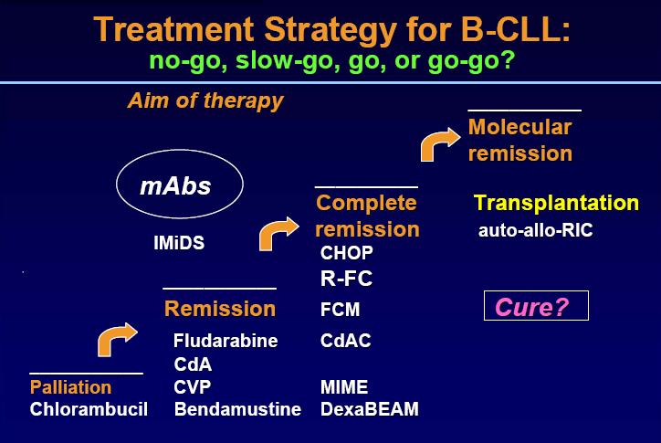

Slide 55
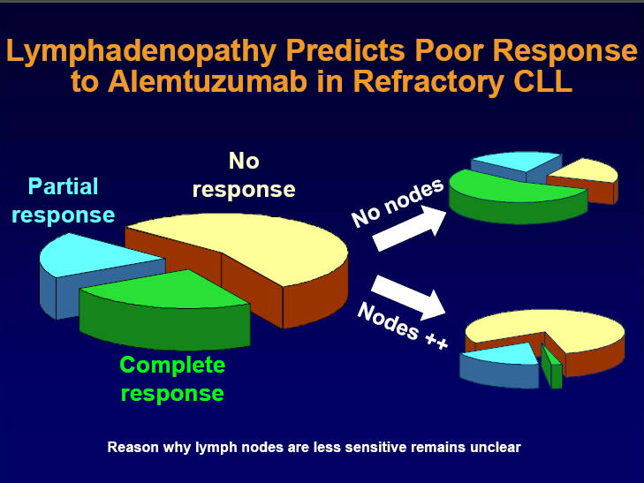

Slide 56
Take home messages
Targeted treatment for cancers and leukaemias work – but we need to know which targets to hit and what is driving the tumour
Translational medicine combining basic science with clinical science will identify many more targets
Many cancers may not be curable (CML is one example) but patients will die WITH their cancer, not OF their cancer.

Slide 57
More info
http://info.cancerresearchuk.org/cancerstats/types/leukaemia/
http://info.cancerresearchuk.org/cancerstats/types/hodgkinslymphoma/
http://info.cancerresearchuk.org/cancerstats/types/nhl/
http://info.cancerresearchuk.org/cancerstats/types/multiplemyeloma/

