Slide 1
Radiology for finals
Dr Antoni Sergot
SpR in Clinical Radiology
Imperial College NHS Healthcare Trust

Slide 2
AIMS
Radiology in modern healthcare.
Radiology and Foundation Years
Radiology and Finals
Chest Radiographs
Abdominal Radiographs
Quiz

Slide 3
RADIOLOGY IN MODERN HEALTHCARE
Diagnostic and Interventional radiology are vital components within any healthcare system.
Almost every patient that comes through the front door of a hospital will undergo some sort of imaging-based investigation.
Incorporates plain film, CT, MRI, Ultrasound, Nuclear Medicine, Angiography/Intervention.
Has a role to play in virtually every single speciality.

Slide 4
Radiology and Foundation Years
As an FY1/2 you will spend A LOT of your time dealing with the radiology department
You will make a radiologist happy if:
You know your patient
You know why you are asking for a test
You manage your time efficiently

Slide 5
Contrary to popular belief most radiologists are very reasonable people.
Responsible for justifying radiation exposure.
Trying to do the best for the patient.
Trying to manage demand for imaging.
What is the best test to help manage the patient?
How can we avoid unnecessary radiation exposure?
How can we make best use of limited resources?

Slide 6
INVESTIGATION
EQUIVALENT NUMBER OF CHEST RADIOGRAPHS
Lumbar Spine
60
Barium Enema
350
IVU
100
Ultrasound abdomen and pelvis
0
CT brain
100
CT thorax
300
CT pneumocolon
500
MRI abdomen and pelvis with gadolinium enhancement
0

Slide 7
Radiation exposure is covered in law by 2 pieces of legislation:
IR(ME)R 2000 --- Covers exposure of patients.
IRR 1999 --- Covers exposure to the general public (not only medicine).
You don't need to know these for exams, however bear in mind that as a doctor requesting examinations requiring radiation these apply to you.
Royal College of Radiologists website (www.rcr.ac.uk)
'Making Best Use of Clinical Radiology Services (MBUR)'

Slide 8
Radiology and FINALS
Radiology will appear in both medical and surgical finals.
Common to see some imaging in PACES.
Could come up in written examinations.
Key Points:
DON'T PANIC
STAY SYSTEMATIC
STAY SAFE

Slide 9
Radiology and Finals
Common Topics / Images
Plain Films (Chest, Abdomen, MSK)
CT (axial slices – intracranial haemorrhage)
Fluoroscopy (Ba Swallow, Meal, Follow through)
MRI and US extremely unlikely.

Slide 10
Exam Technique
What is the image?? (Modality, Type of examination)
What kind of patient (If you are not told)?
  Male / Female
  Young / Old
  Adult / Child
Remember in MSK there should always be more than one view. Ask to see the other view (whether or not the examiner has it!)
Some examinations have sequential images (eg. IVU). Ask to see the control.

Slide 11
Exam Technique
Presentation Style:
Systematic (safe) vs. Direct (impressive but risky)
If in doubt stay safe.
Mention normality as part of your system (the examiner can't read your mind!)
TALK! (no marks for looking intense / confused / constipated)
If you can, say 'radiograph' and not 'x-ray'

Slide 12
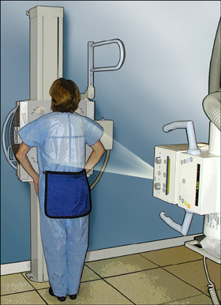
The Chest Radiograph
Technique
Patient directly against cassette.
X-rays emitted
Pass through patient
Partial absorption by the body
Remaining x-rays reach cassette and expose film
Ideal position is PA
AP used if patient cannot tolerate PA.

Slide 13
Presentation Checklist
What is it? --- PA /AP Chest radiograph (frontal if not certain)
Patient ID --- Name if given, sex if not.
Quality of film.
Systematic approach.
Summary

Slide 14
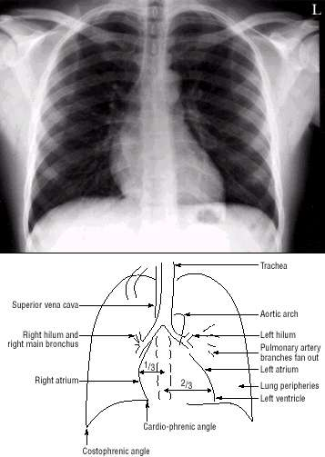
Looking at Radiographs – The System
Technical details
  Male/female
  Old/young
  Good inspiration? (diaphragms at level of 6th ribs anteriorly)
  Good penetration?
  Rotation?
  PA or AP (‘frontal’)

Slide 15
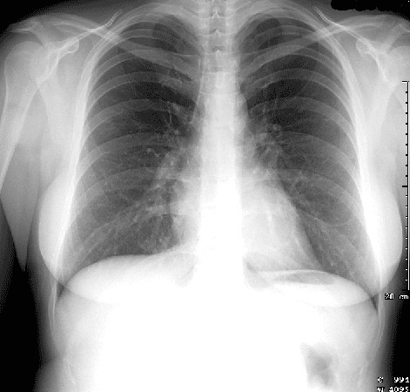
Rotation
Patient should be flat against the cassette
Mediastinum should be central
Look at medial clavicle heads- should be equidistant to the vertebral spinous process

Slide 16
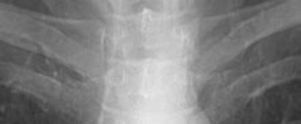
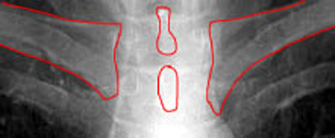
Rotation assessment

Slide 17
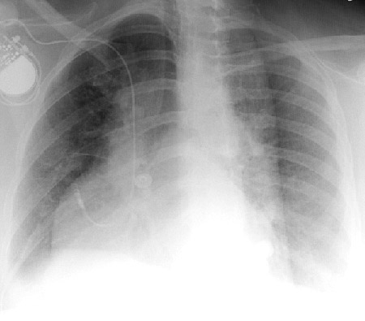
Rotated Patient

Slide 18
Opening Phrase
This is a frontal chest radiograph of a young male patient. The patient has taken a good inspiration and is not rotated; the film is well penetrated.
While you are saying this keep looking at the film!

Slide 19
ANATOMY

Slide 20
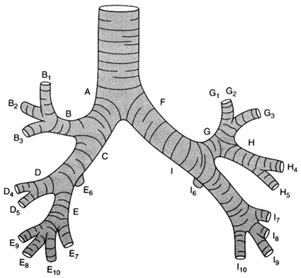
AIRWAYS
Trachea
Main bronchi
Lobar bronchi
Segmental bronchi

Slide 21
Usually only trachea and main bronchi visible

Slide 22
Heart and great vessels

Slide 23
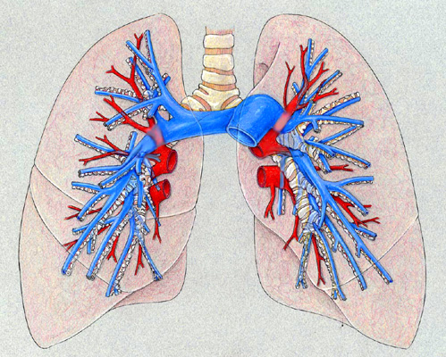
Pulmonary vessels
Pulmonary arteries (blue)
Pulmonary veins (red)
Hilum is defined as where upper lobe vein crosses lower lobe artery

Slide 24
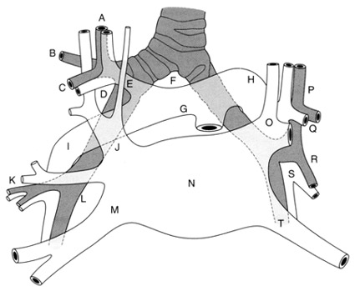
The hila on chest x-ray

Slide 25
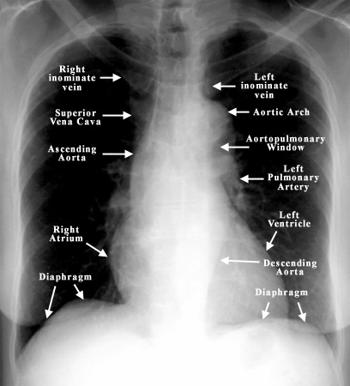

Slide 26
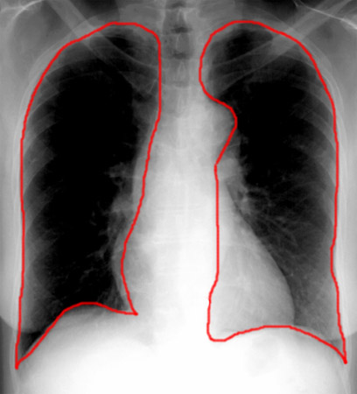
Lungs and Pleural Spaces

Slide 27
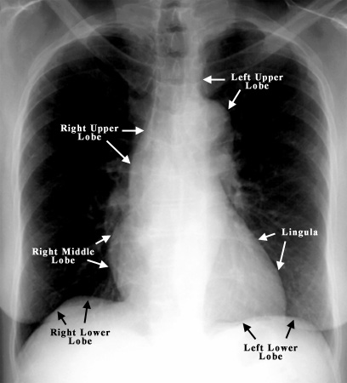
Mediastinal contours
The lungs lie adjacent to mediastinum
Different lobes lie next to different surfaces
This is the most reliable way of depicting the lobar anatomy
If you are not sure, stick to 'zones'

Slide 28
Chest System
Mediastinal Contours
(left side then right)
Trachea – central
On left top to bottom
  Aortic arch
  Left pulmonary artery
  Left heart border

Slide 29
Chest System
Heart
  2/3 on left
  No more than ½ chest cavity
Right mediastinal contour (bottom to top)
  Right atrium (RV is anterior)
  SVC

Slide 30
Chest System
Hilum
Normal:
  Pulmonary vessels
  Main bronchi
  Lymph nodes
Abnormal:
  Primary tumours
  Enlarged nodes

Slide 31
Chest System
Lungs
  Apices down
  Left and right
  Behind heart
  Periphery (no markings)
  ?pneumothorax
  Under hemidiaphragm
  Costophrenic/cardiophrenic angles
  Free air

Slide 32
Chest System
Soft tissues and bones
  Present
  Symmetrical
  #

Slide 33
Chest System
Review Areas
Apices
Costophrenic / Cardiophrenic angles
Behind the Heart
Bones and Soft Tissues

Slide 34
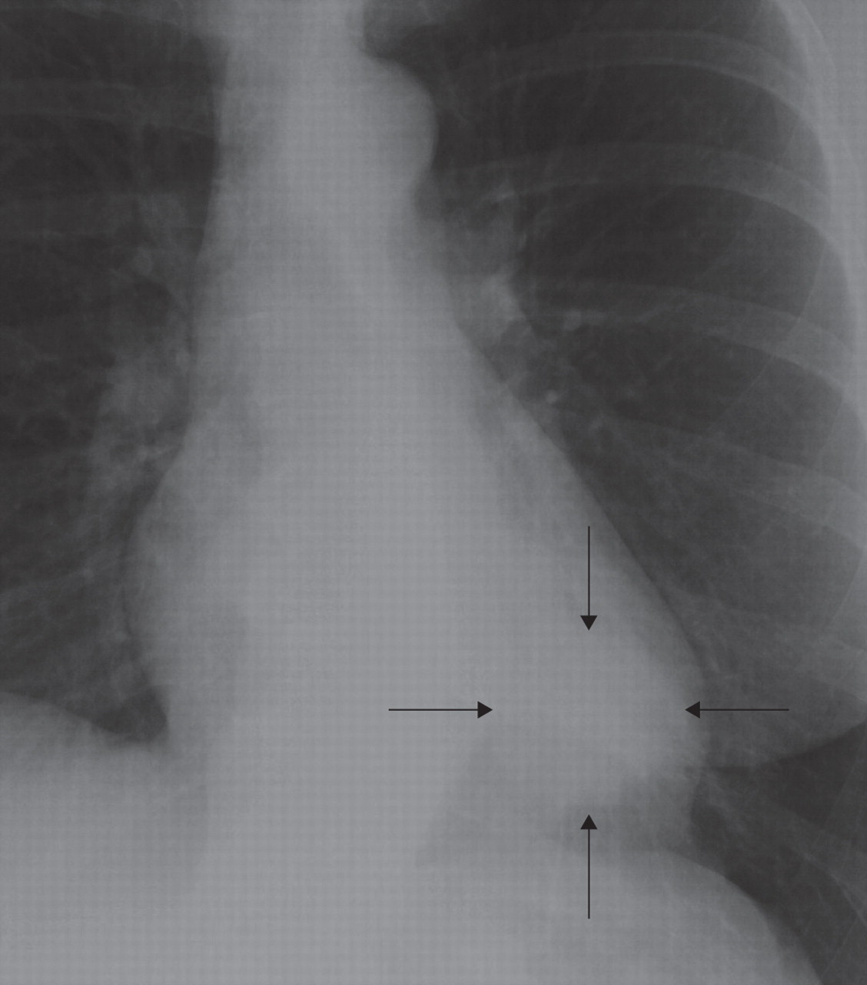

Slide 35
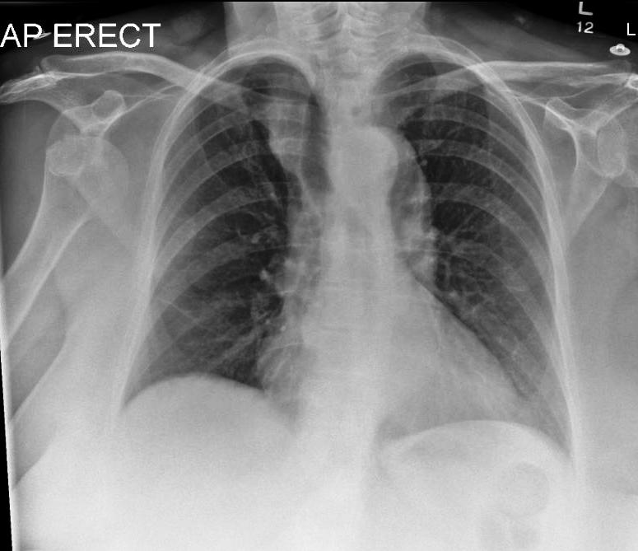

Slide 36
Chest Summary
The trachea is central, the mediastinum is not displaced. The mediastinal contours and hila appear normal. The lungs appear clear with no pneumothorax. There is no free air under the diaphragm. The bones and soft tissues appear normal.
I have not yet identified an abnormality so I will look through my review areas

Slide 37
ABNORMALITIES
Mediastinum and Hila
Pleura.
Lung parenchyma.

Slide 38
Abnormality:
The Trachea and Mediastinum are Deviated.
Trachea is pushed or pulled
  2 pushes
  1 pull
Left sided Pleural effusion pushes trachea and mediastinum to the right
Left sided Tension Pneumothorax pushes trachea and mediastinum to the right
Left sided Collapse pulls trachea to the left side

Slide 39
Abnormality: The trachea and mediastinum are deviated
R lung collapse
Heart pulled over to right

Slide 40
Abnormality: The trachea and mediastinum are deviated
Right Pleural Effusion
Meniscus
Heart shifted to left

Slide 41
Abnormality: The trachea and mediastinum are deviated
Left sided tension pneumothorax
Left lung completely collapsed
Half the heart lies on the right

Slide 42
Abnormality: The heart is enlarged
Most common cause: cardiac failure
Signs of LVF
  upper lobe blood diversion (pulmonary veins)
  Kerley B lines – tiny horizntal from pleural edge
  Bats wings –type peri-hilar haziness
  Alveolar shadowing (hazy shadowing throughout)
Other causes enlarged heart:
  pericardial effusion
  Cardiomyopathy

Slide 43
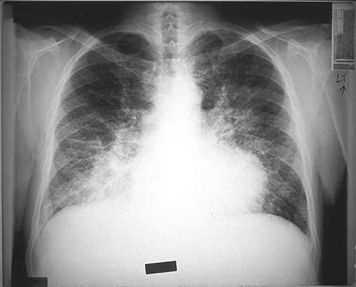
LVF
  upper lobe blood diversion (pulmonary veins)
  Kerley B lines – tiny horizontal from pleural edge
  Bats wings –type peri-hilar haziness
  Alveolar shadowing (hazy shadowing throughout)

Slide 44
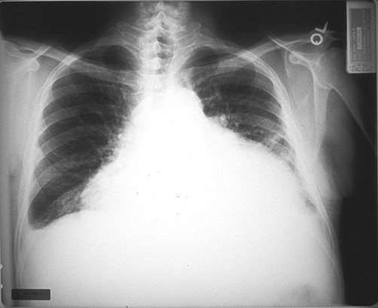
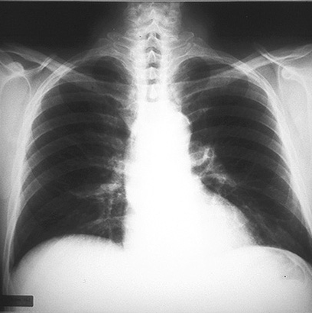
Pericardial effusion before and after

Slide 45
Abnormality: Enlarged Hila
3 structures
Pulmonary artery
  hypertension due to mitral valve disease, chronic PEs, primary pulmonary hypertension
Main bronchus
  carcinoma of proximal bronchus
Lymph nodes
  infection, spread from CA, lymphoma, sarcoidosis

Slide 46
Enlarged Hila: Lymphoma
Normal

Slide 47
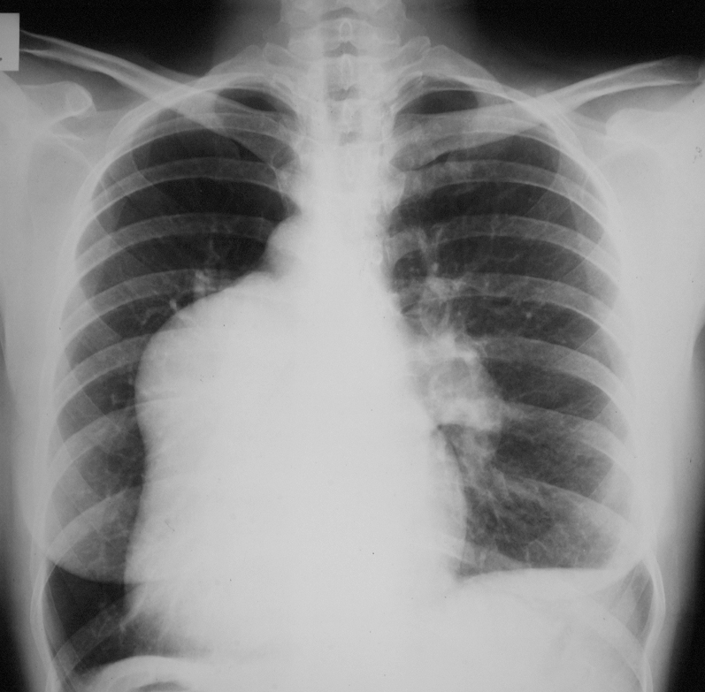
Enlarged Hila
Pulmonary artery hypertension

Slide 48
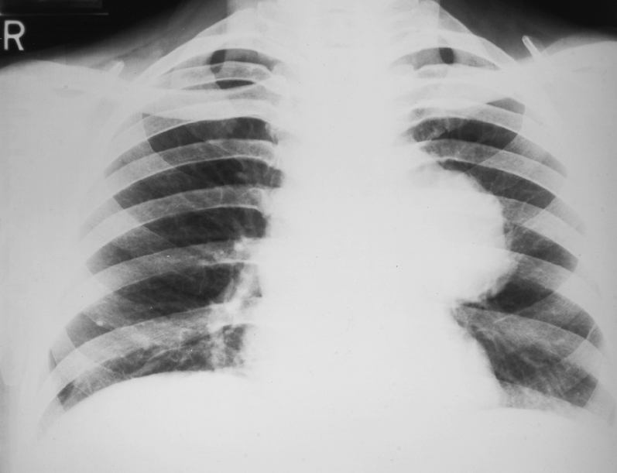
Left Hilar Carcinoma

Slide 49
Abnormality: Pneumothorax
Look at periphery of lungs
air in pleural space
Signs
  one half of lung is blacker (no pulmonary vessel markings)
  edge of collapsed lung

Slide 50
Abnormality: Pneumothorax
Associated abnormalities:
  rib fractures
  surgical emphysema
  tension? Air accumulates in pleural space, opposite lung and mediastinum get compressed, decreased venous return, cardiac arrest

Slide 51
Abnormality: Pneumothorax
There is no shift of the mediastinum and therefore no tension pneumothorax
There is shift of the mediastinum away from the side of the pneumothorax indicating a (right/left) tension pneumothorax.
This is a medical emergency which I would treat immediately by inserting a large bore cannula into the (right/left) pleural space

Slide 52
Abnormality: Pneumothorax

Slide 54
Abnormality: Pneumothorax

Slide 55
Abnormality: There is extra shadowing in the lungs
Look at the peripheries
Airspace
Interstitial

Slide 56
Normal lung anatomy
Air containing (air space):
  Bronchi branch
  Alveoli
Potential space:
  Interstitial space

Slide 57
Air space can fill up
Fluid - pulmonary oedema
Pus - infection/consolidation
Blood – Goodpastures
Tumour cells – eg alveolar cell carcinoma
Alveoli fill first, bronchi still air filled, stand out (air bronchogram)
Air space shadowing – no loss of volume

Slide 58
Air space shadowing – air bronchograms, no loss of volume
There is shadowing in the airspaces of the left and right lower zones

Slide 59
Interstitial Space
surrounds bronchi, vessels and groups of alveoli
reticulo-nodular shadowing
criss-cross lines +/- tiny nodules
Causes:
  fluid accumulation - pulmonary oedema/lymphangitis
  inflammation leading to fibrosis – industrial lung disease, cryptogenic fibrosing alveolitis

Slide 60
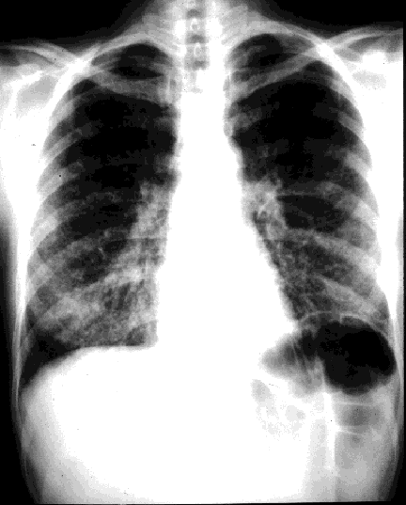
Interstitial shadowing
Normal

Slide 61
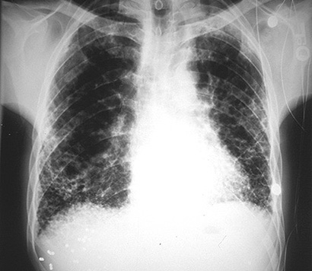
Advanced Fibrosis

Slide 62
Interstitial shadowing
There is reticulonodular shadowing in the lower zones consistent with interstitial lung disease

Slide 63
Air space versus interstitial shadowing
AIR SPACE
Any zone
Confluent shadows
Air bronchograms
Causes
  fluid
  pus
  blood
  cells
INTERSTITIAL
Any zone
linear/reticular/nodular
Causes
  fluid
  inflammation leading to fibrosis (CFA, industrial lung disease, inflammatory arthritides

Slide 64
Abnormality: There is lobar collapse
Cause of collapse: proximal obstruction
  neoplasm
  mucus plug
  foreign body
Loss of volume (cf consolidation/airspace shadowing)
Predictable location

Slide 65
Signs of lobar collapse: Volume loss
Mediastinum shifted towards side of collapse
Hilum is pulled up or down
Horizontal fissure pulled up (Right upper lobe) or down (right lower lobe)
Remaining non-collapsed lung on ipsi-lateral size has to expand, therefore abnormal side is blacker
Proximal obstruction may be visible

Slide 66
Which lobe is involved?
The crisp borders of the diaphragm and heart are due to air-tissue interfaces (ie black/white)
These interfaces are lost, if the air containing portions of lungs become consolidated or collapse
Look for the interface that is lost- this will indicate which lobe is affected

Slide 67
Which lobe?
Right superior mediastinal contour- right upper lobe
Right heart border- right middle lobe
Right hemidiaphragm- right lower lobe
Left superior mediastinal contour- left upper lobe
Left hemidiaphragm- left lower lobe

Slide 68
Collapse versus consolidation
Both affect lobes
Both cause white areas in lungs
Consolidation
  no loss of volume
  air bronchograms
Collapse
  loss of volume
  no air bronchograms

Slide 69
Abnormality: Left lower lobe Collapse
Mediastinum shifted towards side of collapse
Hilum is pulled down
Loss of the left hemidiaphragm
Remaining non-collapsed lung on ipsi-lateral size has to expand, therefore abnormal side is blacker

Slide 70
Left lower lobe consolidation
No loss of volume
No shift of mediastinum
Left hemidiaphragm obscured

Slide 71
Left upper lobe collapse
Mediastinum shifted to left
Loss of left superior mediastinal contour
No air bronchongrams
Loss of volume on left

Slide 72
Left upper lobe collapse
Veil like opacity
lies anteriorly
cause may be hilar CA

Slide 73
Right lower lobe consolidation
No loss of volume
air space shadowing
right hemidiaphragm obscured
right heart border clear

Slide 74
Right middle lobe collapse
Loss of volume on right
right heart border lost on AP
increased shadowing over heart on lateral
RML lies anteriorly and adjacent to right heart border therefore obscures this when it collapses
Ant

Slide 75
Right upper lobe collapse
Right loss of volume
Horizontal fissure pulled up
Loss of right superior mediastinal contour
may be due to proximal obstruction
Normal

Slide 76
Right upper lobe consolidation
No loss of volume
Air bronchogram
therefore consolidation
Above horizontal fissure
therefore upper lobe

Slide 77
Abnormality: There is confluent opacity of the hemi-thorax
Consolidation
Pleural effusion
  fluid
  pus
  blood
Complete collapse of one lung
Post pneumonectomy

Slide 78
Pleural Effusion
if erect, fluid level and meniscus
if large, mediastinum shifts to opposite side
(not so for consolidation)
beware effusion plus collapse

Slide 79
Right lower lobe
consolidation
Pleural Effusion

Slide 80
Complete collapse right lung

Slide 81
Left Pneumonectomy

Slide 82
Abnormality: There are multiple discrete nodules in the lungs
no reticular/linear component
small <5mm
large >5mm

Slide 83
Small nodules <5mm
miliary TB (haematogenous)
other infections eg fungi
sarcoid
metastases (usually bigger)
pneumoconiosis (eg coal dust)
old chickenpox pneumonia

Slide 84
Larger nodules >5mm
Common
  metastases – breast, testis, GIT, kidney, thyroid
Rare
  inflammatory nodules – RA, Wegeners granulomatosis

Slide 85
Miliary TB

Slide 86
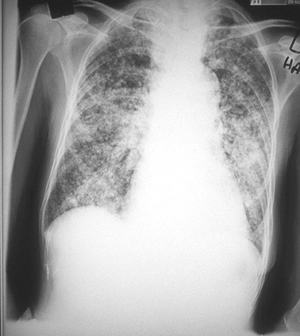
Miliary Metastases (thyroid CA)

Slide 87
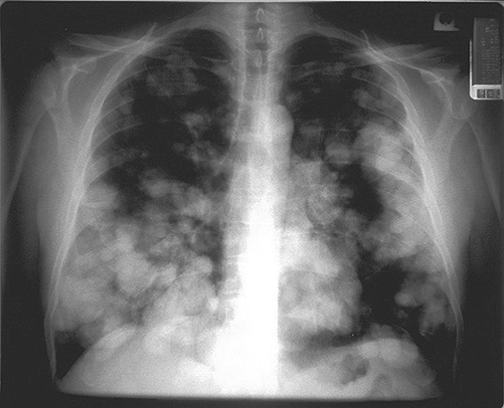
Multiple pulmonary nodules (metastases)

Slide 88
Abnormality: There is a single nodule/mass within the lung
Causes:
Infection eg TB
Neoplasm (primary bronchial or solitary metastasis)
  hilar or peripheral
  spiculated,
  associated with pleural effusion, hilar lymphadenopathy
In both cavitation can occur (typ squamous cell carcinoma)

Slide 89
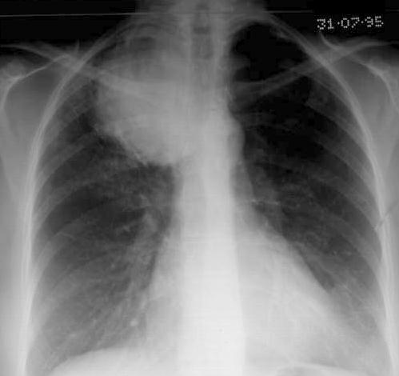
Pancoasts tumour - right apex

Slide 90
Proximal obstructing carcinoma causing left upper lobe collapse

Slide 91
  Have a basic system for looking at chest radiographs
  So you can say something sensible at finals
  Be confident you are not missing serious pathology as a house officer

