Slide 1
Professionalism and the SJT Professionalism in PACES The front row is empty
Karim Meeran

Slide 3
http://www.foundationprogramme.nhs.uk/pages/home/how-to-apply/SJT-FAQs#answer374

Slide 4
SJT
Friday December 7th 2012.
Mock exam this Friday afternoon
Published on the web now
I will send you all a surveymonkey quiz to enable useful feedback.
First do the brief 10 minute quiz by tonight.
I will send you all feedback, then a futher mock for Friday afternoon.

Slide 5
Scoring – Ranked Items
Keyed Rank | Candidate Rank
 | 1 | 2 | 3 | 4 | 5
1 | 4 | 3 | 2 | 1 | 0
2 | 3 | 4 | 3 | 2 | 1
3 | 2 | 3 | 4 | 3 | 2
4 | 1 | 2 | 3 | 4 | 3
5 | 0 | 1 | 2 | 3 | 4
Notes:
This table shows how points are allocated for ranking items.
The principle is that exactly replicating the key gets highest score (20 points with 5 options, 16 points with 4). However if the candidate is close to keyed rank – e.g. ACBDE instead of ABCDE then candidate gets close to maximum score for item – but a very different ordering gets a very low score e.g. CEDBA.

Slide 6
Students will learn whatever it takes to pass
If the GMC decide that to pass you need to know the Geography of Zimababwe, then that is what you will do.
SJTs are the same: the trick is to be totally self sacrificial.
Thus at the end of your shift, you need to stay as long as it takes to ensure the patients are safe. The fact that it is illegal to work (European time directive) is irrelevant.

Slide 7
PACES
External examiners tell us that in FINALS, some candidates are still in OSCE mode (machine like)
My name is Mr Jones, a final year medical student. I’m going to ask you a few questions...
What is your name
What is your date of birth
What is the problem

Slide 8
PACES
Being “nice” to patients.
Being nice takes time.
You need to put more into a relationship that you expect to get out of it.
Do not always look for instant reward
Hello Mr Jones, I’m just going to ask you a few questions, is that OK (wait for an answer)...

Slide 9
PACES
I need to check that I’m talking to the right patient, so can I ask you your name...
And just to be sure, your date of birth.
(etc).

Slide 10
In this exam
Always put the patient first
You are the patient advocate
Always give the patient a choice
If they don’t know what to do, you have to act in their interests
Exams are an artificial situation.

Slide 11
In the next slide
Inspect the patient politely
Write down the clinical signs that you will see
Write down what you should look for on examination
Write down the investigations that need to be performed
Write down what treatments should be made

Slide 12
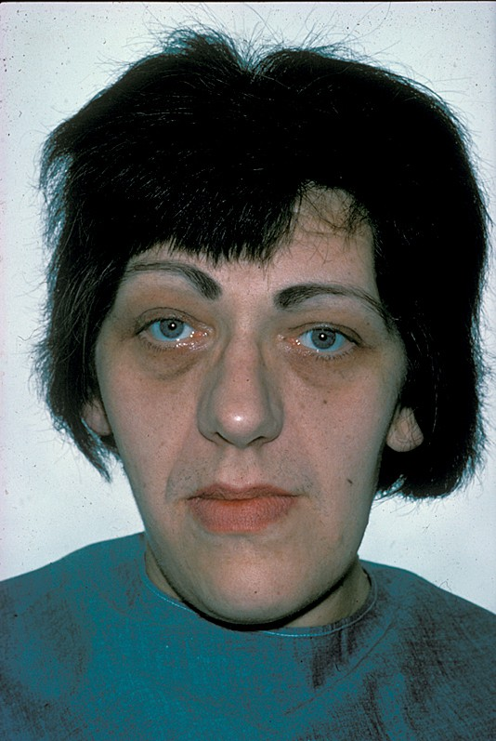
Inspect the patient politely
clinical signs
what you should look for on examination
Investigations that need to be performed
what treatments should be made

Slide 13
Acromegaly
CS
Suprorbital ridges
Large lower jaw, poor occlusion
Kyphotic
Hand appearance
Sweating
Hypertension
CAUSE
Pituitary Mass
Fields
Hypopituitary
ACTH/Cortisol
T4
LH/FSH

Slide 14
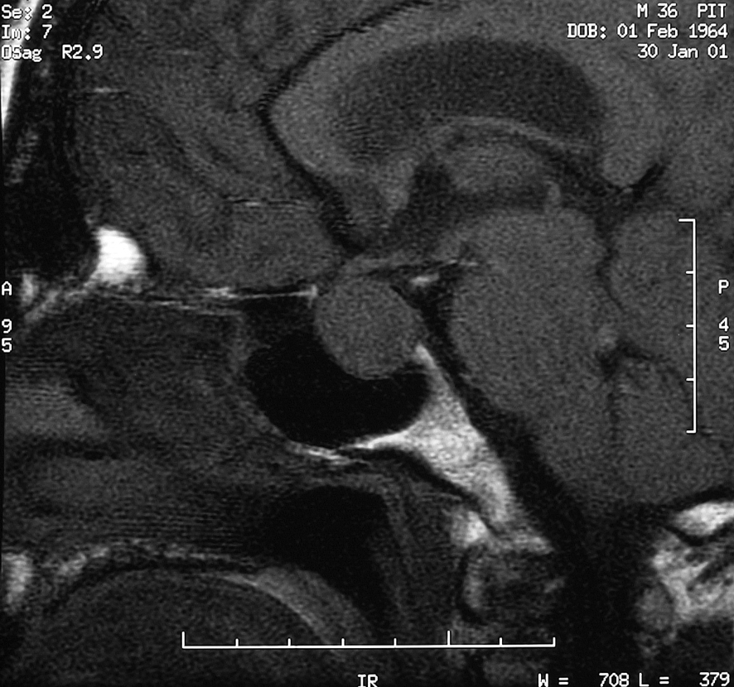

Slide 15
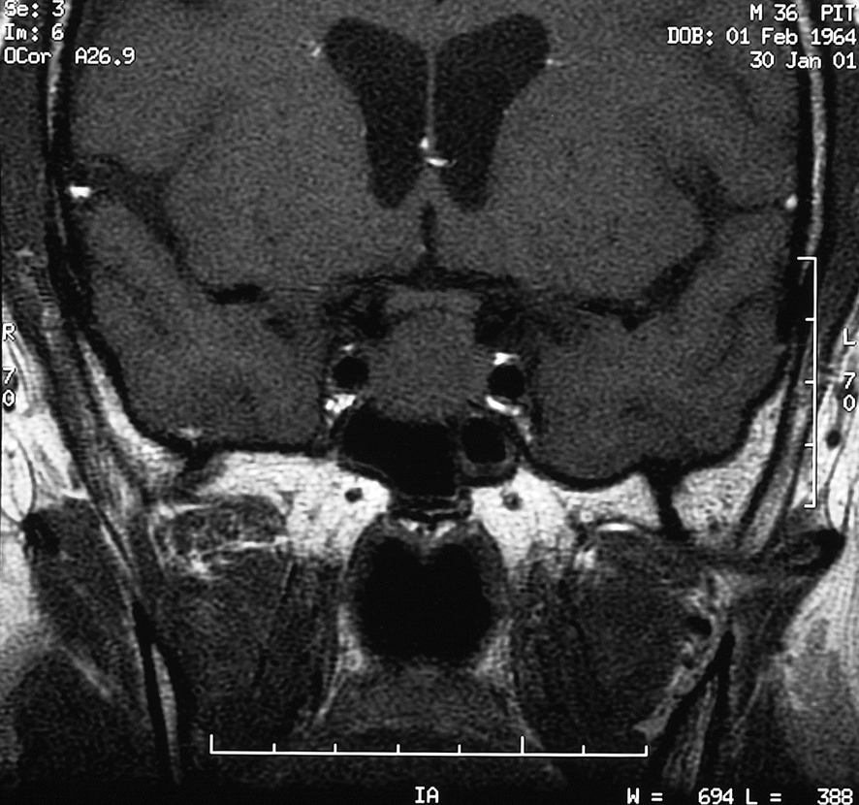

Slide 16
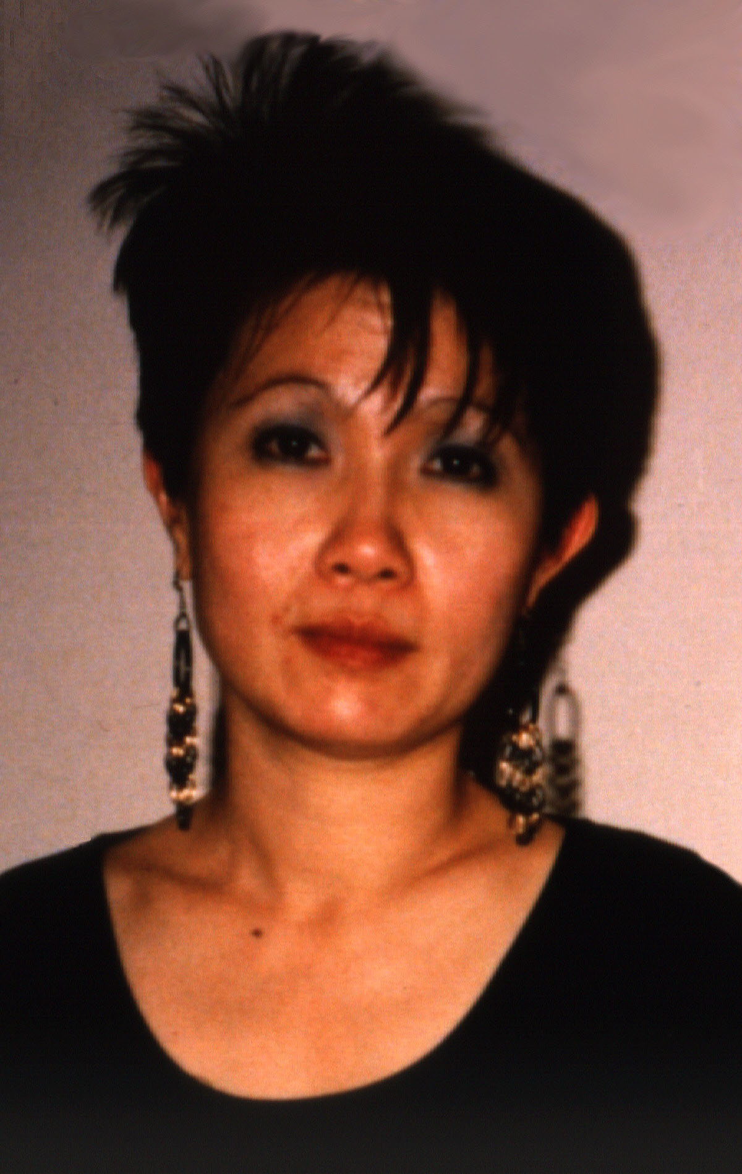
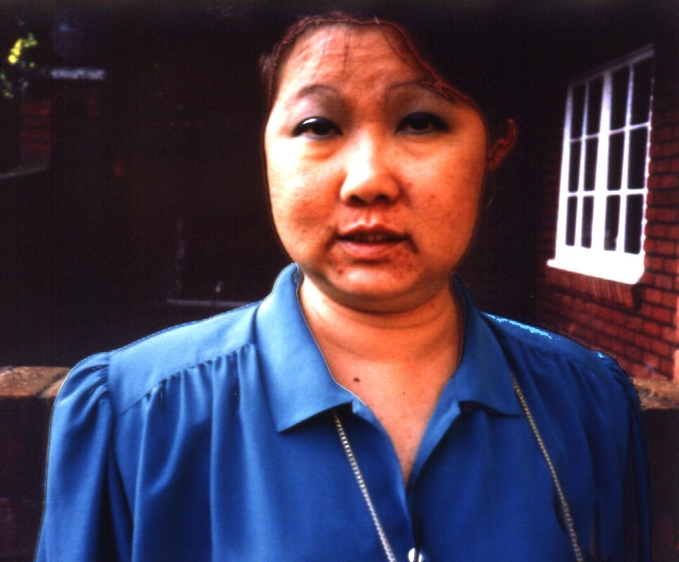

Slide 17
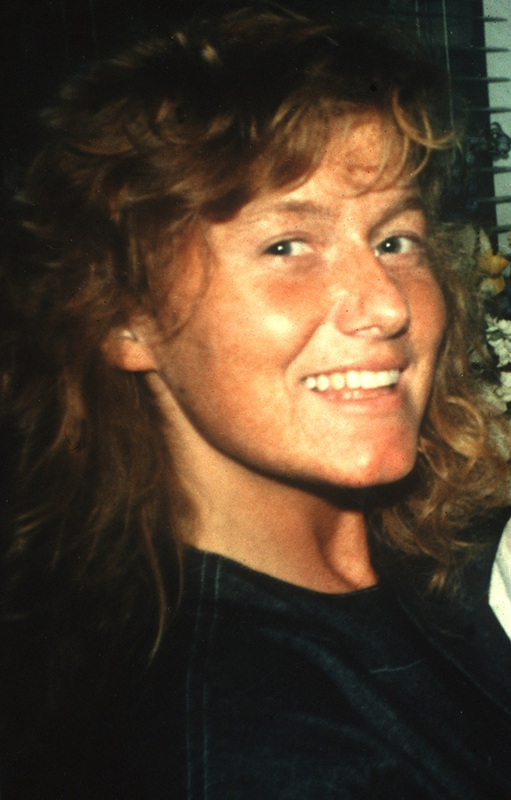

Slide 18
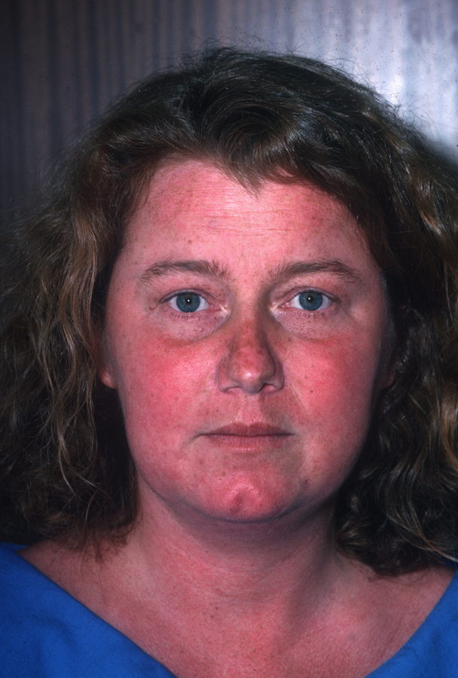
Inspect the patient politely
clinical signs
what you should look for on examination
Investigations that need to be performed
what treatments should be made

Slide 19
Cushing’s syndrome
CS
Thin skin, bruises
facies
Central adiposity
Hirsute
Gynaecomastia
Proximal weakness
hypertension
CAUSE
High ACTH
Pituitary (Nelson)
ectopic
Low ACTH
Exogenous
Adrenal

Slide 20
A 56 yr man has surgery. His [Na] was 121mmol/l. He did not have cardiac failure. Suggest a cause in the following scenarios;
New houseman on 3/8/11 took blood sample
Total protein/globulin elevated, ESR 115, Ca 3.6mmol/l
Productive cough, bed next to air conditioning unit in care home.
Surgery was for carcinoma of bronchus
K 6.4, surgery for TB lymph node

