Slide 1
Plain film interpretation session medical students

Slide 2
Age 80 female, abdominal pain

Slide 3
Free intra-peritoneal air
Erect chest x-ray
Thin opaque line represents diaphragm
Air reaches periphery / no haustra
Continous diaphragm sign
Lateral decubitus film

Slide 4
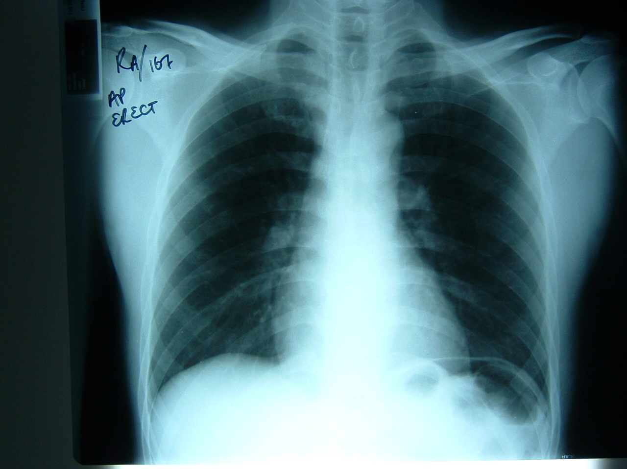
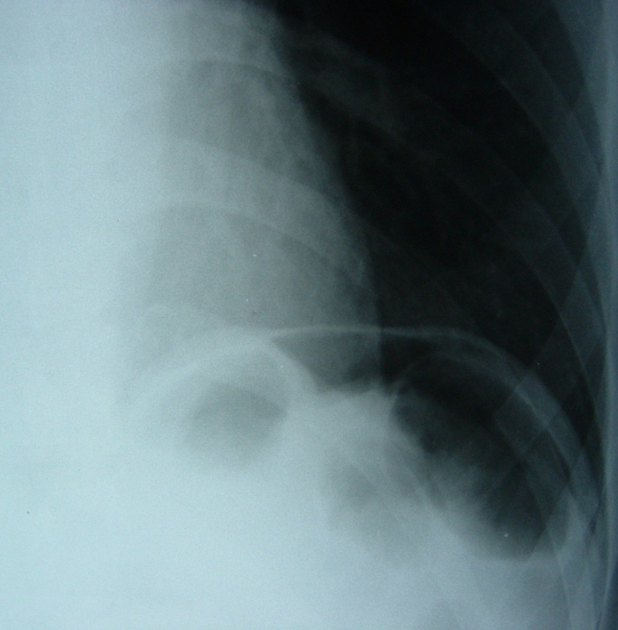
Free intra-peritoneal air

Slide 5
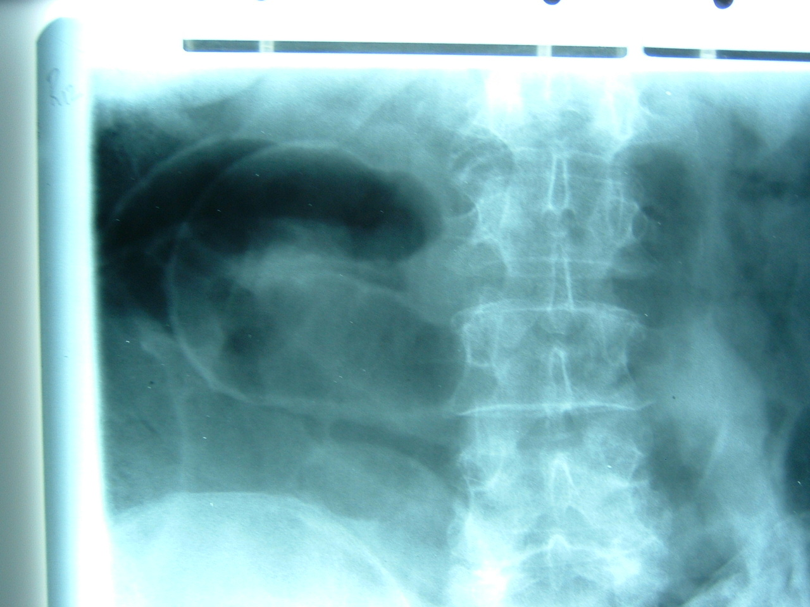
Free air, supine abdominal film
Riggler’s sign
Air outlines both sides of bowel wall

Slide 6
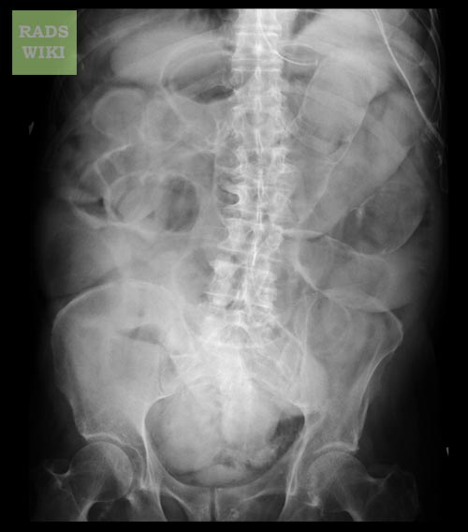

Slide 7
Age 75 female, acute shortness of breath, sweating, tachycardia

Slide 8
LEFT VENTRICULAR FAILURE
Large heart
Peri-hilar haziness
Upper lobe blood diversion
Small pleural effusions

Slide 9
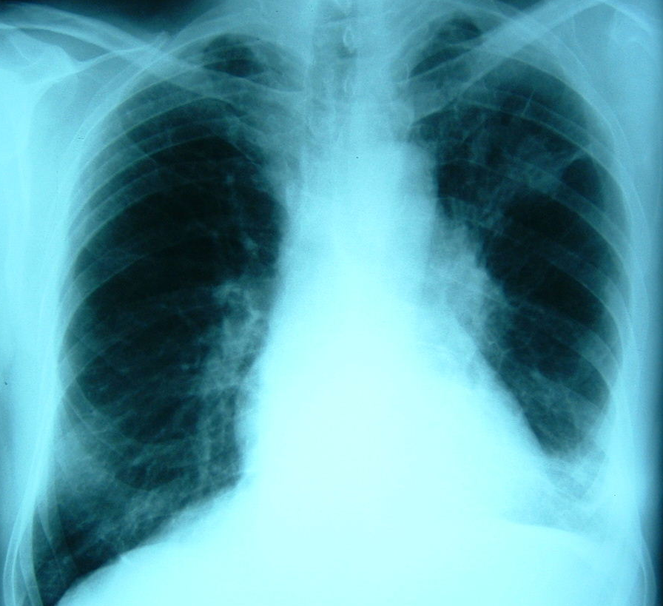
Age 70 male, haemoptysis

Slide 10
Lung cancer

Slide 11
Single pulmonary nodule/mass
Causes:
Infection eg TB
Neoplasm (primary bronchial or solitary metastasis)
hilar or peripheral
spiculated
associated with pleural effusion, hilar lymphadenopathy

Slide 12
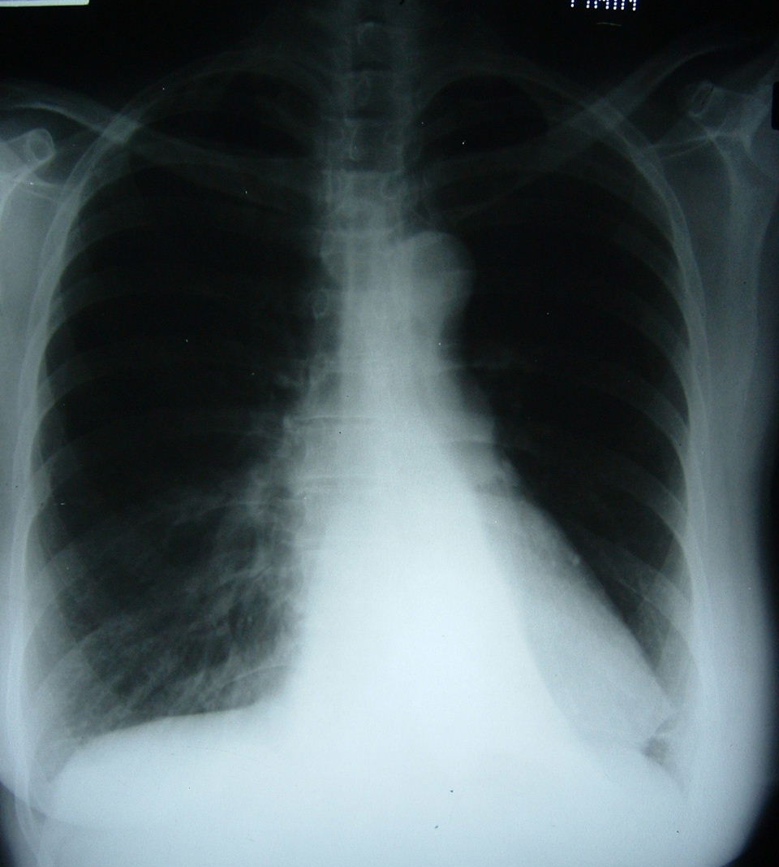
Age 50 female, cough and green sputum

Slide 13
Left lower lobe collapse
Mediastinum shifted towards side of collapse
Hilum is pulled down
Triangular density behind heart
Loss of hemidiaphragm

Slide 14
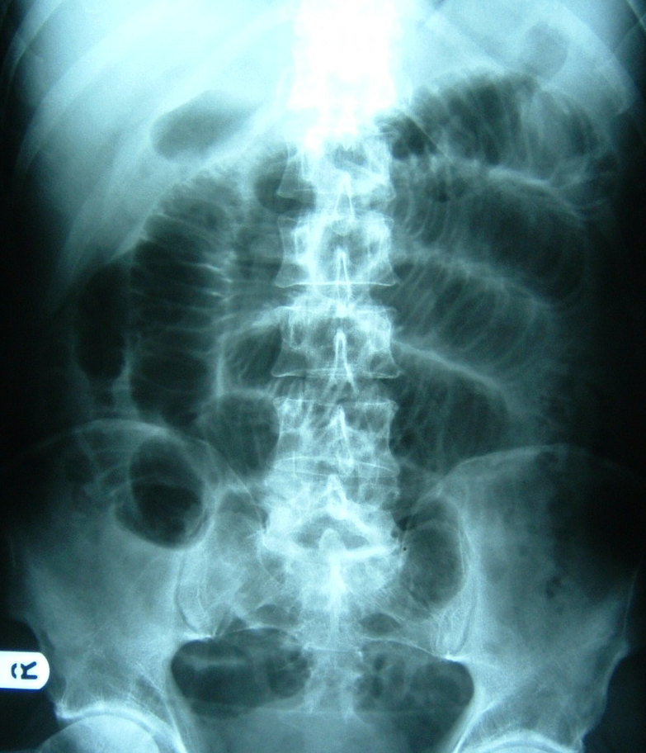
Age 50 male, abdominal distension and vomiting

Slide 15
Small bowel obstruction
Centrally placed loops of dilated bowel
Valvulae conniventes extend across whole bowel wall
Causes
Adhesions
Incarcarated hernia

Slide 16
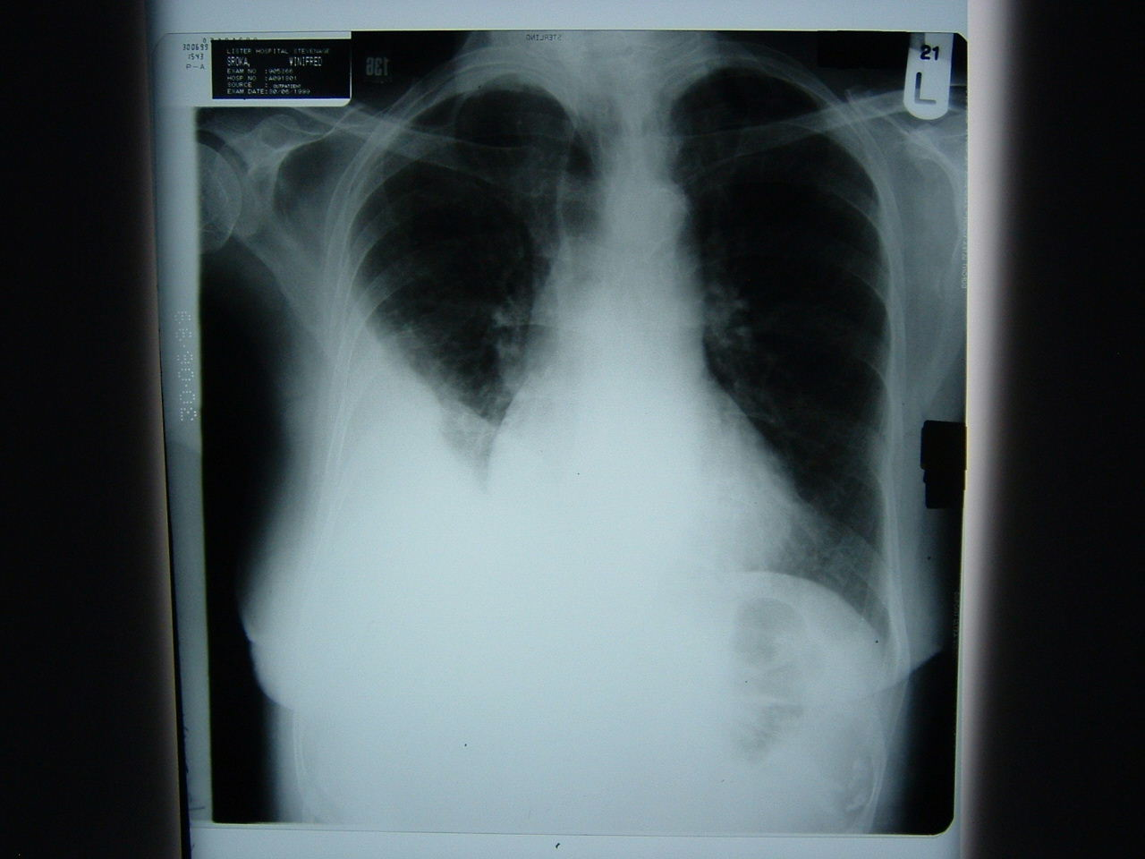
Age 75 female, shortness of breath

Slide 17
Right pleural effusion
Opacification of right lower hemithorax
Loss of costophrenic angle
Curved superior margin- meniscus
Normal heart size

Slide 18
Pleural effusion
Fluid level and meniscus seen on erect film
If large, mediastinum shifts to opposite side
Beware effusion plus collapse
Unilateral or unusual shaped effusions more likely to be complex, ie blood, pus.

Slide 19
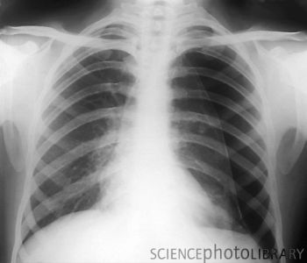
Age 23 male, chest pain

Slide 20
Left tension pneumothorax
Mediastinum shifted to right
Free air seen peripherally- no lung markings
Lung edge visible

Slide 21
Pneumothorax
Look at periphery of lungs
air in pleural space
Signs
one half of lung is blacker (no pulmonary vessel markings)
edge of collapsed lung
Associated abnormalities:
rib fractures
surgical emphysema
tension?

Slide 22
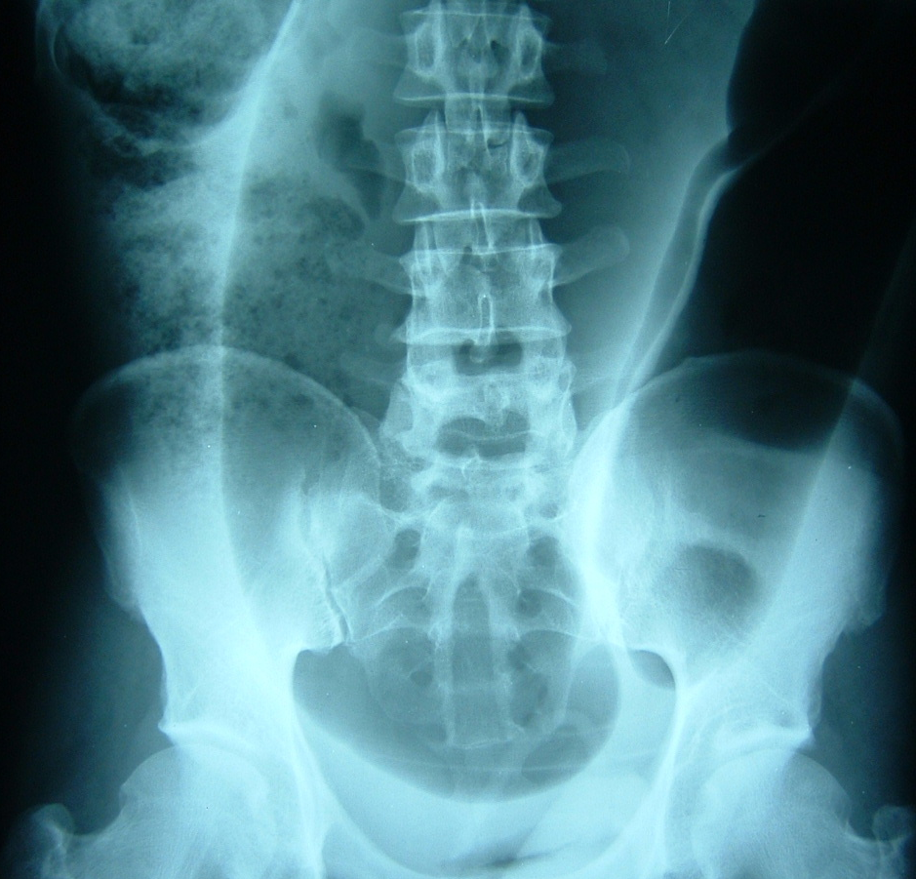
Age 70 male, abdominal pain and distension

Slide 23
Sigmoid volvulus
“Coffee bean sign” (inverted U shape)
Apex in pelvis, projects to upper quadrants
Normal caecum
Large bowel obstruction may be present

Slide 24
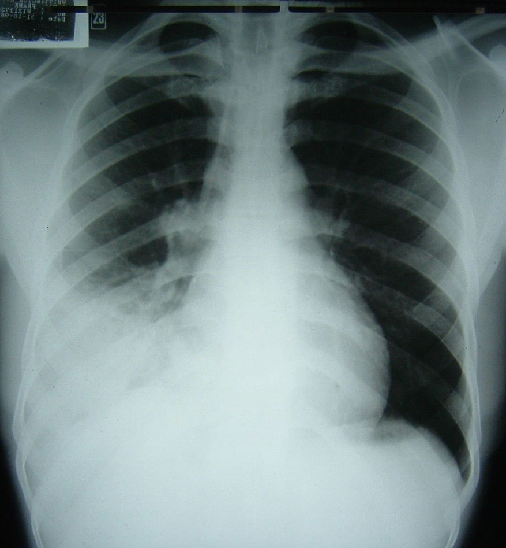
Age 45 male, pyrexial and cough

Slide 25
Right lower and middle lobe consolidation
Right lower zone opacification
No loss of volume
air space shadowing
right hemidiaphragm and right heart border obscured

Slide 26
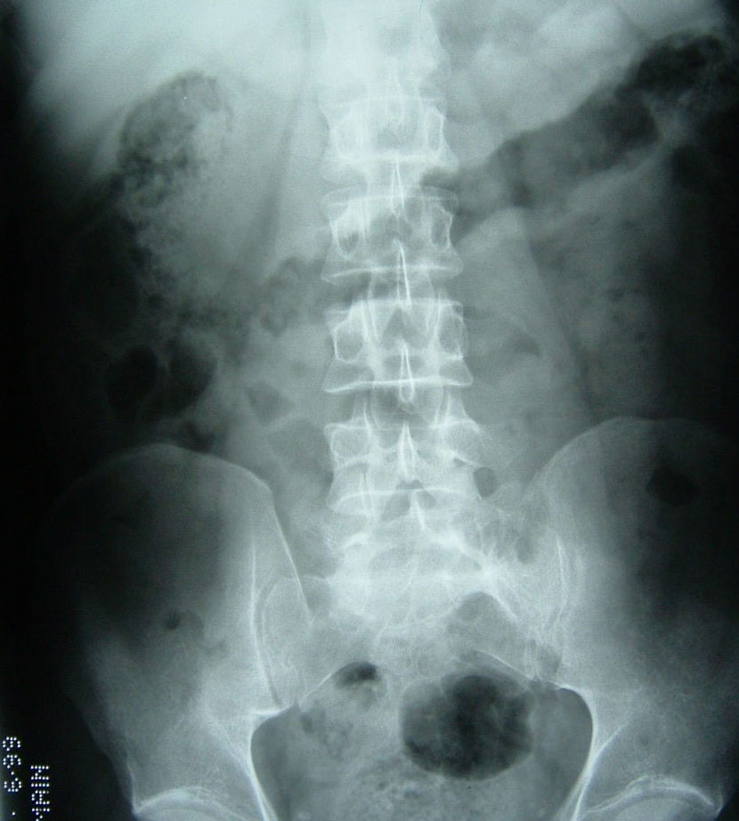
Age 32 male, severe abdominal pain and diarrhoea

Slide 27
Colitis
Abnormal thick walled transverse colon (thumb-printing)
Toxic megacolon if >5.5cm, high risk of perforation
Causes:
Infection
IBD
ischaemia

Slide 28
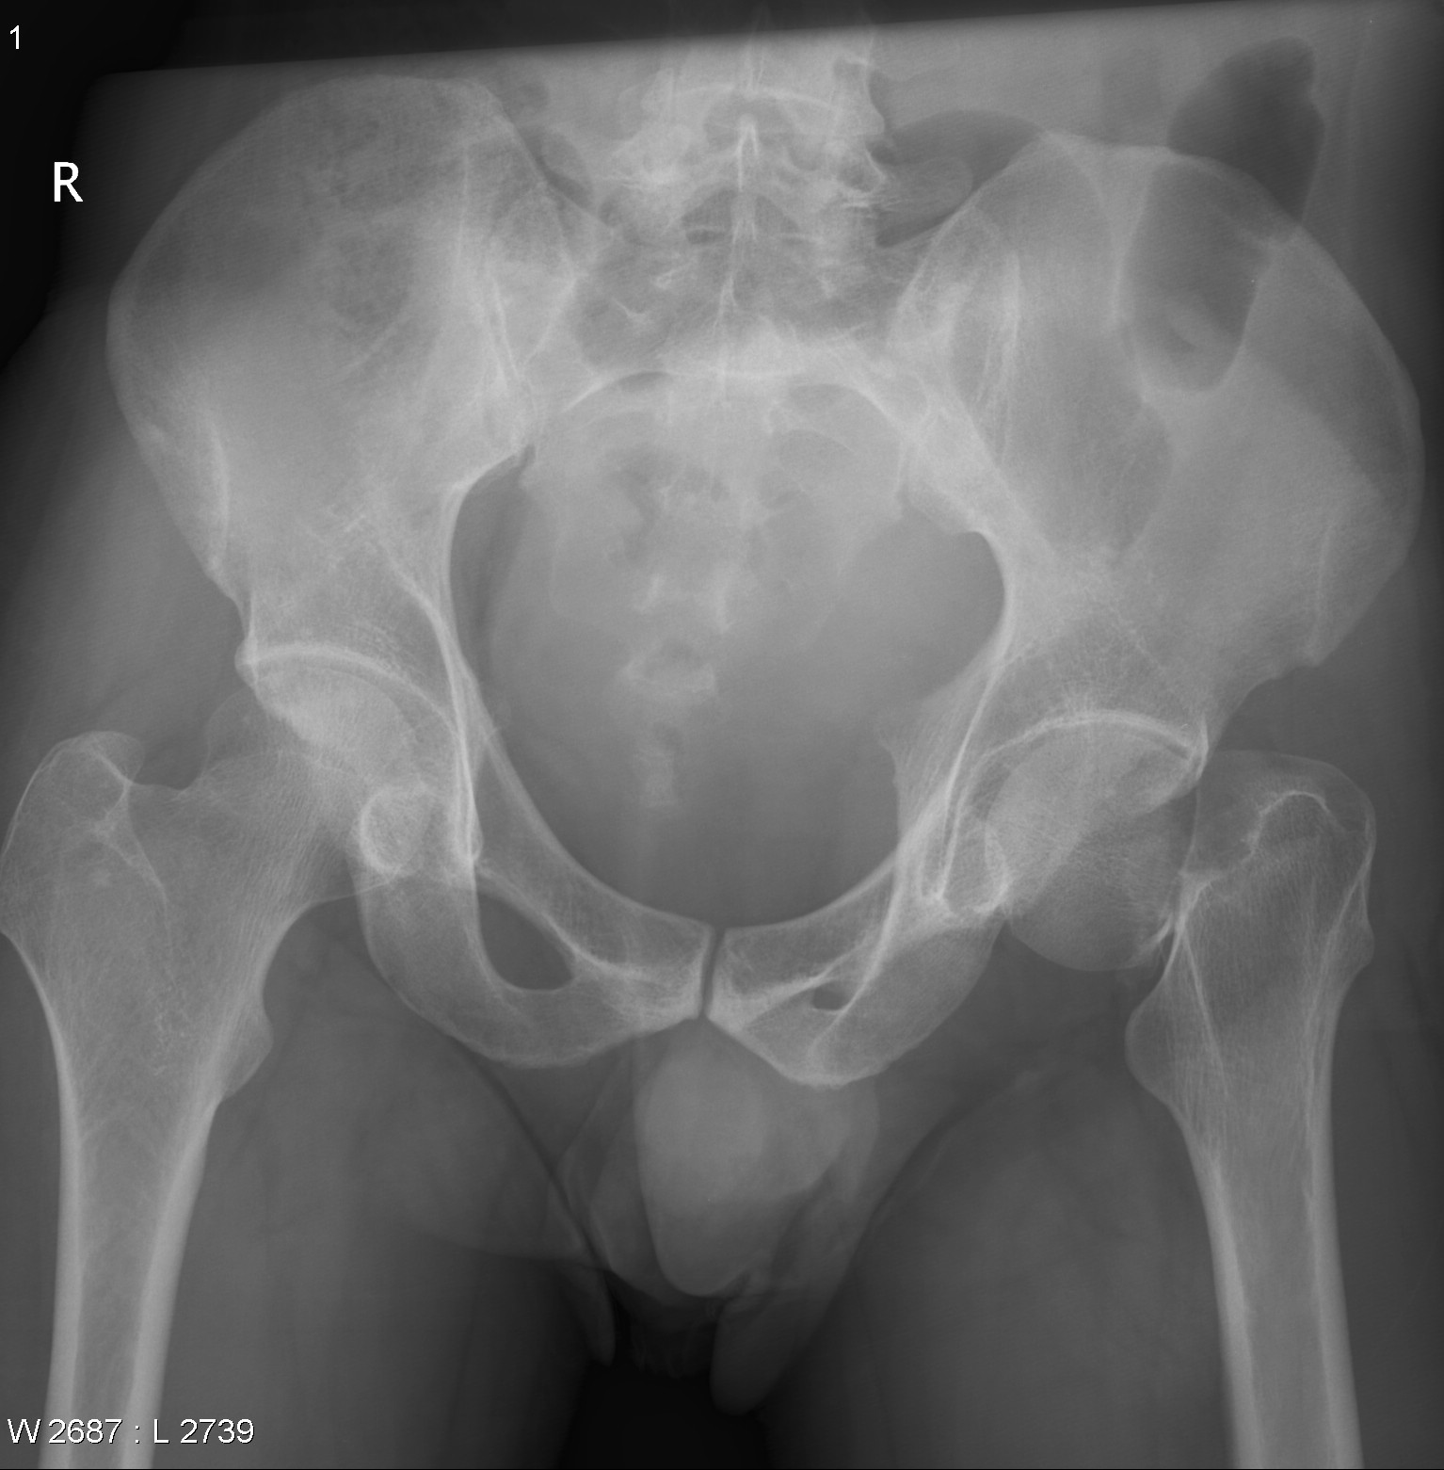

Slide 29
Right fractured neck of femur
Classification
Intra-capsular : capital, subcapital or transcervical
Extra-capsular: intertrochanteric or subtrochanteric
Risk of AVN and non-union

Slide 30
Age 32 male, FOOSH

Slide 31
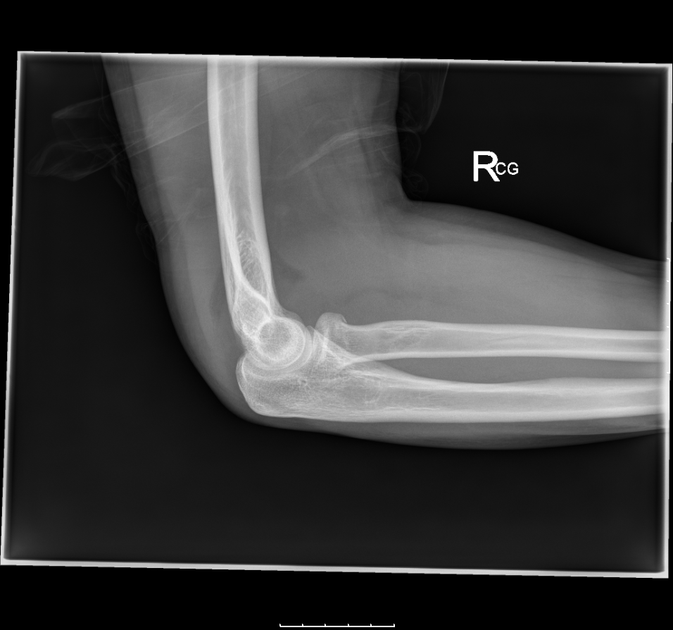

Slide 33
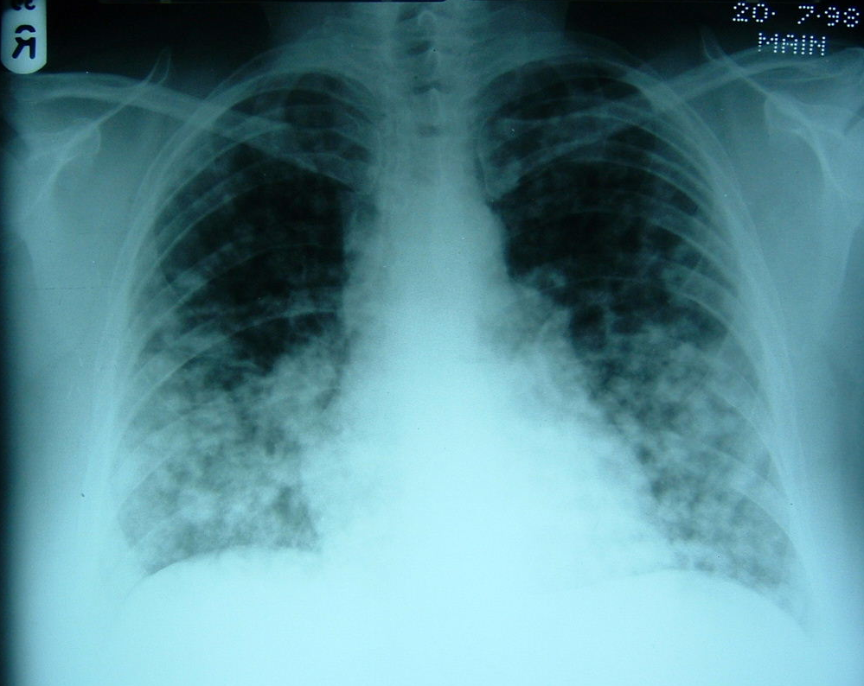
Age 50 female, shortness of breath, previous breast surgery

Slide 34
Multiple pulmonary metastases
Multiple pulmonary nodules >5mm
Surgical clips right axilla

Slide 35
Pulmonary nodules >5mm
Common
metastases – breast, testis, GIT, kidney, thyroid
Rare
inflammatory nodules – RA, Wegeners granulomatosis

Slide 36
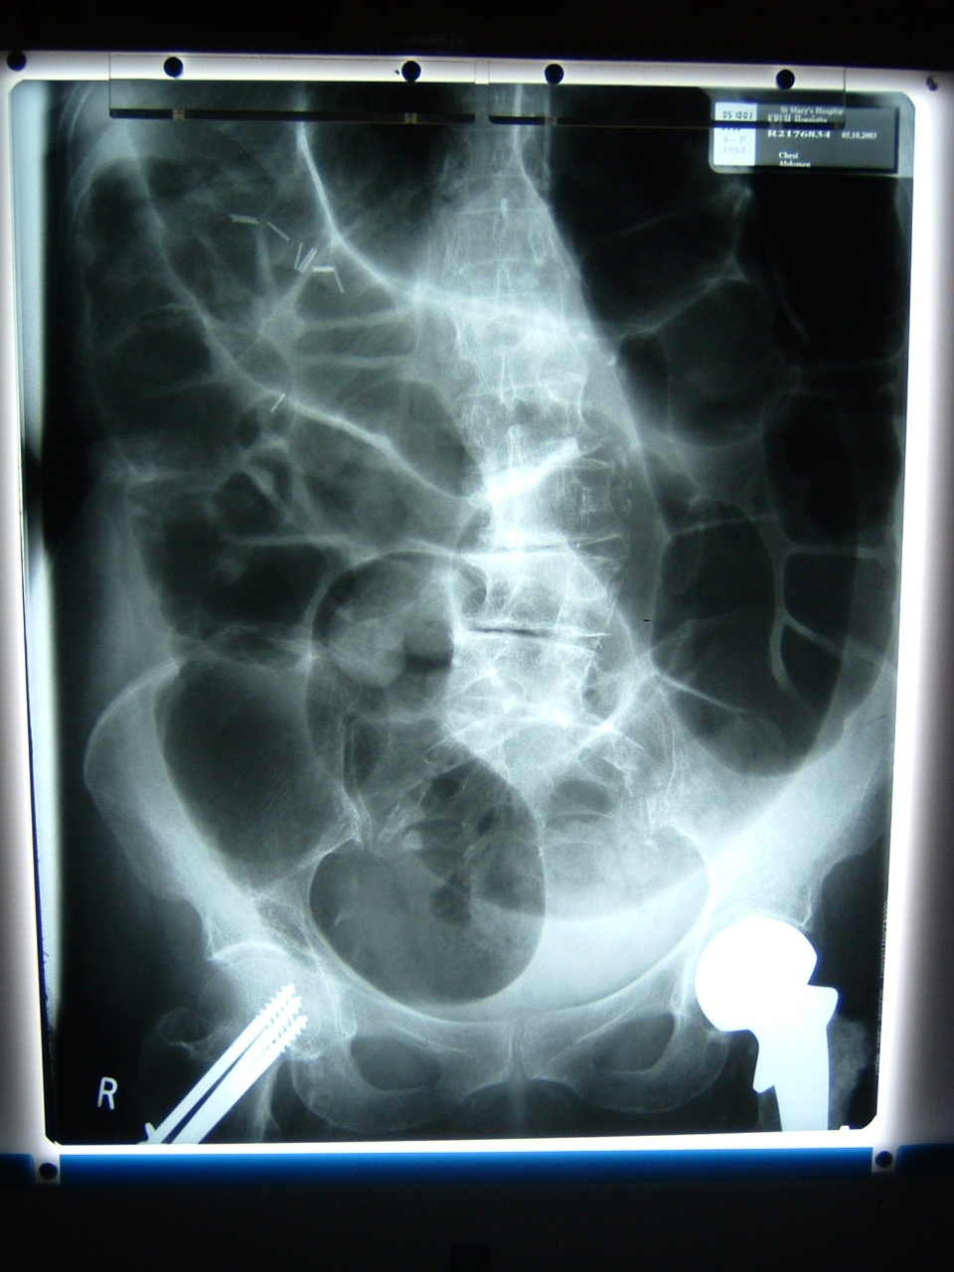
Age 75 female, constipation

Slide 37
Large bowel obstruction
Peripheral dilated bowel loops
Haustrae (do not cross whole diameter of colon)
Causes
Carcinoma LB
Inflammatory mass eg IBD, diverticular mass
Extrinsic – eg volvulus

Slide 38
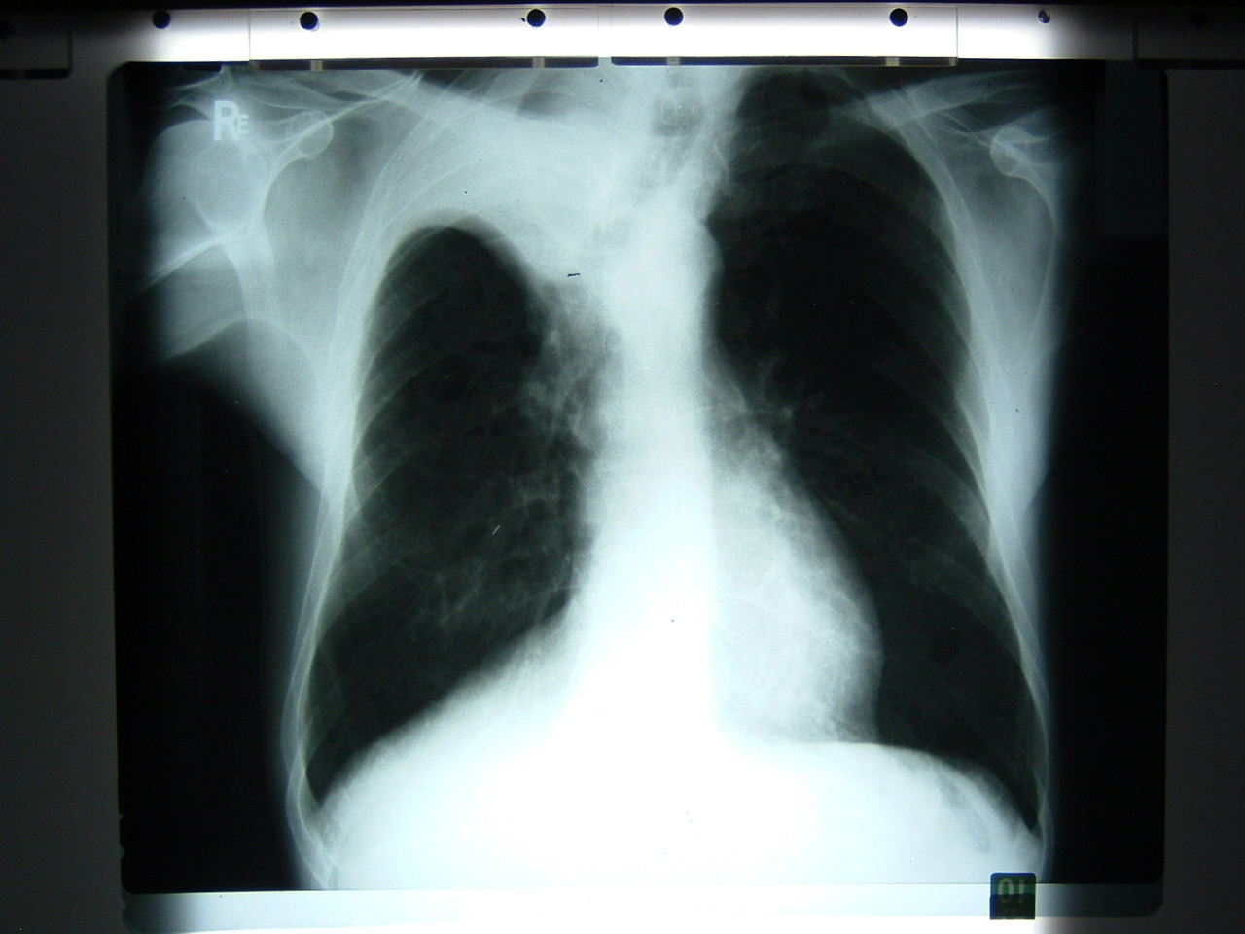
Age 72 male, cough and haemoptysis

Slide 39
Right upper lobe collapse
Right upper lobe opacification
Right loss of volume (tracheal deviation)
Horizontal fissure pulled up
may be due to proximal obstruction- right hilar mass

Slide 40
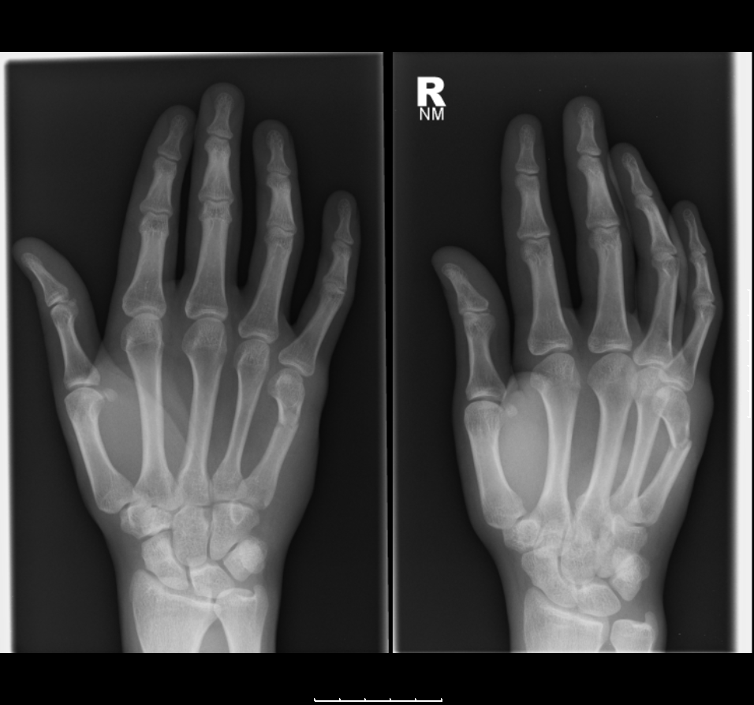
21 years, male, swollen hand

Slide 41
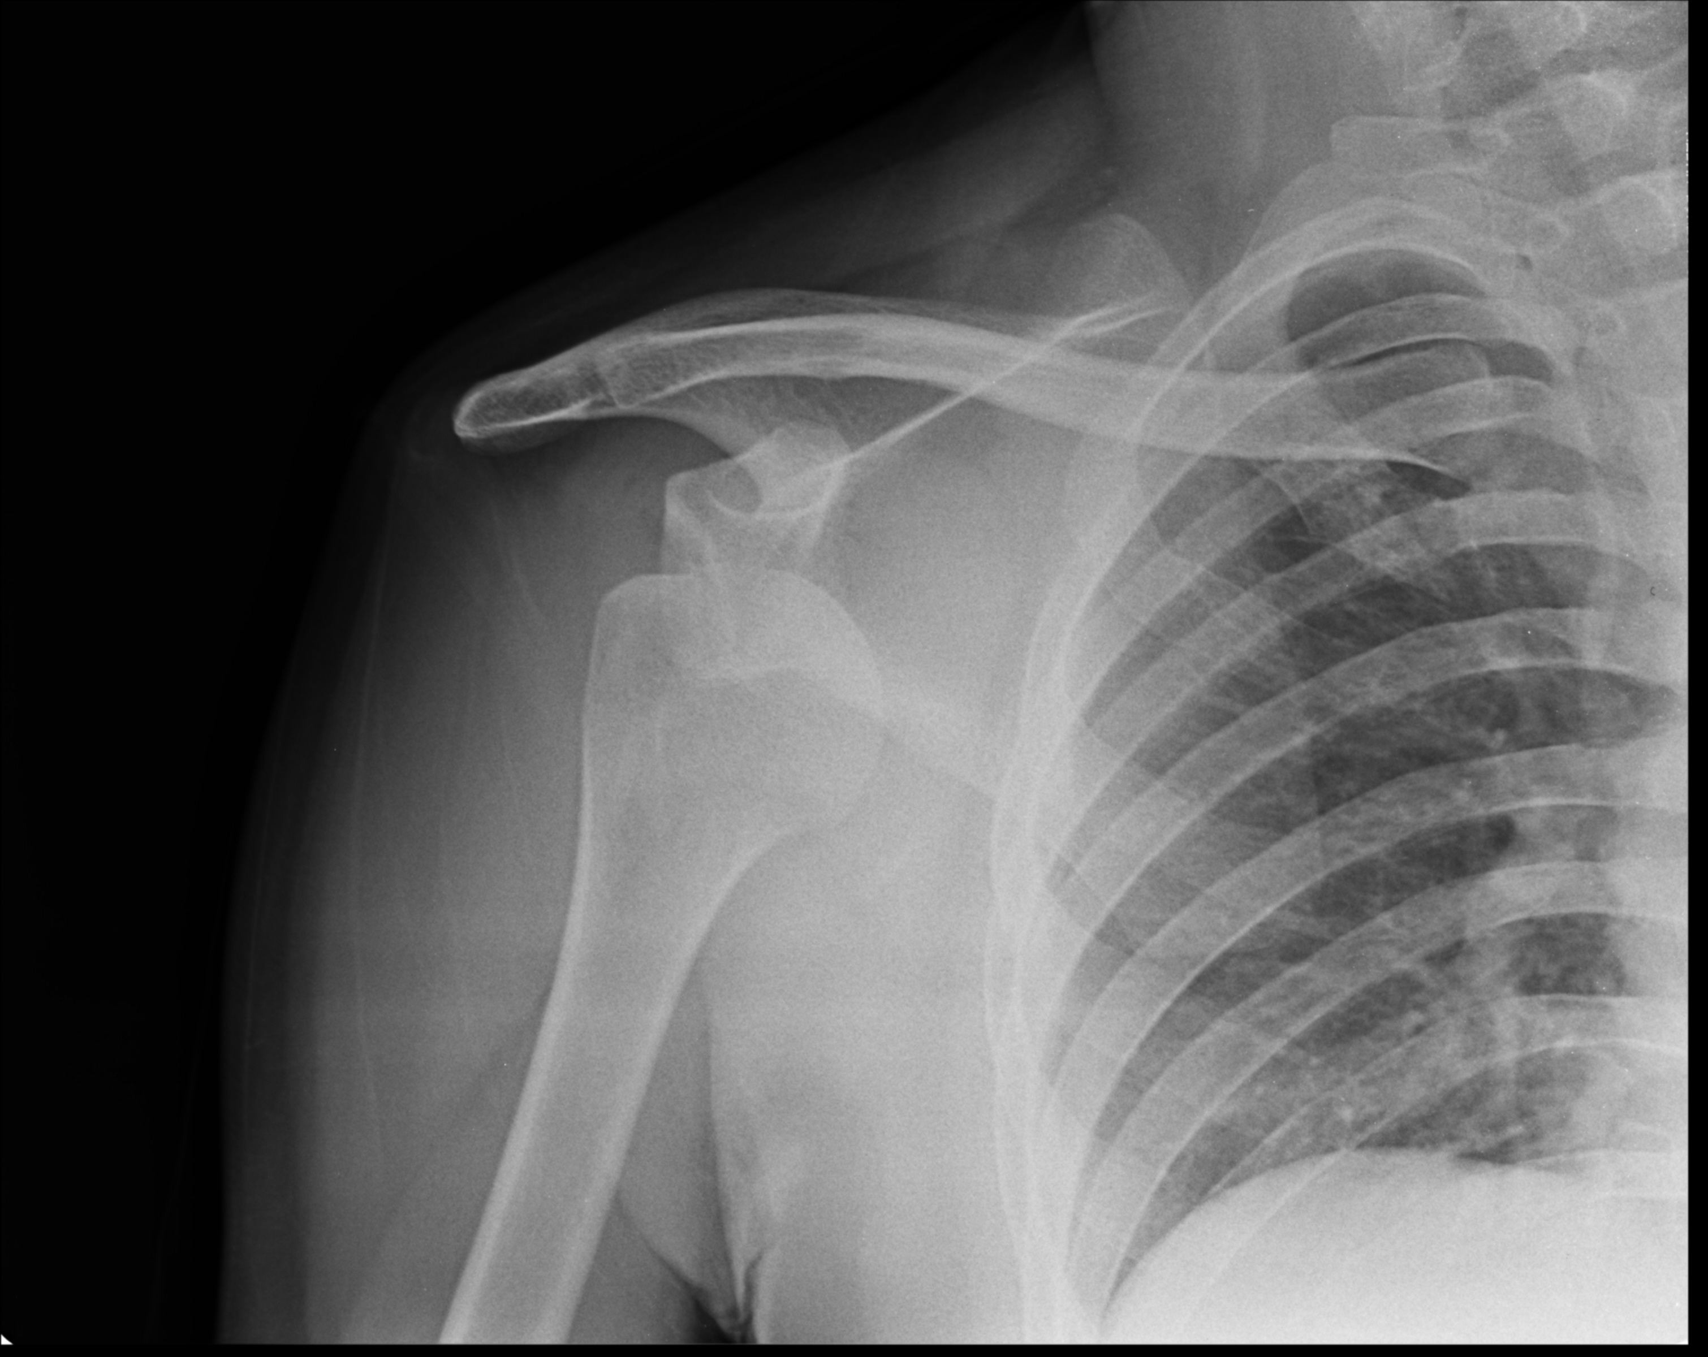

Slide 42
