Slide 1
Orthopaedics for finals Part 1
Mr Harry Krishnan
MRCS, MBBS, BSc (Hons)
Core Surgical Trainee
St Mary’s Hospital
London

Slide 2
Classification of fractures
Nature of injury
Energy involved
Universal communication
Planning treatment
Monitor treatment modalities and outcomes

Slide 3
General classification
Open or closed #
Intra articular / extra articular
Displaced/ undisplaced
Transverse # ( perpendicular to long axis of bone or oblique angle of < 30 degrees)
Oblique # (oblique angle >30 degrees)
Spiral # (line of # curves around the bone)
Comminuted # (>2 fragments)
Segmental #
Pathological #
Hairline/ avulsion #/ fatigue #

Slide 4
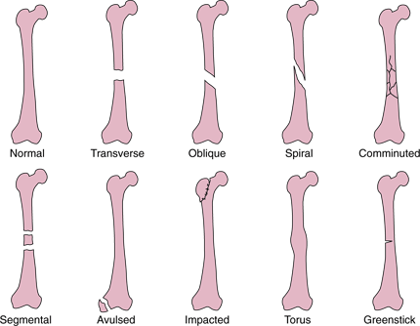
OTA Classification

Slide 5
Describing fractures
Clinically : limb/ bone/ clinical deformity/ open or closed
Radiographs: bone (right or left)
location in bone (proximal/middle/distal third)
pattern
displaced/ undisplaced angulation/ tilt
shortening
intra/ extra articular

Slide 6
Description of fractures
Displacement: cortical contact – is present if the ends of bone have shifted relative to one another
Displacement described in terms of distal fragment

Slide 7
Displacement
Undisplaced 50% displaced 100% displaced

Slide 8
Description of fractures
Angulation: described in terms of point of angle of the fracture (or the apex) classically.
You will not fail finals for describing angulation of the distal fragment
Tilt : direction of distal fragment

Slide 9
Angulation/ tilt
Medial apex angulation Volar apex angulation/
Lateral tilt
dorsal
volar
lateral
medial
It would be ok to say lateral angulation of the distal fragment
It would be ok to say dorsal angulation of the distal fragment

Slide 10
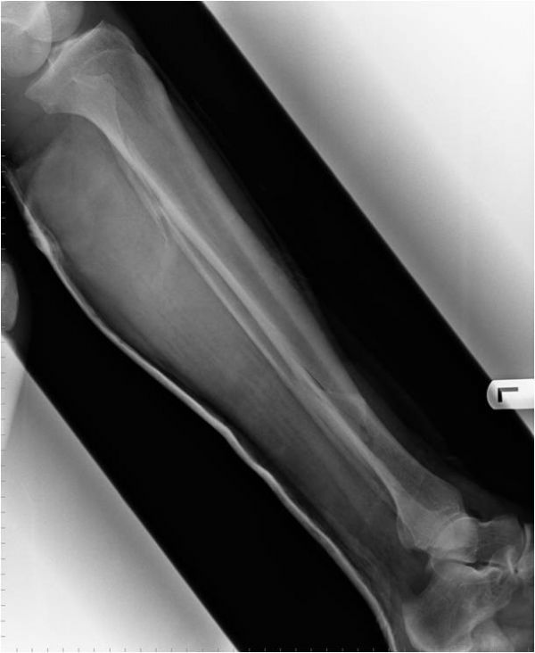
Present this X ray

Slide 11
Summary of #
Spiral # distal third left tibia
50% lateral displacement
Lateral apex angulation of #
Medial tilt of distal fragment
Or
Medial angulation or varus angulation of distal fragment
Short
Medial
Lateral

Slide 12
Treatment of fractures
4 R ‘ s
Open fracture
# NOF
Colles #
Salter-Harris #

Slide 13
4 Rs
Resuscitate - ATLS
Reduce – Open / Closed
Restrict – Collar and cuff, braces, Plaster, Percutaneous k wires, internal fixation, external fixation
Rehabilitate – MDT (Physio/ OT/ Social services)

Slide 14
Restriction

Slide 15
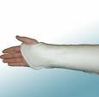
Restriction
Plaster

Slide 16
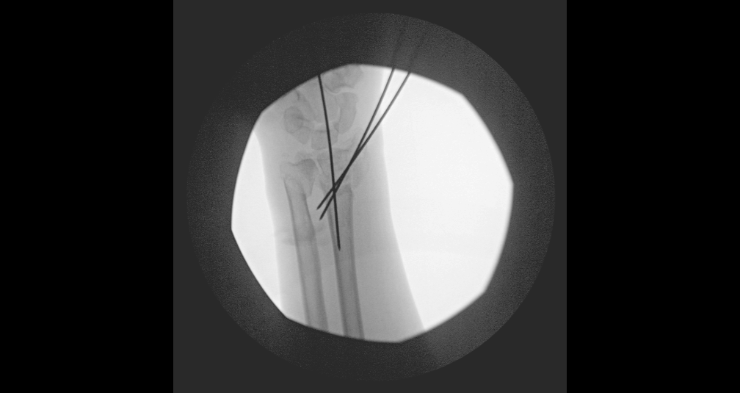
Restriction
K wires

Slide 17
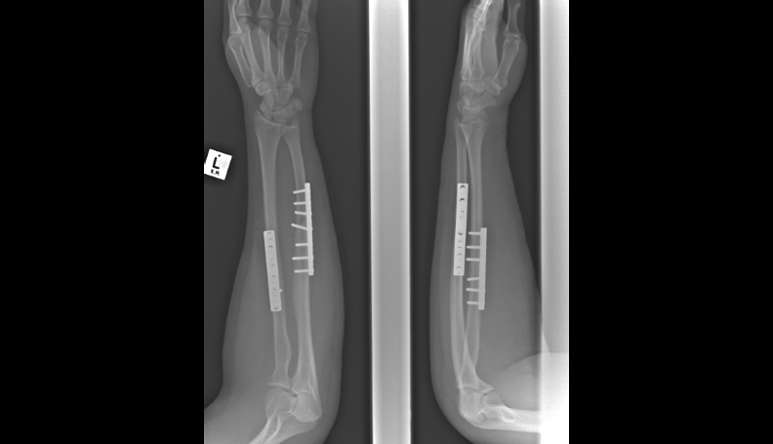
Restriction
Internal fixation – plates and screws

Slide 18
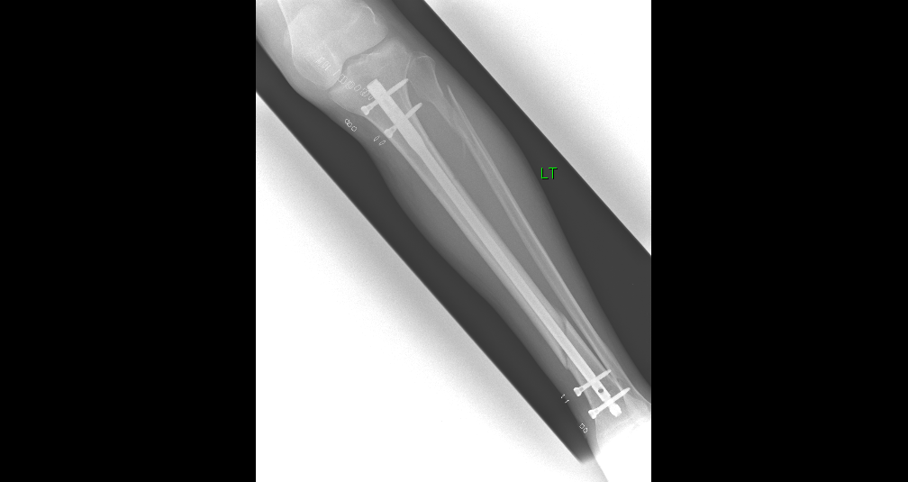
Restriction
Internal fixation – intramedullary nail

Slide 19
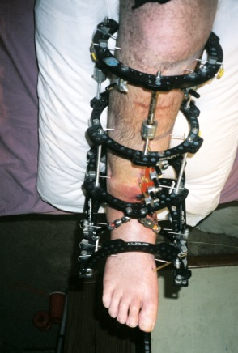
Restriction
External fixation

Slide 20
Complications of fractures
Immediate: Neurovascular injury
Soft tissue injury
Early: Compartment syndrome
Fracture blisters
Infection
Embolus (fat/ DVT/ PE)
Late: Delayed/ mal/ non union
Post traumatic osteoarthritis
Complex regional pain syndrome
Growth arrest, Deformity, Joint stiffness, Myositis ossificans
Chronic infection

Slide 21
Classification of hip fractures
Intracapsular – undisplaced
displaced
Extracapsular

Slide 23
Management
Resuscitate appropriately (ATLS). Hx/ Ex
Assess neurovascular status of limb
Analgesia
iv access – fbc/ u+e/clotting/ group and save
ECG
AP pelvis/ lateral hip/ Chest X ray
Admit
DVT prophylaxis
Inform senior
Not clear on X Ray – MRI pelvis

Slide 24
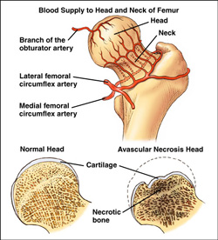
Intracapsular NOF#
Main concern is risk of disruption of blood supply to the femoral head and subsequent avascular necrosis.
Undisplaced: Blood supply ok
Displaced: Blood supply potentially disrupted

Slide 25
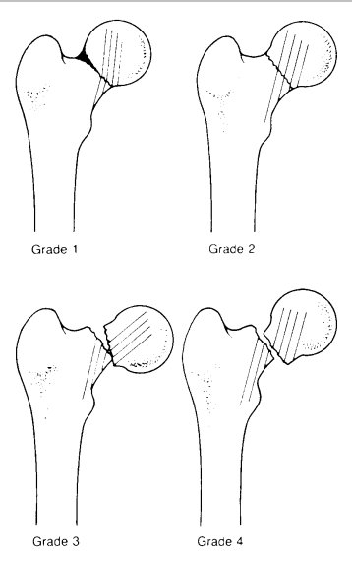
Garden classification

Slide 26
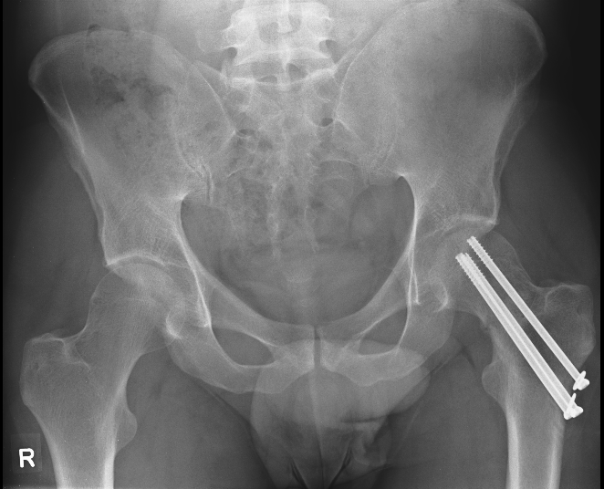
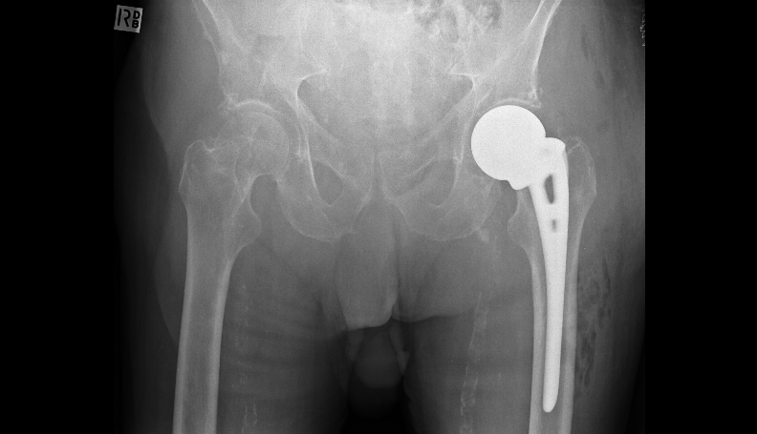
Surgical management
One - two screw
Three – four Austin Moore

Slide 27
Surgical management
Displaced NOF#
< 55 Reduce and fix (screws/DHS)
55-75 Total hip replacement
75+ Hemiarthoplasty (walker - cemented Thompsons, non – mobiliser/serious co-morbidities uncemented Austin Moore)

Slide 28
Complications- Displaced NOF#
Internal fixation – AVN 15 -33%
Non-union 10 -30%
Reoperation 10 -30%
THR- Dislocation (10%).
Hemiarthroplasty – Dislocation
Anterior thigh pain (A-M uncemented prosthesis)

Slide 29
Quiz
76 year old female. Hypertensive. Independent. Still exercises.

Slide 30
Quiz

Slide 31
Quiz
Diagnosis
Initial management
Definitive treatment

Slide 32
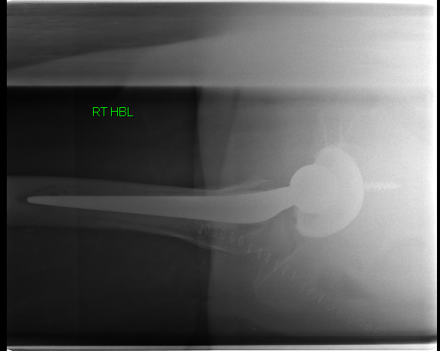
THR

Slide 33
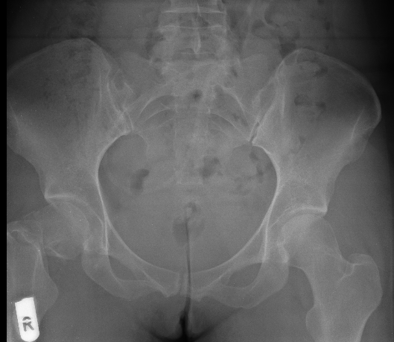
Quiz
36 year old female. Fall. Fit and well.

Slide 34
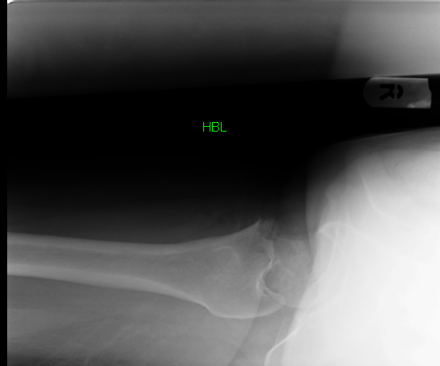
Quiz

Slide 35
Quiz
Diagnosis
Initial management
Definitive treatment

Slide 36
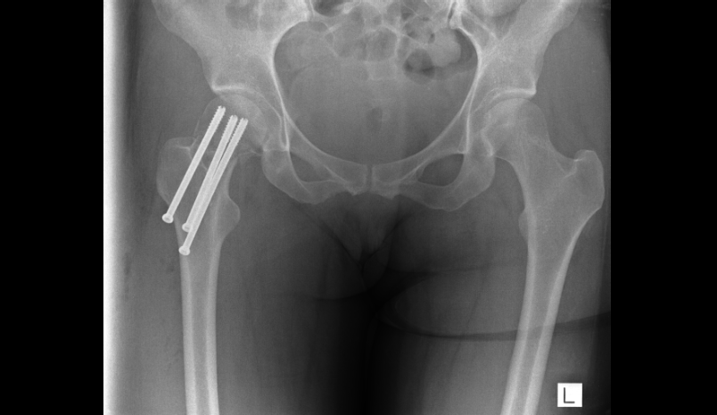
Cannulated screw fixation

Slide 37
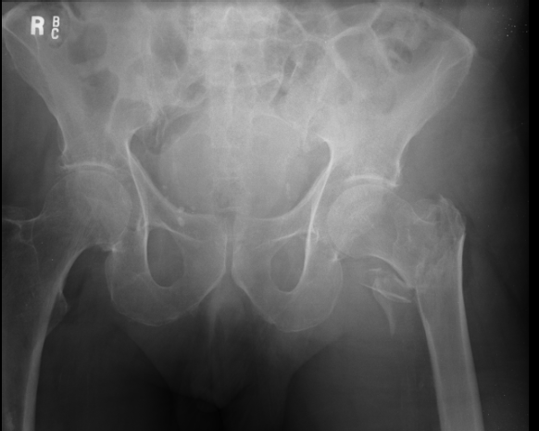
Quiz
93 years. Previous CVA. Arteriopath.

Slide 38
Quiz

Slide 39
Quiz
Diagnosis
Initial management
Definitive treatment.

Slide 40
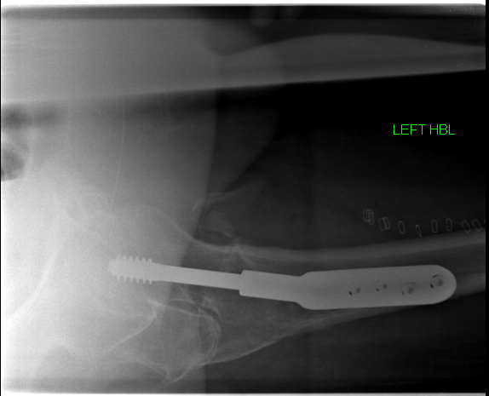
DHS

Slide 41
Salter Harris classification
#’s occurring in the skeletally immature around the growth plate
Salter Harris classified I – V
I: # through the physis
II:# through physis and metaphysis
III: # through physis and epiphysis
IV: # through metaphysis/ physis/ epiphysis
V: Crush injury to the growth plate

Slide 42
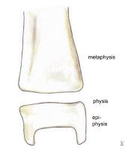
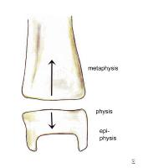
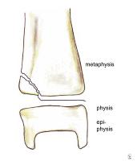
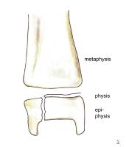
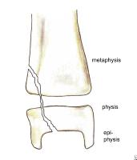
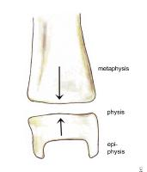
Salter Harris classification
I
II
III
IV
V

Slide 43
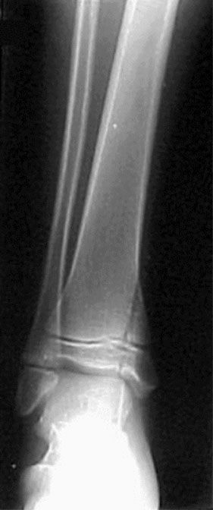
Salter-Harris classification
Salter Harris IV

Slide 44
Salter-Harris classification
I-V indicates higher risk of growth plate injury
III and IV require anatomic reduction
V often diagnosed retrospectively – ie no obvious # initially seen and patient develops subsequent growth arrest in limb

Slide 45
Acute fractures
Periarticular fractures
Open fractures
Significant soft tissue injury
Bone loss
Polytrauma
Open book pelvic fractures

Slide 46
Complications
Neurovascular injury
Soft tissue injury
Pin site infection
Loosening of pins
Septic arthritis (if periarticular ex fix)
Osteomyelitis
Patient non-compliance

Slide 47
Colles fracture
Extra articular # of the distal radius within 2.5 cm of the wrist joint with dorsal and radial displacement
Clinically dinner fork deformity

Slide 48
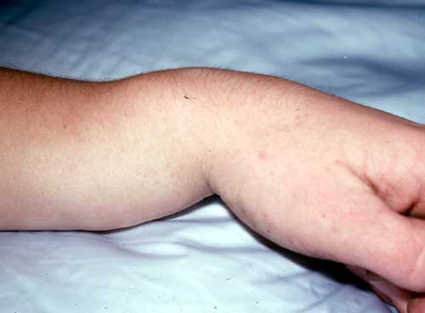
Colles fracture

Slide 49
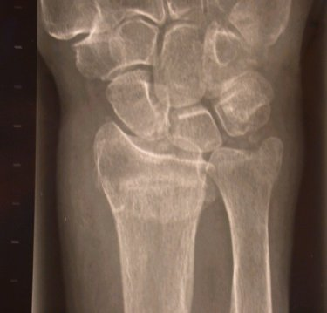
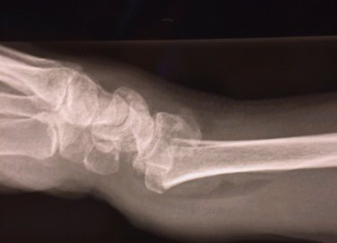
Colles fracture X ray
Loss of radial height (>5mm)
Loss of radial inclination (Normal 20-25 degrees )
Dorsal tilt (Normal 10 degrees volar)
Radial width
Comminution
Ulnar styloid fracture

Slide 50
Colles fracture
Reduction: haematoma block/ midazolam
3 people
Counter traction
In line traction
Disimpact #
Over exaggerate injury
Ulnar + volar deviation

Slide 51
Colles fracture
Apply dorsal backslab
Assess neurovascular status pre and post reduction
Repeat x ray
Satisfactory position?
No- ortho review – Consider MUA and K wires
Yes- home c #clinic r/v next 48 hours for completion of POP.
Review at 1 and 2/52 with X ray to ensure no displacement and POP for a total of 6/52 (follow up same for non-op and operative)

Slide 52
Smith’s fracture
Extra-articular distal radius with volar displacement
Inherently unstable (v Colles)
Closed reduction and POP
High risk of displacement in plaster
Lower threshold for ORIF (open reduction and internal fixation) with volar plate.

Slide 53
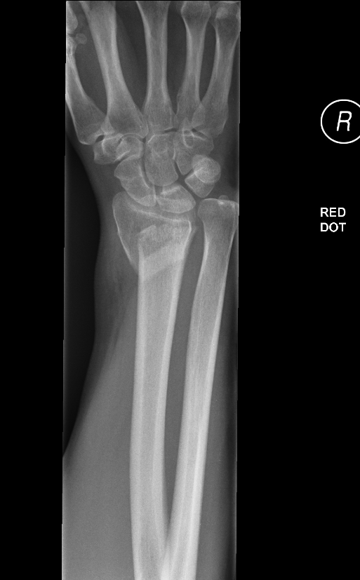
Smith’s fracture- X Ray

Slide 54
Bartons fractures
Distal radial # intraarticular
Dorsal Barton’s
Volar Bartons

Slide 55
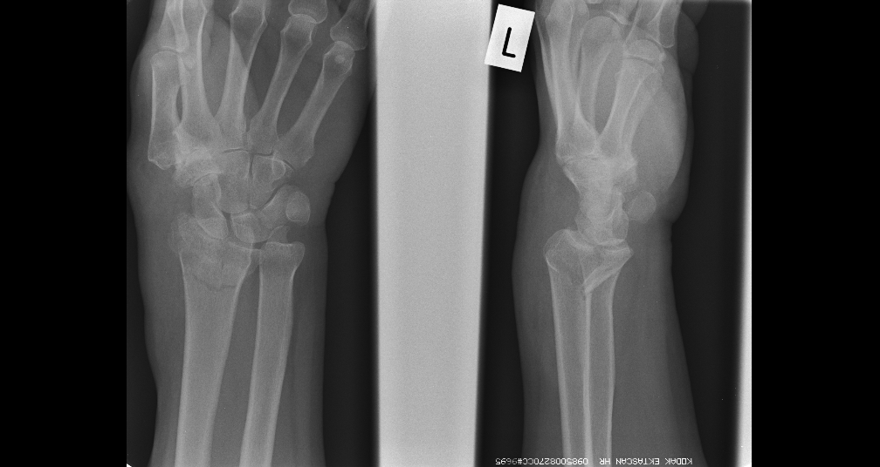
Bartons fractures- X rays
Volar Barton’s

Slide 56
Post ORIF Volar Barton’s

Slide 57
Ankle fractures
Classification
Anatomical – uni/ bi/ tri malleolar
Weber – Relation of fibula # to joint line
A: Below joint line
B: Level of joint line
C: Above level of joint line

Slide 58
Ankle fractures
Relevance of Weber B and C # is they
represent possible injury to the
syndesmotic ligaments between the tibia
and fibula and thus potential instability

Slide 59
Ankle fractures – Uni malleolar

Slide 60
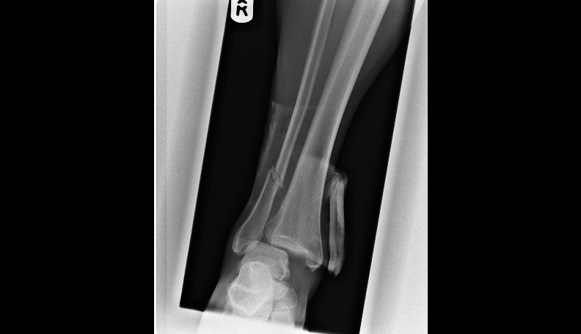
Ankle fractures – Weber C

Slide 61
Ankle fractures- Weber C

Slide 62
Treatment
Resuscitate
Reduce
Restrict
Rehabilitate

Slide 63
Treatment
Weber A: Non-operative. Boot or below knee POP 4-6/52 Weightbearing
Undisplaced Weber B/C: Non-operative. Below knee POP 6/52 Non-weightbearing (NWB)
Displaced Weber B/C:
Non-operative – closed reduction and POP if anatomical reduction achieved
Operative if closed reduction fails – ORIF( open reduction and internal fixation)
Below knee POP 6/52 (NWB)

Slide 64
Scaphoid fractures
Major source of medico-legal claims
Always suspect scaphoid fracture following fall onto hand
Look for tenderness in anatomical snuffbox
Document presence/ absence of scaphoid tenderness

Slide 65
Scaphoid fractures
X rays: scaphoid views
A normal x ray does not exclude a scaphoid #
If clinically tender treat for scaphoid #
Backslab and # clinic review next 48 hours for completion of cast.
Re X ray at 2 weeks or urgent CT/MRI

Slide 66
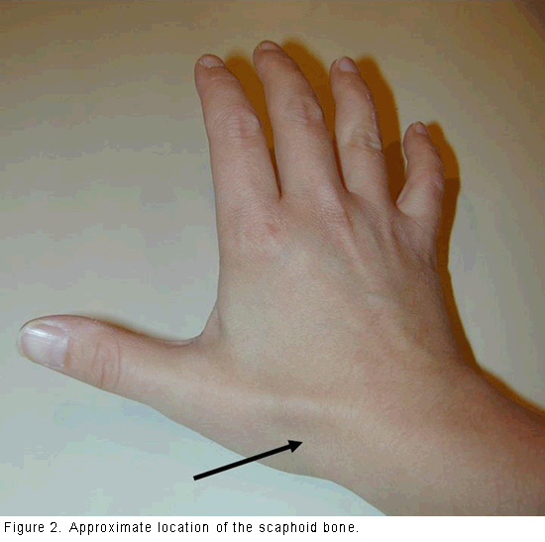
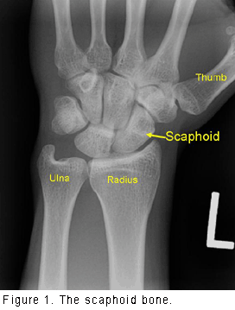
Scaphoid fractures

Slide 67
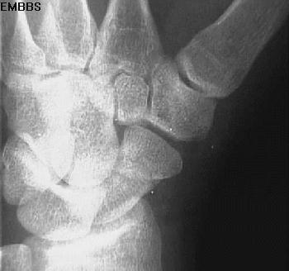
Scaphoid fractures

Slide 68
Treatment
Concerned about non-union and avascular necrosis with displaced scaphoid fractures
Undisplaced – Colles/ Scaphoid POP 6-8/52
Displaced – ORIF with screw.

Slide 69
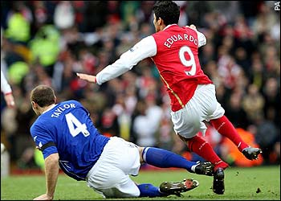
Open fractures

Slide 70
Open fractures
ATLS primary and secondary survey
Analgesia
Assess NV status of limb
Antibiotics
Anti tetanus
An image (photo)
Antiseptic dressing
An X ray
Ask for help
Theatre – wound debridement and skeletal stabilisation

Slide 71
Indications for external fixation
Temporary treatment of acute fracture
Definitive treatment of acute fracture
Complications of fractures
Deformity correction (congenital/acquired)

Slide 72
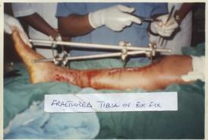
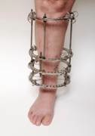
Types of external fixator
Monolateral
Circular

Slide 73
Compartment syndrome
Limbs are divided into osteofascial compartments by thick fascial bands
A condition where the pressure within an enclosed anatomical compartment rises sufficiently to obstruct the micro-vascular circulation causing tissue ischemia and, if left untreated, necrosis

Slide 74
Aetiology
Severe trauma (>85%) usually associated with fractures, dislocations or crush injuries. Can occur in both open and closed injuries.
Externally applied pressure (dressings, POP etc)
Muscle trauma
Vascular injury and reperfusion injury
Prolonged increase in exercise intensity (e.g. military recruits)

Slide 75
Diagnosis
Clinical features
Pain - most important. Especially pain out of proportion to the injury
The 6 p’s of an acutely ischaemic limb appear very late and we should not wait for these (except pain)

Slide 76
Signs
Most reliable signs are
Pain on passive stretching of the involved compartment
Pain on palpation of the involved compartment and
Sensory deficit in the distribution of any sensory nerve traversing the involved compartment.

Slide 77
Diagnosis
Clinical
Pressure monitoring
If clinically high suspicion of compartment syndrome don’t delay treatment to measure intracompartmental pressure.

Slide 78
Treatment
Release external pressure – split plaster and underlying bandaging to skin
Elevate leg to level of heart
DO NOT worry about losing the reduction, amputation would be a far worse complication
If no rapid relief – ASK FOR HELP
Need fasciotomy in theatre

Slide 79
Septic arthritis
Infected joint
Presentation: Painful, hot swollen, joint. Unable to move. Unwell. Fevers.
Recent history of concurrent infection, local trauma
Co-morbidities: Diabetes.
Drugs: Imunosuppressed.

Slide 80
Septic arthritis
FBC/ CRP/ ESR/ Blood cultures
Can aspirate joint if superficial landmarks
(knee/ shoulder/ ankle)
U/S guided hip
Send for urgent gram stain as well as
MC and S
Ultimately needs washout (open/ arthroscopic)

Slide 81
Septic arthritis
At washout send fluid/ tissue for MC+S
Discuss with microbiology

Slide 90
Questions ?

