Slide 1
Epidemiology in the clinic
Helen Ward
Professor of Public Health
27 July 2012
h.ward@imperial.ac.uk

Slide 2
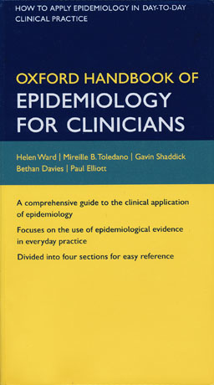




Epidemiology in the clinic
Helen Ward
Professor of Public Health
27 July 2012
h.ward@imperial.ac.uk

Slide 3
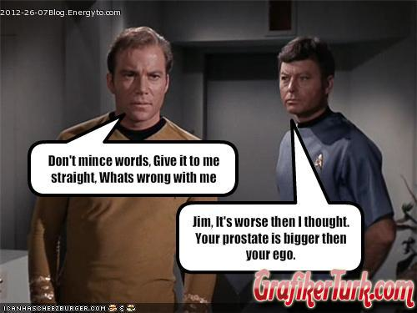
Outline of session
What’s wrong with me, doctor?
What treatment should I take?
What does the future hold?
Why did it happen to me?

Slide 4
Learning objectives
To reflect upon the use of evidence in the diagnostic process, in refining a differential diagnosis using appropriate evidence
To revise the use of evidence in relation to the management of patients
To consider the importance of discussing uncertainty with patients
To recognise that prevention is a key part of care

Slide 5
The diagnostic process

Slide 6

What’s wrong with me, doctor?

Slide 7
What’s wrong with me, doctor?
A 65 year old man consults his GP with chest pain
What is the aim of the diagnostic process?

Slide 8
Objective of diagnostic process
Pain caused by myocardial ischaemia in impending infarction must be differentiated from non-ischaemic chest pain (or other acute causes)
i.e.
To help the patient decide what to do

Slide 9
Exam approach to differential diagnosis
Myocardial infarction
Angina
Pulmonary embolism
Pneumothorax
Aortic Dissection
Reflux oesophagitis
Broken ribs
Shingles
Pericarditis
Pleuritis
Costochondral pain
Early herpes zoster
Ectopic beats
Peptic ulcer
Cholecystitis
Pancreatitis
Depression
etc…
www.guideline.gov

Slide 10

Exam approach to differential diagnosis
Myocardial infarction
Angina
Pulmonary embolism
Pneumothorax
Aortic Dissection
Reflux oesophagitis
Broken ribs
Shingles
Pericarditis
Pleuritis
Costochondral pain
Early herpes zoster
Ectopic beats
Peptic ulcer
Cholecystitis
Pancreatitis
Depression
……
www.guideline.gov

Slide 11
Or in alphabetical order:
Angina
Aortic Dissection
Broken ribs
Cholecystitis
Costochondral pain
Depression
Early herpes zoster
Ectopic beats
Myocardial infarction
Pancreatitis
Peptic ulcer
Pericarditis
Pleuritis
Pneumothorax
Pulmonary embolism
Reflux oesophagitis
Shingles
…..

Slide 12
Not in real life
Use your knowledge to refine the diagnosis
Assess probabilities
  Male, 65 (gender and increasing age are risks for IHD)
  Walked into surgery
  No history of heart disease

Slide 13
Narrowing the differential
Clinical history taking should be a process of narrowing the differential diagnosis
To do this well, need to know
  How common conditions are in your population
  Clinical features (eg type of pain, duration, etc)
  Risk factors
This knowledge focuses the history

Slide 14
What is going on in the diagnostic process?
You estimate a probability that your patient has a disease
  based on epidemiology, presentation etc
That is the “pre-test probability”
  “Test” can be a diagnostic test or a particular symptom or sign that you elicit
You then increase or decrease that probability based on your findings/ test result
This then produces a “post-test probability”

Slide 15
For this patient
What is his pre-test probability of IHD?
Need evidence from epidemiological studies
  Incidence in men (cohort studies)
  Relative risk with increased age
  Relative risk of smoking (cohort or case control)

Slide 16
Pre-test probabilities*
Age
30 to 39
40 to 49
50 to 59
60 to 69
Asymptomatic (0 symptoms)
2%
6%
10%
12%
Non-anginal chest pain (1 symptom)
5%
14%
22%
28%
Atypical angina (2 symptoms)
22%
46%
59%
67%
Typical angina (All 3 symptoms)
70%
87%
92%
94%
*Men: probability of ≥50% coronary artery stenosis in at least one major artery

Slide 17
Next steps
Establish pre-test probability
Carry out an investigation
Use likelihood ratio to produce a post-test probability

Slide 18
Likelihood ratio
The likelihood ratio is a characteristic of diagnosis-related information, whether it be a test or a finding from the history or physical examination. It is expressed as follows:
Likelihood ratio =
p [test result if disease present]
p [test result if disease absent]

Slide 19
Formulae for LR
A likelihood ratio is a measure of how much the test result alters your estimate of the probability of disease
Likeihood ratio for a positive test
LR+ =
sensitivity
1 - specificity
Likelihood ratio for a negative test
LR- =
1 - sensitivity
specificity

Slide 20
How to calculate post-test probability
Calculated using odds
Convert pre-test probability to odds
  odds = probability /(1 - probability)
Then
  post-test odds = pre-test odds x LR
Convert post-test odds back to a probability
  probability = odds/(odds +1)

Slide 21
Chest pain
Atypical angina in 65 year old, probability of having IHD is 65%
Carry out an exercise ECG, it is positive
Pre-test probability = 0.65
  Pre-test odds = 1.85 i.e. 0.65/(1-0.65)
LR+ = 2.03
Post-test odds = 1.85 x 2.03 = 3.76
  Post-test probability = 0.79 i.e. 3.76/ (1+ 3.76)

Slide 22
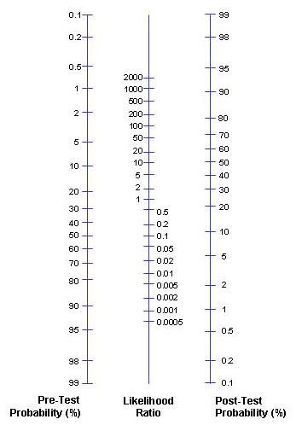
Use a Fagan normogram to convert pre- to post- test probabilities
Pre-test p = 65%
LR+ = 2
Post-test p= 79%
Pre-test p = 65%
If negative, LR- is 0.56
Post-test p= 51%

Slide 23
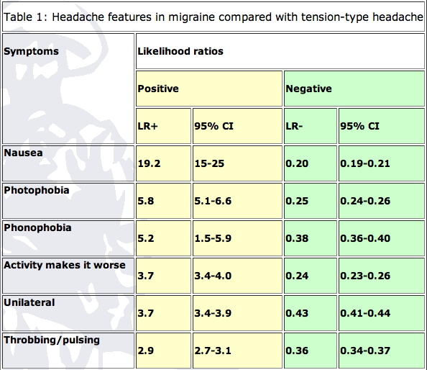
Likelihood ratios: migraine
http://www.medicine.ox.ac.uk/bandolier/booth/Migraine/Diagmig.html

Slide 24
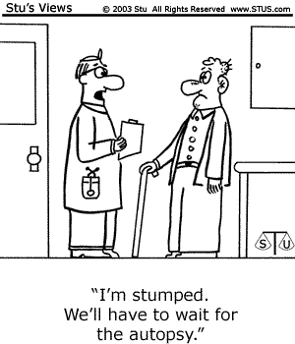
Any questions?

Slide 25
Example from sexual health clinic
28 year old woman, lower abdominal pain, 2 days
Practitioner went into “pain history” mode
  Describe the pain
  What brings it on
  What relieves it
  Have you had it before
  Does it spread anywhere else…etc
One additional question (perhaps two) could have saved him about 5 minutes (she did not speak English very well)
  Any burning when you pee?

Slide 26
What evidence is being used?
Knowledge of how common the condition is in patients like mine (young women)
  Incidence of acute UTI is 0.6 per person year
  Period prevalence: In a survey of 2000 American women (>18), 10.8% had at least one UTI in the past year
  Lifetime risk 50%

Slide 27
What evidence is being used? (2)
Knowledge of the risk factors
  Sexual activity (recent onset, frequent)
  Use of diaphragm
  Use of spermicides
  Family history (for recurrent UTI)
Knowledge of the symptoms
  dysuria, urinary frequency, nocturia, urgency, voiding of small volumes, incontinence, suprapubic or pelvic pain, haematuria, cloudy smelly urine

Slide 28
Clinical predictors of a UTI
 | Positive Likelihood ratio | Negative Likelihood ratio
Self diagnosis | 4.0 | 0
Haematuria | 2.0 | 0.9
Frequency | 1.8 | 0.6
Dysuria | 1.5 | 0.5
Lower abdo pain | 1.1 | 0.9
Bent S, et al. JAMA. 2002;287:2705-2706

Slide 29
Combination of symptoms
Combination of symptoms increased LR further
  Women with dysuria and frequency, but without vaginal discharge or irritation: LR = 24.6

Slide 30
Importance of communication
Identifying risk factors
  Relevance
  Be sensitive
  Non-judgemental
Discussing uncertainty
  Be precise
  Acknowledge when you don’t know – offer to find out
  Follow-up on promises
  Listen

Slide 31
Your 45 year old patient has a mammogram
Report: "suspicious for malignancy”
  Patient: “Does this mean I have cancer?”
  You: "No, we have to do further testing."
  Patient: "OK, I understand that the mammogram isn’t the final answer, but given what we know now, what are the chances that I have breast cancer?".
  You: “let me think about that…”

Slide 32
What do you need to know?
Assume
  the overall risk of breast cancer in any 45 year old woman, regardless of mammogram result, is 1%
  Assume that mammography
    90% sensitive
    95% specific
What is her risk?

Slide 33
Use the LR model
Pre-test probability = 1%
Pre-test odds = 0.01/(1 – 0.01) = 0.01
She has a positive test (mammogram)
Likelihood ratio + test = sensitivity
1 – specificity
= 0.9
1 – 0.95
= 18
Post-test odds = 0.01 x 18 = 0.18
Post-test probability = 0.18/(0.18+1) = 15%

Slide 34
What does all this mean for you?
How to apply in your practice
Use the knowledge you already have
If you don’t know, try to find out (clearly defined questions relating to a clinical question)
Challenge (cautiously!) whether “received wisdom” is evidence-based
Use available evidence

Slide 35
Management decisions

Slide 36
What treatment should I have?
Evidence based medicine
Patient-centred care
Patients should be involved in decisions about their care
They have to be informed
You need to understand the evidence

Slide 37
Evidence based medicine: definition
“Evidence-based medicine is the conscientious, explicit and judicious use of current best evidence in making decisions about the care of individual patients. The practice of evidence-based medicine means integrating individual clinical expertise with the best available external clinical evidence from systematic research.”
Sackett et al. BMJ 1996; 312: 71-2

Slide 38
Five steps of evidence based practice
Question: translation of clinical uncertainty into an answerable question
Search: Systematic retrieval of best evidence
Appraise: critical appraisal of evidence for validity, clinical relevance and applicability
Apply: application of results in practice
Evaluate: evaluation process and impact

Slide 39
EBP in real life
Limitations of time
But an excellent way to continue learning and improve patient care
Best done in teams (eg ward rounds)

Slide 40
Finding answers to clinical questions?
Places to look for answers: secondary sources
    Cochrane
    Clinical Evidence
    PubMed especially the Clinical Queries Option
Primary sources
  Literature review – systematic
What about Google or Yahoo etc?
  Excellent search engines
  But ensure quality of source

Slide 41

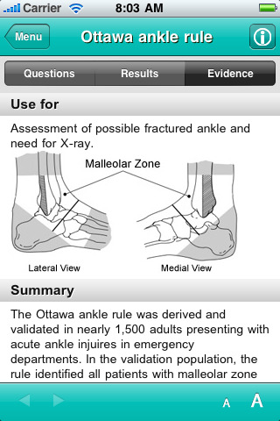

New tools
“I am a med student and this app is totally awesome!
We get taught all these scores and things… but it is hard to remember them. WIth this app you just click on the rule and it… then gives you the results, ie how likely it is that the person has that disease.”

Slide 42
Levels of evidence
Systematic reviews and meta-analyses of randomised controlled trials
Randomised controlled trials
Non-randomised intervention studies
Observational studies
Non-experimental studies
Expert opinion

Slide 43
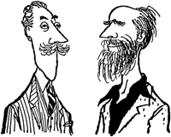
Levels of Evidence for Anecdote-based medicine
Level I: Beardy old gent from royal college
Level II: Doctor with air of credibility and honest face
Level III: Academic with mad stare
Level IV: NHS manager with trust in financial crisis

Slide 44
RCTs
Key evidence for treatment
Need to be critical in reading papers
Assess the quality of the evidence

Slide 45
Interpreting the results of trials
The outcome expressed as
  Relative risk reduction (or hazard ratio, odds ratio)
  Absolute risk reduction
  Number needed to treat

Slide 46
Number needed to treat
In a trial compare results of new treatment with old/none
Calculate absolute risk reduction
  Eg. Mortality after new drug is 20% = 0.2
  Mortality after old drug is 50% = 0.5
  Absolute risk reduction = 0.5-0.2=0.3
NNT is the reciprocal
  NNT = 1/0.3 =3.3
The new treatment will lead to one life saved for every 3 treated
Notes:
Trials with binary end points yield a proportion of patients in each group with the outcome of interest. When the outcome event is an adverse one, the difference between the proportions with the outcome in the new treatment (pN) and standard treatment (pS) groups is called the absolute risk reduction (ARR=pN pS). The number needed to treat is simply the reciprocal of the absolute risk difference, or 1/ARR (or 100/ARR if percentages are used rather than proportions). A large treatment effect, in the absolute scale, leads to a small number needed to treat. A treatment that will lead to one saved life for every 10 patients treated is clearly better than a competing treatment that saves one life for every 50 treated. Note that when there is no treatment effect the absolute risk reduction is zero and the number needed to treat is infinite. As we will see below, this causes problems.

Slide 47
Jupiter trial: Rosuvastatin
18000 people with high C-reactive protein.
Trial stopped after two years follow-up
  highly significant improvement in the primary end point with rosuvastatin (hazard ratio 0.56; 95% confidence interval 0.46 to 0.69; P<0.00001).
HR of 0.56 means there was a 44% reduction in risk in those taking rosuvastatin
Ridker PM et al. N Engl J Med 2008;359:2195-207

Slide 48
Jupiter
Control (placebo) event rate (251 events) = 1.36 per 100 person yrs
Experimental (rosuvastatin) event rate (142) = 0.77 per 100 person yrs
Relative Risk Reduction = CER – EER = 1.36 – 0.77 = 44%
CER 1.36
Absolute Risk Reduction = 0.59 per 100 person years
NNT* = 1/ARR = 169 person years to prevent one vascular event

Slide 49
Meta-analyses: forest plots
show information from individual studies in the meta-analysis
show variation between the studies and overall result

Slide 50
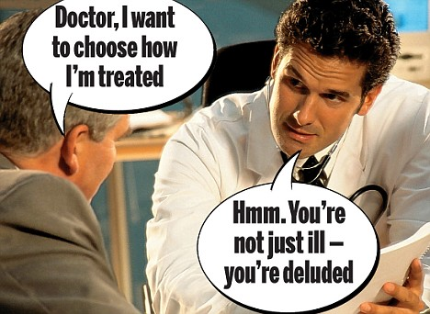
Patient centred care
Medicine traditionally paternalistic
Drive to increase patient autonomy
Requires information and discussion
YOU need to understand evidence

Slide 51
Risk communication and promoting health

Slide 52

Make every contact count
Using clinical contacts to promote health
>90% people see their GP over a 5yr period
Patients often more receptive to messages
Clinician interventions can be effective

Slide 53
How to do it: 3 or 5 As
Advocate (vaccination, screening as appropriate)
Ask (about risks, e.g. smoking, alcohol, diet)
Advise (on reducing risk)
Assist (people get support by referral, prescribing)
Arrange(follow-up)
http://youtu.be/yzWfgjXsgr4

Slide 54
Prevention: not just smoking
Alcohol
Diet
Exercise
Drug use
Sexual Health and HIV
Mental health
Violence (including partner violence)

Slide 55
A plea on HIV
25% of people with HIV are undiagnosed
50% diagnosed late (CD4 <350)
Local prevalence ~0.8%
Most testing still in sexual health clinics and antenatal
Guidelines
  All medical admissions

Slide 56
Study of newly diagnosed HIV at Imperial
515 patients diagnosed 2009-2012
Late diagnosis more likely outside GUM/ANC, OR 3.4 (95%CI 2.1, 5.3)
CD4⁺ cell count at diagnosis | N, (%)
Early (≥350 cells/mm³) | 276 (59.5)
Late (<350 cells/mm³) | 79 (17)
Very Late (< 200 cells/mm³) | 109 (23.5)

Slide 57
Late diagnosis increased with age
CD4⁺ cell count (cells/mm³) and age at time of diagnosis, 95% confidence interval)

Slide 58
Please remember
HIV testing should be routine
No need to extensive pre-test counselling
Offer to
  all routine medical admissions
  New registrants in primary care
  Attenders at A&E having other tests
  Anyone with an indicator illness
Follow-up managed in HIV service

Slide 59
Learning objectives
To reflect upon the use of evidence in the diagnostic process, in refining a differential diagnosis using appropriate evidence
To revise the use of evidence in relation to the management of patients
To consider the importance of discussing uncertainty with patients
To recognise that prevention is a key part of care

