Slide 1
Radiology for medical students - Bones
Trauma – fractures and dislocations

Slide 2
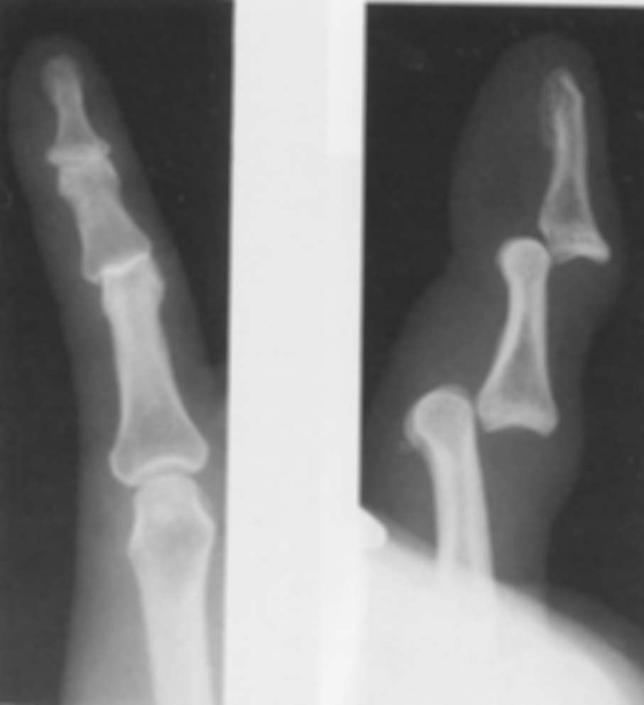
General Orthopaedic Principles
2 views
Angulation
Comminuted
Open/Closed
Neuro-vascular compromise
Other associated fractures/dislocations

Slide 3
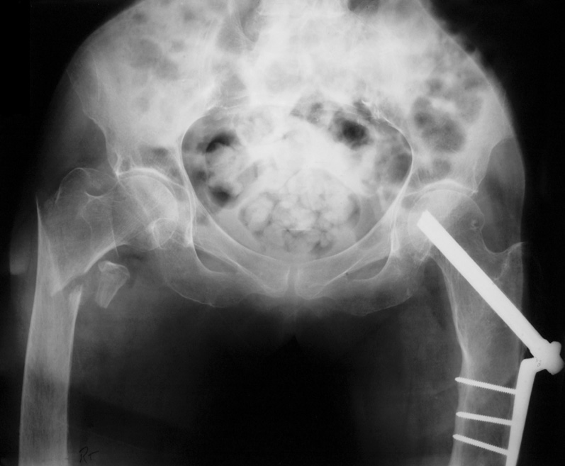
# Neck of Femur
Right inter-trochanteric fracture
Comminuted
Angulated
Vascular compromise?
Old left dynamic hip screw

Slide 4
Common Fractures: Scaphoid
Tender over anatomical snuffbox
High index of clinical suspicion
# may not be visible initially
If X R negative but # strongly suspected, put in cast, re- X R 10/7

Slide 5
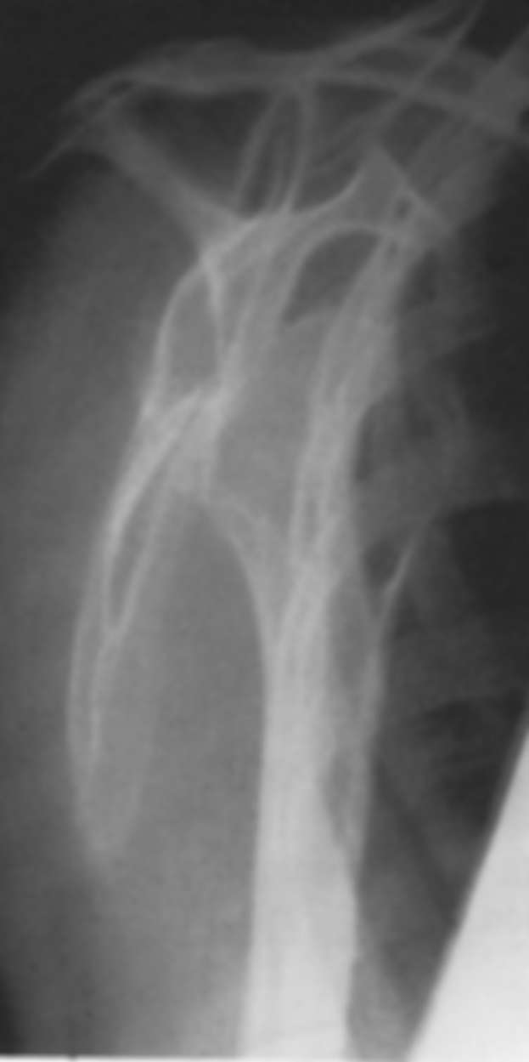
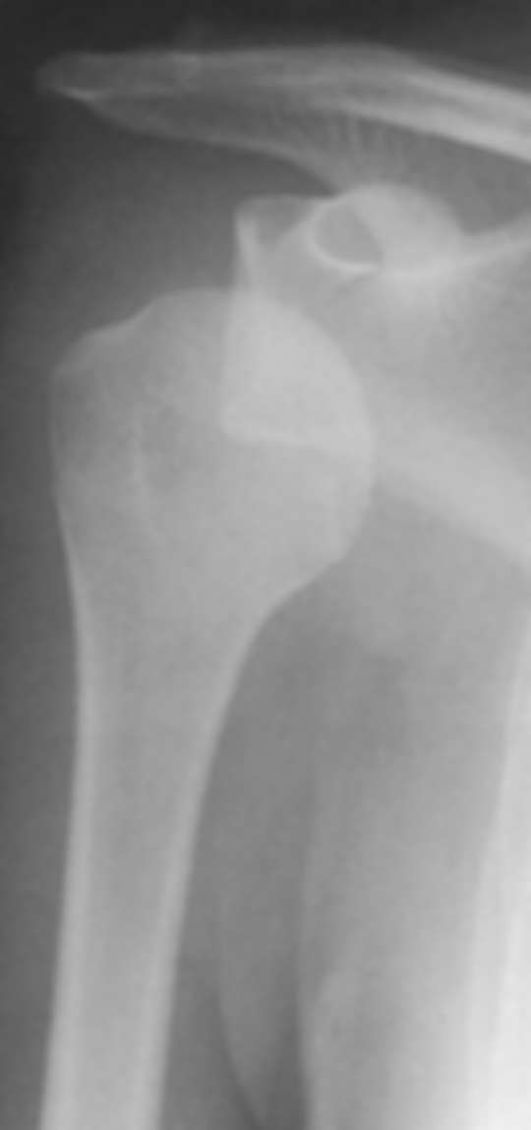
Common Orthopaedic Cases: Shoulder Dislocation
Anterior much more common than posterior
No muscle or bone anteriorly
AP view humeral head is anteromedial to glenoid
2nd view at right angles confirms anterior dislocation
Y view
AP

Slide 6
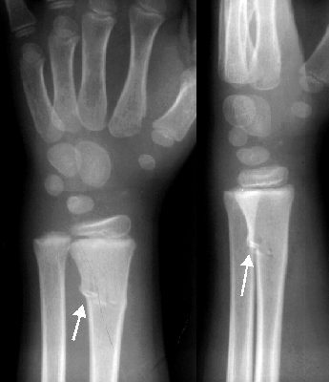
Common Fractures: Paediatric
More flexible bones
Greenstick (bending)
Torus (wrinkle)

