Slide 1
Radiology for medical students: Abdomen

Slide 2
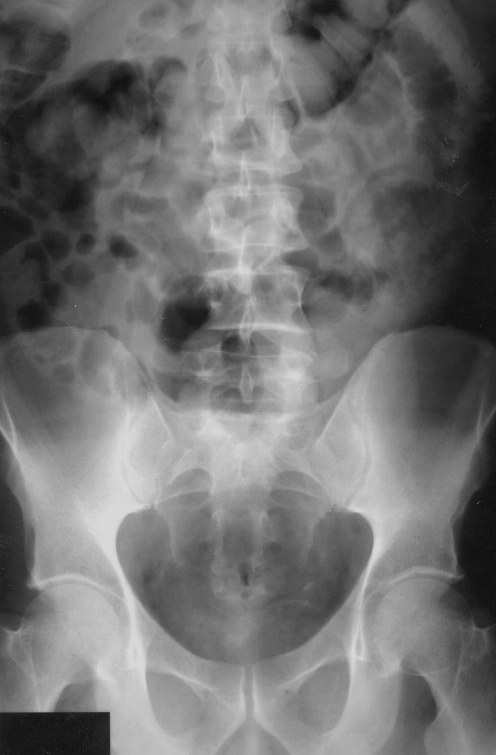
System for Looking at Plain Abdominal Film
Technical details
  Age
  Side marker

Slide 3
Which is the right side of the abdomen?

Slide 4
Which is the right side? Look for the side marker
Symmetrical appearance of pelvis and spine
Variable bowel gas pattern
Side marker critical to avoid misinterpretation
R

Slide 5
Anatomical landmarks on the AXR
Gut
Renal tract
Abdominal organs
Bones and soft tissues

Slide 6
The Gut
Stomach left upper quadrant
SB – central
LB periphery
All contain air
No inguinal hernia
No free air - perforation

Slide 7
The Renal Tract
Calcification over the kidneys, line of ureters, bladder

Slide 8
Abdominal organs
Liver
Spleen
Pancreas
Calcification:
  Pancreas
  Gallstones
  Aorta/ iliac vessels
  Female uterus/ovaries

Slide 9
Bones
Destruction or sclerosis

Slide 10
Summary
This is an abdominal radiograph in a young/old male/female patient. The bowel gas pattern appears normal and there is no free air. No calcification is seen in the abdomen. The bones appear normal.

Slide 11
ABNORMAL BOWEL GAS PATTERN

Slide 12
Abnormality: There are dilated loops of bowel
Normal
Small bowel dilatation

Slide 13
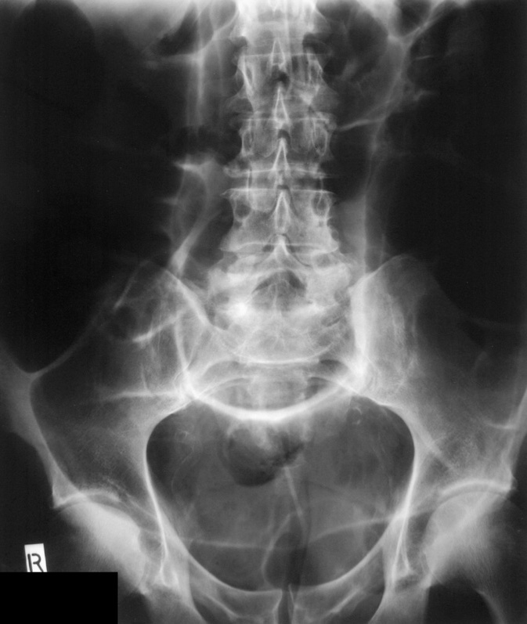
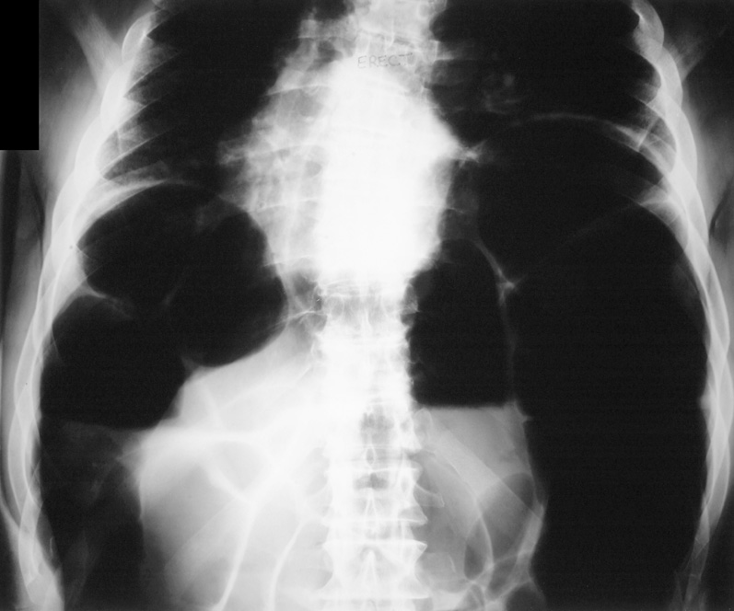
Dilated loops of large bowel

Slide 14
Small Bowel versus Large Bowel Obstruction
Small bowel
Centrally placed loops dilated bowel
Valvulae conniventes extend across whole bowel wall
Large bowel
Peripheral
Haustrae (do not cross whole diameter of colon)

Slide 15
Small bowel obstruction
Causes
  Adhesions
  Incarcerated hernia
Ix
  CT scan
Small bowel dilatation

Slide 16
Large Bowel obstruction
Causes
  Carcinoma LB
  Inflammatory mass eg IBD, diverticular mass
  Extrinsic – eg volvulus
Ix: Contrast Enema or CT scan

Slide 17
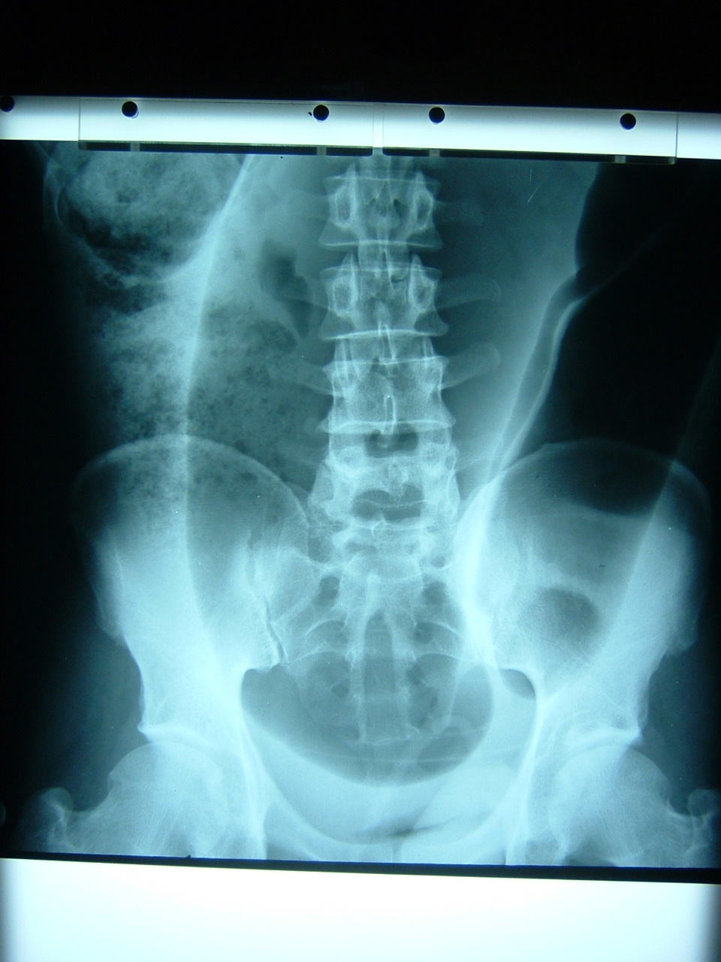
Focal bowel loop distension:
Age 77, female, abdominal distension

Slide 18
Sigmoid volvulus
Ahaustral loop, inverted U shape
Apex in pelvis, projects to upper quadrants
Normal caecum
Large bowel obstruction present

Slide 19
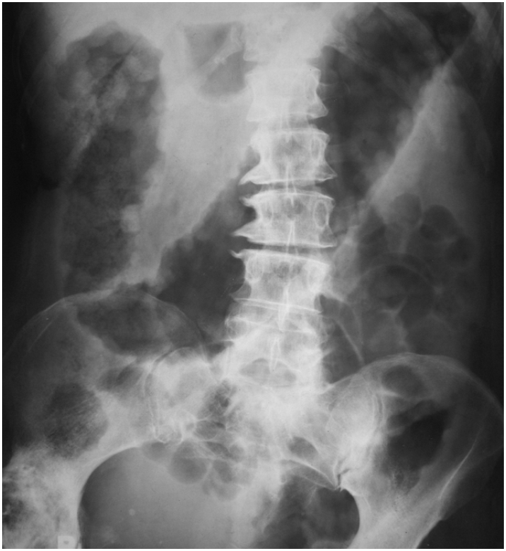
Age 80 male, severe diarrhoea

Slide 20

Toxic megacolon
Severe dilatation >6cm transverse colon
Ahaustral colonic contour
Thumb-printing
Pseudo-polyps
High risk of perforation

Slide 21
FREE AIR

Slide 22
Abnormality: free intra-peritoneal air

Slide 23
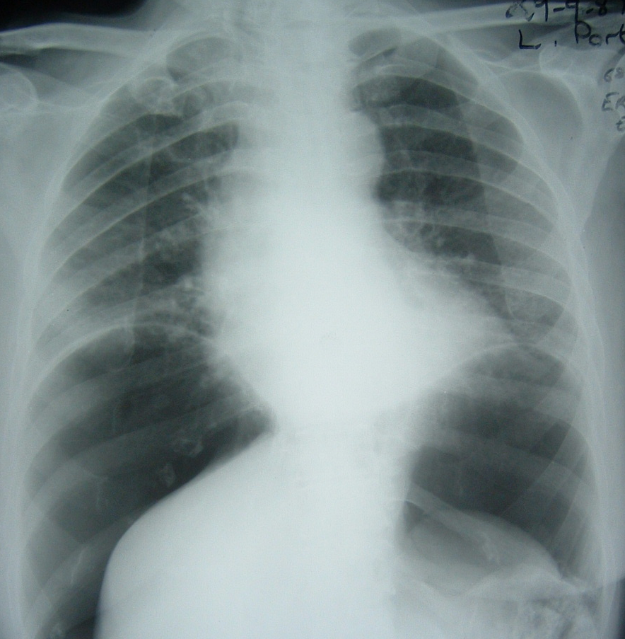
Free intra-peritoneal air
Erect chest x-ray
Thin opaque line represents diaphragm
Air reaches periphery / no haustra
Continous diaphragm sign
Lateral decubitus film

Slide 24
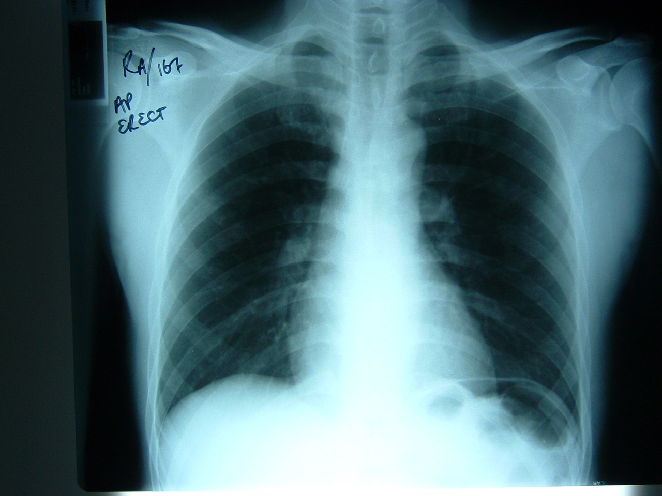
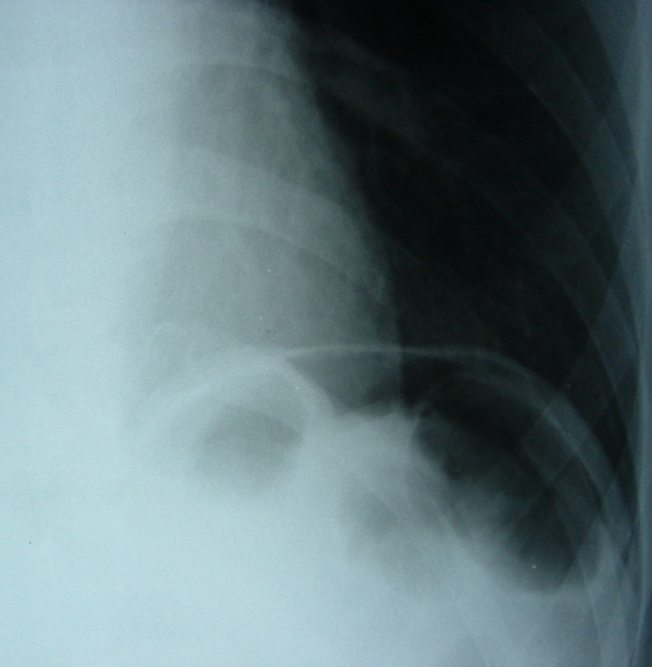
Free intra-peritoneal air

Slide 25
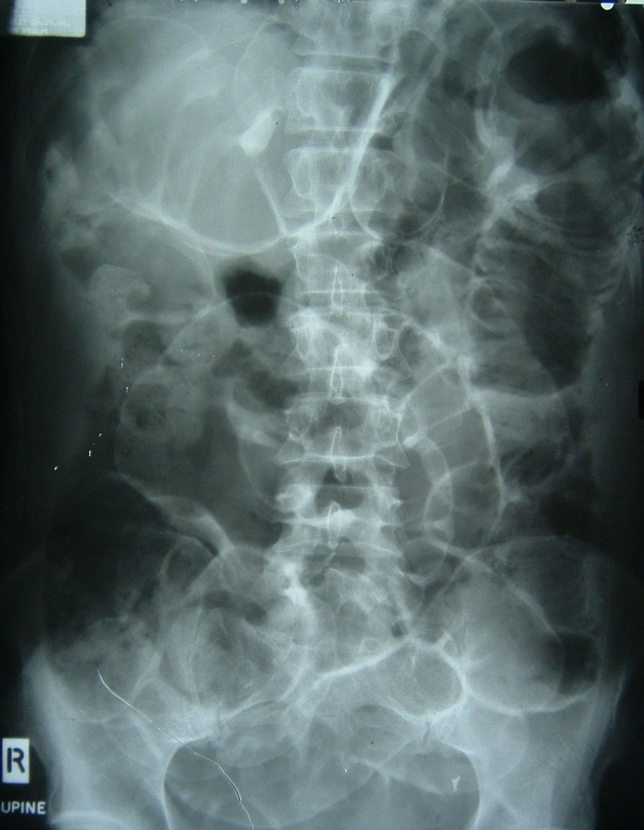
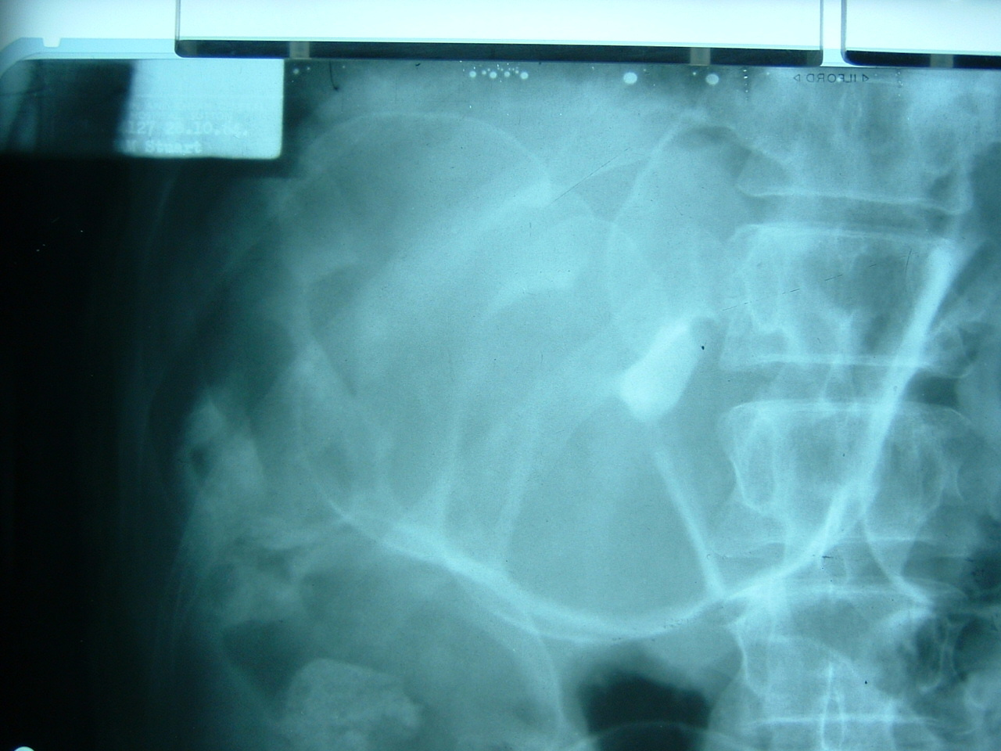
Free air, supine abdominal film

Slide 26
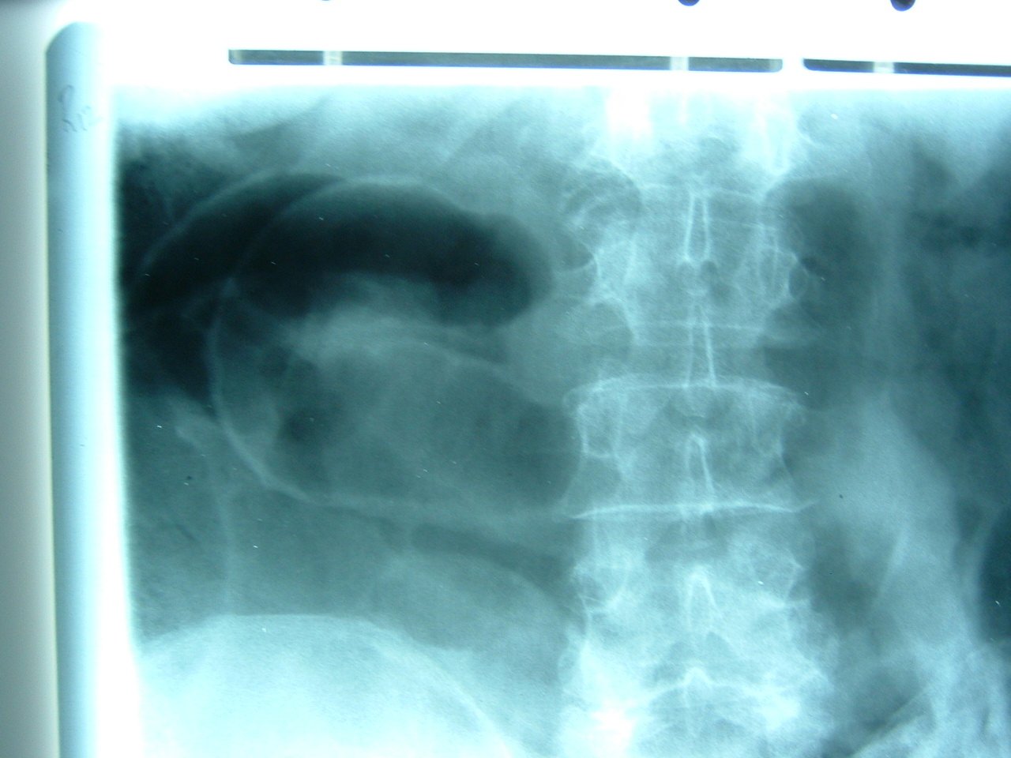
Free air, supine abdominal film
Riggler’s sign
Air outlines both sides of bowel wall

Slide 27
ABNORMAL CALCIFICATION

Slide 28
Abnormality: Calcification on the plain film
Vascular
Renal
Liver or Spleen
Pancreas
Gallstones (see left)
Uterus/ovaries – fibroids, dermoid cysts

Slide 29
Abdominal organs
Liver
Spleen
Calcification:
  Pancreas
  Gallstones
  Aorta/ iliac vessels
  Female uterus/ovaries

Slide 30
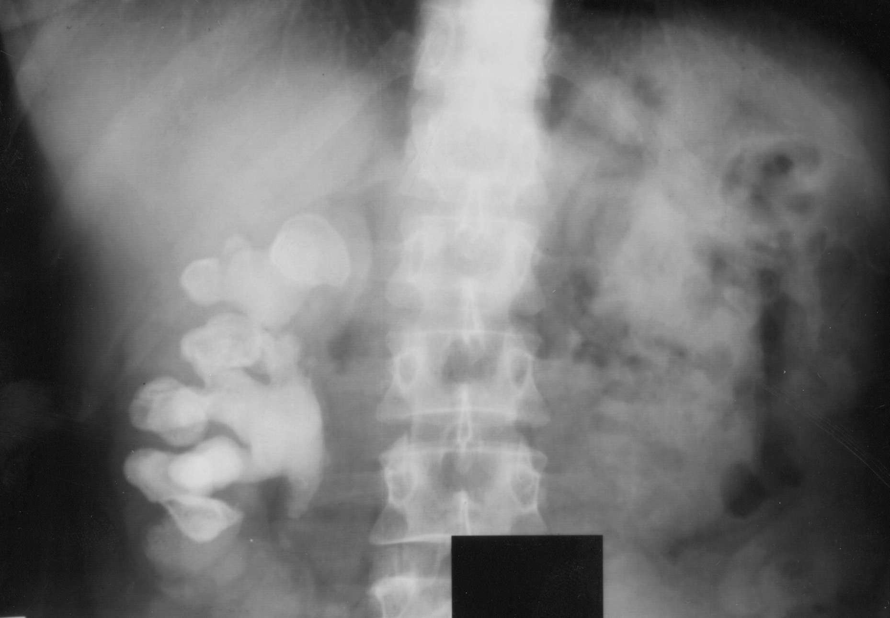
Renal tract- staghorn calculus

Slide 31
Renal Tract- left VUJ stone

Slide 32
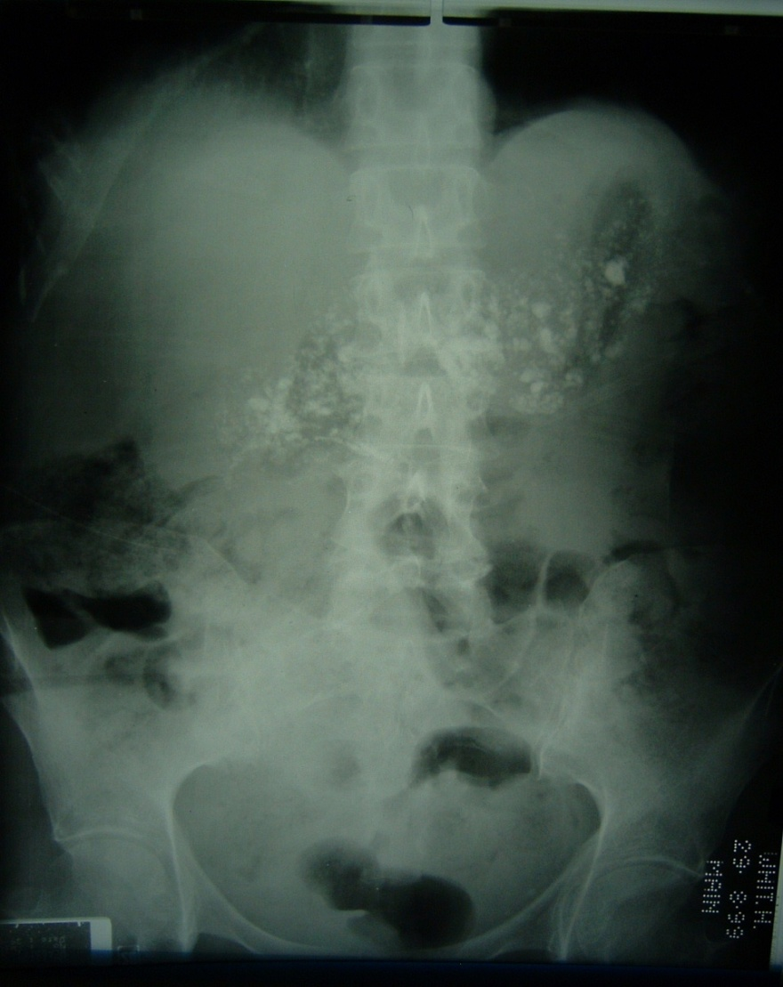
Age 65 male, chronic abdominal pain
Pancreatic calcification across midline
Chronic alcoholic pancreatitis

