Slide 1
Secret diary of an FY1
“Life as an FY1”
Alex and Danielle

Slide 2
E-portfolio
Needs to be completed by the middle of your last rotation
Various supervised learning events and sign off from educational and clinical supervisors
Get started early!

Slide 3
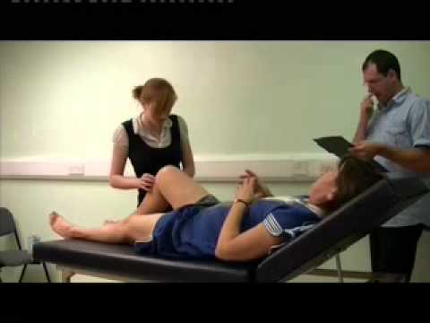
Mini-cex
‘Direct observation of a doctor/patient clinical encounter by a trainer for teaching purposes.’
Use any clinical encounter – can be signed off by SHOs, registrars and consultants
9 required per year – 3 per rotation

Slide 4
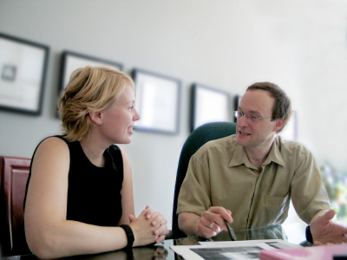
Case based discussion
What it says on the tin – presenting patients that you have clerked is a good way of getting them signed off!
Can be done by registrars or consultants.

Slide 5
Core procedures
15 in total
Some harder to get signed off than others – female catheterisation for example!
Different foundation schools have different rules about who can sign these off, check early!

Slide 6
ALS
Useful to do early on in the year if possible.
Usually organised by your deanery.
Organise annual leave for this – study leave not permitted during FY1.

Slide 7
Supervisor meetings
Can be difficult to organise – consultants often very busy.
Need sign off from both educational and clinical supervisors
Forms are separate even if both supervisors are the same person, make sure that everything is complete.

Slide 8
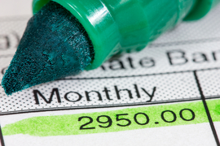
Miscallenous worries
Pay and taxes
Basic FY1 pay- £22, 938
London addition; approximately £2000
Banding added on top- 0, 20%, 40%, 50%
GMC registration fee- £90
First pay check is TAX FREE if no previous taxable work done in that tax year
Deducted from your income
Income tax
Pension
NI

Slide 9
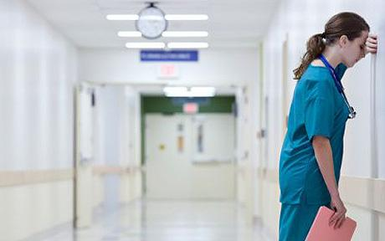
EWTD
Introduced in 2000 to include Junior Doctors
Reviewed in 2009- limit 48 hours per week. Rest requirements introduced.
Banding introduced in 2000
Max 48 hours per week ON AVERAGE
NEW DEAL introduced in 1991- improve working conditions of Junior doctors
Employers have to comply with both EWTD and New Deal.
Junior doctors can voluntarily opt out of EWTD but only for max 56 hours/week
Max 13 continuous duty days
Diary carding

Slide 10
Banding
• Reflects EWTD and New Deal hour controls, rest periods, working pattern, out-of-hours duty, unsocial nature of working arrangements.
Unbanded- 0% supplement
Max 40 hours/week between 7am-7pm Monday-Friday
Band 1- 40 to 48hours/week. Few on-calls.
1A-50%
1B- 40%
1C- 20%
Band 2- over 48-56 hours/week. Compliant with New Deal.
2A-80%
2B- 50%
Band 3- 100%.
Illegal to contract for band 3 although some posts may slip into band 3.
Not compliant with New Deal requirements. >56 hours.
Notes:
The junior doctors pay banding system has been in place since December 2000,
and aims to remunerate junior doctors fairly according to the actual hours worked
and the frequency of their out-of-hours work. A full-time junior doctor’s contract
consists of 40 hours of work plus such further contracted hours as are agreed with
the employer including:
• all out-of-hours work
• agreed prospective cover for annual/study leave of colleagues
• any other regular commitments, eg early starts and late finishes
• any duty hours necessary for continuity of patient care.
However, as detailed in Chapter 8, junior doctors’ contracts and working arrangements
are subject to the strict limits on total hours and minimum rest requirements imposed
by both the EWTD and the New Deal. The pay bands reflect whether the post is
compliant with the New Deal hours controls and rest periods, and also whether the
doctor works up to 40, 48 or 56 hours a week, the type of working pattern, the
frequency of out-of-hours duty and the unsocial nature of the working arrangements.
Full-time junior doctors
Every full-time junior doctor on national terms and conditions will be working on a
rota that falls into either one of three pay bands or will be unbanded:
• Band 3 includes all rotas that are not compliant with the New Deal’s hours limits or
rest requirements. These will be rotas that require more than 56 hours of actual
work per week, or that do not deliver the required rest or natural breaks.
• Band 2 includes all posts that are compliant with the New Deal and require over 48
hours of actual work and up to and including 56 hours per week.
• Band 1 includes all rotas that are compliant with the New Deal and require between
40 and 48 hours of actual work per week.
• Unbanded: full-time doctors, whose entire working week consists of a maximum of
40 hours between 7am and 7pm, Monday to Friday, receive no additional
supplement and their post is therefore not allocated to one of the pay bands.
Bands are subdivided on the basis of the amount of anti-social work. Band 2 is split
into Bands 2A and 2B, and Band 1 is split into Bands 1A, 1B and 1C such that:
• Bands 2A and 1A include all rotas that, within their respective hours’ limits, require
the most frequent work at the most antisocial times, as defined by the banding
criteria.
• Bands 2B and 1B include all rotas that, within their respective hours’ limits, require
less frequent and less anti-social out-of-hours work.
• Band 1C includes all rotas that require juniors to work between 40 and 48 hours per
week with a low frequency non-resident on-call pattern of work.

Slide 11
Leave
27 days annual leave
No study leave in FY1 (30 days in FY2)
One month full pay sick leave and 1 month half-pay sick leave (after 4 months of service in your first year)
8 weeks full-pay maternity leave
2 weeks full pay paternity leave

Slide 12
Locum work
Internal vs external
Can locum for an agency or within your trust
Your responsibility to identify need for locum
Employers’ responsibility to ensure locum cover
Should not be covering other doctors’ work unless for short period ie 48hours

Slide 13
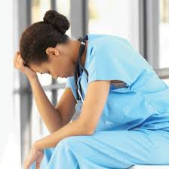
Bullying and Harrassment
It happens!
Speak to someone
your team
fellow FY1
clinical or educational supervisor
foundation programme director
NOT acceptable

Slide 14
Societies to join
MDU vs MPS- join ONE. Mainly legal support and advice
BMA- join! Contract advice, revision courses
Royal Society of Medicine- good teaching opportunities
Royal College of Physicians, surgery, paeds, ObsGynae

Slide 15
Happy and horror stories from Alex and Becki

Slide 16
Dealing with ‘difficult’ patients
Notes:
Lady with double mastectomy for bilateral breast cancer. Needed blood transfusion.
Explained benefit with healing etc.
Pt threatening to throw a table at me

Slide 17
I prescribed…
Notes:
Candesartan
paracetamol

Slide 18
I forgot to…
Notes:
Hand over hyperkalemia and phoned in
Sodium bicarb on TTA

Slide 19
Being thanked
Notes:
Flowers
Hamper of French paistries

