Slide 1
Written and verbal interactions
Matters surrounding death

Slide 2
Learning Objectives
An understanding on how to declare that a person has died
Legal aspects surrounding death
Death Certification
Cremation forms

Slide 3
What we will cover ...
End of life care
The Liverpool Care Pathway
How to declare that a person has died
How to document death in the notes
How to fill in a death certificate
Quiz on certification of death
Cremation forms

Slide 4
There is only one certainty in life and that is death

Slide 5
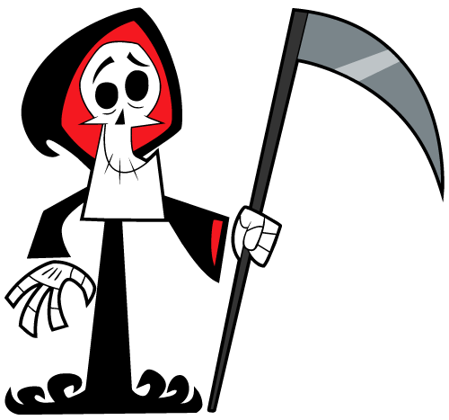
Why is death so important
Medicine is not just about saving lives ...
Some days I am this person
Other days I turn into this person
You have to think about making people comfortable at the end of their lives
Notes:
Since becoming a doctor I have had the realisation that I really can not save everybody. Some times you get home thinking you have really made a difference to a person and their families lives in a positive manner. Unfortunately you can not save everybody and when people are dying it is just as important to make the end of their life as comfortable as the beginning.

Slide 6
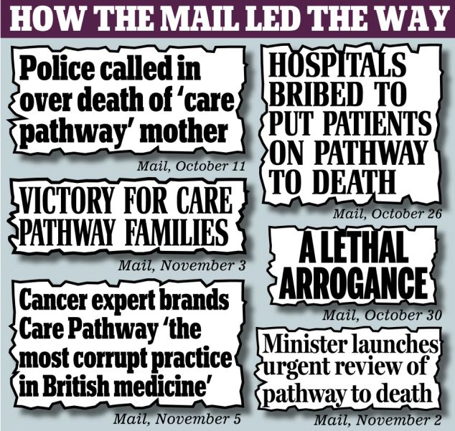
End of life care (Expected deaths)
Controversial
FY1’s should not make the decision to commence LCP
Always ask the family
Notes:
The Liverpool care pathway has recently had lots of negative attention in the press. However it is not made to be seen as us being “god” like figures and killing patients. It is a way in which we make end of life care as comfortable for the patient as possible.
As an FY1 you do not make the decision to put somebody on the LCP this is done by a senior clinician. When a patient fails to respond to treatment or is palliative a decision may be made to withdraw active treatment and make the patient comfortable. A senior clinical will then discuss this with the family to see if they are in agreement. Ultimately it is a MEDICAL decision to end treatment however it is best practice to inform the family.
As an FY1 you will have to clearly document the conversation with the family. Recently families have agreed the patients should be made palliative and treatment should be withdrawn however they do not want the patient on the LCP due to it’s negative press and the family does not want to blame themselves for letting the patient die.

Slide 7
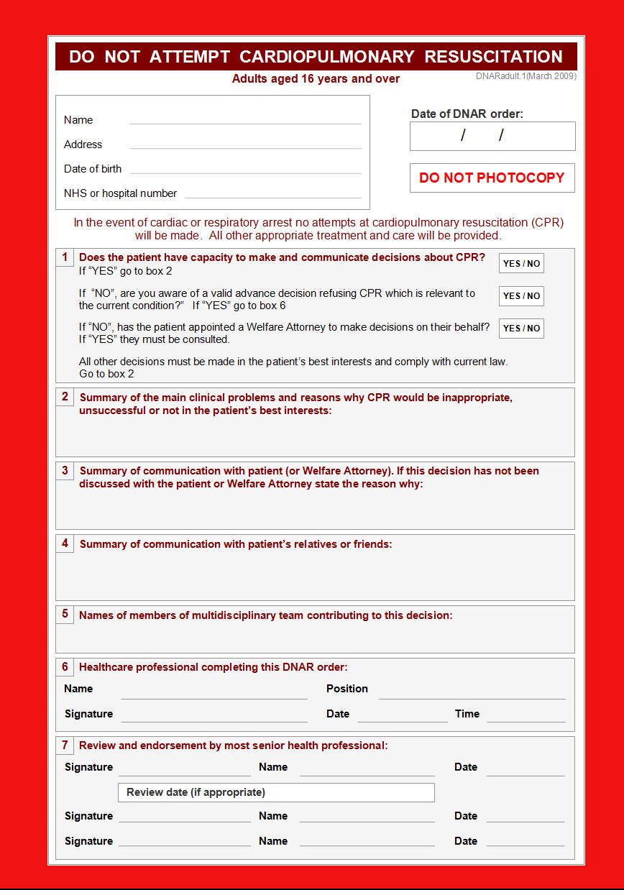
What do I need to do?
Document in the notes the decision with the family
Ensure a valid do not attempt resuscitation “DNAR” form is signed
Notes:
Once the decision has been made to withdraw treatment. You should clearly document the decision in the medical notes. Next ensure that a senior colleague has signed the DNAR form. You can fill in all the clinical information however it should be signed by a senior (reg + consultant)

Slide 8
What do I need to do?
Call the palliative care team
Stop all unnecessary medications
Stop bloods tests + further cannulation
Stop IV fluids and oxygen
Comfort feeding
Notes:
The next step is to call the palliative care team. They are invaluable in communicating with families and ensuring the patient is comfortable. Next you should stop all unnecessary medications for example anticoagulants and antihypertensives. The next step is to ensure that no further bloods and cannulas are inserted. Ensure the patient does not receive IV fluids oxygen and artificial feeding.

Slide 9
Liverpool Care Pathway
Separate proforma used for the MDT – all further documentation must be in this
Prescribe end of life medications (PRN)
Pain: diamorphine
Nausea: cyclizine
Agitation: midazolam
Secretions: hyoscine
Notes:
Once all the above is complete a separate “LCP” proforma is used for the patient by all members of the LCP. Then on the “when required” section of the drug chart prescribe the end of life mediciations this includes diamoprhine, cyclizine, midazolam and hyoscine.

Slide 10
Declaring Death
Any volunteers to practice + document their finding in the notes???
Notes:
Sometimes in medical attachments you will be asked on call to declare that a patient has died. I will always remember the first death I declared at 4am in the morning on my first ever night shift. I had to take my Oxford handbook with me as I had never been told what to do. It is not an urgent request however should be done quickly so the patient can be transferred to the mortuary.
Does anybody want to practice?

Slide 11
Declaring death
Reaction to voice and pain
Talk to the patient
Sternal rub
Pupil response to light
Should be fixed and dilated
Central pulse for 1 minute
Carotid or femoral
Heart sounds for 1 minute
Breath sounds for 1 minute
30 seconds each lung
Notes:
All of the above should be checked in that order. It is normal for you to hear noises from the abdomen when a patient has died.

Slide 12
Confirming death - documentation
1/6/13 FY1 Dr. Smith
4:45am
Asked by nursing staff to confirm the death of Mr/Mrs X
No response to voice and pain
Pupils fixed and dilated
No carotid/femoral pulse felt for 1 minute
No audible heart sounds for 1 minute
No audible breath sounds for 1 minute
Pacemaker present Y/N
Time of death 4:45am 1/6/13
May he/she rest in peace Dr. Smith
FY1 SMITH
Bleep 221

Slide 13
Medical Certificate of Cause of Death
GMC: “If it is your responsibility to sign a death or cremation certificate, you should do so without unnecessary delay”
GMC: “You must comply with the legal requirements where you work for reporting deaths to a coroner”
Notes:
Once a patient has died a medical cause of death certificate must be completed +/- a cremation form. The GMC has issues guidance in the “end of life care booklet” that you must sign the forms with unnecessary delay and comply with legal requirements to inform the coroner.

Slide 14
Medical Certificate of Cause of Death
Allows the family to register the death
Used to monitor the health of the population
To complete the death certificate you must have attended to the deceased during their last illness and seen them within 14 days of death or after death
Notes:
The medical certificate of cause of death provides a certificate that the NOK can register the death. It is a legal document which can record the fact of death, enable disposal of the body and settle the deceased estates. Secondly they are monitored by the national office of statistics to collection information on the health of the population.
To complete the death certificate you must have attended to the deceased during their last illness and seen them within 14 days of death or after death. Therefore if you declare a patient has died on a night shift, usually the day team will complete the death certificate. Ideally the doctor should know the patient, their medical conditions, investigations and treatment. Ultimately it is your consultants responsibility.

Slide 15
Reasons to Refer Patient’s death to the Coroner
Unknown cause of death
Not seen by doctor 14 days before death
Death caused by medical treatment /operations
Suspicious death/Suicide
Death within 24 hours of admission
RTA/ domestic/industrial accident
Notes:
When completing the cause of death it is important that if the death qualifies the above situations it is you job to call the coroner. I have often rang them when I am unsure of the cause of death.

Slide 16
Coroners Outcome
Discussed – not referred
Discussed – referred
Either post mortem held
+/- inquest
This must be done before completing the medical cause of death certificate
Notes:
The coroner will then decided the next step and will inform you of the decision. This is either to discuss and not refer. Or to refer where they will decide to post mortem with or without an inquest. The discussion should always be had prior to completing the medical cause of death certificate

Slide 17
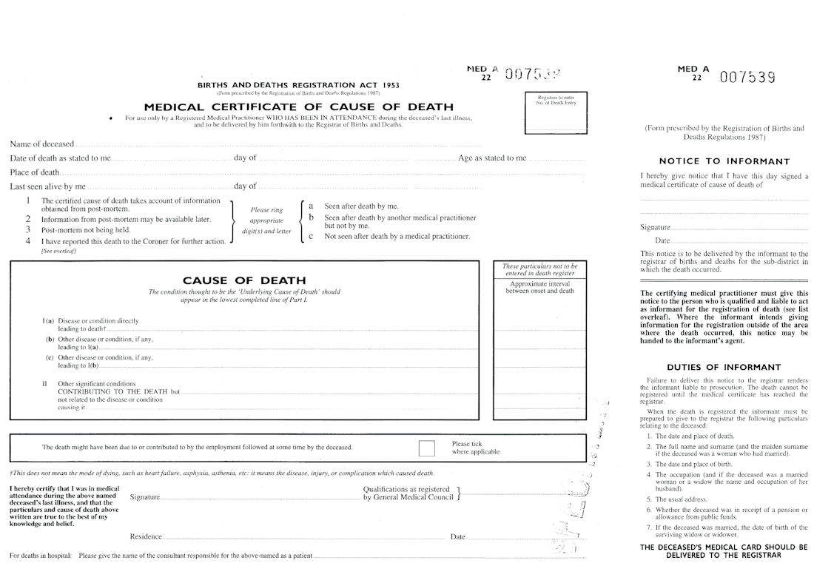
Notes:
This is the medical cause of death certificate. You have to include name, date of death, place of death and the time last seen alive by yourself. Then you have to circle the appropriate letters and numbers more often than not it is 3a. Then you have to document the cause of death (we will go over this later). Then sign add in your degree and GMC number and your place of work. Finally add the consultant to the bottom of the form. Also fill in the section on the right with the patients name, your signature and the date.

Slide 18
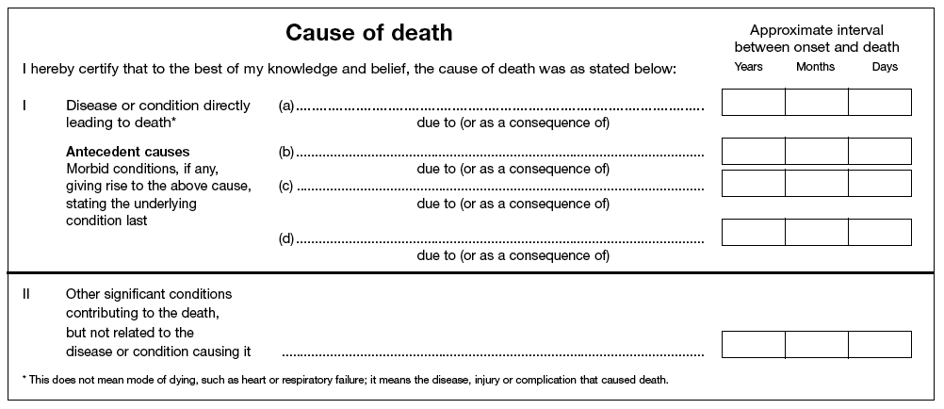
Cause of Death

Slide 19
Cause of Death
1 (a) Disease or condition directly leading to death (NB not the mode of dying)
(b) Other disease or condition if any, leading to I(a)
(c) Other disease or condition, if any, leading to I (b)
II Other significant conditions that contributed to the death but are not related to the disease or condition causing it

Slide 20
Example 1
A 75 year old male with hypertension, COPD and diabetes is admitted following a STEMI. Unfortunately he has a cardio respiratory arrest and dies.
1a – cardio respiratory arrest
1b – ischemic heart disease
1c – Type 2 diabetes mellitus and Hypertension
2 – Chronic obstructive pulmonary disease

Slide 21
Example 2
19 year old otherwise healthy female is brought in by ambulance with meningococcal sepsis and passes away overnight despite best efforts.
1a Meningococcal septicaemia
This is the immediate cause of death – no other lines need to be filled in

Slide 22
Example 3
A 90 year old female has a fall at home leading to a left fractured NOF. While in hospital she has a PE and then dies.
1A – pulmonary embolus
1B– fractures neck of femur
1C – mechanical fall
2 - (blank – no other PMH known)

Slide 23
Example 4
A 50 year old male with a background of HTN, BPH and MND was admitted with SOB + cough. Increased inflammatory markers, right chest signs and consolidation right base on CXR. Unfortunately despite medical treatment he passed away.
1a – Aspiration pneumonia
1b – Motor neurone disease
1c –
2 - Hypertension

Slide 24
Old Age
Can only be used if :
You cared for the deceased over a long period of time
You have observed a gradual decline in function
You are not aware of any identifiable disease that led to the patients death
You are certain the death should not be reported to the coroner
Patient is aged over 80
Notes:
Using old age on a medical cause of death certificate is only really applicable to GP’s.

Slide 25
Avoid the “failures”
Can only certify deaths due to failure if there is a specific disease mechanism which led to that failure
Liver failure secondary to hepatocellular carcinoma secondary to alcoholism and hepatitis B infection
Failures will otherwise be deemed unnatural and referred to the coroner
If you are putting failure – discuss with the coroner first
Notes:
If the coroner is satisfied with the failure he will inform the registrar at the council. The registrar will not accept failure unless he has been informed by the coroner.

Slide 26
Other important information
Never use abbreviations
If the cause of death is an infection state the underlying organism
If using pneumonia state whether it was bronchopneumonia or aspiration pneumonia
If the death was due to an injury report it to the coroner eg. PE, #NOF, mechanical fall

Slide 27
If you a stuck ask your registrar
You can also call the coroners office for advice

Slide 28
Cremation Forms
Sensitively ask the family if they would like burial / cremation
As an FY1 you will complete cremation form 4 (you must have attended to the deceased within 14 days of death)
This form will then be checked by a doctor who has held GMC registration for 5 years and they will complete Cremation Form 5
Notes:
Often you will get bleeped by the person completing form 5 for an accurate medical history.

Slide 33
Items to declare on Cremation form
Pacemakers
Implantable Cardioverter Defibrillators (ICDs)
Cardiac resynchronization therapy devices (CRTDs)
Implantable loop recorders
Ventricular assist devices (VADs): Left ventricular assist devices (LVADs),
Right ventricular assist devices (RVADs), or Biventricular assist devices
BiVADs)
Implantable drug pumps including intrathecal pumps
Neurostimulators (including for pain & Functional Electrical Stimulation)
Bone growth stimulators
Hydrocephalus programmable shunts
Any other battery powered implant
Fixion nails
Dental mercury amalgam
Brachytherapy to the prostate, i.e. radioactive iodine-125 seeds

Slide 34
Learning Objectives
An understanding on how to declare that a person has died
Legal aspects surrounding death
Death Certification
Cremation forms

Slide 35
Thank you for listening
Any questions?

Slide 36
References
http://www.justice.gov.uk/downloads/burials-and-coroners/cremations/cremation-doctors-guidance.pdf
http://www.gmc-uk.org/static/documents/content/Treatment_and_care_towards_the_end_of_life_-_English_1011.pdf
http://www.gro.gov.uk/images/medcert_July_2010.pdf
The Oxford Handbook for the Foundation Program

