Slide 1
Death - the Good, the Bad, and the Ugly
Elizabeth Goodwin & Sophie Batt,
FY1 Doctors Chelsea and Westminster
Notes:
I’m not sure how much experience you had of dealing with dying patients at medical school? I think often as medical students we are sent to talk to patients with “interesting signs” or with a “good history”. As a result we often don’t get much exposure of patients at the end of their life. However, as an F1 a lot of this work will be left to you! We are not claiming to be experts in any way, but we wanted to talk about some of our and other junior doctors experiences and the things we have learnt. We will not be covering what drugs should be prescribed and how to manage symptoms, as you will have had teaching on this at medical school (and your palliative care team or senior doctors can offer advice on this), instead we want to spend some time looking at how we as junior doctors can work to ensure patients in hospital under our care die well.

Slide 2
Why is this Important?
Notes:
As doctors we mainly focus on prolonging life.. But a ‘good’ death makes all the difference to patient, family and team. For family and friends to see their loved one die in distress or pain can cause lasting damage. We want to provide high quality care for our patients throughout their life.

Slide 3
YOU the F1 are often…
The one who sees patients and families day to day
The most approachable/available doctor
May be left to deal with a dying patient
YOU really can make a difference
Notes:
As the F1 you are often the member of the team on the ward the most. As a result you are often the one who sees patients and their families on a day to day basis, you may be the first one to notice a deterioration in their condition, you are the link between members of the MDT and the medical team. Often patients know your name and the consultants name only! Because you are available more than other members of the team patients are likely to be honest and confide in you. While an F1 should not be making decisions regarding ceilings of care you may be left practically implementing a seniors plan.
So much of the F1 year is paperwork, form filling and venepuncture, but this is one area where you can really make a difference to your patient, to their family and to the nursing staff and we have both found it really rewarding to be involved.

Slide 4
Attitudes to death – clickers 1
Have you seen a patient in their last few days of life?
Yes
No

Slide 5
Attitudes to death - 2
On a scale on 1-5 (1: not at all confident, 5: very confident:
I know what the role of an F1 is when dealing with patients at EOL
Notes:
Clicker quiz!

Slide 6
Attitudes to death - 3
On a scale on 1-5 (1: not at all confident, 5: very confident
I feel confident dealing with end of life symptoms.

Slide 7
Attitudes to death - 4
On a scale on 1-5 (1: not at all confident, 5: very confident
I feel confident discussing DNAR status with a patient

Slide 8
Attitudes to death - 5
On a scale on 1-5 (1: not at all confident, 5: very confident
I feel confident discussing the LCP with a family

Slide 9
Attitudes to death - 6
On a scale on 1-5 (1: not at all confident, 5: very confident
I feel confident talking to a patient at the end of life

Slide 10
Death on the Wards..
The Good
The Bad
… And the Ugly….

Slide 11
The Good…
Mr W, 75 year old, cerebellar stroke
Admitted for rehab
Weeks 1-3: Assessment, trial PT/OT, ?candidate for rehab, Week 3: Not making improvement, multiple UTI/LRTI
Week 4-6: Recurrent infections ?continue to treat
Week 6: Deterioration
Death: LCP, side room, 3 sons able to come to hospital, wife able to stay, died peacefully over a weekend.
Notes:
Mr W was a married, 88 year old gentleman who had previously been fit and well until he suffered a cerebellar stroke
He was admitted for rehabilitation
Over the first few weeks the multidisciplinary team were involved trying to ascertain whether he would be suitable for rehabilitation. Over a period of weeks he developed a number of chest infections and urinary tract infections, which were treated with antibiotics. Despite repeated courses of antibiotics he continued to develop infections, and became progressively weaker. He made little gains with physio and became increasingly withdrawn. The family were updated and the decision made that he was not for resuscitation.
On week 6 he developed a urinary infection with worsening renal function. Despite an initial treatment with antibiotics he worsened. In discussion with family the LCP was started.
Mr W died peacefully, with his family around him.

Slide 12
Why was this ‘Good’?
Expected
Updates to family
Kept patient at centre of care
Honest and timely communication with family
Pain free
Dignified & personal/religious beliefs upheld
Family present
Environment
Notes:
Environment: side room, allowed sips of Guiness!

Slide 13
The Bad
Monday 10am: Crash call put out by NS
Resuscitation attempt started
Difficult resuscitation
75 year old, history of IHD, previous MI, DM, CKD 3
Unknown lady walks in and says “patient is DNAR”
No form could be found
Number of members of team left
? To continue
Previous Friday DNAR had been signed, not communicated to NS

Slide 14
What was ‘BAD’?
Poor communication
Poor handover
Inappropriate resuscitation attempt
Not an unusual situation: only 22% of cases reviewed had written explicit statement regarding CPR
Notes:
While as an F1 you are not going to be making these decisions, you can flag the issue to your seniors. It can be helpful to have DNACPR forms available. The SHO on our Geriatrics firm encouraged us to have a ceiling of care round with our SpR on a Friday where we explicitly wrote in notes and handover sheet to on-call whether the patient was suitable for ITU, IV Abx and resuscitation status.

Slide 15
DNAR
Do not attempt resuscitation
Who can sign:
Resuscitation is medical treatment
Communicate to patient/family
Time to Intervene: ¾ resuscitation attempts futile from outset
Poor success rates for in- hospital cardiac arrest
Notes:
Survival to discharge after in-hospital cardiac arrest was 14.6% (85/581) (Time to Intervene)

Slide 16
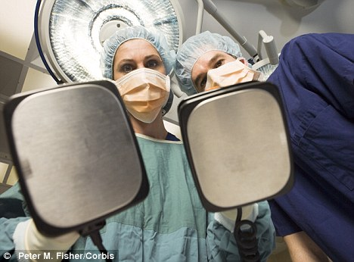
Think: Is CPR appropriate? Even if resuscitation is successful what is likely to be quality of life?
Discuss: With consultant/ Spr
Communicate: Patient/Family/ Nurses
Notes:
Do patients and their families understand what is meant by CPR?
Not as portrayed on TV where patient is shocked and is suddenly and fully revived!

Slide 17
The Ugly
Mr G- large left MCA infarct
Gradual deterioration with multiple infections
Developed chest sepsis
Challenging behaviour from wife
Attempts to involve wider MDT and GP
Difficult communication with patient, element of denial, dysarthria, did not want to be DNAR, ? pressured by wife at times “don’t leave me”
Death: on ward, wife present
Post death: Wife distraught, threatens self harm, disappears
Notes:
Finally, a case which was a bit disastrous!
Mr G was admitted for stroke rehab after a large left MCA infarct. Like Mr W he made little gains with physio and SALT and was rendered bed bound and dysarthric. He developed a serious chest infection, which did not improve despite strong antibiotics, chest physio and good supportive care.
His wife was devoted to him, however struggled to come to terms with his stroke and illness. Caring for him became her life and she was highly critical of nursing staff making repeated allegations that they were negligent. She was quite disruptive on the ward interfering with Mr G and other patients’ care.
Attempts were made to involve the wider MDT, psychologists, social workers and the GP to support Mrs G. She had previously had mental health problems and was noted to be vulnerable, having previously expressed thought of self harm.
Repeated discussion with wife and patient explaining his deterioration and that he was coming to end of life and our focus should change from treating his infections to treating his symptoms and making him comfortable. His medications were rationalised and LCP meds prescribed. All of this was discussed with patient, wife and MDT. Wife at times appeared to understand and agree at other times seemed in total denial. On his last day of life she tried to give him a bed bath and wash his hair while he was tachypnoeic, febrile and tachycardic!
When he finally passed away his wife was present. His minister had visited him and religious rituals were carried out as appropriate. His wife became extremely distressed after he died, threatening self harm and running out of the hospital.

Slide 18
Why was this ‘Ugly’?
Care taken to try and support patient and family
Prompted recognition, clear discussions, involvement of MDT
Religious rituals followed post death
Wife given time pre & post death, flexible visiting hours
On reflection,
?Element of fear of wife- patient did not receive LCP meds until last day (despite prescribed), ?NS avoided
focus on wife rather than patient.
?palliative care input needed (more experience)
Notes:
Repeated efforts were taken to try and support patient and his family. Different avenues were explored and every effort was taken to accommodate his wife allowing her to visit when she wanted and having long discussions with her about his situation.
However, on reflection perhaps our focus was too much on Mr G’s wife rather than Mr G himself. Despite LCP meds being prescribed they were not regularly given as nursing staff were concerned how wife would perceive this. She had stated in the past that we were trying to kill him with these medications. As a team we were encouraged to not refer to other teams unless desperate. I think looking back given the complexity of the situation perhaps we should have referred to palliative care.

Slide 19
Things an F1 can do..
Prompt discussion re ceiling of care/ DNAR
Recognising unwell/ poor prognosis/ deterioration
Escalate concerns
Advanced care planning
Discussion with pt/ family
Clear communication in notes/ handover
Try to pre-empt problems
Involvement of other teams as appropriate
Adapt discussions to family/patient
End of life prescribing- anticipatory prescribing
Notes:
So what can you as the F1 do?
Advanced care planning: if a patient is going home with an
Think about what investigations you are booking? Ask your seniors how the results will change management? If a patient is not fit for surgery is it fair to put them through an invasive uncomfortable colonoscopy

Slide 20
Checklist
Where does patient want to spend end of life? (Hospital/Hospice/ Home- NB Fast track)
Satisfactory symptom relief?
Consideration of psychological needs?
Explored patient’s spiritual needs?
Family supported?
Do I/nursing staff know who to contact and when?

Slide 21
Things an F1 should be wary of
Be aware of:
Black humour on ward
Inaccuracy of time frames
Your own limitations
Your team dynamics
Language used

Slide 22
Euphemisms
“We’ve lost your mother”
“Gone upstairs/ heading up there”
“Gone to sleep”
“Been taken from us”
“No longer with us”
“Departed”
“Popped off”
“Slipped away quietly”

Slide 23
Helpful phrases
“DIED” “DEATH” “DYING”- Be honest.
“In the process of living v’s dying”
Helpful to talk in terms of “Hours to days”, “days to weeks”, “weeks to months”, “months to years”
“You are coming towards the end of your life”
“Do you want me to be honest with you/ tell you everything”
“Some people would like to… whilst others…”

Slide 24
LCP

Slide 25
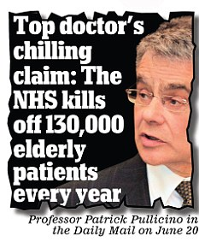
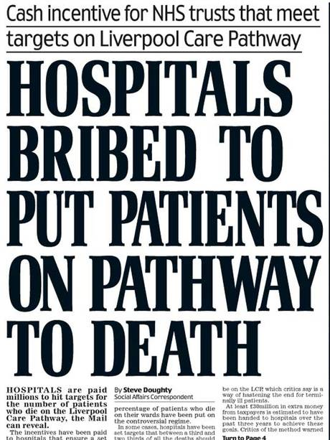
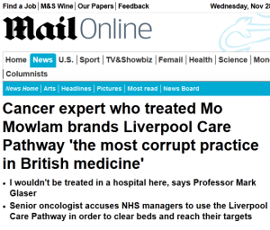
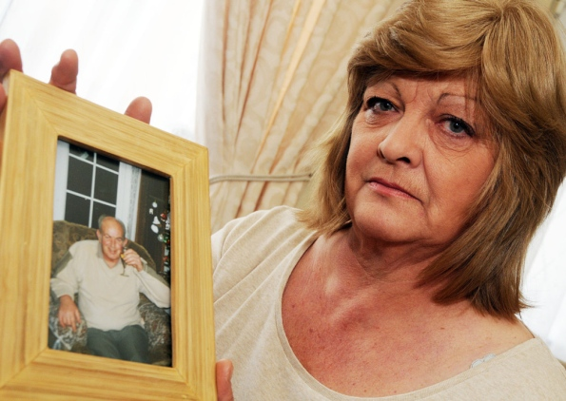
It has a bad press!….
Euthanasia by the back door?

Slide 26
LCP- What is It/ What should I say?
Aim: Treat patients appropriately in their last days of life
Does not hasten death
Multidisciplinary template
Standardise practice and act as a guide
Prompts regarding:
Symptom control- recognise and treating
Minimise inappropriate treatment and investigation
Meeting spiritual needs of patients
Psychological support offered
Family
Notes:
LCP is a nationally recognised pathway with the aim of treating patients appropriately in their last days of life
LCP does not hasten death
guide to remind us of several important things to consider in the last days of life. To flag appropriate and inappropriate medications, investigations and observations. To maximise comfort and dignity, and minimise pain and unnecessary distress. It helps the ward team to be aware of how to treat the patient appropriately, once a patient has been identified as in their last days of life.”

Slide 27
"You matter because you are you, and you matter to the end of your life. We will do all we can not only to help you die peacefully, but also to live until you die.”
Dame Cicely Saunders

Slide 28
In conclusion…
Aim for the Good
Avoid the Bad
… And be prepared for the Ugly

Slide 29
Notes:
http://onlinelibrary.wiley.com/doi/10.1111/j.1365-2923.2010.03873.x/full
As junior doctors, 25% reported no training in any topic, 75% no training in bereavement care and 77% no training in communication skills. Caring for the dying: how well prepared are general practitioners? A questionnaire study in Wales.
Barclay S, Wyatt P, Shore S, Finlay I, Grande G, Todd C.
Breaking bad news: experiences, views and difficulties of pre-registration house officers.
Schildmann J, Cushing A, Doyal L, Vollmann J.

