Slide 1
Choosing your medical career– The foundation years and beyond
Omair Shariq
FY1 Doctor - Chelsea and Westminster Hospital
UKFPO Foundation Doctor Advisor

Slide 2
Outline
Foundation programme overview
Outline of postgraduate training pathway
Choosing your specialty
Competition ratios
Where to go for careers advice
How to strengthen your CV during F1/F2

Slide 3
Foundation Programme overview
Introduced in August 2005 by MMC as part of a major revision of postgraduate medical training
Consists of two years training split into rotations of 3-6 months in different specialties.
Acts as bridge between medical school and specialty training
Required to maintain a portfolio of achievements that demonstrates competencies
Notes:
The foundation programme, which you are about to embark on, was introduced relatively recently, in 2005. It was introduced as part of a programme called Modernising Medical Careers, which aimed to smoothen UK postgraduate medical training with a clear road map, consisting of a curriculum.
Prior to the introduction of the foundation programme, medical graduates went through a chaotic system of training which lacked a clear structure. There were often more SHO posts in some speicalties than were needed to fill the number of SpR posts. This meant a lot of forced career changes, even after up to five years as an SHO.

Slide 4
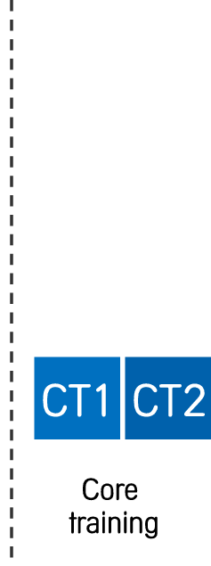
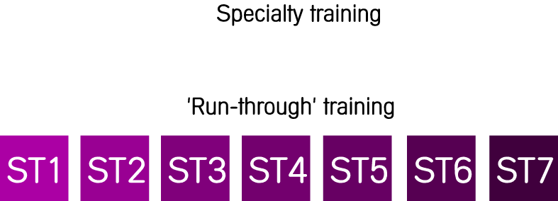
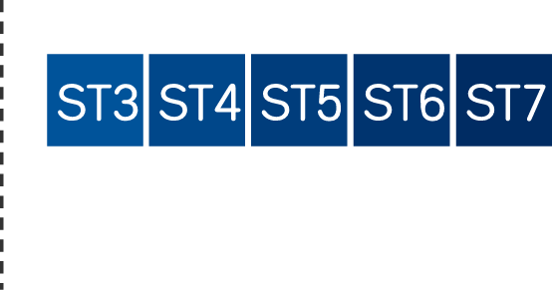
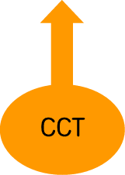
Overview of UK Postgraduate training
Notes:
So how does postgraduate training in the UK work? You begin here, at the stage you guys are at, as medical students who have just obtained a medical degree. You will then embark on a two year long foundation programme, and at the end of your F1 year, will apply for full registration with the General Medical Council. During your F2 year you will competitively apply for entry into specialty training programmes for either general practice or hospital-based specialties. For most specialties, this involves two to three years of ‘core training’ , by the end of which you would be expected to pass your relevant Royal College’s membership exams. At the end of core training, you would compete again for entry into higher specialty training at ST3. This will take you through to the completion of your training. Alternatively, some specialties (which I will talk about later) have run-through training programmes. With run-through training, progression is uninterrupted from ST1 to ST7 or 8, without further competitive selection. All specialty training programmes (whether they’re uncouples or not) lead to the award of a CCT (Certificate of Completion of Training). This makes you eligible to enter to specialist register and practice as a consultant.

Slide 5
Applying for specialty training
>50 different medical and surgical specialties to choose from!
Specialties offering ‘run-through’ training in 2013:
Obstetrics & Gynaecology
Ophthalmology
Paediatrics and Child Health
General Practice
Public Health Medicine
Neurosurgery
Histopathology
Chemical Pathology
Medical Microbiology
Radiology

Slide 6
Applying for specialty training
>50 different medical and surgical specialties to choose from!
Specialties offering ‘uncoupled’ training in 2013
Core medical training
2 years followed by competitive entry to 30 medical specialties at ST3
Core surgical training
2 Years followed by competitive entry to 9 surgical specialties at ST3
Acute Care Common Stem (ACCS)
3 year themed programme followed by competitive entry into Emergency Medicine at ST4
Also an alternative route into medical specialties or anaesthesia at ST3
Core psychiatric training
3 years followed by competitive entry to 5 psychiatry subspecialties at ST4

Slide 7
Choosing your specialty – factors to consider
Personality
Lifestyle
Levels of competition
Geography
Earnings
Future service needs
Notes:
What kind of doctor do you want to be? Everyone’s idea of the perfect job is different, and no one medical specialty will suit all. People decide on their careers at different stages. Some people seem to know that they want to be neurosurgeons the day they were born, whilst others leave medical school still undecided.
Nonetheless, it’s worthwhile thinking about the specialty you want to apply to as a foundation doctor, as applications need to be completed during your F2 year. It really isn’t the end of the world if you’re still undecided at this stage, because with the new training pathway set out by Modernising Medical Careers, you can keep a relatively broad base to your training until relatively late in your career.
A number of factors are likely to influence your choice of career:
Personality – you may be the type of person who enjoys being challenged more than others, and require greater stimulation to retain interest. You may be the type of doctor who feels comfortable with a high degree of diagnostic certainty, whereas others can live with a degree of uncertainty in their practice.
Lifestyle – If spending time with your family is a priority, consider specialties where part-time work is readily available (such as GP). Certain specialties are associated with unsociable hours, such as Emergency Medicine.
Competition – Some specialties (such as radiology and the surgical sub-specialties) are extremely popular. If applying to these, are you prepared to dedicate time on career development and years in research?
Geography - Specialising in something like hepatobiliary surgery means you will need to live and work in just one of the six or so specialist centres. This has major implications, particularly if you have a family or mortgage. Tying in with the previous point and competition- when applying to a competitive specialty you are going to have to be geographically flexible.
Earnings – Money is important, even for doctors. For some specialties private work will be non-existent.
The NHS is changing and part of this change will be how and where services are provided. In the future increasely services will be provided in primary care and community settings rather than in hospitals.

Slide 8
Competition ratios at CT1 and ST1 (2011)
Specialty | Applications | Posts | Ratio
ACCS | 1,232 | 394 | 3:1
Anaesthesia | 937 | 361 | 2.6:1
Core medicine | 2,464 | 1,181 | 2:1
Core surgery | 2,676 | 646 | 4:1
GP | 5,577 | 2,837 | 2:1
Histopathology | 137 | 60 | 2.3:1
Neurosurgery | 254 | 16 | 15.9:1
O&G | 592 | 265 | 2.2:1
Paediatrics | 699 | 407 | 2:1
Psychiatry | 753 | 478 | 1.7:1
Public Health | 694 | 70 | 10:1
Radiology | 587 | 177 | 3.3:1
Notes:
2823
743

Slide 9
Where to seek careers advice
Educational supervisor
Deanery career advisor
FP director
Royal College tutors
Web resources
Careers fairs
Consider a taster week
1 week snapshot of what its like to work in a specialty.
Usually in F2, but can be done in F1 as well
Organised via foundation school
Notes:
You will have built up a relationship with your Educational Supervisor during your Foundation Programme and should have had regular meetings with them. Discuss your future plans with them and seek honest feedback from them.
Do not limit your career discussions to just your Educational Supervisor. You will build up contacts with colleagues many of whom will be experienced clinicians throughout your Foundation Programme – use them effectively. Try to discuss with them your thoughts and ideas for Specialty Training and try to get a real feel for the areas you are interested in. Every job has its good points and bad points. Try to get a sense of this from those that are actually doing the job and conduct a realistic overview of your skills and abilities and how these link into the areas that you are considering pursuing in your career.

Slide 10
Selection into specialty training

Slide 11
Making the most of the Foundation Years
Look for opportunities to strengthen your application:
Audit
Publications
Presentations
Prizes
Teaching
Courses
Worthwhile looking at ‘Person Specifications’ for each Specialty – (available on MMC website)

Slide 12
Audit
Reviewing how something is done and comparing this to what should actually be happening according to guidelines.
More points if:
Self-initiated
Self-designed
Presented at meeting
Practice changed
Audit cycle completed
Identify the issue
Define the standards
Collect data
Compare performance against standards
Suggest changes and present data
Notes:
Ask your consultant or the department’s audit lead (a dedicated consultant) early on for advice about a project
Get involved with audits that interest you and help the service; doing audit for audit’s sake is boring
Remember that you can close someone else’s audit loop
You will be asked what you specifically did in an audit, so help conceive the project, collect data, write the report, and present it
Present your audit at the departmental audit meeting (each specialty has one), and possibly at your hospital’s grand rounds
Submit your audit for the hospital’s audit prize. There are also other prizes out there; search the internet and journals
A good audit can get published. Most journals will publish high quality, well written, and original audits; the Postgraduate Medical Journal or the Annals of the Royal College of Surgeons are potential starting points if your audit is good enough.

Slide 13
Presentations
Topics you can present:
Results of audits and research
Case presentations
Clinical reviews
National and international conferences score more than regional presentations or local meetings.
Conferences that ask for poster submissions have high rate of acceptance.
Most specialist societies host annual (or biannual) national conferences
Abstracts may be published in peer-reviewed journal.

Slide 14
Publications
Most people will not have one, but you will stand out if you do
Most common ways to get published in FY:
Case reports
Look for unusual presentations of common or interesting conditions
More likely to be published if submitted to dedicated case reports journal (e.g. BMJ Case Reports, Journal of Medical Case Reports)
Letters to the editor
Write a response to a recently published article giving an alternative view or highlighting a point that the authors missed
Review papers
Usually discussed with journals prior to submission
Research
Usually clinical research
Start early!
Notes:
Letter to the editor: a trainee in opthalmology reads a review article discussing a new type of cataract surgery. She feels that the article has missed out a key side effect that she has seen in her practice.

Slide 15
Prizes
Bursaries
Some Royal Colleges offer bursaries to attend conferences, meetings etc.
Essay prizes
Search online – most Royal Colleges and specialty societies host essay competitions for students and junior doctors
Presentation prizes
Most trainee conferences award prizes for the best oral and poster presentations
Research prizes
Can be in the form of a writeup or presentation delivered at a society conference
Royal Society of Medicine (RSM) website lists about 100 awards in a variety of specialties (http://www.rsm.ac.uk/academ/awards/)
Notes:
Letter to the editor: a trainee in opthalmology reads a review article discussing a new type of cataract surgery. She feels that the article has missed out a key side effect that she has seen in her practice.

Slide 16
Teaching
Often a neglected part of the CV, but easy to polish
Provide evidence
Give out evaluation forms to students you teach on the wards
Be trained to teach
Scores more points in shortlisting
Many courses: Teaching Skills for Doctors: On-The-Job Teaching, Teach the Teacher
Organise a course
Choose a topic you are interested in (e.g. X-rays)
Recruit some colleagues and design a course timetable for medical students

Slide 17
Courses
Attending courses in addition to mandatory ones will score points at shortlisting
Demonstrates interest in specialty and allow you to improve skills
For surgeons – attendance at Basic Surgical Skills (BSS), Advanced Trauma Life Support (ATLS) and Care of the Critically Ill Surgical Patient (CCrISP) essential at ST3
Apply early as places limited
Can use study budget (F2) to cover costs
Notes:
Courses are good for two reasons—they will help you improve your own skills, and they can help you to stand out. If you don’t get study leave or funding, you’ll have to pay for any courses yourself and use your annual leave.
For the surgically minded F2, there are basic surgical skills and/or advanced trauma life support courses. Taking these courses shows good commitment to a surgical career, and helps develop new skills. For the medically minded there are numerous courses aimed at F1 to specialty training 1 level, covering topics such as managing acute medical problems and basic cardiology care; see college websites and BMJ Careers for full lists. There are also generic courses applicable to all doctors on topics such as presentation skills, communicating with colleagues, evidence based medicine, and statistics (these may also be run in house by your trust for their doctors). These courses all increase your generic skill base.

Slide 18
Taking time out
Many people take a year out after F2 before specialty training
Why take time out?
To gain further experience
To take a career break
Unsuccessful in gaining a training place
Opportunity to travel
To start a family
To do research
Will not disadvantage you – provided the time is used constructively
Notes:
Courses are good for two reasons—they will help you improve your own skills, and they can help you to stand out. If you don’t get study leave or funding, you’ll have to pay for any courses yourself and use your annual leave.
For the surgically minded F2, there are basic surgical skills and/or advanced trauma life support courses. Taking these courses shows good commitment to a surgical career, and helps develop new skills. For the medically minded there are numerous courses aimed at F1 to specialty training 1 level, covering topics such as managing acute medical problems and basic cardiology care; see college websites and BMJ Careers for full lists. There are also generic courses applicable to all doctors on topics such as presentation skills, communicating with colleagues, evidence based medicine, and statistics (these may also be run in house by your trust for their doctors). These courses all increase your generic skill base.

Slide 19
Key points
Research your specialty well
Be organised and start strengthening your CV early
Start, even if uncertain about your specialty
Actively seek careers advice from others
Remember to maintain a work-life balance and be all-rounded

Slide 20
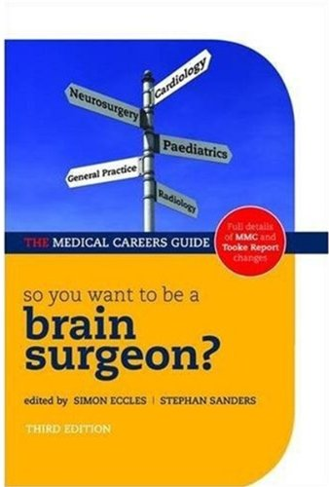
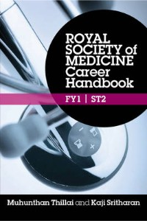
Useful resources
Modernising Medical Careers www.mmc.nhs.uk
BMJ Careers (medical courses, articles on CV preparation and interview tips)—http://careerfocus.bmj.com
MedicalCareers.nhs.uk – practical advice, personality tests, information on all specialties – www.medicalcareers.nhs.uk
So you want to be a brain surgeon by Simon Eccles and Stephan Sanders – excellent source about different specialties
Royal Society of Medicine Career Handbook FY1-ST2 by Muhunthan Thillai and Kaji Stritharan

