Slide 1
Medical emergencies: debrief and summary
25/06/2013
Herman Tam Yousuf Salmasi FY1

Slide 2
Outline
Introduction
Quiz
Feedback

Slide 3
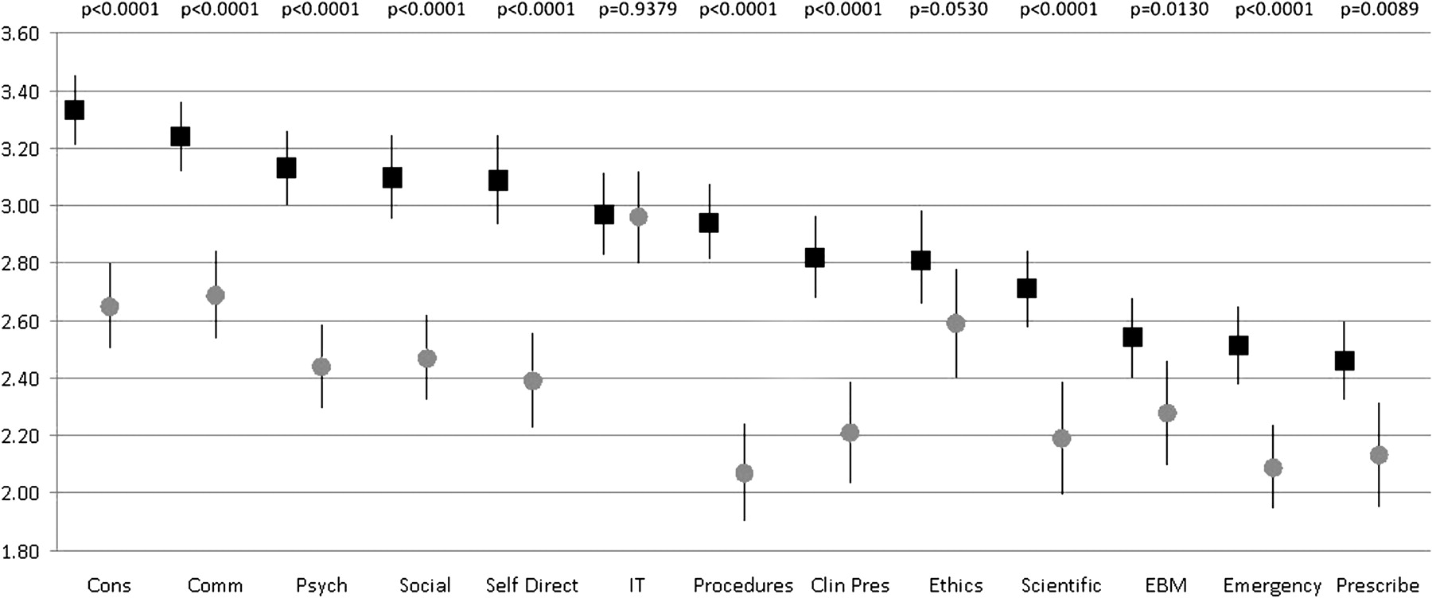
Introduction
FY1 Transition is stressful
Acute care poorly prepared for?
(Tallentire 2011)
Notes:
Overall means and 95% CIs over 3 years for Foundation year 1 doctors (FY1s) (black squares) and educational supervisors (grey circles) in the various domains. Clin pres, clinical presentations; Comm, communication; Cons, consultation; EBM, evidence based medicine; IT, information technology; Psych, psychological aspects.
Tallentire V R et al. Postgrad Med J 2011;87:590-595

Slide 4
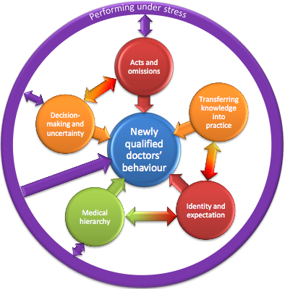
Factors involved
(Tallentire 2011)

Slide 5
But…
Care of acutely unwell patient is complex
New clinical responsibility perhaps cannot be directly prepared for
?Preferable from patient safety perspective that graduates never feel completely at ease
Perceived preparedness is poor surrogate with actual preparedness
Take immediate steps with diagnostic uncertainty

Slide 6
5 Scenarios
ACS
GI bleed
Delirium
Sepsis
Post-op complications

Slide 7
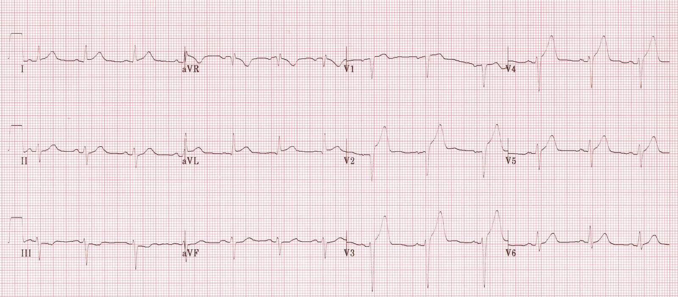
Quiz
1. This ECG shows:
1. Anterior MI
2. NSTEMI
3. Posterior MI
4. STEMI
5. Unstable Angina
Notes:
Correct answer: 1. Anterior MI

Slide 8
Quiz
2. You should prescribe the following immediate treatment in all ACS except:
1. Aspirin 300mg
2. Clopidogrel 300mg
3. LMWH
4. Nitrates
5. Thrombolysis
Notes:
Correct answer: 5. Thrombolysis should only be used in STEMI when immediate PCI is unavailable

Slide 9
Quiz
3. What is the extension for arrest calls?
1. 111
2. 2222
3. 22222222
4. 911
5. 999
Notes:
Correct answer: 2. 2222

Slide 10
Quiz
4. Reversible causes of cardiopulmonary arrest includes all of the following except:
1. Hyperkalaemia
2. Hyperthermia
3. Hypoxia
4. Tamponade
5. Tension pneumothorax
Notes:
Correct answer: 2. Hyperthermia. Hypothermia is a reversible cause of cardiopulmonary arrest

Slide 11
Feedback
Evaluation forms

