Slide 1
“Doctor, we have a patient who is passing malaena”

Slide 2
Questions
Who? Where?
Is this true rectal bleeding?
Obs?
Is the patient haemodynamically stable?
Leave a sample please
I’ll be there in 5, in the meantime..

Slide 3
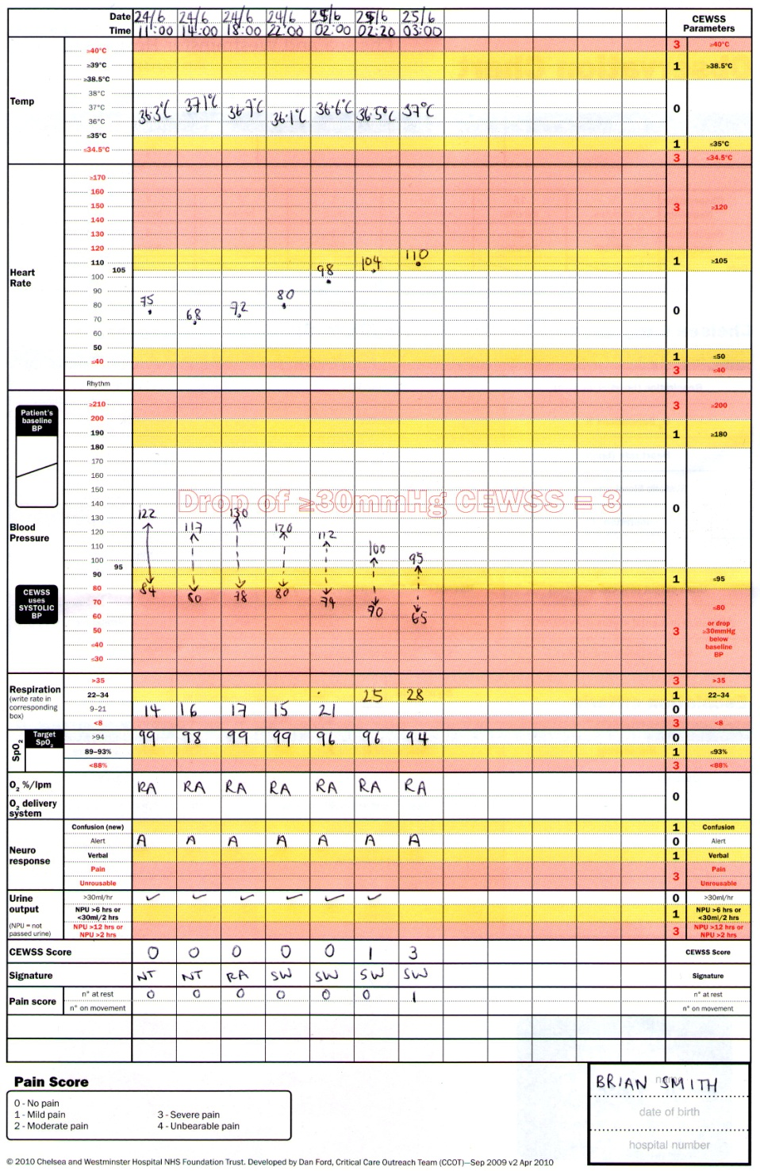
Observation Chart

Slide 4
Upper GI Bleed

Slide 6
APPROACH THE PATIENT
A- Airway
B- Breathing
tachypnoeic, desaturating, signs of heart failure

Slide 7
B- Breathing
oxygen

Slide 8
APPROACH THE PATIENT
A- Airway
B- Breathing
tachypnoeic, desaturating, signs of heart failure
C-Circulation
Hypotension, tachycardia, prolonged CRT, poor UO, thready pulse, cool peripheries

Slide 9
C-Circulation
IV access large bore
Take blood samples incl. G+S
Fluid rescusitation
Blood products

Slide 10
APPROACH THE PATIENT
D - Disability
pupils
BMs
E - Exposure

Slide 11
Abdominal Examination
PR examination
Notes:
Gloves
Lube
Tissues

Slide 12
READ NOTES
Background
Admission details
Previous investigations- endoscopy?
Ceiling of Care- DNAR status
BLOODS (Latest Hb)
DRUGS

Slide 13
Case 1- BLOODS
Na | 135 | Hb | 8.6
K | 3.9 | WCC | 7.7
Ur | 12 | Plts | 145
Cr | 79
 |  | INR | 4.2
Br | 4 | PT | 20
ALT | 30
ALP | 50

Slide 14
DRUG CHART
Amlodipine | 2.5 | Om
Warfarin | 3mg | Od
Adcal | 2 tabs | Tds
Omeprazole | 20mg | Om
Simvastatin | 20mg | On
Notes:
3-6 stop warfarin. Restart when <5
6-8 no/minor bleeding: stop warf. Restart <5
>8 no/minor bleeding: stop warf. Restart <5. + risks vit k 0.5mg iv or 5mg po
Mjor bleeding: stop warfarin. Iv vit k. PCC 30-50U/kg

Slide 15
SUMMARY
Treating hypovolaemic shock.

Slide 16
General Management 1
Fluid balance
IV access
Wide bore (green/grey) cannula
Fluid challenges
Initially give 500ml Gelofusin STAT
Monitor & titrate according to clinical response
Further challenges / 1L saline over 2-4hours
Relay what you prescribe to the nurses
Catheterisation
Strict input/output chart. Aim positive balance.
Notes:
Large bore Cannula, Fluids
Blood bottles : FBC, LFTs, U+Es, Clotting, XM
Prescribing PPI infusion

Slide 17
General Management 2
Urgent Bloods
FBC, U+Es, LFTs, Clotting (incl INR), XM
Initially run a VBG to get a Hb estimate
Remember to correctly label bottles & send as URGENT
Can inform blood bank
NBM
Call for senior help – MedReg
SBAR

Slide 18
Stopping drugs
Warfarin
Clopidogrel
Aspirin
Heparin
Rivaroxaban
NSAIDs
Anti-hypertensive medications

Slide 19
Additional
Transfusion
Risk assess + Monitoring
Endoscopy
DOCUMENT(!) everything you do and every conversation you have about the patient

Slide 20
SBA 1
Patient on warfarin with signs of active bleeding. INR 8.5. What would you do?
1) Give Prothrombin complex concentrate
2) Hold warfarin + give Vitamin K
3) Give Fluids
4) Hold warfarin alone
5) Give Vitamin K alone
Notes:
Answe : hold warfarin + give vit K

Slide 21
SBA 2
Patient is having a suspected variceal bleed. According to current guidelines, when would you arrange for an endoscopy to take place?
1) within 30 minutes
2) within 4 hours
3) within 24 hours
4) within 1 week
Notes:
Answer : within 4 hours

Slide 22
SBA 3
Patient is having an upper GI bleed. Which of the following is most likely to be a cause?
Ramipril
Omeprazole
Atorvastatin
Paracetamol
Ibuprofen
Notes:
Answer : Ibuprofen

Slide 24
Quiz 2
Known alcoholic
Distended abdomen
Yellowing of sclera
Haematemesis
--Suspected Variceal Bleed
IV Terlipressin 2mg STAT
IV Ceftriaxone 2g
Notes:
Drug charts
BNF
Look at trust guidelines!

Slide 25
Quiz 3
Pt with RA
On long-term Ibuprofen
History of epigastric discomfort over past few months
-- Suspected Peptic Ulcer bleed
PPI infusion – IV Pantoprazole 40mg

