Slide 1
Improving selection to the Foundation Programme
NB: Imperial College London:
One-hour Pilot Situational Judgement Test (SJT) for all Year 6
students to be held on the morning of Friday 11 November 2011 at
the Charing Cross Campus. Further details to follow from the FEO.

Slide 2
Foundation Programme Recruitment – improving and evolving
FP 2005 Foundation Programme was introduced: local paper-based applications
FP 2006 National timetable and standard application introduced: 50% paper-based applications + 50% on-line applications
FP 2007 – 100% of applications online using white
Present space application form questions and
academic quartiles

Slide 3
Evolution
2009 DH commissioned a review of selection methods. The Improving Selection into the Foundation Programme project was set up and overseen by the Medical Schools Council
2010/2011 New selection methods were piloted
successfully
FP 2012 Full-scale Parallel Recruitment Exercise (PRE)
FP 2013 New selection methods implemented
Notes:
The Department of Health commissioned a review of the current selection methods, not because they didn’t work, but because they wanted to ensure that we were using the latest research evidence and most modern selection methods to most effectively recruit new foundation doctors into the NHS.
The new selection methods were piloted with a number of schools in the UK, and abroad in Dublin and Malta.

Slide 4
What are the new selection methods?
Situational Judgement Test (SJT)
SJTs will replace the white-space application form questions
This is a two-hour, invigilated test given under exam conditions
The test, consisting of 60 questions, will be machine marked
Educational Performance Measure (EPM)
The EPM will replace the academic quartile scores. The EPM score is comprised of three elements:
medical school performance
additional degrees
academic achievements
Notes:
This review started in January 2009 and involved a cost benefit analysis, literature reviews, expert panel, stakeholder survey and consultation.
After considering all the evidence the project group recommended two new selection methods (for piloting and analysis to ensure best way forward before implementation)
EPM, to reflect performance at medical schools – as the current quartiles do
SJT, mapped against the person specification – as the current white space questions do
This review is about evolution, not revolution. The way that students apply and select choices etc will not change. Only the way the score is produced is being amended.
The EPM scores will be combined with the SJT scores to give an overall score which will be used for selection purposes. The ongoing pilots will consider the relative weightings of the EPM and SJT scores and how they should be combined to produce an overall score for selection purposes.

Slide 5
How will recruitment work in the future?
FP 2012 – FPAS runs as normal + new recruitment process trialled
through the Parallel Recruitment Exercise (PRE)
SJT: All students are expected to participate in a shortened version of the
SJT– the exam will only be one hour and will consist of 30 questions
EPM: Medical school staff will calculate EPM deciles for each student
IMPORTANT: Scores from the EPM and SJT will not impact your FPAS
score
FP 2013 – SJT and EPM implemented nationally for live recruitment,
replacing white space questions and academic quartiles
Notes:
Will not affect allocation in this year’s application round – we are running a Parallel Recruitment Exercise (EPM) in addition to the current FPAS system. All students and schools will be expected to take part to ensure that any problems are ironed out ahead of implementation for FP 2013.
Will only affect those applying to the Foundation Programme for August 2013 and beyond

Slide 6
What is the PRE?
New selection methods will be trialled alongside the normal selection methods during this year’s national FP recruitment round
All final year medical students will be asked to participate, in addition to completing their FPAS forms
The PRE is the final step in ensuring the selection methods can be consistently and robustly applied before implementation for FP 2013
Notes:
Parallel Recruitment Exercise – running in all UK medical schools during the 2011/2012 academic year
Final year medical students will take part in on hour SJT and medical school staff will be required to calculate the EPM decile

Slide 7
What are Situational Judgement Tests?
SJTs are:
a test of aptitude
designed to assess the professional attributes expected of a Foundation doctor
based on a job analysis of an F1 doctor
SJT questions assess your judgement by presenting you with
challenging situations you are likely encounter at work as an F1 doctor
Notes:
Situational Judgement Test
Used in GP training and many other organisations such as FBI and Fire Service, police, civil service
An invigilated assessment which will assess professional judgement and attributes expected of the Foundation Doctor. This is not something students can revise for, but these are skills and attributes that they should exhibit, and that they will have been made aware of throughout their time at medical school and on placements and so on.
Multiple choice questions – may be asked to rank, or identify say three from eight suitable responses
It is proposed that the SJT will be delivered by medical schools in the UK on a three common dates to allow for electives and unavoidable absence.
The live test will consist of 60 questions to be answered in two hours.

Slide 8
Job analysis of F1 doctor
Commitment to professionalism
Coping with pressure
Effective communication
Learning and professional development
Organisation and planning
Patient Focus
Problem solving and decision-making
Self-awareness and insight
Working effectively as part of a team
Notes:
The SJT questions will test 9 different domains that will be looked for – outlined on the slide (alphabetical order, not order of importance). SJT questions will draw on these domains.
These were identifies through shadowing of foundation doctors as far apart as Cambridge, Manchester and the Scottish isles, as well as over fifty interviews with doctors, patients and other professionals working with F1s
Over 50 attributes were identified that were grouped into these nine domains – each of which is reflected in the FY1 person specification.

Slide 9
Why change from white-space questions?
What students say:
Some applicants get help writing their answers from parents/friends who are doctors and it is not fair to those who don’t get help
Model answers can be bought on the internet
Very time-consuming and stressful to complete during a busy time
White-space questions are creative writing exercises
Perceived variability in scoring
Notes:
Students have raised concerns during the recruitment feedback surveys about white-space questions, particularly:
Whilst the current system works well, there are a number of concerns that need to be addressed including:
Longevity of white space questions – there’s a limit to how many variations of questions can be asked when mapping against the same person specification
risk of plagiarism – with a 2 week window within which applicants can answer the questions
Anecdotal feedback that white space questions are an exercise in creative writing
Costly in terms of consultant time to score white space questions – brings about the question ‘is it cost effective?’
As for quartiles, want to recognise achievements at medical school – but the composition of quartiles in one school could be very different from another school
Recommendations on the best way forward, using evidence gathered from pilots during the 2010/2011 academic year.

Slide 10
Why change from white-space questions?
What the UKFPO and deaneries say:
Difficult to ask questions about teamwork, professionalism, etc in sufficiently different ways
The more similar the questions are, the more model answers and “answer writing” workshops will be available resulting in a narrow spread of scores
Difficult to differentiate between candidates with similar scores for ranking and selection into the Foundation Programme
Scoring is resource-intensive
Notes:
Whilst the current system works well, there are a number of concerns that need to be addressed including:
Longevity of white space questions – there’s a limit to how many variations of questions can be asked when mapping against the same person specification
risk of plagiarism – with a 2 week window within which applicants can answer the questions
Anecdotal feedback that white space questions are an exercise in creative writing
Costly in terms of consultant time to score white space questions – brings about the question ‘is it cost effective?’
As for quartiles, want to recognise achievements at medical school – but the composition of quartiles in one school could be very different from another school
Recommendations on the best way forward, using evidence gathered from pilots during the 2010/2011 academic year.

Slide 11
Why change to SJTs?
Exam conditions – therefore fair for everyone
Research evidence to support use
Sufficient questions can be developed for long-term use
Access to questions and answers prior to taking SJT
Marks for near misses
Within medical selection, SJTs have been shown to be a reliable and valid method of selection
Able to differentiate between candidates
Evidence shows ability to predict performance in the role
SJTs are increasingly popular in large-scale selection (both in medical selection in the UK and in other disciplines – police, FBI, fire service)
Notes:
Students will take the SJT in exam conditions and so everyone will have an equal chance to do well. There is also research evidence to support the use of SJTs and it is expected that a sufficient number of questions can be developed in order to use SJTs in the long term.
Students and schools will have access to example questions to help understand the format and prepare them for the SJT so they will feel comfortable with the format and layout prior to taking the test
The scoring key allows for near misses for the ranking questions which means that students will not be penalised if get all but two answers the wrong way round. Does penalise people who get the best and worst options the wrong way round.
Pilots so far have shown that SJTs are able to differentiate between students – some students felt that would result in everyone getting similar score but this was shown not to be the case.

Slide 12
Example Questions
There are two question formats:
Rank the responses given in the most appropriate order
Choose the three most appropriate responses for the situation
You should answer what you ‘should’ do in the scenario
described, not what you ‘would’ do
Notes:
SJTs are a test of aptitude and are designed to assess the professional attributes expected of a Foundation doctor. There are two question formats:
Rank five possible responses in the most appropriate order
Select the three most appropriate responses for the situation
Different scenarios lend themselves to different response formats so using two different formats allows a range of situations to be tested.
Students must answer what they ‘should’ do in the scenario described, not what they ‘would’ do. This is because research into SJT shows that questions asking a candidate what they ‘would’ do are more susceptible to coaching.

Slide 13
Example Question 1 – rank response
Mr Johnson is admitted with a minor groin abscess requiring surgical drainage although
he is otherwise well and has full mental capacity. Four hours prior to surgery Mr
Johnson informs a nurse that he wishes to self discharge as he says he is due in court.
Mr Johnson’s next of kin are aware that he has been admitted for surgery and that he is
due in court. The nurse asks you to speak to him.
Rank in order the following actions in response to this situation (1= most appropriate;
5= least appropriate).
A Allow Mr Johnson to leave but advise him to see his General Practitioner if there are further problems
B Prevent Mr Johnson from leaving by phoning security
C Explain to Mr Johnson the risks of leaving without treatment
D Telephone Mr Johnson’s next of kin to ask them to try and persuade him not to leave
E Allow Mr Johnson to leave but ask him to return to the hospital as soon as possible

Slide 14
Answer to Question 1
C Explain to Mr Johnson the risks of leaving without treatment
E Allow Mr Johnson to leave but ask him to return to the hospital as soon as possible
D Telephone Mr Johnson’s next of kin to ask them to try and persuade him not to leave
A Allow Mr Johnson to leave but advise him to see his General Practitioner if there are
further problems
B Prevent Mr Johnson from leaving by phoning security
Communicating to Mr Johnson the risks of leaving is important as he may not be aware
of these risks. However, it is the patient’s choice as to whether he remains in hospital.
Informing him that he should return to the hospital is important. Mr Johnsons’ kin are
aware of the situation and may be able to persuade him to stay. By asking Mr Johnson
to see his GP, instead of returning to the hospital, you would be passing responsibility
for his care, however this is more appropriate than forcing a patient to stay against his
wishes.
Notes:
Correct answer will get 20 points. If you get E and C wrong way round, for example, you would get 18 points. The scoring grid is quite complex and is still being developed through analysis of results.

Slide 15
Example Question 2 – choose best 3
You review a patient on the surgical ward who has had an appendicectomy done
earlier on the day. You write a prescription for strong painkillers. The staff nurse
challenges your decision and refuses to give the medication to the patient.
Choose the THREE most appropriate actions to take in this situation
A Instruct the nurse to give the medication to the patient
B Discuss with the nurse why she disagrees with the prescription
C Ask a senior colleague for advice
D Complete a clinical incident form
E Cancel the prescription on the nurse’s advice
F Arrange to speak to the nurse later to discuss your working relationship
G Write in the medical notes that the nurse has declined to give the medication
H Review the case again

Slide 16
Answer to Question 2
B Discuss with the nurse why she disagrees with the prescription
C Ask a senior colleague for advice
H Review the case again
Ensuring patient safety is key to this scenario. It is important to discuss the
nurse’s decision with her as there may be something that you have missed
when first reviewing the patient. Therefore it would also be important to review
the patient again. Also relating to this is the importance of respecting the views
of colleagues and maintaining working relationships, even if there is
disagreement. As there has been a disagreement regarding patient care, it is
important to seek advice from a senior colleague.
Notes:
In this example, students will receive 4 marks for each correct answer. However, if they put more than 3 options down they will get no marks. Only three answers must be selected.

Slide 17
Benefits of practicing the SJT
It is good preparation for specialty selection
You will get feedback on how you scored
Your medical school will expect you to take part unless you are on elective
You are helping to form national recruitment policy
Notes:
PRACTICE! This provides students with an excellent chance to familarise themselves and practice this style of question format before encountering it for real during specialty selection
They will receive feedback on their score
They will be helping to form the national recruitment policy – and their views and input are extremely important to ensure a fair system is implemented
All schools will be expecting students to take part and if they cannot it is likely they will need to talk to a senior staff member as to why they aren’t going to take part.

Slide 18
Why change to EPM?
A clear framework with agreed principles will be used to calculate the EPM, ensuring that it is fair, transparent and consistent across the schools of the UK
Splitting cohorts into deciles rather than quartiles provides a wider spread of scores which makes it easier to differentiate between candidates
It makes more sense for all the academic components of the application to form one part of the application, rather than being split between white-space questions (Q1) and academic quartile ranking
Notes:
Regarding quartiles – we want to recognise achievements at medical school but the composition of quartiles in one school could be very different from another school. This makes it less fair for students
An EPM framework has been produced which outlines various rules that schools will need to abide by when calculating the EPM. This will help make it more consistent and as schools will be required to publish how they will produce the EPM score it will be more transparent
Recommendations on the best way forward, using evidence gathered from pilots during the 2010/2011 academic year.

Slide 19
How is the EPM calculated?
Score produced by applicant’s medical school to reflect achievement
and performance compared to rest of cohort
EPM = 3 parts (maximum 50 points):
Medical school performance (34 – 43 points)
E.g. Top 10% = 43; Top 20% = 42; etc
Additional degrees (max 5 points)
Educational achievements (publications, prizes and presentations (max 2 points)
Schools will consult with students about how it plans to calculate the
EPM and publish its method online
Notes:
The EPM reflects a student’s performance at medical school on summative assessments, with all schools (UK and non UK) using the same framework which outlines various rules that each school must obey when calculating the EPM decile score.
An initial pilot took place in 2010 and showed the complexities of producing such a Framework. To address this an EPM Task and Finish Group was set up to look at the complexities and make recommendations, which were:
EPM calculated using deciles ranging from 34 – 43 points rather than quartiles
Students can receive up to 5 points for intercalated degrees, masters etc. The Nottingham/Southampton issue is being discussed and a proposal has been made which is waiting approval.
Students will receive a maximum of 2 points for publications, national prizes and presentations.
Schools will have to consult with students about how the EPM will be calculated/range of assessments selected and will have to publish this information on its website.
Very similar to white space questions which currently award points for intercalated degrees, prizes, publications, presentations.
Extra curricular activities will not be awarded any points.

Slide 20
1. Medical school performance (max 43 points)
Your medical school will use your results from a number assessments
to calculate your decile score, as outlined in the EPM Framework
published at www.isfp.org.uk
The EPM Framework sets out the principles for calculating deciles,
which are listed below. Assessments must:
be summative (and therefore subject to more formal controls)
cover clinical knowledge, skills and performance
cover non-clinical performance
cover all aspects of the curriculum assessed up to the end of the penultimate year at medical school
represent the average performance of applicants over time
include written and practical assessments
Notes:
Students will be assessed and ranked on their medical school performance. Medical school performance will be assessed using a range of assessments and it will be up to each medical school to define which will be used and the relative weighting of each assessment. No matter which assessments are chosen, they must all adhere to the agreed principles outlined on the slide.
The EPM Administrator will then divide their cohort into deciles of roughly equal size and will assign each student a decile score.
There is no minimum number of assessments to be taken into account in constructing deciles. However, only assessments which achieve a fair spread of scores or grades should be included. Pass/fail assessments should not count within the decile score, unless there is a sufficient number of pass/fail assessments that an above-average applicant is likely to fail at least a few.
Each medical school will construct an initial basket of assessments to be used in decile rankings. Students must be consulted with and be given the opportunity to share their views before the final assessments are agreed. Once your assessments have been chosen, these must also be published on your website.
Finalised decile scores calculated as part of the PRE must be sent in an Excel spreadsheet along with each applicant’s RA number to the ISFP project for evaluation by 1 February 2012.

Slide 21
2. Additional degrees (Max 5 points)
A maximum of 5 points for degrees awarded by time of application to
Foundation Programme:
Previous degree | Number of points
Doctoral degree (PhD, DPhil, etc) | 5
Masters degree 1st class honours degree Bachelor of Dental Science (BDS) B Vet Med | 4
2.1 class honours degree 1st class intercalated degree which does not extend the degree programme | 3
2.2 class honours degree 2.1 class intercalated degree which does not extend the degree programme | 2
3rd class honours degree Unclassified or ordinary degree 2.2 class intercalated degree which does not extend the degree programme | 1
Primary medical qualification only 3rd class intercalated degree which does not extend the degree programme | 0
Notes:
Applicants can earn up to 5 points for additional degrees that have been awarded by the time of application to the Foundation Programme (either prior to medical school or an intercalated degree). Official notification from the university must be provided. Where the applicant has received a pass result but has not received the degree certificate, a letter from their medical school Dean confirming that they have passed must be provided on letter headed paper, signed and dated by the Dean.
If an applicant holds more than one degree at the time of application to the Foundation Programme, they should provide evidence of the degree that will achieve the highest number of points.

Slide 22
3. Educational achievements (max 2 points)
A maximum of 2 points will be awarded for national prizes,
presentations and publications:
Educational achievements | Number of points
Prizes 1st prize – National/international educational prize | 1
Presentations Oral presentation at a national or international conference 1st named author in a poster or presentation at a national or international conference | 1
Publications Educational research paper published in a peer-reviewed journal | 1
Maximum number of points available | 2
Notes:
Students can earn a maximum of 2 points in this category. Additional points for previous degrees, prizes, publications and presentations will be automatically awarded by FPAS, and will be subject to verification by medical school and foundation school staff. During the FP 2012 recruitment round, verification will take place on 26 Oct in London at a National Verification Day. It is likely that this will happen for the FP 2013 recruitment round as well.
Prizes
Bursaries and medical school prizes will not count in this category. The prize must be an educational prize, it must be 1st prize and it must be a national or international prize. A letter of evidence from the awarding body must be provided by the student and uploaded onto FPAS.
Presentations
Students must have either personally given a presentation at a national or international conference, or must be the first named author on a poster presentation. The conference must be hosted by a recognised professional medical body in order for a student to receive a point. The conference must have taken place by the time of application to the Foundation Programme. A letter of evidence from the conference host must be provided by the student and uploaded onto FPAS.
Publications
Students must supply a PubMed ID (PMID) at the time of application to the Foundation Programme or provide a letter of evidence that the work has been accepted for publication and is ‘in press’ for a publication which has a PMID. This includes papers, abstracts, book chapters, audits and in rare cases, letters. The front page of the article including the title and authors’ names must be provided by the student and uploaded pnto FPAS.
If an applicant has more than one publication, prize or presentation, they will receive a maximum of one point for any of the three categories individually; a maximum of two points in total.

Slide 23
Parallel Recruitment Exercise - EPM
Your medical school administrator will calculate your decile score which
will be submitted for analysis in Feb 2012, to be analysed alongside
your Question 1 scores (additional degrees and educational
achievements) which will form the EPM score next year.
Your decile score will:
be calculated by your medical school using the methods they are planning to use for FP2013
be used confidentially for the purposes of analysis
NOT have any bearing on your FPAS application score, nor will the information be used to determine your allocation to foundation school or to programme
In the event of failed finals/re-applying to the FP2013, your original EPM decile score will count
Notes:
Students will have minimal involvement in the EPM – accept discussing the assessments that have been chosen with their school. Their input will help decide which assessments are taken into account in the future and ensure this is fair for other students.
Schools will be required to publish which assessments will be taken into consideration when calculating the deciles by December and will need to consult with students during this month. Once any amendments have been made to the framework the school will use, the decile score for each student will need to be calculated and submitted to the ISFP Project Group by Feb 2011
Each school will have a lead EPM administrator.
If a student fails the year or re-applies to the FP2013 it is worth noting that their original EPM decile score will count and will not be able to be increased if do better if re-sit the year. Should only apply to a small number of people. They can still gain extra degree points etc.

Slide 24
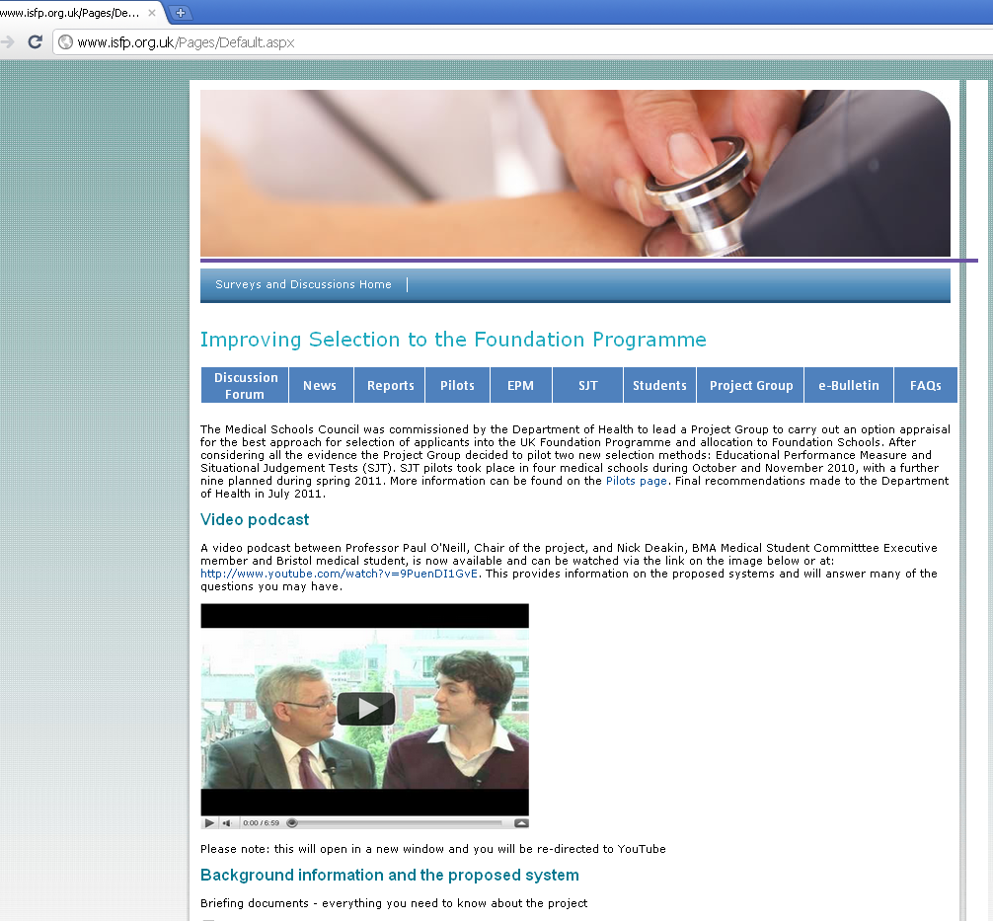
More information
ISFP website – www.isfp.org.uk
Discussion forum
E-bulletin updates
Project handbook
FAQs
Facebook
YouTube (background info)
UKFPO student representative at your school
Emails from medical schools – keep a look out in your inbox!
Notes:
Students views are hugely important to the project group.
These are some of the different ways students can keep update with the project, find out more and send us their comments.

Slide 25
Any questions?
admin@isfp.org.uk
www.isfp.org.uk
Notes:
Please ask if they have any questions.
If you cannot answer these please make a note of them and contact us with these and we will respond directly to you.

