Slide 1
Orthopaedics for finals Part 1
Mr Harry Krishnan
MRCS, MBBS, BSc (Hons)
Core Surgical Trainee
Hillingdon Hospital
London
Mr Chinmay M Gupte, PhD, FRCS (Tr &Orth), MA, BM BCh
Consultant Orthopaedic Surgeon Imperial College Healthcare NHS Trust

Slide 2
Finals – What we expect
Be able to present Radiographs in a succinct manner
Understand basic fracture management principles
Become familiar with a few common fracture classifications
Appreciation of application of instruments/prosthesis
Use Instrument/ Xray as a tool to discuss application and management principles

Slide 3
Outline
Classification of fractures
Presentation of Xrays
4 R ‘ s
Complications
# NOF
Salter-Harris #
Colles #
Ankle fractures
Open fracture

Slide 4
Classification of fractures
Nature of injury
Energy involved
Universal communication
Planning treatment
Monitor treatment modalities and outcomes

Slide 5
General classification
Open or closed #
Pattern
Anatomical location
Intra-articular / extra articular
Displaced/ undisplaced

Slide 6
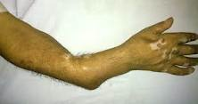
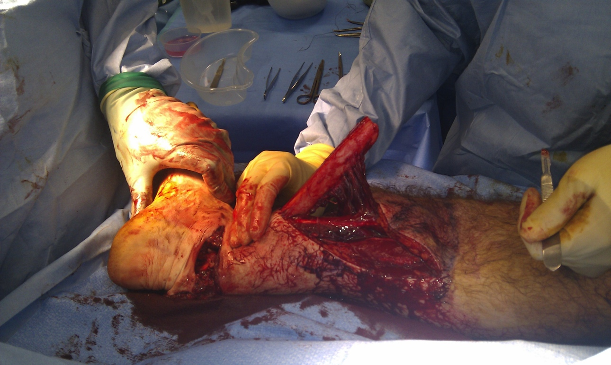
Open or closed #

Slide 7
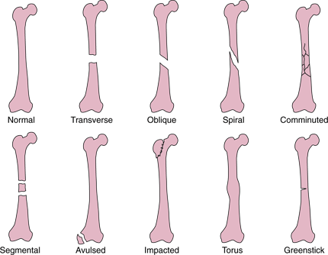
Pattern

Slide 8
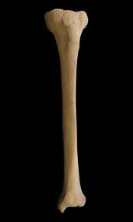
Anatomical location
Proximal 1/3
Middle 1/3
Distal 1/3

Slide 9
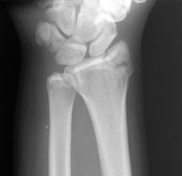
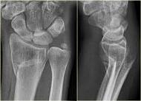
Intra-articular / extra articular

Slide 10
Displaced/ undisplaced
Displacement: cortical contact – is present if the ends of bone have shifted relative to one another
Displacement described in terms of distal fragment

Slide 11
Displacement
Undisplaced 50% displaced 100% displaced

Slide 12
Displaced/ undisplaced Angulation
Angulation: described in terms of point of angle of the fracture (or the apex) classically.
You will not fail finals for describing angulation of the distal fragment
Tilt : direction of distal fragment

Slide 13
Angulation/ tilt
Medial apex angulation/ Volar apex angulation/ dorsal tilt
Lateral tilt
dorsal
volar
lateral
medial
It would be ok to say lateral angulation of the distal fragment
It would be ok to say dorsal angulation of the distal fragment

Slide 14
Describing fractures
Clinically : Open or closed
Radiographs:
bone (right or left)
Pattern
Anatomic location in bone (proximal/middle/distal third)
Intra/ extra articular
Displaced/ undisplaced (angulation/ tilt/shortening)

Slide 15
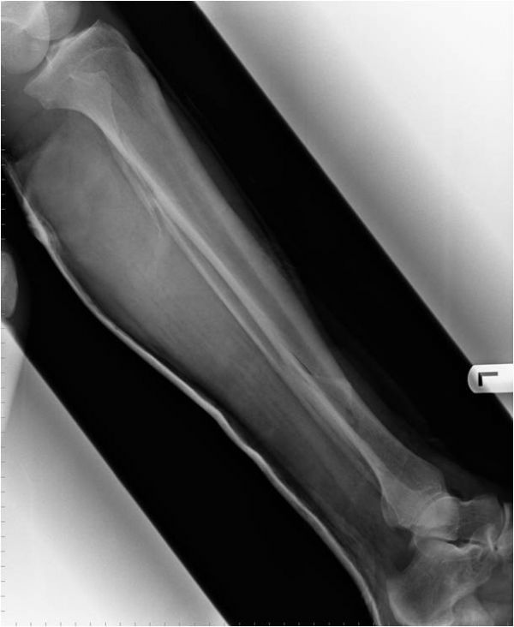
Present this X ray

Slide 16
Summary of #
Spiral # distal third left tibia
50% lateral displacement
Lateral apex angulation of #
Medial tilt of distal fragment
Or
Medial angulation or varus angulation of distal fragment
Short
Medial
Lateral

Slide 17
Outline
Classification of fractures
Presentation of Xrays
4 R ‘ s
Complications
# NOF
Salter-Harris #
Colles #
Ankle fractures
Open fracture

Slide 18
4 Rs
Resuscitate - ATLS
Reduce – Open / Closed
Restrict – Collar and cuff, braces, Plaster, Percutaneous k wires, internal fixation, external fixation
Rehabilitate – MDT (Physio/ OT/ Social services)

Slide 19
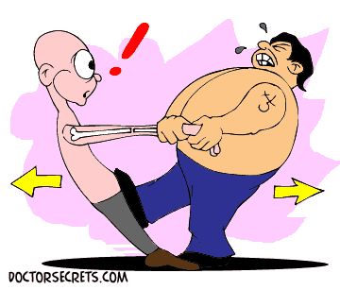
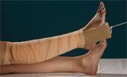
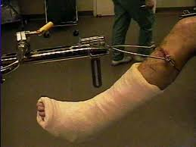
Reduction

Slide 20
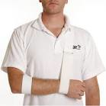
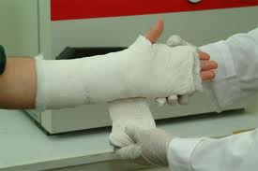
Restriction

Slide 21
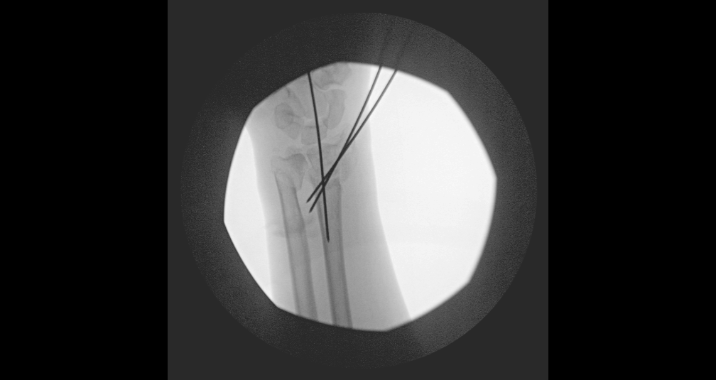
Restriction
K wires

Slide 22
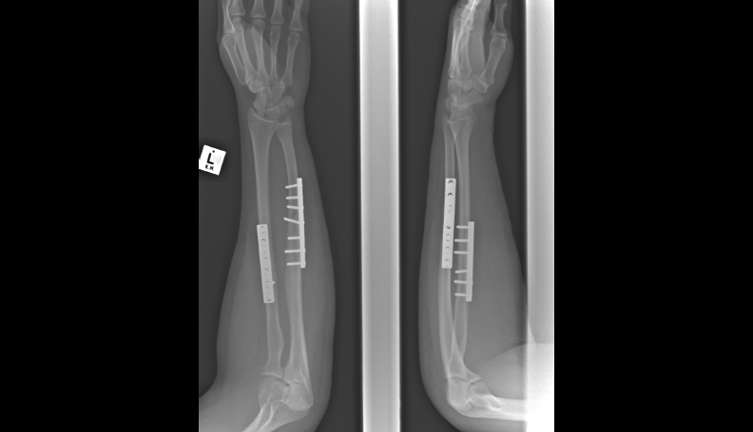
Restriction
Internal fixation – plates and screws

Slide 23
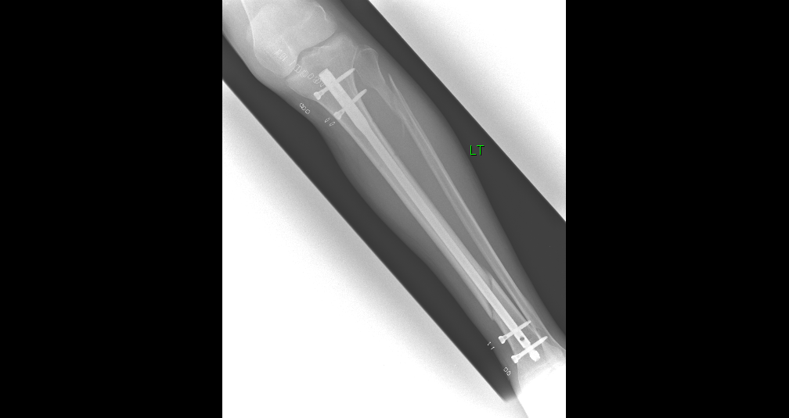
Restriction
Internal fixation – intramedullary nail

Slide 24
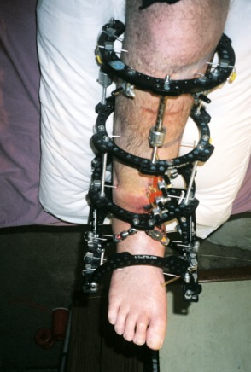
Restriction
External fixation

Slide 25
Outline
Classification of fractures
Presentation of Xrays
4 R ‘ s
Complications
# NOF
Salter-Harris #
Colles #
Ankle fractures
Open fracture

Slide 26
Complications of fractures
Immediate: Neurovascular injury
Soft tissue injury
Early: Compartment syndrome
Fracture blisters
Infection
Embolus (fat/ DVT/ PE)
Late: Delayed/ mal/ non union
Post traumatic osteoarthritis
Complex regional pain syndrome
Growth arrest, Deformity, Joint stiffness,
Chronic infection

Slide 27
Outline
Classification of fractures
Presentation of Xrays
4 R ‘ s
Complications
# NOF
Salter-Harris #
Colles #
Ankle fractures
Open fracture

Slide 28
Classification of hip fractures
Intracapsular – undisplaced / displaced
Extracapsular

Slide 29
Management
Resuscitate appropriately (ATLS). Hx/ Ex
Assess neurovascular status of limb
Analgesia
iv access – fbc/ u+e/clotting/ group and save
ECG
AP pelvis/ lateral hip/ Chest X ray
Admit
DVT prophylaxis
Inform senior
Not clear on X Ray – MRI pelvis

Slide 30
Intracapsular NOF#- anatomy

Slide 31
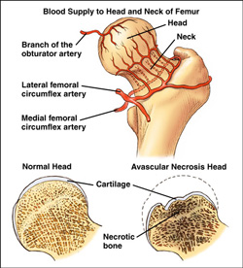
Intracapsular NOF#- anatomy
Main concern is risk of disruption of blood supply to the femoral head and subsequent avascular necrosis.
Undisplaced: Blood supply ok
Displaced: Blood supply potentially disrupted

Slide 32
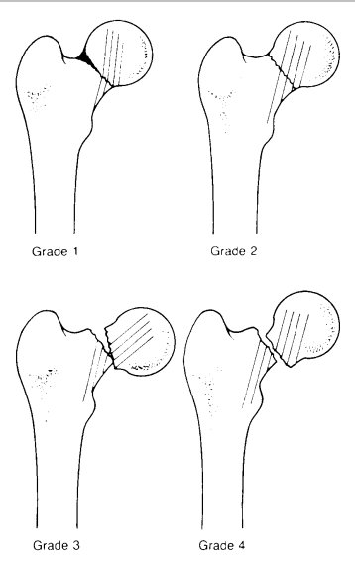
Intracapsular NOF#-Garden classification

Slide 33
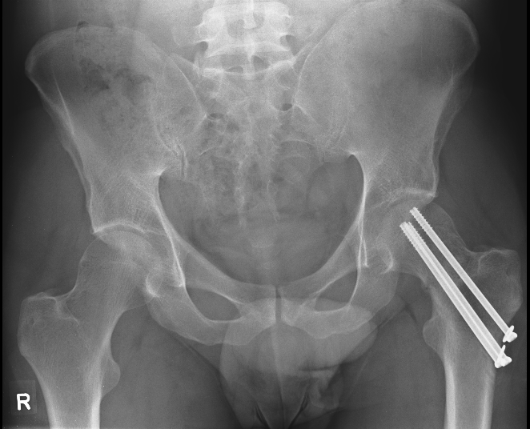
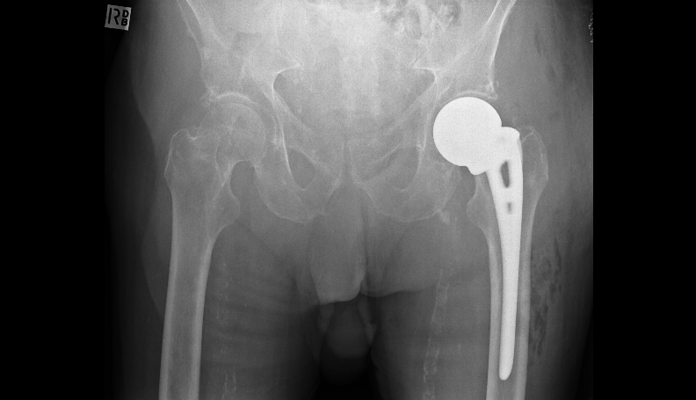
Intracapsular NOF#- Gardens Surgical management
One - two screw
Three – four Austin Moore

Slide 34
Intracapsular NOF#-Surgical management
Displaced NOF#
< 55 Reduce and fix (screws/DHS)
55-75 Total hip replacement
75+ Hemiarthoplasty (walker - cemented Thompsons, non – mobiliser/serious co-morbidities uncemented Austin Moore)

Slide 35
Intracapsular NOF#-Complications
Internal fixation – AVN 15 -33%
Non-union 10 -30%
Reoperation 10 -30%
THR- Dislocation (10%).
Hemiarthroplasty – Dislocation
Anterior thigh pain (A-M uncemented prosthesis)

Slide 36
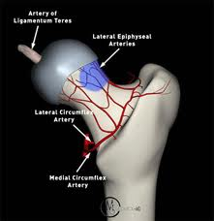
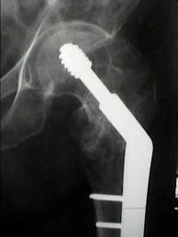
Extracapsular NOF #

Slide 37
Quiz
65 year old female. Hypertensive. Independent. Still exercises.

Slide 38
Quiz

Slide 39
Quiz
Diagnosis
Initial management
Definitive treatment

Slide 40
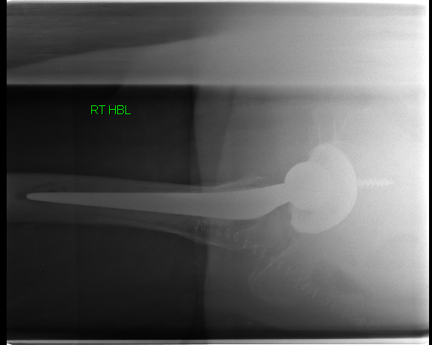
THR

Slide 41
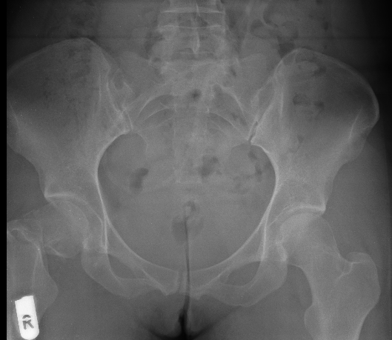
Quiz
36 year old female. Fall. Fit and well.

Slide 42
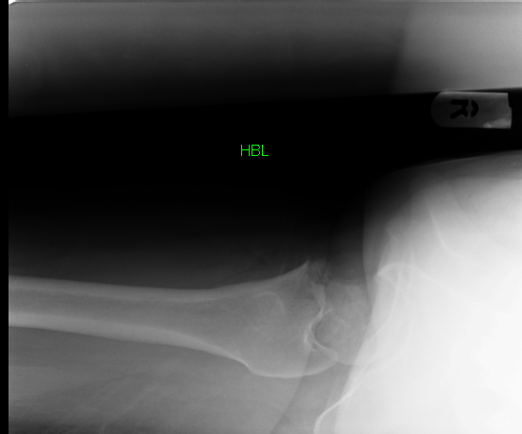
Quiz

Slide 43
Quiz
Diagnosis
Initial management
Definitive treatment

Slide 44
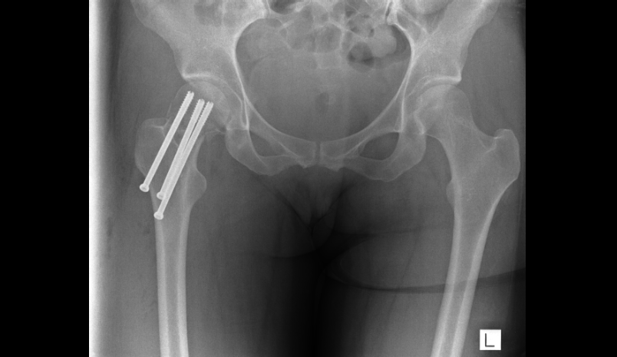
Cannulated screw fixation

Slide 45
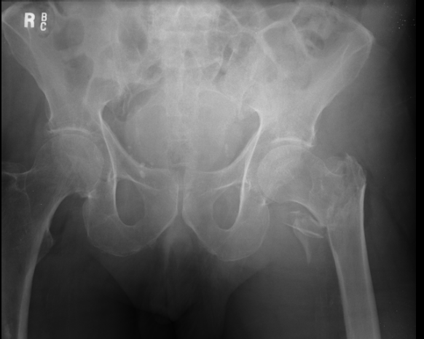
Quiz
93 years. Previous CVA. Arteriopath.

Slide 46
Quiz

Slide 47
Quiz
Diagnosis
Initial management
Definitive treatment.

Slide 48
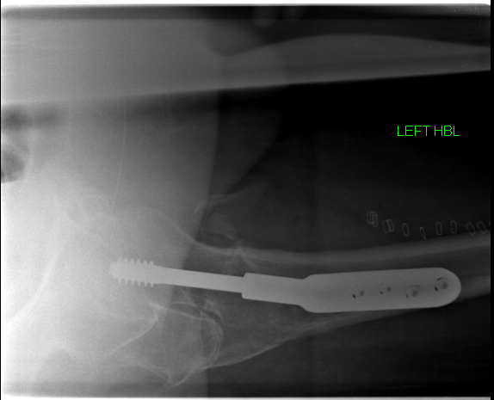
DHS

Slide 49
Outline
Classification of fractures
Presentation of Xrays
4 R ‘ s
Complications
# NOF
Salter-Harris #
Colles #
Ankle fractures
Open fracture

Slide 50
Salter Harris classification
#’s occurring in the skeletally immature around the growth plate
Salter Harris classified I – V
I: # through the physis
II:# through physis and metaphysis
III: # through physis and epiphysis
IV: # through metaphysis/ physis/ epiphysis
V: Crush injury to the growth plate

Slide 51
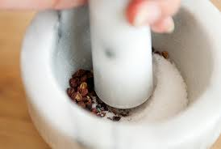
SALT Crush

Slide 52
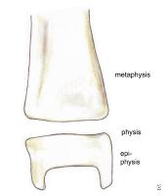
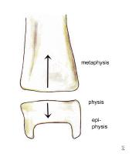
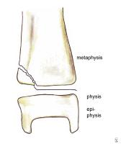
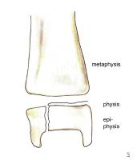
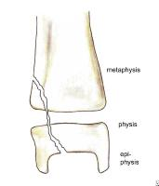
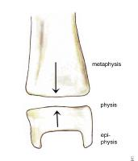
Salter Harris classification
I(S)
II(A)
III (L)
IV (T)
V
(Crush)

Slide 53
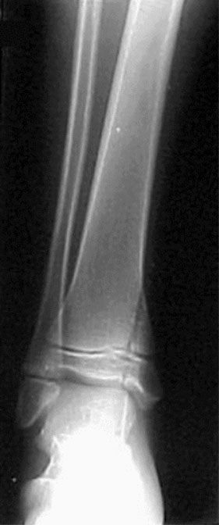
Salter-Harris classification
Salter Harris IV

Slide 54
Salter-Harris classification
I-V indicates higher risk of growth plate injury
III and IV require anatomic reduction
V often diagnosed retrospectively – ie no obvious # initially seen and patient develops subsequent growth arrest in limb

Slide 55
Outline
Classification of fractures
Presentation of Xrays
4 R ‘ s
Complications
# NOF
Salter-Harris #
Colles #
Ankle fractures
Open fracture

Slide 56
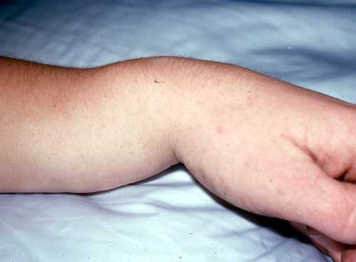
What is this?

Slide 57
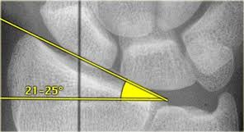
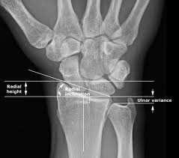
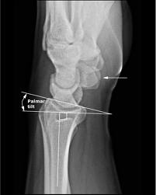
Distal radius – normal anatomy
Radial height (11 mm)
Radial inclination (Normal 22 degrees )
Dorsal tilt (Normal 11 degrees volar)

Slide 58
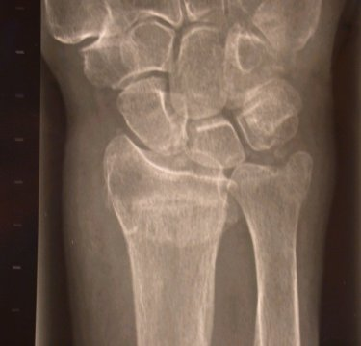
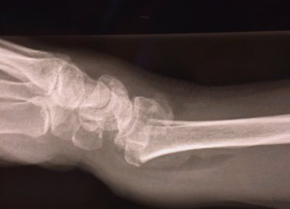
Colles fracture X ray
Loss of radial height (>5mm)
Loss of radial inclination (Normal 20-25 degrees )
Dorsal tilt (Normal 10 degrees volar)
Radial width
Comminution
Ulnar styloid fracture

Slide 59
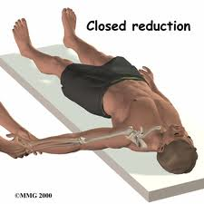
Colles fracture
Reduction: haematoma block/ midazolam
3 people
Counter traction
In line traction
Disimpact #
Over exaggerate injury
Ulnar + volar deviation

Slide 60
Colles fracture
Apply dorsal backslab
Assess neurovascular status pre and post reduction
Repeat x ray
Satisfactory position?
No- ortho review – Consider MUA and K wires
Yes- home c #clinic r/v next 48 hours for completion of POP.
Review at 1 and 2/52 with X ray to ensure no displacement and POP for a total of 6/52 (follow up same for non-op and operative)

Slide 61
Smith’s fracture
Extra-articular distal radius with volar displacement
Inherently unstable (v Colles)
Closed reduction and POP
High risk of displacement in plaster
Lower threshold for ORIF (open reduction and internal fixation) with volar plate.

Slide 62
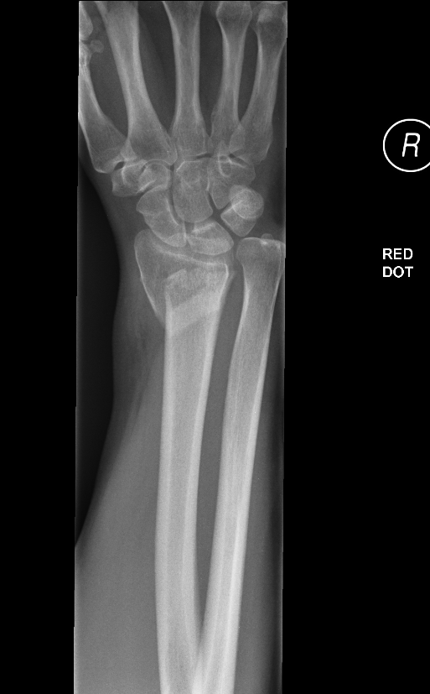
Smith’s fracture- X Ray

Slide 63
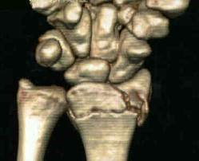
Bartons fractures
Distal radial # intraarticular
Dorsal Barton’s
Volar Bartons

Slide 64
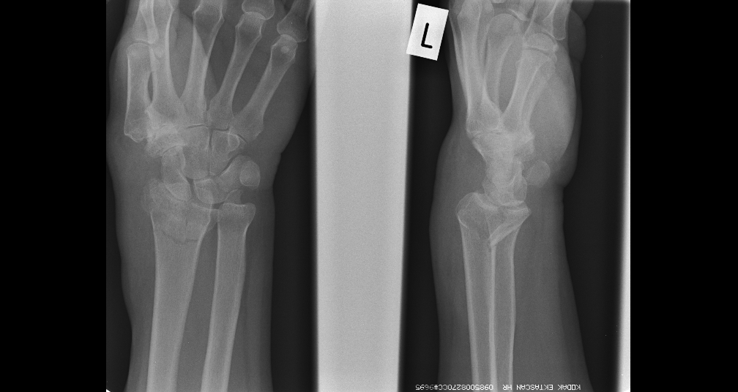
Bartons fractures- X rays
Volar Barton’s

Slide 65
Post ORIF Volar Barton’s

Slide 66
Outline
Classification of fractures
Presentation of Xrays
4 R ‘ s
Complications
# NOF
Salter-Harris #
Colles #
Ankle fractures
Open fracture

Slide 67
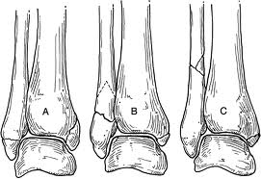
Ankle fractures
Classification
Anatomical – uni/ bi/ tri malleolar
Weber – Relation of fibula # to joint line
A: Below joint line
B: Level of joint line
C: Above level of joint line

Slide 68
Ankle fractures
Relevance of Weber B and C # is they
represent possible injury to the
syndesmotic ligaments between the tibia
and fibula and thus potential instability

Slide 69
Ankle fractures – Uni malleolar

Slide 70
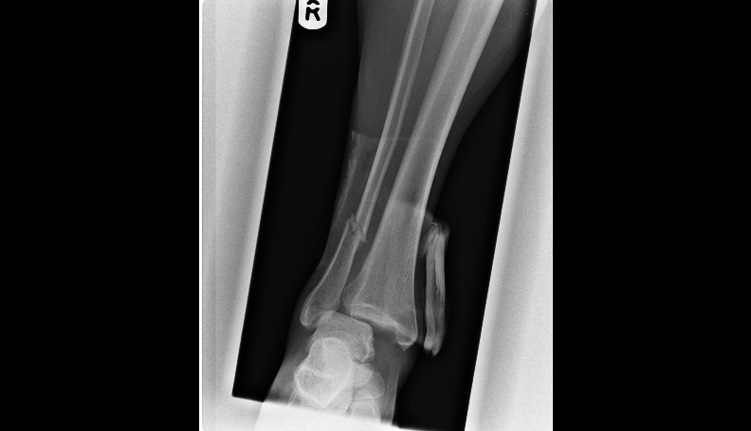
Ankle fractures – Weber C

Slide 71
Ankle fractures- Weber C

Slide 72
Treatment
Resuscitate
Reduce
Restrict
Rehabilitate

Slide 73
Treatment
Weber A: Non-operative. Boot or below knee POP 4-6/52 Weightbearing
Undisplaced Weber B/C: Non-operative. Below knee POP 6/52 Non-weightbearing (NWB)
Displaced Weber B/C:
Non-operative – closed reduction and POP if anatomical reduction achieved
Operative if closed reduction fails – ORIF( open reduction and internal fixation)
Below knee POP 6/52 (NWB)

Slide 74
Outline
Classification of fractures
Presentation of Xrays
4 R ‘ s
Complications
# NOF
Salter-Harris #
Colles #
Ankle fractures
Open fracture

Slide 75
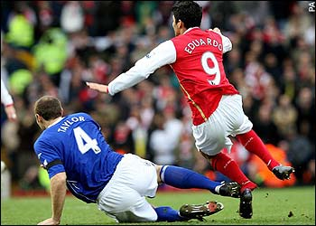
Open fractures

Slide 76
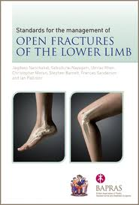
Open fractures
ATLS primary and secondary survey
Analgesia
Assess NV status of limb
Antibiotics
Anti tetanus
An image (photo)
Antiseptic dressing
An X ray
Ask for help
Theatre – wound debridement and skeletal stabilisation

Slide 77
Open fractures

Slide 78
Compartment syndrome
Limbs are divided into osteofascial compartments by thick fascial bands
A condition where the pressure within an enclosed anatomical compartment rises sufficiently to obstruct the micro-vascular circulation causing tissue ischemia and, if left untreated, necrosis

Slide 79
Aetiology
Severe trauma (>85%) usually associated with fractures, dislocations or crush injuries. Can occur in both open and closed injuries.
Externally applied pressure (dressings, POP etc)
Muscle trauma
Vascular injury and reperfusion injury
Prolonged increase in exercise intensity (e.g. military recruits)

Slide 80
Diagnosis
Clinical features
Pain - most important. Especially pain out of proportion to the injury
The 6 p’s of an acutely ischaemic limb appear very late and we should not wait for these (except pain)

Slide 81
Signs
Most reliable signs are
Pain on passive stretching of the involved compartment
Pain on palpation of the involved compartment and
Sensory deficit in the distribution of any sensory nerve traversing the involved compartment.

Slide 82
Diagnosis
Clinical
Pressure monitoring
If clinically high suspicion of compartment syndrome don’t delay treatment to measure intracompartmental pressure.

Slide 83
Treatment
Release external pressure – split plaster and underlying bandaging to skin
Elevate leg to level of heart
DO NOT worry about losing the reduction, amputation would be a far worse complication
If no rapid relief – ASK FOR HELP
Need fasciotomy in theatre

Slide 84
Septic arthritis
Infected joint
Presentation: Painful, hot swollen, joint. Unable to move. Unwell. Fevers.
Recent history of concurrent infection, local trauma
Co-morbidities: Diabetes.
Drugs: Imunosuppressed.

Slide 85
Septic arthritis
FBC/ CRP/ ESR/ Blood cultures
Can aspirate joint if superficial landmarks
(knee/ shoulder/ ankle)
U/S guided hip
Send for urgent gram stain as well as
MC and S
Ultimately needs washout (open/ arthroscopic)

Slide 86
Septic arthritis
At washout send fluid/ tissue for MC+S
Discuss with microbiology

Slide 95
Questions ?

