Slide 1
Using evidence in the consulting room
Helen Ward
1 March 2012
h.ward@imperial.ac.uk

Slide 2
The Problems:
We need evidence (about the accuracy of diagnostic tests, the power of prognostic markers, the comparative efficacy and safety of interventions, etc.) about 5 times for every in-patient (and twice for every 3 out-patients).
We get less than a third of it
Slide from Sackett D, EBM general, www.cebm.net/downloads.asp

Slide 3
The Problems:
To keep up to date in Internal Medicine, I need to read 17 articles a day, 365 days a year
Need to read
Don’t
Nor does anyone else
Slide from Sackett D, EBM general, www.cebm.net/downloads.asp

Slide 4


Reviewing the literature
5,000?
per day
1,500 per day
95 per day

Slide 5
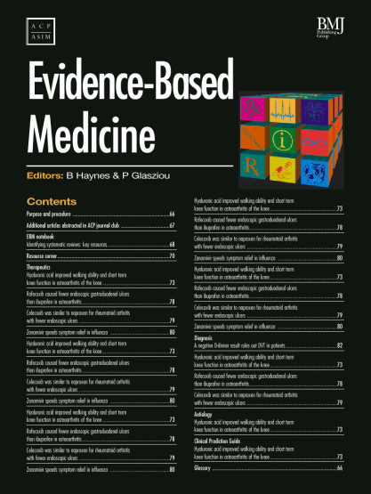
Coping with the overload: three things you might try
A. Read an evidence-based
abstraction journal
(and cancel other journals)
B. Keep a logbook of your
own clinical questions
C. Run a case-discussion journal
club with your practice

Slide 6

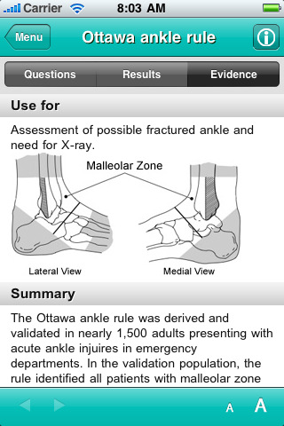

New tools
“I am a med student and this app is totally awesome!
We get taught all these scores and things… but it is hard to remember them. WIth this app you just click on the rule and it… then gives you the results, ie how likely it is that the person has that disease.”

Slide 7


Filtered knowledge - how much is valid AND relevant?
PROCESS
140+ journals scanned
  60,000 articles
Is it valid? (<5%)
  Intervention: RCT
  Prognosis: inception cohort
  Etc
Is it relevant?
  6-12 GPs & specialists asked:
  Relevant? Newsworthy?
< 0.5% selected
www.evidence-basedmedicine.com

Slide 8
Median minutes/week spent reading about my patients:
Self-reports at 17 Grand Rounds:
Medical Students: 90 minutes
House Officers (PGY1): 0 (up to 70%=none)
SHOs (PGY2-4): 20 (up to 15%=none)
Registrars: 45 (up to 40%=none)
Sr. Registrars 30 (up to 15%=none)
Consultants:
  Grad. Post 1975: 45 (up to 30%=none)
  Grad. Pre 1975: 30 (up to 40%=none)
Slide from Sackett D, EBM general, www.cebm.net/downloads.asp
Notes:
This summarises the data from about 12 DGH’s around the England and Scotland.
In summary, HO’s (who don’t read at all) are being taught by old farts (who read 30 minutes a week).

Slide 9
Performance deteriorates, too
Determinants of the clinical decision to treat some, but not other, hypertensives:
Level of blood pressure.
Patient’s age.
The physician’s year of graduation from medical school.
The amount of target-organ damage.
Slide from Sackett D, EBM general, www.cebm.net/downloads.asp

Slide 10
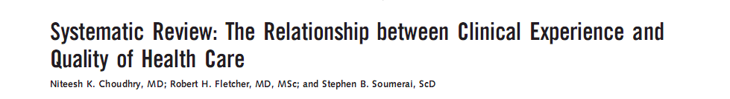
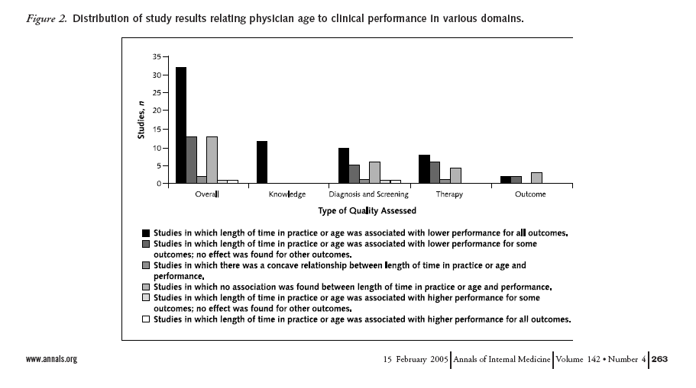
The Prognosis of Ignorance is Poor
Worse with “duration in practice”

Slide 11
Systematic review of bed rest after medical procedures
10 trials of bed rest after spinal puncture
  no change in headache with bed rest
  Increase in back pain
Protocols in UK neurology units - 80% still recommend bed rest after LP
Serpell M, BMJ 1998;316:1709–10
…evidence of harm available for 17 years preceding...
Allen, Glasziou, Del Mar. Lancet, 1999

Slide 12
Learning objectives
To reflect upon the use of evidence in the diagnostic process
To be able to refine a differential diagnosis using appropriate evidence
To be aware of the use of likelihood ratios in the diagnostic processes
To recall the major methods for investigating risk factors
To recognise the five steps of evidence based medicine

Slide 13
Case report
A 65 year old man consults his GP with chest pain

Slide 14
Objective of diagnostic process
Pain caused by myocardial ischaemia in impending infarction must be differentiated from non-ischaemic chest pain.
Non-ischaemic pain may be caused by other severe conditions that require acute treatment; such as pericarditis, aortic dissection and pulmonary embolism.

Slide 15
“The cramming for finals approach” : list the causes of chest pain
Myocardial ischaemia, MI or angina
Reflux oesophagitis, oesophageal spasm
Pulmonary embolism
Hyperventilation
Spontaneous pneumothorax
Aortic Dissection
Pericarditis
Pleuritis
Costochondral pain
Early herpes zoster
Ectopic beats
Peptic ulcer, cholecystitis, pancreatitis
Depression
Alcohol-related
……
www.guideline.gov

Slide 16
Narrow it down…
Use your knowledge to refine the diagnosis
What do you already know?
Male, 65 (gender and increasing age are risks for IHD)
So your suspicion is raised (above that of a woman, or a younger man)

Slide 17
More about the man with chest pain
It has being going on for six weeks
It is substernal
No radiation
"an ache"
Occurs at random, not related to exertion or stress
He tried a friend's nitroglycerin but the pain did not resolve any faster
He smokes cigarettes
He has no history of heart disease

Slide 18
What do we know now?
The character of the pain is atypical for ischaemic disease

Slide 19
Myocardial ischaemic pain
Duration usually over 20 minutes.
Located in the retrosternal area, possibly radiating to the arms, back, neck or the lower jaw.
The pain is described as squeezing, pressing or sensation of heaviness; breathing or changing posture does not notably influence the severity of the pain.
Continuous, enduring, severe pain.

Slide 20
Directing your questions
Clinical history taking should be a process of narrowing the differential diagnosis
To do this well, need to know
  Clinical features (eg type of pain, duration, etc)
  Risk factors
This knowledge focuses the history

Slide 21
What is going on in the diagnostic process?
You estimate a probability that your patient has a disease
  based on epidemiology, presentation etc
That is the “pre-test probability”
  “Test” can be a diagnostic test or a particular symptom or sign that you elicit
You then increase or decrease that probability based on your findings/ test result
This then produces a “post-test probability”

Slide 22
For this patient
What is his pre-test probability of IHD?
Need evidence from epidemiological studies
  Incidence in men (cohort studies)
  Relative risk with increased age
  Relative risk of smoking (cohort or case control)
  Protective factors (eg RCT of statins)
  Etc

Slide 23
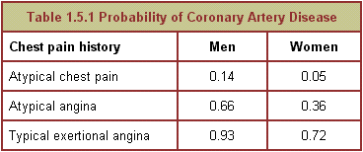
Pre-test probability

Slide 24
Men: probability of ≥50% coronary artery stenosis in at least one major artery
Age
30 to 39
40 to 49
50 to 59
60 to 69
Asymptomatic (0 symptoms)
2%
6%
10%
12%
Non-anginal chest pain (1 symptom)
5%
14%
22%
28%
Atypical angina (2 symptoms)
22%
46%
59%
67%
Typical angina (All 3 symptoms)
70%
87%
92%
94%

Slide 25
How to calculate post-test probability
Calculated using odds
Then to convert odds to probability
  probability = odds/(odds +1)
Post-test odds = pre-test odds x likelihood ratio
What is a likelihood ratio?
  It is a measure of how much the test/finding alters your estimate of the probability of disease

Slide 26
Likelihood ratio
The likelihood ratio is a characteristic of diagnosis-related information, whether it be a test or a finding from the history or physical examination. It is expressed as follows:
Likelihood ratio =
p [test result if disease present]
p [test result if disease absent]

Slide 27
Formulae for LR
The formula for the likelihood ratio for a positive test result is:
LR+ =
sensitivity
1 - specificity
The formula for the likelihood ratio for a negative test is:
LR- =
1 - sensitivity
specificity

Slide 28
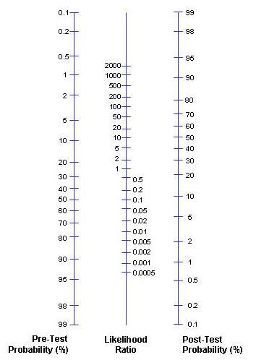

Slide 29
A short diversion via the GUM clinic
28 year old woman, lower abdominal pain, 2 days
Practitioner went into “pain history” mode
  Describe the pain
  What brings it on
  What relieves it
  Have you had it before
  Does it spread anywhere else…etc
One additional question (perhaps two) could have saved him about 5 minutes (she did not speak English very well)
  Any burning when you pee?

Slide 30
What evidence is being used?
Knowledge of how common the condition is in patients like mine (young women)
  Incidence of acute UTI is 0.6 per person year
  Period prevalence: In a survey of 2000 American women (>18), 10.8% had at least one UTI in the past year
  Lifetime risk 50%

Slide 31
What evidence is being used? (2)
Knowledge of the risk factors
  Sexual activity (recent onset, frequent)
  Use of diaphragm
  Use of spermicides
  Family history (for recurrent UTI)
Knowledge of the symptoms
  dysuria, urinary frequency, nocturia, urgency, voiding of small volumes, incontinence, suprapubic or pelvic pain, haematuria, cloudy smelly urine

Slide 32
Clinical predictors of a UTI
 | Positive Likelihood ratio | Negative Likelihood ratio
Self diagnosis | 4.0 | 0
Haematuria | 2.0 | 0.9
Frequency | 1.8 | 0.6
Dysuria | 1.5 | 0.5
Lower abdo pain | 1.1 | 0.9
Bent S, et al. JAMA. 2002;287:2705-2706

Slide 33
Combination of symptoms
Combination of symptoms increased LR further
  Women with dysuria and frequency, but without vaginal discharge or irritation: LR = 24.6

Slide 34
Diagnosis of a UTI
History
  in women with dysuria and frequency, in the absence of vaginitis, the diagnosis is urinary tract infection (UTI) 80% of the time
Urinalysis
  urinalysis for detection of pyuria by dipstick has a sensitivity of 80-90% and a specificity of 50% for predicting UTI
No urine culture
  Urine culture is NOT indicated in the vast majority of UTIs. Urine culture has a sensitivity of 50% (if threshold for positive is >10⁵ organisms); sensitivity can be increased to >90% if threshold is >10² organisms
  Consider urine culture only in recurrent UTI or in the presence of complicating factors

Slide 35
Your 45 year old patient has a mammogram
Report: "suspicious for malignancy”
  Patient: “Does this mean I have cancer?”
  You: "No, we have to do further testing."
  Patient: "OK, I understand that the mammogram isn’t the final answer, but given what we know now, what are the chances that I have breast cancer?".
  You: “let me think about that…”

Slide 36
What do you need to know?
Assume
  the overall risk of breast cancer in any 45 year old woman, regardless of mammogram result, is 1%
  Assume that mammography
    90% sensitive
    95% specific
What is her risk?

Slide 37
Use the LR model
Pre-test probability = 1%
Pre-test odds = 0.01/(1 – 0.01) = 0.01
She has a positive test (mammogram)
Likelihood ratio + test = sensitivity
1 – specificity
= 0.9
1 – 0.95
= 18
Post-test odds = 0.01 x 18 = 0.18
Post-test probability = 0.18/(0.18+1) = 15%

Slide 38
What does all this mean for you?
How to apply in your practice
Use the knowledge you already have
If you don’t know, try to find out (clearly defined questions relating to a clinical question)
Challenge (cautiously!) whether “received wisdom” is evidence-based
Use available evidence

Slide 39
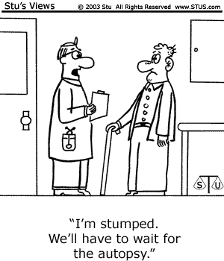
Any questions?

Slide 40
Resources
Centre for evidence based medicine
  http://www.cebm.net/index.asp
Publication of evidence
  http://www.clinicalevidence.com
  http://www.jr2.ox.ac.uk/bandolier/
  www.cochrane.org

Slide 41
Evidence based medicine: definition
“Evidence-based medicine is the conscientious, explicit and judicious use of current best evidence in making decisions about the care of individual patients. The practice of evidence-based medicine means integrating individual clinical expertise with the best available external clinical evidence from systematic research.”
Sackett et al. BMJ 1996; 312: 71-2

Slide 42
Five steps of evidence based practice
Question: translation of clinical uncertainty into an answerable question
Search: Systematic retrieval of best evidence
Appraise: critical appraisal of evidence for validity, clinical relevance and applicability
Apply: application of results in practice
Evaluate: evaluation process and impact

Slide 43
EBP in real life
Limitations of time
But an excellent way to continue learning and improve patient care
Best done in teams (eg ward rounds)

Slide 44
Where can you find best answers to clinical questions?
Places to look for answers
  Start with good secondary sources
    Within the clinical system we use
    Clinical Evidence
    PubMed especially the Clinical Queries Option
  Only if fails go to Medline
  Cochrane for treatments
Alternatively go to Google
  But ensure quality of source
  Google scholar…

Slide 45
Interpreting the results of trials
The outcome expressed as
  Relative risk reduction (or hazard ratio, odds ratio)
  Absolute risk reduction
  Number needed to treat

Slide 46
Number needed to treat
In a trial compare results of new treatment with old/none
Calculate absolute risk reduction
  Eg. Mortality after new drug is 20% = 0.2
  Mortality after old drug is 50% = 0.5
  Absolute risk reduction = 0.5-0.2=0.3
NNT is the reciprocal
  NNT = 1/0.3 =3.3
The new treatment will lead to one life saved for every 3 treated
Notes:
Trials with binary end points yield a proportion of patients in each group with the outcome of interest. When the outcome event is an adverse one, the difference between the proportions with the outcome in the new treatment (pN) and standard treatment (pS) groups is called the absolute risk reduction (ARR=pN pS). The number needed to treat is simply the reciprocal of the absolute risk difference, or 1/ARR (or 100/ARR if percentages are used rather than proportions). A large treatment effect, in the absolute scale, leads to a small number needed to treat. A treatment that will lead to one saved life for every 10 patients treated is clearly better than a competing treatment that saves one life for every 50 treated. Note that when there is no treatment effect the absolute risk reduction is zero and the number needed to treat is infinite. As we will see below, this causes problems.

Slide 47
Jupiter trial: Rosuvastatin
18000 people with high C-reactive protein.
Trial stopped after two years follow-up
  highly significant improvement in the primary end point with rosuvastatin (hazard ratio 0.56; 95% confidence interval 0.46 to 0.69; P<0.00001).
HR of 0.56 means there was a 44% reduction in risk in those taking rosuvastatin
Ridker PM et al. N Engl J Med 2008;359:2195-207

Slide 48
Jupiter
Control (placebo) event rate (251 events) = 1.36 per 100 person yrs
Experimental (rosuvastatin) event rate (142) = 0.77 per 100 person yrs
Relative Risk Reduction = CER – EER = 1.36 – 0.77 = 44%
CER 1.36
Absolute Risk Reduction = 0.59 per 100 person years
NNT* = 1/ARR = 169 person years to prevent on vascular event

Slide 49
Meta-analyses: forest plots
show information from individual studies in the meta-analysis
show variation between the studies and overall result

Slide 50
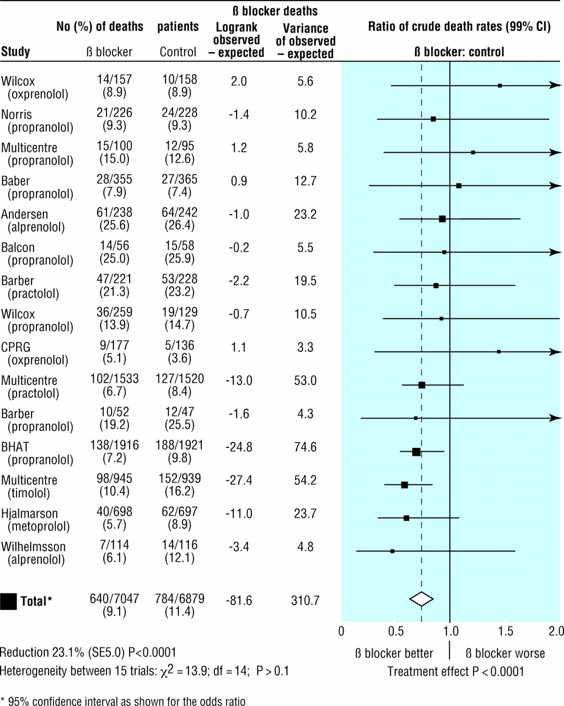

Lewis, S. et al. BMJ 2001;322:1479-1480

Slide 51
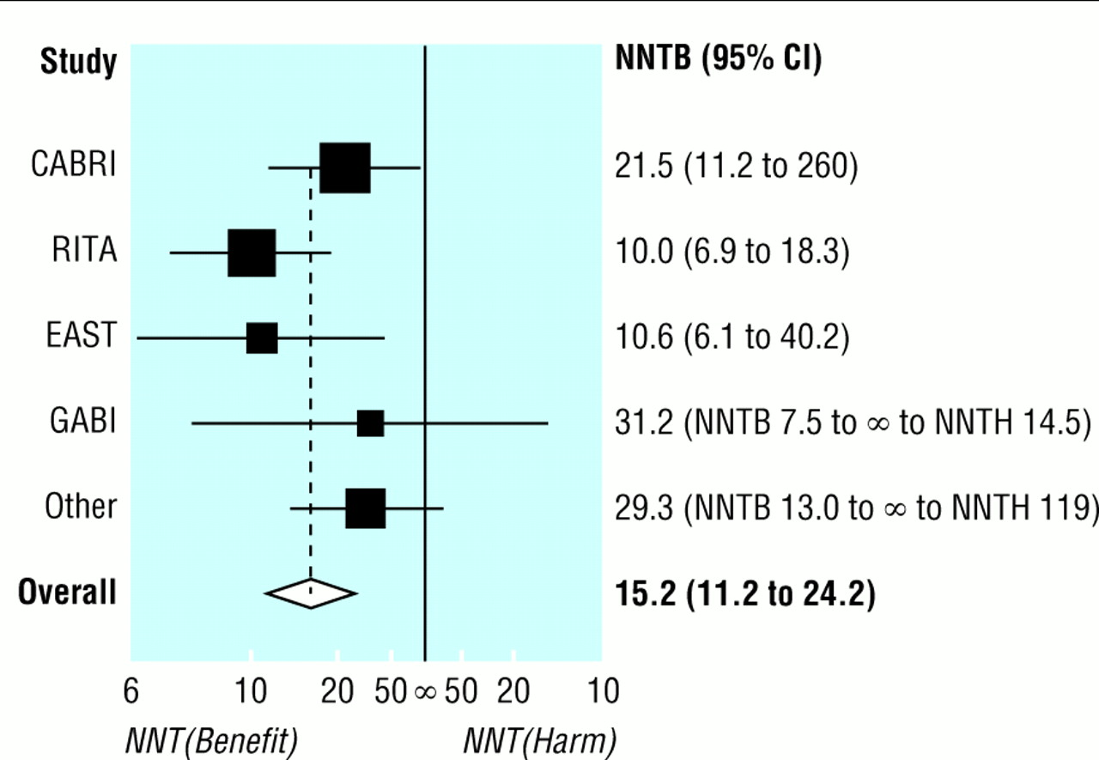
Forest plot of CABG vs Angioplasty
Altman, D. G BMJ 1998;317:1309-1312
Copyright ©1998 BMJ Publishing Group Ltd.

Slide 52
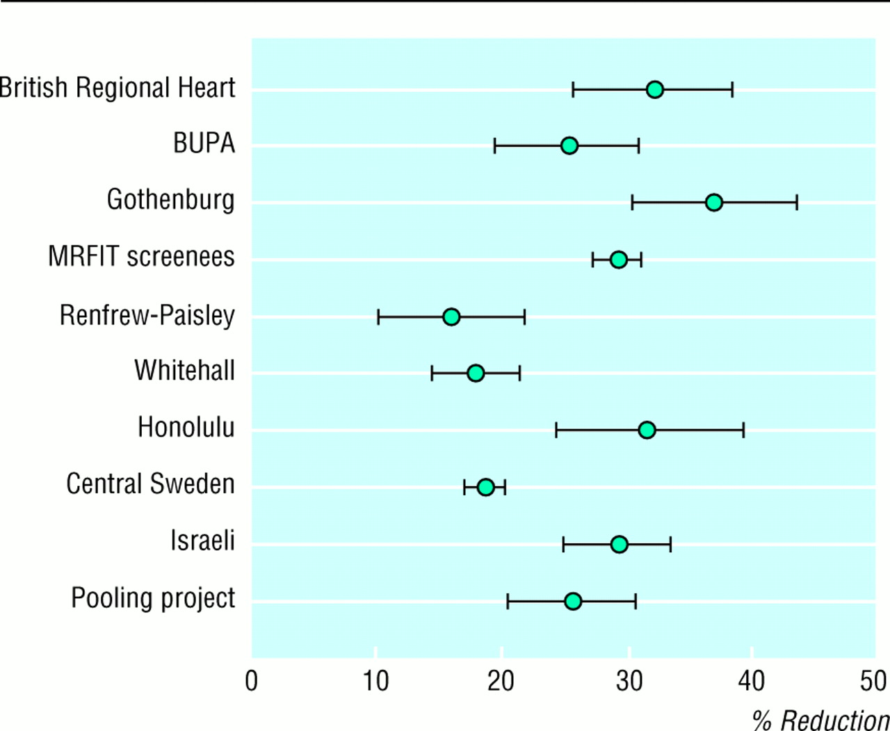
Reduction in risk of heart disease by strategies for lowering cholesterol
Greenhalgh, T. BMJ 1997;315:672-675
Copyright ©1997 BMJ Publishing Group Ltd.

Slide 53
Levels of evidence
Systematic reviews and meta-analyses of randomised controlled trials
Randomised controlled trials
Non-randomised intervention studies
Observational studies
Non-experimental studies
Expert opinion

Slide 54
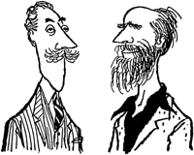
Levels of Evidence for Anecdote-based medicine
Level I: Beardy old gent from royal college
Level II: Doctor with air of credibility and honest face
Level III: Academic with mad stare
Level IV: NHS manager with trust in financial crisis

Slide 55
Communicable disease

Slide 56
objectives
Understand the purpose notification of infectious diseases, and the role of PHROs in the process
Recognise a notification form
Know which diseases are notifiable and why
Be able to describe the appropriate precautions for patients with different communicable diseases in hospital
Understand the importance of contact tracing for different communicable diseases
Know who to contact for advice in relation to cases of communicable diseases

Slide 57
Case 1
In November 2003 Mrs AG attended St Mary’s A&E with a cough. She is a previously healthy 32 year old who moved to the UK from Central Europe five years ago. She had abnormal shadowing on her chest X-ray and was admitted with the diagnosis of possible tuberculosis. You are later phoned by the consultant microbiologist to say that her sputum is smear positive for acid-fast bacilli.

Slide 58
You are the F1/2. What precautions should you take immediately on admitting this patient to the ward?
What additional questions would you need to ask to find out who else might be at risk?
Who would you inform about this case?

Slide 59
single room with respiratory precautions.
Respiratory precautions mean use of a fine mask, usual handwashing etc.
If a patient with open TB has already been on an open ward, then patients who have been close would have to be identified and followed up
Need to identify (a) potential source (s), and (b) potentially exposed contacts.
Important to ask if she has been in contact with anyone known to have TB. Who does she live with or work with, does she have any children. Has she been in prolonged contact, for example aircraft, hostels.
TB is notifiable - notification form available on most wards or from the infection control nurse. In practice TB cases will be referred to the TB control nurse

Slide 60
Mrs G has a four month old son who was being investigated at the same time for failure to thrive. He had a positive smear from gastric washing. The family shares a house with seven other people.

Slide 61
Household contacts are defined as close contacts if they share a kitchen. Close contacts of someone with pulmonary TB should be identified and asked about previous BCG. But since BCG is not 100% protective, also need to do a Heaf test and/or chest Xray. See the diagram reproduced with these notes.

Slide 62
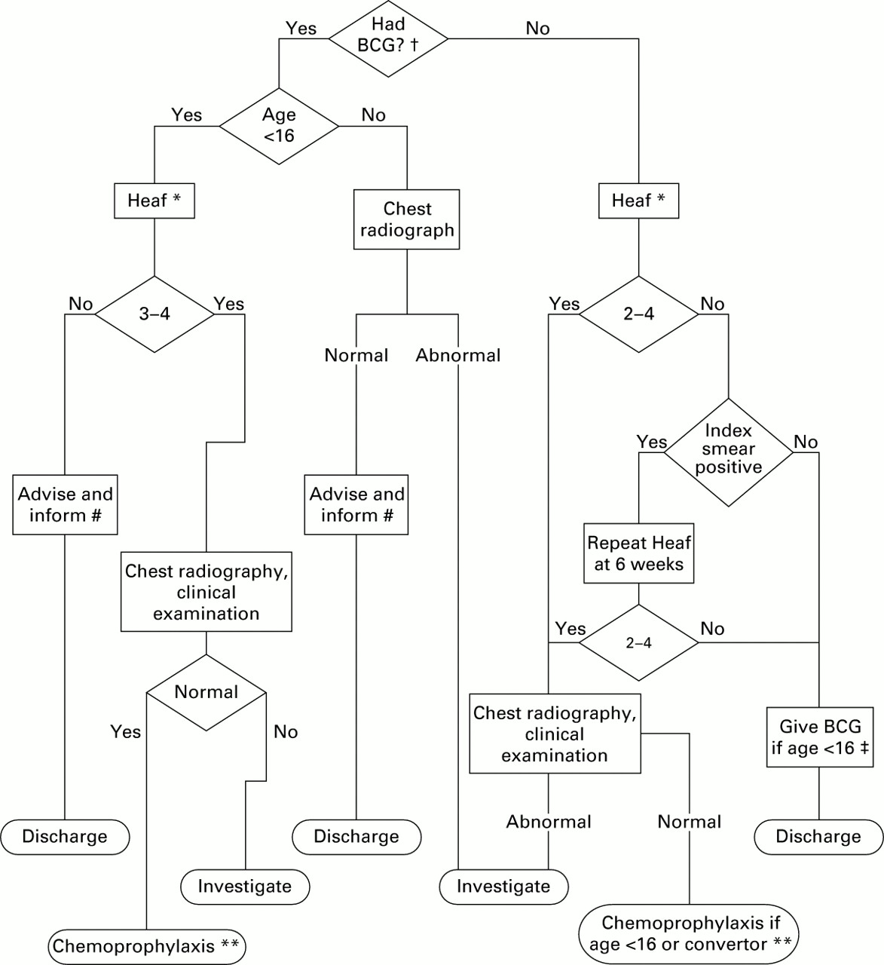

Slide 63
MDR-TB
MDR-TB no more virulent or more infectious, but the consequences of acquiring disease are greater
  All patients with suspected or known infectious MDR-TB should be admitted to a negative pressure ventilation room.
  Staff and visitors should wear dust/mist masks meeting the 1992 Personal Protection Equipment (EC Directive) Regulations
  The decision to discharge must be discussed with the hospital infection control team, the local microbiologist and the CCDC/CDEH.
  Before a discharge from hospital is made, secure arrangements for the supervision and administration of all antituberculosis therapy
  All treatment either as an inpatient or an outpatient should be fully supervised unless there are exceptional circumstances. (from BTS guidelines).

Slide 64
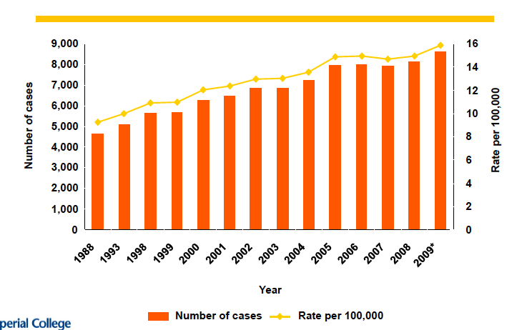
TB 1988- 2009

Slide 65
Case 2
In January 2004, JH, a 37 year old man, called NHS Direct complaining of general malaise, vomiting and watery diarrhoea for the previous five days. He was advised to contact his GP due to the duration and severity of the symptoms. His GP visited him at home and found him to be dehydrated and arranged for admission. He was admitted under the physicians at St Mary’s. Stool culture showed salmonella species.

Slide 66
Precautions?
Side room and enteric precautions (following from http://www.hpa.org.uk/cdr/CDRreview/1995/cdrr1195.pdf )
  Handwashing
  Disposal of excretions and soiled materials
  Disinfection
  Education

Slide 67
specific questions
Need to try and find out where the infection may have come from:
  Travel
  eating in unusual places
  contact with anyone who was ill
Anyone else at risk
  Did he prepare food for anyone
  Does he know if any contacts have got similar symptoms.
In addition need to think about when he is better – is he likely to put others at risk if he becomes a carrier, so ask about occupation, specifically food handling, work with young children or vulnerable people.

Slide 68
Notifiable?
Salmonella is notifiable if it is thought to be the cause of food poisoning
Notify the Consultant in Communicable Diseaes Control. By form (see previous question) or, if an outbreak is possible, by phone. The notification is the responsibility of the doctor treating the patient.

Slide 69
His six year old son
Who else would you need to inform?
childcare – would anyone else (childminder, younger children) be at risk. Not necessary to inform the school but would recommend that parents keep them informed. If the child were attending a nursery then you would have to inform them (see below).
If JH worked in a food-processing factory, what additional precautions would you require?
There are a number of defined risk groups for enteric infections, and different control procedures apply. In the case of salmonella, they should be prevented from resuming activity until 48 hours after their first normal stool.

Slide 70
Regatta
A fit 21-year-old oarswoman was brought to hospital in London by her parents early on a Thursday morning with a history of rapid onset of fever, nausea, vomiting and a petechial rash. Lumbar puncture revealed gram negative intracellular diplococci and both CSF and blood culture produced a pure growth of Neisseria meningitidis. The patient had returned from the four-day national intervarsity rowing championship in Nottingham the previous Sunday, saying that there had been a particular exuberant party on the Saturday evening at the end of the regatta, when 'everyone' (including the patient) had congratulated the winning men's VIII from Durham because they had re-gained the championship for the first time in several decades.

Slide 71
What next
Respiratory (see answer to TB question above).
See http://www.hpa.org.uk/cdph/issues/CDPHvol5/No3/Meningococcal_Guidelines.pdf
Is meningococcal disease notifiable? Yes
Once the patient is stable, who would you inform and how?
Should inform the CCDC by phone.

Slide 72
Contacts
It is your responsibility (in discussion with senior colleagues) to ensure that close contacts are given chemoprophylaxis and, if appropriate, vaccination. Close contacts (see guidelines for full definition) are those who share a household within the last 7 days, shared sleeping (dormitory), in halls of residence those who share a kitchen, plus boyfriends/ girlfriends etc. Chemoprophylaxis (rifampicin or ciprofloxacin) should be given to close contacts within 24 hours of the patient being diagnosed

Slide 73
Group A
Can give close contacts vaccination as well.

Slide 74
Post script
The index patient recovered fully
the next evening ( two days after presentation of the index case), an 18-year-old, first-year undergraduate female member of the Durham University Boat Club, who had also attended the national regatta, presented to her local DGH with headache and fever.
Her symptoms had developed rapidly - she had been well enough to compete in a local regatta that afternoon. She recounted the events of the preceding 10 days described above and said that she was worried that she had meningitis (chemoprophylaxis was not arranged for all competitors from the Durham Club), but a lumbar puncture revealed no abnormality.
She was admitted to hospital for observation, but no antibiotics were given initially. Her condition deteriorated rapidly, intravenous antibiotics were started early on the Sunday morning, and she was transferred to the nearest teaching hospital soon afterwards. Over the following few hours she developed uncontrollable bleeding into her muscles and died at 4 pm on the Sunday afternoon, less than 24 hours after presenting to the DGH. She was an only child.

Slide 75
Meningococcal disease can be fulminant. When a case is diagnosed, the local CCDC must be informed by telephone and as rapidly as possible. Where a patient with suspicious symptoms gives a clear history of possible exposure, collect relevant specimens for microbiological assessment, but treat empirically for the disease.

Slide 76
Case 4
One Saturday morning you are called to see a 24 year old man in A&E. He is complaining of dysuria and urethral discharge which have lasted for 4 days. He has never had this before, and is otherwise well. He went to his GP on the Friday and was given trimethoprim but the symptoms have got worse.

Slide 77
Causes?
Chlamydia trachomatis
N gonorrhoeae

Slide 78
treatment
For chlamydia infection: Docycycline is the standard treatment (give 100mg twice daily for a week). If there is any doubt about compliance, or contraindications, azithromycin, 1g orally as a stat dose is equally effective.
For gonorrhoea, current guidelines are for ceftriaxone, 250mg IM.
Alternatively, ciprofloxacin 500mg stat dose (but increasing resistance reported in London).

Slide 79
Other actions
Refer GUM
Partner notification
advice

Slide 80
Notification?
Is GC notifiable?

Slide 81
Acute encephalitis Acute poliomyelitis Anthrax Cholera Diphtheria Dysentery Food poisoning Leptospirosis Malaria Measles Meningitis Meningococcal Pneumococcal haemophilus influenzae viral other specified unspecified Meningococcal septicaemia (without meningitis) Mumps | Ophthalmia neonatorum Paratyphoid fever Plague Rabies Relapsing fever Rubella Scarlet fever Smallpox Tetanus Tuberculosis Typhoid fever Typhus fever Viral haemorrhagic fever Viral hepatitis Hepatitis A Hepatitis B Hepatitis C other Whooping cough Yellow fever

Slide 82
Notification of infectious disease
The statutory requirement for the notification of certain infectious diseases came into being towards the end of the 19th century.
Diseases such as cholera, diphtheria, smallpox, and typhoid had to be reported in London from 1891, and in the rest of England and Wales from 1899.
The list of diseases has been increased over the decades and now stands at about 30..
The prime purpose of the notifications system is speed in detecting possible outbreaks and epidemics.

Slide 83
