Slide 1
Cognitive and behavioural psychological therapies
Dr Claire Doyle
Clinical Psychologist

Slide 2
Overview
Mental health prevalence and common disorders
Theory & practice of cognitive and behavioural therapies
Evidence base & national guidelines
Improving Access to Psychological Therapies
Future directions

Slide 3
Mental health in the UK
Around 300 people out of 1,000 will experience mental health problems every year in Britain
230 of these will visit a GP
102 of these will be diagnosed as having a mental health problem
24 of these will be referred to a specialist psychiatric service
6 will become inpatients in psychiatric hospitals
  www.mind.org.uk/help/research_and_policy/statistics_1_how_common_is_mental_distress

Slide 4
General Practice
280 million consultations annually
30% have a mental health component
91% of all mental health problems are managed entirely in primary care
25% of people with severe mental health problems are managed entirely in primary care
Notes:
4

Slide 5
1 in 4 British adults experience at least one diagnosable mental health problem in any one year, and 1 in 6 experiences this at any given time.
Mixed anxiety & depression is the most common mental disorder in Britain, with 9% of people meeting criteria for diagnosis.
Between 8-12% of the population experience depression in any year.
The Office for National Statistics Psychiatric Morbidity report, 2001

Slide 6
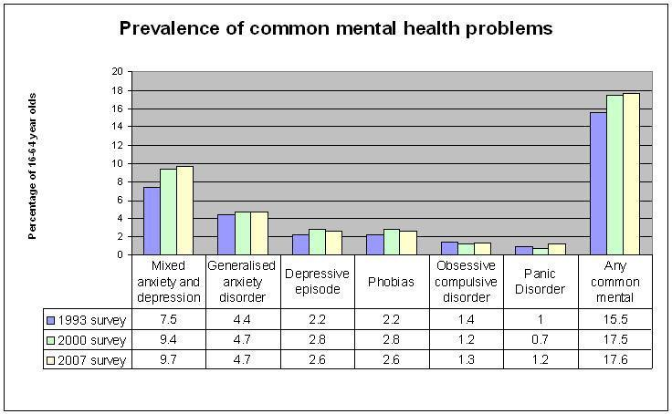
http://www.mind.org.uk/help/research_and_policy/statistics_1_how_common_is_mental_distress

Slide 7
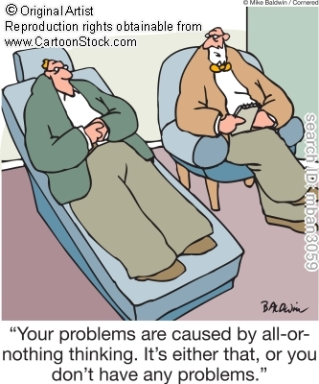
Therapy?

Slide 8
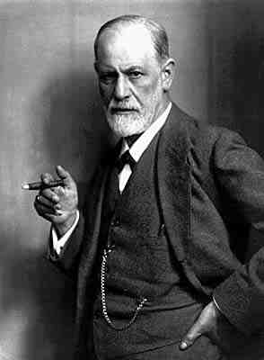
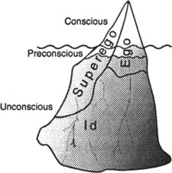
Psychodynamic therapy
Dr Sigmund Freud

Slide 9
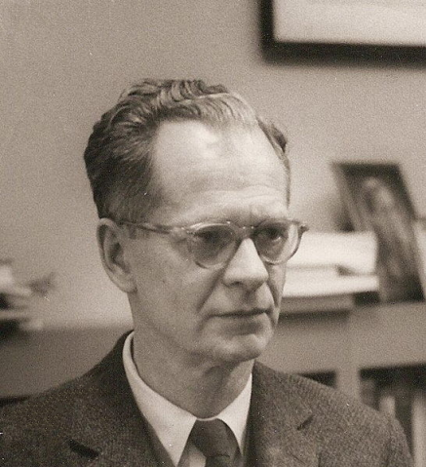
Behavioural theory
B.F. Skinner 1904-1990
Behavioural psychologists believe that:
  Maladaptive behaviours are not merely symptoms of underlying problems
    The behaviours are the problem
  Problem behaviours are learned in the same ways normal behaviours are

Slide 10
Behavioural theory
Learning theory
3 main types of learning
1. Classical conditioning
2. Operant conditioning
3. Social learning

Slide 11
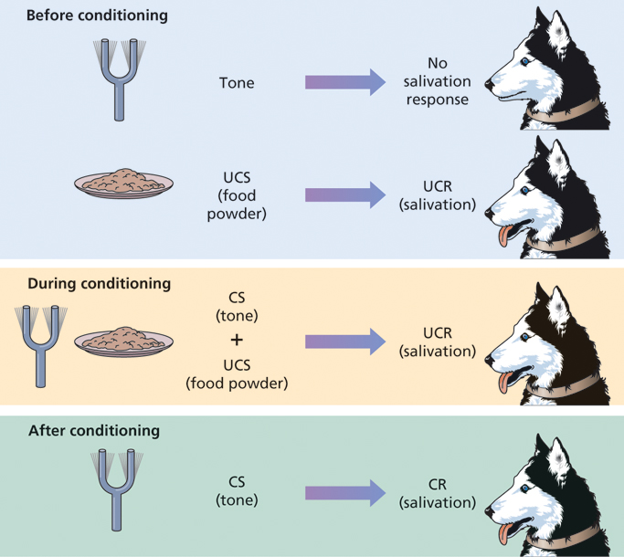

Slide 12
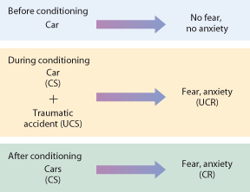
Phobia Development
Notes:
12

Slide 13
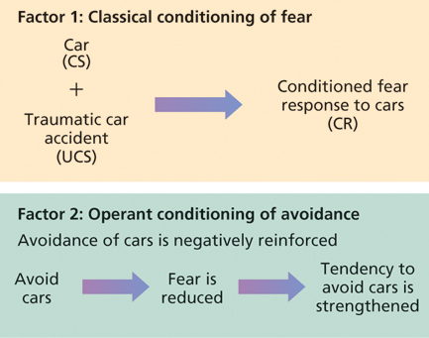
Two-factor theory of maintenance of classically conditioned associations e.g. fear

Slide 14

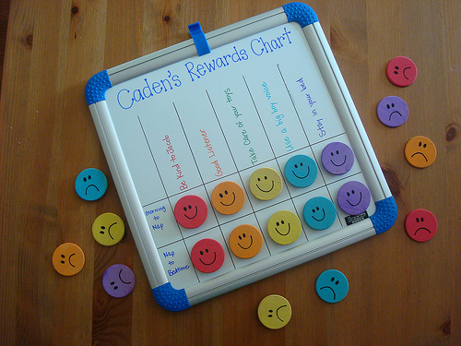
Behaviour therapy

Slide 15
Behaviour Therapies
Exposure Approach:
  Treat phobias through exposure to the feared CS in the absence of the UCS
  Response prevention is used to keep the operant avoidant response from occurring
  Highly effective for reducing anxiety responses
  Controversial because intense temporary anxiety is created by treatment

Slide 16
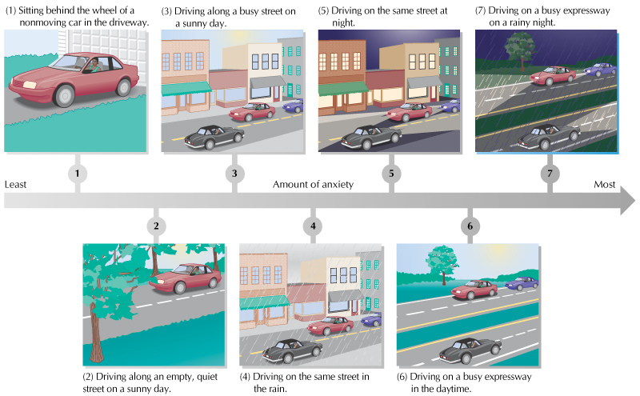
Graded exposure

Slide 17
Cognitive Theory
Stimulus
Response
Stimulus
Cognition
Response

Slide 18
You’re walking down the High Street, and someone you know walks by without acknowledging you…
Notes:
18

Slide 19
THOUGHT | EMOTION
Nobody wants to talk to me, no-one likes me | Sad
Who does she think she is, ignoring me?! | Angry
Ha, she’s probably hungover! | Amused
She must have found out my horrible secret. I bet she’ll tell everyone. | Anxious

Slide 20
Beck (1963) Thinking and depression
Recorded psychotherapy sessions with 50 depressed patients.
Identified three recurring themes in the content
    Self – e.g. I’m useless
    World – e.g. My life is unfulfilling
    Future – e.g. Things will never get better
These became known as the depressive triad

Slide 21
Negative Thinking Traps
LABELLING: Place a fixed, global label on oneself without considering evidence that leads to a less disastrous conclusion
“I’m a loser” ; “I’m no good.”
OVERGENERALIZATION: Drawing general conclusion based on single incident
  “I felt nervous with others at the party; I don’t think I have what it takes to make friends.”
PERSONALIZATION: Inappropriately relating external events to oneself without an obvious basis for making such connections
“She didn’t say hello to me because I must have done something wrong.”
DICHOTOMOUS THINKING: View a situation in only two categories instead of on a continuum
“If I’m not a total success, I’m a failure”

Slide 22
General Principles of Cognitive Therapy
Focuses on unhelpful beliefs and behaviours that maintain disorders (rather than original causes).
Goal oriented
Problem solving
Collaborative relationship e.g. Explicit formulation
Brief (8-16 sessions)
'Scientific' approach e.g. Collecting data, testing hypotheses

Slide 23
Experience
Almost failed last year
Triggering Situation
Sitting Final Year
Med School exams
in an hour
Belief
“I’m a terrible examinee
Thought
I’m going to fail!
Behaviour
Cram all night
Frantically read
your notes
Drink red Bull
Look the person who
always gets a first
to see what
they are doing
Feeling
Anxiety, Dread, Fear
Physiology
Tense
Need the loo
Sweaty
Can’t concentrate

Slide 24
Clark’s Model of Panic
Internal trigger
Perceived Threat
Anxiety
Physiological
Symptoms
Misinterpretation
Of Symptoms

Slide 25
Panic cycle
Feeling “funny”
after climbing the stairs (Body)
“I have a family history of heart problems.
This could be serious” (Thought)
ANXIETY
(Feeling)
Increased Heart rate
Sweaty
Clammy
(Body)
“Oh my God! I’m having a heart attack!
I’m going to die (Thought)
Avoid exertion
(behaviour)
Call ambulance
(behaviour)

Slide 26
Cognitive therapy for panic disorder
Explanation of symptoms
Identify & challenge negative automatic thoughts
Reappraisal of idiosyncratic beliefs
Relaxation, breathing exercises.
Graded exposure to feared stimuli
Dropping of safety behaviours

Slide 27
Interoceptive Exposure
EXERCISE | SENSATIONS | SENSATION INTENSITY | ANXIETY LEVEL | SIMILARITY TO PANIC
Shake head side to side 30 secs | Dizzy | 6/10 | 8/10 | 9/10
Run in place or step ups 60 secs
Hold breath 30 secs
Spin, 60 secs
Body tension 60 secs
Hyperventilate 60 secs

Slide 28
Behavioral Interventions
Breathing retraining
Relaxation
Behavioral activation / Activity scheduling
Exposure techniques
Functional analysis and using this to plan treatment
Social skills training
Graded task assignment

Slide 29
Cognitive Interventions
Socratic questioning/Guided discovery
Monitor automatic thoughts
Promote cognitive restructuring
Examine alternative evidence
Modify core beliefs
Identify and work with safety behaviours
Plan and conduct behavioural experiments

Slide 30
Evidence Base for CBT
Recovery Rate
All Anxiety Disorders 71%
Panic disorder 75%
Posttraumatic stress disorder 75%
Social Phobia 76%
Generalised anxiety disorder 69%
Obsessive compulsive disorder 49%
Specific Phobias 81%
Major depressive disorder 60%

Slide 31
CBT vs Medication
CBT has been shown to have significantly lower relapse rates than anti-depressant medications.
Panic disorder: 5% vs 40%
Social Phobia: 0% vs 33%
OCD: 12% vs 45%
Depression 45% vs 86%

Slide 32
NICE guidelines
CBT recommended as first line treatment for:
Depression,
Social anxiety,
PTSD,
Generalised anxiety disorder,
OCD,
Bulimia,
Panic disorder and specific phobia
(see NICE at www.nice.org.uk)

Slide 33
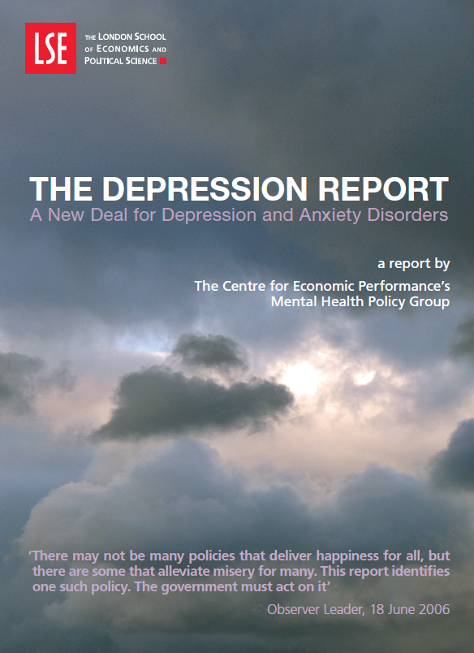
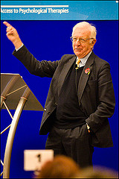

The Depression report (2005)

Slide 34

The programme began in 2006 with demonstration sites in Doncaster and Newham focusing on improving access to psychological therapies services for adults of working age.
By 31 March 2011:
142 of the 151 Primary Care Trusts in England have a service from this programme in at least part of their area and just over 50 per cent of the adult population has access
3,660 new cognitive behavioural therapy workers have been trained
Over 600,000 people started treatment, over 350,000 completed it, over 120,000 moved to recovery and over 23,000 came off sick pay or benefits between October 2008 and 31 March 2011

Slide 35
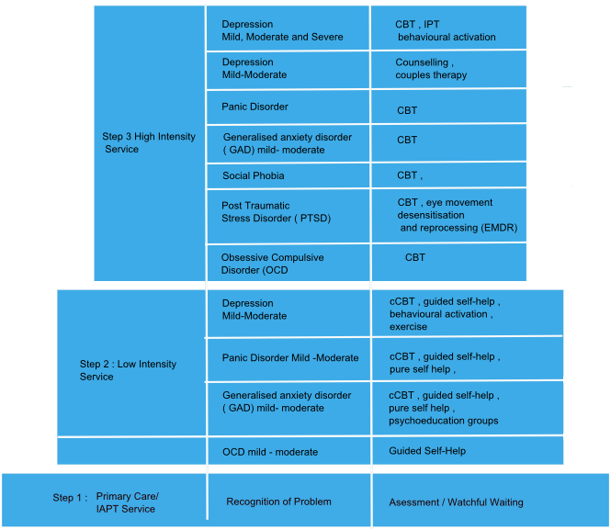

Slide 36
David Clark - http://www.youtube.com/watch?v=JSO6iAFekPw
Operant conditioning
http://www.youtube.com/watch?v=ejjZZNGfIOM
CBT session (3’21”) http://www.youtube.com/watch?v=fCZpUIEUsys

