Slide 1
The Ethics of Covert Medication
Frances Conti-Ramsden, Christina Crossette-Thambiah, Anthony Dorr, David Smith

Slide 2
History: Mr DT THE PATIENT/COLLATERAL
Demographics
76 year old Afro-Caribbean Male
Lives alone in supported accommodation
Retired carpenter/joiner
Admitted S2 converted to S3
Presenting Complaint
Increasing paranoia & neglect
Aggressive towards staff and fellow residents
Notes:
St Vincent
53 years in England
Flat – problems for 17 years between him & manager (‘grievance’). Got worse in last 6 months. Refused to go into more detail as he is concerned about alleged upcoming court case
PC = said no reason for admission. Collateral from housing manager said….(e.g. tap water poisoned, sleeping with kitchen knife under pillow, noises at night, suspicious people takign things from flat, pouring water on him while sleeping, preoccupied with thought of eviction – turned out to be true)
HPC – ‘life was full of joy and beauty until last 6 months’

Slide 3
History THE PATIENT/COLLATERAL
PψH
2009 – paranoid psychosis. No compliance w/ quetiapine
PMH
Lost use of right hand in work related injury
Auditory impairment
Hypertension
Diabetes
Retinopathy (intermittent loss of vision)
Nephropathy (CRF) with 2° anaemia
Notes:
PMH – ‘destroyed hand with saw’
– CRF due to diabetes and high bp

Slide 4
History THE PATIENT/COLLATERAL
FH
Nil of note
PH
Forensic – convicted of manslaughter 1979
SH
Single, lives alone
No family in England – 3 children but all abroad
Feels coping well at home
Notes:
PH – not forthcoming
SH – no family (‘mother took 2 of them away. One is in Trinidad.)
– looked after self with difficulty: burnt fingers etc

Slide 5
Mental State
Appearance & Behaviour
Elderly male with walking stick, eyes closed during interview, appropriate gestures
Cognition
Alert and orientated in time, place & person
Refused formal cognitive tests
Insight
Why here? – ‘your guess is as good as mine’
Hospital the cause of the problems
Notes:
INSIGHT – ‘in excellent health’

Slide 6
Current Situation
Needs
Psychiatric – Antipsychotic medication
Physical – anti-hypertensives, diabetic medication, drugs for renal failure
On Admission
Refusing all medication
However…
Lacks capacity
Notes:
(aka depixol)
Capacity – was unable to repeat the situation back to doctor
Aripriprazole – safest for use in CRF short time

Slide 7
Potential Solution
Use Covert Medication
Widely used practice – 71% residential care homes
Poor reporting due to fear of professional censure
Because 58% compliance with antipsychotics vs 76% for nonpsychiatric medications
Notes:
Best interests meeting – decided covert medication would avoid complication. DEFINE what COVERT MEANS.
Although this figure could be unrealistically low due to underreporting

Slide 8
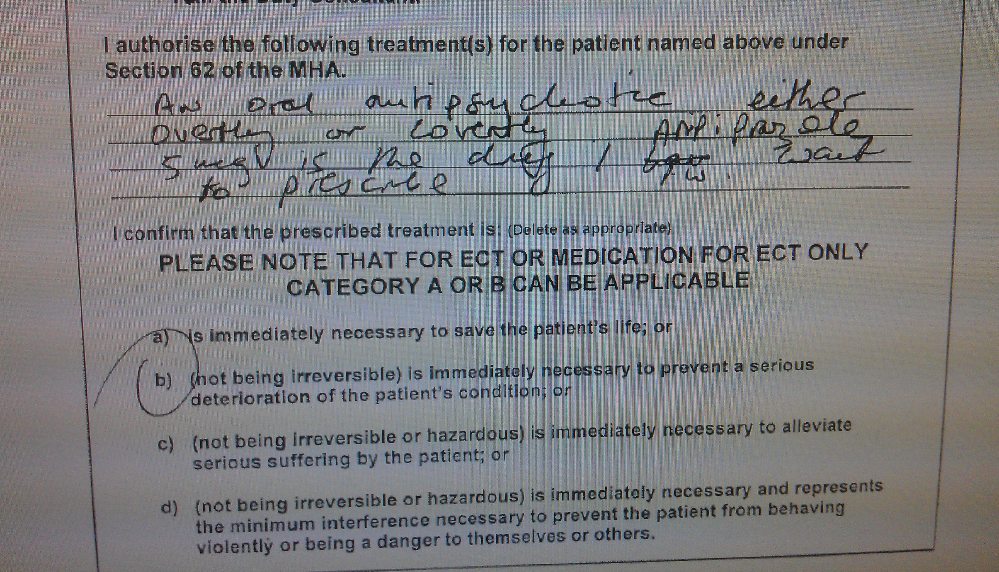
Notes:
Urgent rx under SECTION 62 stating…Note: under section 62, any treatment for mental disorder can be given without consent in specific emergencies, subject to restrictions when a treatment is irreversible or hazardous.

Slide 9
Ethical Question
Is it ethical to treat DT with covert medication?

Slide 10
Ethical viewpoints
Virtue ethics
Character of a moral agent driving force for ethical behaviour
Consequential ethics
Morality of action determined only by its resulting outcome
Deontological ethics
Morality of action based on the adherence to a rules/duty

Slide 11
Virtue ethics
No, it is not ethical:
Patient autonomy is paramount and covert medication is paternalistic
Deception is intrinsically wrong, abuses trust & is disrespectful
Notes:
Patient autonomy is paramount and a basic right, covert medication is paternalistic
Deception is intrinsically wrong and breaches trust – there is a difference between treating a patient against their knowledge vs. against their will, regardless of intent
Treatment may be for benefit of staff rather than patient – e.g. managing difficult patients
Cannot be justified on aim of improving quality of life as only patient can decide this
However, patient’s view could reflect premorbid view or their current psychopathology

Slide 12
Virtue ethics
Yes, it is ethical:
Treatment is necessary and in best interests
Risks associated with delayed treatment & increased duration of untreated psychosis
Alternatives more restrictive, distressing & less dignified
May facilitate treatment of physical illness
No harm intended – non-maleficence
Notes:
Patients cannot refuse treatment as patient autonomy is deprioritised in the context of mental health – Hay's paradox: the organ giving consent is the organ affected
Treatment is occurring in best interests and is necessary
Substantial risks to patient and costs associated with delayed treatment – e.g. patient self-harm
Duration of untreated psychosis causes increased morbidity and poorer patient outcome
Only option as alternatives are more restrictive – Covert medication is a least restrictive alternative: less distressing and preserves some dignity – i.e. rather than restraint and forcible treatment
If treatment is primarily undertaken to benefit patient and improve quality of life – beneficence
No harm is intended – non-maleficence

Slide 13
Utilitarianism/consequentialism
No, it is not ethical:
Patient could find out and become distressed
Patient could experience adverse event

Slide 14
Utilitarianism/consequentialism
Yes, it is ethical:
If patient improves, method of treatment does not matter
Patients who do not understand their treatment are being treated in a covert sense
Physical restraint therefore no different to covert medication or lying to patients about drugs
Forcible overt treatment may ultimately be detrimental
Fuel delusions, cause distress

Slide 15
Deontological ethics
No, it is not ethical:
Duty to keep patient informed of medications and side effects
Duty not to deceive

Slide 16
Deontological ethics
Yes, it is ethical:
Duty of beneficence – duty of care/to treat physical and psychiatric illness – also least restrictive
Duty not to deny patient treatment simply due to mental illness

Slide 17
Patient DT
Is being ethically covertly treated, as:
Virtue ethics
Primarily to improve psychiatric illness & improve QoL
Deontological and virtue ethics
Duty of care
Least restrictive alternative
Avoids fuelling paranoid delusions & minimise distress
Consquentialism
Allowed management of physical illness – increased insight

Slide 18
Legally…
Under section 44 of the Mental Capacity Act (2005) it is a criminal offence to wilfully neglect care.
Thus, for those with fluctuating capacity or those who lack capacity to accept or refuse medication, covert medication is an option that should be carefully considered.

Slide 19
MCA & Covert Medication
When determining if covert administration is appropriate consider:
Opportunity to accept/refuse medication
Covert administration will be considered unlawful if the patient has not been given the opportunity of consenting to or refusing such medication.
Capacity to consent
The medical practitioner needs to confirm that the service user lacks ‘capacity to consent to treatment’. (The two-stage functional test)
Patients lacking capacity
Treatment can be in their best interests under the MCA 2005 and the Common Law Doctrine of Necessity.
To save life/ prevent deterioration /ensure improvement in physical or mental health

Slide 20
MHA: Treatment without consent
First 3 months: Section 63
a detained patient may be forcibly medicated for three months, provided there has been an attempt to gain consent
Second 3 months: Section 57/58
Under s58, a non-consenting patient may be subjected to compulsory medical treatment if they are considered to lack capacity
It is only when “the patient's consent is not forthcoming” that the RMO must obtain certification by a SOAD
Non-disclosure of information to a patient must be for a “compelling” reason
The RMO's right to decide to withhold information about the proposed treatment only applies after consent has been sought – not non-disclosure of the treatment itself

Slide 21
Nursing Midwifery Council, RCPsych and Mental Welfare for Scotland
Guidelines which say that ‘disguising medication in food or drink can be justified in the best interests of patients who actively refuse medication but who lack the capacity to refuse treatment’
Suggests that there might be “exceptional circumstances” where covert medication would be necessary as “a contingency measure”
What would amount to such “exceptional circumstances” is not explained.

Slide 22
Human Rights Act 1998
Article 2: ‘Everyone’s right to life shall be protected by law’
Article 3: ‘No one shall be subject to torture or inhuman or degrading treatment or punishment’

Slide 23
Do the existing legal structures adequately protect individuals/provide adequate guidance?
MHA not entirely appropriate legal framework for covert medication
Lack of policy
Fear of litigation/abuse

Slide 24
Management
Management needs: MDT approach
Short term:
What are the alternatives?
Long term:
Maintenance and transition to overt?

Slide 25
Who needs to be involved? The MDT
Carers
Physical needs
Pharmacist opinion
Advice on how to take meds, whether acceptable to crush tablets/food interaction etc.
Psychiatry input
Periodically review need for medications
Social worker
Finding a new place to live, likely needs a nursing home
Occupational therapist
Working with pt to define what tasks he is able to achieve, influencing choice of accommodation

Slide 26
Short Term
Alternatives:
Do not give medication
Where possible give by depot/injection
Continue covert: Best interests meeting inc. family
We believe important to continue covert

Slide 27
Long Term
Ensure regular formal review meetings
Continuing covert medication:
Possible as likely transfer to a nursing home
Transition to overt medication:
When patient has enough insight?
Would this lead to total breakdown of trust?

Slide 28
More ethical with safeguards?
Consideration of patient’s pre-morbid views on treatment
Standardisation to prevent arbitrary use and potential discrimination
Agreement with family members and carers
Limit use only for when essential
Use for limited time - until regains insight?

