Slide 1
Vasculitis made easy
Dr Sonya Abraham
Senior Lecturer Rheumatology
Imperial College London

Slide 2
Vasculitis
Inflammation of blood vessel leading to occlusion (ischaemia and gangrene) and end organ dysfuntion

Slide 3
Classification of systemic Vasculitis
By vessel size
Large
Takayasu’s vasculitis
Temporal arteritis
Medium
Polyarteritis nodosum
Kawasaki disease
Small
Wegener’s granulomatosis
Churg-Strauss syndrome
microscopic polyangiitis

Slide 4
Large: Takayasu’s vasculitis and Temporal arteritis
Both cause giant cell infiltration of major vessels with destruction of IEL and intimal hyperplasia
Takayasu’s: disease of Japanese women aged 30-40 involving major vessels of the aortic arch
Inflammatory phase: responds to steroids
Occlusive phase: Surgery
Temporal arteritis: disease of elderly Caucasians affecting predominantly cranial arteries. Causes blindness
Headaches, scalp tenderness, blurring of vision
Associated with polymyagia rheumatica.
High ESR, responds to steroids

Slide 5
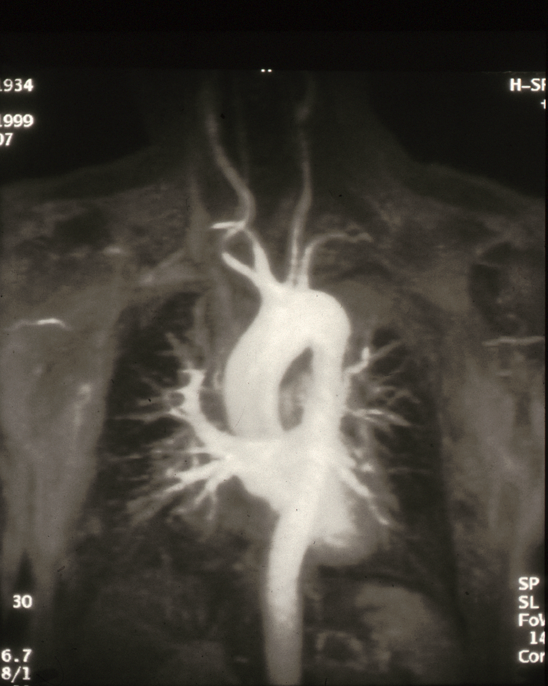
MRA of a 35 year-old
Japanese woman

Slide 6
18^{F} FDG-Positron Emission Tomography
Pre-Rx
6 months immunosuppression

Slide 7
Medium: Polyarteritis nodosum and Kawasaki disease
Polyarteritis Nodosum
A rare disease of young men affecting arteries of kidneys (renal failure), gut (haemorrhage)
Kawasaki disease
A disease of infants causing mucocutaneous erythema, lymphadenopathy and vasculitis
Coronary vasculitis main cause of death
Virtually cured by IV immunoglobulin

Slide 8
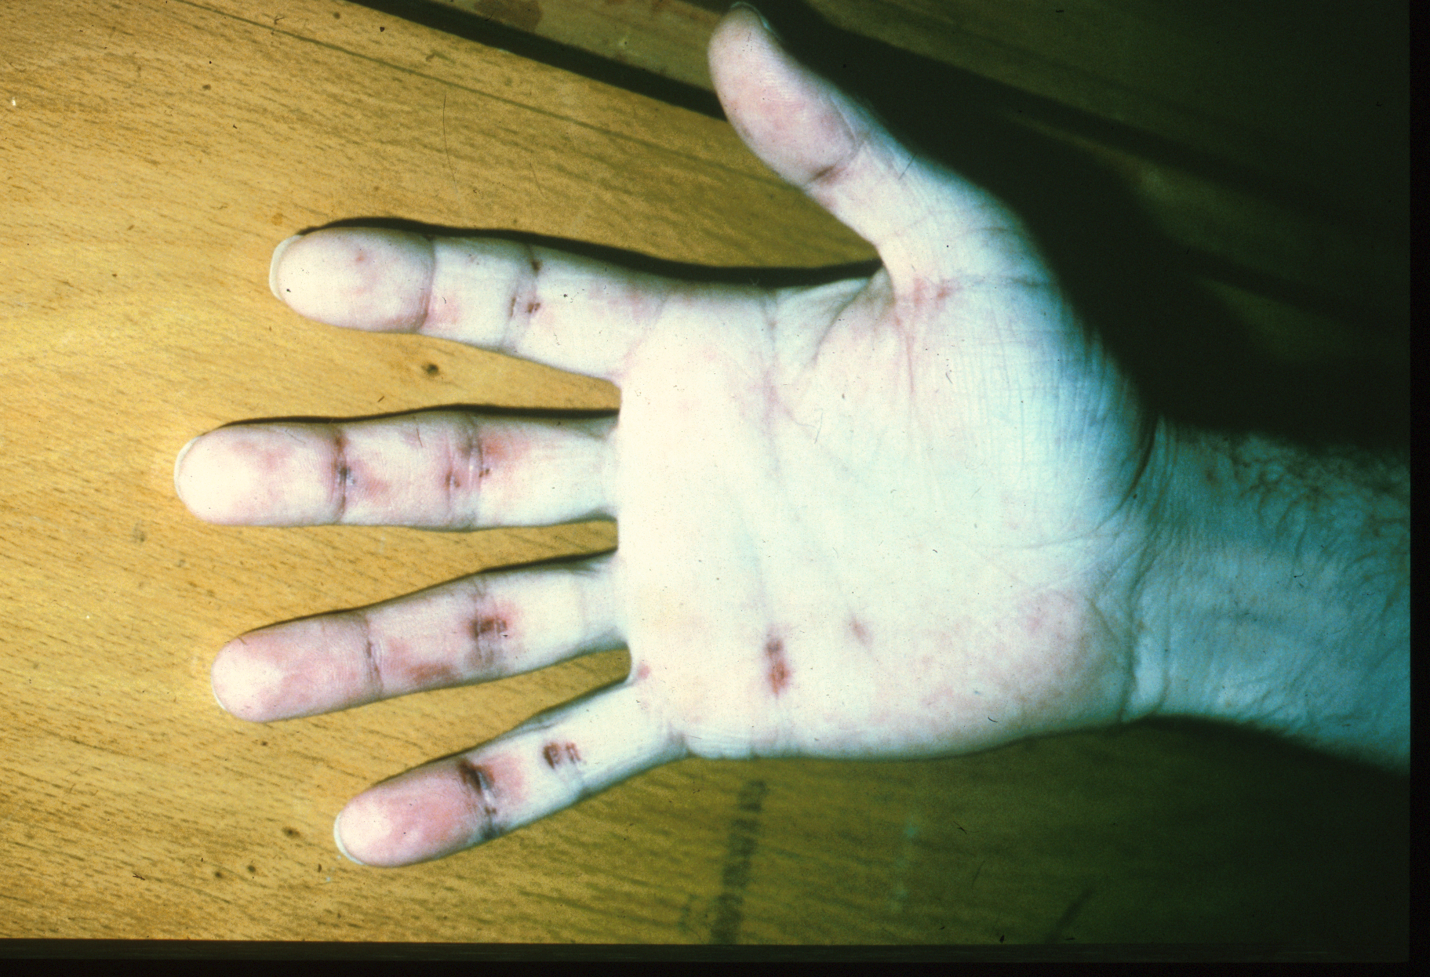
Hand of a young man with polyarteritis nodosum

Slide 9
Small: Wegener’s granulomatosis, Churg-Strauss syndrome, Microscopic polyangiitis
Rare: small vessel vasculitidies predominantly affecting kidneys, lung and peripheral nerves
associated with anti-neutrophil cytoplasmic antibodies (ANCA)
Respond to treatment with high dose steroids and cyclophosphamide

Slide 10
Clinical features and ANCA in the small vessel vasculitidies
Wegener’s Churg-Strauss, Micr. Polyangiitis
ENT +++ + 0
Lung ++ (granuloma) ++ (asthma) 0
Kidney ++ + +++
nerves + ++ ++
GIT ++ ++ 0
ANCA cANCA c & pANCA pANCA
>90% ~40% >90%

Slide 11
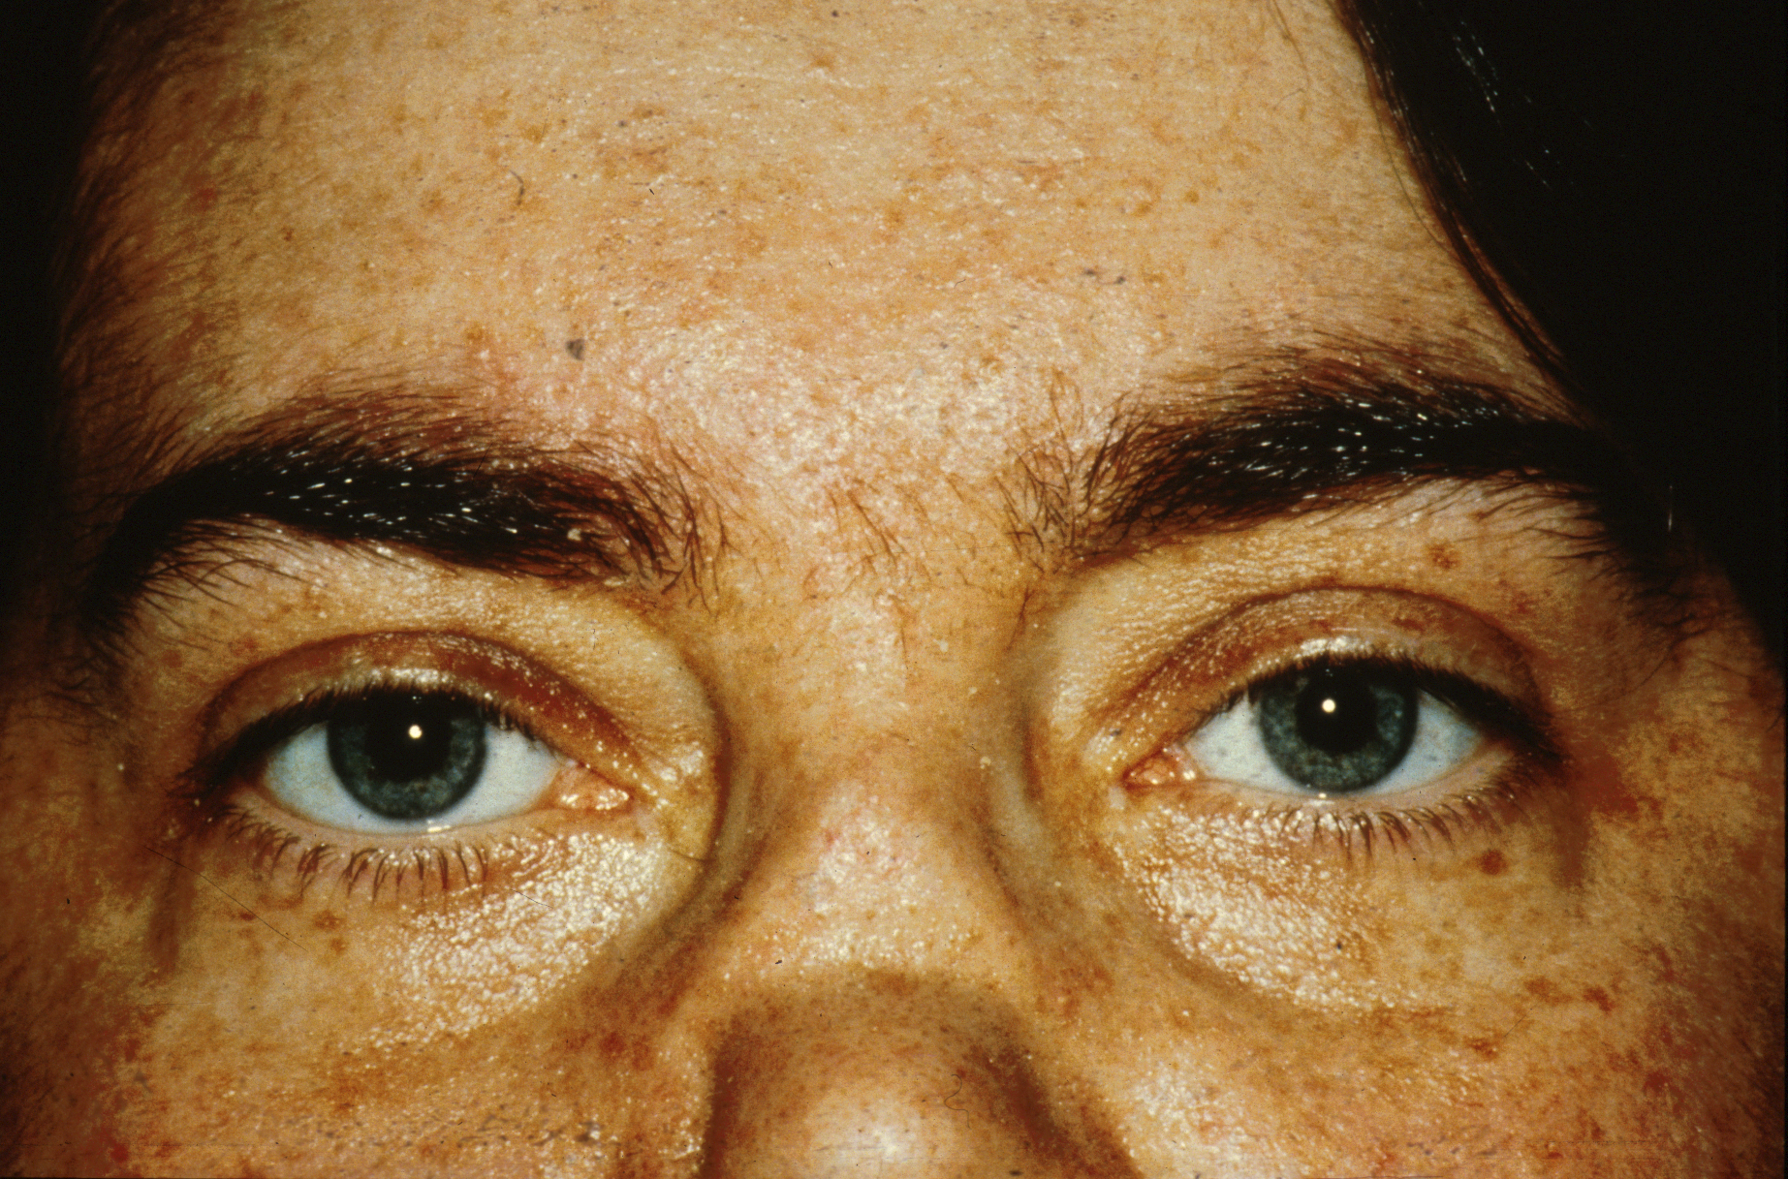
Face of a woman with Wegener’s granulomatosus
showing erosion and destruction of the nasal carlilage

Slide 12
Vasculitis: summary
Vasculitis is classified by vessel size.
Important clinical features:
Takyasu’s – pulseless disease in oriental females
Temporal arteritis – blindness and polymyalgia in the elderly
Kawasaki – mucocutaneous erythema in infants
Small vessel - Renal failure, neuropathies, lung disease.
Treatment:
Temporal arteritis – steroids
Kawasaki – IV immunoglubulin
Small vessel – Steroids and cyclophosphamide

