Slide 1
Rheumatoid arthritis
Dr Sonya Abraham
Senior Lecturer/Honorary Consultant
Imperial College Healthcare NHS Trust
Medical Student Lecture (Yr 5)
May 2012

Slide 2
Rheumatoid Arthritis
Historical
Epidemiology
Disease Pathogenesis
Clinical Considerations
Clinical Case Study

Slide 3
History of RA
First description : 18th century
Coining of the term : 1856 by Garrod
Evolving concepts of disease definition, causation and therapy

Slide 4
Prevalence of RA in World Populations
Denmark
0.8%
Finland
2.0%
Inuit
Canada
0.6%
England
0.9%
North
America
1.0%
Sweden
0.9%
Bulgaria
0.8%
Japan
0.6%
Netherlands
0.9%
China
0.3%
Pima &
Chippewa
Indians
USA 5.3%
Liberia &
Nigeria
0.1%
S. Africa
Soweto 0.9%
Rural 0.1%

Slide 5
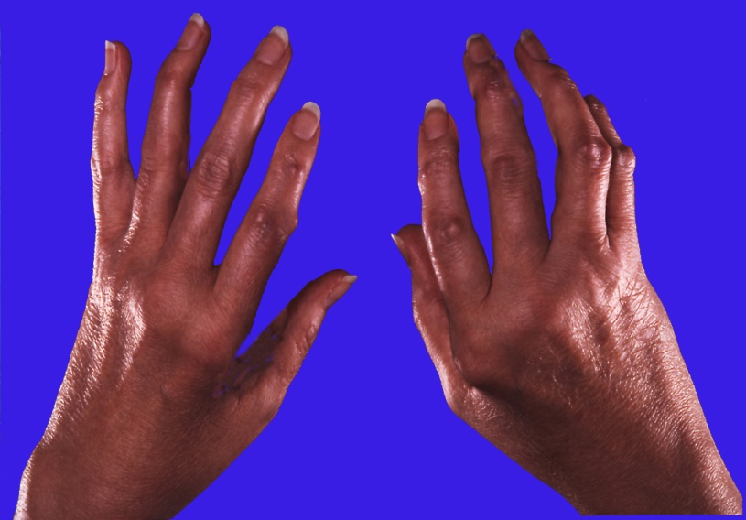
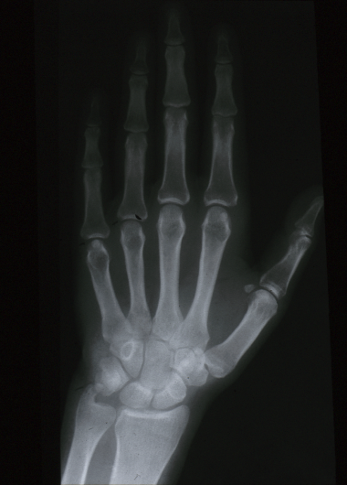
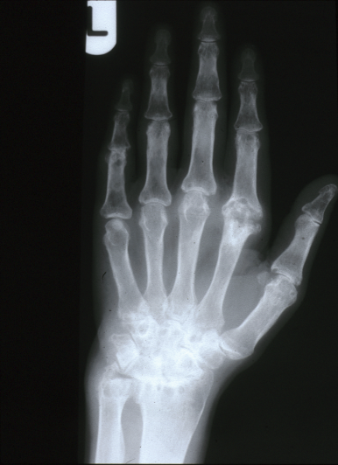
Prevalence and Outcome of
Rheumatoid arthritis (RA)
Prevalence : 0.5-1% of population
Incidence : 40-50 per 100,000/year
Sex : F:M 3:1
Reduced quality of life
Structural damage :
early and progressive
Baseline
+ 5 years

Slide 6
Rheumatoid Arthritis
Systemic
Chronic
Inflammatory
Primarily targets the synovium of diarthrodial joints
Etiology likely combination genetic and environmental

Slide 7
Joint Involvement in RA
N = 68

Slide 8
INITIATION OF RA
Genetic ~ 15 to 30%
Non-genetic ~ 70 to 85%

Slide 9
RA is Not a Benign Disease
Disability occurs early and is progressive
Radiological damage evident in 80% by 2 yrs:maximum rate of change also 2-3 yrs
Work/employment capacity : 50% less in 10 yrs
Co-morbidity and mortality significant

Slide 10
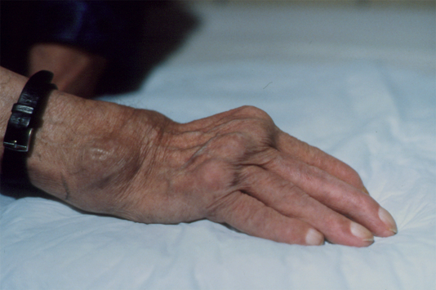
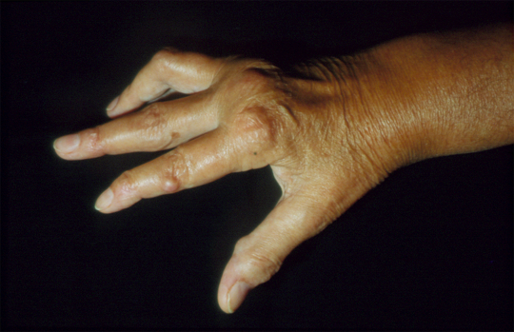
The Fate of RA
Pain & destruction
Loss of function
Systemic disease
Work disability
Economic losses
Premature death

Slide 11
Shortened Life-span of Severe Rheumatoid Arthritis
100
80
60
Percent surviving
40
Whole population
20
RA and joint disease only (n = 38)
RA and extra-articular disease (n = 33)
0
1
3
5
7
9
Years after entry
From : Erhardt, et al. Ann Rheum Dis 1989;48:7

Slide 12
Mechanisms of Immune Mediated Inflammatory Diseases
Genes
Health
Homeostasis
Disease Mechanisms:
Immunity/Inflammation
Non-genetic
Factors
Disease
Loss of
equilibrium

Slide 13

Normal Joint
Rheumatoid Arthritis Joint
Pannus
Synovial
membrane
Synovial fluid
rich in neutrophils
Synovitis
T cells
B cells
macrophages
fibroblasts
plasma cells
endothelial cells
dendritic cells
mast cells
Cartilage
Capsule
Cartilage erosion
Periosteum
Cartilage
loss
Bone erosion

Slide 14
Rheumatoid Arthritis :
A Disease of Imbalance in Homeostasis
Immune cells APC promote autoimmunity
Th1 > Th2
Loss of regulatory T cells
B cell autoimmunity
Cytokines and
Chemokines
Matrix turnover Enzymes > Inhibitors
Inflammation and tissue damage > Repair
:
Proinflammatory >
Anti-inflammatory
:
:

Slide 15
A Growing List of Cytokines Expressed in RA
Pro-inflammatory
e.g. IL-1, IL-6, TNFα, IL-12, IL-15, IL-17, IL-18, GM-CSF
Anti-inflammatory
e.g. IL-10, IL-1RA, TGFβ, IL-11, IL-13
Chemokines
e.g. IL-8, MIP-1α, MCP-1, RANTES, ENA-78, GROα
Growth Factors
e.g. VEGF, PDGF, FGF

Slide 16
Disequilibrium of Pro-Inflammatory and Anti-Inflammatory Cytokines in RA Joints
Chemokines
_{VEGF}
_{IL-6}
_{LIF}
_{OSM}
_{IL-10}
_{IL-13}
_{IL-11}
_{sTNF-R}
_{IL-1ra}
_{IL-12}
_{IL-15}
_{IL-17}
_{IL-18}
_{TGFβ}
_{IL-1}
_{TNFα}
_{GM-CSF}
_{M-CSF}
_{VEGF}
ANTI-INFLAMMATORY
PRO-INFLAMMATORY

Slide 17
Why do patients with RA see a doctor ?
Complain of symptoms
  pain in joints
  stiffness of: hands, in and around joints and neck
  fatigue
Problems in coping with activities related to :
  daily living
  social, sport, travel
  work

Slide 18
How Do We Diagnose RA Clinically ?
Morning Stiffness > 1
Arthritis at least 3 joints
Arthritis hand joints
Symmetric arthritis
Rheumatoid nodule
Rheumatoid factor
Joint erosion X-ray
*must have 4 out of 7 criteria

Slide 19
Proximal interphalangeal joint Swelling

Slide 20
Ulnar Deviation, MCP Swelling, Left Wrist Swelling

Slide 21
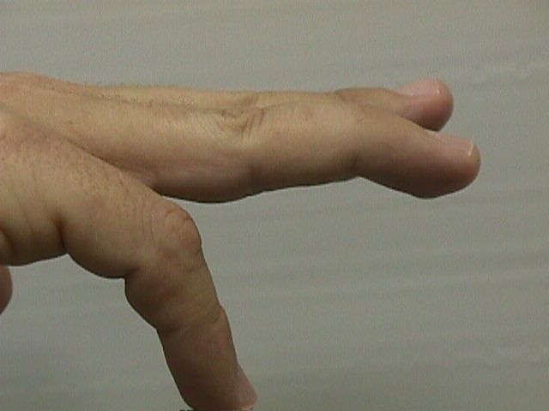
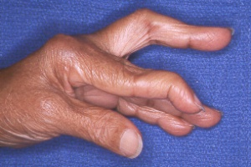
Rheumatoid hand deformities
“Swan neck” deformity
“Boutonniere” deformity

Slide 22
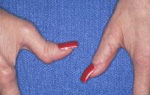
Z- thumbs

Slide 23
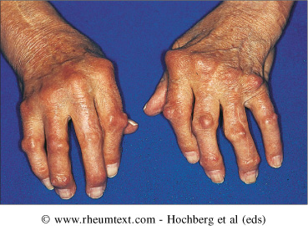
Nodules

Slide 24
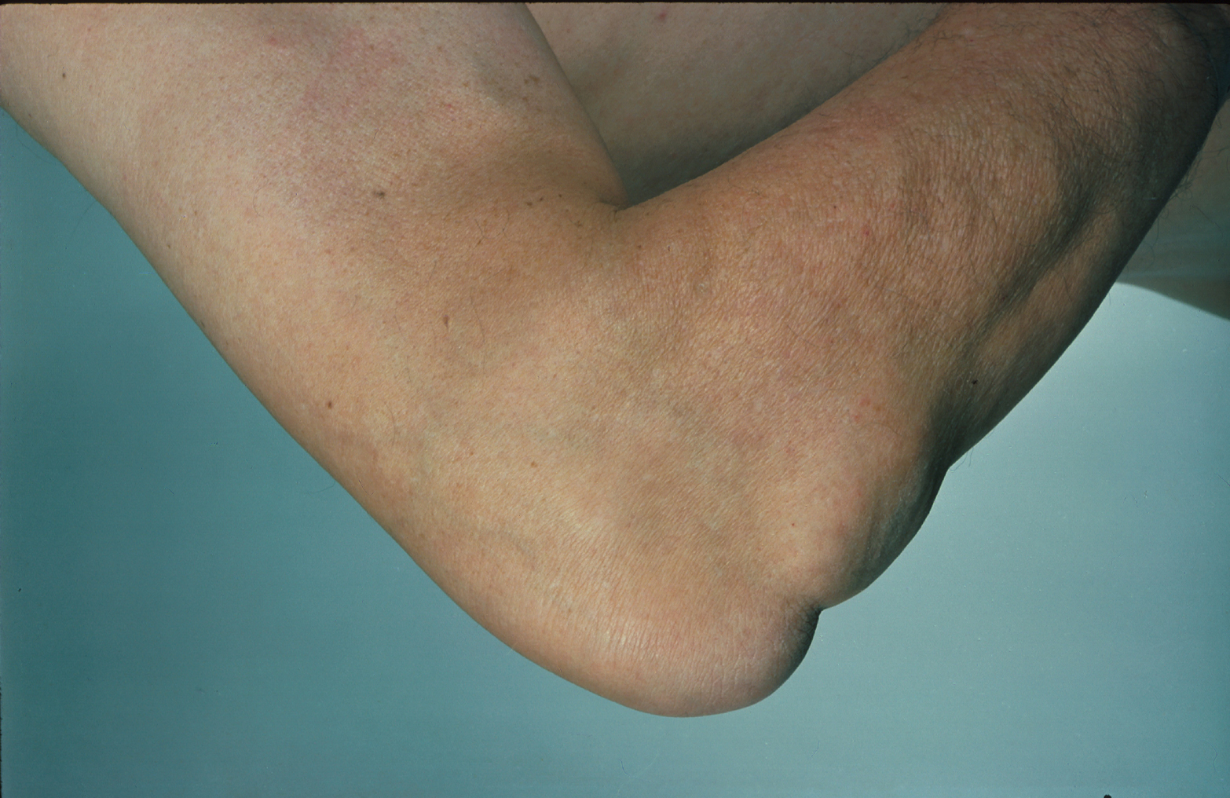

Slide 25
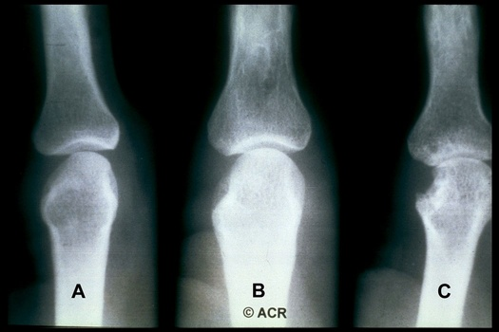

Slide 26
Extra-articular features in RA
Respiratory
    Pleural effusion M>F (need to exclude other causes)
    Rheumatoid nodules (Caplan’s syndrome)
    Interstitial lung disease (fibrosing alveolitis/fibrosis)
    Bronchiolitis obliterans (small airway disease)
Pericarditis/pericardial effusion
Neurological
  Most commonly carpal tunnel syndrome
  Peripheral neuropathy (stocking and glove)
  Mononeuritis multiplex eg foot drop
Haematological
  Anaemia common – many causes…
  Neutropaenia + splenomegaly +RA = Felty’s syndrome
Amyloidosis
Atlanto-axial subluxation – endangers spinal cord

Slide 27
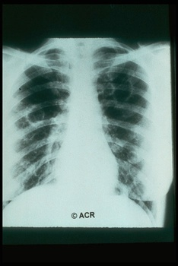
Pulmonary Nodules

Slide 28
How Do We Diagnose RA Clinically ?
Extra-articular features
  nodules, vasculitis
  pleural-pericardial disease
  organ involvement ; e.g. lungs, eyes

Slide 29
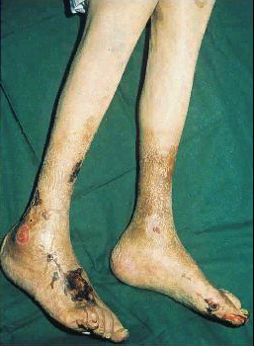

Slide 30
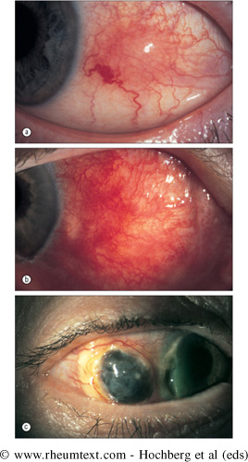
Corneal Melt

Slide 32
What Tests are Useful in Diagnosis ?
Laboratory tests for:
  anaemia, leucocytosis, thrombocytosis
  Acute phase response: ESR, CRP
  rheumatoid factor
X-rays : hands and feet for joint space narrowing, osteopenia and bone erosions

Slide 33
Rheumatoid Factor
Antibodies that recognize Fc portion of IgG
Can be IgM, IgG, IgA, IgE
85% of patients with RA over the first 2 years become RF+

Slide 34
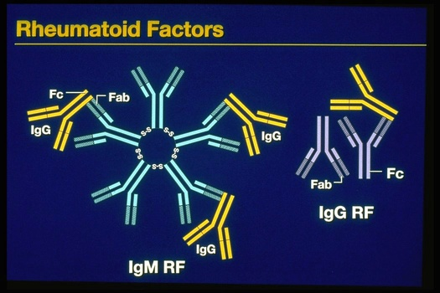

Slide 35
Anti-citrullinated cyclic-peptides in RA
An ELISA assay consisting of several citrulline-containing peptide variants has
sensitivity for RA of >75%
specificity for RA of > 95%
Schellekens GA et al, J Clin Invest 1998; 101:273

Slide 36
What we want to achieve:
Control of symptoms
Objective control of inflammation
Control acute phase response
Prevent tissue degeneration
Limit loss of function, well being and premature death

Slide 37
Pharmacotherapeutics in Rheumatoid Arthritis
NSAIDs
Glucocorticoids
DMARDs
Biologics

Slide 38
Non-Steroidal Anti-Inflammatory Drugs (NSAIDS)
Many preparations; widely used; long-term
Helpful in control of symptoms
Can (and do) cause side-effects including serious ones, especially gastropathic
For patients at risk (elderly, past history of ulcers etc) : use with gastro-protective agents or use selective cox-II inhibitors

Slide 39
Disease Modifying Anti-rheumatic Agents
Drugs that actually control the disease and not just treat symptoms
Should be used early on in patients
Erosions can develop in the joints of patients within the first two years of disease

Slide 40
Disease-Modifying Anti-rheumatic Drugs (DMARDS)
Introduce early : control symptoms and retard structural damage
Mild disease : hydroxychloroquine
Moderate to severe disease :
  salazopyrine
  methotrexate
  gold
  azathioprine
  cyclosporine
  leflunomide
Need careful monitoring for toxicity and efficacy

Slide 41
Corticosteroids
Intra-articular
Pulse : during induction period of DMARDS or for significant disease flare
Low-dose, long-term : for severe disease,
control of symptoms, function,
slows radiographic damage

Slide 42
Problems Therapy
Limited efficacy
Diminishing effect over time
Unacceptable toxicity
No effect on longterm mobility, mortality
High cumulative cost

Slide 43
What is a biologic therapy?
Protein-based drugs designed to target specific aspects of the inflammatory process.

Slide 44
Anti-TNF Therapy a significant Advance
Approved for Treatment :
  5 anti-TNF drugs which block action of TNF
    infliximab given intravenously 8 weekly
    etanercept self administered injections twice weekly
    Adalimumab self administerd injections fortnightly
    Certolizumab self administerd injections fortnightly
    Golimumab self administerd injections monthly
Durable control of symptoms and signs; improve function; quality of life; and prevent joint damage
Not all patients respond and remissions uncommon, continuing therapy required

Slide 45
Overproduction of TNFα causes rheumatoid inflammation and tissue damage
TNFα
TNFα
TNF-Receptor
Target Cells
SIGNALS
Pain, Stiffness
Swelling, Tenderness
Inflammation
Deformities,
Disability
Tissue damage

Slide 46
How Anti-TNF Therapy Works
Anti TNF Drugs
Monoclonal
Antibody
(infliximab,
adalimumab,
golimumab))
or
TNFα
Soluble TNF
receptor-fusion
protein
(etanercept)
Fab fragment
(Certolizumab)
TNF-Receptor
Cell Recruitment
Cytokine Network
Inflam-mediators
Deformities,
Disability
Pain, Stiffness
Swelling, Tenderness
Inflammation
Tissue damage

Slide 47
Biologic-free remission induction
There is preliminary data suggesting that early infliximab treatment can induce a biologic-free remission
BeST Study: Goekoop-Ruiterman et al, Arthritis Rheum 2005; 52: 3381-3390.
Allaart CF, Clin Exp Rheumatol 2006;24(6 Suppl 43):S-77-82

Slide 48
Anti-B cell Therapy another significant Advance
Approved for Treatment :
  Rituximab
Durable control of symptoms and signs; improve function; quality of life;

Slide 49
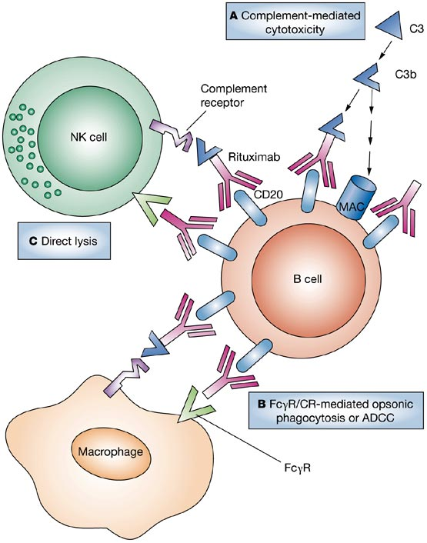
Rituximab-opsonized B cells are subject to attack and killing by at least three pathways
Taylor RP and Lindorfer MA (2007) Drug Insight: the mechanism of action of rituximab in autoimmune
disease—the immune complex decoy hypothesis
Nat Clin Pract Rheumatol 3: 86–95 doi:10.1038/ncprheum0427

Slide 50
Anti-T cell Therapy another significant Advance
Approved for Treatment :
  Abatacept
Durable control of symptoms and signs; improve function; quality of life;

Slide 51
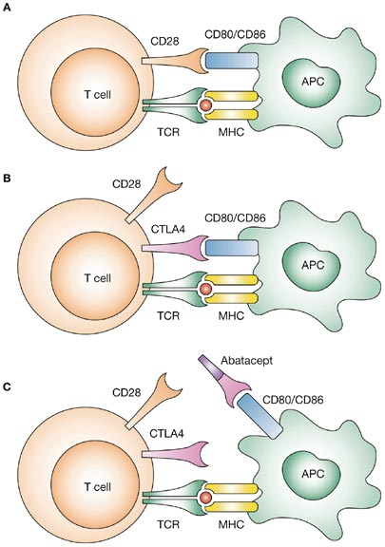
The two-signal hypothesis of T-cell activation and the potential mechanism of action of abatacept in the blockade of T-cell co-stimulation
Ruderman EM and Pope RM (2006) Drug Insight: abatacept for the treatment of rheumatoid arthritis
Nat Clin Pract Rheumatol 2: 654–660 doi:10.1038/ncprheum0345

Slide 52
Management
Focused on relieving pain and preventing damage/disability
Patient education about the disease is key
Physical Therapy for stretching and range of motion exercises
Occupational Therapy for splints and adaptive devices
Surgery

Slide 53
Members of the Multidisciplinary Team
Rheumatologist
Nurse
General Practitioner
Occupational therapist
Physical therapist
Podiatrist
Social worker
Psychologist/psychiatrist
Neurologist
Orthopaedic surgeon
General physician

Slide 54
Clinical Case
Ms. HK 29 yr old Administrator
1998- polyarthritis hands, wrists, elbows, hips,knees after “viral illness”
2hrs early morning stiffness
Profound fatigue
SJC-19 TJC- 11

Slide 55
Personal history
Indian Origin
Non-smoker
No alcohol intake
Lived with parents
2 sisters fit and well
Studying/working but difficulties due to illness

Slide 56
Investigations
Rheumatoid factor -ve
anti-CCP ab 500u/ml (<50u/ml)
ESR 100mm/hr (1-12)
CRP 296mg/l (<10)
Hb 11g/dl (12-16)

Slide 57
Treatments
Voltarol
Dihydrocodeine
Prednisolone
Omeprazole

Slide 58
DMARD’s
Methotrexate (PO/IM)
Hydroxychloroquine
Sulphasalazine
Leflunomide
Azathioprine

Slide 59
Medical History
Upper GI bleed -1999
Left extensor and flexor synovectomy -2000
Right indisplaced fracture of base of 5th Metatarsal -2001
Diagnosis Osteoporosis

Slide 60
Medical History
Recurrent vaginal candidiasis -2002
Right hip replacement 2003
Started etanercept March 2003
Diarrhoea and flare arthritis 2004

Slide 61
Present medical history
Presently feels well
ESR and CRP normal
SJC-4 TJC 0
Married in May 2005
Gave Birth to Baby Boy 2011

Slide 62
To conclude
Rheumatoid arthritis
  Historical
  Epidemiology
  Science
  Diagnosis and Treatment
  Case study

Slide 63
Revision Questions
How common is RA in Britain?
Name 2 antibodies associate with RA
Name 2 disease modifying drugs
Where was therapeutic use of anti-TNF agents in the treatment of RA pioneered

