Slide 1
The Hand
GENERAL APPEARANCE
SKIN, RASHES
NAILS
JOINTS
TENDONS
NEURO
X-RAY

Slide 2
SKIN AND RASHES
‘SAUSAGE FINGERS” MCTD, EARLY SCLERODERMA
SCLERODACTYLY SCLERODERMA
DERMATOMYOSITIS GOTTRON’S PAPULES, NAILBED & PULP ERYTHEMA
VACSULITIS
PALMAR ERYTHEMA LIVER, RA, OESTROG., THYROID

Slide 3
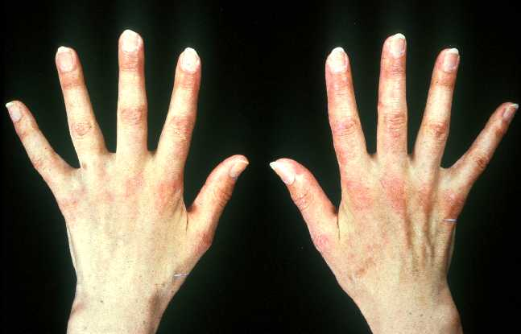

Slide 4
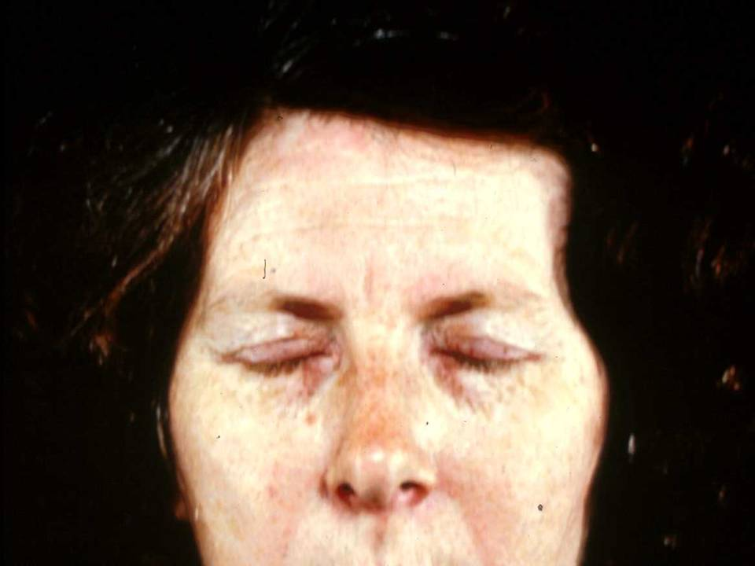

Slide 5
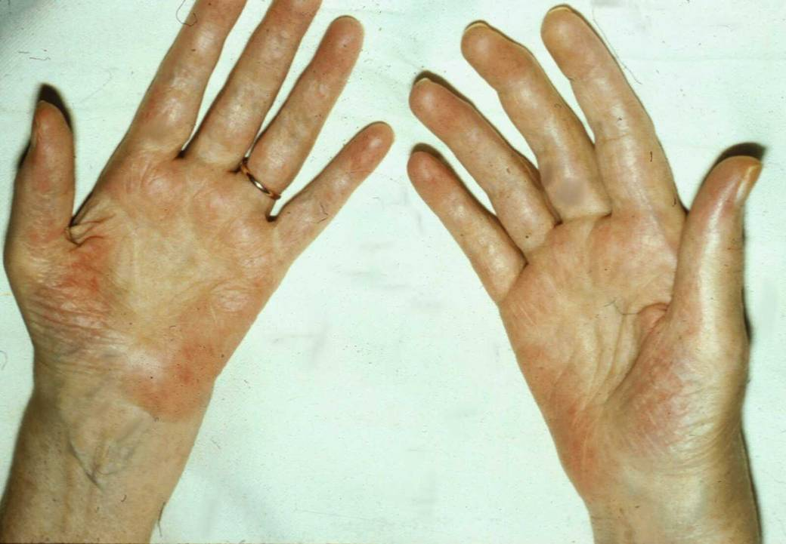

Slide 6
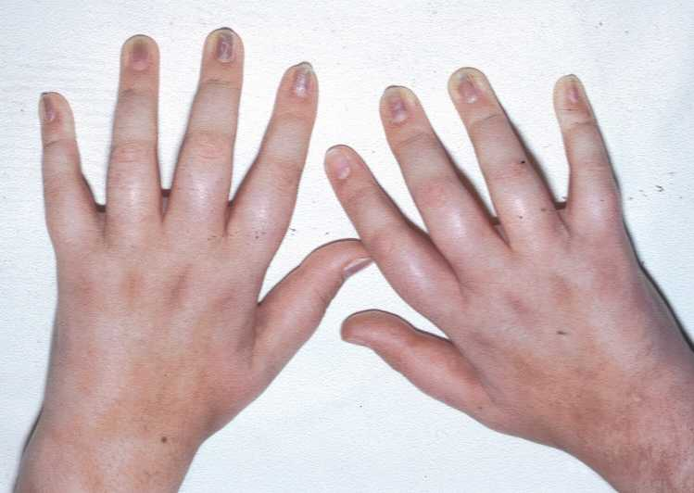

Slide 7
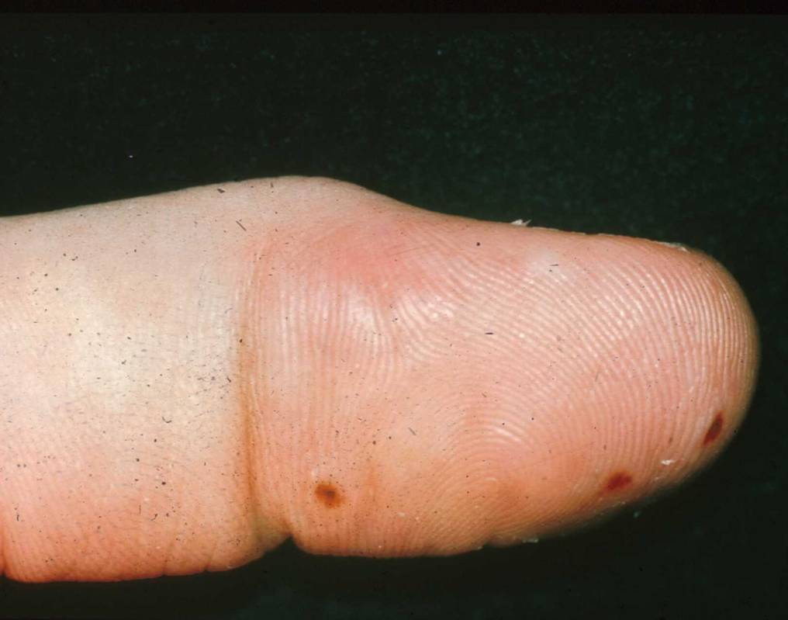

Slide 8
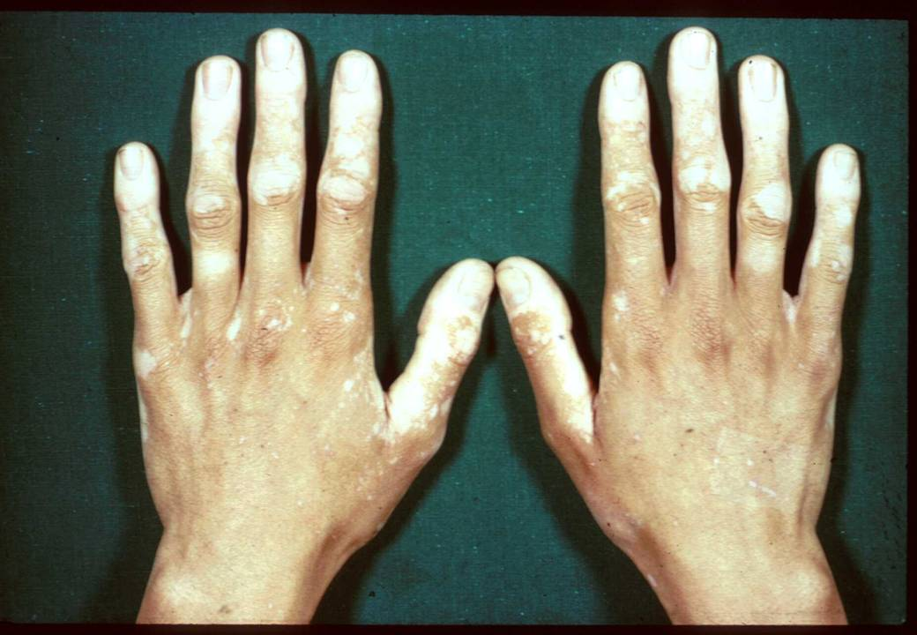

Slide 9
NAILS
CLUBBING CA BRONCUS, ETC
PITTING PSORIASIS
KOILINYCHIA IRON DEFFICIENCY
LEUCONYCHIA LIVER DISEASE
SPLINTERS SBE, VASCULITIS

Slide 10
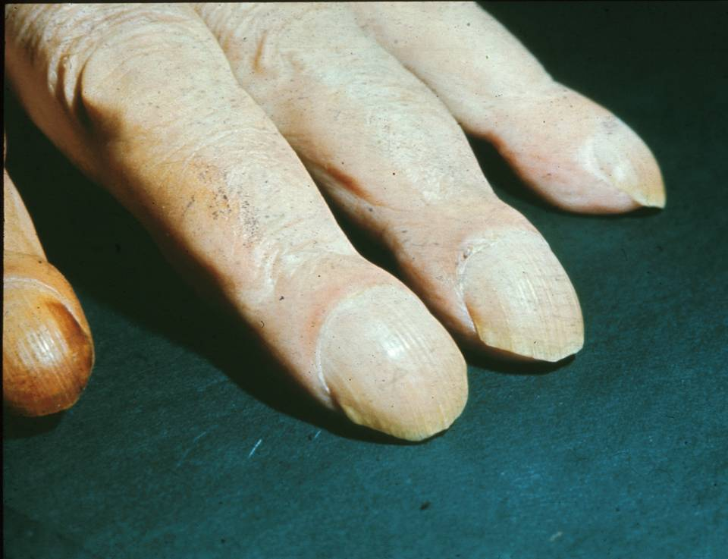

Slide 11
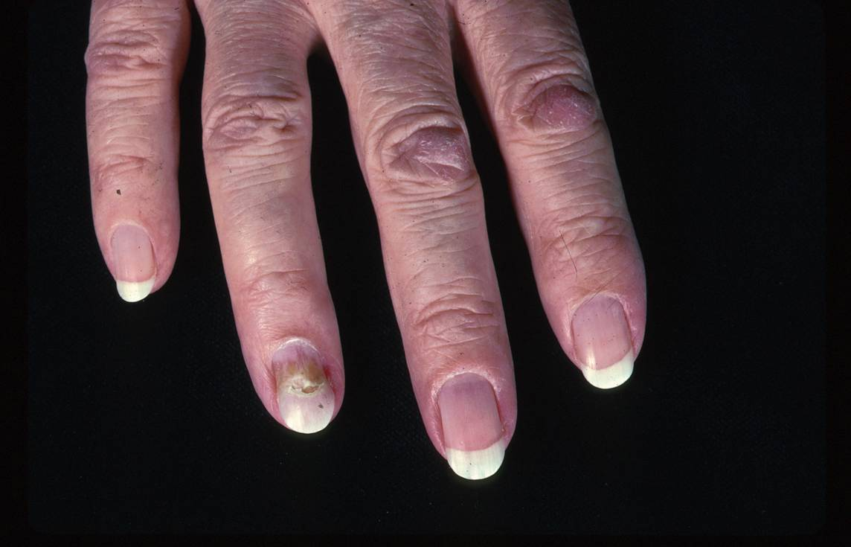

Slide 12
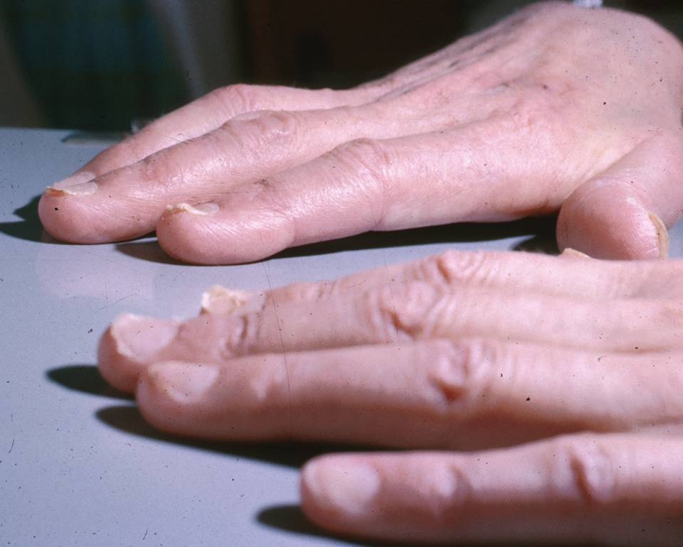

Slide 13
JOINTS
DISTRIBUTION (OA VS RA)
DEFORMITY
“NODES”
RANGE OF MOVEMENT
TENDERNESS
SOFT TISSUE SWELLING
CREPITUS (PARTICULARLY CMC OA)

Slide 14
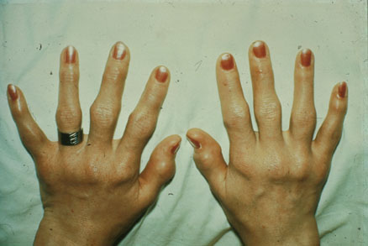

Slide 15
OA
RA

Slide 17
TENDONS
THICKENING OF PALMAR TENDONS EARLY RA, SLE
TRIGGERING
DUPUYTREN’S
TENDERNESS + CREPITUS OF ADDUCTOR AND EXTENSORS OF THUMB (SNUFF BOX) DE QUERVAINS TENDONITIS
TENDON RUPTURE

Slide 18
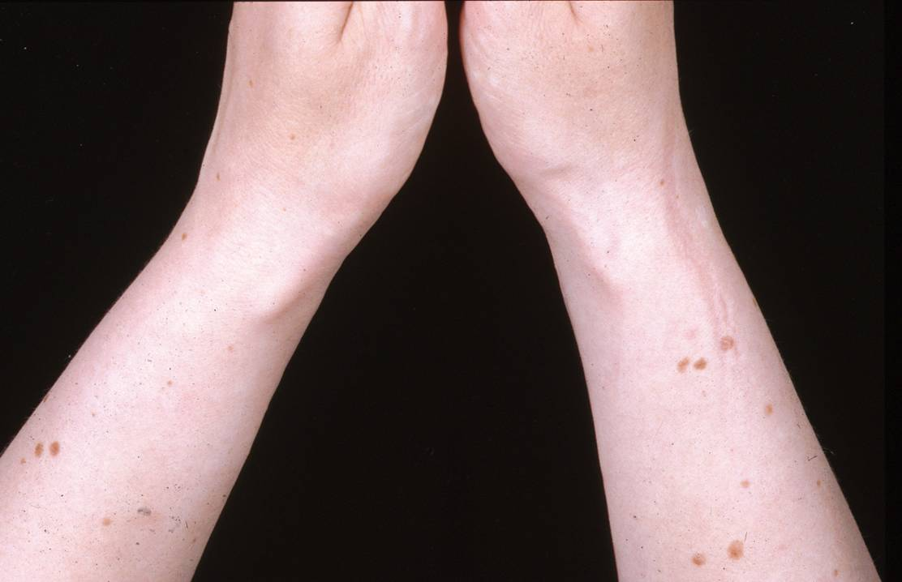

Slide 19
NEUROLOGICAL
MEDIAL NERVE COMPRESSION (WRIST) CARPAL TUNNEL SYNDROME
ULNAR NERVE DAMAGE (ELBOW)
RADIAL NERVE DAMAGE WRIST DROP

Slide 20
SENSORY DISTRIBUTION OF MEDIAN AND ULNAR NERVES

Slide 21
X-RAY
SOFT TISSUE SWELLING
OSTEOPOROSIS /SCLEROSIS
EROSIONS
JOINT SPACE
OSTEOPHYTES
CALCINOSIS

Slide 22
Radiological changes in OA vs RA

