Slide 1
"Whoever thought exams were a good idea?”
what makes a good assessment and why
how to pass your year 5 exams

Slide 2
Teaching skills course: Understanding Assessment
Objectives
Discuss principles of assessment
In context of your year 5 examinations
Understand what makes a good assessment
What are the pitfalls and problems

Slide 3
Why assess?
Academic
To grade your achievement
To discover problems
With individual students
With course
Professional
To ensure students meet standards
To reassure public

Slide 4
Design your own exams
You are the Imperial Exam Board
How should we test your knowledge, skills, and attitudes in year 5?
Think of two ways of assessing.
Think out of the box
You are the General Medical Council
What’s wrong with Imperial exams?
Criticise what’s done at present.
How would you make it better
2 examples

Slide 5
Key concepts
Meanings
Reliability
Validity
Consequences: “backwash”
Formative & Summative

Slide 6
Meanings
“High stakes assessments”
Typically professions
50.5%: doctor, career, mortgage etc
49.5%: jobless, more loans, girlfriend leaves you for a surgeon, etc
But public need to believe you are competent
Don’t award grades of pass
(eg 1st class doctor ... pass degree doctor)
1% may separate “competent” from “incompetent”
Finals?

Slide 7
Reliability
If you took the same test over again would you get the same result?
If you could pass the exam one day and fail it the next
What does that mean?
How many people fail who should pass?
Implications for career
How many people pass when they should fail?
Implications for public
Measure reliability statistically eg; Cronbach’s alpha
Measure of internal consistency not above
Measured because it can be – cf validity

Slide 8
Validity
How closely does this exam mimic what doctors are expected to do? Does it look right?
“Face validity”
Will it have public confidence?
How closely does it measure the objectives of the course? Does it measure what we need it to measure? – “Construct validity”
How well does it correlate with future performance? – “Predictive validity”
But can we really measure it?

Slide 9
Validity & reliability
Usually exams with high validity have low reliability
eg?
Exams with high reliability have low validity
eg?
Use mix of methods
Pragmatic approach

Slide 10
Backwash
Exams don’t exist in isolation, they have consequences
How did you work for year 3 exams?
Are you going on a finals course?
Positive and Negative effects:
Working to the exam, Teaching to the exam
Strategic learning
“The hidden curriculum”
“Assessment drives learning”

Slide 11
What about year 5 assessment?
Combines O&G, Paeds, Psyche, GP aspects
Separate Pathology examination
Test clinical skills in-course
Developing understanding via
SEAs, mini CEX
Knowledge via MEQs and SBAs
Clinical management via Y5 PACES

Slide 12
In-course assessment
Must show competence in key skills
O&G, Psyche, Paeds, GP
Condition of entering end of year exams
via Mini-CEXs & DOPSs
Formative and summative process
Don’t cheat
Need this as foundation doc
Fitness to practice offence!!

Slide 13
MEQ & MCQ
90 questions of each
ie 90 SBAs, 18 EMQs with 5 answers each
range in difficulty, cover wide aspects of disciplines
Eg science, diagnosis, investigations, management ethics and law
“Criterion referenced pass mark” at level of “just good enough” for Foundation posts”
Highly reliable ...but validity??...
“Context dependant learning”

Slide 14
A test...
The stanon frequently overheats because
a. all grestels are belious
b. no immon is directly fectitious
c. ports are always actial
d. the octal is usually casable

Slide 15
Flugulation usually occurs:
a. in the mornings
b. at night
c. on hot sunny afternoons following humid overcast mornings
d. in February

Slide 16
Non-responsive frattling is usually found in an:
a. gringle
b. janket
c. kloppie
d. uckerpod

Slide 17
Year 5 “PACES”
“PACES” Practical Assessment Of Clinical Examination Skills
Developed for RCP (by Leslie Southgate)
Year 6 exam is “clone”
Year 5 exam nothing like original!!
Renamed
“Clinical Assessment and Management exam” (ClAM)

Slide 18
Rationale
Tests diagnosis and management of everyday clinical problems
Use actors, videos and some patients
You are told little when you go in
Just like real medicine
Up to you to clarify issues and decide how to sort them out –
Just like real medicine
Discuss with examiner rationale for what you have done / understanding of issues –
Just like real medicine
High Validity ...High Reliability

Slide 19
Practicalities
6 x 15 min stations
Often combine disciplines eg post natal depresssion
You have (typically)
7 mins to take selective “focussed” history & examination
Take the history you need to gain adequate view
4 mins to discuss management with patient
4 mins discussion with examiner

Slide 20
Preparing for the exam
Backwash effect
Need combination of well honed clinical skills with good medical knowledge
Practice doctoring
Take all opportunities to talk to patients, esp unsorted
Examine ill patients
Practice focussed history taking
Discuss management with student colleagues
Practice skills and get signed off when competent
Read up clinical problems
Focus on everyday issues
Lectures etc are key source of exam info!!

Slide 21
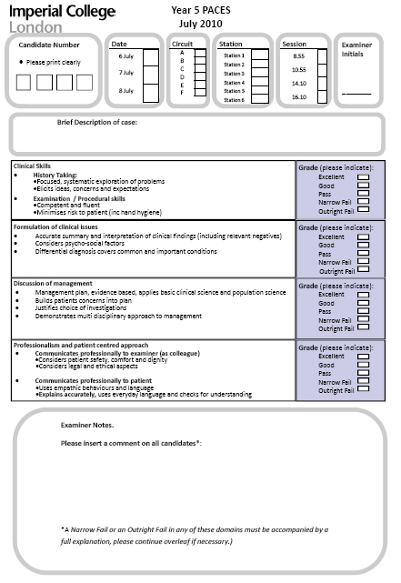
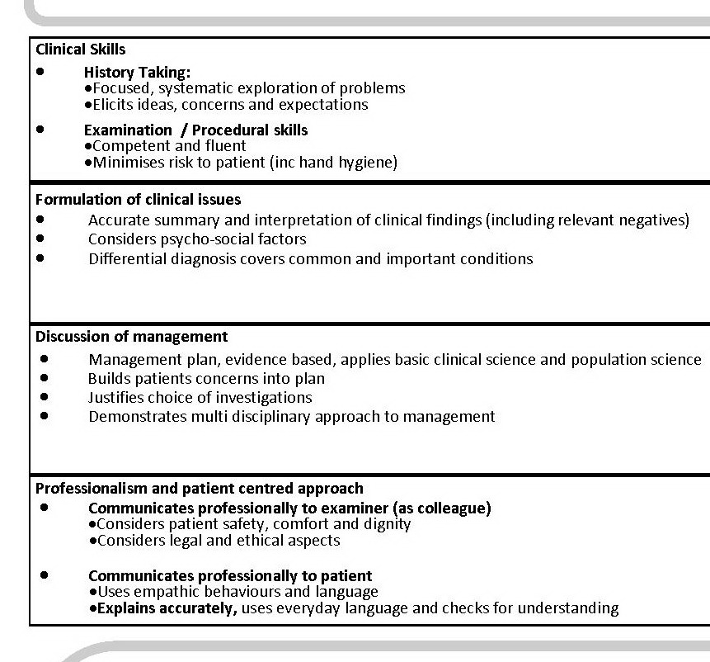

Slide 22
Conclusion
Assessments must be:
Valid & Reliable
They have meanings beyond the test
They have consequences (esp for learning)
They can be formative or summative
(but usually not both)
Good exams are:
Criterion referenced (mainly)
Pragmatic combination of high validity and high reliability items
Assessment drives learning
Use it to drive yours!

