Slide 1
of
Viral
hepatitis

Slide 2
A

Slide 3
Hepatitis A virus
Acute hepatitis
Often subclinical
Faecal oral spread
Notify
Occupational risks
GUM clinics – terminology –MSM etc

Slide 4
Hepatitis A virus
Anti-HAV IgM -recent infection
(or vaccine!)
Anti-HAV IgG -previous infection
(or vaccine!)
NEW VACCINES

Slide 5
New Zealand blueberries
Waikato blueberries
December 2001 - January 2002
17 cases
NB HAV not killed by freezing

Slide 6
Shanghai blood clams
1988
n = 310 000
Each filter 40l of water/day
2004 5-10% HAV positive

Slide 7
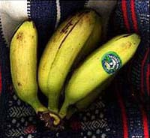
B

Slide 8
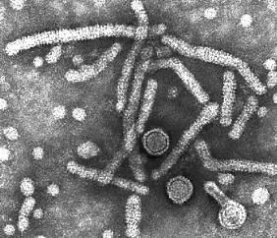

Slide 10
HEPADNA VIRUSES.

Slide 11
HEPATITIS B VIRUS
Sexual
Vertical
Blood products
ACUTE AND CHRONIC
Chronic = 6 months or more

Slide 12
Swedish cross country runners
n = 568
1957-1963
More than 95% had scratches
Protective clothing advised
More cases 1965-1966 when rules relaxed

Slide 13
North London alternative clinic
Autohaemotherapy
Acute hepatitis B in one patient
investigation
352 patients and 4 staff checked
57 (16%) prev HBV exposure
33 HBsAg pos
30 complete nucleotide identity

Slide 14
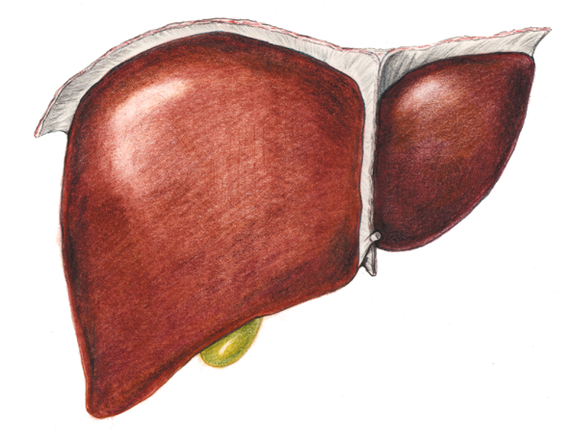
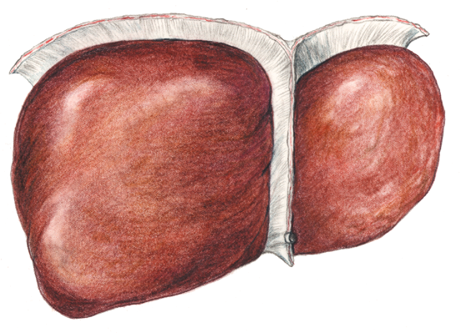
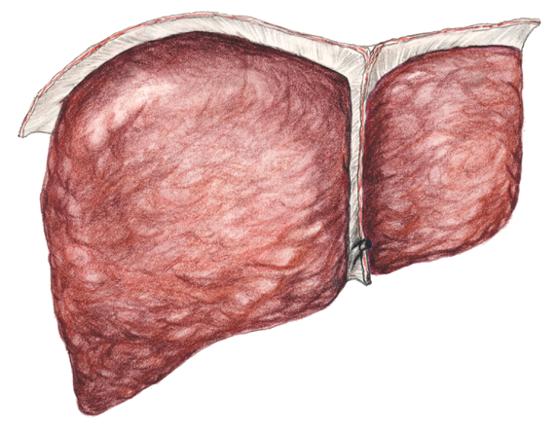
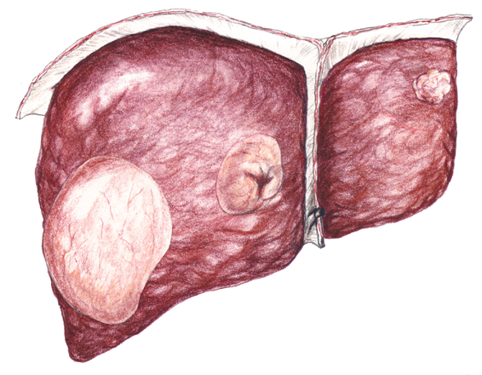
Healthy liver
Hepatic fibrosis
Cirrhosis
Liver cancer
Notes:
These diagrammatic representations of the liver again show the serious consequences of long term hepatitis B infection on this organ.
The liver is the largest organ in the body, situation in the upper right hand side of the abdomen, just below the ribcage.
It is made up of cells called hepatocytes (liver cells) arranged into groups called lobules.
Liver cells perform a variety of very important functions, including
processing absorbed nutrients
storing vitamins and sources of energy
detoxifying waste products that could be harmful
If liver function is disrupted by disease, toxins and waste products accumulate in the body, stores of vital vitamins become depleted and less nutrients are processed for use by the body.
Severe disruption to the liver can result in death.

Slide 15
HBV- disease stages
Immune tolerant
Immune reactive
Inactive HBV carrier state
HBeAg negative chronic HBV
HBsAg negative phase
BMJ 2010

Slide 16
The REVEAL Study
Risk Evaluation of Viremia Elevation & Associated Liver Disease
Prospective, multicenter, observational cohort study
1991-1992
Recruitment
7 Taiwanese townships
aged 30–65 years
(n=89,293)
Baseline HBsAg+
(n=9800)
24% PCR neg
85% HBeAg neg
94% ALT<45 IU/L
98% non-cirrhotic (on ultrasound)
Baseline HBV DNA
(n=3851)
June 2004: 43,993 PYs follow-up
Follow-up analysis
for cirrhosis/HCC
(n=3774)
Chen CJ. JAMA. 2006;295:65-73.
Notes:
16

Slide 17
REVEAL-Incidence of Cirrhosis (11yr) Increases with Increasing Baseline Serum HBV DNA Level
*
Iloeje U H, et al. Gastroenterology 2006;130:678-86.
* p < 0.001 test for trend
Notes:
This describes the relationship between baseline HBV-DNA levels and the risk for cirrhosis in patients followed for a mean of 11 years. The 1563 patients (44%) with a level of 10⁴ copies/mL or more accounted for 274 (75%) of the cirrhosis cases. The cumulative incidence of cirrhosis increased with increased baseline viral levels. For patients with a baseline serum HBV-DNA level of less than 300, the incidence was 4.5%. For patients with a baseline serum HBV-DNA level of 10⁶ copies/mL or more, the incidence was 36.2% Serum hepatitis B virus (HBV) DNA level is a marker of viral replication and efficacy of antiviral treatment in individuals with chronic hepatitis B.
The objective of the REVEAL study was to evaluate the relationship between serum HBV DNA level and risk of hepatocellular carcinoma. This was a prospective cohort study of 3653 participants (aged 30-65 years), who were seropositive for the hepatitis B surface antigen and seronegative for antibodies against the hepatitis C virus, recruited to a community based cancer screening program in Taiwan between 1991 and 1992. The main outcome measure was the incidence of hepatocellular carcinoma during follow-up examination and by data linkage with the national cancer registry and the death certification systems.
164 incident cases of hepatocellular carcinoma and 346 deaths during a mean follow-up of 11.4 years and 41 779 person-years of follow-up were reported. The incidence of hepatocellular carcinoma increased with serum HBV DNA level at study entry in a dose-response relationship ranging from 108 per 100 000 person-years for an HBV DNA level of less than 300 copies/mL to 1152 per 100 000 person-years for an HBV DNA level of 1 million copies/mL or greater. The corresponding cumulative incidence rates of hepatocellular carcinoma were 1.3% and 14.9%, respectively. The biological gradient of hepatocellular carcinoma by serum HBV DNA levels remained significant (P.001) after adjustment for sex, age, cigarette smoking, alcohol consumption, serostatus for the hepatitis B e antigen (HBeAg), serum alanine aminotransferase level, and liver cirrhosis at study entry. The dose-response relationship was most prominent for participants who were seronegative for HBeAg with normal serum alanine aminotransferase levels and no liver cirrhosis at study entry. Participants with persistent elevation of serum HBV DNA level during follow-up had the highest hepatocellular carcinoma risk.
Elevated serum HBV DNA level (10 000 copies/mL) is a strong risk predictor of hepatocellular carcinoma independent of HBeAg, serum alanine aminotransferase level, and liver cirrhosis.

Slide 18
REVEAL-Incidence of HCC (13 yr) Increases with Increasing HBV DNA Baseline Viral Level
20%
14.9%
15%
12.2%
% cumulative incidence of HCC
10%
5%
3.6%
1.3%
1.4%
0%
<300
>300 - 10³
> 10³ - 10⁴
>10⁴ - 10⁶
≥10⁶
Baseline HBV DNA (copies/mL)
Chen JC, et al. JAMA. 2006;295:65-73.
Notes:
This compares the cumulative hepatocellular carcinoma incidence at the end of the 13th year of follow-up derived from the stepwise analyses of different baseline viral levels. Approximately 15% of all participants with serum HBV DNA levels of 1 million copies/mL or greater at study entry developed hepatocellular carcinoma by the 13th year of follow-up compared with 1.3% of participants with undetectable levels of HBV DNA.The biological gradient of cumulative hepatocellular carcinoma incidence by serum HBV DNA level remained prominent in all stepwise analyses. Among the 2925 participants seronegative for HBeAg with a normal ALT level and no liver cirrhosis, the cumulative hepatocellular carcinoma incidence was 13.5% for HBV DNA levels of 1 million copies/mL or greater and 0.7% for those with undetectable levels of HBV DNA. Serum hepatitis B virus (HBV) DNA level is a marker of viral replication and efficacy of antiviral treatment in individuals with chronic hepatitis B.
The objective of the REVEAL study was to evaluate the relationship between serum HBV DNA level and risk of hepatocellular carcinoma.This was a prospective cohort study of 3653 participants (aged 30-65 years), who were seropositive for the hepatitis B surface antigen and seronegative for antibodies against the hepatitis C virus, recruited to a community based cancer screening program in Taiwan between 1991 and 1992.The main outcome measure was the incidence of hepatocellular carcinoma during follow-up examination and by data linkage with the national cancer registry and the death certification systems.
164 incident cases of hepatocellular carcinoma and 346 deaths during a mean follow-up of 11.4 years and 41 779 person-years of follow-up were reported. The incidence of hepatocellular carcinoma increased with serum HBV DNA level at study entry in a dose-response relationship ranging from 108 per 100 000 person-years for an HBV DNA level of less than 300 copies/mL to 1152 per 100 000 person-years for an HBV DNA level of 1 million copies/mL or greater. The corresponding cumulative incidence rates of hepatocellular carcinoma were 1.3% and 14.9%, respectively. The biological gradient of hepatocellular carcinoma by serum HBV DNA levels remained significant (P.001) after adjustment for sex, age, cigarette smoking, alcohol consumption, serostatus for the hepatitis B e antigen (HBeAg), serum alanine aminotransferase level, and liver cirrhosis at study entry. The dose-response relationship was most prominent for participants who were seronegative for HBeAg with normal serum alanine aminotransferase levels and no liver cirrhosis at study entry. Participants with persistent elevation of serum HBV DNA level during follow-up had the highest hepatocellular carcinoma risk.
Elevated serum HBV DNA level (10 000 copies/mL) is a strong risk predictor of hepatocellular carcinoma independent of HBeAg, serum alanine aminotransferase level, and liver cirrhosis.

Slide 19
Staging disease
ALT
HBV DNA levels
Fibrosis and inflammation
(Biopsy, fibroscan?)
[HIV status, anti-HDV,antiHAV IgG]

Slide 20
Staging disease
ALT new normal range
HBV DNA levels
Fibrosis and inflammation
(Biopsy, fibroscan?)
[HIV status, anti-HDV,antiHAV IgG]

Slide 21
Treatments
Standard interferon
Pegylated interferon
L-nucleosides
Deoxyguanosine analogs
Acyclic nucleoside phosphonates

Slide 22
Treatments
Pegylated interferon
L-nucleosides
Lamivudine, telbivudine, emtricitabine
Deoxyguanosine analogs
entecavir
Acyclic nucleoside phosphonates
adefovir, tenofovir

Slide 23
Interferon
One-off course
Host and viral factors predict response
But
Side effects/monitoring
Careful selection of patients

Slide 24
NUCs
Finite v long term suppression?
Cost - drugs and monitoring
Compliance
Resistance
Flares
Long term toxicity

Slide 25
First line
Entecavir
High genetic barrier
? Long term toxicity
Tenofovir
High genetic barrier
? Monitoring
? Renal toxicity

Slide 26
94% of patients achieved HBV DNA 300 copies/mL (~<69 IU/L) through 5 years* of entecavir therapy in a continuous treatment cohort
ETV-022
HBeAg(+) Baraclude Long-term Cohort (ETV-022→ETV-901)
Year 1
Year 1
Year 2
Year 3
Year 4
Year 5
100
94%
89%
91%
83%
80
67%
60
55%
Proportion of patients (%) HBV DNA <300 copies/mL
40
20
0
n =
236/354
80/146
116/140
116/131
98/108
88/94†
* Different dosing regimen for naïve patients in the 901 study
† Five patients who remained on treatment at the Year 5 visit had missing PCR values (NC=M).
Adapted from Han S, et al. 59th AASLD, October 31-November 4 ,2008, San Francisco, USA. Poster 893.
Notes:
Speaker notes
The grey bar shows that 67% of patients achieved undetectable HBV DNA at Week 48 among the 354 patients treated with ETV in Study ETV-022.
The turquoise bars show the progressive increase in proportion of patients who achieved undetectable HBV DNA at Weeks 48, 96, 144 and 192 among the patients treated with ETV in the 4-year cohort
The results are consistent at Week 48 between the ETV 3-year cohort (55%) and the overall ETV-022 population (67%), indicating, that the 4-year cohort is representative of the overall study population from a virologic perspective.
Note that:
The majority of the incremental benefit occurs between years 1 and 2
Treatment after Year 2 represents an effective maintenance of virologic efficacy
Reference
Han S, et al. 58th AASLD, 2-6 November 2007, Boston, USA. Poster Presentation 938. Hepatology 2007;46(Suppl 1):654A

Slide 27
LIVER TRANSPLANTATION AND HBV
graft reinfection
interferon
immunosuppression
hepatitis B Ig
nucleoside analogs
PRE
PERI
POST

Slide 28
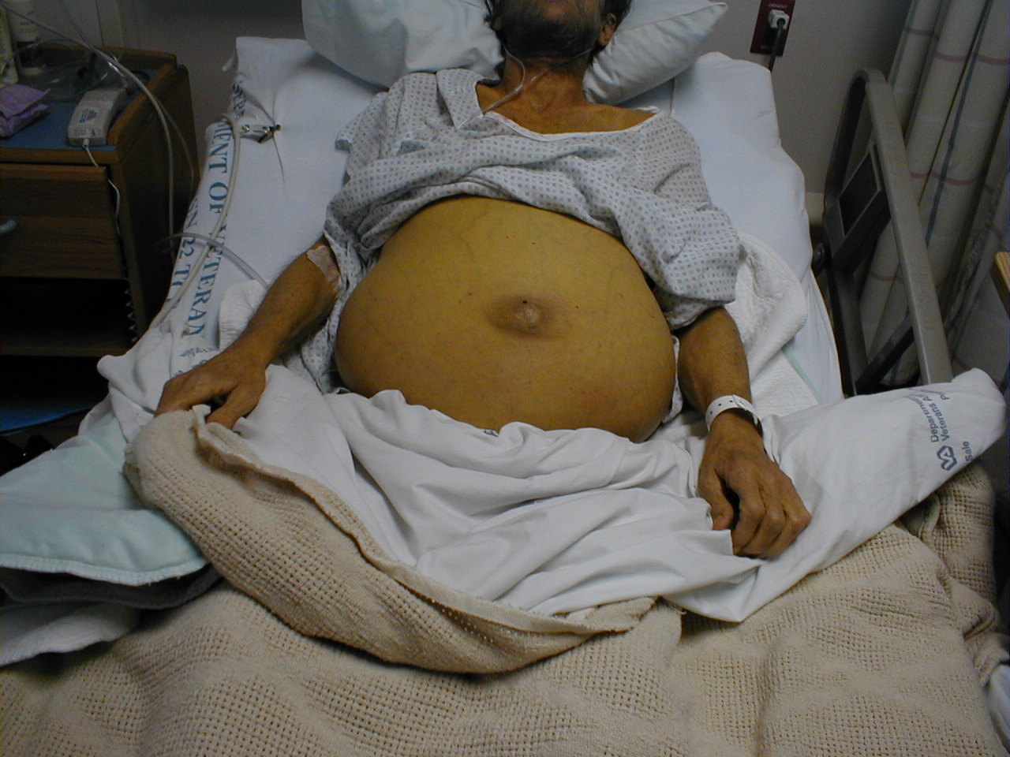
LIVER FAILURE

Slide 29
Patients With End-stage Chronic Hepatitis B Median Bilirubin and Albumin Levels
2.0
10
Albumin
1.8
5
Bilirubin
(xULN)
1.6
Albumin
(% Change)
0
1.4
Bilirubin
-5
1.2
1.0
-10
0
4
8
12
20
28
36
44
52
n=30
n=19
Weeks of Therapy
Perrillo et al 1999

Slide 30
HBV vaccines
Non-responders - new vaccines
? Need for boosters
Clinic policy

Slide 31
C

Slide 32
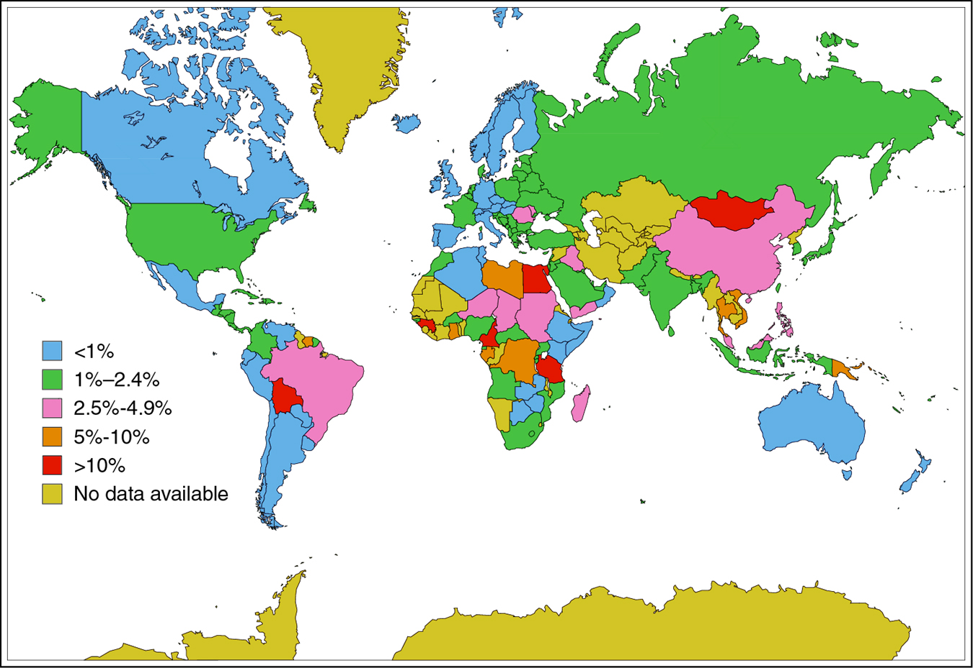
HCV Infection: Worldwide Prevalence
Reprinted from Cohen J. Science. 1999;285:26.

Slide 33
FLAVIVIRIDAE
BVDV
HChV
HCV
GBV-A
YFV
GBV-B
GBV-C
dengue 2
dengue 1
WNV
JEV

Slide 34
Hepatitis C virus
Flaviviridae
Mainly blood product spread
60-80% chronicity
Natural history
HCV and the brain?!
Acute HCV in HIV pos men

Slide 35
dodgy Spanish anaesthetist
Dr Juan Maeso 63 yrs
n = 276 patients 1988-1998
? Post-op morphine
Prosecution demanding 8 yrs/case
(2 212 years) and lots of euros

Slide 36
Irish anti-D
1977-1978 contaminated anti-D
Discovered 1994
Screening of all women who received anti-D 1970-1994
62 667 women
704 past or present
390 pos PCR

Slide 37
Acute HCV in HIV-positive men: an emerging epidemic
UK August 2004 STI
Germany March 2005 JViralHep
UK September 2005 JAIDS
Netherlands January 2004 Ned TijdschrGeneeskd
France July 2004 HIV Medicine
Netherlands June 2005 AIDS
USA January 2006 JAIDS
France January 2006 AIDS
USA September 2008 JID
Australia January October 2007 Int J Drug Policy

Slide 38
Acute hepatitis C - outcomes
Acute infection
Clears 20-40%
Chronic 60-80%

Slide 39
Acute hepatitis C
Anti-HCV
ALT

Slide 40
Healthy liver
Hepatic fibrosis
Cirrhosis
Liver cancer
Notes:
These diagrammatic representations of the liver again show the serious consequences of long term hepatitis B infection on this organ.
The liver is the largest organ in the body, situation in the upper right hand side of the abdomen, just below the ribcage.
It is made up of cells called hepatocytes (liver cells) arranged into groups called lobules.
Liver cells perform a variety of very important functions, including
processing absorbed nutrients
storing vitamins and sources of energy
detoxifying waste products that could be harmful
If liver function is disrupted by disease, toxins and waste products accumulate in the body, stores of vital vitamins become depleted and less nutrients are processed for use by the body.
Severe disruption to the liver can result in death.

Slide 41
Improvements in sustained virologic response rates with progressions in therapy
60
Peginterferon alfa-2b
Combination therapy
IFN/ribavirin
Combination therapy
48 weeks
54%
50
40
41%
Sustained response rate in
treatment naive patients (%)
30
IFN Monotherapy
48 weeks
20
IFN
Monotherapy
24 weeks
16%
10
No therapy
6%
0
0%
1989
1995
1999
2001

Slide 42
The peginterferon alfa-2b molecule

Slide 43
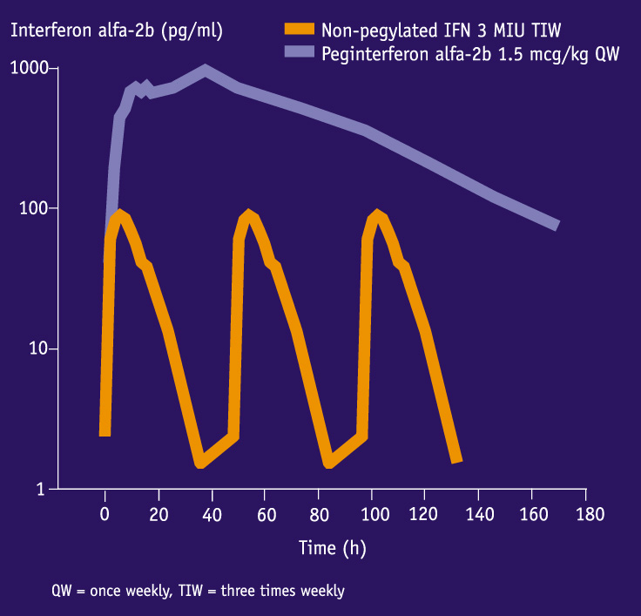
Delayed plasma clearance of pegylated vs non-pegylated interferon
Glue P et al. Clin Pharmacol Ther 2000;68:556-567.

Slide 44
Interferon treatment
HCV
RNA
No response
Partial response
Breakthrough
Relapse
Sustained
response
Time

Slide 45
PEG-IFN α2A (40kD) + RBV; SVR IN Genotype non-1
800mg 1000/1200mg 800mg 1000/1200mg
24 weeks 48 weeks

Slide 46
PEG-IFN α2A (40kD) + RBV; SVR IN Genotype 1
800mg 1000/1200mg 800mg 1000/1200mg
24 weeks 48 weeks

Slide 47
HCV MANAGEMENT
Risk v benefit
PCR pos
LIVER BIOPSY
mild
cirrhosis
moderate
await trial
?
treat
genotype 1, 4
genotype 2, 3
48 weeks
24 weeks

Slide 48
HCV MANAGEMENT- POST TRIAL
PCR pos
genotypes 2 or 3
genotype 1, 4
Less than
65 yr
treat

Slide 49
LIVER TRANSPLANTATION AND HCV
graft reinfection
interferon
immunosuppression
Fe
ribavirin
combination
PRE
PERI
POST

Slide 50
TREATMENT OF ACUTE HCV
1998-2001,Germany
n = 44
IFN monotherapy
5MU daily for 4 weeks
5MU tiw for 20 weeks
SR 98% Jaeckel et al, 2002

Slide 51
Healthy liver
Hepatic fibrosis
Cirrhosis
Liver cancer
Notes:
These diagrammatic representations of the liver again show the serious consequences of long term hepatitis B infection on this organ.
The liver is the largest organ in the body, situation in the upper right hand side of the abdomen, just below the ribcage.
It is made up of cells called hepatocytes (liver cells) arranged into groups called lobules.
Liver cells perform a variety of very important functions, including
processing absorbed nutrients
storing vitamins and sources of energy
detoxifying waste products that could be harmful
If liver function is disrupted by disease, toxins and waste products accumulate in the body, stores of vital vitamins become depleted and less nutrients are processed for use by the body.
Severe disruption to the liver can result in death.

Slide 52
HEPATITIS C
5’UT
3’UT
C E1 E2 NS2 NS3 NS4 NS5A NS5B
NS3 serine protease
RNA helicase
NS5B RNA dependent RNA polymerase
5’UTR antisense oligos
3’UTR ribozymes

Slide 53
HCV protease inhibitors
Genotype 1
Telaprevir
Boceprevir
Given as additional therapy with peginterferon and ribavirin
NICE approved 2012

Slide 54
D

Slide 55
E
E

Slide 56
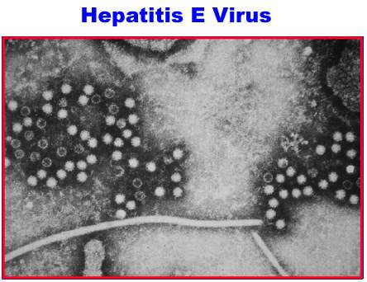

Slide 57
F

Slide 58
G
G

Slide 59
FLAVIVIRIDAE
BVDV
HChV
HCV
GBV-A
YFV
GBV-B
GBV-C
dengue 2
dengue 1
WNV
JEV

