Slide 1
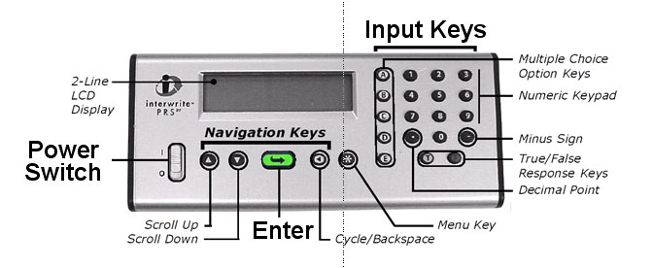
Turn your handset (OFF) THEN ON- slide the Power Switch up (I = ON)
Wait 4 seconds till GTCO CalComp disappears. It will start scanning.
Join the class by pressing the number <4> and
then the green arrow
4. It should say “ANS”
        year 5 PATH
<C>
WARNING: Your handset will go to SLEEP when not in use.
Press * ANY KEY to WAKE UP your handset.
Notes:
1

Slide 2

World War I lasted 4 years from 1914 to 1918 and resulted in 7 million deaths worldwide.
How many people died as a result of the 1918 influenza pandemic?
Press
Then press green arrow to join
You should now be connected…
ANS:
YEAR5 PATH:
<C>
1. 50,000
2. 500,000
3. 5 million
4. 50 million

Slide 3
The influenza pandemic of 1918 killed 50 million people.

Slide 4
Annual influenza in the UK

Slide 5
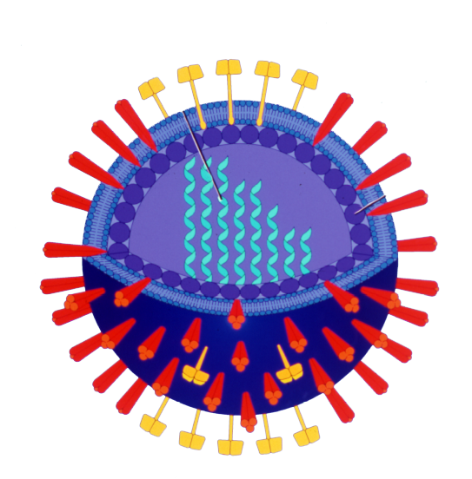
Influenza virus morphology
RNA segments
NA
HA
RNA dependent RNA polymerase
PB1,PB2 and PA
M2 ion channel
Matrix,M

Slide 6
Influenza virus replication
mRNA
mRNA
Sialic Acid
cRNA
vRNA

Slide 7
Influenza tropism
Influenza virus infection causes respiratory disease because:
1. The host cell receptor the virus binds to is only expressed in the lung
2. The influenza virus can only get into the body through the mouth
3. The influenza virus requires activation by host cell proteases that are only expressed in the respiratory tract
4. The influenza virus envelope can only fuse with membranes of cells that secrete mucus.

Slide 8
Cleavage of influenza HA
Clara Tryptase
(lung)
R

Slide 9
Influenza virus entry is blocked by antibody
mRNA
mRNA
cRNA
vRNA

Slide 10
Antigenic drift.
Vaccine updated every year to best represent the circulating strains.

Slide 11
Influenza Viruses circulating in humans today; we need a trivalent vaccine
H5N1, H9N2, H6N6
2000 2010 2020
pH1N1
H3N2
B Yamagata
B Victoria

Slide 12
Three antigenically distinct types of influenza have circulated in humans in the past 40 years
Notes:
however the levels do fluctuate as the virus mutates thru antigenic drift. this years flu season saw lower initial levels of flu B which peaked in the later part of the flu season

Slide 13
Influenza vaccine
The influenza vaccine given to those at greater risk of complications from flu in the UK is
1. A live attenuated virus
2. A purified fraction containing HA and NA of an inactivated virus
3. A purified HA protein expressed in insect cells
4. An immunoglobulin fraction from sera of immune patients.

Slide 14
Influenza trivalent vaccine

Slide 15
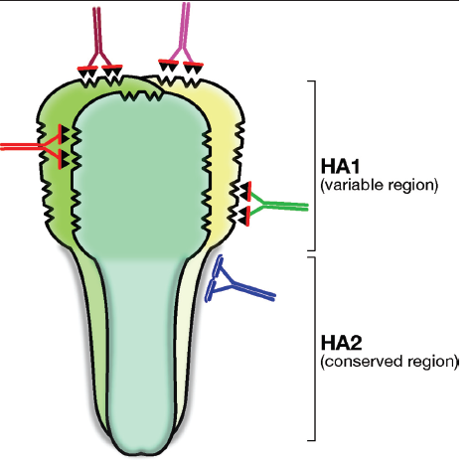
Influenza vaccines in the future
A universal vaccine?
M2 ion channel

Slide 16
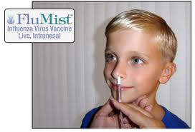
Influenza vaccines in the future
Live attenuated vaccine for children in Europe/ UK?
Recombinant vaccines to stimulate T cell responses?

Slide 17
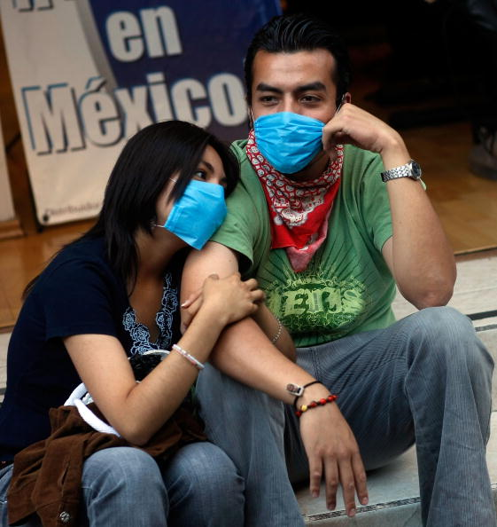
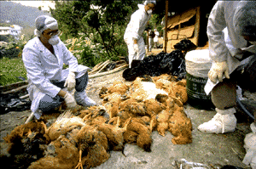
The pandemic potential of influenza A virus

Slide 18
Host range of influenza A virus
The natural reservoir of influenza A viruses is
1. Pigs
2. Chickens
3. Ducks
4. Tigers

Slide 19
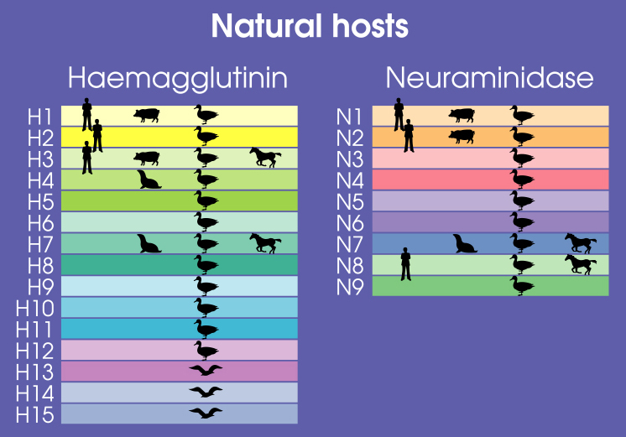
Birds are natural hosts for influenza viruses
Haemagglutinin
Neuraminidase
H16

Slide 20
Reassortment leading to antigenic shift
H3N2
H5N1

Slide 21
Influenza Pandemics in the 20th Century.
H5N1, H7N7
1900 1910 1920 1930 1940 1950 1960 1970 1980 1990 2000
H1N1
H2N2
H3N2
Avian circulating
viruses

Slide 22
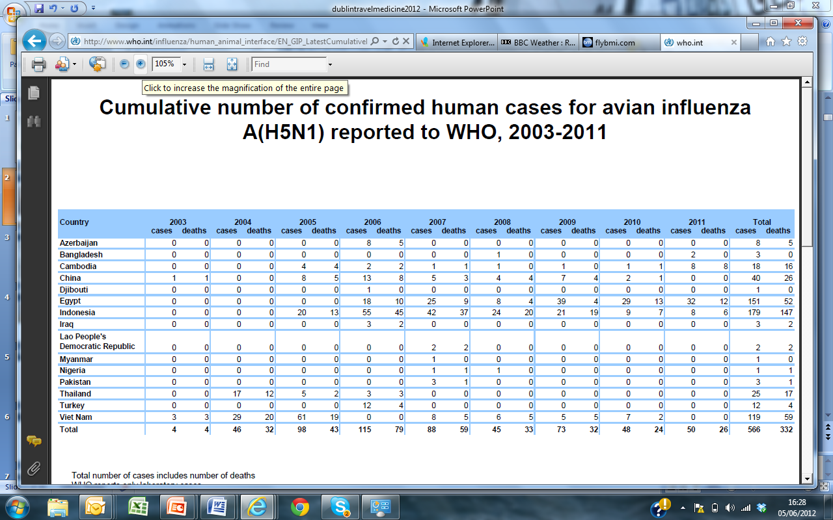

2004
2005
2006
2011

Slide 23
Why has H5N1 not caused an influenza pandemic?

Slide 24
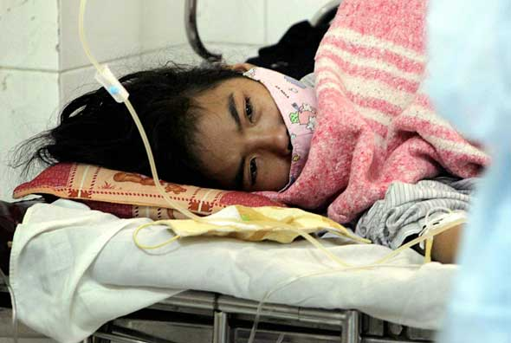
H5N1 does not transmit between people.

Slide 25
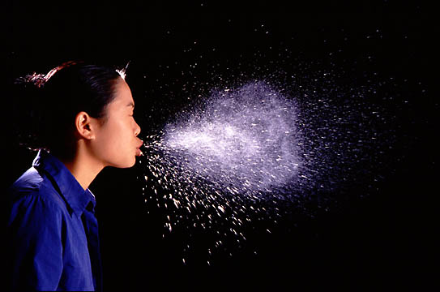
Transmission.

Slide 26
Avian and human influenza viruses bind to different types of sialic acid receptors.
Avian influenza virus
Human influenza virus
Human HA
Avian HA
α-2,3
α-2,6
Cell
Cell

Slide 27
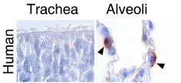
H5N1 avian influenza virus binds to human lung but not to upper airway cells
Kuiken et al. Science. March 2006

Slide 28
Sialic acid distribution varies through the human respiratory tract.
Upper respiratory tract
Nasal mucosa paranasal sinus bronchus
Lung
Shinya et al. Nature. March 2006.

Slide 29
Airway tropism of avian influenza in humans
Avian influenza viruses can infect human lower airway cells using α2,3SA receptors
Lack of infection of upper airway cells, or of the appropriate cell type in upper airway cells may explain lack of transmission of avian influenza from human to human.

Slide 30
Influenza viruses circulate in pigs
H16

Slide 31
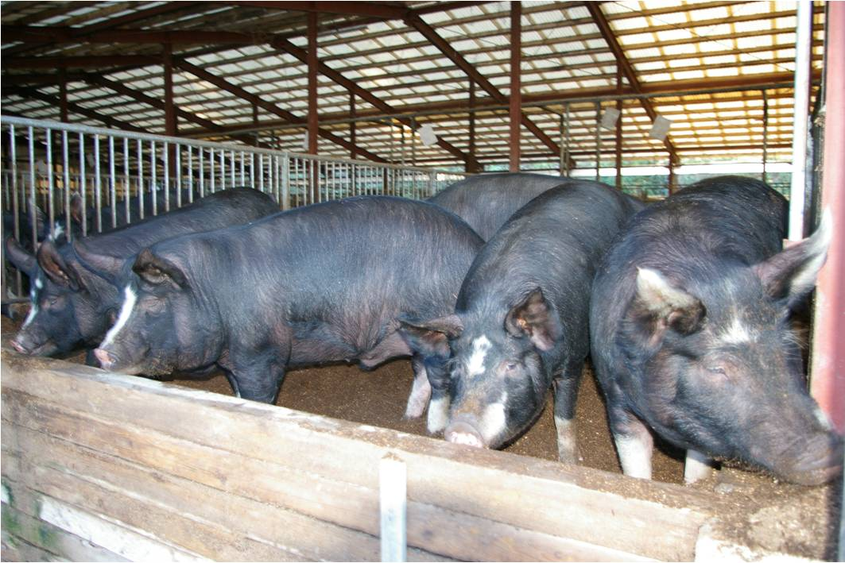

Generation of swine origin influenza : an octagenic jackpot!

Slide 32
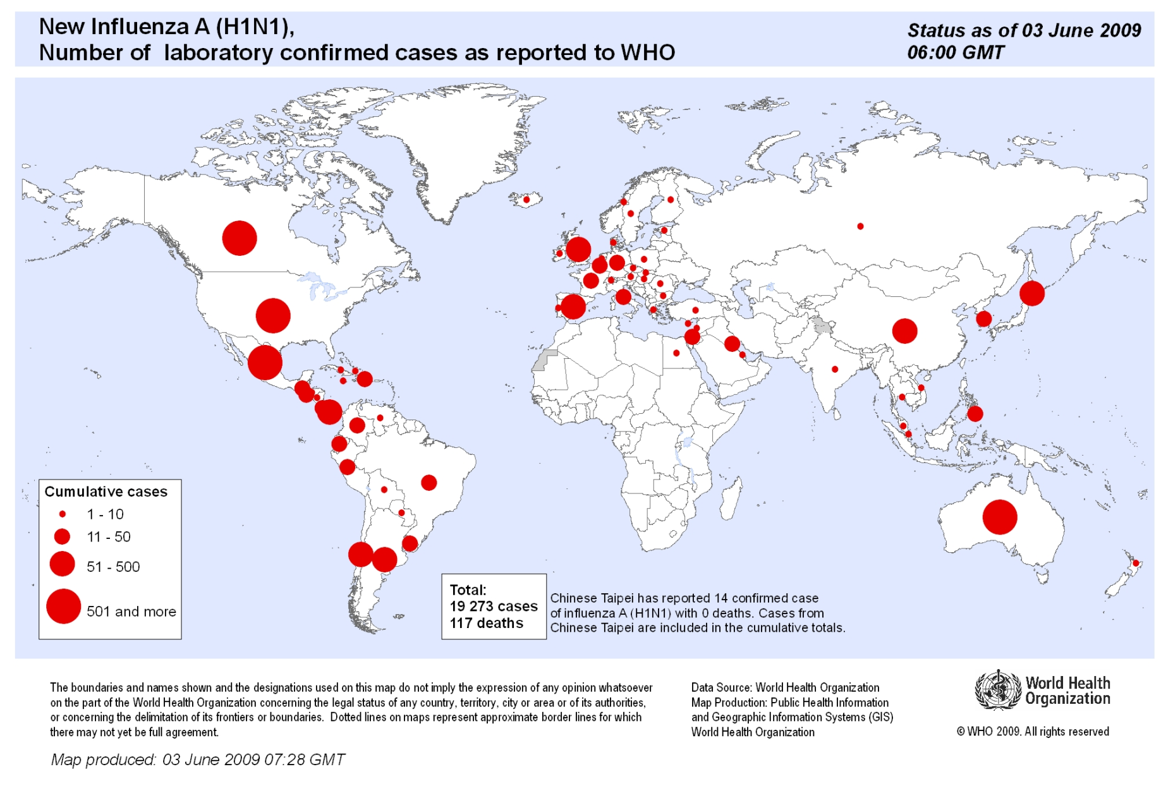
Swine origin H1N1 influenza spread globally in a matter of weeks

Slide 33
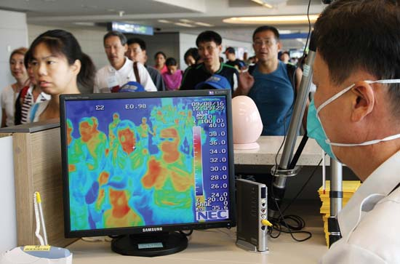
Screening at airports to contain a pandemic?

Slide 34
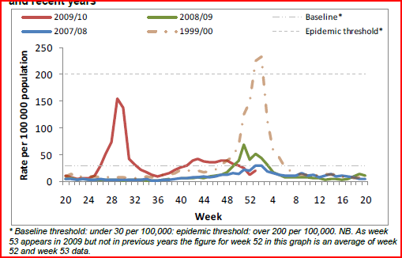
The impact of pH1N1 in the UK 2009

Slide 35
The 2009 influenza pandemic
1500 hospitalizations in the UK, 400 deaths
Globally 18,000 deaths reported to WHO (underestimate)
Seropositivity in London and Birmingham >40% in children by September 2009 (Miller et al. 2010)
Case fatality ~ 0.02%
Mild disease in majority of cases.
50% of those hospitalized were previously healthy (FLUCIN Thorax 2010).

Slide 36
Pathogenesis
What determines the outcome of influenza infection?

Slide 37
Cleavage of influenza HA leads to extended tropism for H5 and H7
Clara Tryptase
(lung)
R
H5
H7
Furin
(ubiquitous)
KRRRRR

Slide 38
H5N1 patients have a high viral load and viraemia.
Patient infected with: | H3N2 | H5N1 (nonfatal) | H5N1 (fatal)
Viral load in nose (log) | 4.5 | 4.5 | 5.8
Viral load in throat (log) | 4.8 | 5.9 | 7.0
Viral RNA detected in blood | 0/6 | 0/5 | 9/11
De Jong et al. Nature Medicine. 2006.

Slide 39
Inappropriate cytokine response
IFN-β
IFN-β
IFN-β
IFN-β
IFN-β
IFN-β
IFN-β
IFN-β
IFN-β
IFN-β
IFN-β
IFN-β
IFN-β
IFN-β
IFN-β
IS genes
IFN-β
IFN-β
IFN-β
IFN-β
IFN-β
Cell 1
Cell 2
IFN-β

Slide 40
Influenza predisposes to secondary bacterial pneumonia
ATG
N
PB1
C
ATG +1 READING FRAME
N
PB1-F2
C
MTS
McCauley et al.
Cell Host and Microbe 2008

Slide 41
Causes of severe outcomes from pH1N1 2009
High dose, route of exposure
Mutant virus (D225G mutation in HA associated with 25% fatal cases in Norway)
Bacterial superinfection (Odds ratio of 125 after other factors accounted for in Argentinian study)
Co morbidity: Asthma, pregnancy, obesity, diabetes
Genetic predisposition: IFITM3 mutation; ethnic bias

Slide 42
Previous experience of influenza affects disease outcome
Antibodies to a matched strain protect from infection

Slide 43
Elderly spared from H1N1 2009

Slide 44
People alive in 1920-1940 had been infected with antigenically similar virus to pH1N1 2009.
1910 1920 1930 1940 1950 1960 1970 1980 1990 2000 2009
H1N1
1918
Classical
swine flu
pH1N1 2009

Slide 45
Previous experience of influenza
Protective antibodies to a matched strain
Recent infection induces cross reactive T cells that protect from disease.
Cross reacting but non-neutralizing antibodies leading to complement deposition in the lung and ENHANCED disease

Slide 46
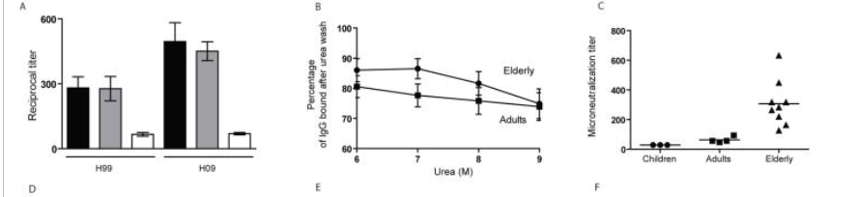
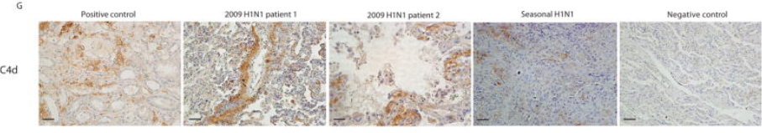
Antibodies that bind influenza but do not neutralize are bad news!
Complement deposition in lung and other organs
Monsalvo et al. Nature Medicine 2011.

Slide 47
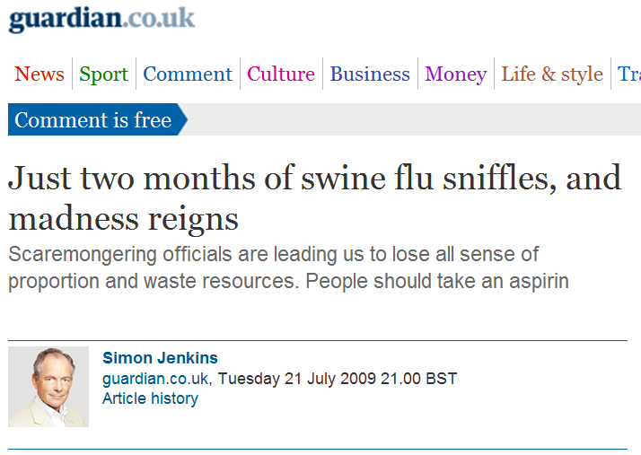
Self remedy?

Slide 48
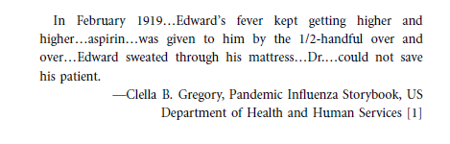
Aspirin and influenza
Aspirin use up to 7g in 24 hours
Pulmonary oedema, hyperventilation, increased lung fluid, decreased mucociliary clearance.
1918 mortality 1% without aspirin and 5-30% treated with aspirin in hospitals or armed forces.

Slide 49
The appropriate response to a pandemic?
Antiviral to target virus (and prophylaxis in the ‘containment phase’)
Vaccines
Therapies to counter the host response.
Independent review by Dame Deirdre Hine published 2010

Slide 50
Antiviral therapy to treat influenza virus infection
Three or four different antiviral drugs already exist for influenza, and are licensed for use in the clinic. However unlike HAART for HIV we don’t use them together.
True of false?

Slide 51
Antivirals for Influenza
Amantadine
Targets M2 ion channel
Single amino acid mutation in M2 (S31N) renders virus resistant
Does not work against influenza B
Neuraminidase inhibitors,
Tamiflu (oseltamivir)
Relenza (zanamivir)
peramivir

Slide 52
New viruses stick back onto the cell surface.

Slide 53
The virus neuraminidase enzyme destroys cell surface receptor

Slide 54
Inhibiting NA inhibits virus spread

Slide 55
Problems with the use of Tamiflu
Only effective if administered within 48 hours of infection
Administration to intubated patients difficult
Solution to use iv zanamivir or peramivir in ITU.
Emergence of drug resistant variants

Slide 56
Pandemic Vaccines: at least a 3 month lag phase

Slide 57
Pandemic H1N1 vaccines
Inactivated vaccines to novel HA proteins (H5N1) require adjuvant to generate a robust immune response
Novel oil-in-water adjuvants (AS03) were used (but now some association with narcolespy in adolescents in Finland)
Whole virus vaccines produced in Vero cells were also given eg.to those with egg allergy

Slide 58
pH1N1 2009 replaced the previous seasonal H1N1 viruses
2000 2010 2020
pH1N1
H3N2
B Yamagata
B Victoria

Slide 59
Uptake of vaccine in health care workers
More than 1 million HCWs have direct patient care and all are offered influenza vaccines.
This year the uptake rate for seasonal vaccine was 44.5%.
Flu vaccine does not give you flu.
A person infected with influenza virus is contagious before they know they are infected.
By not getting flu vaccine you put your vulnerable patients at risk.

Slide 60
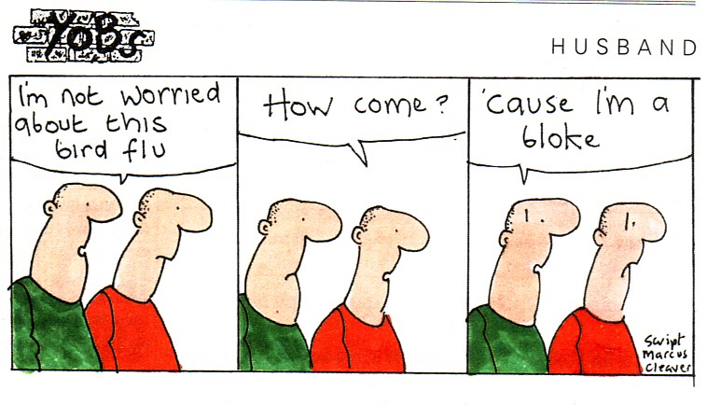
Please now enter your CID and then press the green enter key…

Slide 61
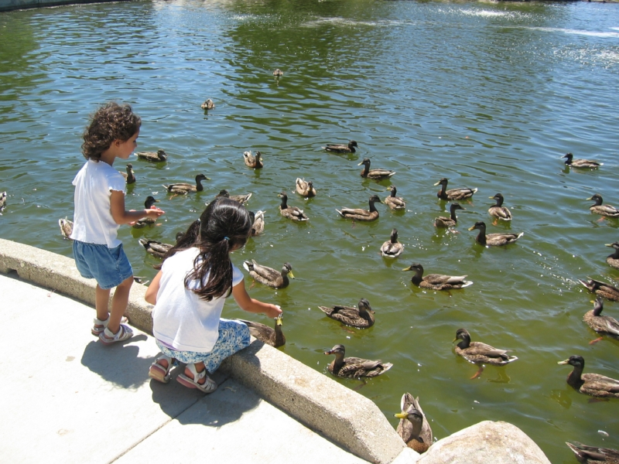
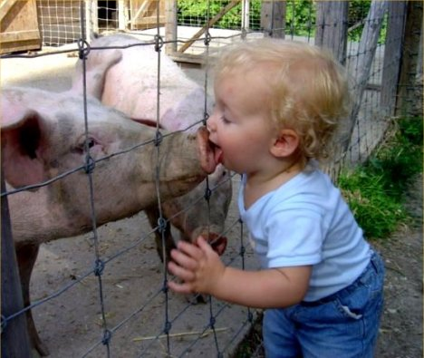

Future: new antivirals
novel interventions
live attenuated vaccines
immunomodulatory therapies
antibiotic use
genetic predispositions

