Slide 1
Opportunistic viral infections
Emilie Sanchez
Virology SpR

Slide 2
Opportunistic viral infections
Basic principles
Diagnostic in the virology lab
Organisms and clinical infection
Notes:
Refers to viral infections only! Does not address bacterial or fungal infections.

Slide 3
Opportunistic viral infections
Overview
Humoral immunity & complement
Cell-mediated immunity
Immunosurveillance
Notes:
Immunosurveillance is the continuous process whereby the immune system keeps a check on the emergence of cancers and dissemination of infection.

Slide 4
Immunocompromised hosts
Innate immunodeficiency
  Primary immunodeficiency:
  Severe Combined Immunodeficiency
Acquired immunodeficiency
  Malignancy: lymphoma
  Viral infections: HIV/AIDS
  Iatrogenic immunosuppression
    Drugs: chemotherapy, steroids, cyclosporine, tacrolimus...
    Other transplantation-related
Notes:
4

Slide 5
Bone marrow transplants
Viral infections: leading cause of mortality in
allogenic BMT, and a major cause of morbidity in
autologous BMT
Risk factors for virus-associated morbidity
and mortality
Allogenic BMT
Mismatched related, matched unrelated
Acute or chronic Graft Versus Host Disease
Immunosupressive therapy
In-vitro T-cell depletion
Delayed CD4 cell recovery
Notes:
Predominantly associated with defects in T-cell immunity
except enterovirus and parvovirus B19: associated with antibody defects
5

Slide 6
Disease manifestations
Increased severity of disease
Wider range of systems involved
Multi-system involvement / disseminated disease
More varied disease manifestation
  eg retinitis, pneumonitis, colitis, adenoviral hepatitis
Notes:
Infection is able to disseminate more in the immunocompromised
Multi-system
eg colitis + pneumonitis + encephalitis
Noverlsyndromes:
Syndromes that are not seen in the immunocompetent

Slide 7
Disease manifestations
Each organism gives rise to different disease manifestations in different patient groups (eg CMV pneumonitis in BMT vs retinitis in AIDS)
Novel syndromes
  eg EBV-associated post transplant lymphoproliferative disease (PTLD)

Slide 8
Different routes of infections in the transplant recipient
Infection post-Tx:
  measles, parvovirus, VZV
Viruses acquired from graft
  Hepatitis B, hepatitis C, HIV, HTLV, CMV, EBV, adenovirus
May primarily involve the grafted organ

Slide 9
Virology lab
Serology:
  Limited diagnostic value
Virus detection:
  Preferred option
  Nucleic acid detection (PCR etc…), virus isolation (culture), antigen detection
Use of viral load (CMV, EBV, adenovirus):
  Guide to clinical significance of infection
  Monitor response to Rx (eg CMV)

Slide 10
What is PCR anyway?
GI
Polymerase Chain Reaction
  Method for amplifying specific RNA (RT-PCR) or DNA sequences
  Cycle:
Taq
polymerase
1.Denature
3. Chain
elongation
dsDNA
RT
RNA
2. Primer annealing
Notes:
a short DNA segment (primer) is annealed to a longer segment (template). DNA polymerase can attach to the complex and add, from the 3’ end, bases complementary to the template. The new strand and template can be separated by heat (melting)
A primer to the new strand would allow a copy of the template to be made. The short section delimited by the two primer sequences is called amplicon
“amplifying” = making multiple copies of
“denature” = separate the two strands of DNA
Cycling the temperature (eg 95, 60, 72)
Repeat amplification process X 30. Exponential amplification - 2,4,8,16,32,64 copies. Requires detection system (eg gel)

Slide 11
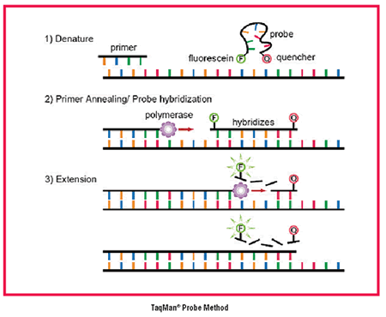
Real Time PCR
'fluorescent reporter probes'
http://www.foodsafetywatch.com
Notes:
Once enough copies have been generated, the next step in the process is to detect them, and there are two main types of detection method.
End-point PCR detection - this takes place when the amplification process is complete and typically involves gel electrophoresis, followed by staining to detect the amplified DNA fragments. This method is quite time consuming, vulnerable to contamination and can only give a qualitative result.
Real-time PCR detection - combining the amplification and detection stages of the process so that amplification is monitored continuously. Real-time detection is more accurate and the result can also be quantified.
Commercial test kits typically use 'fluorescent reporter probes' as the detection method. This method utilizes an additional primer, the probe, which also binds specifically to the target DNA sequence. Probes have a fluorescent 'reporter' dye at one end and a 'quencher' dye, which inhibits fluorescence, at the other. During the extension stage the probe is broken apart by the DNA-polymerase and begins to fluoresce more strongly.

Slide 12
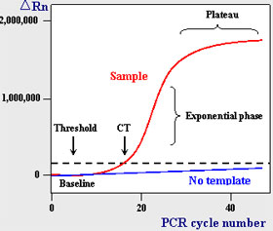
Real Time PCR

Slide 13
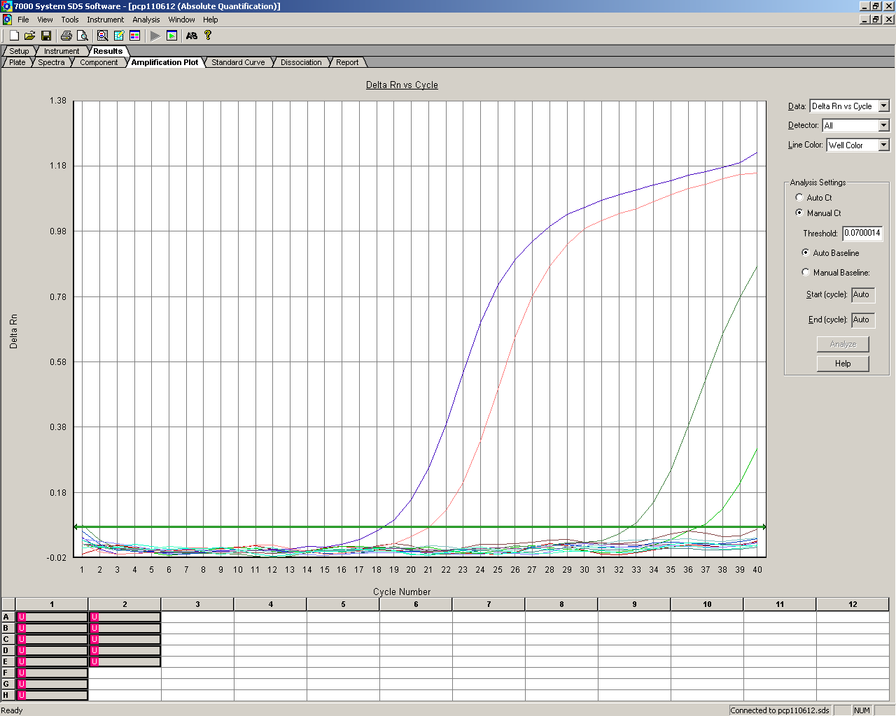
Real Time PCR

Slide 14
Human herpesvirus
(HHV)
Herpes simplex virus (HSV) 1 & 2
Varicella zoster virus (VZV)
Cytomegalovirus (CMV)
HHV6 and HHV7: Human herpes viruses (HHV) 6 & 7
Epstein Barr Virus (EBV)
HHV-8

Slide 15
Human herpesvirus
DNA viruses
Latent infection
  Only a small subset of genes are expressed during latency
  Reactivation can occur leading to the expression of viral genes and production of progeny virus
    Leads to destruction of the host cells
Notes:
The virus establishes a latent infection that persists for the life of the host.
In the latent state only a small subset of the viral genes are expressed.
Reactivation with expression of viral proteins and production of new virus particles may occur at intervals to produce recurrent infections.

Slide 16
Human herpesvirus
Herpes viruses
Sites of latency
HSV1
HSV2
VZV
CMV
EBV
HHV6A and HHV6B
HHV8
Sensory nerve ganglia
Sensory nerve ganglia
Sensory nerve ganglia
B lymphocytes
Leucocytes, epithelial cells
T lymphocytes, epithelial cells
B lymphocytes, epithelial cells

Slide 17
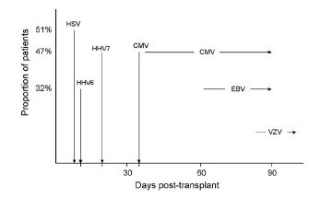
Paul Griffiths, Antivirals in the transplant setting 2006
Allo Stem cell transplants
Notes:
Change in the epidemiology of viral infections post BMT: ACV prophylaxis and GCV pre-emptive trtt has changed the epidemiology

Slide 18
Organisms and clinical features

Slide 19
Main opportunistic viruses
Herpesvirus family
HSV: recurrent genital herpes, generalised infection, oesophagitis, colitis, hepatitis,
VZV: multi-dermatomal zoster, disseminated infection
CMV: pneumonitis, retinitis, encephalitis, hepatitis
EBV: post-transplant lymphoproliferative disease, lymphoma
HHV6: graft failure, hepatitis
HHV8: Kaposi’s sarcoma, Castleman’s disease (body cavity-associated lymphoma)
Notes:
All these produce a lifelong latent infection

Slide 20
Herpes simplex virus and the immunocompromised
Site of latency: sensory nerve ganglia
Most commonly:
  Cold sores
  Difficulty swallowing
  stomatitis in 85 % of cases
  Recurrent genital disease (HIV)
Cutaneous dissemination and visceral involvement: oesophagitis, hepatitis...
Rarely multi-organ involvement (liver, lungs, GI tract, skin…)
HSV encephalitis not increased in frequency

Slide 21
Herpes simplex virus and the immunocompromised
Reactivation is common in the first month post-Tx
Diagnosis: Mainly clinical.
Swab PCR
PCR on biopsy
Blood PCR for disseminated infection
Treatment: IV or oral aciclovir, valaciclovir
Prevention: Aciclovir prophylaxis (started pre-Tx)

Slide 22
Varicella-zoster infection and the immunocompromised
Site of latency: sensory nerve ganglia
Varicella (VZV primary infection)
  Increased risk of complications:
    2º bacterial infection of rash
    bullous or haemorrhagic skin lesions, purpura fulminans
    Visceral involvement:
      In 50% of patients without antiviral therapy, resulting in 10-20% mortality
      Pneumonitis and hepatitis+++

Slide 23
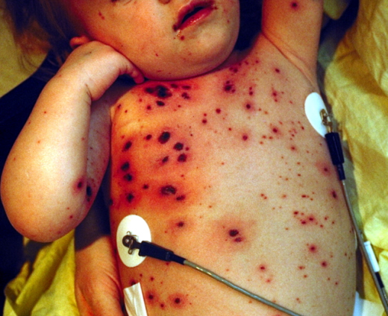
Hemorrhagic chicken-pox
American Academy of Paediatrics

Slide 24
Varicella-zoster infection and the immunocompromised
Shingles or herpes zoster (HZ):
  from reactivation of endogenous virus in patients who are VZV IgG positive pre-transplant
  HZ is a late complication: >100 days post-BMT
  3 patterns:
    Dermatomal skin eruptions
    Varicella-like skin lesions with no dermatomal distribution (“atypical generalised zoster”): high risk of visceral involvement
    VZV reactivation without skin lesions
Notes:
Reactivation in several dermatomes simultaneously.
Disseminated zoster – behaves like chickenpox
ACV given iv to immunocompromised patients
VZIG helps to prevent severe disease

Slide 25
Varicella-zoster infection and the immunocompromised
Rx: iv aciclovir if develop chickenpox or shingles
Prevention: Varicella zoster immunoglobulin (VZIG) prophylaxis within 10 days of a significant contact with a case of chickenpox (airborne) or shingles (direct contact).

Slide 26
CMV infection
Site of latency: B lymphocytes
3 sources of CMV infection after transplant:
  exogenous infection (CMV primary infection)
  (sources: graft, blood products, persons excreting virus)
  endogenous reactivation+++
  exogenous reinfection
Notes:
Risk of CMV in allograft much higher than in autograft (CMV disease ,10%)

Slide 27
CMV and the transplant patients
CMV and solid organ transplant
Risk of CMV disease:
  CMV serostatus (CMV IgG) Incidence of disease
  D+/R- 50%
  D+/R+ or D-/R+ 10-15%
  D-/R- 0%
CMV and bone marrow transplant: adoptive immunity
  D-/R+ : carries the greatest risk (reactivation)
  Greater risk of disease with mismatched / unrelated donors
  High risk period: First 100 days post-Tx

Slide 28
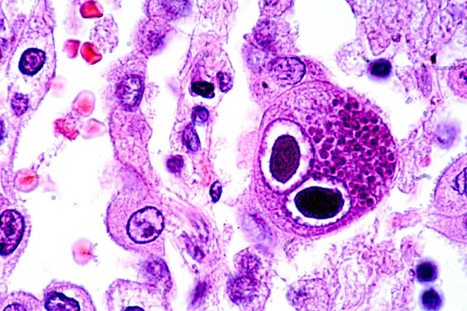
CMV infection
Disease manifestations
Fever
Bone marrow supression
Intersticial pneumonitis
Delayed engraftment/graft failure
Hepatitis
Oesophagitis
Gastritis, enterocolitis
GI ulcerations
Rarely: retinitis, CNS disease, myocarditis, adrenalitis
Immunosupression, risk of bacterial and fungal infections
Histology. Owl’s eye inclusions

Slide 29
CMV PCR
    Monitoring CMV viral load in blood in asymptomatic patients
    For diagnosis of CMV infection:
      blood
      biopsy
      cerebro-spinal fluid....
    BAL, urine: less useful as coincidental finding due to asymptomatic shedding.
  NB: Serology
    Useful for pre-Tx screen, but not for diagnosis in the immunocompromised
Notes:
Patients often shed CMV in urine or resp. secretions asymptomatically. Would not Rx on this basis. So if +ve urine or BAL → do blood PCR, and Rx if high vl

Slide 30
CMV and BMT
- Management: 3 options -
Wait until develops disease and then treat
  poor outcome in BMT
Prophylaxis (ganciclovir) during high risk period
  bone marrow toxicity
  emergence of resistant strains
  late-onset CMV disease
Preemptive therapy
  monitor CMV viral load in blood during high risk period, on a weekly basis
  Treat (GCV) when rises above threshold (eg 1000 c/ml) – most favourable for BMT

Slide 31
EBV/PTLD – illustration of immunosurveillance breakdown
EBV infection in the normal host:
  Acute: Infectious mononucleosis. EBV infects mainly B cells
  Chronic: Lifelong low-grade replication in B lymphocytes with polyclonal activation, kept in check by the cellular immune system (immunosurveillance)
Notes:
Acute phase: febrile illness with lymphadenopathy & moderate hepatitis
After the acute phase: lifelong, latent, subclinical infection of B cells.
Intermittent attempts at viral replication kept in check by immunosurveillance
EBV stimulates host cells to divide – also kept in check.

Slide 32
EBV/PTLD – illustration of immunosurveillance breakdown
2. Post-transplant lymphoproliferative disease
  Breakdown of immunosurveillance
  Latently infected B cells – polyclonal activation
  Predispose to lymphoma
  Diagnosis: suspicion on EBV viral load (> 10⁵ c/ml), biopsy
  Management:
    Reduce immunosuppression (regression in < 50%)
    Anti-CD20 monoclonal Ab therapy (B cell marker) (“rituximab”)

Slide 33
HHV-6 infections
Usually result from reactivation of endogenous virus (primary and reinfection may occur)
HHV-6 infections:
  May cause graft rejection
  In BMT patients, can cause pneumonitis, hepatitis, bone marrow suppression and encephalitis
Diagnosis: PCR on blood
Treatment: ganciclovir, foscarnet or cidofovir
Notes:
An uncommon cause of morbidity in the immunocompromised.
HHV7 probably immunosupressive
33

Slide 34
Adenovirus
Particular problem post-BMT (paeds!)
Exogenous infection or reactivation of persistent endogenous infection.
More common with T cell-depleted grafts
Prognosis: High mortality with disseminated infection
Notes:
Less common than CMV disease, but still a problem in BMT
Particularly Paeds BMT!

Slide 35
Adenovirus
Immunocompromised host
        Fever
        Bone marrow supression
Haemorrhagic cystitis
Necrotising pneumonitis
Hepatitis
Colitis
Notes:
Disseminated disease:
involvment of ≥ 2 organ systems (frequently hepatitis)
50% risk of mortality if disseminated

Slide 36
Adenovirus
Immunocompromised host
Diagnosis:
  Adenovirus PCR in blood (weekly surveillance?)
  Virus detection in two different sites (eg stool and BAL) = disseminated infection

Slide 37
Treatment of Adenovirus infection in the immunocompromised
Preemptive therapy: different policy
Strong association between immune reconstitution and clearance of ADV
Cidofovir:
  Acyclic nucleoside phosphonate analogue
  nephrotoxic++
T cell donor infusion
IVIG…
Notes:
Anecdotal evidence

Slide 38
HIV patients

Slide 39
HIV patients
Risk of developing specific opportunistic infections can be predicted from CD4 count
eg CMV retinitis when CD4 <100 /ul
Notes:
39
As you would expect, CD4 count predicts susceptibility to infection.
The decision of when to initiate antiretroviral Rx is largely based on the CD4 count.

Slide 40
HIV patients
Viral opportunistic infections
Retinitis (CMV, HSV, VZV)
Oral hairy leucoplakia (EBV)
Kaposi’s sarcoma (HHV8)
EBV-associated lymphomas
Recurrent/chronic genital HSV
Multidermatomal zoster
Molluscum contagiosum (poxvirus)
CMV or HSV oesophagitis
PML (JC virus)

Slide 41
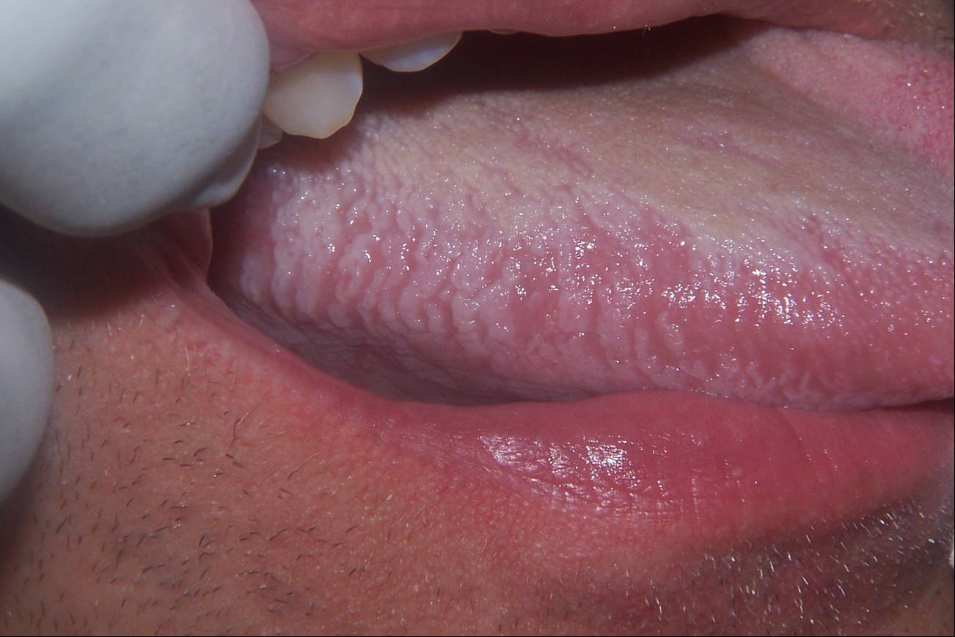
Epstein Barr virus (EBV)
HIV patients:
  Oral hairy leukoplakia
  Lymphomas
  (primary brain lymphoma…)
  Oral hairy leukoplakia
  hivdent
Notes:
41

Slide 42
Human herpesvirus 8
Particular problem in AIDS patients
(pre-HAART era !)
Presentation:
  Kaposi’s sarcoma
  Primary effusion (body cavity-associated) lymphoma (PEL)
  Multicentric Castleman’s disease
Notes:
42
Not such a problem since the advent of HAART
>90% of HIV-assoc. KS, vs <50% of non-HIV KS.

Slide 43
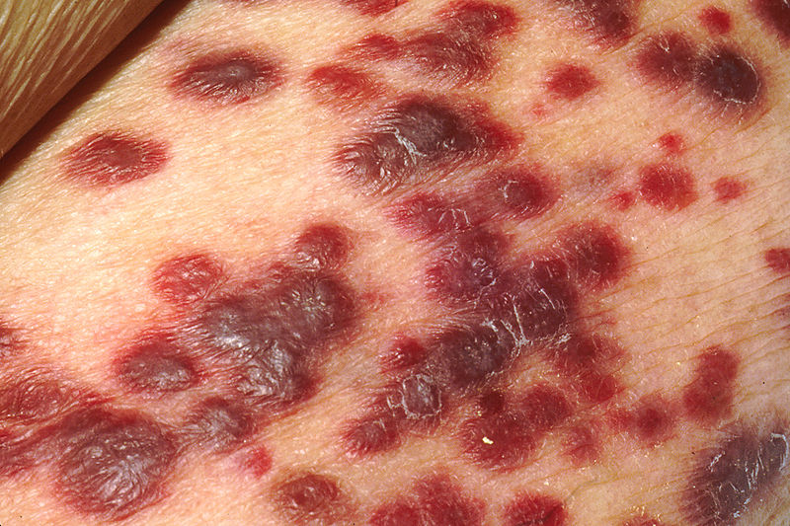
Kaposi sarcoma
KS actually is a cancer of lymphatic
endothelium
The tumor is highly vascular, giving the
tumor its dark color
Inflammation around the tumor may produce swelling and pain
Clinical suspicion, definite diagnosis can only be made by biopsy :
presence of spindle cells, KSHV proteins are uniformly detected
in KS cancer cells.
Notes:
generally not considered a true sarcoma, which is a tumor arising from mesenchymal tissue
forms vascular channels that fill with blood cells,
Trtt: RT, surgical, INF alpha, chemo
43

Slide 44
Respiratory viruses

Slide 45
Respiratory viruses in the immunocompromised
Increased risk of complications (pneumonitis) and high mortality associated particularly with:
  Influenza
  Parainfluenza 3 and 4
  Respiratory Syncitial Virus (RSV) infection

Slide 46
Respiratory tract infection in post-transplant patients
GI
Diagnosis:
  Specimens: Naso-pharynx aspirates (paeds), BAL, throat swab
  Investigations:
    PCRs for:
    Respiratory Syncitial Virus,
    Human metapneumovirus,
    Influenzae
    Parainfluenzae 1, 2, 3 , 4
    Adenovirus
    CMV, HSV...
    Direct Immunofluoresence
    Solid phase EIA for:
    RSV and flu
    Cell culture (virus isolation)
Notes:
Multiplex PCR is rapidly becoming the method of choice

Slide 47
Treatment:
  Oseltamivir for influenza
  Ribavirin (aerosolised +/- iv) for RSV & parainfluenza (before progression to LRTI!)
Prevention:
  Life-long seasonal influenza vaccination of organ/BMT recipients
  Influenza vaccination for close contacts (eg family members and HCWs) prior to flu season.
  Oseltamivir prophylaxis if significant contact with case of influenza.
Notes:
The impact of respiratory viruses in this patient group is often under-estimated.
High morbidity and mortality in this patient group.
Treatment is relatively ineffective, unless started early, before progression to LRTI has occurred.

Slide 48
Measles
Fatal disease in the immunocompromised (often in the absence of the typical rash)
Giant cell pneumonia
Subacute measles encephalitis
Consider Immediate administration of HNIG (immunoglobulin)
Notes:
Measles causes severe disease in the immunocompromised.
Contact with a case of measles is an indication for immediate prophylaxis with HNIG.

Slide 49
Parvovirus
Cause of chronic anaemia in the immunocompromised
Diagnosis:
  Serology (IgM) not useful in the immunocompromised
  PCR on blood
Treatment: Human normal immunoglobulin. May require blood transfusion
Notes:
Not so serious but can be problematic

Slide 50
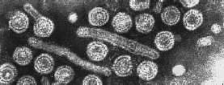
Hepatitis B
Notes:
The virus is one of the smallest enveloped animal viruses, but pleomorphic forms exist, including filamentous and spherical bodies lacking a core. These particles are not infectious and are composed of the lipid and protein that forms part of the surface of the virion, which is called the surface antigen (HBsAg), and is produced in excess during the life cycle of the virus.
The core protein is the major component of the nucleocapsid. HBeAg may be generated from the core protein by proteolytic cleavage.
50

Slide 51
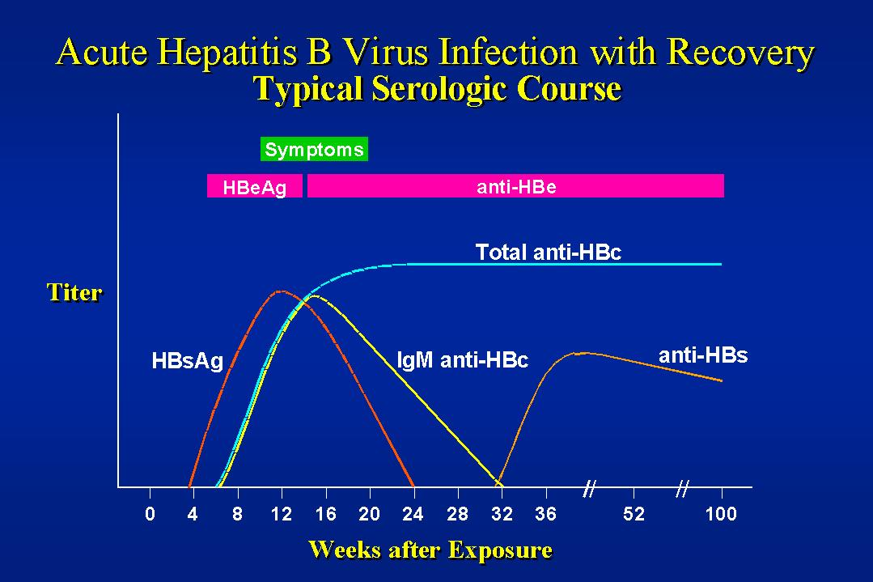
http://virology-online.com/viruses/HepatitisB.htm
Notes:
51

Slide 52
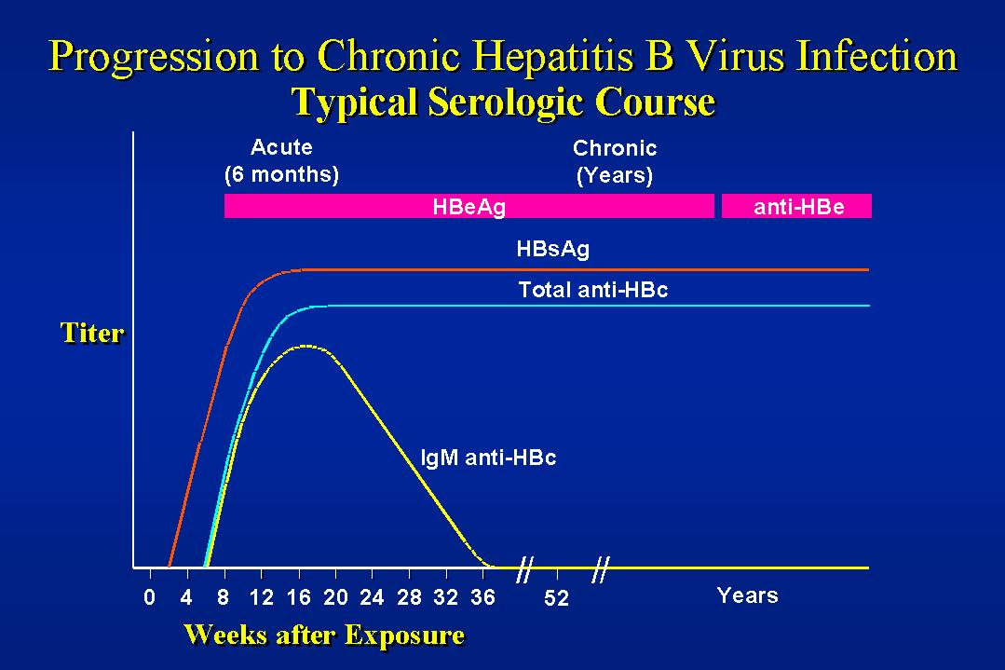
http://virology-online.com/viruses/HepatitisB.htm

Slide 53
Hepatitis B markers in vaccinated
GI
Immunized :
    Surface Ab⁺
    Core Ab–
Surface antibody titres :
    < 10mIU/ml : Non-responder - ? cAb⁺
    > 10mIU/ml : Protective level
Notes:
53
The vaccine consists of synthetic sAg…
10-100 is considered protective

Slide 54
Hepatitis B in the immunocompromised
Risk of reactivation in the immunocompromised
sAg-/cAb+ can revert to sAg+
Notes:
54
Two things can happen:
1. Carriers may have flare of disease.
2. Those who have had past infection (ie cAb+/sAg-) may revert to sAg+

Slide 55
Hepatitis B
Liver transplantation – recurrence of hepB
Prevent:
  Immunoglobulin (HBIG):
    maintain serum levels at >100 mIU/ml (monthly administration)
  Nucleoside/nucleotide analogues (eg lamivudine, tenofovir, entecavir) pre and post transplant
  → reduce risk from 80% to <10%
Notes:
55

Slide 56
Other opportunistic viruses
BK virus (polyoma): haemorrhagic cystitis (BMT) ureteric stenosis (renal Tx)
JC virus (polyoma): progressive multifocal leucoencephalopathy (PML)

Slide 57
Prevention
Infection control
Nosocomial infections (hospital-acquired) – common for adenovirus, respiratory viruses and VZV
Infection control measures:
  Handwashing, protective clothing, limit visitors
  Isolate immunocompromised patients (BMT)
  Cohort nursing
Notes:
Term “nosocomial”

Slide 58
Opportunistic viral infections
Viruses also affect healthy individuals, but give rise to greater morbidity in the immunocompromised
Often more difficult to treat
Increased risk of antiviral drug resistance
Notes:
Require:
iv ; higher dose ; Longer Rx course
Drug combinations ; Start Rx earlier
Monitoring response to Rx

