Slide 1
Are toilets more important than doctors?
Oliver Cumming
London School of Hygiene and Tropical Medicine

Slide 2
Teaching objectives:
Attributable disease burden
Related disease transmission
Preventive measures
Cost-effectiveness

Slide 3
Sanitation & Health Overview
Problem
Causes
Solutions

Slide 4
2.5 Billion

Slide 5
1.0 billion

Slide 6
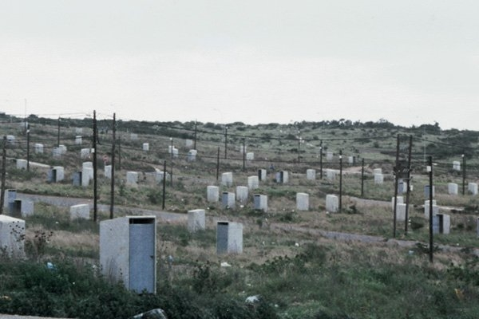
… and even toilets without people

Slide 7
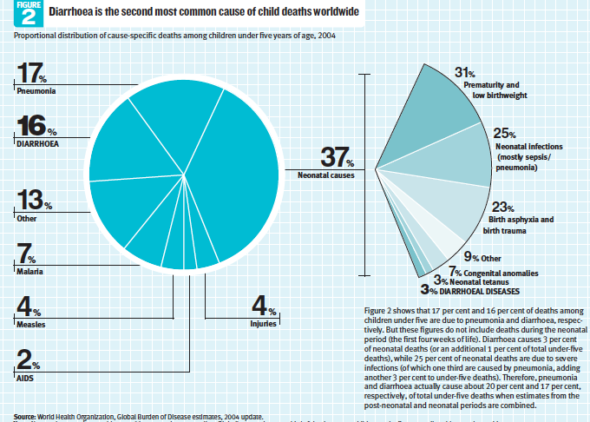
Childhood Mortality by Cause
WHO/UNICEF 2009

Slide 8
Distribution of child deaths due to diarrhoea

Slide 9
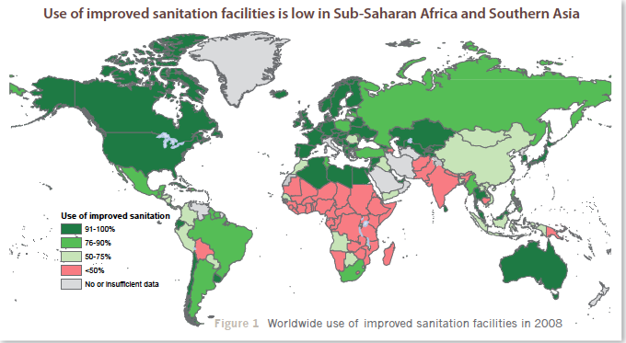
Sanitation & Health Overview
SOURCE: WHO/UNICEF Joint Monitoring Programme 2012eir impact on function and development. J. Clinical Investigation 118:1277-90

Slide 10
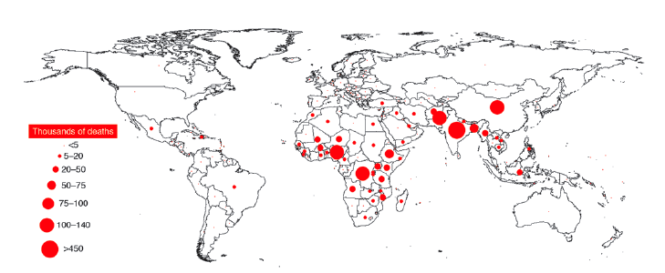
Global Distribution of <5 deaths from diarrhoea
SOURCE: Petri WA, Miller M, Binder HJ et al. (2008).and their impact on function and development. J. Clinical Investigation 118:1277-90

Slide 11
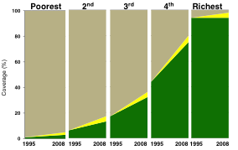
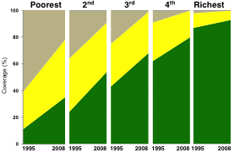
Progress often inequitable

Slide 12
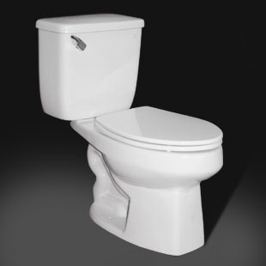
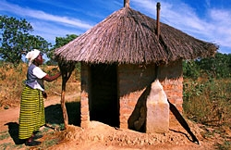
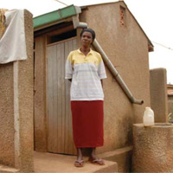
Sanitation
“the state of being clean and conducive to health”
“The hygienic separation of human waste from human contact”
“Safe containment, transportation , treatment and disposal of human excreta”

Slide 13
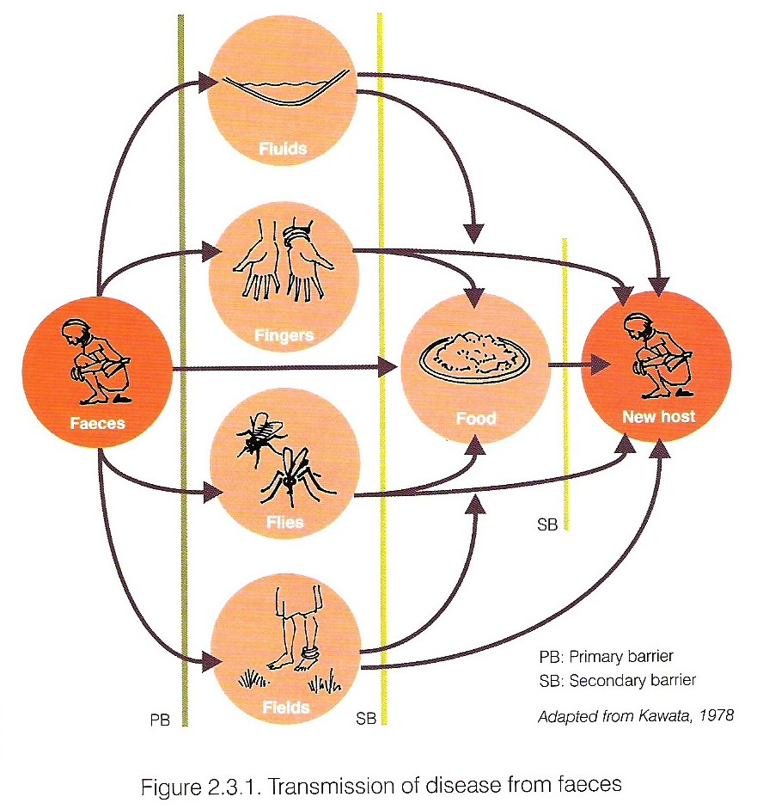
Sanitation and disease
Primary barriers:
Sanitation
Hygiene

Slide 14

John Snow… Not Jon Snow

Slide 15
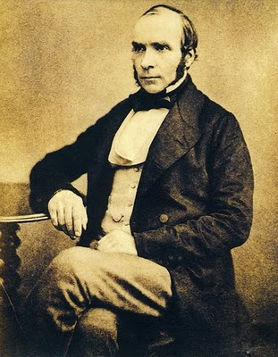
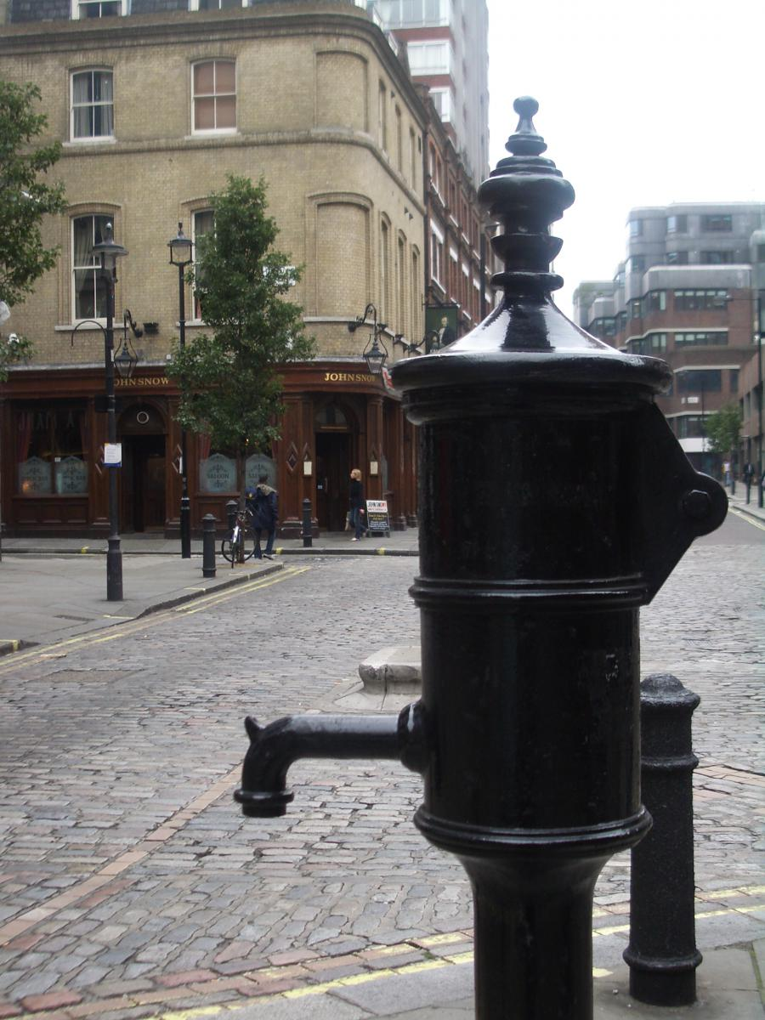

Slide 16
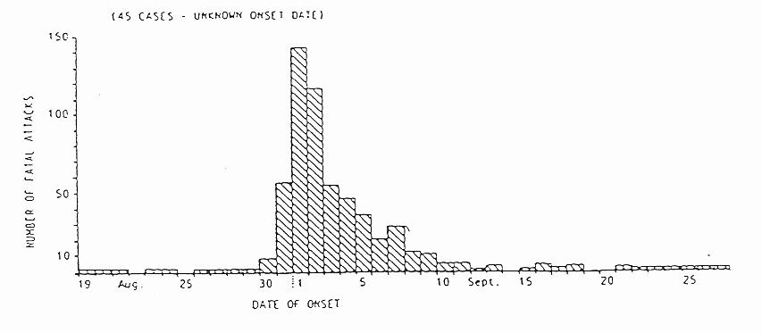
Fatal cholera cases near Golden Square, 1854
Pump handle removed

Slide 17
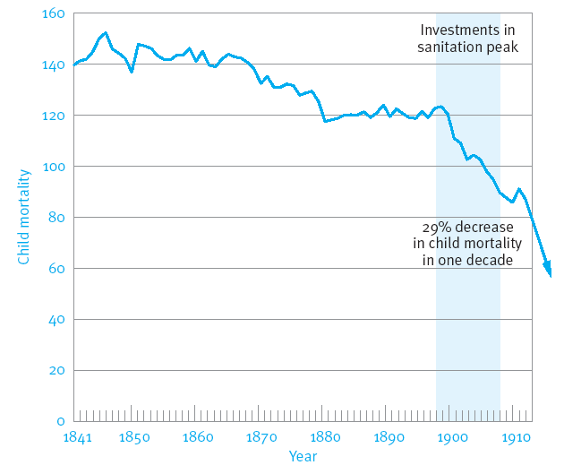
Learning the lethal lesson

Slide 18
Health impacts of WASH
10% of the global disease burden
4 billion cases of diarrhoea each year
2 billion helminth infections
5 million people are blind from trachoma
200 million people in the world are infected with schistosomiasis
And:
Undernutrition
SOURCE: WHO Safe Water Better Health (2008)and their impact on function and development. J. Clinical Investigation 118:1277-90

Slide 19
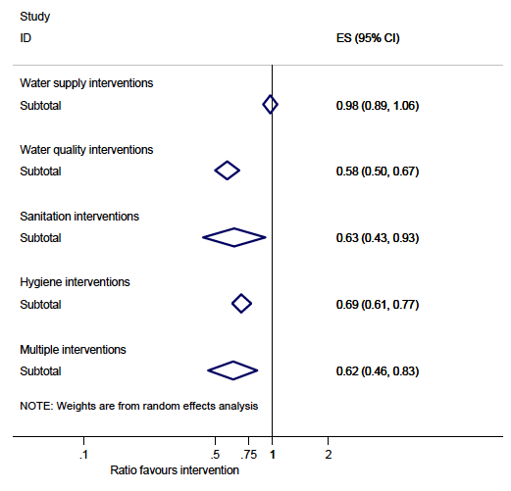
Waddington et al, 2010
Health Impacts of Sanitation

Slide 20
Systematic Review: Waddington et al.
“The analysis suggests that sanitation ‘hardware’ interventions are highly effective. However, relatively few studies have been conducted in this area to-date and studies are particularly needed that quantify the possible environmental spillovers from sanitation provision.”

Slide 21
Not just health
Education – especially girls
Cost to the economy – 9% GDP in LIC
Gender – violence and pyscho-social stress
SOURCE: World Bank (2008) Hutton et al 2012their impact on function and development. J. Clinical Investigation 118:1277-90

Slide 22
Delivering sanitation
Strong political support (local and national)
Community participation
Meeting people’s demand
Low cost appropriate solutions
Subsidy for promotion not provision
“A wanted latrine is a used latrine”

Slide 23
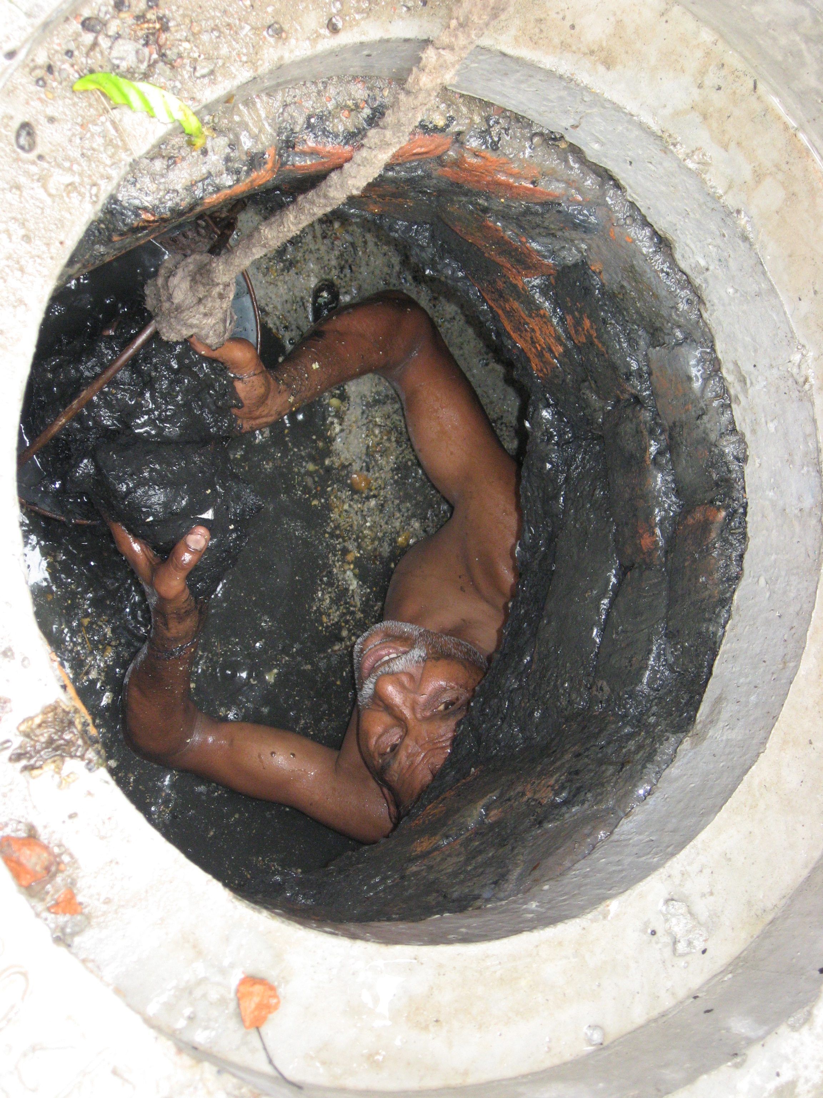
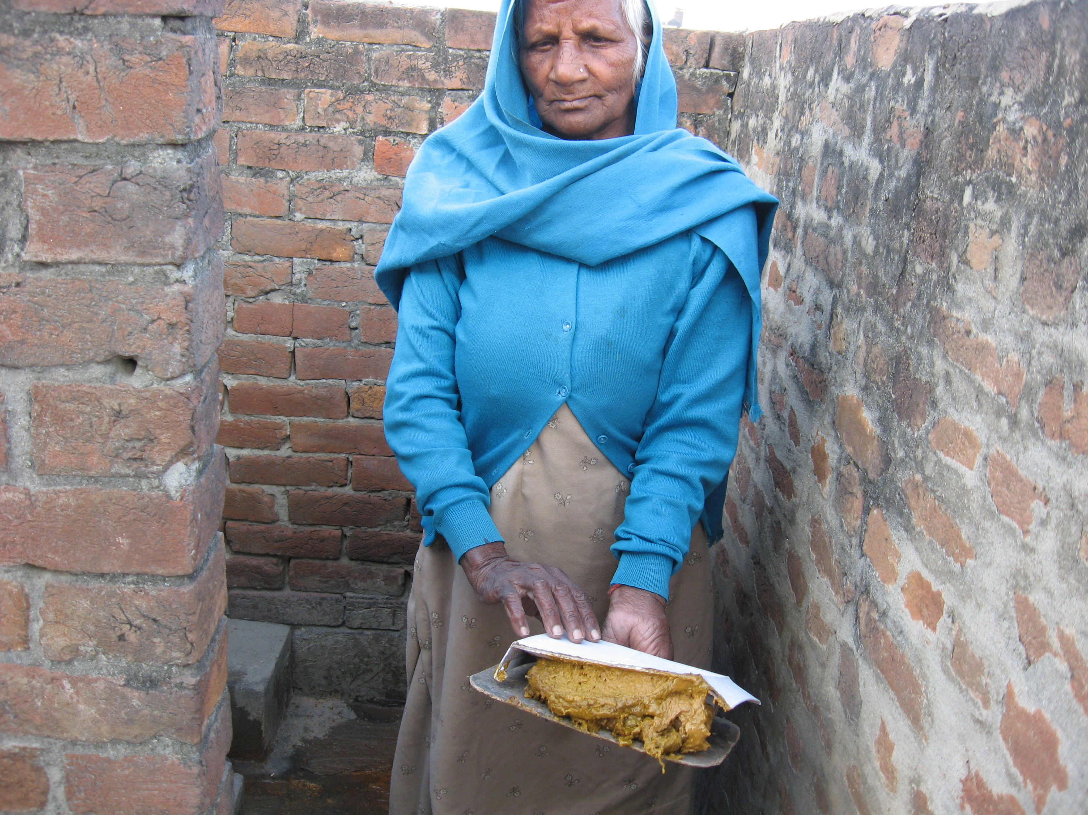
Safe and sustainable sanitation?

Slide 24
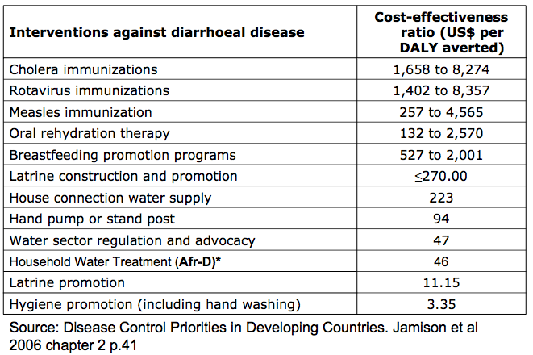
Cost-effectiveness

Slide 25

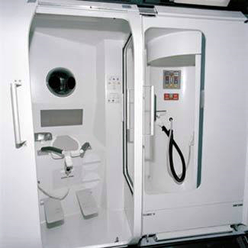
The Final Frontier

Slide 26
2.5 Billion
… with toilets.

Slide 27
Thank you
www.SHAREresearch.org
oliver.cumming@lshtm.ac.uk

