Slide 1
Central Nervous System infections
Dr Luke Moore
MBChB MRCP FRCPath MSc MPH DTM&H
Infectious Diseases
& Microbiology SpR
1
1
1

Slide 2
Overview
Meningitis
Encephalitis
Brain abscess
Spinal infections
Sample collection and examination
Diagnostic protocols and limitations
Management
2
2
2

Slide 3
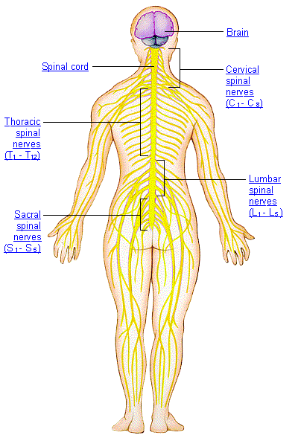
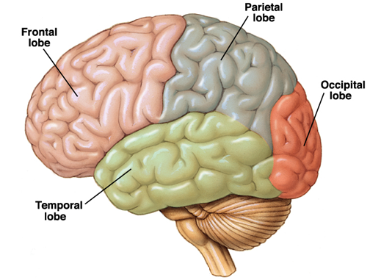
3

Slide 4
Central Nervous System Infections
Time to presentation & speed of progression varies widely
Mode of presentation varies widely
Life-threatening diseases
Prompt diagnosis with appropriate therapy is essential.
4
4
4

Slide 5
Pathogenesis
Four routes of entry:
a) haematogenous spread
b) direct implantation - via instrumentation
c) local extension - secondary to established infections
d) PNS into CNS - viruses

Slide 6
Clinical Syndromes
Syndromes Region Affected Signs and Symptoms Causative Agents
Meningitis Meninges Fever, headache, stiff neck, Neisseria meningitidis
usually some disturbance of Streptococcus pneumoniae
brain function Haemophilus influenzae
TB
Various viruses Cryptococcus neoformans
Encephalitis Brain Disturbance of brain Rabies virus, arboviruses,
function Trypanosoma brucei gambiense
T. b. rhodesiense
Prions
Amoeba
Myelitis Spinal cord Disturbance of nerve Poliovirus
transmission
Neurotoxin CNS & PNS Paralysis, rigid (tetanus) Clostridium tetani
or flaccid (botulism) Clostridium botulinum

Slide 7
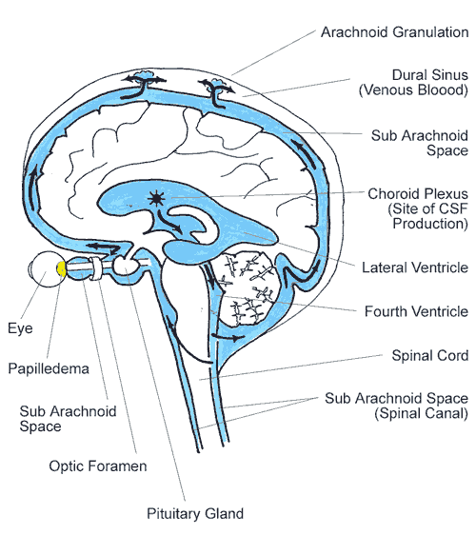
Meningitis
inflammatory process of
meninges and CSF
Meningoencephalitis
inflammation of meninges and
brain parenchyma
Notes:
Three fibrous membranes that surround the brain and spinal cord to protect the central nervous system. The pia mater, a very thin membrane, adheres to the surface of the brain and spinal cord. The subarachnoid space, containing cerebrospinal fluid, separates the pia mater from a second membrane, the arachnoid. Around the brain, fine filaments connect these two membranes, which are believed to be impermeable to fluid. The third membrane, the dura mater, is strong, thick, and dense. It envelops the arachnoid, covers the inside of the skull, and surrounds and supports the large venous channels carrying blood from the brain. Several septa divide it and support different parts of the brain. In the spine, the dura mater and the arachnoid mater are separated by the subdural space; the arachnoid and pia mater are separated by the subarachnoid space.
CP: choroid plexuses
LV: lateral ventricle

Slide 8
Classification of Meningitis
a) Acute
usually bacterial meningitis
b) Chronic
usually TB, spirochetes, cryptococcus
c) Aseptic
usually acute viral meningitis

Slide 9
Acute Meningitis
Neisseria meningitidis
Streptococcus pneumoniae
Haemophilus influenzae
Listeria monocytogenes
Group B Streptococcus
Escherichia coli
Mycobacterium tuberculosis
Staphylococcus aureus
Treponema pallidum
Cryptococcus neoformans
Candida
(Coccidioides immitis, Histoplasma capsulatum, Blastomyces dermatitidis in USA)
9
9

Slide 10
N.meningitidis
Infectious cause of childhood death in all countries.
Transmission is person-to-person, from asymptomatic carriers.
Pathogenic strains are found in only 1% of carriers.
Through nasopharyngeal mucosa in a susceptible individual.
Cause infections in less than 10 days.
10
Notes:
The clinical difference between septicemia and meningitis is important because patients who present with shock are treated
differently than patients who present primarily with increased intracranial pressure (ICP).

Slide 11
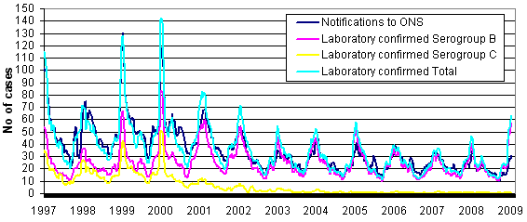
N.meningitidis
Most common in the winter.
Vaccine available against A, C, Y, and W135
In the UK, the incidence was 7.5 cases per 100,000 population (aged <20 y).
Approximately 1500 laboratory-confirmed cases occur each year in the UK; 5000 cases are believed to occur in total.
11
11

Slide 12
N.meningitidis
50% of cases have meningitis
7-10% have septicemia
40% have septicemia AND menignitis
The clinical difference between septicemia and meningitis is important.
WHY?
12
12

Slide 13
Meningitis
13
13
13
provided by The National Meningitis Trust www.meningitis-trust.org.uk

Slide 14
Meningitis
A nonblanching rash (petechial or purpuric) develops in 80% of children.
A maculopapular rash remains in 13% of children, and no rash occurs in 7%.
14
14

Slide 15
Meningitis
Neurological damage by:
Direct bacterial toxicity.
Indirect inflammatory process and cytokine release and edema.
Shock, seizures, and cerebral hypoperfusion.
Mortality rate around 10%
In the UK, ~ 5% of meningitis survivors have neurological sequelae, mainly sensorineural deafness.
15

Slide 16
Septicaemia
The clinical spectrum is produced by four processes:
Capillary leak; albumin and other plasma proteins leads to hypovolemia.
Coagulopathy; leads to bleeding and thrombosis.
Endothelial injury results in platelet-release reactions
The protein C pathway.
Plasma anticoagulants.
Metabolic derangement; particularly acidosis
Myocardial failure….multi-organ failure.
16
16

Slide 17
17
17
17
severe meningococcal disease and purpura fulminans

Slide 18
18
18
18
Amputation or skin grafting due to digital or limb ischemia is required in 2-5% of survivors.

Slide 19
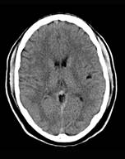
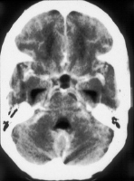
Chronic Meningitis
Normal
CT scan - tuberculous meningitis –
enhancement in the basal cistern and
meninges, with dilatation
of the ventricles.

Slide 20
Tuberculous Chronic Meningitis
Incidence: 544 per 100,000 population in Africa.
More common in patients who are immunosuppressed.
Mortality was 5.5 deaths per 100,000 persons.
Involves the meninges and basal cisterns of the brain and spinal cord.
Can result in tuberculous granulomas, tuberculous abscesses, or cerebritis

Slide 21
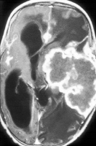
Tuberculous Chronic Meningitis
Normal
CT scan - tuberculous meningitis –
enhancement in the basal cistern and
meninges, with dilatation
of the ventricles.
Tuberculous abscess in the left
parietal region. Note the enhancing
thick-walled abscess.

Slide 22
Aseptic Meningitis
Aseptic meningitis is the most common infection of the CNS.
Patients with aseptic meningitis have headache, stiff neck, and photophobia.
A nonspecific rash can accompany these symptoms.
The coxsackievirus group B and echoviruses are responsible for 80-90% cases in which a causative organism of aseptic meningitis is identified.
It most frequently occurs in children younger than 1 year.
The clinical course of aseptic meningitis is self-limited and resolves in 1-2 weeks.
22
22
22

Slide 23
Viral agents
Organism
Major Age Group Affected
Seasonal Variation
Mumps
Measles
Varicella-zoster
Epstein-Barr virus/ cytomegaloviruses
Other (myxoviruses, paramyxoviruses, adenoviruses)
Enteroviruses (Coxsackie A & B; echovirus; polio)
Herpes simplex (1&2)
Arboviruses
Western equine encephalitis
St. Louis encephalitis
California encephalitis
Eastern equine encephalitis
Rabies
Children
Infants, children
Infants, children
Children, young adults
Infants, children
All ages
Adults
Neonates, young adults
Infants, children
Adults over 40 yr old
School-aged children
Infants, children
All ages
Winter-spring
Spring
Spring
Summer-Autumn
Summer-Autumn
Summer-Autumn
Summer-Autumn
Summer-Autumn
Summer-Autumn

Slide 24
Encephalitis
24
24
24

Slide 25
Meningitis
inflammatory process of
meninges and CSF
Meningoencephalitis
inflammation of meninges and
brain parenchyma
Notes:
Three fibrous membranes that surround the brain and spinal cord to protect the central nervous system. The pia mater, a very thin membrane, adheres to the surface of the brain and spinal cord. The subarachnoid space, containing cerebrospinal fluid, separates the pia mater from a second membrane, the arachnoid. Around the brain, fine filaments connect these two membranes, which are believed to be impermeable to fluid. The third membrane, the dura mater, is strong, thick, and dense. It envelops the arachnoid, covers the inside of the skull, and surrounds and supports the large venous channels carrying blood from the brain. Several septa divide it and support different parts of the brain. In the spine, the dura mater and the arachnoid mater are separated by the subdural space; the arachnoid and pia mater are separated by the subarachnoid space.
CP: choroid plexuses
LV: lateral ventricle

Slide 26
Encephalitis
Transmission is commonly either person to person, or through vectors:
Mosquitoes
Lice
Ticks
Various viridae from Togavirus, Flavivirus, and Bunyavirus families.
26
26
26

Slide 27
Viral agents
Organism
Major Age Group Affected
Seasonal Variation
Mumps
Measles
Varicella-zoster
Epstein-Barr virus/ cytomegaloviruses
Other (myxoviruses, paramyxoviruses, adenoviruses)
Enteroviruses (Coxsackie A & B; echovirus; polio)
Herpes simplex (1&2)
Arboviruses
Western equine encephalitis
St. Louis encephalitis
California encephalitis
Eastern equine encephalitis
Rabies
Children
Infants, children
Infants, children
Children, young adults
Infants, children
All ages
Adults
Neonates, young adults
Infants, children
Adults over 40 yr old
School-aged children
Infants, children
All ages
Winter-spring
Spring
Spring
Summer-Autumn
Summer-Autumn
Summer-Autumn
Summer-Autumn
Summer-Autumn
Summer-Autumn

Slide 28
Encephalitis
Transmission is commonly through vectors:
Mosquitoes
Lice
Ticks
Various viridae from Togavirus, Flavivirus, and Bunyavirus families.
But, West Nile Virus is becoming a leading cause of encephalitis, caused by the arbovirus from the Flaviviridae family.
28
28
28

Slide 29
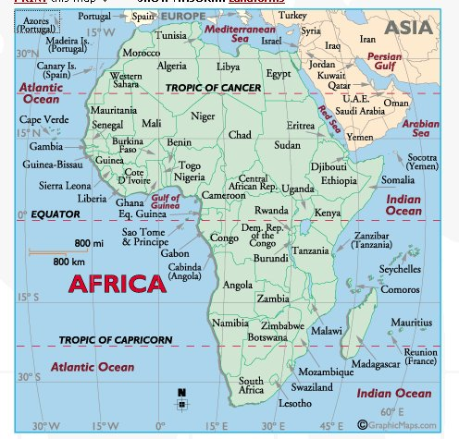
West Nile
1937: West Nile District, Uganda
First isolated
1950: Egypt
Ecology studied
Additional outbreaks
1951-54, 1957, Israel
1962, 2000: France
1973-74: South Africa
1996: Romania, 1998: Italy
Notes:
WNV was first isolated from a feverish woman in the West Nile District of Uganda in 1937. Based on extensive studies done in Egypt in the 1950s, the ecology of the disease was found to vary greatly depending on the prevalence of the disease. At one epidemiological extreme are areas where WNV circulates in most years; uncomplicated WN fever is a mild and common childhood disease. Many people are immune in these areas, and WN fever epidemics and WN meningoencephalitis cases are rare. At the other extreme are the industrialized urban areas, where little or no previous WNV activity has occurred. When aging or immunologically naive populations encounter WNV for the first time, large numbers of neuroinvasive cases have been observed. There have been many West Nile outbreaks throughout the world. In 1957, nursing homes in Israel reported severe neurologic disease and death associated with West Nile fever. The outbreak in 1996 Romania seemed to spark the beginning of several outbreaks worldwide in large industrialized urban areas.

Slide 30
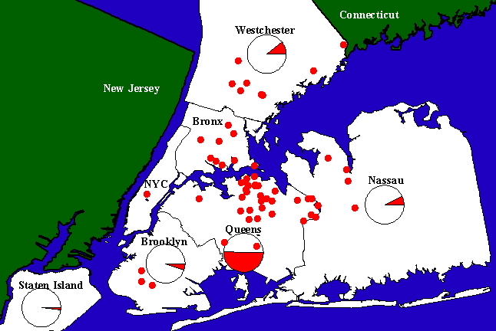
WNV Activity - 1999 NYC
Mosquitoes
Birds
Humans
Notes:
This map shows the distribution of cases in New York City in 1999. The green dots indicate where WNV positive mosquitoes were found. The red dots indicate cases of WNV in humans, and the large circles show areas where WNV positive birds were found.

Slide 31
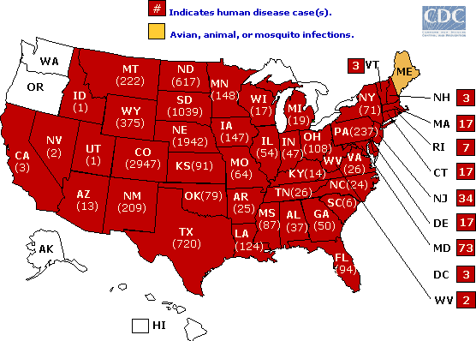
Human WNV Activity - 2003
Notes:
By 2003, WNV had spread across the U.S. to California. This map shows the number of cases of human disease in 2003. The states in red are those with human WNV cases; states in yellow (Maine) indicate avian, animal or mosquito infections.
Source: http://www.cdc.gov/ncidod/dvbid/westnile/Mapsactivity/surv&control03Maps.htm

Slide 32
Other Infectious Encephalitis
Amoebic encephalitis
Naegleria fowleri, Bacterial meningitis.
Habitat – warm water.
Acanthamoeba species, and Balamuthia mandrillaris, brain abscess, aseptic or chronic meningitis.

Slide 33
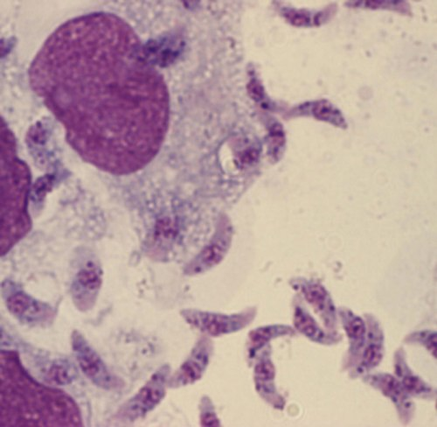
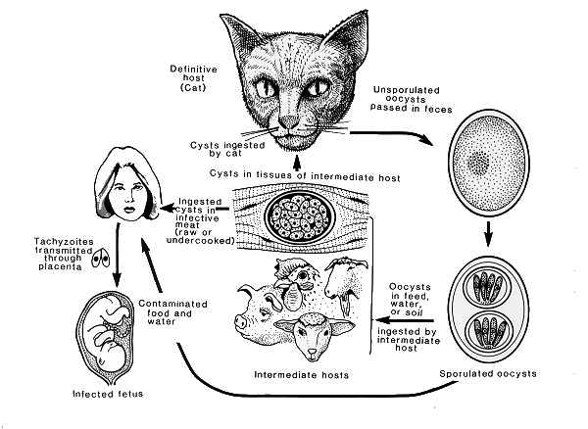
Other Infectious Encephalitis
Toxoplasmosis
An obligate intracellular protozoal parasite, Toxoplasma gondii.
Via the oral, transplacental route or organ transplantation.
Severe infection in immunocompromised
patients.
Affected organs include the gray and
white matter of the brain, retinas,
alveolar lining of the lungs, heart,
and skeletal muscle.

Slide 34
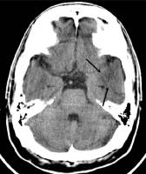
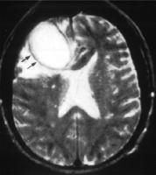
Brain abscess
Normal
Brain abscess
34
34

Slide 35
Brain abscess
Pathophysiology:
otitis media/mastoiditis/paranasal sinuses
endocarditis
haematogenously
Microbiology:
Streptococci (both aerobic and anaerobic)
Staphylococci,
Gram-negative organisms. (particularly in neonates)
Mycobacterium tuberculosis
fungi
parasites
Actinomyces and Nocardia species
35
35

Slide 36
Spinal Infections
Pyogenic vertebral osteomyelitis common form of vertebral infection.
Direct open spinal trauma, from infections in adjacent structures, from hematogenous spread of bacteria to a vertebra.
Left untreated, it can lead to permanent neurologic deficits, significant spinal deformity, or death.
36
36
36

Slide 37
Spinal Infections
Risk factors
Advanced age
Intravenous drug use
Long-term systemic steroids
Diabetes mellitus
Organ transplantation
Malnutrition
Cancer
37
37

Slide 38
Investigations
MRI is superior to CT scanning in detecting parenchymal abnormalities such as abscesses and infarctions.
Central nervous system infections: CSF sample, brain tissue from post-mortem.
Meningitis:
Blood cultures
Throat swabs
Samples of choice?
38
38
38

Slide 39
CSF Studies
Color/Clarity
Cell counts/WBC diff
Chemistries (protein, glucose)
Stains/Smears (Gram)
Cultures (routine)
+/- Antigen screens
PCR
39
39
39

Slide 40
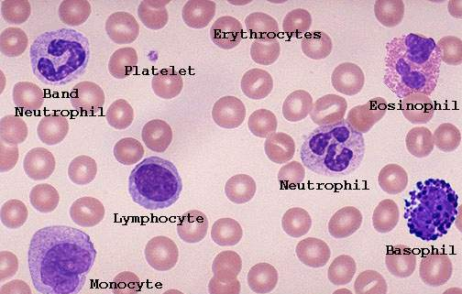
CSF Studies
40
40
40

Slide 41
CSF changes in meningitis
Condition | Appearance | Cells, x 106/l (per cmm) | Gram stain or antigen tests | Protein g/l | Glucose, mmol/l | Main differential diagnosis
Normal | Clear | 0-5 leukocytes | Negative results | 0.15-0.4 | 2.2-3.3, 60% blood glucose level
Purulent meningitis | Turbid | 100-2000 polymorphs | Positive results | 0.5-3.0 | 0-2.2 | Bacterial meningitis, ? Meningococcus ? Pneumococcus ? Listeria
Aseptic meningitis | Clear or slightly turbid | 15-500 Lymphocytes | Negative results | 0.5-1.0 | Normal | Viral meningitis, partially antibiotic treated bacterial meningitis, encephalitis, brain abscess, TB/fungal meningitis
Tuberculous meningitis | Clear or slightly turbid | 30-500 lymphocytes plus polymorphs | Negative results (scanty acid fast bacilli) | 1.0-6.0 | 0-2.2 | TB meningitis, brain abscess, Cryptococcal meningitis
41
41

Slide 42
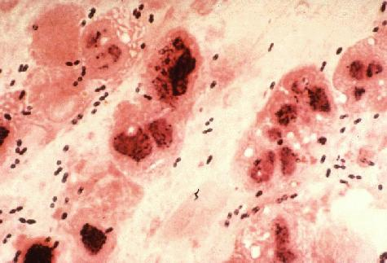
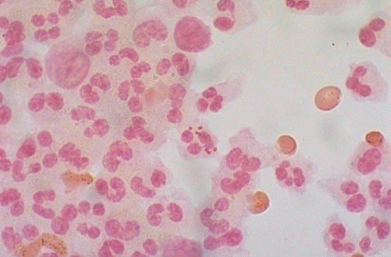
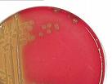
Gram positive cocci
pneumoococcus
Gram negative cocci
meningococcus
42
42
42

Slide 43
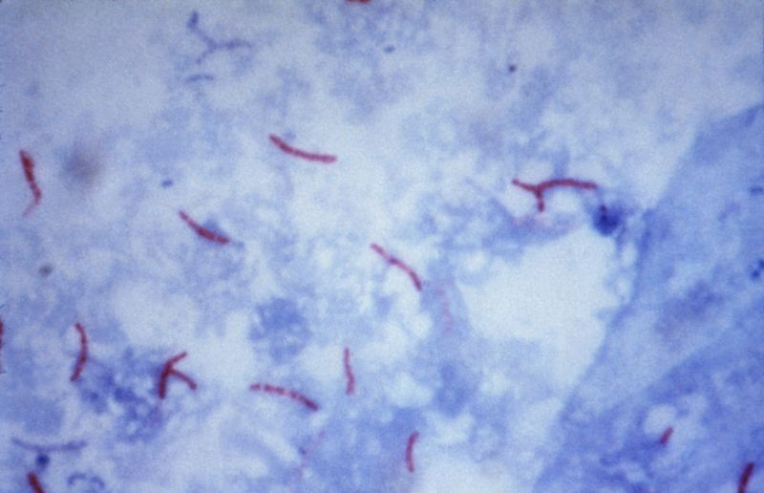
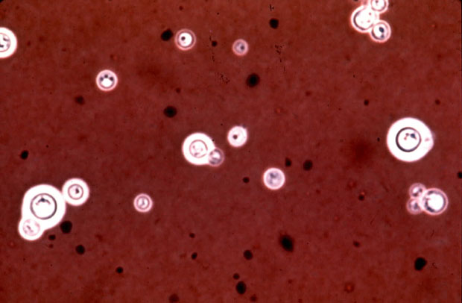
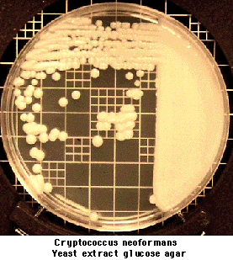
Ziehl-Neelsen stain - TB
Indian ink stains - cryptococcus
43
43
43

Slide 44
Limitations of Techniques
MRI oedema pattern and moderate mass effect cannot be differentiated from tumor or stroke or vasculitis in some patients.
Infections in early stages and serological tests.
Amount of CSF.
PCR techniques.
Methods to detect amoebic infections.
Availability of good laboratory technique.
44
44

Slide 45
Approach to the patient with possible CNS infection
Crucial and recurring question addressed sequentially over time
Points in Decision- Available Data Base
Making Process For Decision-Making
Within the 1st 30 mins Clinical assessment
of patient contact
After 1-2 hours CSF analysis
At 24-48 hours CSF cultures
Thereafter as clinically indicated
45
45
45

Slide 46
Specific therapy
Pathogen Recommended Therapy
S. pneumoniae { Pen G 18-24 mu/d or Ampicillin 12 g/d or
N. meningitidis { Ceftriaxone 4 g/d or Chloro 75-100 mg/kg/d
Streptococci {
H. influenzae Cefotaxime 12 gm/d or Ceftriaxone 4 g/d
Group B strep Pen G 18-24 mu/d or Ampicillin 12 g/d
[plus aminoglycoside]
Listeria Ampicillin 12 g/d or Pen G 18-24 mu/d
[plus aminoglycoside]
Gram negative bacilli Cefotaxime 12 g/d or Ceftriaxone 4g/d
Pseudomonas Meropenem 6g/d or Ceftazidime 6g/d
46
46
46

Slide 47
Generic therapy
Meningitis
Ceftriaxone 2g iv bd
If >50yrs or immunocompromised add:
Amoxicillin 2g iv 4hourly
Meningoencephalitis
Aciclovir 10mg/kg iv tds
Ceftriaxone 2g iv bd
If >50yrs or immunocompromised add:
Amoxicillin 2g iv 4hourly
47
47
47

Slide 48
?
luke.moore@imperial.nhs.uk
48
48

