Slide 1
Allergic disorders
Peter Kelleher
Senior Lecturer, Immunology Section, Division of Infectious Diseases, Imperial College, Chelsea & Westminster Hospital Campus, London
Consultant HIV/GUM Directorate, Chelsea & Westminster NHS Foundation Trust
Hon Consultant, Dept of Respiratory Medicine, Royal Brompton & Harefield Hospitals NHS Trust
Hon Consultant & Lead Clinician, Division of Immunology, Imperial College Healthcare NHS Trust

Slide 2
Learning objectives
1. Outline the epidemiology of allergic disorders
2 Describe the clinical features of type 1 hypersensitivity responses
3. Discuss the investigation and management of allergic disorders
4. Outline the clinical features/management of the following conditions:
Anaphylaxis
Food allergy
Atopic Dermatitis
Allergic rhinitis
Chronic urticaria and angioedema

Slide 3
Definitions
Atopy: the production of specific IgE responses to common environmental antigens
Allergic disease is the development of Type 1 hypersensitivity responses to environmental allergens.
Atopy and allergic disease are not synonymous
IgE + Factor x = Allergic disease

Slide 4
Age of onset of allergic diseases
Infants Atopic dermatitis
Food allergy (milk, egg, nuts)
Childhood Asthma (HDM, pets)
Allergic rhinitis (grass, tree pollen)
Adults Drug allergy
Bee allergy
Oral allergy syndrome
Occupational allergy

Slide 5
Allergic disorders are common and co-exist
Prevalence of allergic disorders in UK children aged 13-14 years in 1998
Asthma 30%
Allergic rhinitis 20%
Atopic dermatitis 15%
Food allergy 2.3%
4% of children with asthma had food specific IgE concentration associated with clinical food allergy: 45% of children sensitised to at least 1 food

Slide 6
Epidemiology of allergic disorders
Prevalence of allergic rhinitis in Swiss military conscripts
Prevalence of atopic dermatitis in children < 5 years old in UK
1926 | 1958 | 1985 | 1995
0.3% | 4.6% | 9.6% | 14.2%
1946 | 1970 | 1985 | 1994
5.1% | 7.3% | 12.2% | 20%

Slide 7
The reasons for the rise in allergic disorders are not known
Hygiene hypothesis
Infection and unhygienic contact may prevent the development of allergic disease
? Role of overt viral and bacterial infection
? Environmental exposure to microbial compounds
Other reasons (route of exposure to antigens, food processing, use of antacids)

Slide 8
Clinical history
IgE allergic responses
Occurs within minutes or up to 2 hours after exposure to allergen
Responses are consistent
Reactions are predictable: angioedema, urticaria, rhinoconjunctivitis, wheeze, diarrhoea vomiting and anaphylaxis
At least 2 organ systems are usually involved
May be triggered by cofactors such as exercise, alcohol, ?infection

Slide 9
Clinical history
Non IgE mediated responses
Recurrent episodes of abdominal pain, diarrhoea
Fatigue
Migraine
Hyperactivity
Depression
Confusion

Slide 10
Investigation of allergic disease
Elective investigations
Skin prick tests
Quantitate specific IgE to putative allergen
Component-resolved diagnostics
Challenge test
Supervised exposure to the putative antigen
During acute episode
Evidence of mast cell degranulation
Serum mast cell tryptase levels

Slide 11
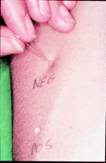
Skin-prick tests
Skin testing is the "gold standard" to support a diagnosis of allergy
Local wheal and flare response to allergen

Slide 12
How to do a skin prick test
Expose patient to standardised solution of allergen extract through a skin prick to the forearm
Use standard skin test solutions and positive control (histamine) and negative control (diluent)
A positive test is indicated by a wheal ≥ 2mm greater than the negative control
NB
Antihistamines should be discontinued for at least 48 hours beforehand
Corticosteroids do not influence skin prick tests

Slide 13
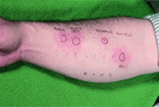

Slide 14
Skin prick tests
Advantages
Rapid
Cheap
Easy to do
More sensitive than blood tests
More specific than blood tests
Patient can see the response
Disadvantages
Requires experience to interpret
Risk of anaphylaxis: 1 in 3000
Limited value in patients with dermatographism or extensive eczema
Commercial food extracts are often labile

Slide 15
Specific IgE test (RAST tests)
Quantitate IgE in serum directed against a specific allergen (peanut, cat dander, egg etc)
Uses: Confirms diagnosis of allergy
Prognosis (which children may outgrow allergy)
Monitoring clinical responses to anti-IgE Tx
Sensitivity and specificity about 70 to 75% compared with skin prick tests

Slide 16
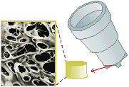
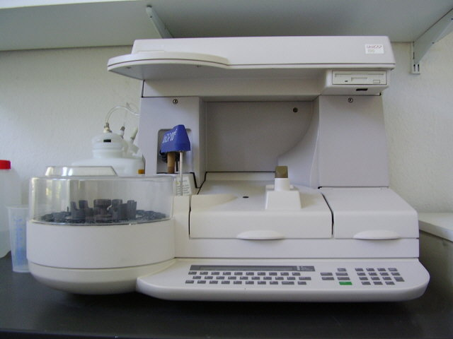
Chemiluminescence IgE test
Allergen bound to sponge in a plastic cap and patient’s serum is added
Specific IgE (if present) binds to allergen
Sponge is washed
Anti-IgE tagged with a flourescent label is added
Amount of IgE/Anti-IgE is measured by immunoflourescence

Slide 17
Indications for specific IgE testing
Patients who can’t stop anti-histamines
Patients with dermatographism
Patients with extensive eczema
History of anaphylaxis
Borderline/equivocal skin prick test results

Slide 18
Component Allergen Specific IgE
Conventional IgE tests measure responses to a range of proteins. Component allergen sIgE measures response to a specific allergen related protein.
Peanuts for example: contain at least 5 major allergens:
Measure of specific IgE to individual allergen within peanuts may provide useful clinical information on severity of reaction likely to be experienced in a patients with specific IgE to whole peanut extracts or select patients for food challenges tests if history and results of SPT, conventional specific IgE are unclear
Ara h 2 High risk anaphylaxis to peanut and nuts: Ara h 8 – localised oral reactions to peanut and stone-fruit only.

Slide 19
Other allergy tests
Detection of mast cell-derived mediators of anaphylaxis
Mast cell tryptase
Product of mast cell granules
Systemic degranulation of mast cells during anaphylaxis results in increase in serum tryptase
Peak concentration at 1-2 hours; returns to baseline by 6 hours
Useful if the diagnosis of anaphylaxis is not clear
eg hypotension + rash during anaesthesia

Slide 20
Challenge Tests: food and drug allergy
Gold standard for food allergy diagnosis
Increasing volumes of the offending food/drug are ingested
Double blind placebo or open challenge
Food challenges take place under close medical supervision. Very expensive in terms of clinical staff time.
How to interpret mild symptoms
Risk of severe reaction

Slide 21
Anaphylaxis: clinical definition
Anaphylaxis: a severe systemic allergic reaction
A severe allergic reaction is defined as:
Respiratory difficulty (asthma, laryngeal oedema)
Hypotension (faint, lightheaded, collapse, LOC)
Almost all patients with anaphylaxis will have skin involvement (itch, erythema, urticaria, angioedema)
Other features of anaphylaxis include nausea, vomiting, diarrhoea, uterine cramps, rhinitis and a ‘sense of doom’

Slide 22
Mechanisms of anaphylaxis
IgE-mediated mast degranulation
Peanut
Penicillin
Wasp or bee venom
Latex
Non IgE-mediated mast cell degranulation
Aspirin and NSAID
Intravenous contrast media
Opioid analgesics
Exercise

Slide 23
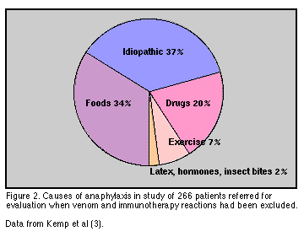
Causes of anaphylaxis

Slide 24
Reactions that can mimic anaphylaxis
Histamine poisoning
C1 inhibitor deficiency
Systemic mastocytosis
Carcinoid syndrome
Phaechromocytoma
Myocardial infarction
Pulmonary embolism
Vaso-vagal attack
Anxiety or panic disorder

Slide 25
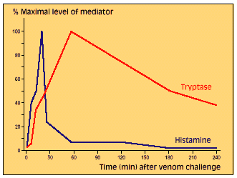
Laboratory diagnosis of anaphylaxis
Serum Tryptase at
1 hour
3 hours
24 hours
The rise in tryptase concentration is α to the drop in blood pressure

Slide 26
Emergency management of anaphylaxis
Lie down and elevate legs to boost venous return to the heart
IM adrenaline 500ug
Oxygen 100%
Fluid replacement
Chlorpheniramine 10mg IV
Hydrocortisone 100mg IV
Inhaled Bronchodilators

Slide 27
Follow up management of anaphylaxis
Referral to an allergy/immunology clinic
Investigate the cause of anaphylaxis
Written information sheet on the following;
Recognition of symptoms
Avoidance of identifiable triggers
Indications for self treatment with an Epipen
Involve the family

Slide 28
Follow up management for anaphylaxis
Advice and training for schools and nurseries
Refer patients with food induced anaphylaxis to a qualified dietitian
Advise patients to acquire a Medic Alert bracelet
Review patients to ensure that they understand their disease and can use their Epipen
Utilise patient support groups ie Anaphylaxis Campaign

Slide 29
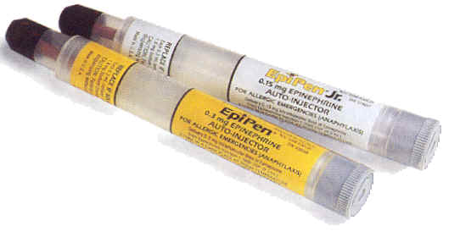
Anaphylaxis
Epipen
Preloaded adrenaline syringe
Contains 300ug adrenaline for adult patients
Contains 150ug adrenaline for children
All patients should be prescribed 2 pens

Slide 30
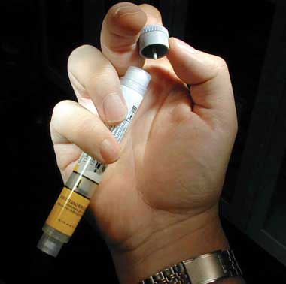
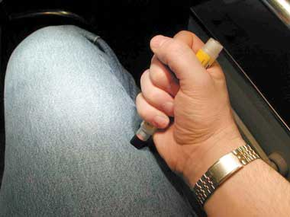
How to use an Epipen

Slide 31
Filaggrin and atopic dermatitis
FiIaggrin is a structural protein which maintains integrity of epithelial barrier and contributes to hydration of skin
Loss of function mutation in filaggrin are found in 10% of European population and 50% cases of patients with severe AD
Filaggrin gene defects are important risk factor for AD, AD and allergic airway diseases and IgE sensitisation
Almost all infants with AD, food allergy and filaggrin gene defects will develop asthma: defects in cutaneous epithelial barrier contributory to manifestation of ‘allergic march’

Slide 32
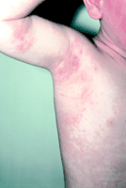
Atopic dermatitis
80% of cases present in the first year of life
Prevalence of AD falls with age
Distribution of rash depends upon mobility
Defects in β defensin and a cathelicidin protein predispose to Staph aureus superinfection
Immune responses to viral warts
and molluscum contagiosum are reduced

Slide 33
Treatment of atopic dermatitis
Emollients as soap substitutes
Skin oils, creams and ointments
Topical steroids to suppress inflammation
Antibiotics for secondary infection
Sedative anti-histamines
Bandages and wet dressings
PUVA phototherapy
Allergen avoidance
Cyclosporin/topical tacrolimus

Slide 34
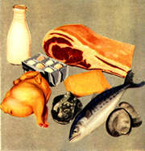
Food allergy

Slide 35
Examples of adverse reactions to foods
1) Food intolerance Food poisoning (bacterial, scromboid)
Enzyme deficiencies (lactase)
Pharmacological (caffeine, tyramine )
2) Food aversion Fads, eating disorders
3) Food allergy IgE mediated reactions (anaphylaxis, OAS)
Cell mediated (coeliac disease)
IgE/cell mediated (atopic dermatitis, AEG)

Slide 36
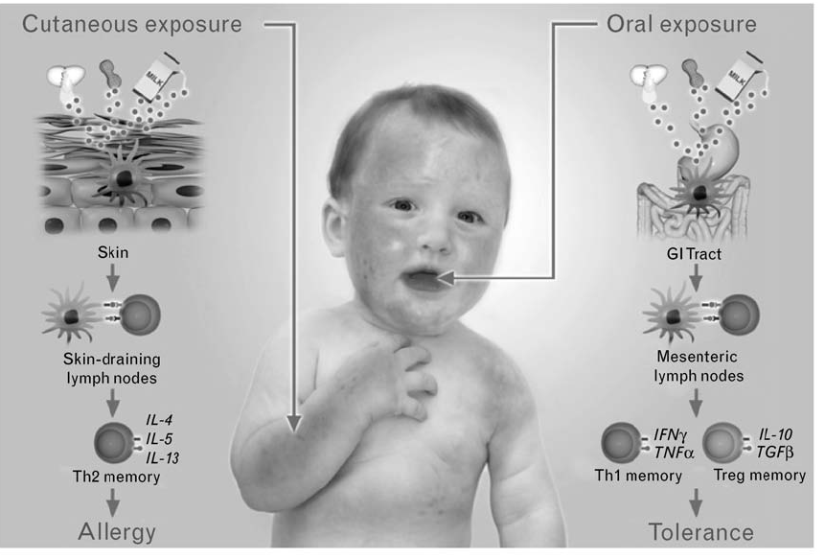
Route of exposure to food antigens may determine whether allergy or tolerance develops

Slide 37
Food allergy
20% of adults believe they have a food allergy
The prevalence of food allergy (food specific IgE antibodies, cell mediated immune responses or combined pathways) is 6% in children and 3.7% in adults.
Atopic disorders are a risk factor for food allergy
35% of children with moderate-severe atopic dermatitis have IgE mediated food allergy
Up to 8% of children with asthma have a food-induced wheezing

Slide 38
Prevalence of food allergy in the USA
Food Young children Adults
Milk 2.5% 0.3%
Egg 1.3% 0.2%
Peanut 0.8% 0.6%
Tree nut 0.2% 0.5%
Fish 0.1% 0.4%
Shellfish 0.1% 2.0%
Overall 6% 3.7%

Slide 39
Food allergy: clinical history
What does the patient mean by allergy
What foods are involved
Distinguish between IgE and non IgE mediated symptoms
Does the patient have any history of asthma, allergic rhinitis, eczema
Enquire about previous investigations for food allergy ie SPT, RAST, complementary medical tests
Has elimination of food made any difference to symptoms
Consider other differential diagnoses (food intolerance, eating disorders, coeliac disease

Slide 40
Investigations for food allergy
A positive SPT is useful to confirm a clinical history of food allergy
A negative SPT essentially excludes IgE mediated allergy (NPV = 95%)
Fruit and vegetable skin prick test solutions are labile and it often better to useful use prick-prick testing
Increasing SPT wheal size is correlated with an increasing likelihood of clinical allergy
Increasing serum concentration of food specific IgE (CAP based technology) can be used to predict who is at risk of an allergic reaction
Negative blood tests are associated with clinical reactions in 10-25% of cases
Gold standard for diagnosis of food allergy is double blind oral food challenge

Slide 41
Predictive value of food allergen specific IgE levels in children
Allergen (kU/L) PPV
Egg 7 98
(infants < 3yr) 2 95
Milk 15 95
(infants < 3 years) 5 95
Peanut 14 100
Fish 20 100
Tree nuts 15 95

Slide 42
Causes of food allergy in adults
Major foods
Peanuts
Tree nuts
Fish
Shellfish
Sesame seed
Cross reactive reactive food allergens
Oral allergy syndrome Birch pollen & Rosacea fruit
Ragweed & melons
Mugwort & celery
Latex food syndrome (BACK)

Slide 43
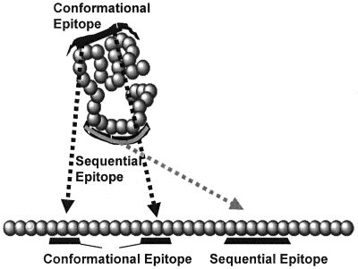
Birch pollen oral allergy syndrome
Respiratory exposure to pollen (birch) results
in IgE directed to homologous proteins in
stone fruit and nuts
Symptoms limited to the mouth:(anaphylaxis
seen in less than 2% of cases)
CRD may help predict severity of reaction
(profilins mild reaction, LTP more severe
reactions)
Cooking usually denatures proteins to avoid
symptoms
Spit out food, wash mouth and take an
anti-histamine

Slide 44
Causes of food allergy in children
Major foods
Cow’s milk
Egg
Wheat
Peanut
Tree nut
Milk, egg and wheat allergy usually resolves by the age of 8
Peanut allergy persists in 80% of children

Slide 45
Management of food allergy
Investigation of IgE mediated symptoms
Food symptom diary
Skin prick tests commercial food extracts
fresh food
RAST tests
Challenge test DBPFC
Treatment of food allergy
Food avoidance (Dietitian input is vital)
Epipen for severe reactions
Ensure that concurrent asthma is well controlled

Slide 46
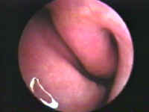
Allergic rhinitis
Classification of allergic rhinitis
Seasonal
Tree pollen
Grass pollen
Fungal spores
Perennial
HDM and pets
Occupational
Latex, Lab animals

Slide 47
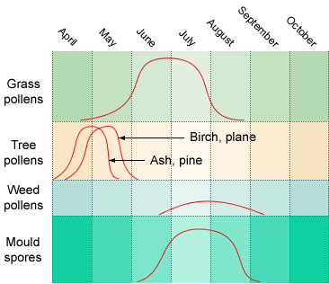
Onset of pollen induced rhinitis in SE England

Slide 48
Diagnosis of allergic rhinitis
History
Nasal itch, sneezing
Nasal discharge
Nasal obstruction
Loss of smell
Eye symptoms
Examination
Pale, bluish, swollen nasal mucosa
Investigations
Exclude other causes of rhinitis: SPT & RAST

Slide 49
Management of allergic rhinitis
Initial therapy
Non sedating anti-histamines
Corticosteroid nasal spray
Sodium comoglycate eye drops (Mast cell stabiliser)
Second line therapy
Short course of oral steroids
Ipratropium nasal spray
Third line therapy
Allergen avoidance ? Efficacy
Immunotherapy Grass pollen desensitisation

Slide 50
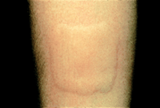
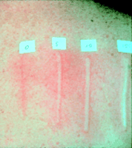
Urticaria

Slide 51
Acute urticaria
Acute urticaria is very common
Aetiology
Idiopathic in 50% of cases
IgE mediated reactions to food, drugs and latex
Viral infections and febrile illnesses
Management
Allergen avoidance
Antihistamines

Slide 52
Chronic urticaria
Persistent itchy wheals lasting more than 6 weeks
In 50% of cases associated with deep mucoutaneous swellings (angioedema)
Aetiology Idiopathic
Autoimmune IgG against FcεR1 or IgG against IgE
Physical Heat
Cold
Pressure
Solar
Exercise

Slide 53
Management of chronic urticaria
Avoid precipitating or exacerbating factors
Aspirin, NSAID, opiates,
ACE inhibitors in those with angioedema
Check for underlying thyroid disease
Preventative antihistamine therapy
IM adrenaline for pharyngeal angioedema
1% menthol in aequous cream for pruritus

Slide 54
Management of chronic urticaria
Doxepin is helpful in some patients who do not respond to
anti-histamines
Ciclosporin for refractory cases
50% of patients will still have the disease after 3 years
Exclude urticarial vasculitis in those who respond poorly to anti-histamines

Slide 55
Learning points
1. Allergic disorders are very common and have increased significantly over the last 50 years
2. The gold standard for the diagnosis of IgE mediated disorders remains skin prick testing
3. Blind testing for specific IgE is unrewarding and sensitization is not allergy
4. The most important treatment for anaphylaxis is intramuscular adrenaline

Slide 56
SBA
Anaphylaxis is best diagnosed in the laboratory by measuring which of the following analytes ?
Tryptase
Tumour Necrosis Factor-α
Eosinophilic cationic protein
Nitric oxide
IgE

Slide 57
SBA
Correct Answer = A

Slide 58
Allergy: 10 tips for hospital doctors/GP’s
Clinical history is very important in allergic disorders (usually multi-site symptoms, including pruritus, past history or family of atopy)
Isolated GI symptoms are rarely due to purely IgE disorders
Blind screening for allergens using SPT or RAST tests is misleading in the diagnosis of allergy
It can be difficult to distinguish between anaphylaxis and anxiety disorder
IM adrenaline is the treatment of choice for anaphylaxis

Slide 59
Allergy: 10 tips for hospital doctors/GP’s
Ensure that your patient knows when and how to use an Epipen
Chronic urticaria and angioedema is not an allergic disorder
Angiotension enzyme inhibitors are a common cause of angioedema: stop the drug and see if angioedema settles
Make sure that you start treatment for seasonal allergic rhinitis 2-4 weeks before onset of pollen season
Immunotherapy is used for bee and wasp anaphylaxis and grass pollen hayfever refractory to maximal medical therapy

