Slide 1
Immunology case studies devised by Sara Marshall and Margaret Callan presented by Keith Gould

Slide 2
Learning objectives
At the end of this case study session, you should:
Be able to recognise common immunological conditions
Be familiar with how immunological investigations can inform the diagnosis and management of a wide range of infectious, allergic and inflammatory disorders
Understand how immune based therapies can be used in clinical practice

Slide 3
Case study 1

Slide 4
40 year old man
Presents to A&E
C/O lip swelling
Over the next 20 minutes, he develops:
Itching of his hands and feet
Increasing breathlessness and chest tightness
Fall in PEFR to 200 l/min
Fall in BP to 80/30 mmHg
Oxygen saturations are 88% on room air

Slide 5
Questions
What is the working diagnosis?
What are the clinical features of anaphylaxis? (10 for complete answer)
What immediate treatment would you instigate and why?
What questions would you ask once the patient is stabilised?
How would you confirm the diagnosis?
What long term management advice would you give?

Slide 6
What is the working diagnosis?
Anaphylaxis
Definition: “A systemic hypersensitivity reaction in which the response is so overwhelming as to be life-threatening”
Mechanism: Type I hypersensitivity response
Cross-linking of IgE on surface of mast cells
Causes mast cells to degranulate
Results in release of specific biological mediators including histamine and leukotrienes

Slide 7
What are the clinical features of anaphylaxis?
For full marks, need at least 10 features….

Slide 8
What are the clinical features of anaphylaxis?
feeling of impending doom, loss of conciousness, death
Angioedema of lips and mucous membranes
Laryngeal obstruction, Stridor
Conjunctival injection, rhinorrhea,
angioedema
Hypotension
Cardiac arrhythmias
Myocardial infarct
Vomiting
Diarrhoea
Abdominal pain
Flushing
Urticaria
Wheeze, bronchoconstriction
Itch of palms, soles of feet and genitalia

Slide 9
Clinical Manifestations of Anaphylaxis
Signs/symptoms | Incidence %
Urticaria and angioedema | 88
Upper airway oedema | 56
Breathlessness and wheezing | 47
Flushing | 46
Dizziness, syncope, and hypotension | 33
Gastrointestinal symptoms | 30
Rhinitis | 16
Headache | 15
Substernal pain | 6
Itch without rash | 4.5
Seizure | 1.5
Notes:
This table summarizes the presenting signs and symptoms documented in 4 studies involving 743 patients with anaphylaxis. The most common symptoms were urticaria and angioedema, occurring in 88% of patients. The next most common manifestations were respiratory symptoms, such as upper airway edema, dyspnea, and wheezing. Cardiovascular symptoms of dizziness, syncope, and hypotension, were less common, but it is important to remember that cardiovascular collapse may occur abruptly, without the prior development of skin or respiratory manifestations.
Other symptoms of rhinitis, headache, substernal pain, and pruritus without rash were less commonly observed.
Lieberman P. Distinguishing anaphylaxis from other serious disorders. J Respir Dis 1995;16:411–420.

Slide 10
Differential diagnoses to consider
Causes of collapse
Myocardial infarction
Cardiac arrythmia
Acute asthmatic attack
Pulmonary embolus
Vasovagal attack
Epilepsy

Slide 11
What immediate treatment would you instigate and why?

Slide 12
Immediate treatment of anaphylaxis
May require respiratory support
Intubation may be required for severe bronchoconstriction
Tracheostomy if develops upper respiratory tract obstruction (eg laryngeal swelling, or severe swelling of tongue)

Slide 13
Immediate treatment of anaphylaxis
Oxygen by mask
Improve oxygen delivery
Adrenalin im (0.5mg for adult and may repeat)
Acts on B2 adrenergic receptors to constrict arterial smooth muscle
Increases blood pressure
Llimits vascular leakage
Bronchodilator
Intravenous anti-histamines (10mg Chlorpheniramine)
Acts to oppose the effects of mast-cell derived histamine

Slide 14
Immediate treatment of anaphylaxis
Oxygen by mask
Improve oxygen delivery
Adrenalin im (0.5mg for adult and may repeat)
Acts on B2 adrenergic receptors to constrict arterial smooth muscle
Increases blood pressure
Limits vascular leakage
Bronchodilator
Intravenous anti-histamines (10mg Chlorpheniramine)
Acts to oppose the effects of mast-cell derived histamine

Slide 15
Immediate treatment of anaphylaxis
Oxygen by mask
Improve oxygen delivery
Adrenalin im (0.5mg for adult and may repeat)
Acts on B2 adrenergic receptors to constrict arterial smooth muscle
Increases blood pressure
Llimits vascular leakage
Bronchodilator
Intravenous anti-histamines (10mg Chlorpheniramine)
Acts to oppose the effects of mast-cell derived histamine

Slide 16
Immediate treatment of anaphylaxis
Nebulised bronchodilators
Improve oxygen delivery through bronchial dilatation
Intravenous corticosteroids (Hydrocortisone 200mgs)
Systemic anti-inflammatory agent.
Effect takes about 30minutes to start, and does not peak for several hours.
Important in preventing rebound anaphylaxis
Intravenous fluids
Increase circulating blood volume and therefore increase blood pressure

Slide 17
Immediate treatment of anaphylaxis
Nebulised bronchodilators
Improve oxygen delivery through bronchial dilatation
Intravenous corticosteroids (Hydrocortisone 200mgs)
Systemic anti-inflammatory agent.
Effect takes about 30minutes to start, and does not peak for several hours.
Important in preventing rebound anaphylaxis
Intravenous fluids
Increase circulating blood volume and therefore increase blood pressure

Slide 18
Immediate treatment of anaphylaxis
Nebulised bronchodilators
Improve oxygen delivery through bronchial dilatation
Intravenous corticosteroids (Hydrocortisone)
Systemic anti-inflammatory agent.
Effect takes about 30minutes to start, and does not peak for several hours.
Important in preventing rebound anaphylaxis
Intravenous fluids
Increase circulating blood volume and therefore increase blood pressure

Slide 19
Immediate treatment of anaphylaxis
Inhaled: Oxygen
Salbutamol (bronchodilator)
Intramuscular: Adrenalin
Intravenous: Chlorpheniramine (anti-histamine) Hydrocortisone (anti-inflammatory)
Fluids

Slide 20
Common causes of anaphylaxis
IgE mediated mast cell degranulation
Foods
Peanuts
Tree nuts
Fish and shellfish
Milk
Eggs
Soy products
Insect stings
Bee venom
Wasp venom
Chemicals, drugs and other foreign proteins
Penicillin and other antibiotics
Intravenous anaesthetic agents, eg suxamethonium, propofol
Latex

Slide 21
What questions would you ask once he has stabilised?

Slide 22
What was he doing immediately prior to the onset of symptoms?
As his first symptom was lip swelling, specifically ask what had his lips been in contact with, & what he had eaten.
Does he have any known allergies?
Has anything like this happened before?
How is his general health?

Slide 23
You obtain a history from the patient’s wife
He is a medical laboratory technician
General health is excellent
He was blowing up balloons for their daughter’s birthday party when he became unwell
He has a known allergy to bananas which cause diarrhoea and lip tingling
He is meticulous about avoiding exposure to bananas

Slide 24
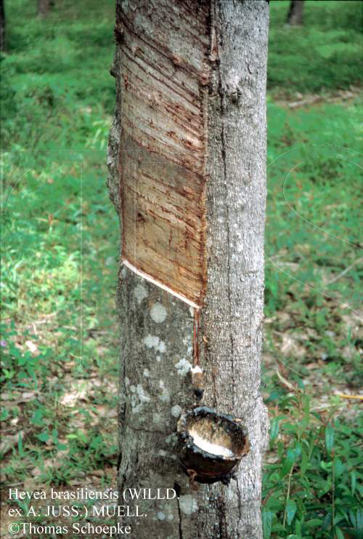
What is the likely allergen?
Latex
= milky fluid produced by rubber trees (Hevea brasiliensis)

Slide 25
There are two types of latex allergy
Type I hypersensitivity
Acute onset of classical allergic symptoms after exposure e.g. wheeze, urticaria, angioedema, anaphylaxis.
Spectrum of severity
Mucosal route is associated with more severe reactions
Different rubber products vary significantly in their allergenic content
Type IV hypersensitivity
Contact dermatitis
Usually affect hands (glove usage) or feet (due to rubber in footwear)
Mainly due to rubber additives eg thiuram rather than latex itself

Slide 26
There are two types of latex allergy
Type I hypersensitivity
Acute onset of classical allergic symptoms after exposure e.g. wheeze, urticaria, angioedema, anaphylaxis.
Spectrum of severity
Mucosal route is associated with more severe reactions
Different rubber products vary significantly in their allergenic content
Type IV hypersensitivity
Contact dermatitis
Usually affect hands (glove usage) or feet (due to rubber in footwear)
Mainly due to rubber additives eg thiuram rather than latex itself

Slide 27
Type IV hypersensitivity to latex
Symptoms occur 24-48 hours after exposure (Much later than in IgE mediated reactions)
Itch++
Rash well-demarcated, often flaky
Not responsive to anti-histamines

Slide 28
Type I allergy to Latex is a major health problem
Specific patient groups
Patients undergoing multiple urological procedures
Preterm infants
Patients with indwelling latex devices (e.g. ventriculoperitoneal shunts)
Occupational exposure
60% of occupational asthma in the UK is associated with latex exposure
Health care workers (7-10% vs <1% general population!)
Laboratory workers
Operating theatre staff
Latex or manufacturing industry workers

Slide 29
Type I allergy to Latex is a major health problem
Specific patient groups
Patients with spina bifida or cerebral palsy
Patients undergoing multiple urological procedures
Preterm infants
Patients with indwelling latex devices (eg ventriculoperitoneal shunts)
Occupational exposure
- Health care workers (7-10% vs <1% general population!)
- Laboratory workers
- Operating theatre staff
- Latex or manufacturing industry workers
-

Slide 30
Is the allergy to bananas a red herring?

Slide 31
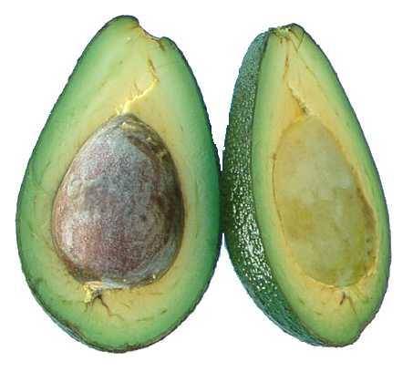
Type I hypersensitivity to latex; cross reactivity with chitinase containing foods
Avocado
Apricot
Banana
Chestnut
Kiwi
Passion fruit
Papaya
Pear
Pineapple

Slide 32
How would you confirm the diagnosis?

Slide 33
In vitro IgE test for latex allergy
In vitro tests for specific IgE to latex
History of anaphylaxis - therefore blood tests are preferable to skin tests because of the small but significant risk of inducing anaphylaxis
But poor sensitivity (70-80%) and specificity (60-80%)
Blanket testing to other allergens which have not been implicated will not aid diagnosis

Slide 34
Testing for type I latex allergy - in vivo tests
Skin prick testing
Commercial latex extracts at a range of concentrations
Some non-standard tests are available for use in specialised centres
individualised skin test with particular glove/other products used by patient

Slide 35
Testing for type IV latex allergy - in vivo tests
Patch tests
Moisten blotting paper with suspected allergen
Tape to area of healthy skin for 24-48 hours
Eczema will be seen where the substance is in contact with skin
Biopsy
Infiltrating T lymphocytes
Granuloma

Slide 36
What long term management advice would you give?

Slide 37
What long term management advice would you give?
All patients with anaphylaxis should be referred to an allergist/immunologist
Given occupational implications, a plan of avoidance should be made in conjunction with occupational physician

Slide 38
Recommendations 1: Avoidance of latex
Latex-Containing Products in Household
and Health Care Settings
balloons
condoms
dish-washing gloves
sports equipment
rubber bands
shoe soles
erasers
health care gloves
blood pressure cuffs
catheters
face masks
rubber stoppers
bandages
stethoscope tubing
Component of ~40,000 commonly used items
Particularly avoid exposure at mucosal surfaces

Slide 39
Recommendations 1: Avoidance of latex
Alert health professionals prior to any procedure, especially dentists!
Written plan for surgical or dental procedures
Latex-free equipment
Patient should be first on the list to reduce risk of latex exposure
Peri-operative antihistamines and corticosteroids may be considered
Avoidance of cross reactive foods
May need assistance of specialist dietician
Major occupational health issue

Slide 40
Recommendations 2: Medic Alert
Medic-Alert bracelet

Slide 41
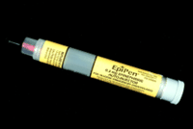
Recommendations 3: Self injectable adrenalin e.g. EpiPen
Prescribe judiciously
only for those who have previously experienced anaphylaxis
Always provide training in use of EpiPen
Parents, older children, teachers

Slide 42
Is desensitisation an option?
No, desensitisation only works for insect venom and some aero-allergens (eg grass pollen).

Slide 43
Sources of information
http://www.anaphylaxis.org.uk/
Source of child-friendly videos and books
Also parent-friendly information, advice for schools etc

Slide 44
Case study 2

Slide 45
48 year old man is admitted to ITU with meningococcal septicaemia
Goes on to develop multi-organ failure requiring ventilation and dialysis
His wife tells you he has had two previous episodes of meningococcal meningitis

Slide 46
Questions
What disorders are associated with recurrent meningococcal meningitis?
What other questions would you ask him or his family?
What immunological investigations would you request?
How would you manage him?

Slide 47
What disorders are associated with recurrent meningococcal meningitis?
Immunological
Complement deficiency
Recurrent infection with encapsulated organisms
Neisseria meningitis,
Gonococcus, H influenza B, pneumococcus
Antibody deficiency
Recurrent bacteria infections, especially of upper and lower respiratory tract
Neurological
Any disruption of blood brain barrier
Occult skull fracture
Hydrocephalus

Slide 48
What questions would you ask him or his family?
History of other infections
Past medical history
General health and wellbeing
Family history

Slide 49
History of other infections | Serious Persistent Unusual Recurrent
Past medical history
General health and wellbeing
Family history

Slide 50
History of other infections | Serious Persistent Unusual Recurrent
Past medical history | Specifically ask about neurological disease and head injury
General health and wellbeing
Family history

Slide 51
History of other infections | Serious Persistant Unusual Recurrent
Past medical history | Specifically ask about neurological disease and head injury
General health and wellbeing | Energy, weight loss, sleep, work status
Family history

Slide 52
History of other infections | Serious Persistant Unusual Recurrent
Past medical history | Specifically ask about neurological disease and head injury
General health and wellbeing | Energy, weight loss, sleep, work status
Family history | Consanguinuity History of meningitis

Slide 53
History of other infections | No episodes of significant infection apart from meninigitis & meningococcal septicaemia x 3
Past medical history | Appendectomy as child. Otherwise well.
General health and wellbeing | Good general health
Family history | Family history of meningitis in brother and maternal uncle

Slide 55
Which immunological investigations would you perform?
Complement
C3 and C4
CH50
AP50
Immunoglobulins
Serum IgG, IgA and IgM
Protein electrophoresis

Slide 56
So what’s a CH50?
Classical pathway
C1 C4 C2
Alternative
pathway
Functional test of integrity of the classical complement cascade
All components of the cascade need to be in place for the test to give a positive (normal) result
Lectin
MBL
C3
C5
C6
C7
C8
C9
Final common pathway
Membrane attack complex

Slide 57
So what’s a AP50?
Functional test of integrity of the alternative complement cascade
All components of the cascade need to be in place for the test to give a positive (normal) result
Classical
C1 C2 C4
Alternative
pathway
Lectin
MBL
Bacterial cell wall
C3
Properdin
Factor B, H, I
C5
C6
C7
C8
C9
Final common pathway
Membrane attack complex

Slide 58
Results
Normal C3 and C4
Absent CH50
Absent AP50
Indicates deficiency of component in final common pathway (C5-9)
Subsequently shown to be complete deficiency of C7

Slide 59
How would you manage this patient?
Meningovax, Pneumovax and HIB vaccines
Daily prophylactic penicillin
High level of suspicion

Slide 60
Complement deficiencies
Any deficiency of the complement pathway may be associated with recurrent meningococcal infection
Particularly alternative pathway and final common pathway deficiencies
Generally suggested that adults with sporadic meningococcal disease should be screened for complement deficiency
CH50 and AP50

Slide 61
Case study 3

Slide 62
21 year old student referred with arthralgia and rash
Facial rash
Tender joints
Hypertension 165/95
Pedal oedema

Slide 63
21 year old student referred with arthralgia and rash
FBC: Hb 9.5mg/dl Nc Nc, WCC normal, Plts 460
U&E: Normal
CRP: 1
RF: Negative
Anti-CCP antibody: Negative
ANA: 1/1280

Slide 64
Questions
What further immunological tests would you request
to help diagnosis and assess disease activity?
Are you reassured by normal urea or are there other
tests you would request?
What is the predominant effector mechanism of
disease in terms of Gel and Coombs classification?
Which drugs might be useful in management?

Slide 65
What further immunological tests would you
request to help diagnosis and assess disease activity?
ANA+ve
dsDNA+ve
ENA+ve
Cytoplasmic
SLE
t-RNA synthetase (Jo1)
SRP
Mitochondria
Ro, La, Sm, RNP
SCL70, RNA Pol, Fibrillarin
Mi2, SRP
SLE, Sjogrens
DC Scleroderma
Myositis
Myositis
Primary biliary cirrhosis
Anti-centromere antibodies are suggestive of LC Scleroderma. They are not always
detected by routine ANA staining and may need to be requested separately
This patient has dsDNA antibodies

Slide 66
What further immunological tests would you
request to help diagnosis and assess disease activity?
Classical pathway
C1 C4 C2
Alternative
pathway
MBL
Immune complexes bind to
C1q and activate classical
pathway
Complement is consumed
Low levels of C4 and C3 complement
suggest SLE is active
ESR and dsDNA titre also reflect
activity of disease
C3
Final common pathway
C5-C9
Membrane attack complex

Slide 67
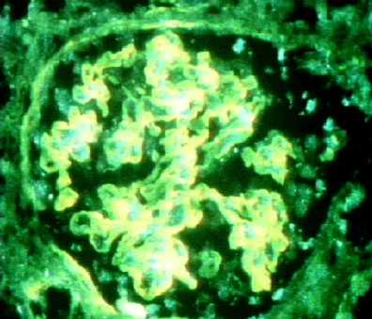
Are you reassured by the normal urea or are there
other tests you would request?
Urinalysis:
Proteinuria
Microscopic haematuria
Urine microscopy:
Red cells
Red cell casts
Renal biopsy:
Diffuse proliferative nephritis
Immune complex and complement deposition

Slide 68
What is the predominant effector mechanism of disease
in terms of the Gel and Coombs classification?
Neutrophil and
macrophage
infiltration
Complement
activation
Glomerulus
Type III response

Slide 69
Which of the following drugs might be useful in this patient?
Prednisolone | Yes | Widely used immunosuppressant
Pegylated IFN alpha | No | Effective in some inflammatory diseases eg Behcet’s
Azathioprine | Yes | Widely used anti-proliferative immunosuppresant Check TPMT status before use
Hydroxychloroquine | Yes | Alters pH and affects antigen presentation / processing. Inhibits production of some cytokines. Upregulates apoptosis.
Allopurinol | No | Xanthine oxidase inhibitor used in gout
Rituximab | Yes | Antibody to CD20 that depletes B cells
IVIG | Yes | Effective immunosuppressive agent Precise mechanisms unclear Used in SLE, DMy, Pemphigus…..
Mycophenolate Mofetil | Yes | Anti-proliferative immunosuppressant with preferential effect on lymphocytes
Adalimumab | No | Anti-TNF alpha antibody. May precipitate cutaneous lupus
Cyclophosphamide | Yes | Cytotoxic immunosuppressant
Colchicine | No | Inhibits neutrophils – used in gout, Behcets

Slide 70
Which of the following drugs might be useful in this patient?
Prednisolone | Yes | Widely used immunosuppressant
Pegylated IFN alpha | No | Effective in some inflammatory diseases eg Behcet’s
Azathioprine | Yes | Widely used anti-proliferative immunosuppresant Check TPMT status before use
Hydroxychloroquine | Yes | Alters pH and affects antigen presentation / processing. Inhibits production of some cytokines. Upregulates apoptosis / clearance.
Allopurinol | No | Xanthine oxidase inhibitor used in gout
Rituximab | Yes | Antibody to CD20 that depletes B cells
IVIG | Yes | Effective immunosuppressive agent Precise mechanisms unclear Used in SLE, DMy, Pemphigus…..
Mycophenolate Mofetil | Yes | Anti-proliferative immunosuppressant with preferential effect on lymphocytes
Adalimumab | No | Anti-TNF alpha antibody. May precipitate cutaneous lupus
Cyclophosphamide | Yes | Cytotoxic immunosuppressant
Colchicine | No | Inhibits neutrophils – used in gout, Behcets

Slide 71
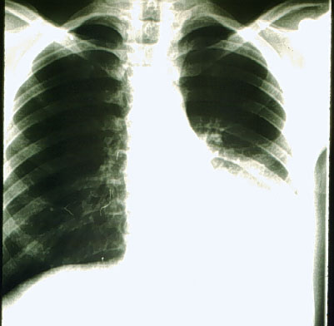
Case study 4: 35 year old male is admitted with chest pain and breathlessness

Slide 72
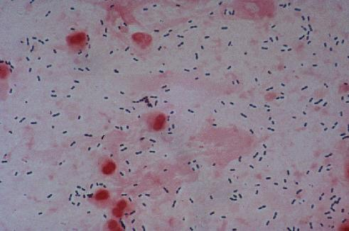
Case study 4
Streptococcus pneumoniae subsequently confirmed on sputum culture

Slide 73
Investigations
Investigation | Result
CXR | Left lower lobe pneumonia
FBC | WCC 19.5x10⁹/l, Neutrophils 92%
ESR | 45 (Normal range <10mm/hr)
CRP | 60 (Normal range <6mg/l)
Urea/electrolytes | Normal
Creatinine | Normal
LFTs | Normal
Sputum culture | S. pneumoniae, sensitive to penicillin

Slide 74
Diagnosis
Community acquired pneumonia
Treatment
Intravenous penicillin

Slide 75
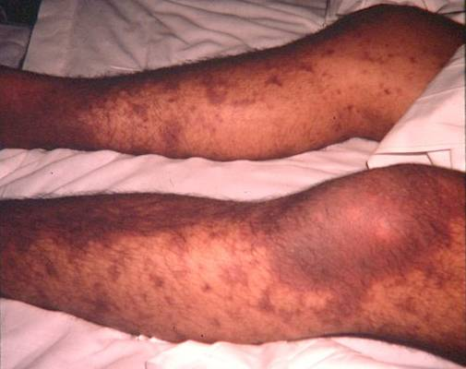
Hospital course
Initially responds well to treatment.
However 3 days after admission
Develops fever (temperature 39C)
Arthralgia of large joints
Vasculitic skin rash
Renal function starts to deteriorate
Over next 24 hours, becomes increasingly unwell and disoriented

Slide 76
Investigations: Day 4 after admission
Investigation | Result
CXR | Left lower lobe pneumonia – now resolving
FBC | WCC 15.5x10⁹/l
ESR | 65 (Normal range <10mm/hr)
CRP | 120 (Normal range <6mg/l)
Urea/electrolytes | Normal
Creatinine | 200 umol/l
LFTs | Raised ALT, AST
Sputum culture | negative
Urine microscopy | ++ blood ++ protein

Slide 77
Questions
What is the likely diagnosis?
What is the immunological mechanism of disease?
What further investigations would you do to confirm the diagnosis?
Explain the clinical manifestations of disease
How would you manage the patient?

Slide 78
Diagnosis:
Serum Sickness
B
T
B
B
B
T
Mechanism
Penicillin can bind to cell surface proteins
Acts as “neo-antigen”: stimulates very strong IgG antibody response
Individual is “sensitised” to penicillin

Slide 79
Serum sickness
IgG anti-penicillin antibodies
Subsequent exposure to penicillin stimulates
formation of immune complexes with circulating penicillin
the production of more IgG antibodies
Circulating penicillin

Slide 80
Immune complex deposition in small vessels
Complement activation
Infiltration of macrophages and neutrophils
Glomerulus

Slide 81
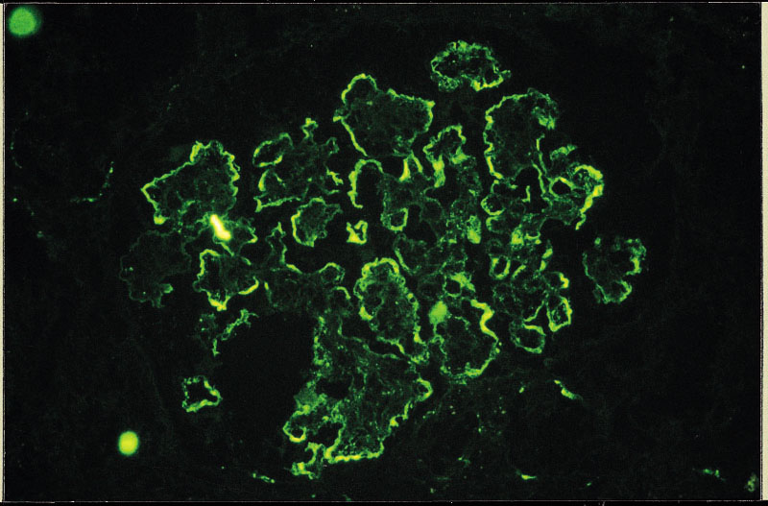
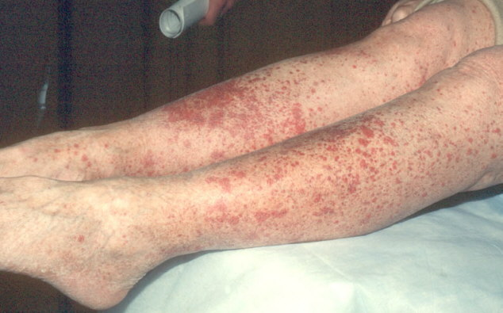
Immune complexes deposited in small vessels causing small-vessel vasculitis
Immune complex deposition in joints causes arthralgia
Deposition of IgG immune complexes in glomeruli causes renal dysfuntion
Immune complex deposition in skin causes vasculitis with local haemorrhage = purpuric

Slide 82
What further investigations would you do to confirm the diagnosis?
Low serum C3 and C4
Indicative of classical complement pathway activation
(Immune complex measurements unreliable)
Specific IgG to penicillin
Can be performed if specifically indicated, but takes time
Characteristic biopsy features (skin, kidney)
Infiltration of macrophages and neutrophils
Deposition of IgG, IgM and complement

Slide 83
What further investigations would you do to confirm the diagnosis?
Low serum C3 and C4
Indicative of classical complement pathway activation
(Immune complex measurements unreliable)
Specific IgG to penicillin
Can be performed if specifically indicated, but takes time
Characteristic biopsy features (skin, kidney)
Infiltration of macrophages and neutrophils
Deposition of IgG, IgM and complement

Slide 84
What further investigations would you do to confirm the diagnosis?
Low serum C3 and C4
Indicative of classical complement pathway activation
(Immune complex measurements unreliable)
Specific IgG to penicillin
Can be performed if specifically indicated, but takes time
Characteristic biopsy features (skin, kidney)
Infiltration of macrophages and neutrophils
Deposition of IgG, IgM and complement

Slide 85
Explain the clinical manifestations of serum sickness
Why did his renal function deteriorate?
Deposition of immune complexes causes local complement activation and neutrophil and macrophage infiltration
Results in inflammation of the glomeruli
Results in increase in serum creatinine, proteinuria and haematuria
Why did he become disorientated?
Small vessel vasculitis affecting cerebral vessels may compromise oxygen supply to the brain

Slide 86
Explain the clinical manifestations of serum sickness
Why did he develop purpura?
Inflamed blood vessels are likely to leak
results in local haemorrhage
Also become plugged with clots, further compromising oxygen delivery.

Slide 87
How would you manage the patient?
Discontinue penicillin immediately
Decrease systemic inflammation
Corticosteroids
Ensure appropriate fluid balance

Slide 88
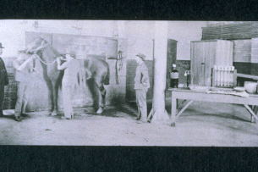
Why is this reaction called serum sickness?
Von Piquet and Schick 1905
Management of diphtheria:
Immunise horses with diphtheria toxin
Use immune horse serum to treat clinical diphtheria (passive immunisation)
Observed that repeated dosing of horse serum resulted in the classic symptoms of “serum sickness”

Slide 89
Case study 5

Slide 90
Case study 5
Jack’s mother thinks he has had too many infections for a 3 year old and wants to know why.

Slide 91
Clinical history
Presenting complaint – recurrent infections
3 year old Caucasian male
Full term, normal delivery
Normal pre and post natal screen
Not breast fed – parental choice
Normal immunisation schedule.
Weight and height dropping from 50th centile to 10th centile
First infection aged 3 months
Cellulitis of gluteal region
Responded to antibiotics

Slide 92
Infection history
Recurrent ear infections
Age 5 months otitis media, Rx oral antibiotics
4 subsequent episodes of otitis media, all responding to antibiotics,
ENT appointment pending
(12 month waiting list)
Likely to require grommets
Age 15 months hospitalised for severe tonsillitis
Tonsils removed
Recurrent chest infections
Age 8 months, 3 years, hospitalised for bronchiolitis/ pneumonia, resolved after intravenous antibiotics.
Most recently Haemophilus Influenza isolated

Slide 93
4th of 5 children, all under 10 years
2 indoor cats, one indoor dog
Both parents smoke cigarettes
Family are frequent attenders to your GP practice

Slide 94
Summary
Recurrent upper and lower respiratory tract infections with failure to thrive
Recurrent otitis media
Courses of antibiotics
12 months
2 years
3 years
Hospitalisations for pneumonia/tonsillitis
Is this normal?

Slide 95
Questions
What are the features that suggest Jack may have an immunodeficiency?
What other disorders would you consider?
How would you evaluate Jack for possible immunodeficiency?
Jack is subsequently diagnosed as having X-linked agammaglobulinaemia. What treatment would you recommend?

Slide 96
What are the features that suggest that Jack may have an immunodeficiency?

Slide 97
What are the features that suggest that Jack may have an immunodeficiency?
Severe infections | More than one hospitalisation for infection per year
Recurrent minor infections / Failure to respond to conventional antibiotics | Recurrent minor infections requiring more than one course of antibiotics
Evidence of early end-organ damage

Slide 98
What are the features that suggest that Jack may have an immunodeficiency?
Unusual organisms | Burkholderia cepacia, etc
Opportunistic organisms | Including CMV, Pneumocystis, Candida, Aspergillus etc etc Infection following live vaccines
Unusual sites of infection | Deep muscle abscesses
Concomitant problems | Failure to thrive Family history History of autoimmune dx, malignancy etc

Slide 99
What other factors can cause a 3 year old to have too many infections?

Slide 100
What other factors can cause a 3 year old to have too many infections?
Allergic rhinitis, sinusitis, asthma
Non-immunologic disorders
Cystic fibrosis
Local factors eg foreign body
Ciliary disorders
Over estimation of infections

Slide 101
Which investigations would you do?
Investigation | Result
FBC | Normal differential WCC
U&E, Creat | Normal
LFTs | Normal, with normal albumin
CRP | 25mg/dl (normal<6)
Sweat test (CF) | Normal
Chest Xray | Normal
Immunoglobulins | Very low IgG, undetectable IgA, undetectable IgM

Slide 102
Further investigations
Lymphocyte surface markers
Quantitation of B lymphocytes
Quantitation of T lymphocytes
Quantitation of CD4+ and CD8+ T cells
Examine for abnormal populations

Slide 103
Further investigations
Specific antibodies to known antigens to which he has been exposed
Antibodies to tetanus
Antibodies to HIB

Slide 104
Results of further investigations
CD4 and CD8 T cells - present
B cells – very low numbers
Specific responses to tetanus / HIB - negative

Slide 105
Cause of immunodeficiency?
T cells
Pre-T cells
Lymphoid progenitors
Plasma cells
Stem cells
IgG
Lymphoid progenitors
IgE
Pro B cells
IgM
Pre B cells
IgM B cells
IgA
IgM & IgD
Plasma cells

Slide 106
Cause of immunodeficiency?
T cells
Pre-T cells
Lymphoid progenitors
Plasma cells
Stem cells
IgG
Lymphoid progenitors
Bruton’s X linked
agammaglobulinaemia
IgE
Pro B cells
IgM
Pre B cells
IgM B cells
IgA
IgM & IgD
Plasma cells

Slide 107
Eventual diagnosis for Jack
X-linked agammaglobulinaemia
Failure of pre-B cells to mature in bone marrow
Failure to produce any immunoglobulin
Management
Immunoglobulin replacement therapy
Pooled serum immunoglobulin
Administered every 3 weeks
Indefinite treatment

Slide 108
Case study 6

Slide 109
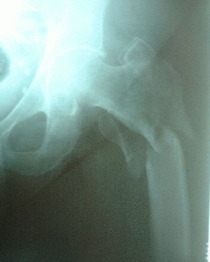
64 year old lady is seen in A&E after slipping and injuring her left hip when getting out of the bath

Slide 110
Other problems
Persistent back pain and generalised lethargy for 12 months
Three episodes of pneumococcal pneumonia in last 2 years
Post-menopausal – on HRT
Physical examination
Swollen, tender hip with marked limitation of movement
Clinically anaemic

Slide 111
Investigations
Investigation | Result
X ray pelvis | Fracture of neck of femur, through area of decreased bone density
FBC | HB 7.5mg/dl: normocytic, normochromic normal wcc and platelet count
ESR | 100
CRP | <6 (Normal range <6mg/l)
LFTs | Normal

Slide 112
What is your differential diagnosis?

Slide 113
What is your differential diagnosis?
Multiple myeloma
Osteoporosis and Sjogren’s syndrome
Osteoporosis and SLE

Slide 114
The patient is admitted to an orthopaedic ward. Further investigations:
Investigation | Result
Serum immunoglobulins | IgG 22.3g/l (NR 6.0-13.0g/l) IgA 0.7g/l (NR 1.3–3.5g/l) IgM 0.4g/l (NR 1.5-3.2g/l)

Slide 115
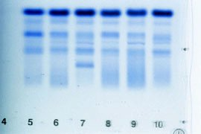
Further investigations
Investigation | Result
Serum immunoglobulins | IgG 22.3g/l (NR 6.0-13.0g/l) IgA 0.7g/l (NR 1.3–3.5g/l) IgM 0.4g/l (NR 1.5-3.2g/l)
Serum protein electrophoresis | Monoclonal band in gamma region,
Umm… what is a “monoclonal band” thing?

Slide 116
Characterising the monoclonal protein
Subsequently stained with panel of antibodies to determine heavy and light chain isotype
In this example, IgM lambda monoclonal band
(This is from different patient)

Slide 117
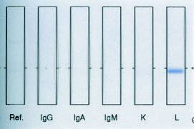
Further investigations
Investigation | Result
Serum immunoglobulins | IgG 22.3g/l (NR 6.0-13.0g/l) IgA 0.7g/l (NR 1.3–3.5g/l) IgM 0.4g/l (NR 1.5-3.2g/l)
Serum protein electrophoresis | Monoclonal band in gamma region, subsequently shown to be IgG lambda
Urine electrophoresis | Free light chains detected

Slide 118
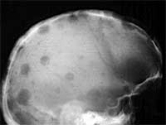
“Punched out” or lytic lesions
Lytic lesions of the skull
Pathological fracture through lytic lesion of humerus

Slide 119
Questions
What is the diagnosis?
Why is the patient susceptible to recurrent pneumonia?
Why is she anaemic?
Why is the ESR elevated if the CRP is normal?

Slide 120
What is the diagnosis?
Multiple myeloma
Definition: neoplastic proliferation of plasma cells
Results in massive expansion of single plasma cell clone
Production of excess amounts of a single immunoglobulin molecule with single specificity (usually both heavy chain and light chain)
Increased numbers of abnormal plasma cells in bone marrow
Lytic lesions of bone

Slide 121
Why is the patient susceptible to recurrent infections?
Investigation | Result
Serum immunoglobulins | IgG 22.3g/l (NR 6.0-13.0g/l) - majority is the single (useless) malignant clone IgA 0.7g/l (NR 1.3–3.5g/l) IgM 0.4g/l (NR 1.5-3.2g/l)
Suppression of production of normal immunoglobulin by the malignant clone results in functional antibody deficiency
Sometimes known as “immune paresis”

Slide 122
Why is she anaemic?
Anaemia is found in majority of patients with multiple myeloma
Mechanism:
Space limitation
Expansion of malignant clone crowds out normal red cell and white cell precursors in bone marrow
Inhibitors
Tumour may produce local cytokines which inhibit normal bone marrow function

Slide 123
Why is the ESR elevated?
ESR: measures the rate of fall of erythrocytes through plasma
Normally, erythrocytes do not clump
Repellent negative surface charge > attractant charge of plasma constituents
However, if protein constituents of plasma increase or change
Increases attractant charge
Causes erythrocytes to clump together
Clumped erythrocytes fall more quickly through plasma
higher ESR

Slide 124
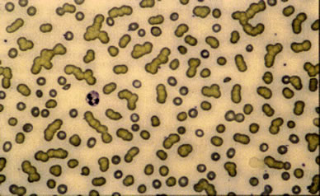
Rouleaux formation in multiple myeloma

Slide 125
Multiple Myeloma
High index of suspicion
Unusual or vertebral fractures
Initial clues
Anaemia, high ESR, high calcium
Investigations
Igs and electrophoretic strip, Urinary BJP, skeletal survey
Refer to haematologist for specialist management

Slide 126
Case study 7

Slide 127
32 year old lady
3 month history
Pain and stiffness of joints
Particularly hands
Previously entirely well
Recently given birth
Family history of gout and
rheumatoid arthritis
Smokes 20/day

Slide 128
FBC | Hb 9.5 NC NC Normal WCC Platelet count 490
ESR | 40
CRP | 18
RF | Negative
ACPA (anti-CCP) | >300
ANA | Negative
Hand X ray | Normal

Slide 129
Questions
What is the diagnosis?
Is the history of recent childbirth relevant?
What are RF and anti-CCP antibody tests and what are their approximate specificity and sensitivity for diagnosis of this condition?
Give examples of genetic polymorphisms which predispose to this condition – what do these suggest about disease pathogenesis?
Which drugs would you prescribe for this patient in the first instance?
If her disease remains active despite 6 months’ treatment which drugs would you consider using? What tests would you do before using these agents?

Slide 130
Rheumatoid arthritis
What is the diagnosis?
Peripheral, symmetrical, polyarthritis with stiffness
Persists for > 6 weeks
May be associated with RF and/or anti-CCP Ab
Post-partum presentation frequently described - possibly related to changes in Th cell profiles during/after pregnancy; Th2 cells tend to dominate during pregancy with switch back to Th1 post-partum

Slide 131
What are the RF and anti-CCP antibody tests?

Slide 132
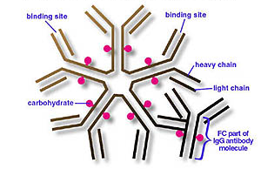
Rheumatoid arthritis
Rheumatoid factor
- Antibody directed at the Fc region of human IgG
- Assays usually look for IgM RF although patients may sometimes also have IgG and IgA RF
- Approximately 60-70% sensitive
- Approximately 60-70% specific (found in other diseases)

Slide 133
Rheumatoid arthritis
Anti-CCP antibody
- Arginine residues may be deiminated to form citrulline residues by PADI enzymes
- Polymorphisms within PADI enzymes may increase generation of citrullinated residues in patients who develop RA
- Loss of tolerance to the citrullinated residues results in production of antibodies specific for citrullinated proteins in ~60-70% individuals (sensitivity similar to RF)
- Development of anti-citrullinated peptide antibodies is associated with RA in ~95% individuals (highly specific)

Slide 134
Rheumatoid arthritis – genetic predisposition

Slide 135
Rheumatoid arthritis – genetic predisposition
Twin concordance rates for disease development
- 30% identical 5% non-identical
- suggests both genetic and environmental factors important
HLA DR
- HLA DR4 present in 60-70% patients cf 20-35% controls (caucasian)
- only specific DR4 subtypes, ie Dw4, Dw14, Dw15, are RA associated
- HLA DR1 also predisposes to RA
- Predisposing HLA class II molecules share common sequence at positions 70-74, an area predicted to lie within the alpha helix forming the wall of the peptide-binding groove
- ? Peptide presentation by disease associated HLA class II molecules may be involved in disease pathogenesis

Slide 136
Rheumatoid arthritis – genetic predisposition
PAD type 2 and4
- Peptidylarginine deiminase polymorphisms increase citrullination of proteins
- Suggests increased load of citrullinated proteins may increase likelihood of developing rheumatoid arthritis. Note the loss of B cell tolerance to citrullinated proteins in patients who develop rheumatoid arthritis
PTPN 22
- Protein tyrosine phosphatase non-receptor 22 is a lymphocyte specific tyrosine phosphatase which suppresses T cell activation.1858T allele increases susceptibility to rheumatoid arthritis, SLE, type 1 diabetes
- Suggests T cell activation is involved in pathogenesis of rheumatoid arthritis

Slide 137
Rheumatoid arthritis – approaches to treatment

Slide 138
Rheumatoid arthritis
First line treatment
- Disease modifying drugs to include methotrexate.
- Sulphasalazine, hydroxychloroquine, leflunomide also frequently used in addition or if methotrexate not tolerated.
Further treatment
- TNFalpha antagonist. Inhibits downstream events in inflammation.
- Rituximab. Antibody specific for CD20. Depletes B cells (not plasma cells).
- Abatacept. CTLA-4 – Ig fusion protein. Binds to ligands of CD28 (CD80 and CD86) and thereby inhibits T cell activation.
- Tocilizumab. Antibody specific for IL-6 receptor – widespread effects

Slide 139
Rheumatoid arthritis
Before subjecting a patient to immunosuppression ensure you have balanced the benefits vs the risks
Consider risk of infection especially prior to use of ‘biologic’ agents
- Screen for exposure to TB using CXR and TB ELISPOT
- Screen for exposure to Hepatitis B
- Screen for exposure to Hepatitis C
- Consider possibility of HIV infection
- Prior history of septic arthritis/infected joint prosthesis
- Educate patient to stop drug and seek advice if acute infection
- Consider need for vaccinations
Consider risk of malignancy
- Prior history of malignancy
- Advise re sun exposure/skin protection

Slide 140
All of these slides will be on the Intranet

