Slide 1
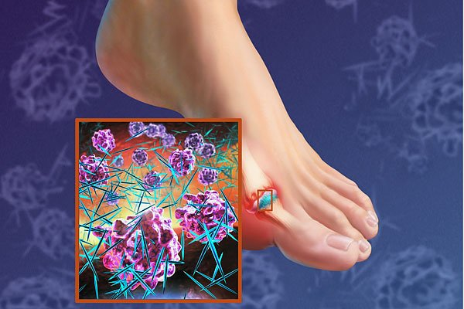
Uric acid metabolism
Yehani Wedatilake
Wellcome Trust Research Fellow & SpR Metabolic Medicine / Clinical Biochemistry

Slide 2
Crystals of what, are the cause of acute gout?
Press letter
Then press green arrow to join
You should now be connected…
ANS:
YEAR5PATH
<C>
Sugar
Pyrophosphate
Monosodium urate
Urea
Uricase
Notes:
2
2

Slide 3
Learning Outcomes
Know the basics of purine metabolism
Understand the aetiology, diagnosis and management of gout
Understand the inborn error of metabolism, Lesch-Nyhan disease

Slide 4
Concepts
Introduction
Uric acid metabolism- production /excretion
Hyperuricaemia
-causes
-effects
Gout
Hypoxanthine-guanine phosphoribosyl transferase (HGPRT) deficiency (Lesch-Nyhan syndrome)

Slide 5
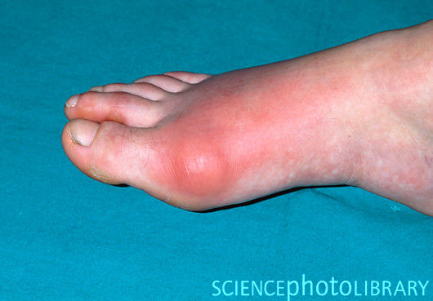
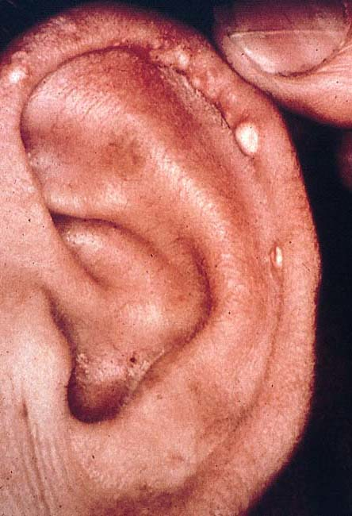
Introduction
Uric acid is the end product of purine metabolism
Hyperuricaemia is associated with gout, renal calculi, tophi (urate in soft tissues) and nephropathy

Slide 6
Concepts
Introduction
Uric acid metabolism- production /excretion
Hyperuricaemia
-causes
-effects
Gout
Hypoxanthine-guanine phosphoribosyl transferase (HGPRT) deficiency (Lesch-Nyhan syndrome)

Slide 7
Sources of Uric acid
Uric acid (urate) is the end product of purine metabolism.
Purines are from
Diet – e.g. anchovies, mackerel, liver, beer
Degradation of endogenous nucleotides
De novo synthesis

Slide 8
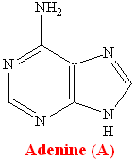
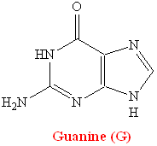
Purines are Ubiquitous Biomolecules
Adenosine, Guanosine and Inosine
Genetic code A & G
Second Messengers for hormone action eg cAMP
Energy transfer eg ATP

Slide 9
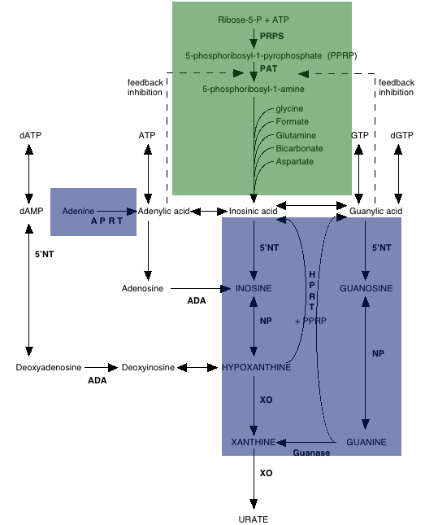

Slide 10
Purine Metabolism
Metbio.net

Slide 11
Body urate pool (and plasma concentration) depends on the relative rates of urate formation and urate excretion

Slide 12
Uric acid excretion
Urate is excreted via 2 routes
1/3: Secretion into the gut and degradation by bacterial uricase
2/3: Renal excretion
Net excretion is: 10% of filtered load

Slide 13
Renal Urate Handling
Glomerulus
Proximal
Convoluted
Tubule
Loop of
Henle
Distal
Convoluted
Tubule
Filtration
Reabsorbtion
Secretion
Collecting
Duct
Fractional Excretion of
Uric Acid (FEUA)≈10%

Slide 14
Concepts
Introduction
Uric acid metabolism- production /excretion
Hyperuricaemia
-causes
-effects
Gout
Hypoxanthine-guanine phosphoribosyl transferase (HGPRT) deficiency (Lesch-Nyhan syndrome)

Slide 15
Monosodium Urate
Plasma concentrations.
Men 0.12 – 0.42 mmol/l
Women 0.12 – 0.36 mmol/l

Slide 16
Urate in the ECF
At physiological pH, 98% of uric acid is in the ionised form of urate
Urate is largely present as monosodium urate in the ECF
When urate concentrations exceed 0.38 mmol/L, risk of monosodium urate crystal formation and precipitation increases
Human beings and higher primates do not have the enzyme uricase that degrades uric acid to the highly soluble allantoin

Slide 17
Causes of hyperuricaemia
Urate underexcretion
Primary (idiopathic) hyperuricaemia
Secondary hyperuricaemia
Reduced renal function
Inhibition of urate secretion (ketoacidosis, lactic acidosis)
Drugs
Urate overproduction
Primary hyperuricaemia
Phosphoribosyl pyrophosphate synthetase overactivity
Hypoxanthine-guanine phosphoribosyl transferase deficiency
Secondary hyperuricaemia
Excessive dietary purine intake
High nucleotide turnover (psoriasis, myeloproliferative and
lymphoproliferative diseases)
Increased adenosine triphosphate (ATP) degradation (vigorous muscle exertion)

Slide 18
Effects of hyperuricaemia
Hyperuricaemia is associated with
a tendency to form crystals of monosodium urate causing clinical gout
Renal calculi
Tophi (urate in soft tissues)
Acute urate nephropathy (due to sudden increases in urate production -widespread crystallisation in the renal tubules).

Slide 19
Concepts
Introduction
Uric acid metabolism- production /excretion
Hyperuricaemia
-causes
-effects
Gout
Hypoxanthine-guanine phosphoribosyl transferase (HGPRT) deficiency (Lesch-Nyhan syndrome)

Slide 20
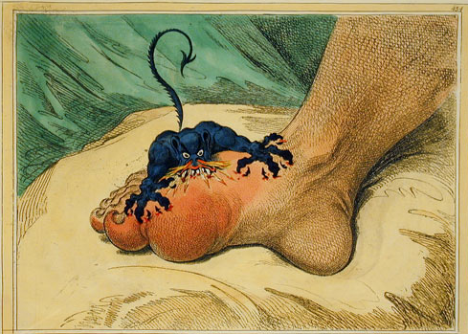
Gout
James Gilray

Slide 21
Gout
Inflammatory arthritis
Deposition of monosodium urate crystals in the cartilage, synovium and synovial fluid of joints
Can be acute (Podagra) or chronic (Tophaceous)

Slide 22
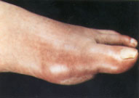
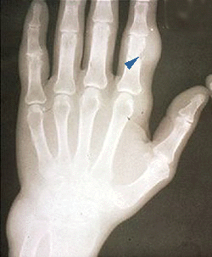
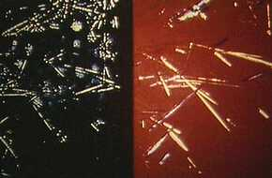
Gout
Monosodium urate crystals are pro-inflammatory

Slide 23
Gout
Gout commonly affects middle aged men
Risk factors: hyperuricaemia family history
obesity
alcohol consumption hypertension
renal impairment
drugs

Slide 24
Acute Gout
Abrupt onset
Rapid build up of pain
Exquisitely tender
Affected joint red, hot and swollen
1st MTP joint is involved in 90% overall
A third of patients have normal uric acid concentrations during an acute attack of gout

Slide 25
Management
Important to distinguish between therapy for reducing inflammation and that for managing hyperuricaemia

Slide 26
Treatment: Reducing Inflammation
Acute gout.
NSAIDs
Colchicine
Glucocorticoids
Do NOT attempt to modify plasma urate concentration

Slide 27
Managing Hyperuricaemia
Interval (non acute) gout.
Drink plenty (water!)
Reverse factors elevating urate
Urate lowering therapy is indicated for patients with recurrent gout attacks, chronic arthropathy, tophi, and gout with uric acid stones
reduce synthesis with allopurinol
increase renal excretion with probenecid: “uricosuric”

Slide 28
Drugs to lower uric acid
Water soluble
Inhibit proximal tubular urate reabsorption
Lancet. 2010 Jan 23;375(9711):318-28. E

Slide 29
Drugs which raise serum uric acid concentrations
Diuretics - a combination of volume depletion and decreased renal tubular secretion of uric acid
Tacrolimus
Ciclosporin
Cytotoxic chemotherapy
Ethanol -Alcohol increases ATP turnover. Purines in beer during fermentation process.
Salicylates (low dose) - At high doses aspirin is uricosuric, at low doses it causes uric acid retention

Slide 30
In the Treatment of gout
Allopurinol should be used acutely
NSAIDS are the first line treatment acutely
Colchicine lowers urate levels
Allopurinol lowers urate levels by inhibiting HPRT
Allopurinol lowers urate levels by inhibiting xanthine oxidase

Slide 31
Diagnosis of gout
Clinical
Tap effusion
View under polarised light

Slide 32
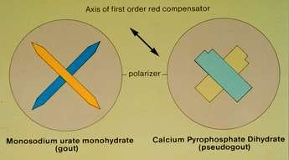

Slide 33
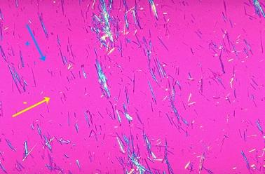
Negatively birefringent

Slide 34
Pseudogout
Occurs in patients with osteoarthritis
Pyrophosphate crystals
Self limiting 1 – 3 weeks

Slide 35
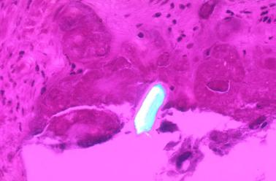
Positively birefringent

Slide 36
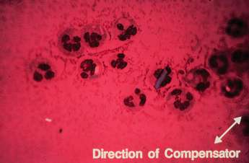
What is this ?
-vely birefringent Urate crystal
+vely birefringent Urate crystal
+vely birefringent Pyrophosphate crystal
Rheumatoid arthritis
Gonococcal arthritis

Slide 37
Calcium pyrophosphate
Now type in your CID then press the green enter key

Slide 38
Concepts
Introduction
Uric acid metabolism- production /excretion
Hyperuricaemia
-causes
-effects
Gout
Hypoxanthine-guanine phosphoribosyl transferase (HGPRT) deficiency (Lesch-Nyhan syndrome)

Slide 39
HGPRT deficiency
Complete: Lesch Nyhan syndrome.
Normal at birth
Developmental delay apparent at 6/12
Hyperuricaemia
Choreiform movements (1 year)
Spasticity, mental retardation
Self mutilation (85%) aged 1-16

Slide 40
Summary
Uric acid is an end product of purine metabolism
Purines are from diet, breakdown of nucleotides and de novo synthesis
Gout is a monosodium urate crystal arthritis
Hyperuricaemia without attacks of gout is common
During an acute attack of gout plasma uric acid can be normal
Uric acid lowering drugs should not be given during an acute attack of gout

