Slide 1
Sodium and fluid balance
Amir H Sam
Clinical Lecturer

Slide 2
Aim
To be able to manage patients with serum sodium abnormalities

Slide 3
Question 1
What is the commonest electrolyte abnormality in hospitalized patients?

Slide 4
Hyponatraemia
Serum sodium < 135 mmol/L
Commonest electrolyte abnormality in hospitalized patients.

Slide 5
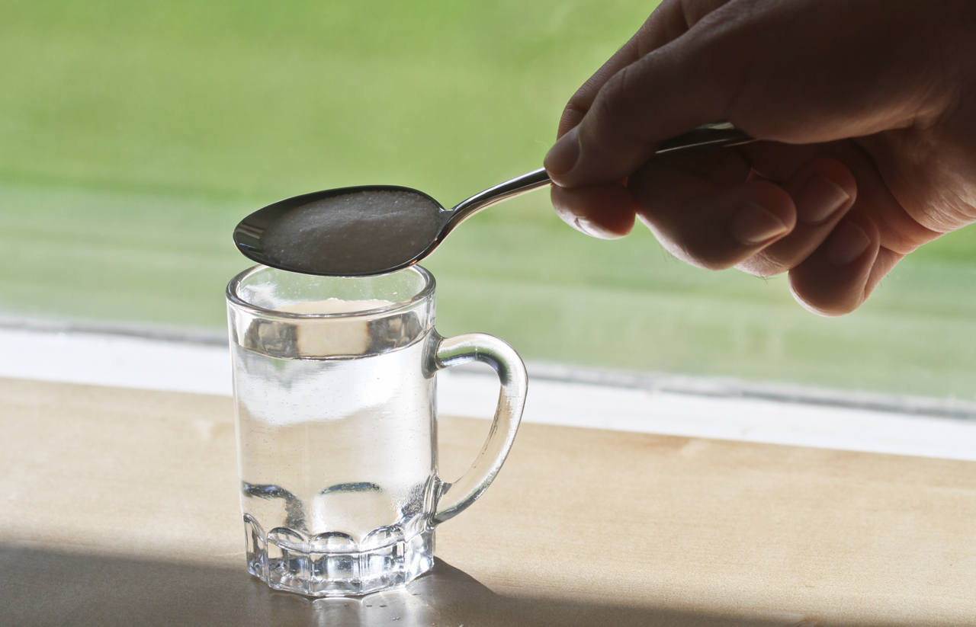
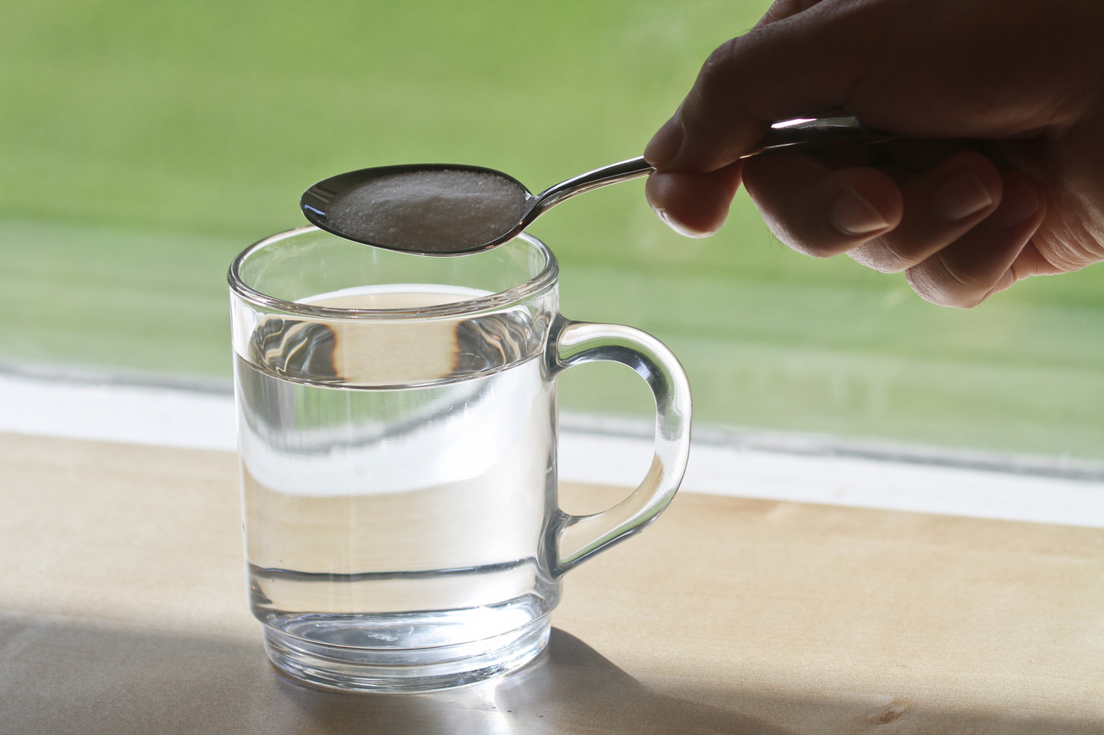
Pathogenesis of hyponatraemia

Slide 6
Question 2
What is the underlying pathogenesis of hyponatraemia?
Increased extracellular water

Slide 7
Question 3
Which hormone controls water balance?

Slide 8
Control of water balance
ADH (vasopressin)
water retention
through water channels (aquaporin-2)

Slide 9
ADH
Acts on V₂ receptors on renal tubular cells in the collecting duct.
Results in insertion of water channel proteins (aquaporin-2) into the tubular membrane.
At higher concentrations, binds to V₁ receptors on vascular smooth muscle causing vasoconstriction (hence the alternative name ‘vasopressin’).

Slide 10
Question 4
What are the two main stimuli for ADH secretion?
Serum osmolality (mediated by hypothalamic osmoreceptors).
Blood volume/pressure (mediated by baroreceptors in carotids, atria, aorta).

Slide 11
Stimuli for ADH release
Osmolality (Osmoreceptors)
Bld volume/pressure
(baroreceptors)
Thirst
ADH

Slide 12
Question 5
What is the effect of increased ADH secretion on serum sodium?
Hyponatraemia

Slide 13
Water reabsorption [Na⁺]

Slide 14
Question 6
What is the first step in the clinical assessment of a patient with hyponatraemia?
Clinical assessment of volume status

Slide 15
Hyponatraemic patient
Clinical assessment
? Hypovolaemic
?
Euvolaemic
?Hypervolaemic

Slide 16
Question 7
What are the clinical signs of hypovolaemia?
Tachycardia
Postural hypotension
Dry mucous membranes
Reduced skin turgor
Confusion/drowsiness
Reduced urine output

Slide 17
Question 8
What are the clinical signs hypervolaemia?
Raised JVP
Bibasal crackles (on chest examination)
Peripheral oedema

Slide 18
Hyponatraemic patient
Clinical assessment
? Hypovolaemia
? Euvolaemia
Diarrhoea Vomiting Diuretics Salt losing nephropathy
Hypervolaemia
Hypothyroidism Adrenal insufficiency SIADH
Cardiac failure Cirrhosis Nephrotic syndrome

Slide 19
Question 9
What are the causes of hyponatraemia in a hypovolaemic patient?
Renal cause of volume depletion e.g. diuretics
Extra-renal cause of volume depletion e.g. diarrhoea, vomiting

Slide 20
Question 10
What are the causes of hyponatraemia in a hypervolaemic patient?
Cardiac failure
Cirrhosis
Renal failure

Slide 21
Question 11
What are the causes of hyponatraemia in a euvolaemic patient?
Hypothyroidism
Adrenal insufficiency
Syndrome of inappropriate ADH (SIADH)

Slide 22
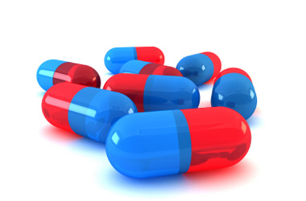
Question 12
What are the causes of Syndrome of Inappropriate ADH secretion (SIADH)?
CNS pathology
Lung pathology
Drugs (SSRI, TCA, opiates, PPIs, carbamazepine)
Tumours

Slide 23
Hyponatraemic patient
Clinical assessment
? Hypovolaemia
? Euvolaemia
Diarrhoea Vomiting Diuretics Salt losing nephropathy
Hypervolaemia
Hypothyroidism Adrenal insufficiency SIADH
Cardiac failure Cirrhosis Nephrotic syndrome
TFTs
Short Synacthen test
Plasma & urine osmolality
? Clinically hypovolaemic
? Fluid overloaded

Slide 24
Question 13
What investigations would you order in a patient with euvolaemic hyponatraemia?
? Hypothyroidism: Thyroid function tests
? Adrenal insufficiency: Short Synacthen test
? SIADH: Plasma & urine osmolality (low plasma & high urine osmolality)

Slide 25
Diagnosis of SIADH
No Hypovolaemia
No Hypothyroidism
No Adrenal insufficiency
Reduced plasma osmolality AND
Increased urine osmolality (>100)

Slide 26
Question 14
How would you manage a hypovolaemic patient with hyponatraemia?
Volume replacement with 0.9% saline

Slide 27
Question 15
How would you manage a hypervolaemic patient with hyponatraemia?
Fluid restriction
Treat the underlying cause

Slide 28
Question 16
How would you manage a euvolaemic patient with hyponatraemia?
Fluid restriction
Treat the underlying cause

Slide 29
Severe hyponatraemia
Reduced GCS
Seizures
Seek expert help (Treat with Hypertonic 3% saline)

Slide 30
Question 17
What is the most important point to remember while correcting hyponatraemia?
Serum Na must NOT be corrected > 12 mmol/L in the first 24 hours
Risk of osmotic demyelination (cebtral pontine myelionlysis)
quadriplegia, pseudobulbar palsy, seizures, coma, death

Slide 31
Central pontine myelionlysis

Slide 32
Drugs used to treat SIADH
If water restriction is insufficient
Demeclocycline
Reduces responsiveness of collecting tubule cells to ADH
Monitor U&Es (risk of nephrotoxicity)
Tolvaptan
V₂ receptor antagonist

Slide 33
Do you remember the main points (1)?
Hyponatraemia is mostly due to
Reduced body sodium
Increased extracellular water

Slide 34
Do you remember the main points (2)?
What are the two main stimuli for ADH secretion?
Reduced bld volume & reduced serum osmolality
Increased bld volume & increased serum osmolality
Increased bld volume & reduced serum osmolality
Reduced bld volume & increased serum osmolality

Slide 35
Do you remember the main points (3)?
What is the first step in the clinical assessment of a patient with hyponatraemia?
Measure plasma & urine osmolality
Measure plasma & urine sodium
Clinical assessment of volume status

Slide 36
Do you remember the main points (4)?
Which of the following is consistent with SIADH?
Reduced plasma osmolality & urine osmolality
Reduced plasma osmolality & increased urine osmolality

Slide 37
Hypernatraemia
Serum [Na⁺] > 145 mmol/L

Slide 38
Question 18
What are the main causes of hypernatraemia?
Ureplaced water loss
Gastrointestinal losses, sweat losses
Renal losses: osmotic diuresis, reduced ADH release/action (Diabetes insipidus)
Patient cannot control water intake e.g. children, elderly

Slide 39
Question 19
What investigations would you order in a patient with suspected diabetes insipidus?
Serum glucose (exclude diabetes mellitus)
Serum potassium (exclude hypokalaemia)
Serum calcium (exclude hypercalcaemia)
Plasma & urine osmolality
Water deprivation test

Slide 40
Question 20
How would you treat hypernatraemia?
Fluid replacement
Treat the underlying cause

Slide 41
Clinical example
A 70-year-old woman presents with a 3-day history of diarrhoea. She has altered mental status & dry mucous membranes. Her serum Na⁺ is 168 mmol/L.
Need to correct both electrolyte & water deficits
0.9% saline through one IV line and 5% dextrose through a second IV line

Slide 42
Estimate water deficit
TBW x (serum Na⁺ - 1)
140
(0.4 x 60) x (168/140 -1) = 4.8 L
(TBW: 40% lean body weight in hypernatraemic women & 50% lean body weight in hypernatraemic men)

Slide 43
Calculate rate of correction
Rate of correction: 10 mmol in 24 hours
In her case 28 mmol (168-140) needs to be corrected over 67.2 hours
(28 x 24 /10 = 67.2)
We needs to give 4.8 L (4800 ml) over 67.2 hours
(4800/67.2 = 71 ml per hour)
Add in obligatory water losses from stool and skin (about 40 mL/hour)
71 + 40 = 111 mL/hour.
Measure the serum sodium every 4-6 hours for at least the first 12 to 24 hours.

Slide 44
Question 21
What are the effects of diabetes mellitus on serum sodium?
Variable
Hyperglycaemia draws water out of the cells leading to hyponatraemia
Osmotic diuresis in uncontrolled diabetes leads to loss of water and hypernatraemia

Slide 45
Summary
Hyponatraemia is common
Most cases are due to increased ADH
Assess the volume status first
Treat the underlying cause

Slide 46
Questions?

