Slide 1
Potassium handling
Amir H Sam
Clinical Lecturer

Slide 2
Learning objectives
To describe the hormones involved in the renal regulation of potassium
To discuss the underlying pathophysiology and main causes of hyper and hypokalaemia
To outline the main points in the management of hyper and hypokalaemia

Slide 3
Potassium
Potassium is the most abundant intracellular cation.
Serum concentration: 3.5-5.0 mmol/L

Slide 4
Question 1
Which hormones are involved in renal regulation of potassium?
Angiotensin II
Aldosterone

Slide 5
Renin-angiotensin-aldosterone system
Angiotensinogen
(from liver)
Angiotensin I
Converting
enzyme
(lung)
Angiotensin II
Renin (from JGA)
Lung
Angiotensin II
Aldosterone
Na⁺
K⁺
Na⁺ and H₂O retention
Increased blood volume/pressure
Adrenal

Slide 6
Renin-angiotensin-aldosterone system
Angiotensinogen
(from liver)
Angiotensin I
Renin (from JGA)
Converting
enzyme
(lung)
Angiotensin II
Lung
K⁺
Angiotensin II
Aldosterone
Na⁺
K⁺
Na⁺ and H₂O retention
Increased blood volume/pressure
Adrenal

Slide 7
Aldosterone & potassium secretion
Aldosterone
Lumen +
Na+
Na+
K+
K+
Principal cells
(cortical collecting tubule)

Slide 8
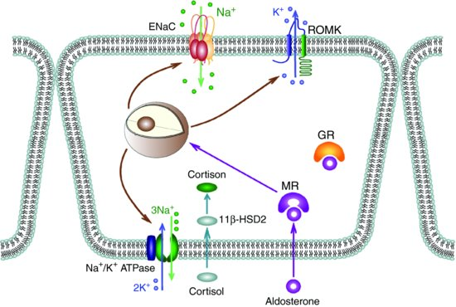
Lumen
-ve
Notes:
Na reabsorption through ENaC (epithelial sodium channels) leads to tubular lumen negative electrical potential, driving potassium secretion

Slide 9
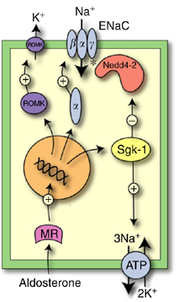
Kidney International (2007) 72, 762–768

Slide 10
Aldosterone & Potassium secretion
Aldosterone number of open Na⁺ channels in the luminal membrane
Sodium reabsorption
makes the lumen electronegative & creates an electrical gradient
Potassium is secreted into the lumen

Slide 11
Question 2
What are the stimuli for aldosterone secretion?
Angiotensin II
Potassium

Slide 12
Question 3
What are the main causes of hyperkalaemia?

Slide 13
Angiotensinogen
(from liver)
Angiotensin I
Renin (from JGA)
Converting
enzyme
(lung)
Angiotensin II
1. GFR
Lung
Angiotensin II
Aldosterone
Na⁺
K⁺
Adrenal

Slide 14
Angiotensinogen
(from liver)
Angiotensin I
Renin (from JGA)
Converting
enzyme
(lung)
2. Renin
Type 4 renal tubular acidosis (diabetic nephropathy)
NSAIDs
Angiotensin II
Lung
Angiotensin II
Aldosterone
Na⁺
K⁺
Adrenal

Slide 15
3. ACE inhibitor
Angiotensinogen
(from liver)
Angiotensin I
Renin (from JGA)
Converting
enzyme
(lung)
Angiotensin II
Lung
Angiotensin II
Aldosterone
Na⁺
K⁺
Adrenal

Slide 16
Angiotensinogen
(from liver)
Angiotensin I
Renin (from JGA)
Converting
enzyme
(lung)
Angiotensin II
Lung
Angiotensin II
4. Ag II receptor
blocker
Aldosterone
Na⁺
K⁺
Adrenal

Slide 17
Angiotensinogen
(from liver)
Angiotensin I
Renin (from JGA)
Converting
enzyme
(lung)
Angiotensin II
Lung
Angiotensin II
Aldosterone
Na⁺
K⁺
5. Addison’s disease
Adrenal

Slide 18
Angiotensinogen
(from liver)
Angiotensin I
Renin (from JGA)
Converting
enzyme
(lung)
Angiotensin II
Lung
Angiotensin II
Aldosterone
Na⁺
K⁺
6. Aldosterone antagonists
Adrenal

Slide 19
Potassium release from cells
Rhabdomyolysis
Acidosis
K⁺
H⁺
K⁺
Need to maintain electroneutrality

Slide 20
Question 3
What are the main causes of hyperkalaemia?
Renal impairment: reduced renal excretion
Drugs: ACE inhibitors, ARBs, spironolactone
Low Aldosterone
Addison’s disease
Type 4 renal tubular acidosis (low renin, low aldosterone)
Release from cells: rhabdomyloysis, acidosis

Slide 21
Question 4
What is the main the ECG change associated with hyperkalaemia?
Peaked T waves

Slide 22
Question 5
How would you manage a patient with hyperkalaemia?
10 ml 10% calcium gluconate
50 ml 50% dextrose + 10 units of insulin
Nebulized salbutamol
Treat the underlying cause

Slide 23
Question 6
What are the causes of hypokalaemia?
GI loss
Renal loss
Redistribution into the cells

Slide 24
Understanding renal potassium loss
Cortex
Na⁺ Cl⁻
Medulla
Na⁺
K⁺
Cl⁻

Slide 25
Understanding renal potassium loss
Na⁺ Cl⁻
Na⁺ delivery to distal nephron
Cortex
Medulla
Na⁺
K⁺
Cl⁻
Loop diuretics
Bartter syndrome

Slide 26
Understanding renal potassium loss
Na⁺ Cl⁻
Na⁺ delivery to distal nephron
Cortex
Thiazide diuretics
Gitelman syndrome
Medulla
Na⁺
K⁺
Cl⁻

Slide 27
Understanding renal potassium loss
Na+
Na+
K+
K+
Principal cells
(cortical collecting tubule)

Slide 28
Understanding renal potassium loss
Aldosterone
+
Na+
Na+
K+
K+
Principal cells
(cortical collecting tubule)

Slide 29
Causes of hypokalaemia
GI loss
Renal loss
Hyperaldosteronism, (Excess cortisol)
Increased sodium delivery to distal nephron
Osmotic diuresis
Redistribution into the cells
Insulin, beta-agonists, alkalosis
Rare causes: Renal tubular acidosis type 1& 2, hypomagnesaemia

Slide 30
Question 7
What are the clinical features hypokalaemia?
Muscle Weakness
Cardiac arrhythmia
Polyuria & polydipsia (nephrogenic DI)

Slide 31
Question 8
What screening test would you order in a patient with hypokalaemia and hypertension?
Aldosterone: Renin ratio

Slide 32
Question 9
How would you manage a patient with hypokalaemia?
Serum potassium 3.0-3.5 mmol/L
Oral potassium chloride (two SandoK tablets tds for 48 hrs
Recheck serum potassium
Serum potassium < 3.0 mmol/L
IV potassium chloride
Maximum rate 10 mmol per hour
Rates > 20 mmol per hour are highly irritating to peripheral veins
Treat the underlying cause e.g. spironolactone

Slide 33
Quiz (1)
Hyperkalaemia is a side-effect of which of the following drugs?
Furosemide
Bendroflumethiazide
Salbutamol
Ramipril

Slide 34
Quiz (2)
Hypokalaemia is a side-effect of which of the following drugs?
Spironolactone
Indomethacin
Perindopril
Furosemide

Slide 35
Questions

