Slide 1
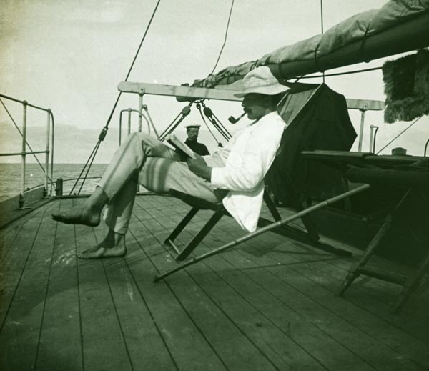
Collect week 4 handout now What are you wearing on Friday?
A smart suit
Bare below the elbows and no tie
My Birthday suit
Tropical gear
Black tie
Tropical gear 1902
Press C
Then press green arrow to join
You should now be connected…
ANS:
YEAR5 PATH:

Slide 2
Portal triads contain branches of the hepatic artery, the hepatic portal vein and a bile duct
Press C
Then press green arrow to join
You should now be connected…
ANS:
YEAR5 PATH:
T TRUE
F FALSE
TRUE FALSE
Notes:
2

Slide 3
Before we start
Remember to wear tropical dress on Friday
Bring your clicker for the mock exam in the afternoon at 2.30pm !

Slide 4
SOLE
Please also start SOLE for week 4 immediately after the test.
It will go off line early next week, and we will go through the data carefully to improve the next course and do what we can between now and the exam to help you.

Slide 5
Final webCT mock exams
Please do it the them asap, so that both are complete before you do the formative on Friday.
They will go offline, but will return later and will be available on line all year for revision purposes.

Slide 6
webCT quizzes
Mock exam 1:
Do it by MON night
Mock exam 2:
Do it by THU night
They will both go offline.

Slide 7
Formative exam
Friday
2.30 pm.
After Tropical morning
Bring your clicker.
There will one question per minute…

Slide 8
Before we start: EMQs
We have 145 so far. (thanks)
Could the rest of you please submit one urgently.

Slide 9
Mock exam 2.30pm, 27 July
After the exam, you can exchange the clicker for your cheque, which will be available.

Slide 10
Liver disease
CPC
Pathology: Y5: 23 July
Karim Meeran and Gemma Petts

Slide 11
Medical Student: Y2
Aged 20
Referred by Medical school because of abnormal LFTs.
Seen sign on notice board offering £1500 for a weekend measuring gastric acidity.
Need NG tube for 24 hours and take new trial drugs (already used in others)

Slide 12
Medical Student: Y2
Never took part.
Screening blood tests showed abnormal LFTs.
Bilirubin 32 micromol/l (5-17)

Slide 13
Medical Student: Y2
Never took part.
Screening blood tests showed abnormal LFTs.
Bilirubin 32 (5-17)
Causes ? (Q1): List as many as you can.

Slide 14
Medical Student: Y2
Never took part.
Screening blood tests showed abnormal LFTs.
Bilirubin 32 (5-17)
GGT, ALT, Alk Phos, AST normal.
Never drunk a drop of EtOH
PMH: None
FH: cousin had had 1 episode jaundice.

Slide 15
FH
FH: cousin had had 1 episode jaundice.
Investigated at another teaching hospital
Liver biopsy.

Slide 16
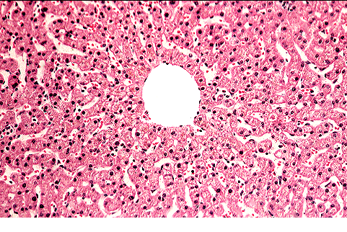

Slide 17
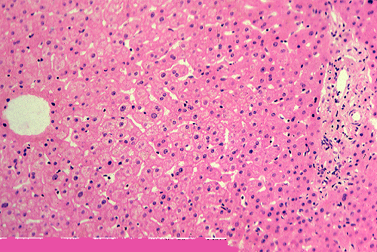
Central
Vein
Portal
Triad

Slide 18
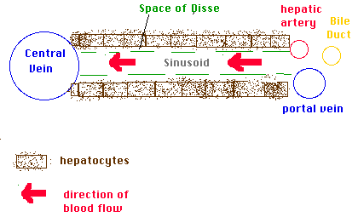

Slide 19
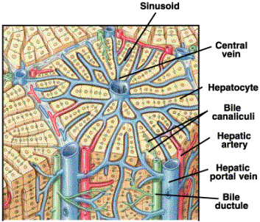

Slide 20
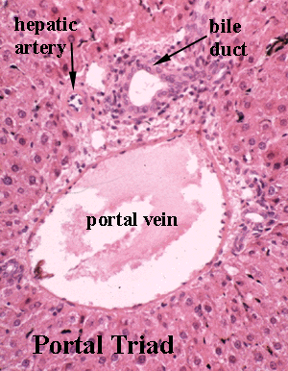

Slide 21
Medical Student: Y2
Plan:
A. Do nothing
B. Repeat bilirubin fasting.
C. Other blood tests (? Which)
D. Ultrasound abdo
E. CT abdo
F. Liver biopsy

Slide 22
Causes of high Bili ?
1. (pre hepatic) (unconjugated)
Haemolysis
(FBC + film)
2. Hepatic disease
Repeat LFTs
3. Post hepatic:
(obstructive jaundice).

Slide 23
Causes of high Bili ?
The van den Bergh reaction measures serum bilirubin via fractionation. A direct reaction measures conjugated bilirubin. The addition of methanol causes a complete reaction, which measures total bilirubin (conjugated plus unconjugated); the difference measures unconjugated bilirubin (an indirect reaction).

Slide 24
Van den Bergh
A direct reaction measures conjugated bilirubin. The addition of methanol causes a complete reaction, which measures total bilirubin (conjugated plus unconjugated); the difference
(indirect reaction) unconjugated bilirubin

Slide 25
Repeat bloods (fast)
1. Hb 14.7 WC 5.0 plat 250
Film normal
2. Bili: 45
Repeat LFTs otherwise normal.
3. Post hepatic:
(obstructive jaundice): normal alk phos

Slide 26
3. Name the condition

Slide 27
Gilberts
Common (I have it)
How inherited ? (Q4)
A. Recessive
B. Dominant
C. X- linked
D. No idea

Slide 28
Gilberts Q5
Common (I have it)
How inherited ?
Recessive
What percentage of us carry the gene?

Slide 29
Gilberts
Common (I have it)
How inherited ?
Recessive
50% carry gene

Slide 30
Gilberts Genetics Q6
Recessive inheritance
50% of us carry the gene
What will the population prevalence (as a percentage (%) of the full syndrome be given that half of us carry the gene?

Slide 31
Gilberts Genetics
Recessive inheritance
50% of us carry the gene
Probability of both partners being carriers is thus …..

Slide 32
Gilberts Genetics
Recessive inheritance
50% of us carry the gene
Probability of both partners being carriers is thus 25%.
Mum
carrier
Dad
carrier

Slide 33
Gilberts Genetics
Recessive inheritance
50% of us carry the gene
Probability of both partners being carriers is thus 25%.
Mum
carrier
Dad
carrier
6%

Slide 34
Gilberts
5-6% of the population have the disease
1 in 20
(15 in 300)

Slide 35
Gilberts
My cousin did indeed have liver biopsy
Should not have happened.
Worsened by fasting
Effects of phenobarb : reduces levels

Slide 36
Gilberts
UDP glucuronyl transferase activity reduced to 30%
Unconjugated bilirubin tightly albumin bound and does NOT enter urine.
(see Dr. Hoare’s handout)

Slide 37
Liver enzymes vs LFTs
Function of liver is measured by:

Slide 38
Liver function Q7
Which is the most representative of liver function?
A. Prothrombin time
B. Bilirubin
C. Alanine Amino Transferase (ALT)
D. Aspartate Amino Transferase (AST)
E. Alkaline phosphatase
F. Gamma GT

Slide 39
Liver enzymes vs LFTs
Function of liver is measured by:
Albumin
Clotting factors (PT, PTTK)
Bilirubin
Other tests are “enzymes”, not truly tests of liver function.

Slide 40
Case: 2
Aged 35
Chronic alcohol intake
Often appeared drunk to A + E
Nausea, abdo pain and jaundice.
LFTs abnormal: Bilirubin 90

Slide 41
Q8: Differential Dx
Write it down now…

Slide 42
Q8: Differential Dx
Pre hepatic
Hepatic
Post hepatic

Slide 43
Q8: Differential Dx
Pre hepatic (Gilberts, haemolysis)
Viral hepatitis
Alcoholic hepatitis
Cirrhosis
Post hepatic: Gallstones, pancreatic ca.

Slide 44
Case: 2
Aged 35
Chronic alcohol intake
Often appeared drunk to A + E
Nausea, abdo pain and jaundice.
LFTs abnormal: Bilirubin 90
Alk Phos 200 (NR <130)
AST 1500 (<50); ALT 750 (<50)

Slide 45
Q9: What is suggested?
LFTs abnormal: Bilirubin 90
Alk Phos 200
AST 1500; ALT 750
Pre-hepatic
Hepatic
Post hepatic

Slide 46
Q9: What is excluded?
LFTs abnormal: Bilirubin 90
Alk Phos 200
AST 1500; ALT 750
AST and ALT very high
Suggest hepatocyte damage
Alk Phos marginal:
Excludes obstructive jaundice.

Slide 47
Differential Dx
Pre hepatic (Gilberts, haemolysis)
Viral hepatitis
Alcoholic hepatitis
Cirrhosis
Post hepatic: Gallstones, pancreatic ca.

Slide 48
Hepatitis
Viral: check viral titres.
Autoimmune ?
Alcoholic ?

Slide 49
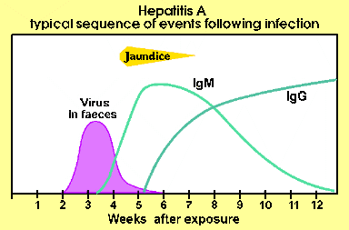
Hepatitis A serology

Slide 50
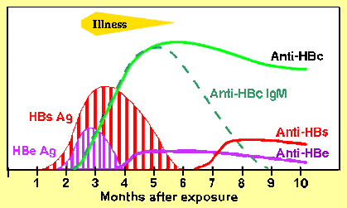
Hepatitis B serology

Slide 51
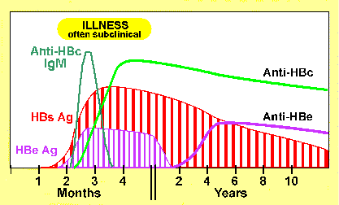
Hepatitis B carrier

Slide 52
Liver Biopsy:
GP

Slide 53
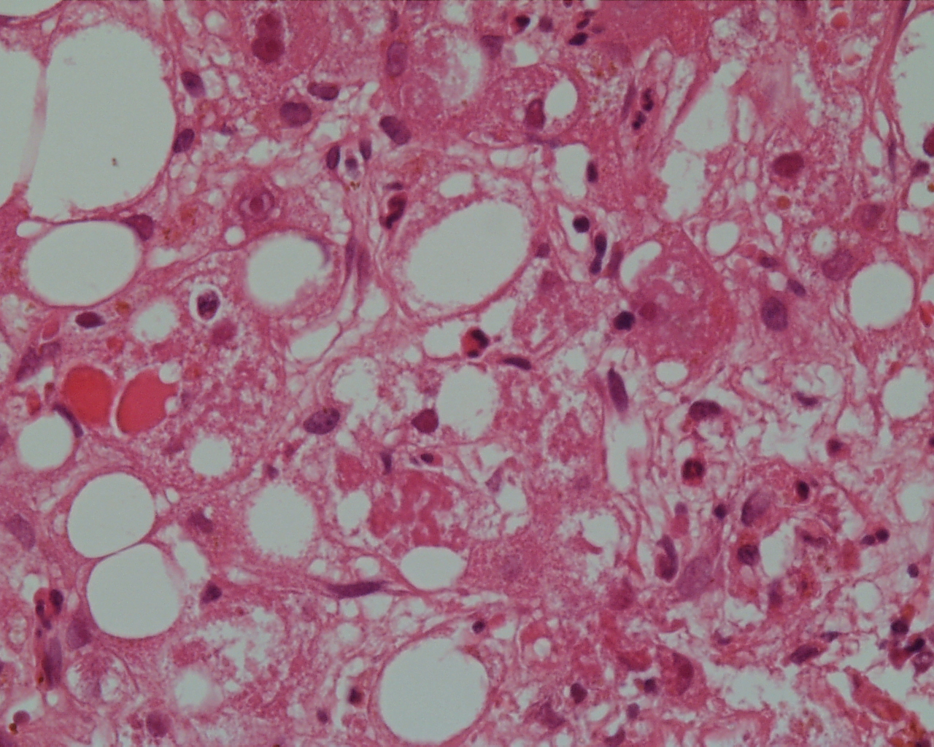

Slide 54
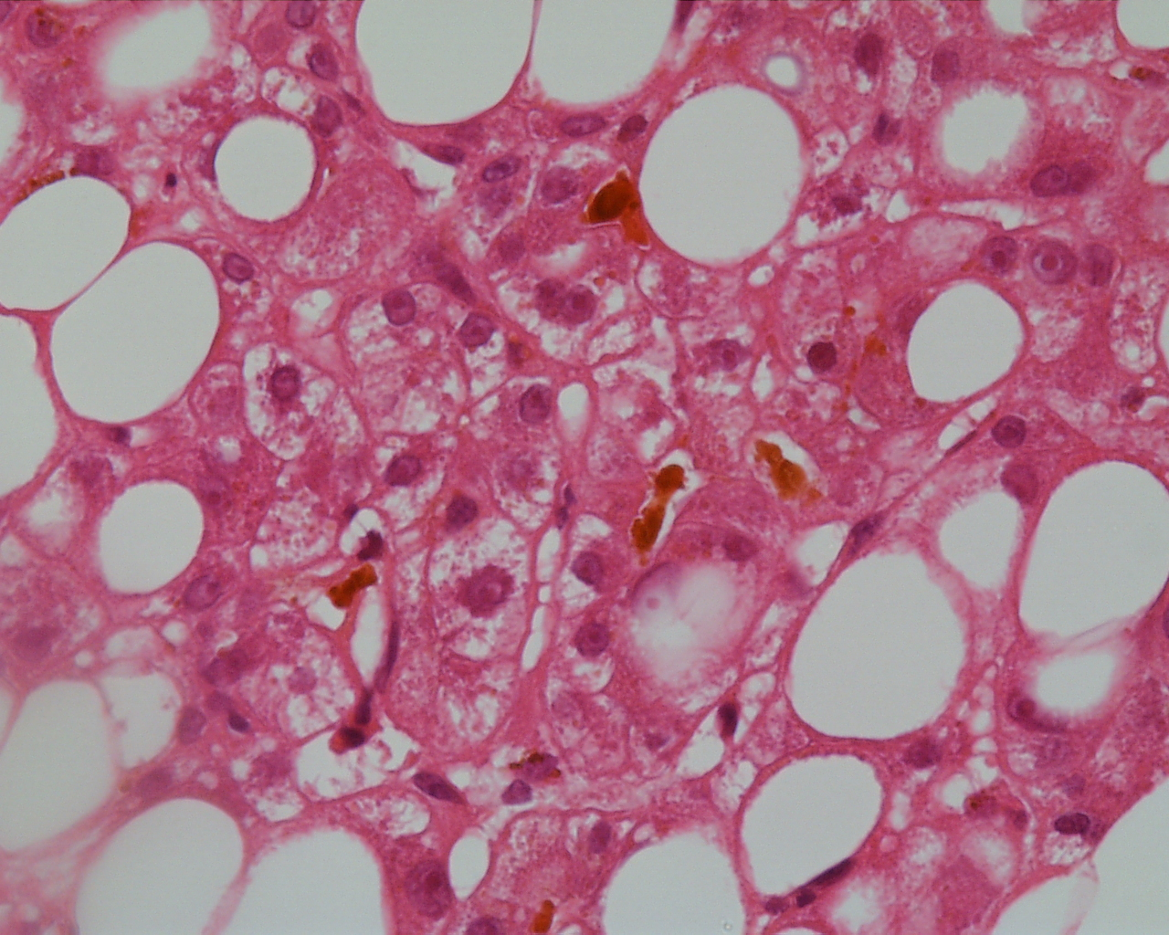

Slide 55
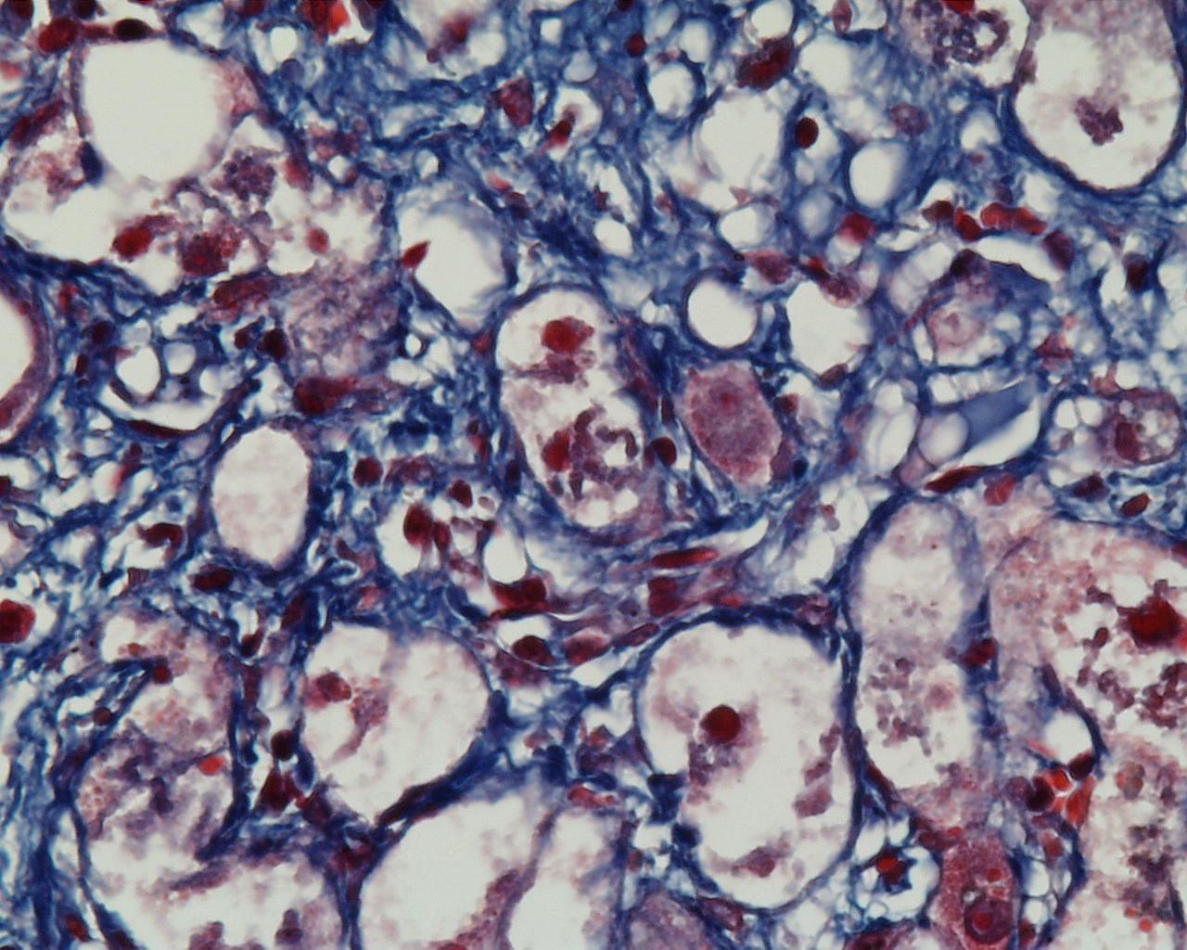

Slide 56
Alcoholic hepatitis
defining histological features:
liver cell damage
inflammation
fibrosis
associated histological features:
fatty change
megamitochondria

Slide 57
Alcoholic hepatitis
differential diagnosis:
= NASH (Non Alcoholic Steato Hepatitis).

Slide 58
What treatment is needed?
Q10: write it down

Slide 59
What treatment is needed?
Supportive.
Stop alcohol.
Nutrition:
Vitamins (esp B1, thiamine)
Occasionally steroids.

Slide 60
Q11: Which is caused by B1 deficiency?
Rickets
Scurvy
Pernicious aneamia
Beri-Beri
Pellagra
Neural tube defects

Slide 61
Two years later
Recovered, not jaundiced.
Stable
Trying to cut down on alcohol
Admitted for detox

Slide 62
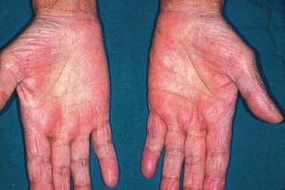

Slide 63
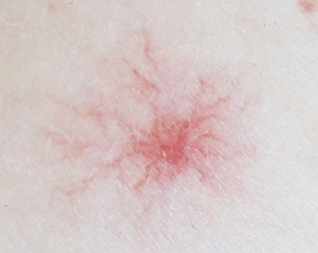

Slide 64
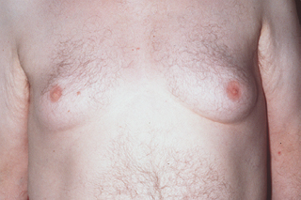

Slide 65
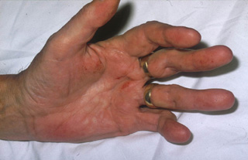
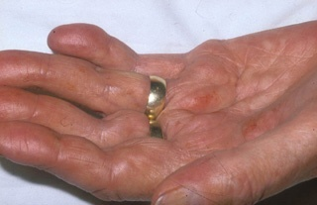

Slide 66
Two years later: OE
Multiple spider naevi
Dupuytren’s contracture
Palmar erythema
Gynaecomastia
What do these signify?

Slide 67
Q13: Two years later: OE
Multiple spider naevi
Dupuytren’s contracture
Palmar erythema
Gynaecomastia
What do these signify?
A. Jaundice
B. Hepatitis
C. Chronic stable liver disease
D. Portal hypertension.
E. Liver failure
F. Obstruction of the bile ducts.

Slide 68
Two years later: OE
Multiple spider naevi
Dupuytren’s contracture
Palmar erythema
Gynaecomastia
What do these signify?
Signs of chronic stable liver disease

Slide 69
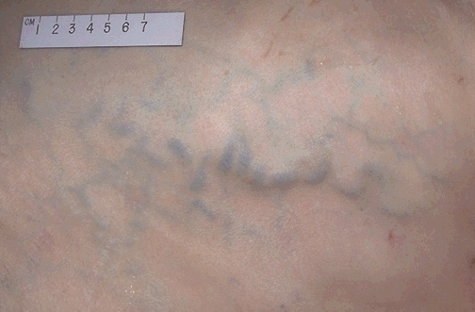
Five years later
Q14:What is this, and what causes it?
This is a visible vein on the anterior abdominal wall.
It occurs because of pressure in the umbilical vein

Slide 70
Five years later
What else are you MOST likely to find on careful abdominal examination, given the visible vein on the anterior abdominal wall?
A. Hepatomegaly
B. Splenomegaly
C. Bilateral palpable kidneys
D. A palpable bladder
E. An enlarged prostate gland on PR.

Slide 71
Five years later
Stable for 5 years but then notices abdominal distension
Examination reveals scrotal oedema and shifting dullness.
What has happened?
Answer 16: he has developed ascites.

Slide 72
Q17:Five years later
Visible veins
Splenomegaly
Ascites (shifting dullness.)
What has happened?
A. Jaundice
B. Hepatitis
C. Chronic stable liver disease
D. Portal hypertension.
E. Liver failure
F. Obstruction of the bile ducts

Slide 73
Portal hypertension
Caused by cirrhosis
Clinical signs:

Slide 75
Portal hypertension
Caused by cirrhosis
17b. Clinical signs:

Slide 76
Portal hypertension
Caused by cirrhosis
17b. Clinical signs:
Visible veins
Splenomegaly
Ascites

Slide 77
18. Now what?
Admitted to drain ascites, but developed encephalopathy shortly afterwards.
A. Jaundice
B. Hepatitis
C. Chronic stable liver disease
D. Portal hypertension.
E. Liver failure
F. Obstruction of the bile ducts

Slide 78
Liver failure
Failed synthetic function
Failed clotting factor and albumin
Failed clearance of bilirubin
Failed clearance of ammonia
(encephalopathy)

Slide 79
PM
GP

Slide 80
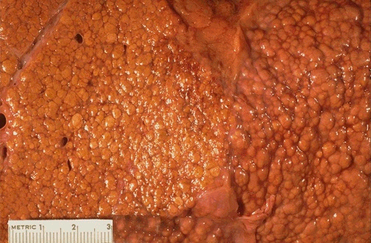

Slide 81
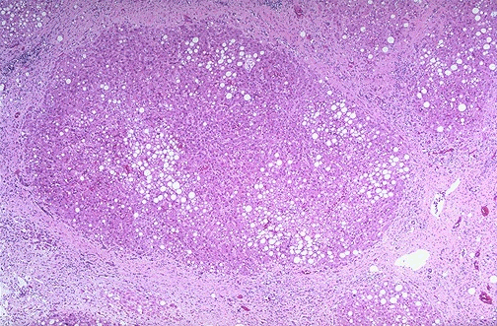

Slide 83
PM2
Alcoholic cirrhosis

Slide 84
Summary of EtOH
Alcoholic hepatitis
Chronic stable liver disease
Resultant portal hypertension
Liver failure (flap)

Slide 85
Porto systemic anastomoses
List the possible sites

Slide 86
19: Porto systemic anastomoses
List the possible sites
Oesophageal varices
Rectal varices
Umbilical vein recanalising
Spleno-renal shunt

Slide 87
Case 3:
71 year old man presents with jaundice
No previous history at all
Weight loss

Slide 88
Examination
Severely jaundiced
Cachectic
Palpable gall bladder
Multiple scratch marks on skin
What do scratch marks suggest?

Slide 89
Q20: Examination
Q20: What do scratch marks suggest?
A. Jaundice
B. Hepatitis
C. Chronic stable liver disease
D. Portal hypertension.
E. Liver failure
F. Obstruction of the bile ducts

Slide 90
Differential Dx
Pre hepatic (Gilberts, haemolysis)
Viral hepatitis
Alcoholic hepatitis
Cirrhosis
Post hepatic: Gallstones, pancreatic ca.

Slide 91
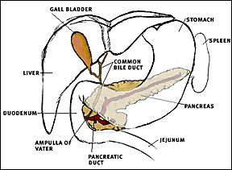
.

Slide 92
Investigations
Bilirubin 340
Alk Phos: 1750
AST 50 ALT 45

Slide 93
Q21: Investigations
Bilirubin 340
Alk Phos: 1750
AST 50 ALT 45
What do these results suggest?
A. Jaundice
B. Hepatitis
C. Chronic stable liver disease
D. Portal hypertension.
E. Liver failure
F. Obstruction of the bile ducts

Slide 94
Q22.Obstructive jaundice
What causes the itching?
A. Bilirubin
B. Urobilinogen
C. Bile salts
D. Bile acids
E. Stercobilinogen.

Slide 95
Obstructive jaundice
What causes the itching?
A. Bilirubin
B. Urobilinogen
C. Bile salts
D. Bile acids
E. Stercobilinogen.

Slide 96
23: Ultrasound guided liver biopsy
What does this suggest?
A. Primary hepatocellular carcinoma
B. Metastasis from a pancreatic carcinoma.
C. Metastasis from a sarcoma
D. Metastasis from a malignant melanoma
E. Metastasis from a colonic carcinoma
Histology on next slide.

Slide 97
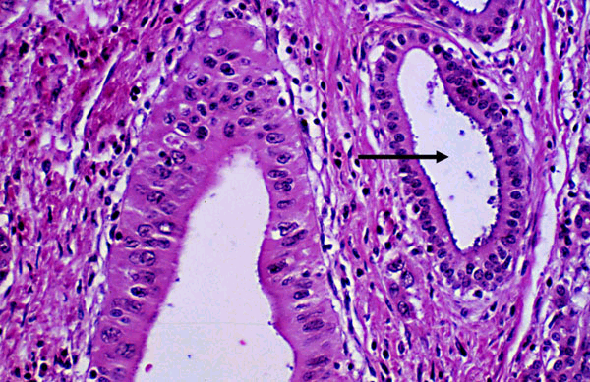

Slide 98
23a: Ultrasound guided liver biopsy
What does this suggest?
A. Primary hepatocellular carcinoma
B. Metastasis from a pancreatic carcinoma.
C. Metastasis from a sarcoma
D. Metastasis from a malignant melanoma
E. Metastasis from a colonic carcinoma

Slide 99
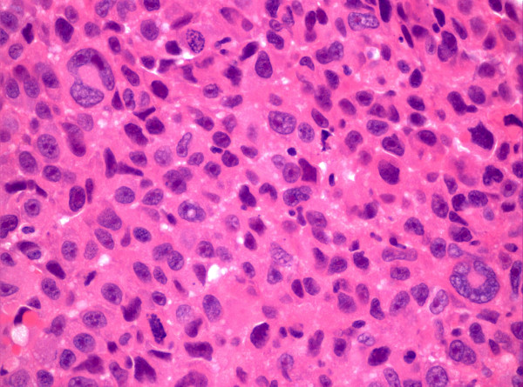
23b: Ultrasound guided liver biopsy
What does this suggest?
A. Primary hepatocellular carcinoma
B. Metastasis from a pancreatic carcinoma.
C. Metastasis from a sarcoma
D. Metastasis from a malignant melanoma
E. Metastasis from a colonic carcinoma

Slide 100
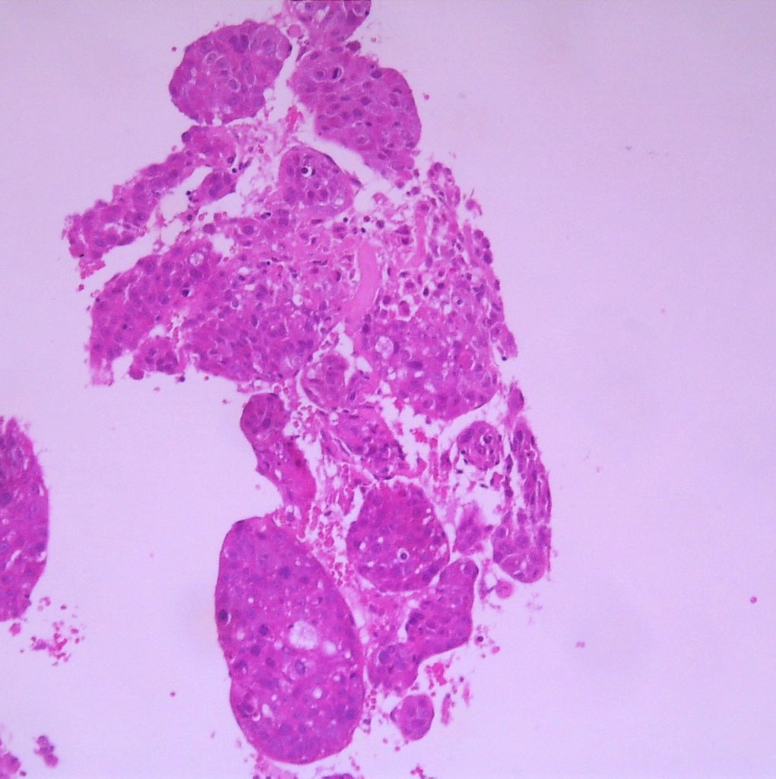
23c: Ultrasound guided liver biopsy
A. HCC
B. pancreatic.
C. sarcoma
D. melanoma
E. colonic ca

Slide 101
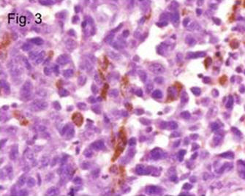
23d: Ultrasound guided liver biopsy
What does this suggest?
A. Primary hepatocellular carcinoma
B. Metastasis from a pancreatic carcinoma.
C. Metastasis from a sarcoma
D. Metastasis from a malignant melanoma
E. Metastasis from a colonic carcinoma

Slide 102
Courvoisier’s law
gall bladder is palpable

Slide 103
Courvoisier’s law
gall bladder is palpable
A. The cause is gallstones
B. The cause is pancreatic Ca.

Slide 104
Courvoisier’s law
In the presence of jaundice, if the gall bladder is palpable, the cause is unlikely to be gall stones.
This is because a gall bladder with stones is usually small and fibrotic and incapable of being large.

Slide 105
.

Slide 106
What investigation?
Ultrasound abdomen
Dilated bile ducts
Probable metastatic disease

Slide 107
PM3
GP

Slide 108
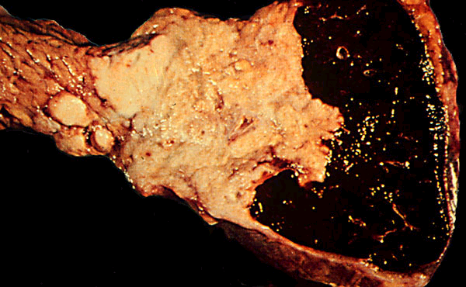

Slide 109
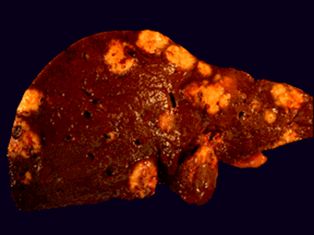

Slide 111
Pancreatic Carcinoma

Slide 112
Summary
Obstructive jaundice commonly caused by pancreatic cancer or gallstones
Distinguish them clinically
Courvouisiers law

