Slide 1
Update on lipoprotein metabolism, cardiovascular disease & obesity
Gilbert Thompson
Metabolic Medicine
Imperial College London
Hammersmith Hospital

Slide 2
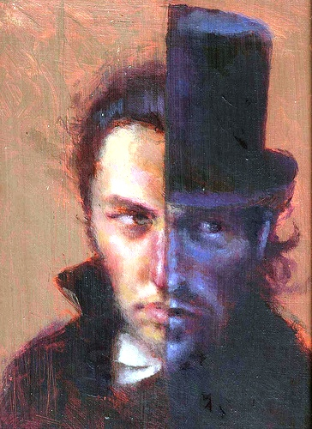
Cholesterol, a “Jekyll & Hyde” molecule

Slide 3
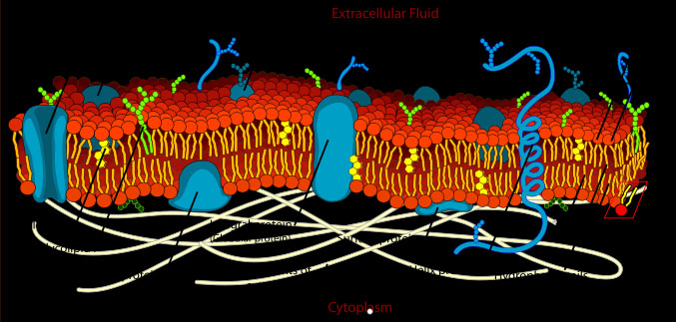
Essential component of all cell membranes
Cholesterol

Slide 4
Cross section of atheromatous plaque in coronary arterial wall
Cholesterol

Slide 5
Topics
Lipoprotein metabolism & dyslipidaemia

Slide 6
Plasma lipoproteins

Slide 7
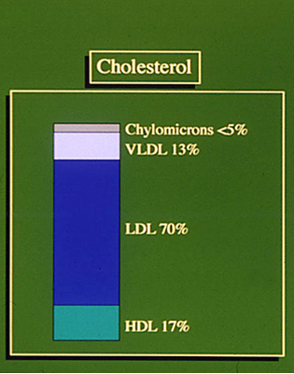
Lipid transport in fasting plasma

Slide 8
Cholesterol Absorption & Metabolism
PERIPHERAL
CELLS
PERIPHERAL C
LIVER
LIVER
Diet & bile
Diet and bile
ABC A1
ABC A1
HMG CoA reductase
HMG CoA reductase
ACAT
NPC1L1
FC
NPC1L1
FC
Acetate
MVA
Acetate
Cholesterol
MVA
Cholesterol
Cholesterol
holesterol
ABC G5
ABC G8
CE
ABC G5
ABC G8
HDL
CE
SR-B1
ACAT
HDL
SR-B1
ACAT
7αOHxy-
lase
JEJUN
7αhydro
lase
Cholesterol
ester
Cholesterol
ester
JEJUNUM
TG
CETP
CE
CETP
MTP
TG
MTP
Bile acids
Bile acids
PPARα
apoB
TG
PPARα
apoB
TG
VLDL
VLDL
Bile acids
Bile acids
BAT
ILEUM
LDL
LDL
LDL receptor
LDL receptor
PPARγ
PPARγ
PLASMA
PLASMA
ADIPOSE UE
ADIPOSE TISSUE

Slide 9
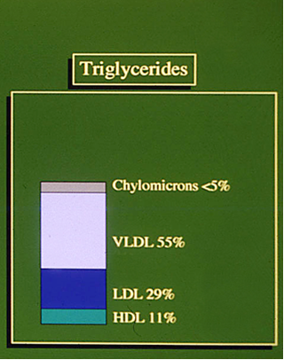
Lipid transport in fasting plasma

Slide 10
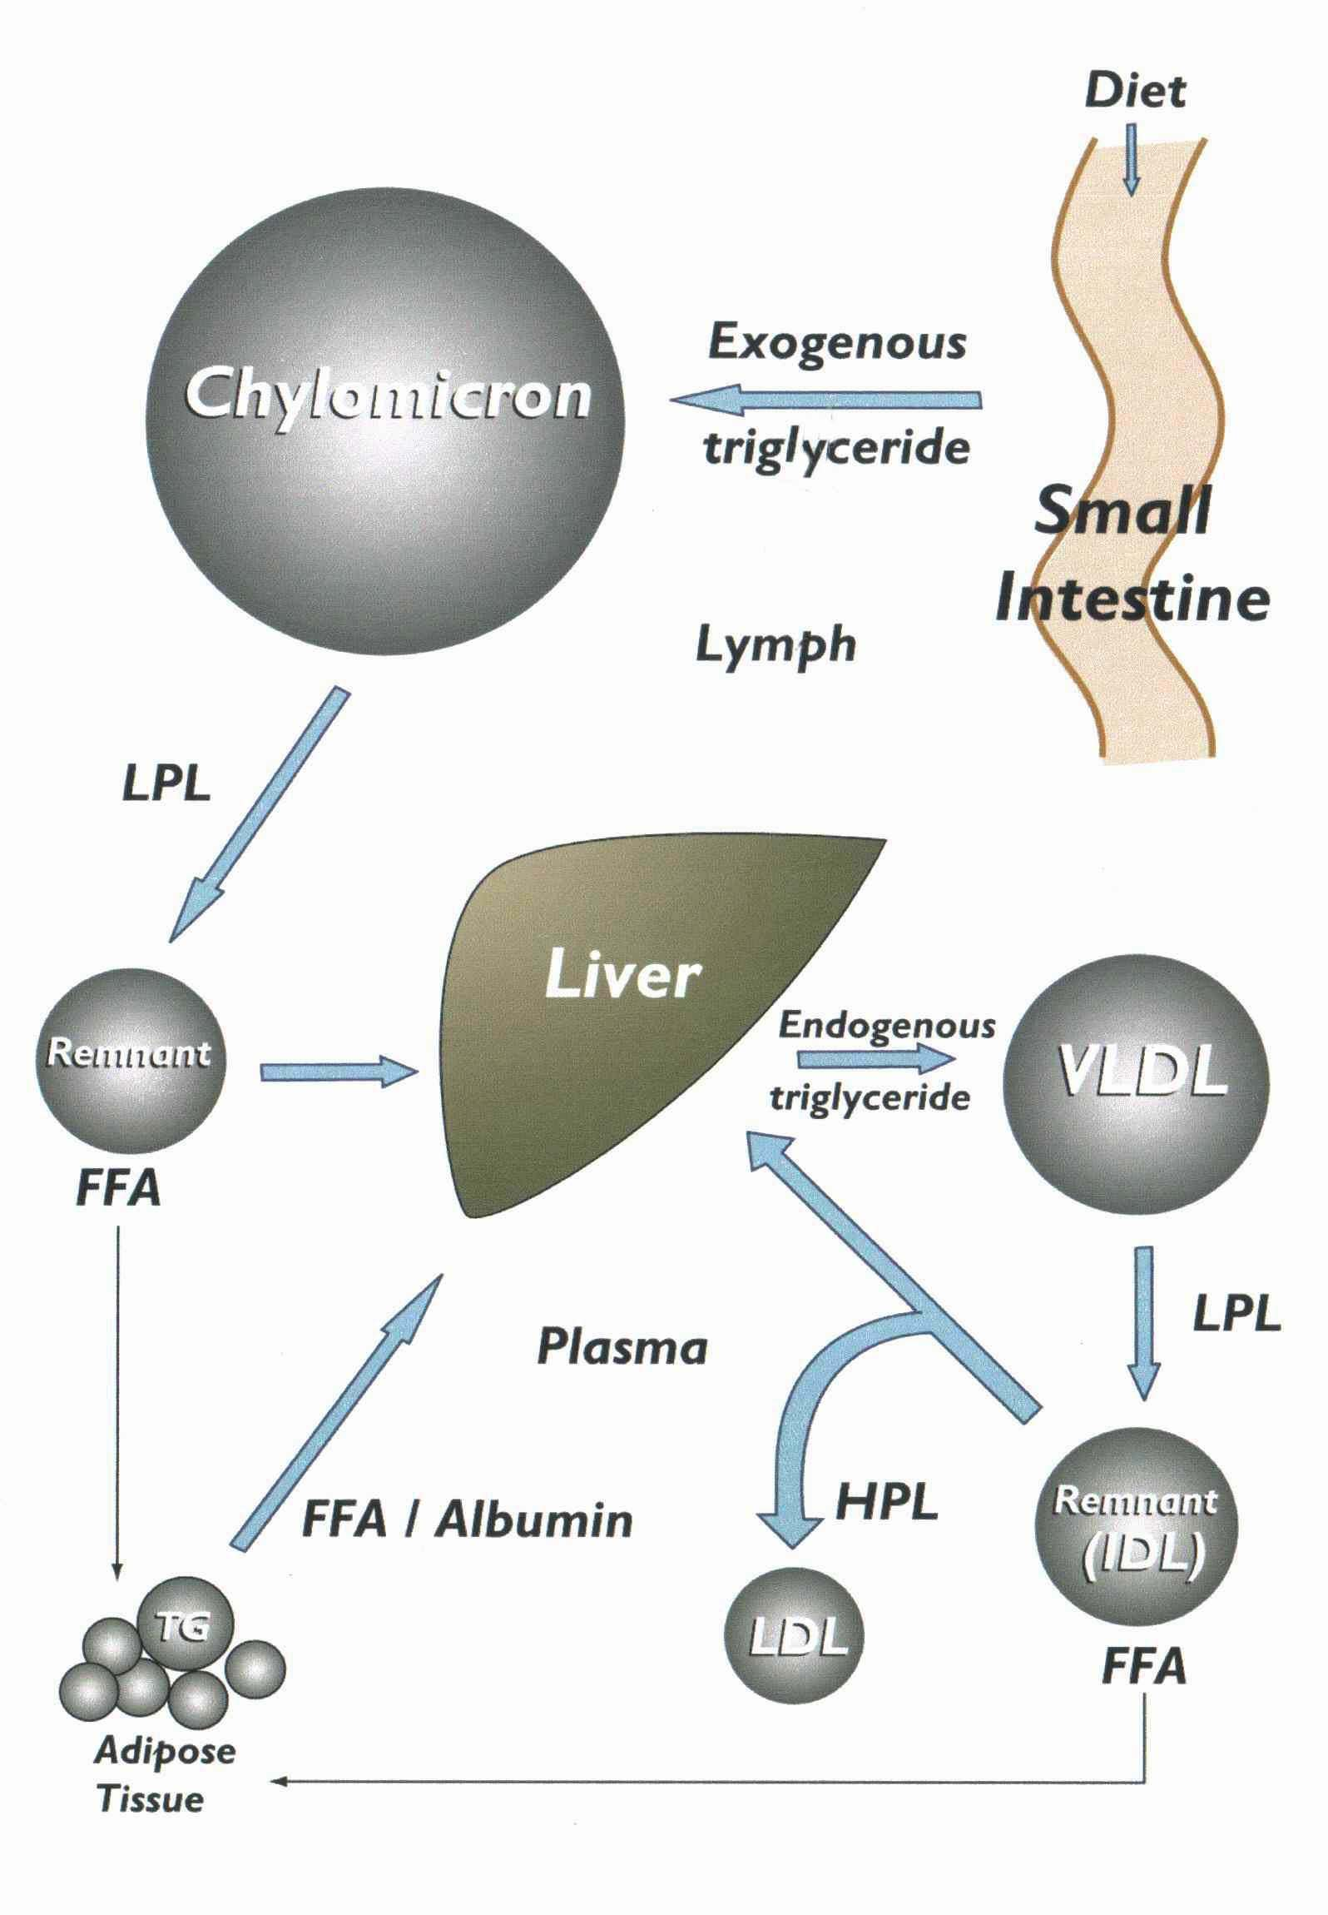
Triglyceride Transport & Metabolism

Slide 11
Dyslipidaemia
Hypercholesterolaemia
Hypertriglyceridaemia
Mixed hyperlipidaemia
Hypolipidaemia

Slide 12
Primary hypercholesterolaemia
Familial hypercholesterolaemia (type II): dominant mutations of LDL receptor, apoB or PCSK9 genes. Rarely, autosomal recessive inheritance (LDLRAP1).
Polygenic hypercholesterolaemia: Numerous loci incl. NPC1L1, HMGCR, CYP7A1 polymorphisms
Familial hyperαlipoproteinaemia: sometimes CETP deficiency
Phytosterolaemia: mutations of ABC G5 & G8

Slide 13
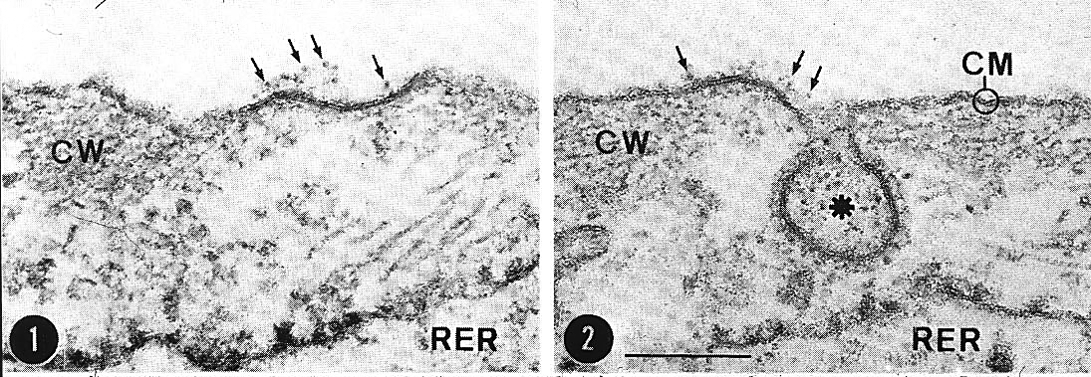
LDL binds to receptors in coated pits (1) and subsequently undergoes endocytosis (2).

Slide 14
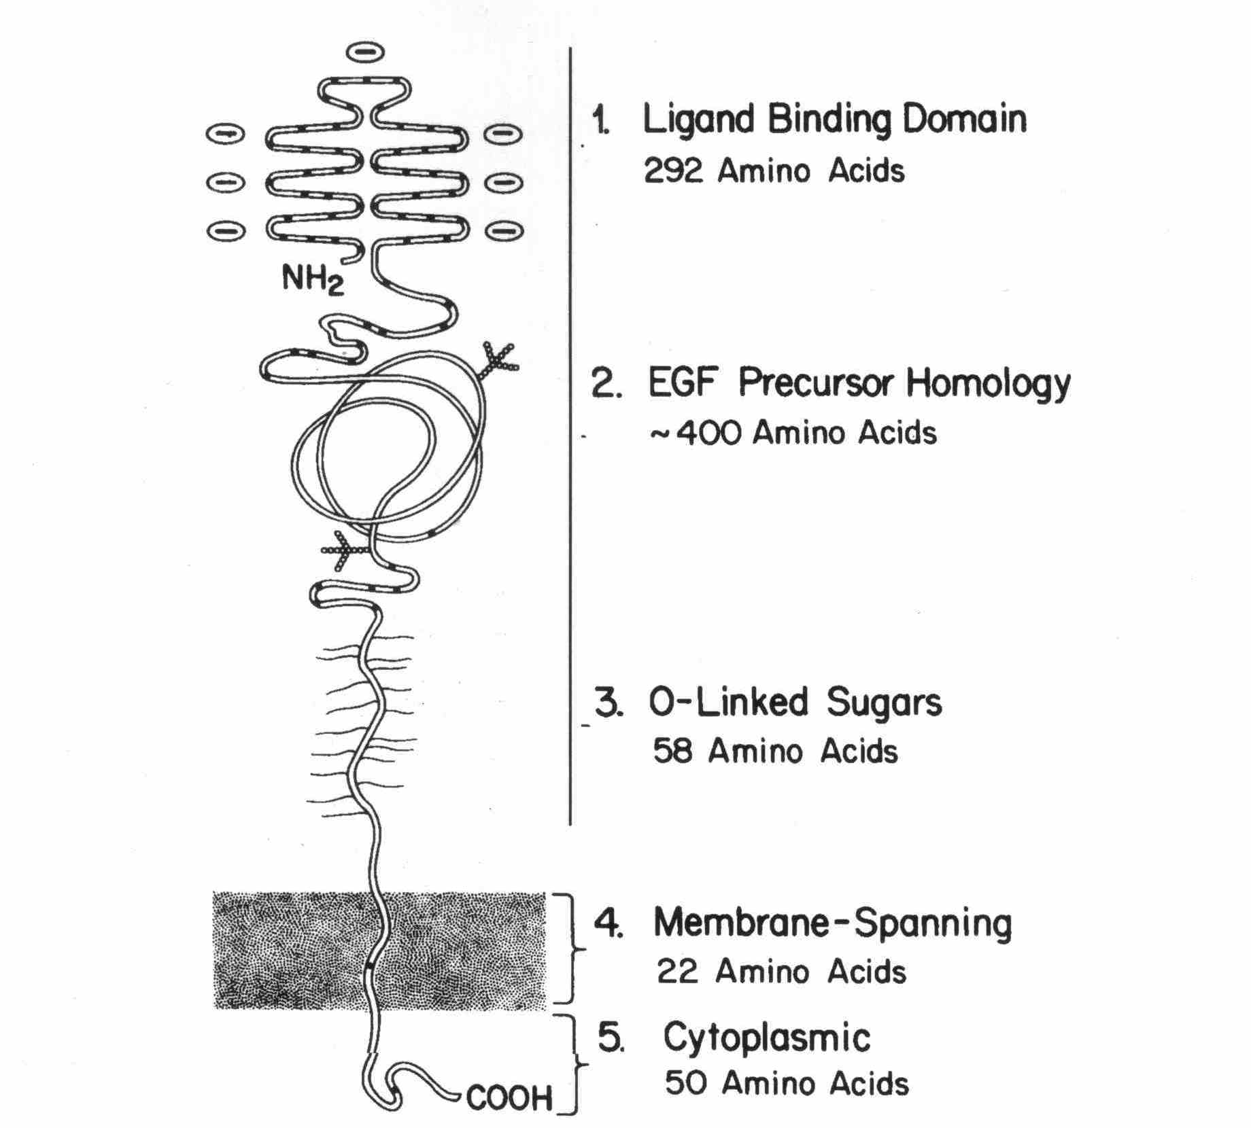
Domains of the LDL receptor
(Brown & Goldstein, 1985)

Slide 15
LDL receptor mutations identified in the UK by
Soutar et al

Slide 16

FH homozygote (1: 1 x 10⁶)

Slide 17
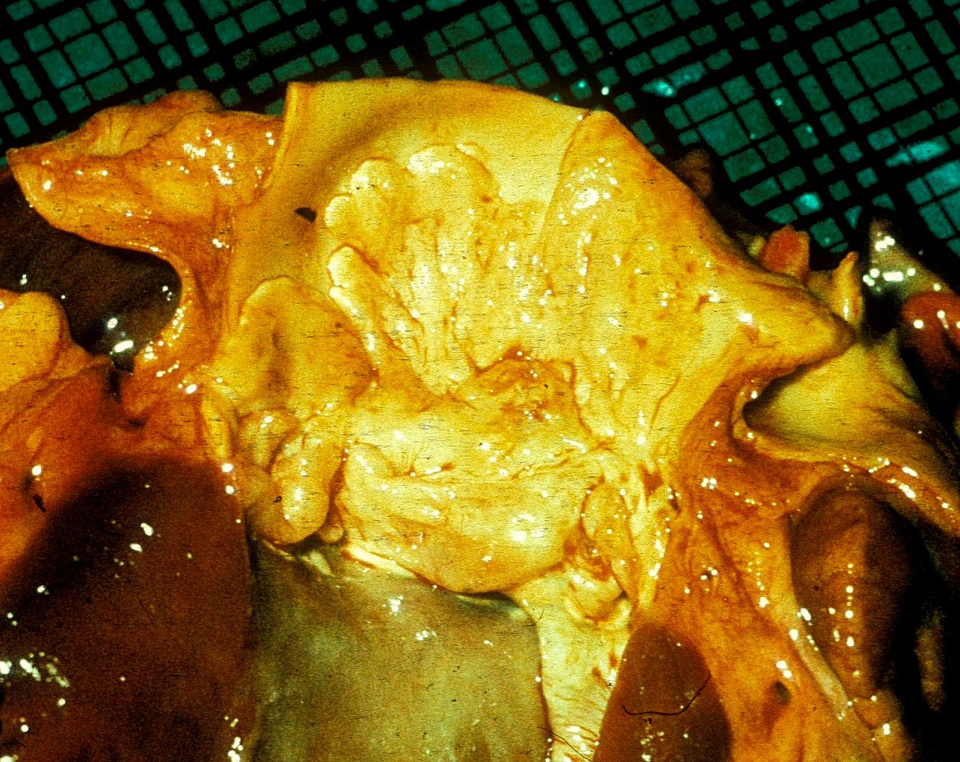
Atheroma of aortic root in an FH homozygote

Slide 18
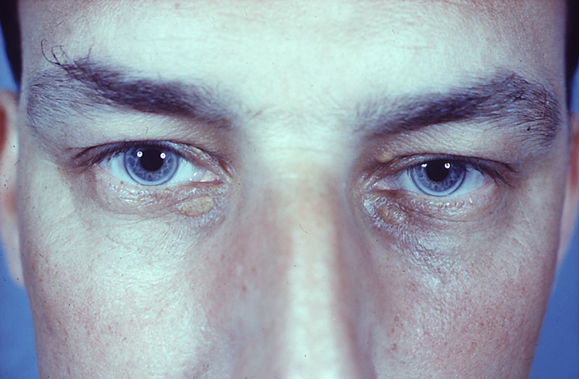
FH heterozygote (1: 500)

Slide 19
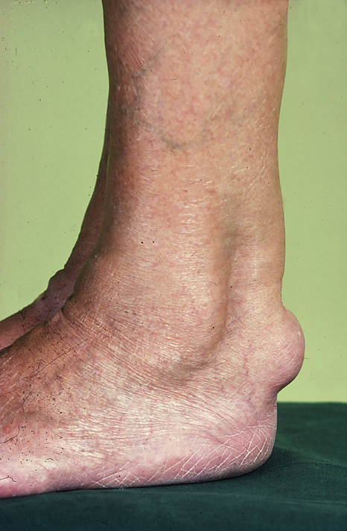
Tendon xanthoma in FH heterozygote

Slide 20
Proprotein convertase subtilisin/kexin type 9 (PCSK9)
Function is to bind to LDL receptor and promote its degradation.
Rarely FH is caused by dominantly-inherited gain of function mutations of PCSK9, which increase rate of degradation of LDL receptors.
Loss of function mutations of PCSK9 are associated with low LDL levels.

Slide 21
Primary hypertriglyceridaemia
Familial type I: lipoprotein lipase or apoC II deficiency
Familial type IV: Increased synthesis of TG
? Cause
Familial type V: sometimes due to apoA V deficiency

Slide 22
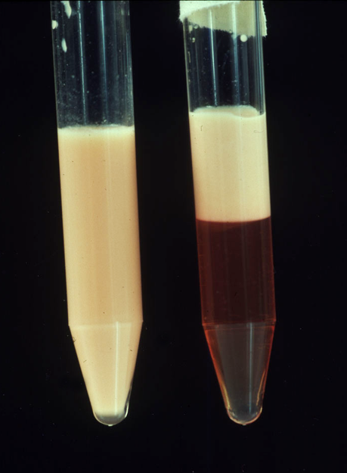
Type 1 hyperlipidaemia
chylomicrons
Plasma After O/N in fig

Slide 23
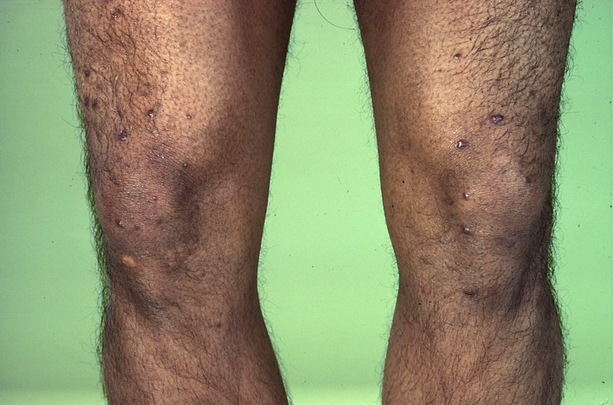

Slide 24
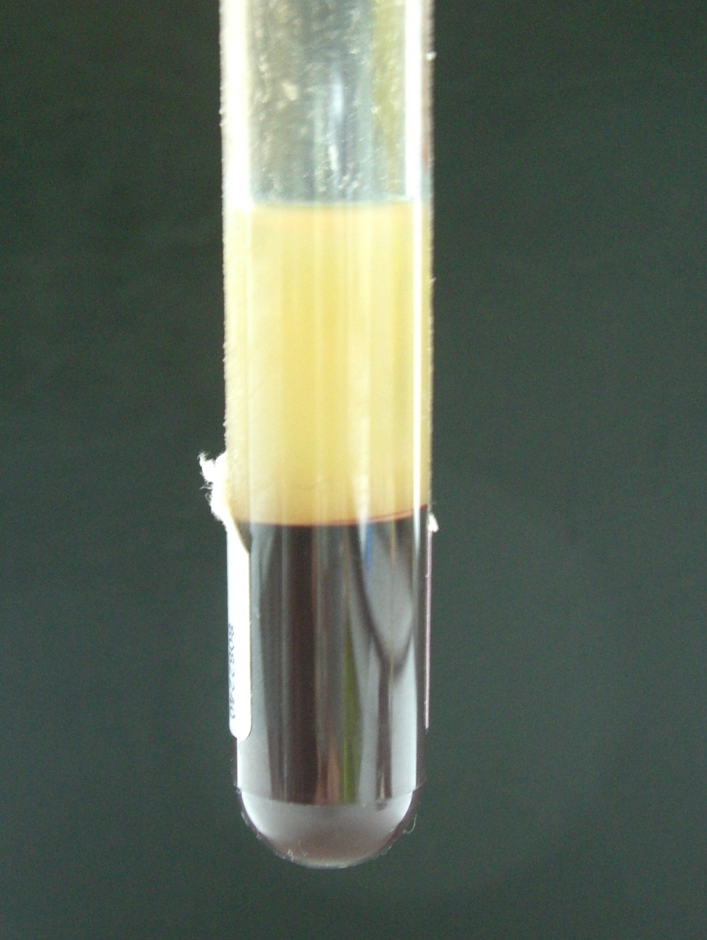
Type IV hyperlipidaemia
VLDL
EDTA blood

Slide 25
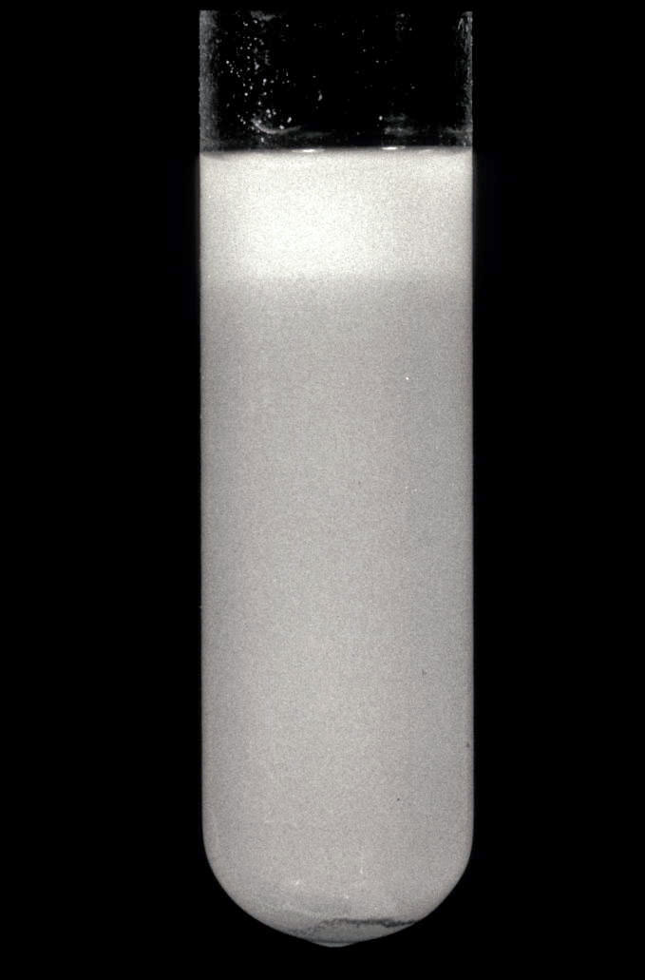
Type V hyperlipdaemia
chylomicrons
VLDL
Plasma

Slide 26
Primary mixed hyperlipidaemia
Familial combined hyperlipidaemia: ? cause
Familial hepatic lipase deficiency
Familial dysβlipoproteinaemia (type III)

Slide 27
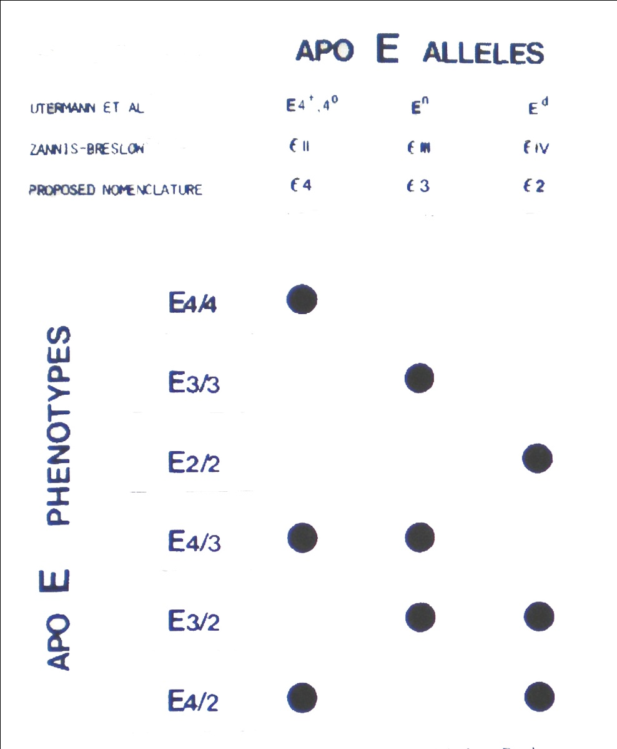
ApoE polymorphism
Alzheimer’s d
“Normal”
Type III

Slide 28
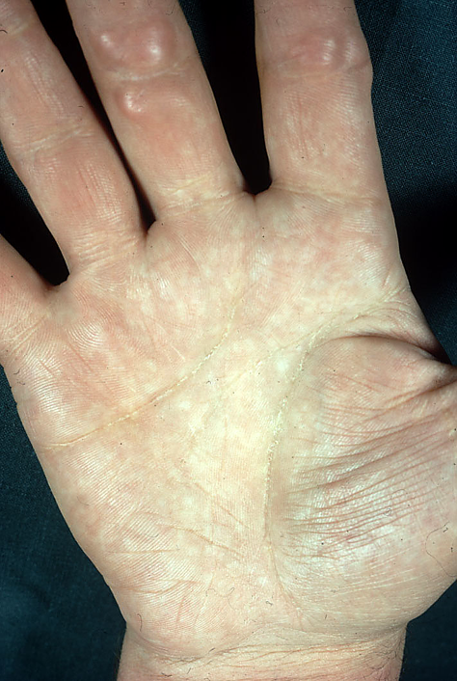

Slide 29
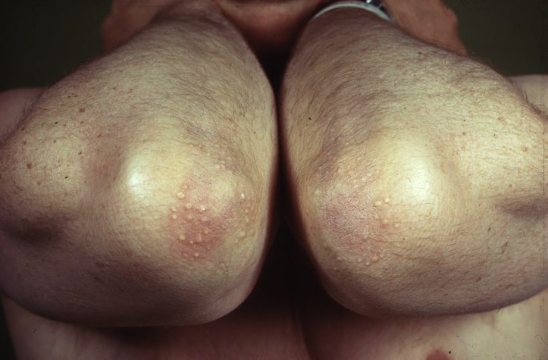

Slide 30
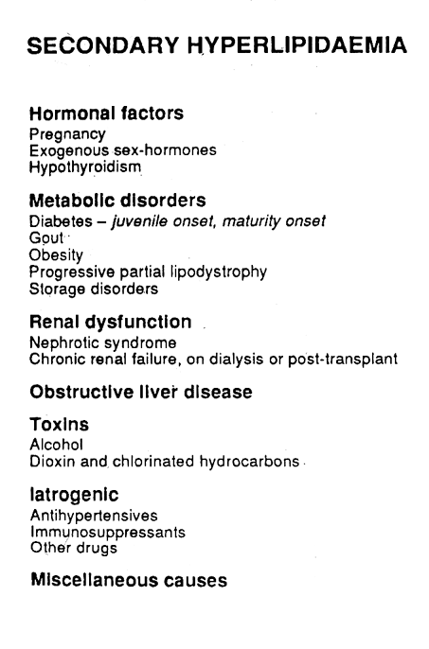

Slide 31
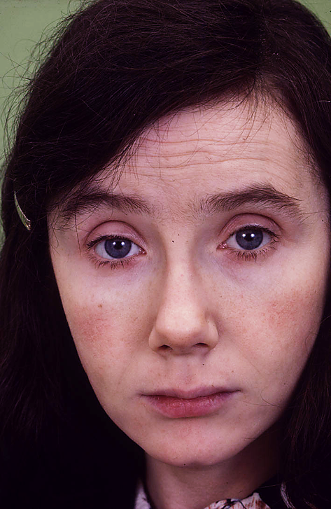

Slide 32
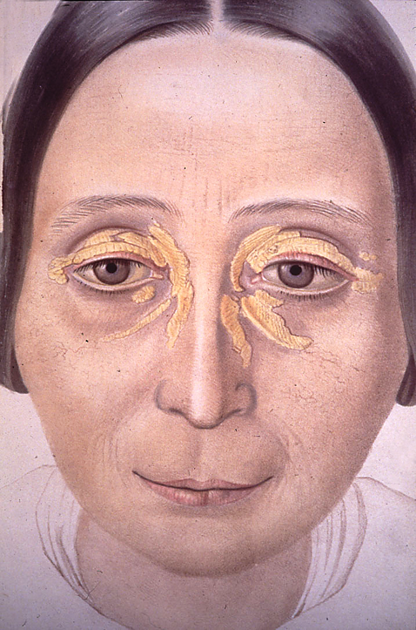

Slide 33
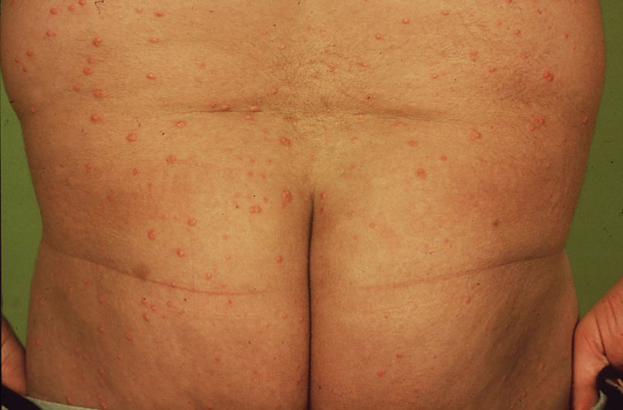

Slide 34
Hypolipidaemia
Aβ-lipoproteinaemia: MTP deficiency (recessive)
Hypoβ-lipoproteinaemia: truncated apoB (dominant)
Tangier disease: HDL deficiency caused by ABC AI mutations
Hypoα-lipoproteinaemia: sometimes due to apoA-I mutations

Slide 35
Topics
Lipoprotein metabolism and dyslipidaemia
Lipids and cardiovascular disease

Slide 36
Deaths during 2006 in England and Wales (National Statistics)
All deaths
273,488
CHD deaths
52,585
CHD
<65
Men
65-74
19%
>75
297,546
41,796
CHD
Women
>75
14%
65-74
<65

Slide 37
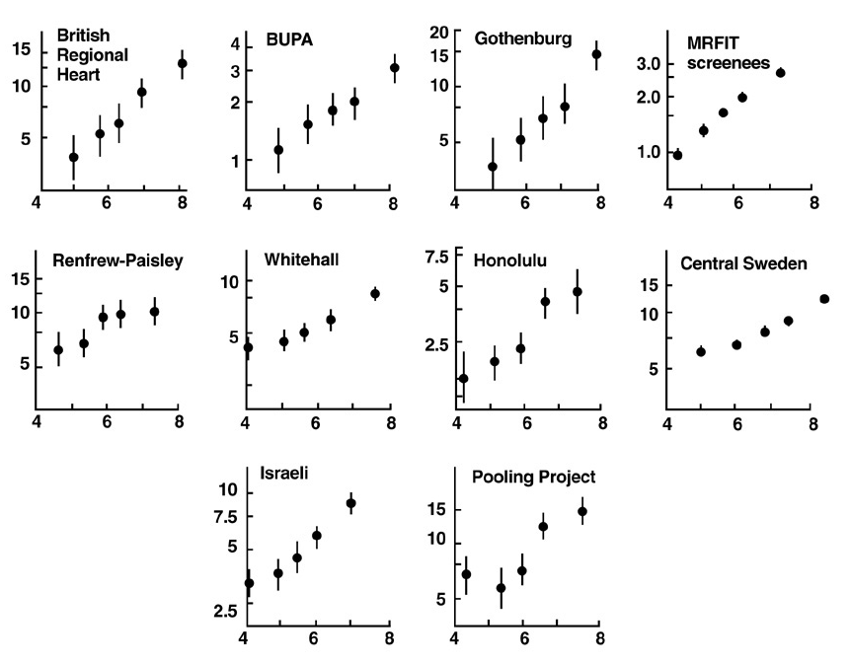
Age-adjusted Incidence of Coronary Heart Disease
relative to Serum Cholesterol (Law et al, 1994)
Incidence of CHD per 1000 man-years)
Serum cholesterol mmol/l

Slide 38
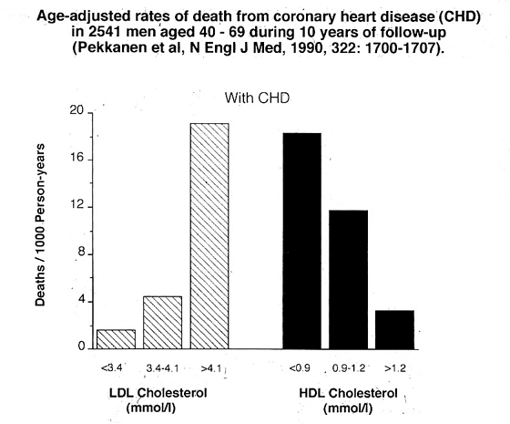

Slide 39
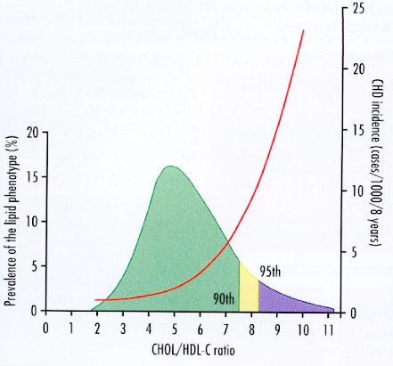

Slide 40
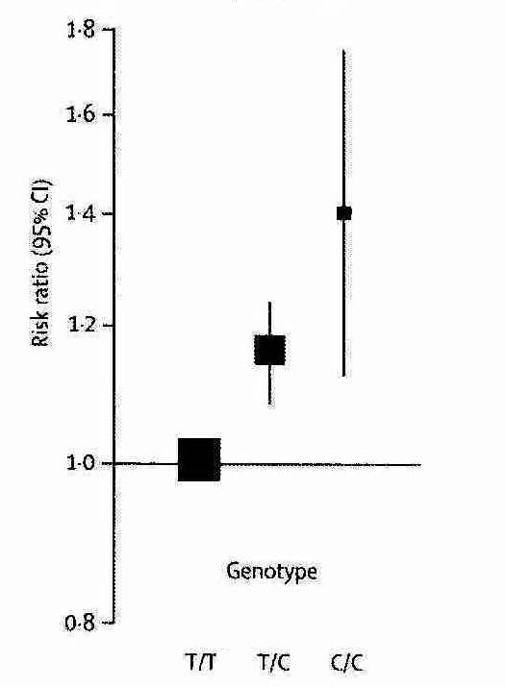
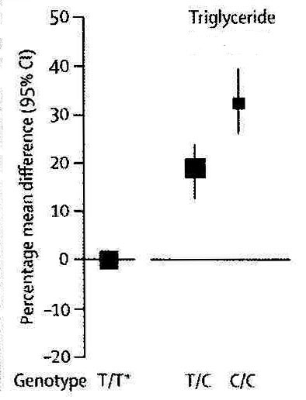
Increases in triglyceride and CHD risk associated with apoA-V promoter genotypes (Sarwar et al, 2010)

Slide 41
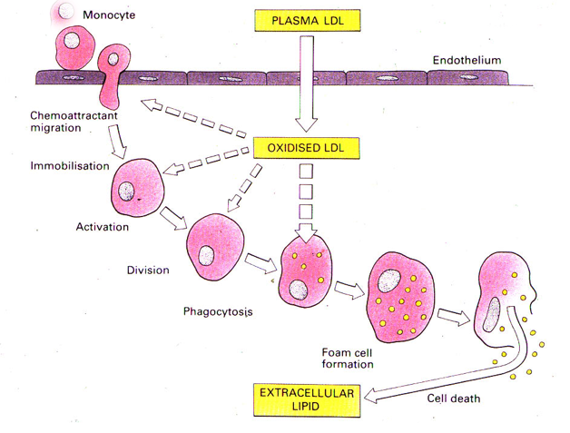

Slide 42
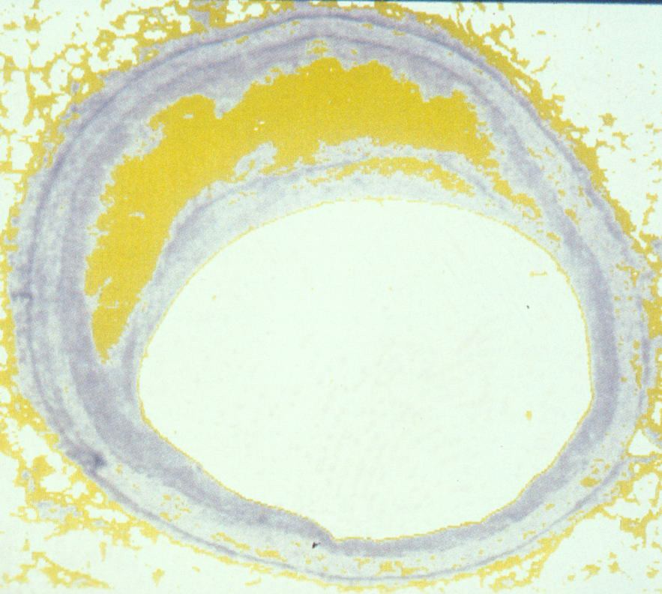
Lipid-rich coronary plaque
( Davies & Woolf, 1999)

Slide 43
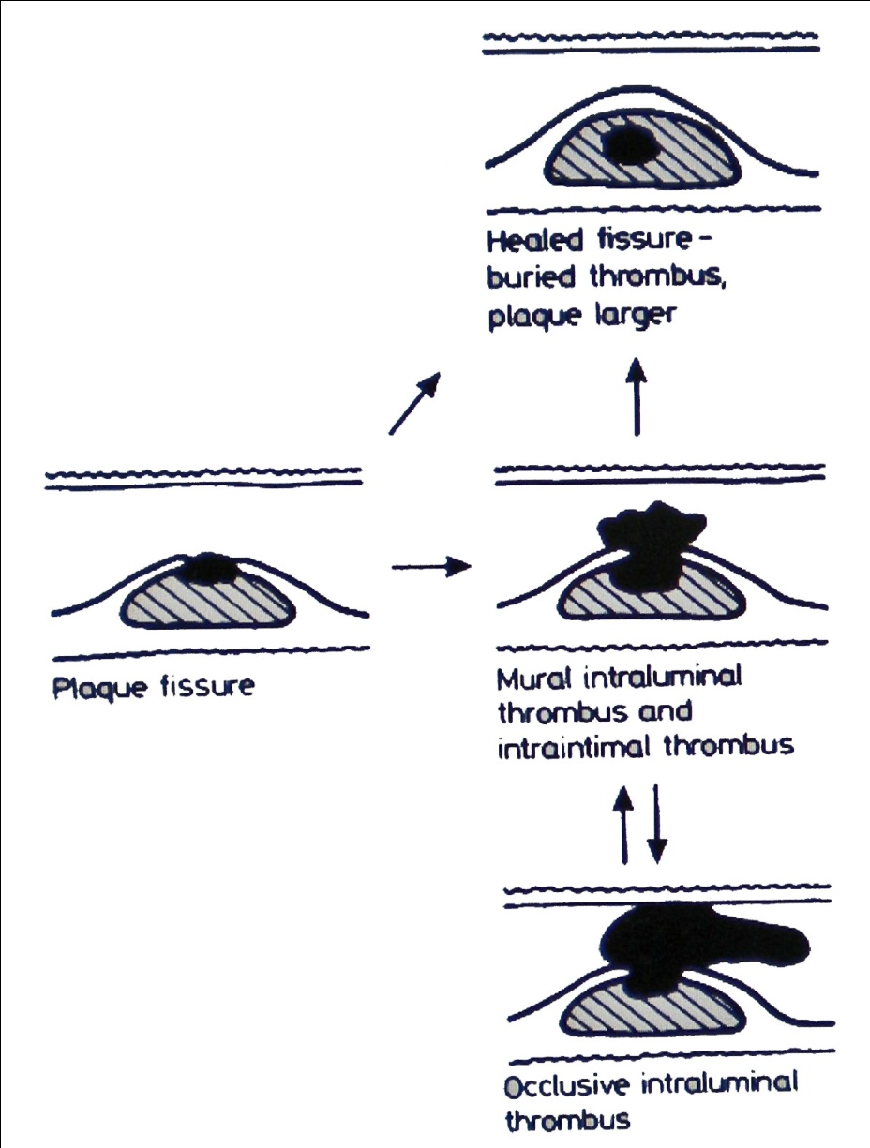
Sequelae of plaque fissuring (Davies & Thomas, 1985)

Slide 44
Comparative effects of lipid-regulating drugs
Daily dose
Mean change (%)
LDL-C
HDL-C
TG
Atorvastatin 40 mg
Nicotinic acid 4 g
Gemfibrozil 1.2 g
Ezetimibe 10 mg
Colestyramine 24 g
-51
-9
-18
-18.5
-23
+5
+43
+12
+3.5
+8
-32
-34
-40
-5
+11

Slide 45
Cholesterol Treatment Trialists’ Collaboration
(Baigent et al, 2005)
Meta-analysis of 90,000 individuals in 14 statin
trials, 1994- 2004
Total & coronary mortality ↓ 12% & 19% and
major vascular events including strokes ↓ 25%
for each 1 mmol/l ↓ in LDL cholesterol (26%)

Slide 46
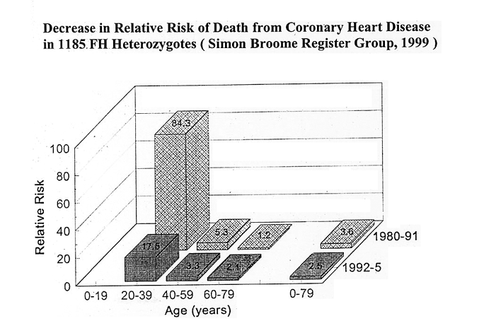

Slide 47
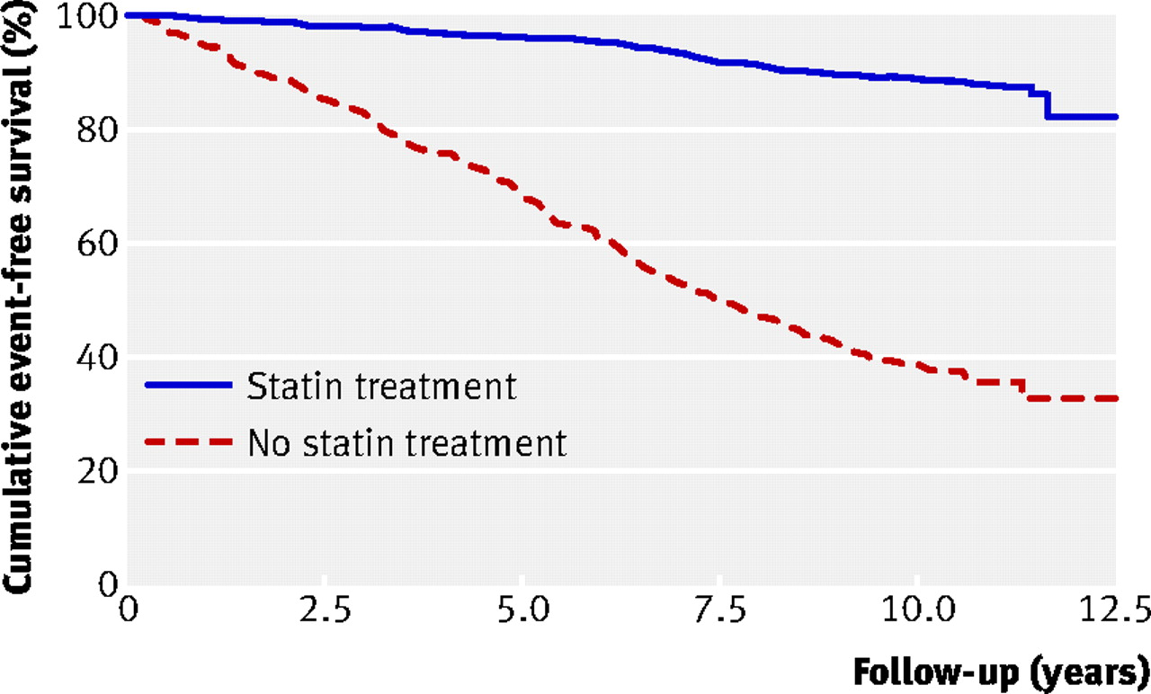
Kaplan-Meier curve estimates of cumulative coronary heart disease-free survival among patients with FH according to statin treatment (P<0.001)
- 76%
Versmissen J et al. BMJ 2008;337:bmj.a2423
Notes:
Fig 2 Kaplan-Meier curve estimates of cumulative coronary heart disease-free survival among patients with familial hypercholesterolaemia according to statin treatment (P<0.001 for difference)‏

Slide 48
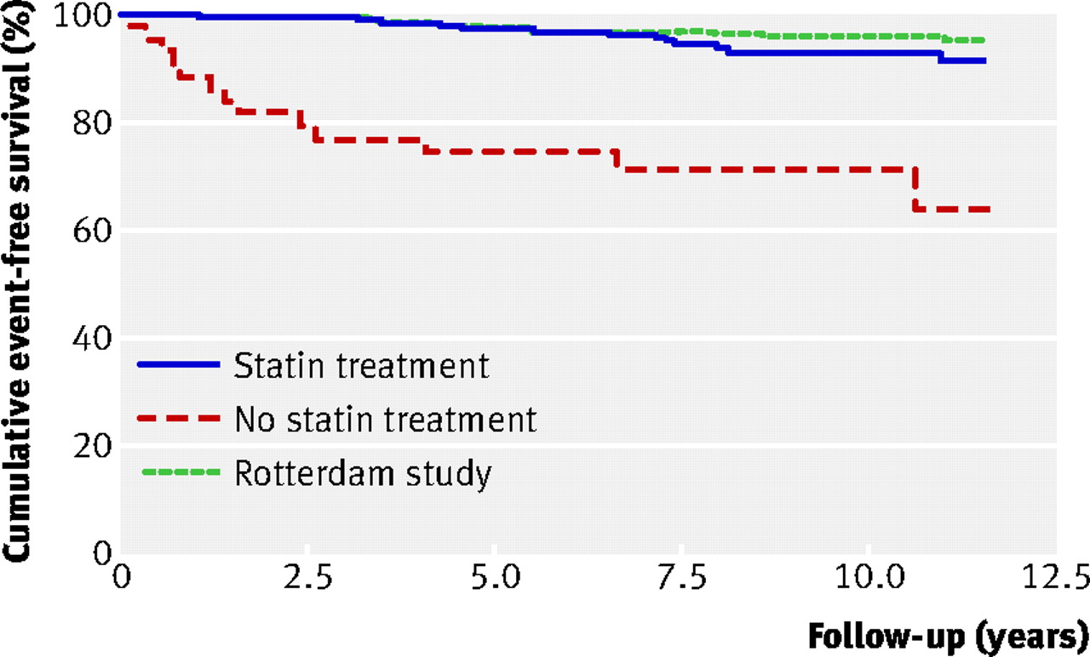
Cumulative myocardial infarct-free survival among patients with FH > 55 years according to statin treatment compared with a sample from the Dutch population
Versmissen J et al. BMJ 2008;337:bmj.a2423
Notes:
Fig 4 Kaplan-Meier curve estimates of cumulative myocardial infarct-free survival among patients with familial hypercholesterolaemia older than 55 years according to statin treatment compared with a sample from the general population (Rotterdam study). (P<0.001 for difference between untreated patients and general population; P=0.07 for difference between treated patients and general population)‏

Slide 49
Novel forms of LDL-lowering therapy
Microsomal Triglyceride Transfer Protein (MTP) inhibitor (lomitapide)
Anti-sense apoB oligonucleotide (mipomersen)
Anti-PCSK9 monoclonal antibody (REGN727)

Slide 50
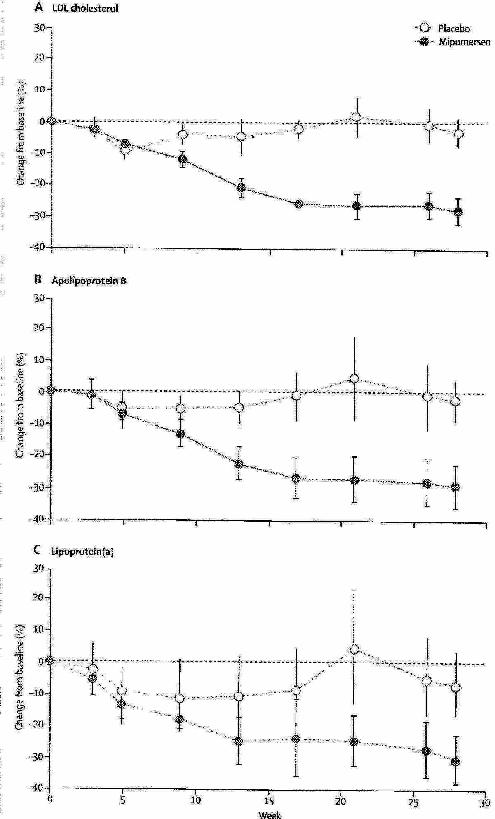
Effect of antisense inhibitor of apolipoprotein B synthesis (mipomersen) in statin-treated homozygous FH (Raal et al, 2010)
Δ%
LDL cholesterol
O Placebo
O Mipomersen
Apolipoprotein B
Lipoprotein (a)

Slide 51
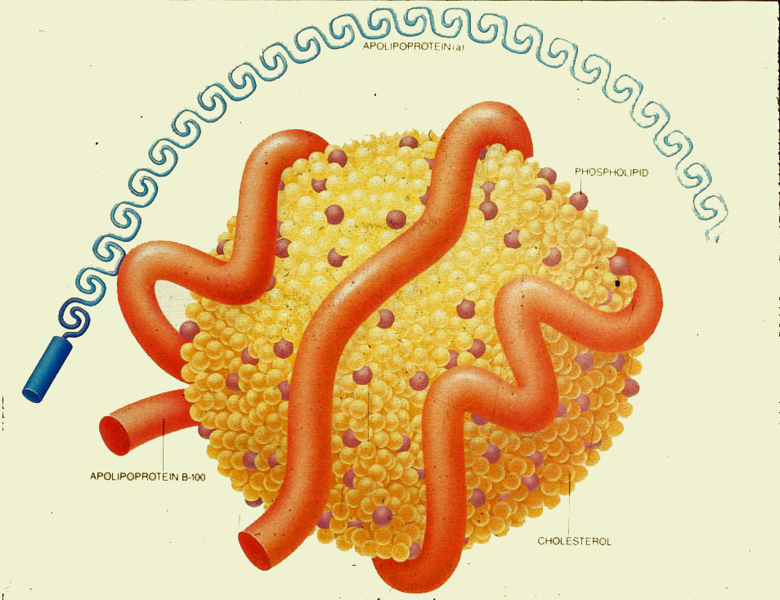
Lipoprotein (a)

Slide 52
Lp(a) as a cardiovascular risk factor
(EAS Consensus Panel, 2010)
Lp(a) should be measured once, using an isoform-insensitive assay, in subjects at intermediate or high CVD/CHD risk, including familial hypercholesterolaemia, or with premature or statin-resistant CVD.
A desirable level of Lp(a) is <500 mg/L. Treatment should primarily be nicotinic acid 1–3 g/day. In refractory cases, weekly LDL-apheresis is effective in removing Lp(a).

Slide 53
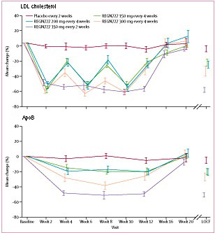
Effect of mAb to PCSK9 on LDL cholesterol and apoB in statin-treated heterozygous familial hypercholesterolaemia (Stein et al, 2012)

Slide 54
Novel HDL-based therapies
(Joy, 2012)
Apolipoprotein A-I mimetics
Enhanced apo A-I synthesis (RVX-208)
Apolipoprotein A-I based infusion therapy
Cholesterol ester transfer protein (CETP) inhibitors

Slide 55
Topics
Lipoprotein metabolism and dyslipidaemia
Lipids and cardiovascular disease
Treatment of obesity

Slide 56
Treatment of obesity
Hypocaloric diet and exercise
Iatrogenic malabsorption: Orlistat
120 – 360 mg daily
Bariatric surgery if BMI > 40 (Kg/m²)

Slide 57
Gastric banding (Poirier et al, 2011)

Slide 58
Roux- en-Y gastric bypass (Poirier et al, 2011)

Slide 59
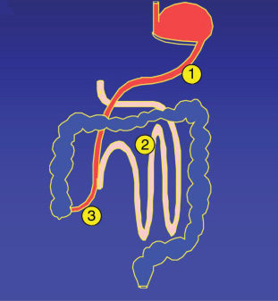
Biliopancreatic diversion (Poirier et al, 2011)

Slide 60
Benefits and risks of bariatric surgery
Success = > 50% ↓ in excess weight (i.e. actual – ideal)
Diabetes ↓ 72%
Serum triglyceride ↓ 50-60%
HDL cholesterol ↑13-47%
Fatty liver ↓
Hypertension ↓
Post-op mortality 0.1-2%

Slide 61
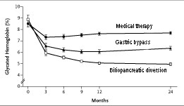
Effect of conventional medical therapy v bariatric surgery on HbA₁C in obese diabetics ( Mingrone et al, 2012)

Slide 62

Prevalence of obesity among adults aged 16+ years
Health Survey for England 1993-2010 (3-year average)
© NOO 2012
Adult (aged 16+) obesity: BMI ≥ 30kg/m²
Notes:
This chart shows a three year rolling average, with the middle year displayed on the chart.
The rise in prevalence appears to be slowing for both sexes.
Obesity prevalence remains higher for women, but the gap appears to have narrowed over time.

Slide 63
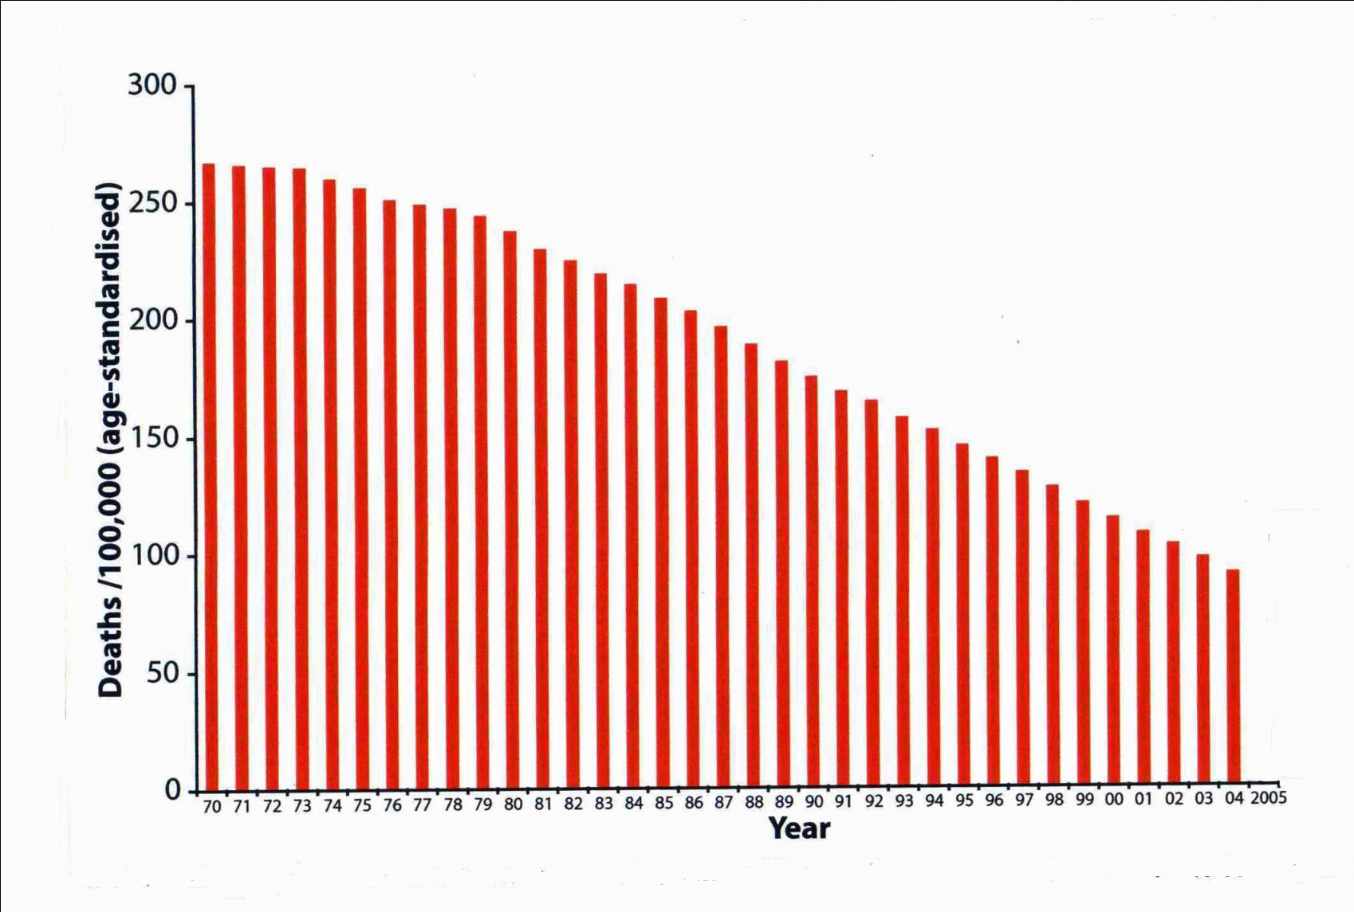
Fall in death rate from CHD, stroke and other circulatory diseases in people aged <75 yrs in England, 1969 - 2005
(BHF Coronary heart disease statistics)
↓ 50%
1981- 2000

Slide 64


