Slide 1
Calcium handling, bones and renal stones
Ben Jones
Academic Clinical Fellow in Chemical Pathology/ Metabolic Medicine

Slide 2
Learning objectives
Review calcium metabolism
Common calcium disorders
  Hypercalcaemia
  Hypocalcaemia
Common metabolic bone disorders
  Osteporosis
  Osteomalacia / Rickets
  Pagets
Renal stones

Slide 3
Calcium handling
Ca²⁺ homeostasis
Hypercalcaemia
Hypocalcaemia

Slide 4
Calcium: facts 1
Roles
  Structural – skeleton
  Metabolic – action potentials, IC signalling
Total body calcium ~1.5 kg
  99% in skeleton
  Of that, 1% exchangeable with ECF

Slide 5
Calcium: facts 2
Serum Ca²⁺ in 3 forms
  Free (“ionised”) ~50% - biologically active
  Protein-bound ~40% - albumin
  Complexed ~10% - citrate / phosphate
Total serum Ca²⁺ 2.2 – 2.6 mmol/L
“Adjusted” Ca²⁺ usually reported
  serum Ca²⁺ – 0.02 * (40 – serum albumin in g/L)
Ionised Ca also measured

Slide 6
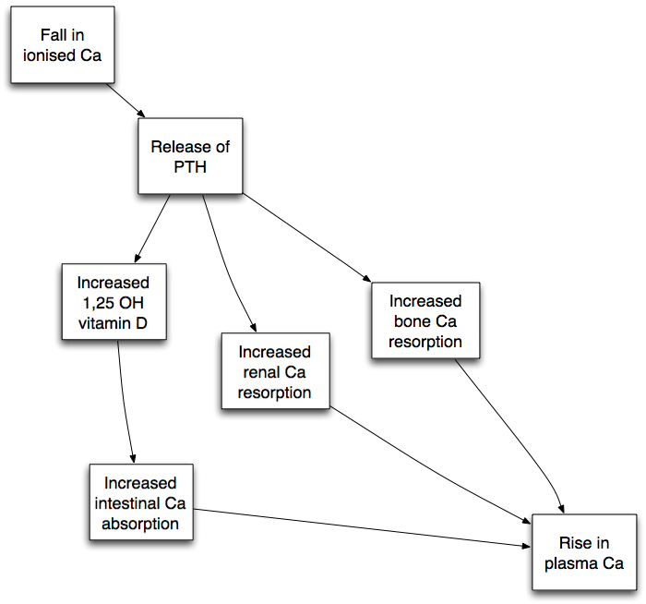
Summary of Ca²⁺ homeostasis
Parathyroid hormone (PTH)
  from parathyroid gland
1,25 (OH)₂ vit D
  from kidney

Slide 7
PTH
84 aa protein
Only released from parathyroids
Roles
  Bone & renal Ca²⁺ resorption
  Stimulates 1,25 (OH)₂ vit D synthesis (1α hydroxylation)
  Also stimulates renal P_{i} wasting

Slide 8
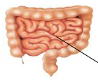

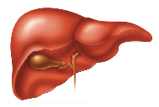
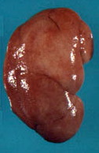
Vitamin D Metabolism
UV B
Cholecalciferol (D₃)
7-dehydrocholesterol
25-OH-D₃
+
1α OHase
PTH
1,25-(OH)₂-D₃

Slide 9
Roles of 1,25 (OH)₂ vitamin D
Intestinal Ca²⁺ absorption
Also intestinal P_{i} absorption
Critical for bone formation (see later)
? Other physiological effects
  Vit D receptor controls many genes eg for cell proliferation, immune system etc
  Vit D deficiency associated with cancer, autoimmune disease, metabolic syndrome

Slide 10
Hypercalcaemia
Symptoms
  Polyuria / polydipsia
  Constipation
  Neuro – confusion / seizures / coma
  Unlikely unless Ca²⁺ > 3.0 mmol/L
Acute management
  Fluids+++
  Bisphosphonates
  TREAT UNDERLYING CAUSE

Slide 11
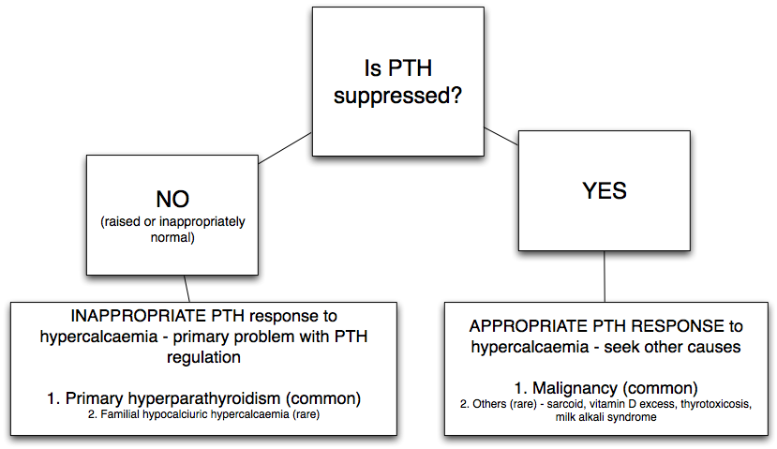
Causes of hypercalcaemia
Repeat measurement first
If confirmed, need [PTH] to interpret!

Slide 12
Primary Hyperparathyroidism
Commonest cause of hypercalcaemia
Parathyroid adenoma / hyperplasia / carcinoma
Hyperplasia associated with MEN1
Women > men
↑serum Ca, ↑ or inappropriately N PTH, ↓serum P_{i}, urine ↑Ca (due to hypercalcaemia)
BONES (PTH bone disease) and STONES (renal calculi)
Hypercalcaemia -> abdominal MOANS (constipation, pancreatitis), psychiatric GROANS (confusion)

Slide 13
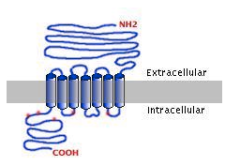
Calcium sensing receptor (CaSR)
PTH release
Inactivating Mutation causes R shift of curve
Normal
FBH
[Ca²⁺]
Parathyroids: detects serum ionised Ca²⁺ -> regulates PTH release
Renal: influences Ca²⁺ resorption (PTH independent)
Familial hypocalciuric (/benign) hypercalcaemia (FHH / FBH)
  CaSR inactivating mutation
  Higher “set point” for PTH release -> mild hypercalcaemia
  Reduced urine Ca²⁺

Slide 14
Causes of hypercalcaemia
Repeat measurement first
If confirmed, need [PTH] to interpret!

Slide 15
Hypercalcaemia in malignancy
Humoral hypercalcaemia of malignancy (eg small cell lung Ca)
  PTHrP
Bone metastases (eg breast Ca)
  Local bone osteolysis
Haematological malignancy (eg myeloma)
  cytokines

Slide 16
Other causes of non-PTH driven hypercalcaemia
Sarcoid (non-renal 1α hydroxylation)
Thyrotoxicosis (thyroxine -> bone resorption)
Hypoadrenalism (renal Ca²⁺ transport)
Thiazide diuretics (renal Ca²⁺ transport)
Excess vitamin D (eg sunbeds…)

Slide 17
Hypocalcaemia
Must adjust Ca²⁺ for albumin before diagnosing hypocalcaemia
  May need to measure ionised Ca²⁺
Non-PTH driven* | Due to low PTH
vitamin D deficiency – dietary, malabsorption, lack of sunlight | Mg deficiency (PTH regulation)
chronic kidney disease (1α hydroxylation)** | Surgical (inc post thyroidectomy)
PTH resistance (“pseudohypoparathyroidism”) | Auto-immune hypoparathyroidism
 | Congenital absence of parathyroids (eg DiGeorge syndrome)
*PTH will be raised – secondary hyperparathyroidism
**can progress to tertiary hyperparathyroidism!

Slide 18
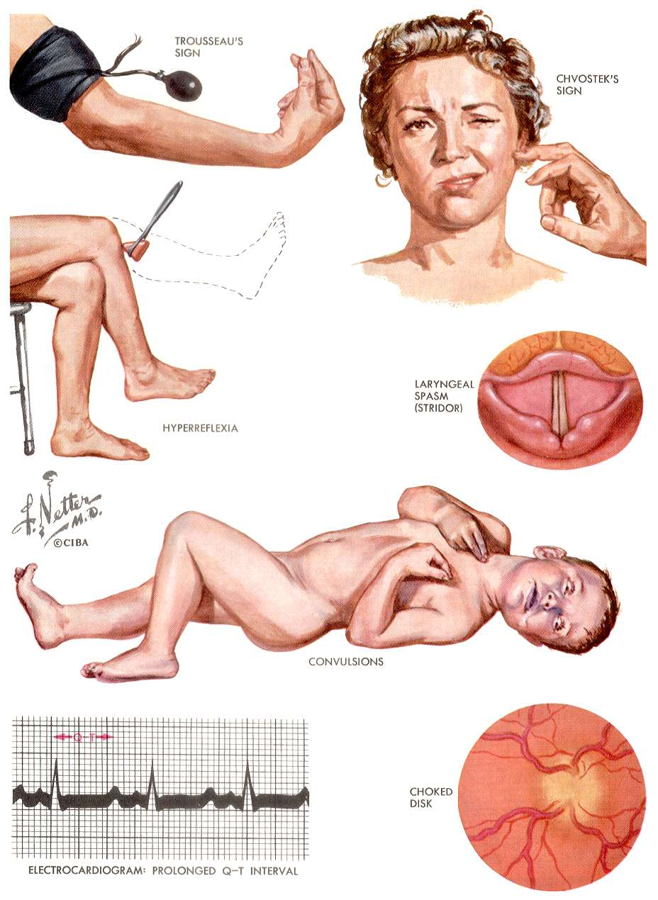
Clinical Signs of
Hypocalcaemia
Neuro-muscular excitability
Rx: Ca + vit D (usually “activated” ie 1α forms, except simple vit D deficiency)

Slide 19
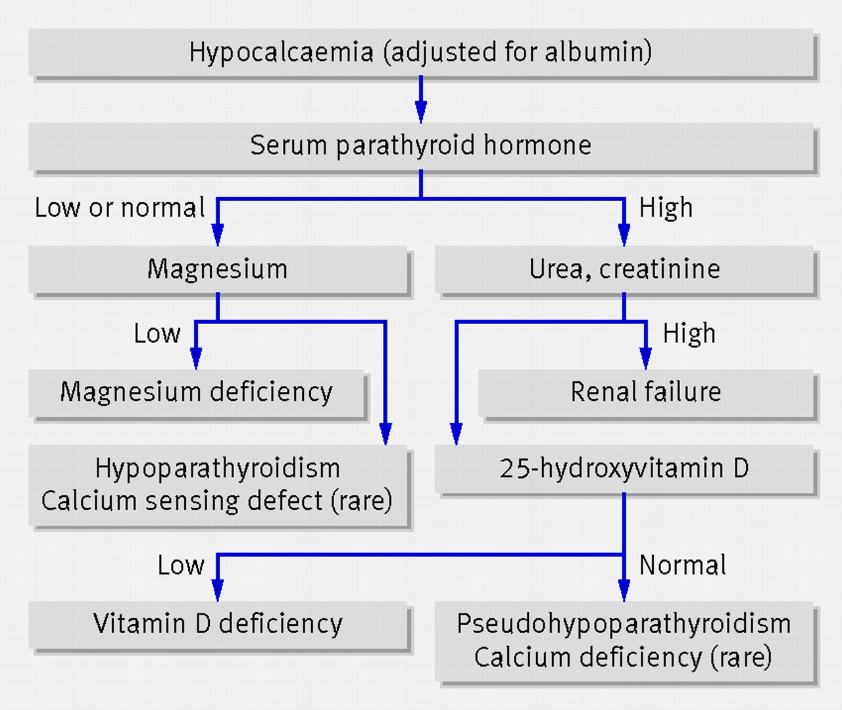

Fig 5 Algorithm for requesting investigations to elucidate the cause of hypocalcaemia.
Cooper M S , Gittoes N J L BMJ 2008;336:1298-1302
©2008 by British Medical Journal Publishing Group
Notes:
Fig 5 Algorithm for requesting investigations to elucidate the cause of hypocalcaemia

Slide 20
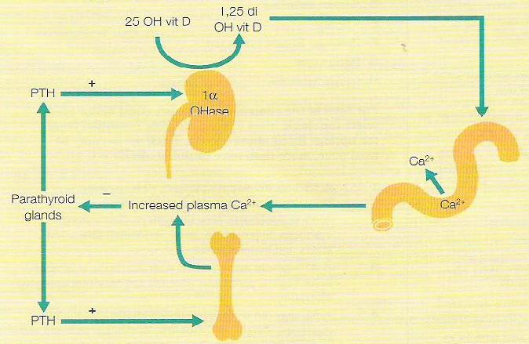
Another summary of Ca²⁺ Homeostasis

Slide 21
Metabolic bone disease
(biochemical / clinical aspects)
Osteoporosis
Osteomalacia / rickets
Pagets disease
Parathyroid bone disease
Renal osteodystrophy

Slide 22
Osteoporosis
Reduction in bone density (normal mineralisation)
Biochemistry NORMAL
Asymptomatic until 
Typical  - neck of femor (NOF), vertebral, wrist (Colle’s)

Slide 23
Osteoporosis
Diagnosis usually using DEXA scan
  Dual energy X-ray absorptiometry
  hip (femoral neck etc) & lumbar spine
  T-score – sd from mean of young healthy population (useful to determine # risk)
  Z-score – sd from mean of aged-matched control (useful to identify accelerated bone loss in younger patients)
Osteoporosis – T-score <-2.5
Osteopenia – T-score between -1 & -2.5

Slide 25
Osteoporosis - causes
Skeletal
mass
Age-related decline in
bone mass
menopause
# threshold
20
50
Age

Slide 26
Osteoporosis - causes
Skeletal
mass
Failure to
Attain peak bone mass
menopause
20
50
Age
Childhood illness

Slide 27
Osteoporosis - causes
Skeletal
mass
Early
menopause
menopause
20
50
Age

Slide 28
Osteoporosis - causes
Skeletal
mass
More rapid
bone loss during
adulthood
menopause
20
50
Age
Lifestyle: sedentary, EtOH, smoking, low BMI/nutritional
Endocrine: hyperprolactinaemia, thyrotoxicosis, Cushings
Drugs: steroids
Others eg genetic, prolonged intercurrent illness

Slide 29
Treatment for Osteoporosis
Lifestyle
  Weight-bearing exercise
  Stop smoking
  Reduce EtOH
Drugs
    Vitamin D/Ca
    Bisphosphonates (eg alendronate) –↓ bone resorption
    Teriparatide (PTH derivative) – anabolic
    Strontium – anabolic + anti-resorptive
    (Oestrogens – HRT)
    SERMs eg raloxifene

Slide 30
Vitamin D Deficiency
Defective bone mineralisation
Childhood -> Rickets
Adulthood -> Osteomalacia
Vitamin D deficiency in the UK
  More than 50% adults have insufficient vitamin D
  16% have severe deficiency during winter and spring
Risk factors
  Lack of sunlight exposure
  Dark skin
  Dietary
  malabsorption

Slide 31
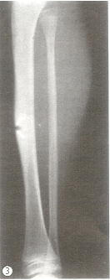
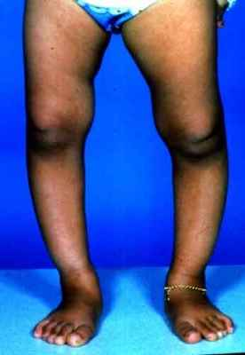
Clinical features of vit D deficiency
Osteomalacia
  Bone & muscle pain
  ↑# risk
  Biochem – low Ca²⁺ & P_{i},
  raised ALP
  Looser’s zones (pseudo#s)
Rickets
  Bowed legs
  Costrochondral swelling
  Widened epiphyses at the wrists
  Myopathy

Slide 32
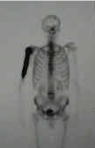
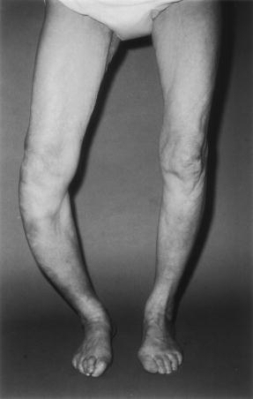
Paget’s Disease
Focal disorder of bone remodeling
Focal PAIN, warmth, deformity, fracture, SC compression, malignancy, cardiac failure
Pelvis, femur, skull and tibia
Nuclear med scan / XR
Elevated alkaline phosphatase
Treatment = Bisphosphonates for pain

Slide 33
Other metabolic bone disorders
In primary hyperparathyroidism
  Loss of cortical bone ->  risk
  Osteitis fibrosa
Renal osteodystrophy
  Due to secondary hyperparathyroidism + retention of aluminium from dialysis fluid
Both rare due to modern Rx of underlying disorders

Slide 34
Biochemistry in metabolic bone disease
 | Primary defect | Ca²⁺ | P_{i} | PTH | Vit D | ALP
Osteoporosis | Bone loss | N | N | N | N | N
Osteomalacia / rickets | ↓ vit D | ↓ / N | ↓ / N | ↑ (2ary ↑PTH) | ↓ | ↑
Paget’s | Remodelling | N | N | N | N | ↑
Parathyroid bone disease | ↑ PTH | ↑ | ↓ | ↑ / N (innap N) | N | ↑ / N
Renal bone disease | ↓ 1α hydroxylation Al toxicity | ↓ / N | ↑ (Pi retention) | ↑ (2ary ↑PTH) | N (1α is lo though) | ↑ / N

Slide 35
Renal stones

Slide 36
Renal stones
5% lifetime risk
Clinical features
  Renal colic
  Asymptomatic
Risk factors
  Anatomical abnormalities eg PUJ obstruction
  Urine infection
  Hot climate (dehydration) -> concentrated urine
  Abnormal urine pH eg meat intake, renal tubular acidosis
  Increased excretion of stone constituents including specific conditions

Slide 37
Calcium stones
Ca oxalate (35%), Ca phosphate (1%), or mix (45%)
Radio-opaque
Hyperoxaluria
  increased intake (eg chocolate…)
  increased intestinal absorption (eg short bowel syndrome)
  primary genetic defect (rare++)
Hypercalciuria
  hypercalcaemia (eg 1ary hyperPTH)
  normocalcaemic
    Bone resorption eg prolonged immobilisation
    Renal leak eg loop diuretics, renal tubular defects
    Increased intestinal absorption

Slide 38
Calcium stones – preventative management
General
  Avoid dehydration
Reduce oxalate intake
Don’t reduce Ca intake (-> bone resorption + increased oxalate excretion)
Thiazides -> hypocalciuric
Citrate
Treat underlying cause

Slide 39
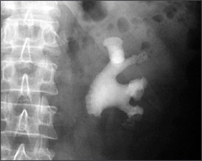
Triple phosphate stones
Mg NH4 phosphate + Ca phosphate (“struvite”)
10% of stones
Form when urine infection by urea splitting organisms (Klebsiella, proteus etc)
Staghorn calculi
Management
  General measures
  Treat / prevent infection

Slide 40
Other stones
Uric acid stones (5%)
  radiolucent
  hyperuricaemia (multiple causes…)
Cystine stones (1-2%)
  Radiolucent
  Underlying genetic defect - cystinuria

Slide 41
Biochemical investigation of recurrent renal stones
Serum
Creatinine
Bicarbonate
Calcium
Phosphate
Urate
PTH (if hypercalcaemic)
Urine
Spot urine
pH (fresh sample)
C+S
Amino acids
albumin
24 hour urine
Volume (>2.5L)
Calcium, oxalate,urate, citrate
Stone analysis

Slide 42
Management of established stones
Allow to pass spontaneously
Lithotripsy
Surgical: Cystoscopy, uretoroscopy

Slide 43
Key messages
Hypercalcaemia – measure PTH to aid diagnosis
Primary hyperparathyroidism commonest cause of hypercalcaemia, followed by malignancy
Osteomalacia – inadequate mineralisation due to vitamin D deficiency
Osteoporosis – loss of bone mass
Paget’s disease – focal disorder of bone remodelling
Think about pain, biochemistry, radiology to differentiate
Most renal stones contain Ca (and often oxalate)
Recurrent stone-formers need investigation for underlying cause

