Slide 1
Adrenal
Clinical cases
Chemical Pathology: Y5
Karim Meeran

Slide 2
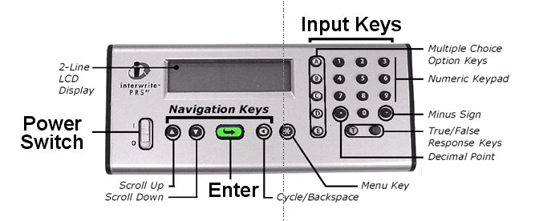
Turn ON your handset - slide the Power Switch up (I = ON)
Wait 4 seconds till GTCO CalComp disappears. It will start scanning.
Join the class by pressing the letter <4> and
then the green arrow
4. It should say “ANS”
Year 5path
<5>
WARNING: Your handset will go to SLEEP when not in use.
Press any KEY to WAKE UP your handset.

Slide 3
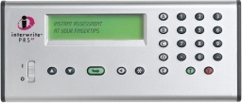
The zona fasiculata makes cortisol
Press 5
Then press green arrow to join
You should now be connected…
ANS:
YEAR5 PATH:
T TRUE
F FALSE
TRUE FALSE

Slide 4
Adrenal microanatomy
Look at the pic.
Label the zones:
Glomerulosa
Fasciculata
Reticularis
Medulla
capsule

Slide 5
Adrenal microanatomy
You should be able to recognise this shape. No other tissue looks like it. There are a small number of histologies that you should be able to recognise. Adrenal is one of them.
See webpath link.
http://library.med.utah.edu/WebPath/ENDOHTML/ENDO077.html
Notes:
5

Slide 6
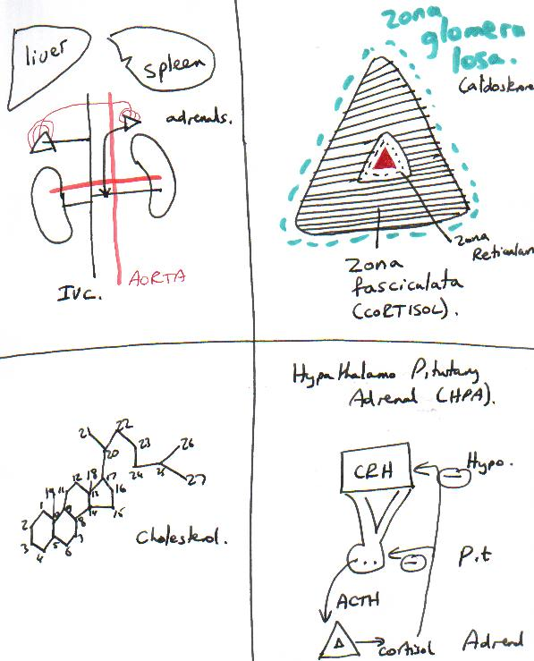

Slide 7
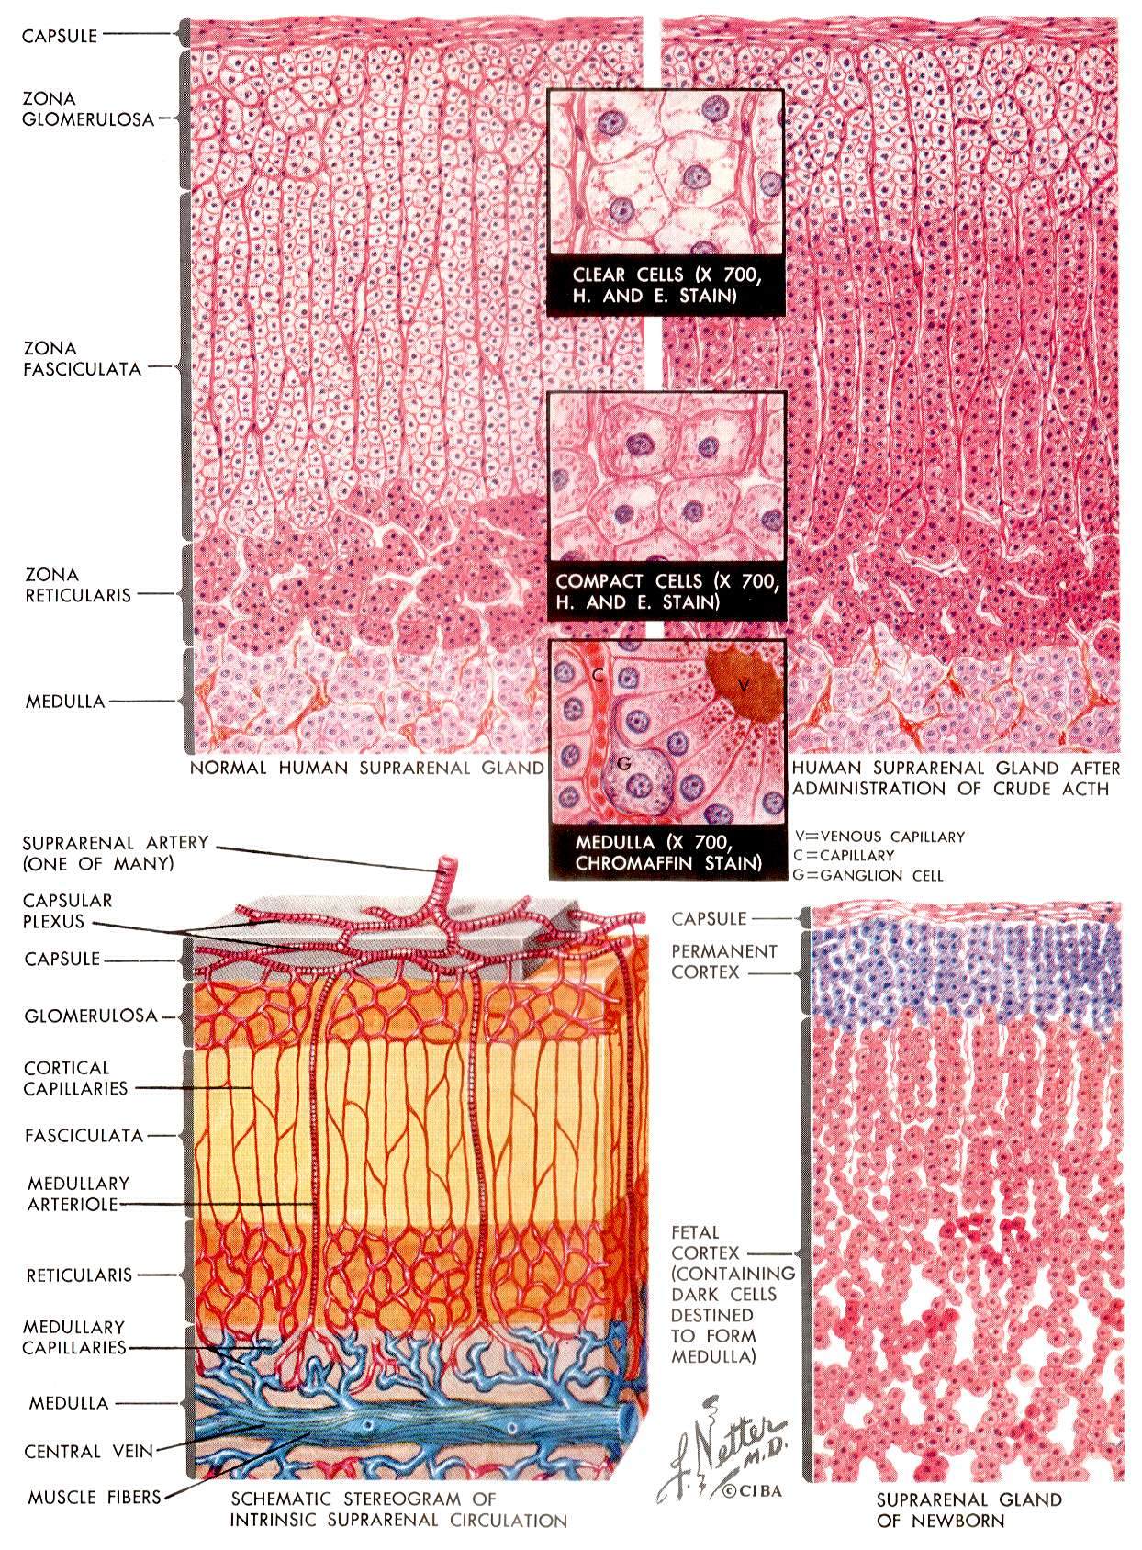

Slide 8
Case 1:
31 year old presents with profound tiredness.
Acutely unwell a few days.
Vomiting
Notes:
8

Slide 9
Case 1: data.
Na: 125, K: 6.5, U 10, Glucose 2.9mM.
FT4 < 5nM TSH > 50mU/l
What does this TSH suggest?
A. A TSH producing pituitary adenoma
B. Graves disease
C. A toxic thyroid nodule
D. Primary hypothyroidism
E. de Quervain’s (viral) thyroiditis.

Slide 10
Case 1: data.
Na: 125, K: 6.5, U 10, Glucose 2.9mM.
FT4 < 5nM TSH > 50mU/l
What does this TSH suggest?
A. A TSH producing pituitary adenoma
B. Graves disease
C. A toxic thyroid nodule
D. Primary hypothyroidism
E. de Quervain’s (viral) thyroiditis.

Slide 11
Case 1: data.
FT4 < 5nM TSH > 50mU/l
Suggests thyroid failure.
Hypothyroidism can cause profound tiredness.
Hypothyroidism does NOT explain the unusual electrolytes:
Na: 125, K: 6.5, U 10, Glucose 2.9mM.

Slide 12
Case 1: data.
Hypothyroidism does NOT explain the unusual electrolytes:
Na: 125, K: 6.5, U 10, Glucose 2.9mM.
Hyponatraemia, hyperkalaemia
Deficiency of mineralocorticoid.
Hypoglycaemia
Deficiency of glucocorticoid.

Slide 13
Case 1:
Hyponatraemia, hyperkalaemia
Deficiency of mineralocorticoid.
Hypoglycaemia
Deficiency of glucocorticoid.
ADDISON’S DISEASE

Slide 14
Case 1:
ADDISON’S DISEASE
Primary Hypothyroidism
SCHMIDT’s SYNDROME

Slide 15
Schmidt’s syndrome:
Addison’s disease and primary hypothyroidism occur together more commonly than by chance alone.
Ref: Schmidt, MB (1926)
Eine biglandulare Erkrankung bei morbus Addisonii. Verhandl. Dtsch. Path. Gesellsch. 21: 212-221

Slide 16
Tests for Addison’s
A. Low dose dexamethasone suppression test
B. High dose dexamethasone suppression test
C. Synacthen test
D. Glucose tolerance test
E. TRH stimulation test

Slide 17
Tests for Addison’s
Short SYNACTHEN test.
Measure cortisol + ACTH at start of test
Administer 250 micrograms synthetic ACTH by IM injection.
Check cortisol at 30 and 60 minutes.

Slide 18
Tests for Addison’s
Short SYNACTHEN test.
Results in this patient:
ACTH > 100 ng/dl
Cortisol < 10 nM
Check cortisol at 30 and 60 minutes.
Both times, cortisol < 10 nM

Slide 19
Case 2:
A 32 year old presents with hypertension.
He is noted to have an adrenal mass.
There are three possible differentials:
What is the differential diagnosis ?

Slide 20
Possible adrenal masses
Phaeochromocytoma
(Adrenal medullary tumour secreting adrenaline).
Conn’s syndrome (adrenal tumour secreting aldosterone)
Cushing’s syndrome (secretes cortisol)

Slide 21
Case 2:
Further investigations reveal that he has high levels of urinary catecholamines.
What urgent drug treatment is required?
What is the cure?

Slide 22
Phaeochromocytoma
Adrenal medullary tumour that secretes adrenaline, and can cause severe hypertension, arrhythmias and death.
THUS A MEDICAL EMERGENCY
Urgent alpha blockade with phenoxybenzamine.
Add beta blockade.
Finally arrange surgery.

Slide 23
Case 3:
Hypertensive 33 year old.
Na 147, K 2.8, U 4.0. Glucose 4.0 mM
Plasma aldosterone raised.
Plasma renin suppressed.
What is the diagnosis ?
[write it down now]

Slide 24
Case 3:
Primary hyperaldosteronism
Conn’s syndrome.

Slide 25
Primary hyperaldosteronism.:
Conn’s syndrome.
The adrenal gland secretes high levels of aldosterone autonomously. This will cause hypertension and this will in turn suppress the renin at the JGA.

Slide 26
Case 4.
34 year old obese woman with type 2 diabetes, presents with hypertension and bruising.
Na: 146, K: 2.9, U 4.0, Glucose 14.0
Aldosterone <75 (low). Renin low
TRUE or FALSE:
This excludes Conn’s and suggests another hormone is causing the hypertension.

Slide 27
Case 4.
34 year old obese woman with type 2 diabetes, presents with hypertension and bruising.
Na: 146, K: 2.9, U 4.0, Glucose 14.0
Aldosterone <75 (low). Renin low
TRUE or FALSE:
This excludes Conn’s and suggests another hormone is causing the hypertension.

Slide 28
Case 4.
34 year old obese woman with type 2 diabetes, presents with hypertension and bruising.
What is the diagnosis?
[write it down now]

Slide 29
Case 4.
34 year old obese woman with type 2 diabetes, presents with hypertension and bruising.
What is the diagnosis?
[write it down now]
Cushing’s syndrome

Slide 30
Tests for Cushing’s
9am cortisol
12 midnight cortisol

Slide 31
Tests for Cushing’s
Which dynamic test?
A. Insulin tolerance (stress) test
B. Dexamethasone suppression test
C. Synacthen test
D. Glucose tolerance test
E. TRH stimulation test

Slide 32
Tests for Cushing’s
Which dynamic test?
Dexamethasone suppression. This will usually suppress cortisol levels to undetectable levels.
Not so in Cushing’s.

Slide 34
Causes of Cushing’s syndrome
Please type in your CID NOW...
Being on oral steroids for something else
Pituitary dependent Cushings disease (85%)
Ectopic ACTH (5%)
Adrenal adenoma (10%)

Slide 35
Cushing’s syndrome (5)
An obese 35 year old patient has the following results:
9am cortisol (Monday): 650 nM
Given 0.5 mg dexamethasone every 6 hours for 48 hours
9am cortisol (Wednesday) < 50nM
What is the diagnosis?
What should be done next ?

Slide 36
Cushing’s syndrome (5)
9am cortisol (Monday): 650 nM
Given 0.5 mg dexamethasone every 6 hours for 48 hours
9am cortisol (Wednesday) < 50nM
What is the diagnosis?
A. Pituitary dependent Cushing’s disease
B. Adrenal tumour causing Cushing’s syndrome
C. Ectopic ACTH causing Cushing’s syndrome
D. Normal obese person
E. Cushing’s syndrome of indeterminate cause.

Slide 37
Cushing’s syndrome (5)
An obese 35 year old patient has the following results:
9am cortisol (Monday): 650 nM
Given 0.5 mg dexamethasone every 6 hours for 48 hours
9am cortisol (Wednesday) < 50nM
What is the diagnosis?
What should be done next ?
NORMAL

Slide 38
Cushing’s syndrome (5)
What should be done next?
A. Pituitary MRI
B. Adrenal CT scan
C. Chest X-ray to look for an ectopic source
D. Tell her she does not have any serious adrenal problem
E. High dose dexamethasone suppression test

Slide 40
Cushing’s syndrome (6)
9am cortisol (Monday): 650 nM
Given 0.5 mg dexamethasone every 6 hours for 48 hours
9am cortisol (Wednesday) 500nM
What is the diagnosis?
A. Pituitary dependent Cushing’s disease
B. Adrenal tumour causing Cushing’s syndrome
C. Ectopic ACTH causing Cushing’s syndrome
D. Normal obese person
E. Cushing’s syndrome of indeterminate cause.

Slide 41
Cushing’s syndrome (6)
9am cortisol (Monday): 650 nM
Given 0.5 mg dexamethasone every 6 hours for 48 hours
9am cortisol (Wednesday) 500nM
What is the diagnosis?
A. Pituitary dependent Cushing’s disease
B. Adrenal tumour causing Cushing’s syndrome
C. Ectopic ACTH causing Cushing’s syndrome
D. Normal obese person
E. Cushing’s syndrome of indeterminate cause.

Slide 42
Cushing’s syndrome (6)
An obese 36 year old patient has the following results:
9am cortisol (Monday): 650 nM
Given 0.5 mg dexamethasone every 6 hours for 48 hours
9am cortisol (Wednesday) 500nM
What is the diagnosis?
What should be done next ?
Cushing’s syndrome

Slide 43
Causes of Cushing’s syndrome
Being on oral steroids for something else
Pituitary dependent Cushings disease (85%)
Ectopic ACTH (5%)
Adrenal adenoma (10%)

Slide 44
Cushing’s syndrome (6)
What should be done next?
A. Pituitary MRI
B. Adrenal CT scan
C. Chest X-ray to look for an ectopic source
D. Tell her she does not have any serious adrenal problem
E. High dose dexamethasone suppression test

Slide 45
Cushing’s syndrome (6b)
9am cortisol (Wednesday): 500 nM
Given high dose dex suppression
9am cortisol (Friday) 170nM
What is the diagnosis?
A. Pituitary dependent Cushing’s disease
B. Adrenal tumour causing Cushing’s syndrome
C. Ectopic ACTH causing Cushing’s syndrome
D. Normal obese person
E. Cushing’s syndrome of indeterminate cause.

Slide 46
Cushing’s syndrome (6b)
9am cortisol (Wednesday): 500 nM
Given high dose dex suppression
9am cortisol (Friday) 170nM
What is the diagnosis?
A. Pituitary dependent Cushing’s disease
B. Adrenal tumour causing Cushing’s syndrome
C. Ectopic ACTH causing Cushing’s syndrome
D. Normal obese person
E. Cushing’s syndrome of indeterminate cause.

Slide 47
Cushing’s syndrome (6b)
High Dose Dex suppression
9am cortisol (Wednesday): 500 nM
Given 2.0 mg dexamethasone every 6 hours for 48 hours
9am cortisol (Friday) 170nM
What is the diagnosis?
What should be done next ?
Pituitary dependant Cushing’s Disease

Slide 48
Cushing’s syndrome (6b)
What should be done next?
A. Pituitary MRI
B. Adrenal CT scan
C. Chest X-ray to look for an ectopic source
D. Tell her she does not have any serious adrenal problem
E. High dose dexamethasone suppression test

Slide 49
Please now type in your Clicker No
And then press the green enter key
Notes:
49

