Slide 1
Oncology plenary teaching session
Presentation and Diagnosis
Department of Medical Oncology
Imperial College/Hammersmith Hospitals NHS Trust

Slide 2
How do Patients with Cancer
Present?

Slide 3
1. Screening Programme
2. Non-specific Symptoms
3. Loco-Regional Problems
4. Metastatic Manifestations
5. Paraneoplastic Syndromes

Slide 4
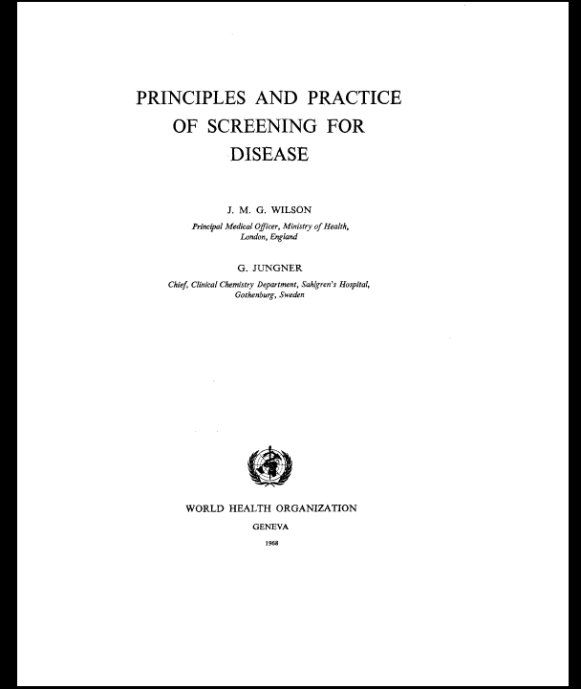

Slide 5
Principles of Screening
The condition should be an important health problem
There should be a treatment for the condition
Facilities for diagnosis and treatment should be available
There should be a latent stage of the disease
There should be a test or examination for the condition
The test should be acceptable to the population
The natural history of the disease should be adequately understood
There should be an agreed policy on whom to treat
The total cost of finding a case should be economically balanced in relation to medical expenditure as a whole
Case-finding should be a continuous process

Slide 6
Current NHS Screening Programmes

Slide 7

Who Gets Invited for Screening

Slide 8
The NHS Breast Screening Programme:
50-70: every three years
By 2012 age extension: 47 to 73
70:can request screening
NHS Cervical Screening Programme:
25: First invitation
25 – 49: 3 yearly
50 – 64: 5 yearly
>65: No screen since 50 or recent abnormal tests
The NHS Bowel Cancer Screening Programme:
60-69 every two years
>70:can request screening

Slide 9
How?

Slide 10
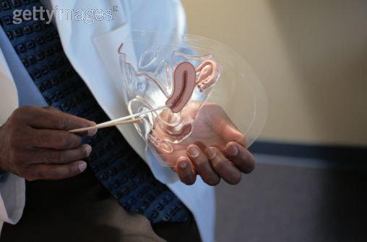
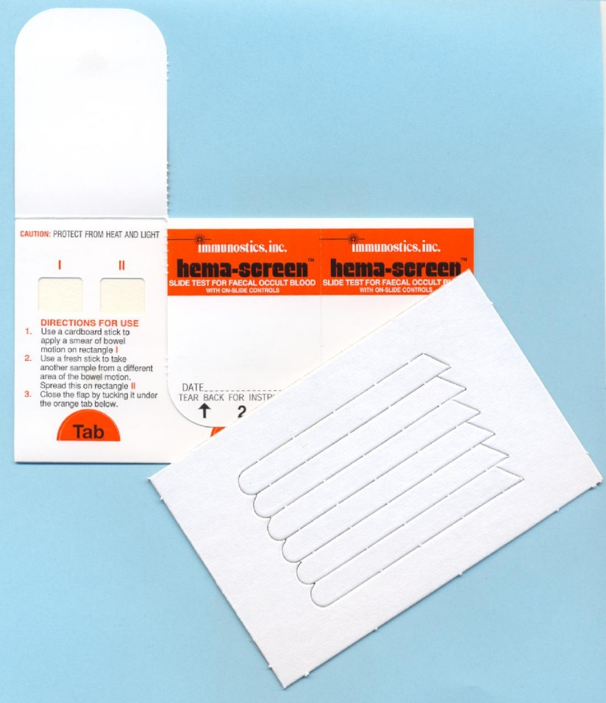
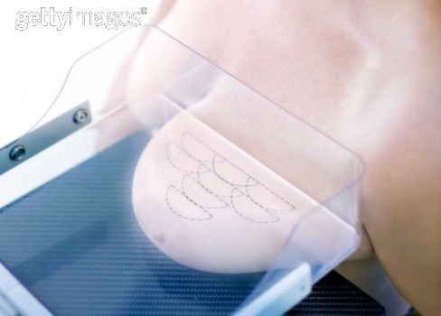
Cervical
Bowel
Breast

Slide 11
1. Local
2. Regional
3. Distant

Slide 12
1. Local
Direct Invasion into surrounding normal tissue
or
Mass Effect without direct invasion
Breast carcinoma
Direct invasion of chest wall (muscle and bone) or underlying structures such as Pericardium causing pain and pericardial effusion respectively.
Apical carcinoma of the lung
Invasion of brachial plexus leading causing neuropathy and neuralgia.
Thyroid Tumour
Direct pressure on trachea causing stridor
Brain Tumour
Midline shift causing neurological symptom

Slide 13
2. Regional
Lymphatic drainage to regional lymph nodes eg
Breast Cancer: axillary lymph nodes
Palpable Lymph nodes
Neurological problems: Brachial plexus involvement
Testicular Cancer: para-aortic nodes
Back Pain

Slide 14
3. Distant
Blood: invasion of vasculature and dissemination into general circulation
Lymphatic: for example ‘virchow’s node’ in the left supraclavicular fossa due to lymphatic spread of colonic carcinoma
Transcolemic: dissemination of malignant cells into coelomic cavity eg peritoneal by ovarian cancer or Krukenberg tumours from eg gastric cancer
Cerebrospinal: spread of primary brain tumour into CSF to other parts of brain and spinal cord

Slide 15
Sites of Metastatic Deposits
Bone
Brain
Lung
Liver

Slide 16
Metastatic Bone Disease
Breast, Lung, Prostate, Thyroid
Sclerotic: Dense Metastasis whiter than
normal bone (Breast/Prostate)
Lytic: Darker than normal bone ‘hole’
Differential Diagnosis: Multiple Myeloma

Slide 17
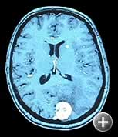
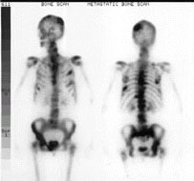
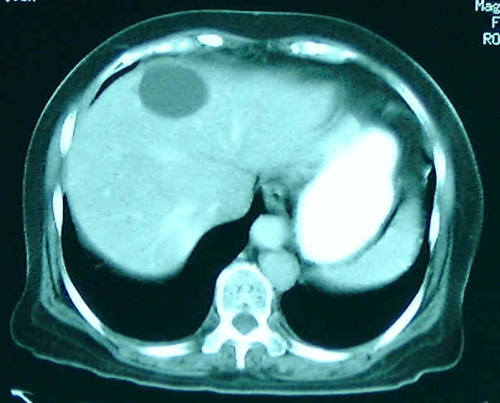
Metastases

Slide 18
Paraneoplastic Syndromes

Slide 19
Definition
Not due to the physical presence of the primary tumour or a metastasis at a particular site
BUT
Remote effects caused by a tumour, usually due to the production and secretion of a substance such as a hormone into the bloodstream.
Also when normal cells produce/secrete products in response to presence of tumour eg antibodies

Slide 20
Endocrine/Metabolic
Neurological
Dermatological

Slide 21
        Endocrine/Metabolic
a. Cushing’s Syndrome
Small Cell Lung Ca (rare)
b. SIADH
Small Cell Lung Cancer
(Tx: systemic Tx +/- Demeclocycline)
c. Hypoglycaemia
Non-islet cell tumours eg intrathoracic
sarcoma
d. Hypercalcaemia
Breast, Lung
PTHrP

Slide 22
2. Neurological (immune mediated)
a. Lambert Eaton Myasthenic Syndrome
Ab to presynaptic Calcium channel→ reduced ACh release at motor nerve terminal
eg commonly SCLC
eg less commonly breast, thymoma, colon
b. Anti-Yo Ab (cerebellar syndrome)
Cerebellar signs eg SCLC

Slide 23
3. Dermatological
Pigmented lesions (Acanthosis Nigrans)
Bullous (Pemphigus)
Erythemas (E. Annulare, Necrolytic Migratory E)
Metabolic (Cushings, Gynaecomastia)
Miscellaneous
Clubbing
Pruritis
Dermatomyositis

Slide 24
Diagnosis

Slide 25
HISTORY
EXAMINATION
SPECIAL INVESTIGATIONS

Slide 26
‘The only diagnosis is a tissue diagnosis’

Slide 27
Biopsy
Pre-operatively
  Image guided
  Endoscopy
Operatively
  Direct visualisation
  Removal of tissue

