Slide 1
Clinical reasoning Dr James Stratford-Martin GPPHC Course Lead
Adapted from slides by Dr Aisha Newth – GPPHC Course Lead

Slide 2
Why Teach clinical reasoning?
Doctors require
Perceptual skills
Psychomotor skills
Communicative skills
Decision making skills
Developing the Attributes of Medical Professional Judgement and Competence, DOH report
Eraut, M and du Boulay, B University of Sussex 2001
53% cases seen by junior doctors in Hull A+E 2009 had a symptom as final diagnosis
Estimated 15% overall diagnostic error rates in medicine

Slide 3
Why now?- PACES
15min stations
Why do people fail?
History taking
Examination
Interpretation of results
Communication skills
Appropriate differential
Discussion of management

Slide 4
Learning outcomes
Discuss models of clinical decision making
Hypothetico-deductive/iterative hypothesis testing
Combined approach
Dual process theory
Steps in reaching/refining a diagnosis or treatment plan
Apply the theory to clinical cases
Discuss the use of red flag questions

Slide 5
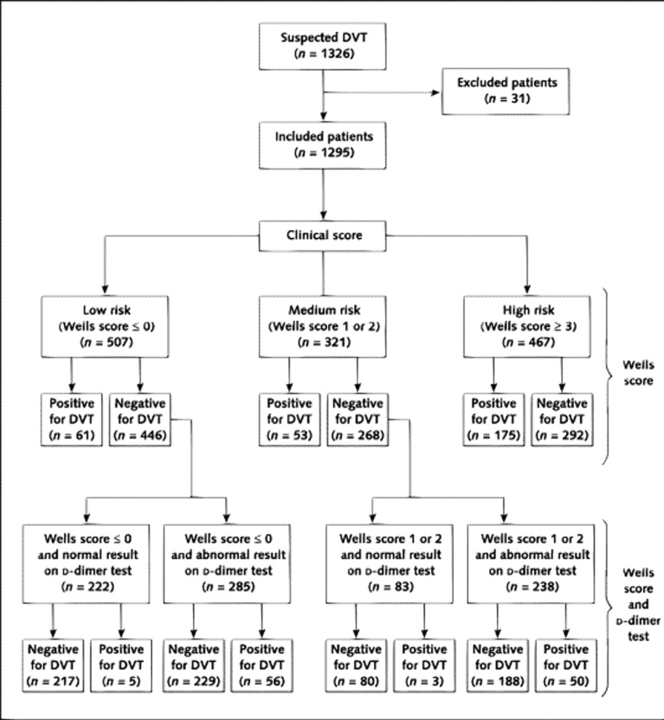
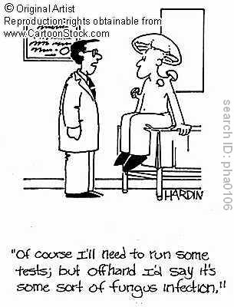
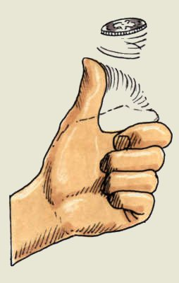
How do you make clinical decisions?
Ann Intern Med. 19 July 2005;143(2):100-107

Slide 6
Iterative Hypothesis Testing
Initial hypothesis
Intuitive/heuristic – non-analytical
Analytical Reasoning
Hypothesis testing- systematic gathering of data and weighing the elicited information against the mental rules
Intuitive brake
“it just doesn’t feel right”
Norman, G et al BMJ 2009;339 747-752
Notes:
Non-analytical
Then analytical
BUT a non-analytical brake will encourage further detailed assessment as a more complex/significant cause is suspected

Slide 7
How does iterative diagnosis go wrong?
Inadequate data collection
Premature closure
‘Confirmation bias’ -gathering information that will confirm rather than refute the diagnosis
‘availability bias’-relating the case to easily recalled examples
Norman, G et al BMJ 2009;339 747-752

Slide 8
How can we improve?
Routinely second guess- “am I sure?”
Seek data that would not fit with the hypothesis
‘Reframe’ when recording -re-examine data as we write the notes
Reconsider dissonant facts- review and re-examine facts that don’t fit
Be aware of test accuracy/inaccuracy
Use time as a diagnostic test
Norman, G et al BMJ 2009;339 747-752

Slide 9
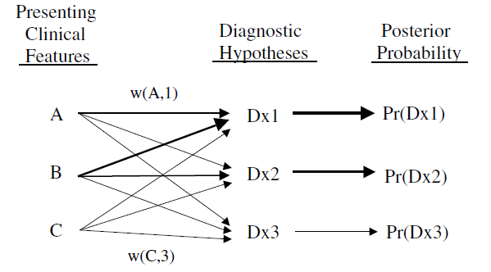
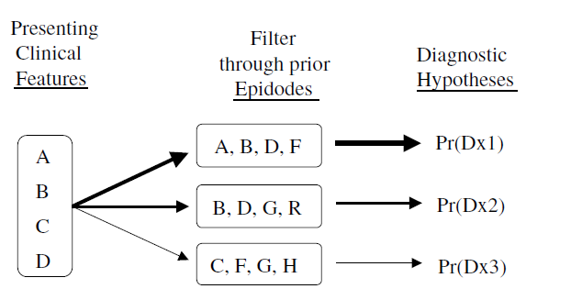
Models of decision making- combined model
Type 2- analytical
Type 1- intuitive
Eva, K Medical Education 2005

Slide 10
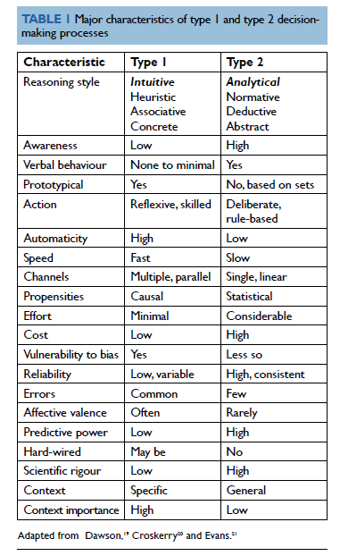
Models of decision making- dual process

Slide 11
Stages in Reaching a Diagnosis
Diagnostic Strategies used in Primary Care: Heneghan, Glasziou et al
BMJ 2009;338:b946
Notes:
It’s all well and good describing how one should approach clinical decision making but what do we actually do?

Slide 12
Initiating a diagnosis

Slide 13
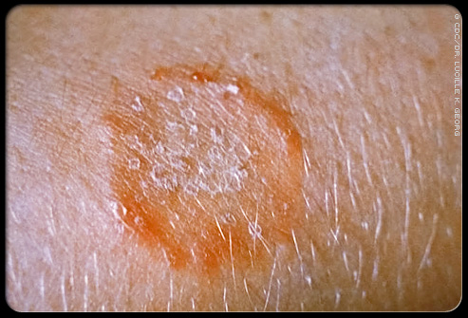
Spot Diagnosis
Notes:
In this trial used in 20% of cases and in those cases 63% of doctors used no other clinical reasoning method

Slide 14
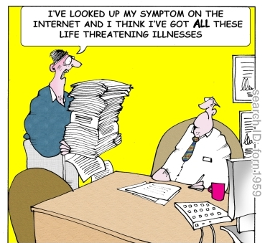
Self labelling
Notes:
84% of patients with recurrent UTI were correctly self diagnosed Gupta, K et al An Internal Med 2001 135: 9-16

Slide 15
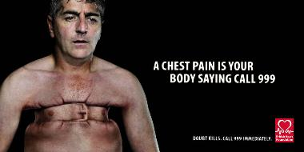
Pattern Recognition Trigger
Notes:
Time to diagnosis is vital and therefore hypothesis testing is not appropriate

Slide 16
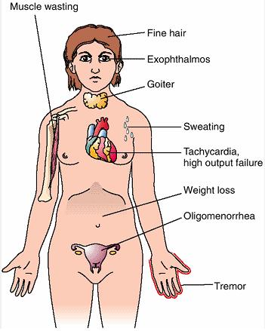
Pattern Recognition Trigger
Notes:
A pattern of symptoms is required for illness script testing

Slide 17
Refining a diagnosis

Slide 18
Restricted rule out (Murtagh’s process)
Highest probability cause then rule out ‘red flag’ diagnoses
Headache= tension or migraine
Rule out –subarachnoid/temporal arteritis/malignant HT etc.

Slide 19
Stepwise refinement
55 year old man with acute leg pain, erythema and swelling
Refinement:
Foot
1st MTP joint
Diagnosis: GOUT

Slide 20
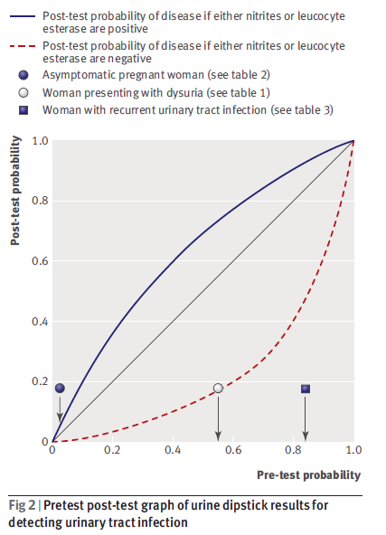
Probabilistic Reasoning
‘Bayesian Reasoning’ where we consider
the diagnostic accuracy of associated symptoms, examination and tests in our clinical decisions
Pre test probability
The accuracy of the diagnostic test
Post test probability
BMJ 2009;339:b3823
Notes:
Change in test probability depending on disease prevalence.

Slide 21
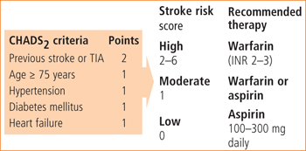
Clinical prediction rules-examples
Pneumonia - CRB 65
AF and stroke risk - CHADS 2 Stroke Risk - ABCD²
Notes:
These should probably described as guides rather than rules. The context in which they are developed, statistical method used to derive them and validity of the tests in clinical practice are variable.

Slide 22
Final definition stage

Slide 23
Red Flags !
What is a red flag?
Why are these important to GP’s?
“alarm symptoms” features in the clinical presentation that are considered to predict serious, often malignant, disease.

Slide 24
Red Flags!
New onset of alarm symptoms is associated with an increased likelihood of a diagnosis of cancer, especially in men and in people aged over 65. These data provide support for the early evaluation of alarm symptoms in an attempt to identify underlying cancers at an earlier and more amenable stage.
Red flags are part of the restricted rule out method- considered to be a clinically safe method.

Slide 25
Group Exercise -Red Flags
In your teams, write down 5 ‘alarm’ signs or symptoms for a patient presenting with:
T1- back pain
T2- dyspepsia
T3- rectal bleeding
T4- headache
T5- cough

Slide 26
Alarm Symptoms- Low Back Pain
Presentation less than age 20 or onset over age 55 years
Violent Trauma: eg fall from a height, RTA
Constant, progressive, non-mechanical pain or Thoracic pain
PMH - Carcinoma
Systemic steroids
Drug abuse, HIV
Systemically unwell / Weight loss
Persisting severe restriction of lumbar flexion
Cauda equina syndrome/widespread neurological disorder
Difficulty with micturition / Loss of anal sphincter tone or faecal incontinence / Saddle anaesthesia about the anus, perineum or genitals
Widespread (>one nerve root) or progressive motor weakness in the legs or gait disturbance
Sensory level
Inflammatory disorders (ankylosing spondylitis and related disorders)
Gradual onset before age 40 Marked morning stiffness Persisting limitation spinal movements in all directions Peripheral joint involvement Iritis, skin rashes (psoriasis), colitis, urethral discharge
Family history

Slide 27
Alarm Symptoms- Low Back Pain
1000 patients in Sydney
25 point red flag checklist
Sensitive - Only 11 cases of significant pathology detected but all had red flag symptoms.
Not specific - A high false positive rates for red flag questions
Arthritis and Rheumatism 2009

Slide 28
Alarm Symptoms- dyspepsia
Dyspepsia NICE 2010
Alarm signs
1. gastrointestinal bleeding
2. difficulty swallowing
3. unintentional weight loss
4. abdominal swelling
5. persistent vomiting
If >55 4-6/52 symptoms then urgent referral

Slide 29
Alarm Symptoms- rectal bleeding
Blood mixed with stool
Malaena
Associated weight loss
Change in bowel habit
Symptoms of anaemia
Blood on wiping/in pan/sitting on stool
Age

Slide 30
Rectal bleeding- urgent referral (NICE2010)
40+ rectal bleeding with a change to looser stools +/- increased stool frequency persisting 6+ weeks
60+ rectal bleeding persisting for 6+ weeks without a change in bowel habit and without anal symptoms
60+ with a change in bowel habit to looser stools and/or more frequent stools persisting for 6 weeks or more without rectal bleeding
of any age with a right lower abdominal mass
of any age with a palpable rectal mass
men of any age with unexplained iron deficiency anaemia Hb <11
non-menstruating women with unexplained iron deficiency anaemia Hb<10

Slide 31
Alarm Features- Headache
Definite cause for concern
Visual loss - GCA, Acute angle-closure glaucoma
Ataxia - CVA, Brain tumour
Confusion or lethargy - Intracerebral haemorrhage, Meningitis
Encephalitis, Brain tumour, Brain abscess
New onset seizure - CVA, Encephalitis, Brain tumour
May indicate a serious cause for headache
Fever - Meningitis, Encephalitis, Brain abscess
Weight loss - Brain tumour
History of malignancy - Brain metastasis
History of HIV - lymphoma, Toxoplasmosis, Cryptococcal meningitis
Thunderclap headache - Subarachnoid haemorrhage
Symptoms of raised intracranial pressure

Slide 32
Headache
The British Journal of Radiology, 76 (2003), 532–535
Most reliable ‘red flags’ for presence of abnormal brain imaging were:
Paralysis
Reduced conscious level
Papilloedema

Slide 33
Cough - urgent CXR (NICE2007)
haemoptysis, or
any of the following unexplained 3/52+:
− chest and/or shoulder pain
− dyspnoea
− weight loss
− chest signs
− hoarseness
− finger clubbing
− cervical and/or supraclavicular lymphadenopathy
− cough with or without any of the above
− features suggestive of metastasis from a lung cancer

Slide 34
Summary
Type 2- analytical
Type 1- intuitive
Eva, K Medical Education 2005
Notes:
Balance both intuitive and analytical processes

Slide 35
Stages in Reaching a Diagnosis
Diagnostic Strategies used in Primary Care: Heneghan, C et al
BMJ 2009;338:b946

Slide 36
Suggested reading
Heneghan C, et al “Diagnostic Strategies used in Primary Care”
BMJ 2009;338:b946
Norman, G et al “Iterative diagnosis” BMJ 2009;339 747-752
Croskerry, P and Nimmo, GR “Better clinical decision making and reducing diagnostic error” J R Coll Physicians Edinb 2011; 41: 155-62
Doust, J “Using Probabilistic reasoning” BMJ 2009; 339: 1080-1082

