Slide 1
BSc Exchange programme Health and Safety Dr Michael Barrett Head of Learning Resources mike.barrett@imperial.ac.uk
October 2012

Slide 2
Important contact details
Student matters - Antony Aleksiev 020 8383 1071 Your Superviser check for details
Occupational Health 020 7594 9401
Security (SK) 020 7594 8910
Safety Dept 020 7594 9423
Estates helpdesk 020 7594 8000
Teaching intranet https://education.med.imperial.ac.uk

Slide 3
Safety policy and guidance
Details are to be found on the Intranet at https://education.med.imperial.ac.uk/Policies/Safety.htm

Slide 4
FIRE & Evacuating the area
Know the exit routes and where to assemble
Leave the area when instructed so to do
Do NOT delay your exit to collect personal effects
Do NOT interfere with Fire Safety Equipment under ANY circumstances
If there is a fire, do NOT use fire fighting equipment unless 500% sure you know what to do
i.e. leave it to the professionals
Get informed about the local “Fire Alarm” system - http://www1.imperial.ac.uk/medicine/intranet/healthandsafety/campus/

Slide 5
Local emergencies
Call the College Emergency Number who will advise the relevant campus staff immediately
020 7589 1000
Hospital areas – see local information
Fire Drills – these are arranged locally and details will be given by campus staff

Slide 6
First Aiders
For general areas in College Buildings
Contact Emergency number who will send a trained First-Aider
If working in a research lab, the academic department will have designated trained First Aiders
For Clinical areas
Local ward staff
A & E Dept
Hospital Occupational Health Dept.

Slide 7
Injuries and Incidents
Seek immediate assistance from local “responsible” persons
Get medical attention if injured, however minor
Local first-aider | A & E Dept | Occupational Health
REPORT IT
On College premises - http://www3.imperial.ac.uk/safety
On NHS Trust/general practice premises – see local documentation for reporting incidents/accidents – also report to College, via on-line system as above
There will be an investigation & follow-up
Faculty of Medicine Campus Safety Officer
College Safety Officer
College Occupational Health

Slide 8
Reporting Incidents and Accidents
FoM Campus Safety Officers:
Charing Cross
St Mary’s
Hammersmith
Chelsea & Westminster
Royal Brompton
Email problems and queries to smhq-medicine-ug-accidents
For incidents in Clinical areas, also report to local senior staff

Slide 9
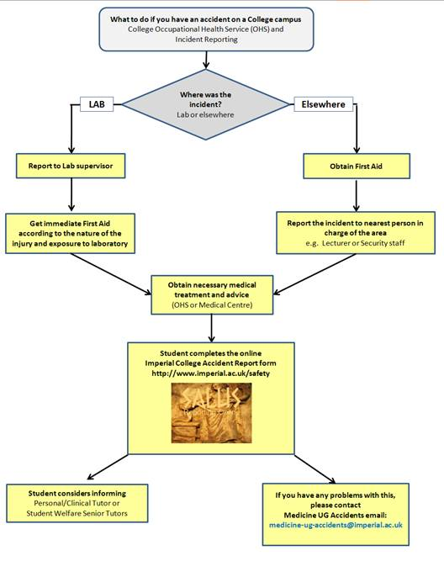
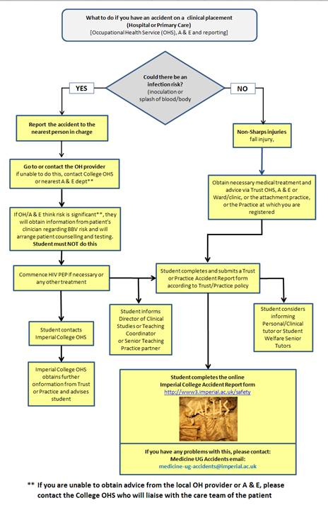
Reporting Injuries and Incidents – click on image to go to intranet version

Slide 10
Functions
Safety Department
Policy
Investigation
Reporting
Advice
Occupational Health
Surveillance
Immunisations
Investigation
Security
College & personal security
First Aiders (College)

Slide 11
Safety Issues – hazard awareness
Chemicals
Ionising radiation
Electrical
Lasers
Heavy objects
Infectious agents
Allergens
Temperature
Pressure systems
Lone working
These are as applicable in the Clinic/Ward/Treatment Room, as in a Lab
Can you name any more hazards?
People!
Trip hazards!

Slide 12
Risk Assessments
Legal requirement
Must be done by the department providing the course
The assessments include:
Identification of hazard(s)
The likely exposure (amount/duration/etc)
Protocol to minimise/eliminate exposure to safe levels
Procedure in event of an accident/spillage
If in doubt…. check with your Departmental Safety Officer

Slide 13
Personal and local issues
Disposal – know the correct protocols
Spillages – know how to be deal with what you are using
Decontamination – find out how to before needing to
Protective clothing “PPE” – correct type(s)
Are you pre-sensitised?
tell your supervisor and Occupational Health
If you don’t understand, ask

Slide 14
Typical problems – know what you should do
Am I working unsupervised before my competency is proven (keen and/or pressured)?
What if I have a needlestick injury?
Know what to do and do it immediately
Report it to College
I might be working late? Should I work alone?
What if I am ill? (Especially any infection, e.g. gastrointestinal) Should I continue to see patients?

Slide 15
Take Care!
Good luck with your course
mike barrett@imperial.ac.uk

