Slide 1

Decision-making in surgery
Dr Nick Sevdalis
Department of Surgery & Cancer
(n.sevdalis@imperial.ac.uk)

Slide 2
Learning outcomes for this lecture
Define terms used within surgical education
Select appropriate tools for training and assessment of surgical skills
Define the multidimensional nature of surgical performance
Justify the importance of simulation (as prerequisite to surgical practice)
Evaluate research studies (in simulation)
and their limitations
2
Notes:
2

Slide 3
What is a decision in clinical practice?
What is good clinical judgement?

Slide 4
Judgement & decision-making
Judgement
  How bright is a light?
  How likely is a diagnosis?
  How tender is the abdomen?
  How likely is a patient to quit smoking?
Decision-making
  Deciding whether to treat
  Choosing a treatment to follow
← perception
← action

Slide 5
‘Systems approach’ to patient outcomes
Individual skills (motor, cognitive etc.)
Patient Risk Factors
Teamwork & communication
Outcome
Clinical environment & procedures

Slide 6
Decision-making as a surgeon’s skill
Individual decision-making
  Diagnosis
  Whether to offer treatment; choice of treatment
  On-going decision-making as the treatment progresses
  ……

Slide 7
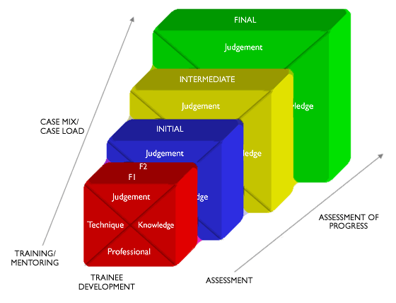
The surgical curriculum

Slide 8
Decision-making as a team skill
Team decision-making
  Multidisciplinary cancer teams
Decision-making between doctors and patients
  Shared; how much is truly shared?

Slide 9
Think of a patient with symptomatic gallstone disease
What decisions would you have to make pre-, intra- and post-operatively?

Slide 10
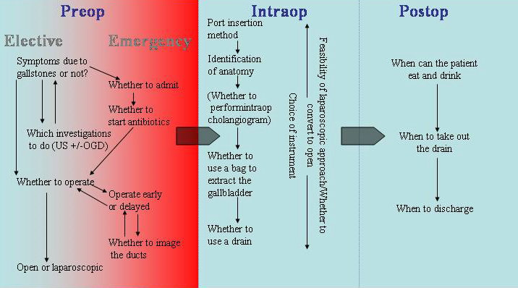
Jacklin et al, Am J Surg 2008;195:689-96.

Slide 11

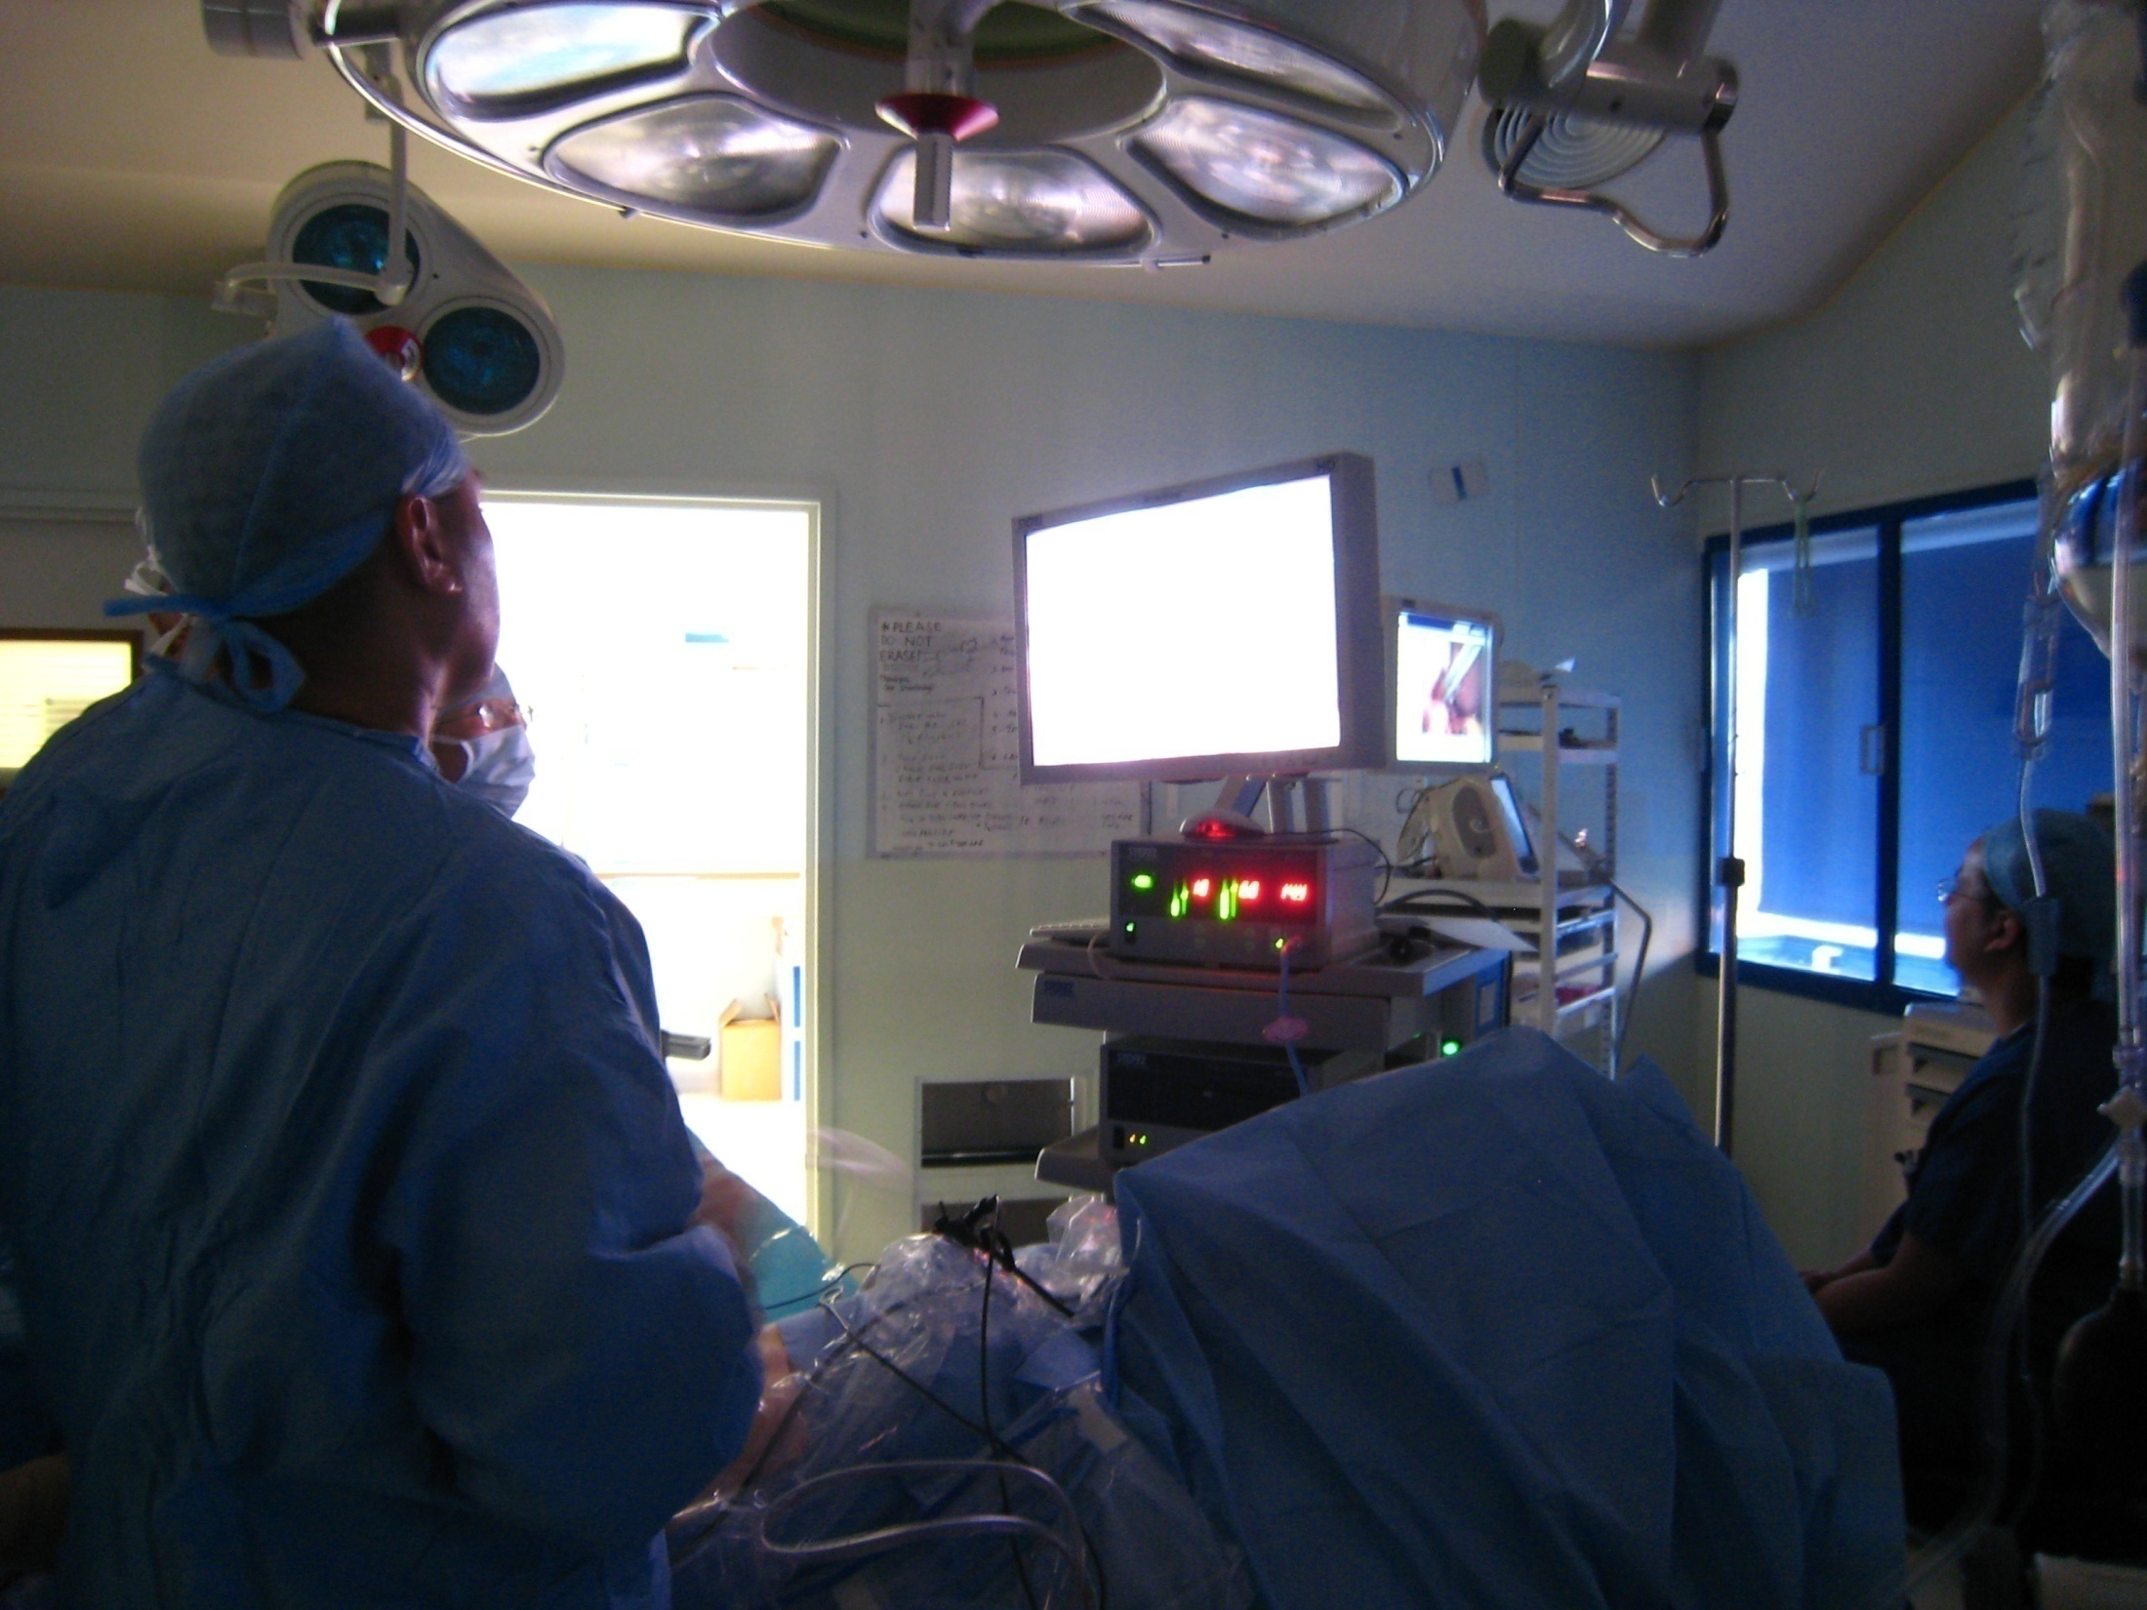
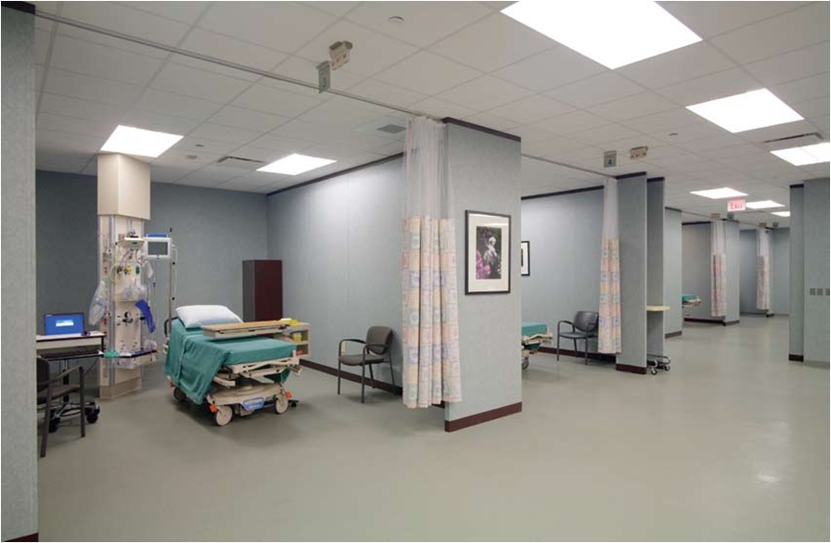

Slide 12
Flin et al, Qual Saf Health Care 2007;16:235-9.

Slide 13
Analytical: Decision tree for appendicitis
Patient with right iliac fossa pain
Admit
Operate
Normal appendix
P=0.40
Utility=0.80
Appendicitis
P=0.60
Utility=0.90
Watch and wait
Normal appendix
P=0.40
Utility=1.00
Appendicitis
P=0.60
Utility=0.60
Discharge
0.32 0.54 0.40 0.36
0.86
0.76

Slide 14
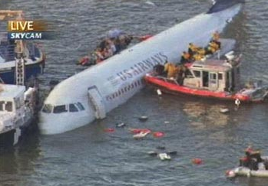
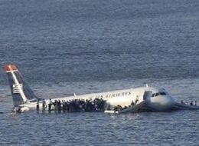
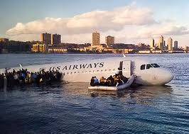
Creative: situation not previously seen

Slide 15
Assessing and training
decision making skills

Slide 16
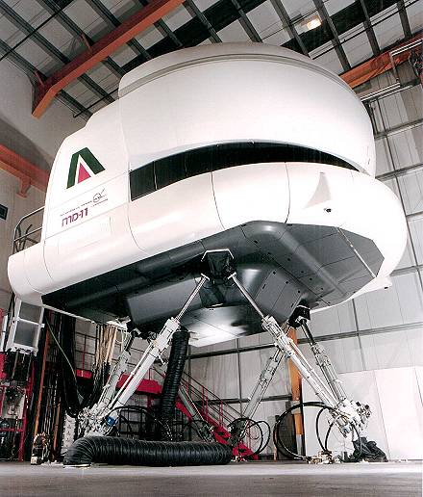

Slide 17

Originally developed for commercial aviation
‘Crew Resource Management’ training modules

Slide 18
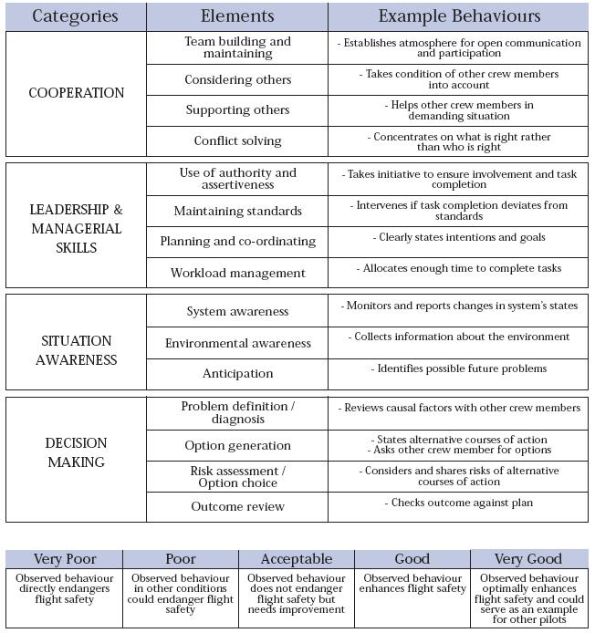
Concrete, observable “Behavioural Markers”
Typically derived via observation and expert consensus procedures

Slide 19
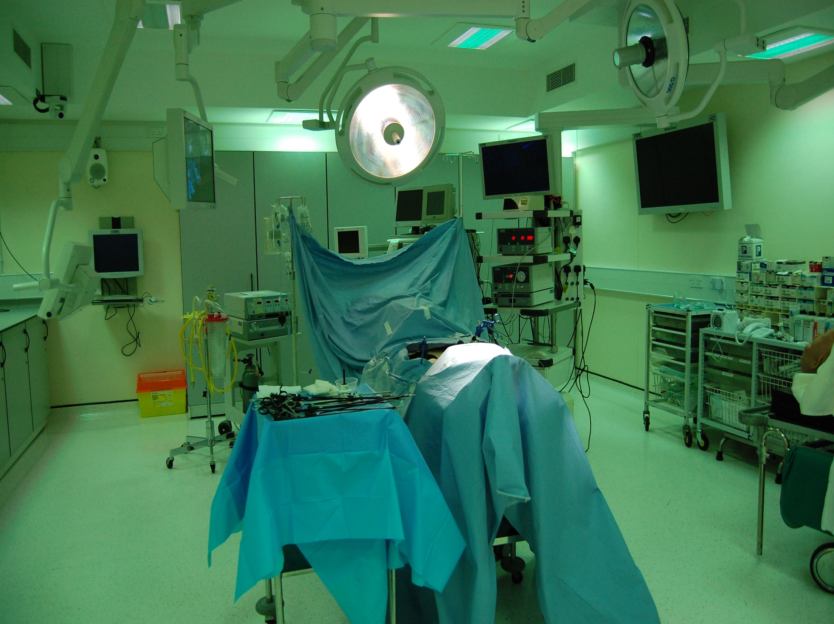

Slide 20
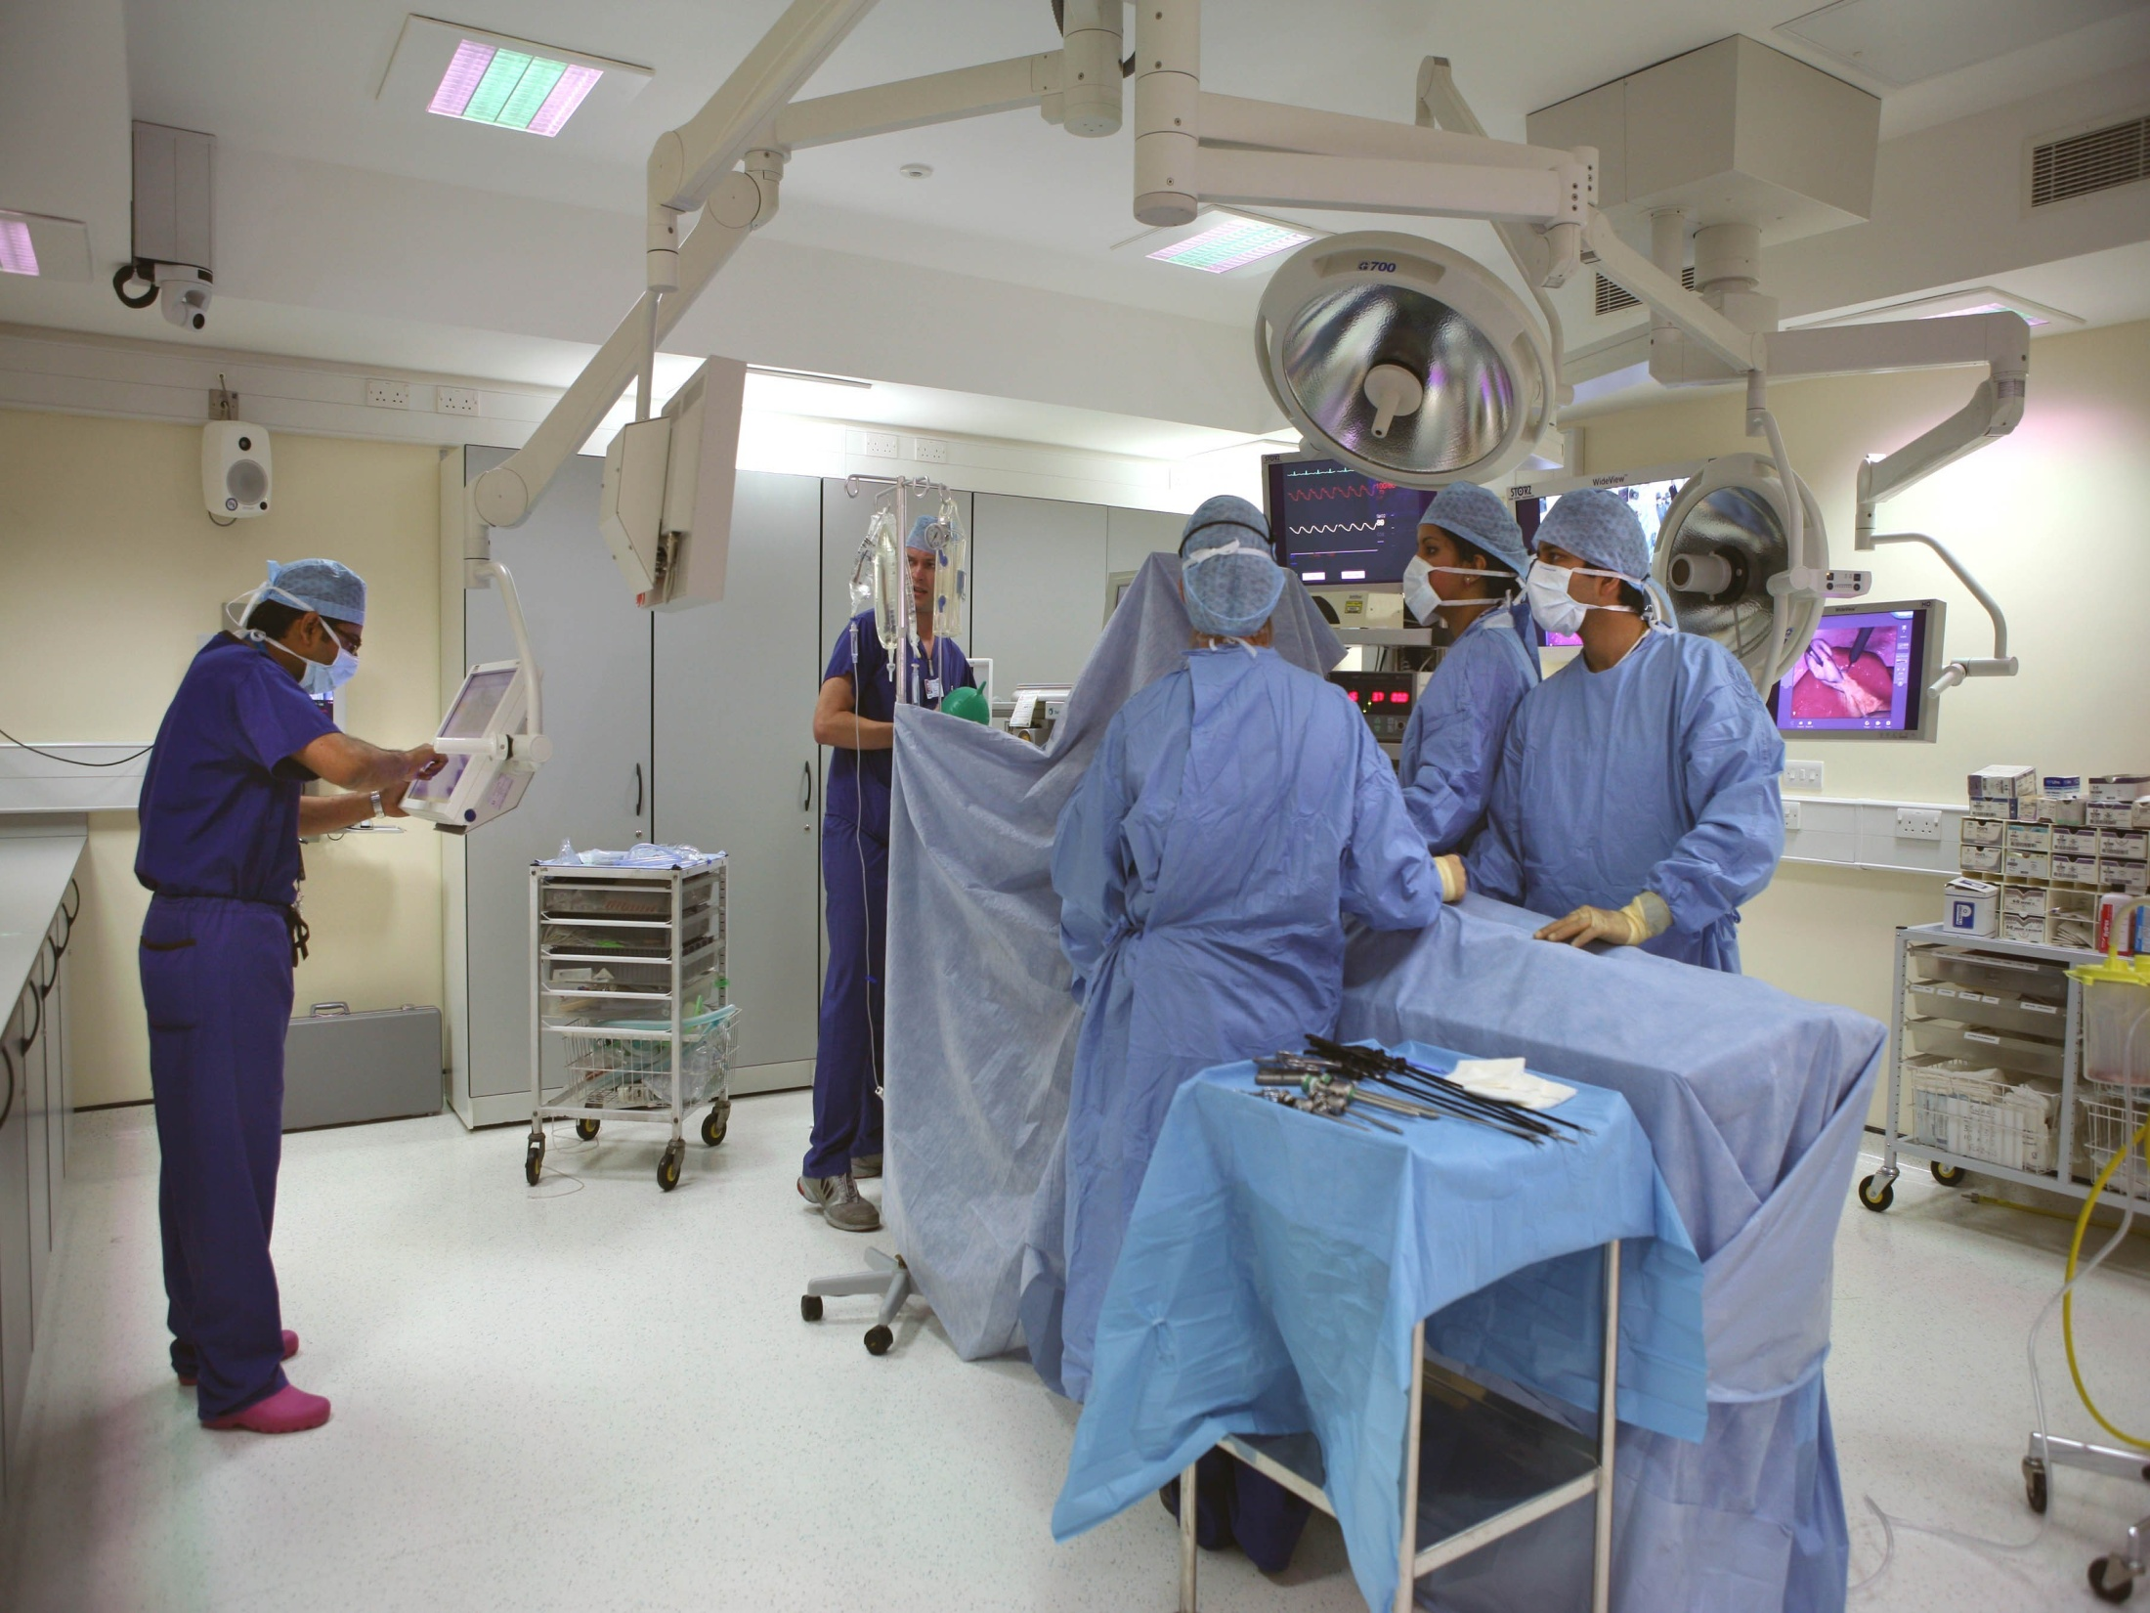
Simulators

Slide 21
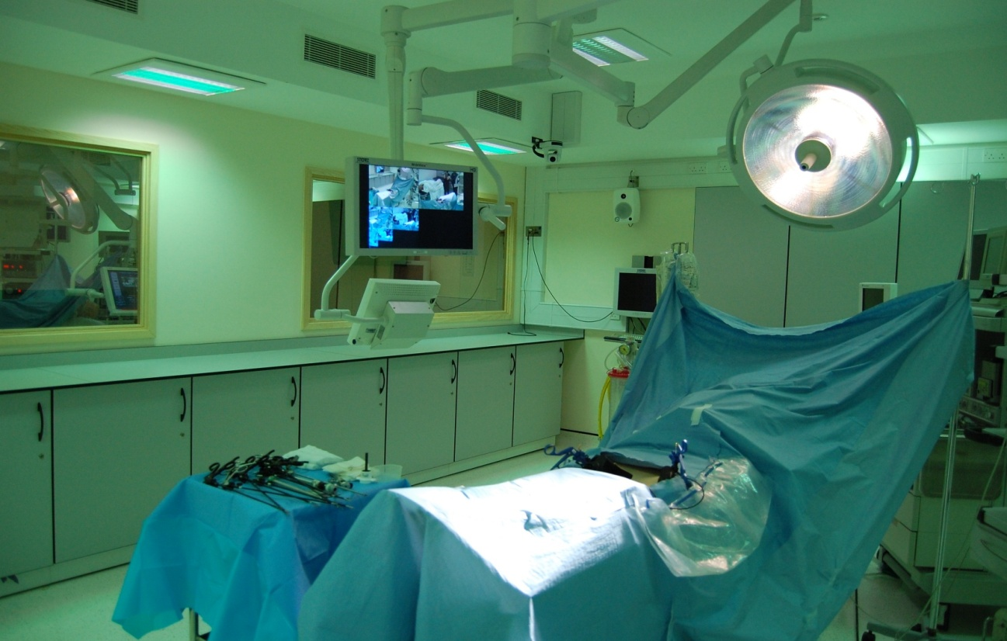
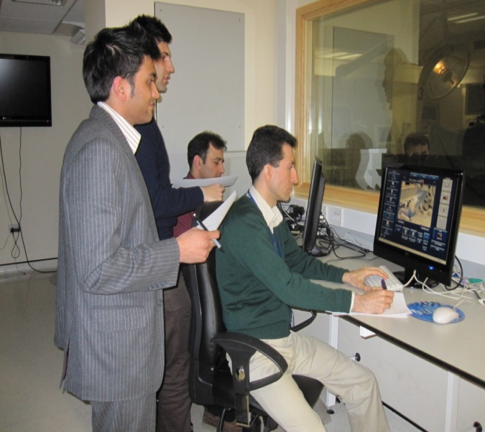
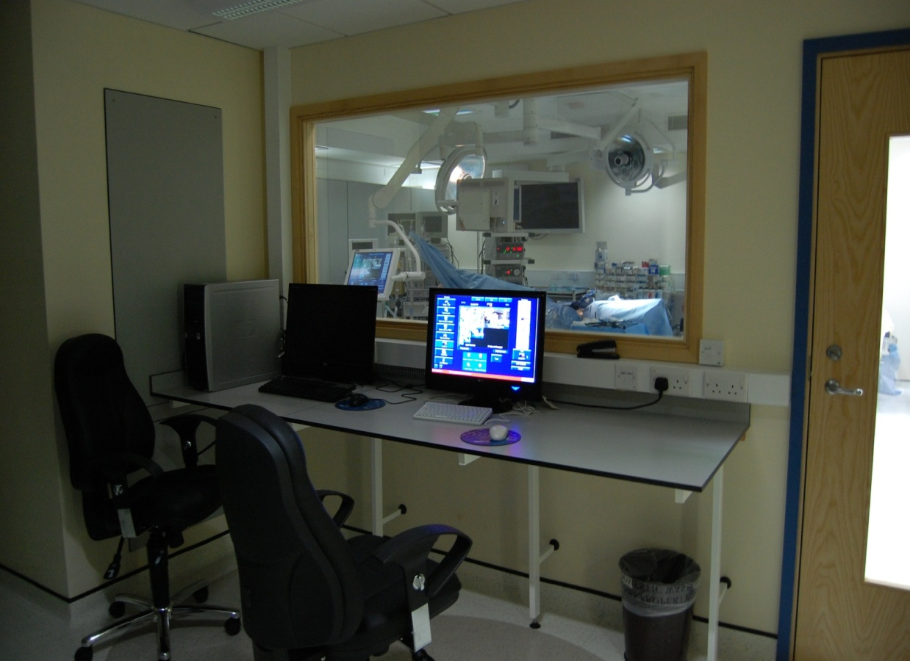
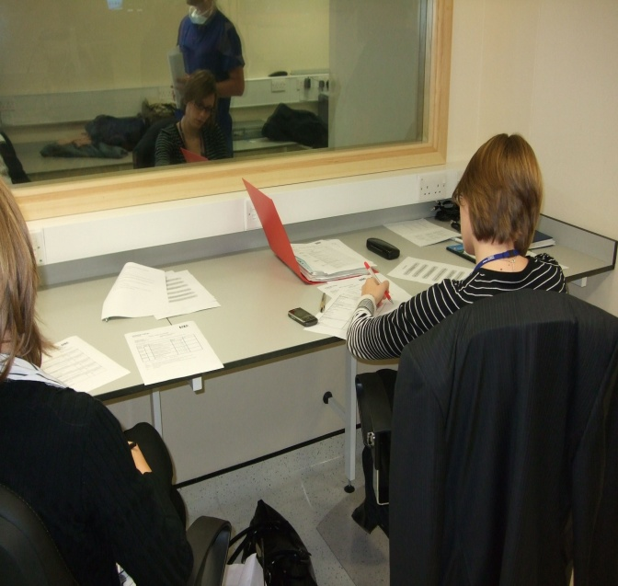

Slide 22
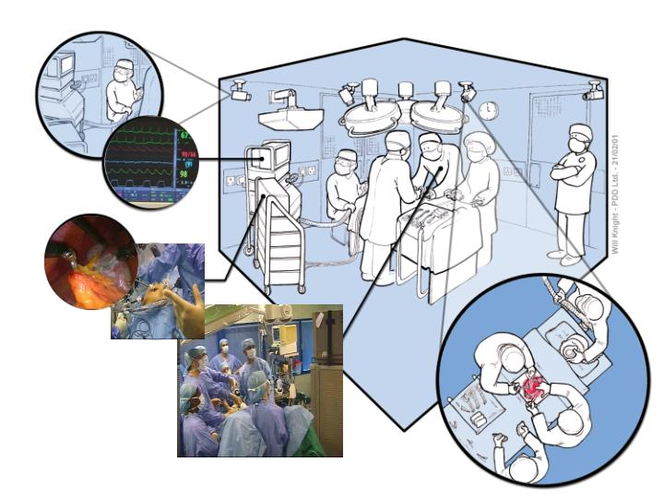
Clinical data recorder
Trainers observe and assess via one-way mirror

Slide 23
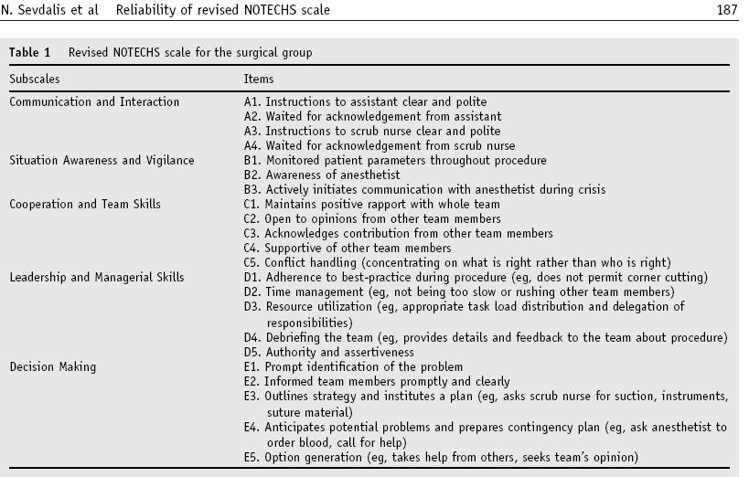
Revised NOTECHS for surgery

Slide 24
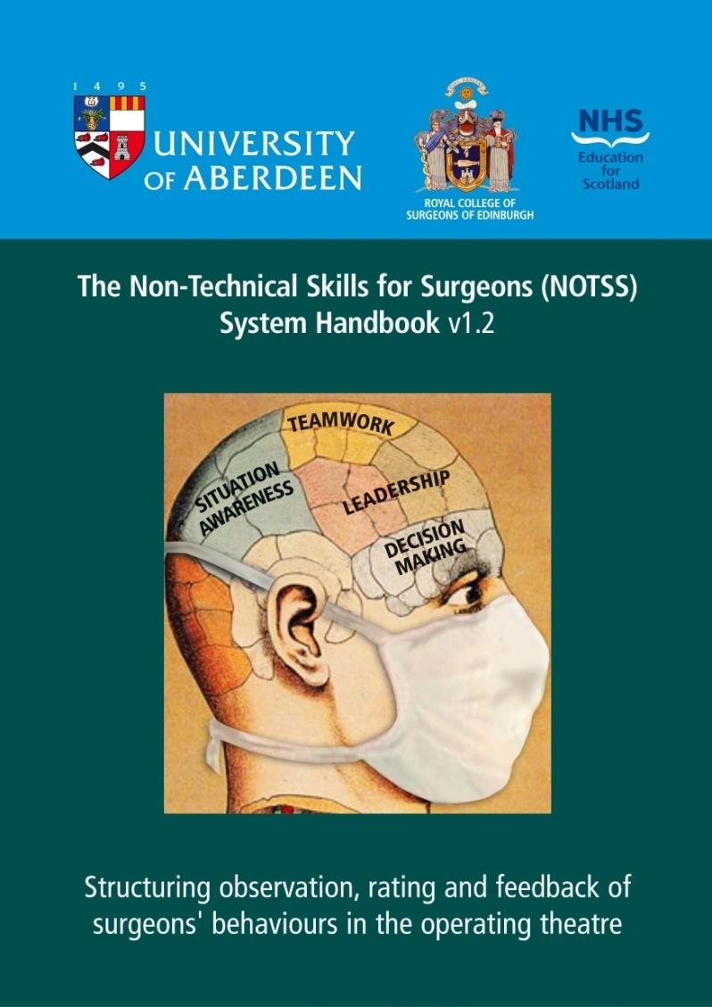
Decision-making in NOTSS

Slide 25
Questions?
Email: n.sevdalis@imperial.ac.uk

Slide 26

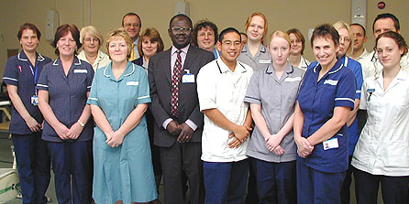
Team decision-making: Cancer MDTs
  Implemented in UK since 1995 (Calman-Hine Report)
  Intended to standardise and improve care
  Ensure expert input of specialists and improve timeliness of treatment

Slide 27
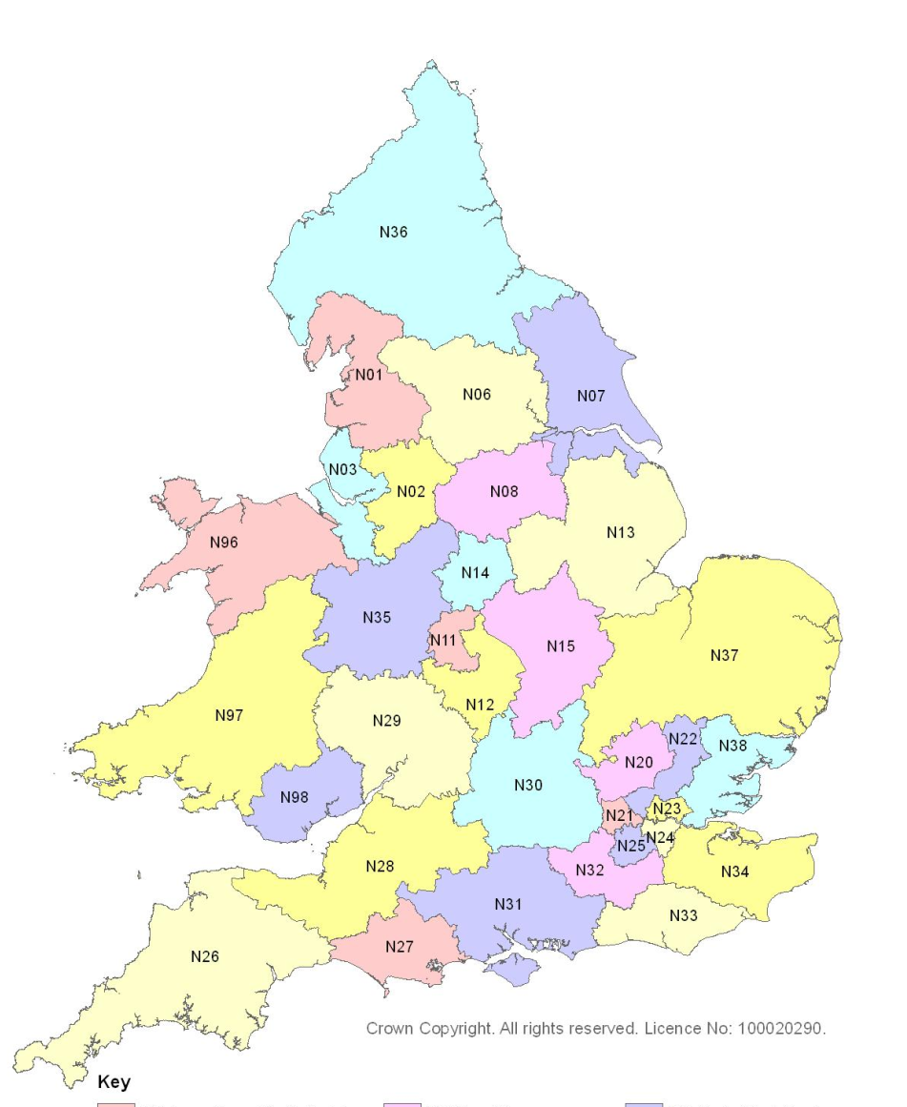
Current MDT practice
≈1500 MDTs in England
Cancer Units and Centres for each tumour type
Delivery of care by MDTs:
  1996: 20%
  2006: >80%

Slide 28
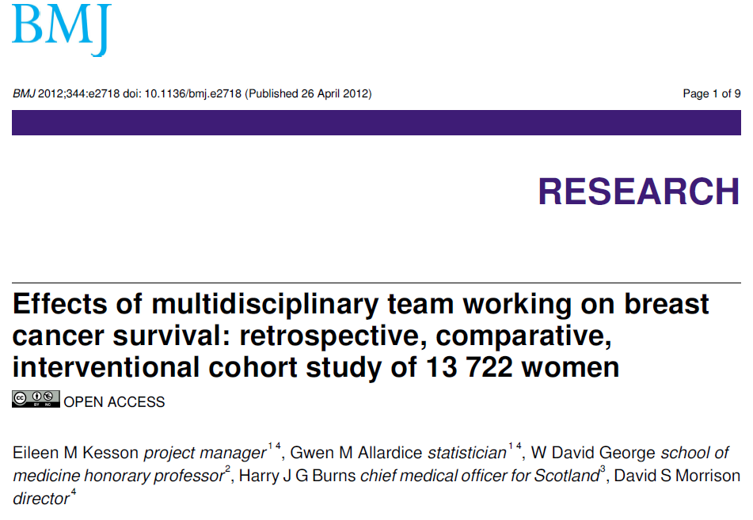
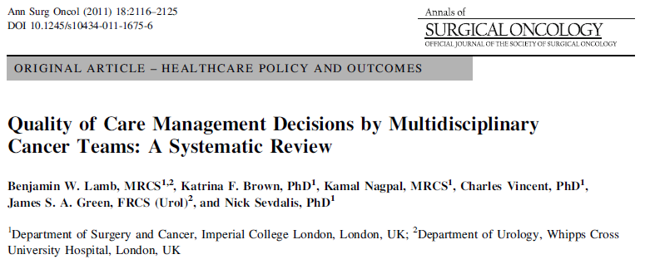
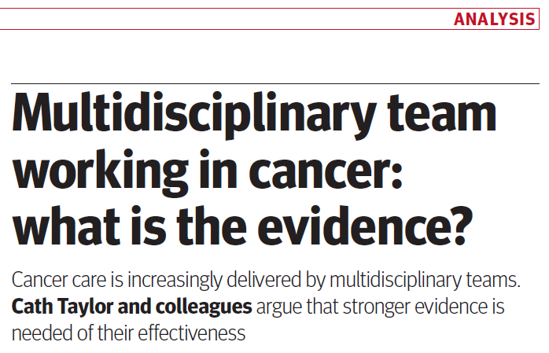
Effectiveness of MDTs
Some positive studies
Generally variable evidence base across tumour types

Slide 29

The MDT process
TEAM INPUTS
TEAM PROCESSES
TEAM OUTPUTS
  Lamb, Green, Vincent, Sevdalis, Surg Oncol 2011;20:163-8.

Slide 30
The MDT process
TEAM INPUTS
TEAM PROCESSES
TEAM OUTPUTS
Attendance
Expertise
Information
Equipment
Expert review
Teamwork
Open discussion
Leadership
Decision
Implementation
Documentation
Communication
Research
MDT MEETING
  Lamb, Green, Vincent, Sevdalis, Surg Oncol 2011;20:163-8.

Slide 31
Why do MDTs fail to reach a decision?

Slide 32
Why do MDTs fail to reach a decision?
  Lack of clinical or staging information
  Lack of personal knowledge of patient
  Lack of information on co-morbidities
  Poor attendance
  Disagreement
  Case complexity
Order of importance
  Lamb et al, World J Surg 2011;35:1970-6.

Slide 33

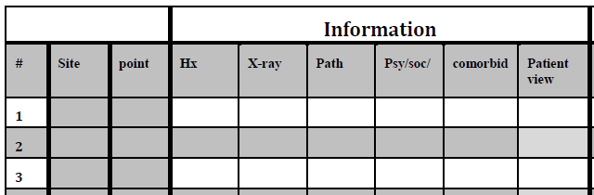
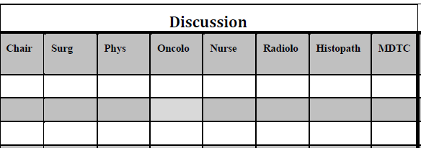
How do we assess MDT functioning scientifically?
Assessing
quality of
information
Assessing
quality of
contributions
  Lamb et al, BMJ Qual Saf 2011;20:849-56.

Slide 34
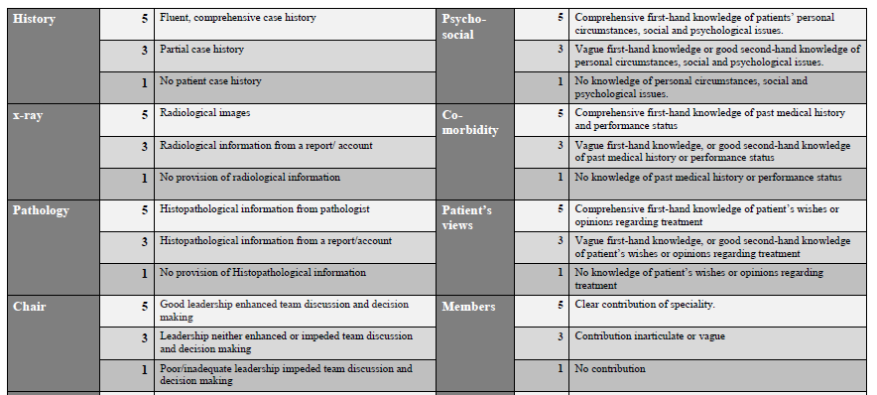
How do we assess MDT functioning scientifically?
Scales and
scoring anchors
for assessors
  Lamb et al, BMJ Qual Saf 2011;20:849-56.

Slide 35
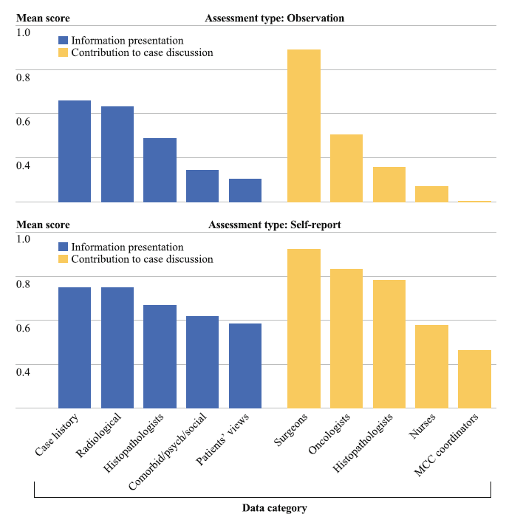
Team-members’ contribution to team decision-making
Self report & observation
  Lamb, Sevdalis, Mostafid et al, Ann Surg Oncol 2011;18:3535-43.

Slide 36
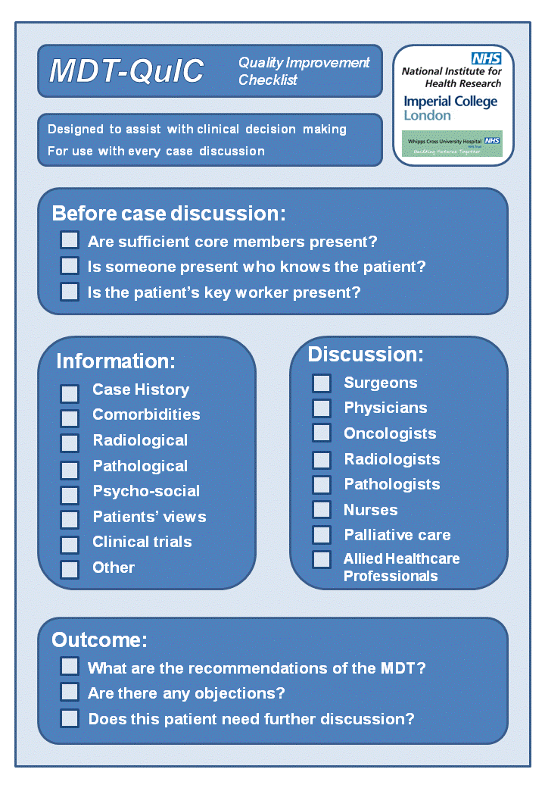
Improving MDT decision- making:
Development and application of a decision checklist
  Lamb et al, Ann Surg Oncol 2012;19:1759-65

Slide 37
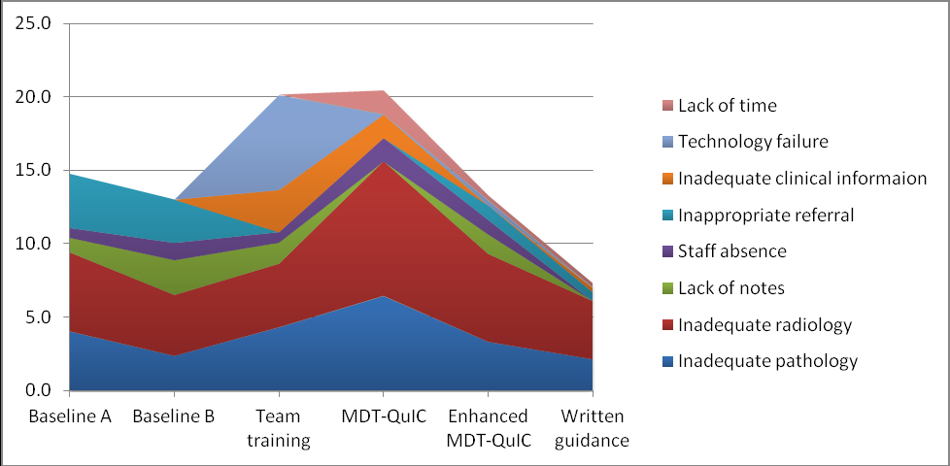
MDT-QuIC facilitates team decision-making
  Lamb et al, Ann Surg Oncol 2013;under review.

Slide 38
How do patients contribute to decision making?

Slide 39
Decision-making with patients
Paternalistic
Decisions made by doctor for the patient
Shared
Interactive option generation and discussion; joint decision on treatment, implementation and review
Informed
Options presented by doctor, burden of responsibility and choice to patient

Slide 40
Decision-making process
Entwistle & Watt (2006)

Slide 41
Patients’ decision-making skills
Question asking (most common)
Clarification seeking
Checking
Understanding information/communication
Raising concerns
Taking active role
Obtaining information
Expressing opinions
Verifying information
Review of interventions to enhance patient-physician communication. Harrington et al. (2004)

Slide 42
Very similar skills as those we discussed for surgeons

Slide 43
Questions?
Email: n.sevdalis@imperial.ac.uk

