Slide 1

An introduction to biomechanics
Dr Dominic Southgate
Sports Bioengineering Teaching and Research Fellow
Department of Bioengineering
January 2013
a.bull@imperial.ac.uk
www.bg.imperial.ac.uk/staff/abull

Slide 2
Lecture content
Part 1 – General Mechanics
Part 2 – Mechanics in the Body

Slide 3
Learning Outcomes
Part 1 – General Mechanics:
• Define loading, stress and strain
• Describe how materials can be tested for their mechanical properties

Slide 4
Learning Outcomes
Part 2 – Mechanics in the Body:
• Explain how the structures in the body are related to function
• Describe the levels of biomechanical assessment including muscle and joint motion that can be applied to assess human motion and function
• Estimate joint loading

Slide 5
Learning Outcomes
Part 2 – Mechanics in the Body:
• Apply a knowledge of mechanics to the design of an implant for use in gastrointestinal, orthopaedic, vascular and other specialist surgeries
• Illustrate how a knowledge of mechanics can explain features of disease presentation and progression in the field of musculoskeletal or vascular medicine

Slide 6
Learning Outcomes
Both parts may also help you:
• Recognise the limitations of tools to assess performance
• Manage and interpret data within the context of its acquisition
• Judge the quality of research outputs

Slide 7
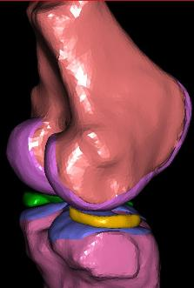
What is Biomechanics?
"The study of forces acting on and generated within the body and of the effects of these forces on the tissues, fluids or materials used for diagnosis, treatment or research purposes."

Slide 8
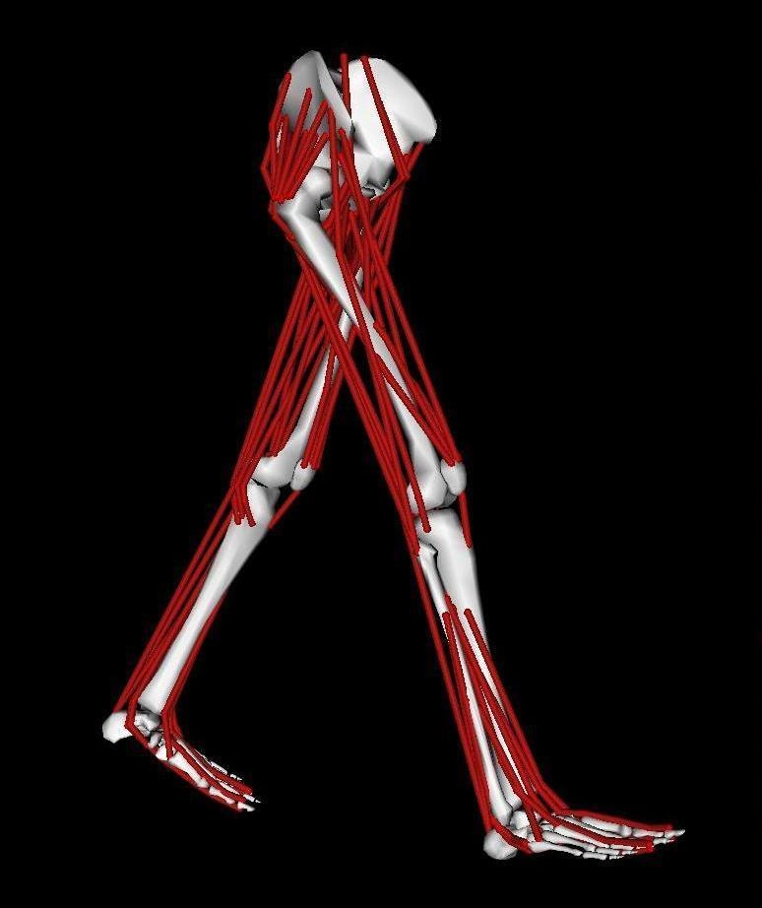
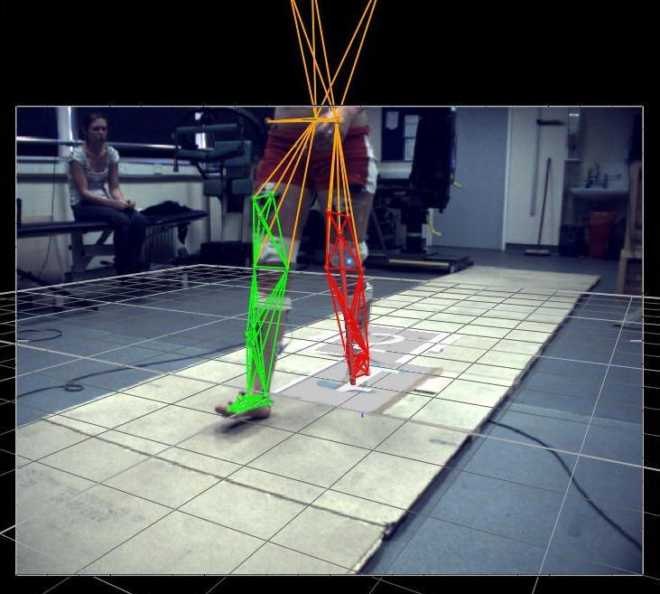
Applications
Research e.g.
Osteoarthritis Centre

Slide 9
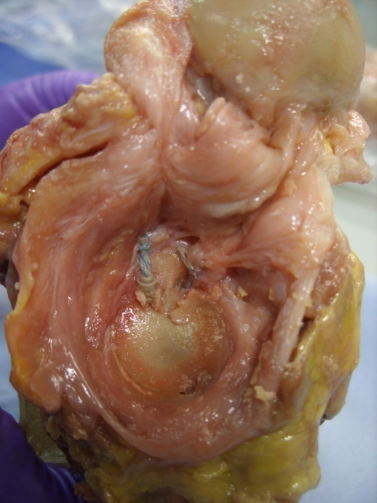
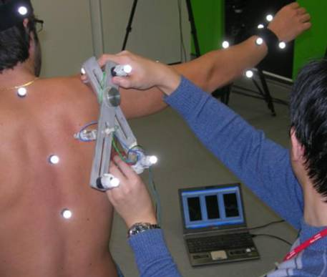
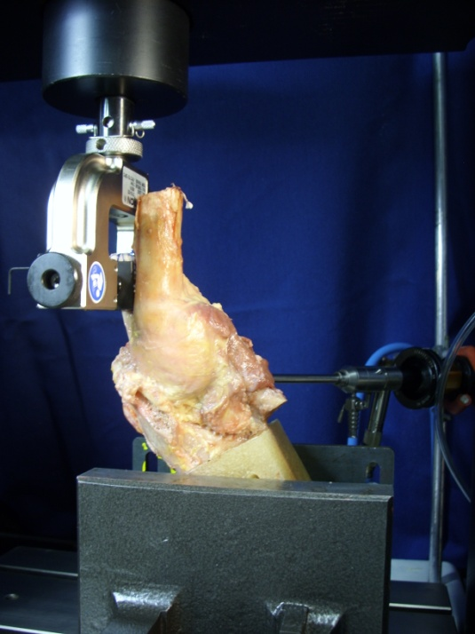
Applications
Research e.g. shoulder

Slide 10
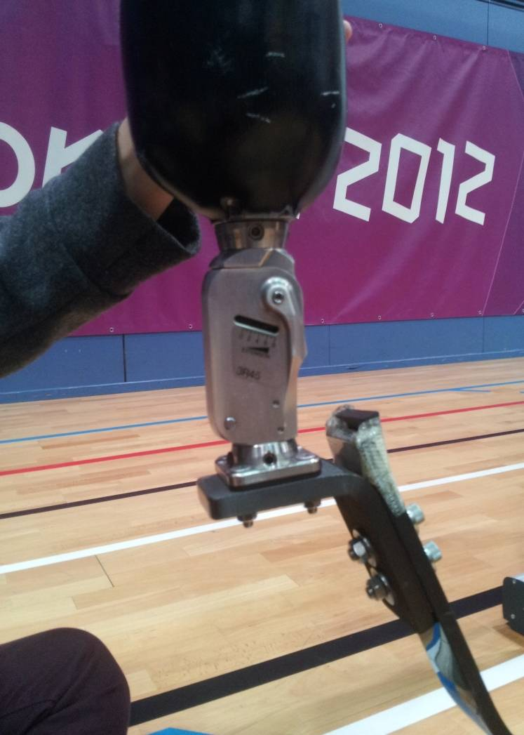
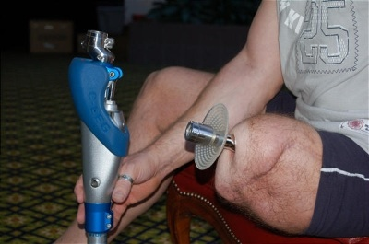
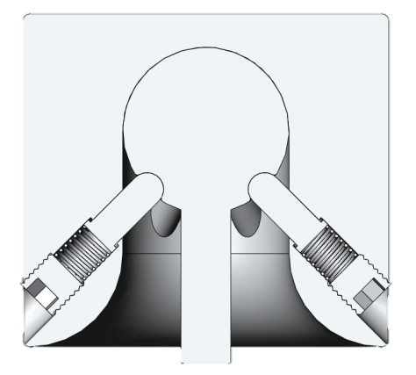
Applications
Research e.g. sports medicine

Slide 11
Part 1 – General Mechanics
Basic Concepts Combining&Calculating Stress&Strain

Slide 12
Part 1 – General Mechanics
Forces and Moments
Equilibrium
Free Body Diagrams
Bending, Torsion, Shear
Stress and Strain
Young’s Modulus
Basic Concepts Combining&Calculating Stress&Strain

Slide 13
Sources of Force
External
Internal
Friction
Acceleration
Weight (Weight = mass × g ; g is a type of acceleration)
Basic Concepts Combining&Calculating Stress&Strain

Slide 14
Force
…is a vector
…is measured in Newtons (N)
Basic Concepts Combining&Calculating Stress&Strain

Slide 15
Combining Forces
“Resultant”
=
Basic Concepts Combining&Calculating Stress&Strain

Slide 16
Polygon of forces
=
Basic Concepts Combining&Calculating Stress&Strain

Slide 17
Combining Forces
“Components”
F_{y}
F_{x}
Basic Concepts Combining&Calculating Stress&Strain

Slide 18
Resolving Forces
Summation: Σ
ΣF_{x}, ΣF_{y}
In equilibrium:
ΣF_{x} = 0
ΣF_{y} = 0
Basic Concepts Combining&Calculating Stress&Strain

Slide 19
Equilibrium
µ = coefficient of friction
R = reaction force
R
Maximum frictional force = µR
Basic Concepts Combining&Calculating Stress&Strain

Slide 20
Equilibrium
F = resultant force
m = mass
a = acceleration
F = m x a
a = F / m
Basic Concepts Combining&Calculating Stress&Strain

Slide 21
Moments
“Moment of a force”
Levers
Measured in Nm
d
F
Moment = F × d
Basic Concepts Combining&Calculating Stress&Strain

Slide 22
Moments
Direct moments
In equilibrium:
ΣM = 0
Moment = M
M
Basic Concepts Combining&Calculating Stress&Strain

Slide 23
Free Body Diagrams
A way of calculating unknown forces and moments
Example
Basic Concepts Combining&Calculating Stress&Strain

Slide 24
Free Body Diagrams
Basic Concepts Combining&Calculating Stress&Strain

Slide 25
Free Body Diagrams
F
W
R
1 unit
10 units
Basic Concepts Combining&Calculating Stress&Strain

Slide 26
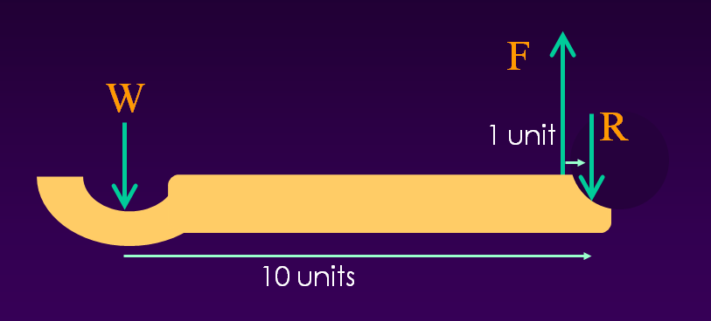
Free Body Diagrams
Resolve Forces:
ΣF_{y} = 0
F – W – R = 0
Resolve Moments:
ΣM_{Joint} = 0
(F x 1unit) – (W x 10units) = 0
F = W x (10/1) R = …
Basic Concepts Combining&Calculating Stress&Strain

Slide 27
Modes of loading
Tie (tension)
Strut (compression)
Axial
Basic Concepts Combining&Calculating Stress&Strain

Slide 28
Examples – Tension/Compression
Ligaments
Tendons
Bone
Articular cartilage
Basic Concepts Combining&Calculating Stress&Strain

Slide 29
Modes of loading
Shear
Basic Concepts Combining&Calculating Stress&Strain

Slide 30
Examples – Shear
Tendons
Bone
Articular cartilage
Basic Concepts Combining&Calculating Stress&Strain

Slide 31
Modes of Loading
Bending
Beam
Basic Concepts Combining&Calculating Stress&Strain

Slide 32
Examples - Bending
Fracture plates
Fracture fixation pins
Bones
Basic Concepts Combining&Calculating Stress&Strain

Slide 33
Modes of Loading
Shaft/axle
Torsion
Basic Concepts Combining&Calculating Stress&Strain

Slide 34
Examples - Torsion
Fracture plates
Bones
Basic Concepts Combining&Calculating Stress&Strain

Slide 35
Bending
Compression
y
−σ
+σ
Tension
Basic Concepts Combining&Calculating Stress&Strain

Slide 36
Combined Loading
Compression
Tension
y
y
y
+
=
−σ
+σ
−σ
+σ
−σ
+σ
Basic Concepts Combining&Calculating Stress&Strain

Slide 37
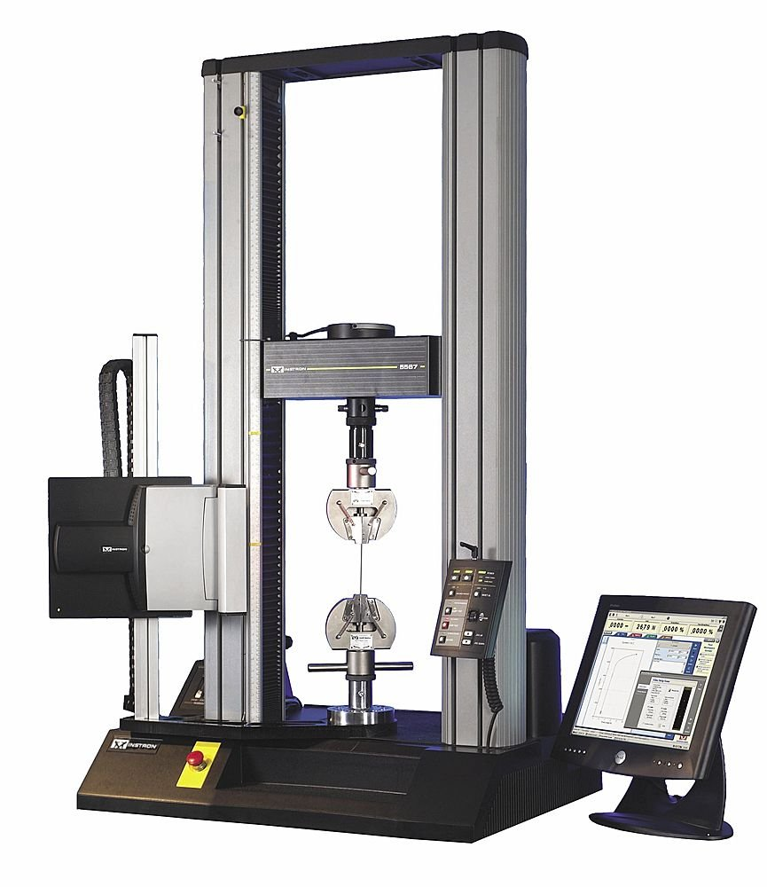
Materials Testing
Basic Concepts Combining&Calculating Stress&Strain

Slide 38
Materials Testing
Measure force
Measure extension
Basic Concepts Combining&Calculating Stress&Strain

Slide 39
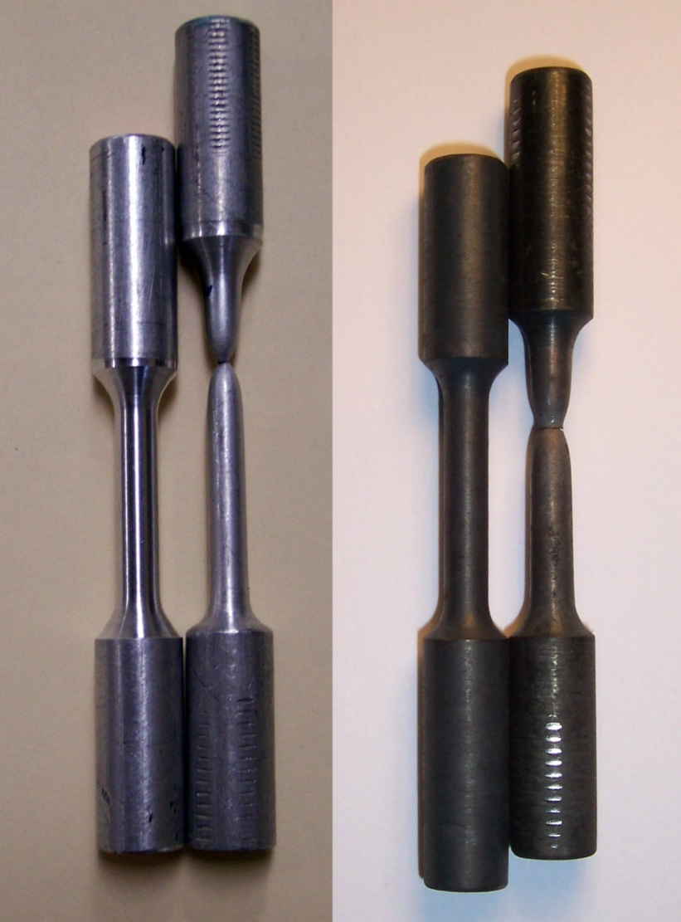
Materials Testing
Elastic deformation
Plastic deformation
Basic Concepts Combining&Calculating Stress&Strain

Slide 40
Distribution of load/force
F
F
F
F
Basic Concepts Combining&Calculating Stress&Strain

Slide 41
Stress
Stress (normalised Force)
Pressure (acting equally in all directions)
Stress or Pressure = Force/Area
Area
Basic Concepts Combining&Calculating Stress&Strain

Slide 42
Normalisation of extension
F
F
F
F
Basic Concepts Combining&Calculating Stress&Strain

Slide 43
Strain
Normalised Extension
Strain = Extension/Original Length
L
F
F
x
Basic Concepts Combining&Calculating Stress&Strain

Slide 44
Stiffness
Extension per unit force
“Young’s Modulus”
  Normalised stiffness
= Stress/Strain
Basic Concepts Combining&Calculating Stress&Strain

Slide 45
Normalising Stiffness
σ = F / A
ε = ΔL / L
Basic Concepts Combining&Calculating Stress&Strain

Slide 46
Young’s Modulus
Units: Pa (N/m²) x10⁹ or GPa
Steel
Aluminium
Bone
Ligaments
Cartilage
Basic Concepts Combining&Calculating Stress&Strain

Slide 47
Summary
Forces and Moments
Equilibrium
Free Body Diagrams
Bending, Torsion, Shear
Stress and Strain
Young’s Modulus

Slide 48
Part 2 – Mechanics in the Body
Intersegmental Finite Element Cadaveric Testing

Slide 49
Part 2 – Mechanics in the Body
Cadaveric Testing
Intersegmental models
Finite Element models
Intersegmental Finite Element Cadaveric Testing

Slide 50
Cadaveric Testing
Uses
Establishing material properties
Investigating joint laxity and restraints
Simulating pathology and surgical intervention
Intersegmental Finite Element Cadaveric Testing

Slide 51
Ligament/Tendon
‘Viscoelastic’
Load-extension response is time dependent
Intersegmental Finite Element Cadaveric Testing

Slide 52
Ligament/Tendon
Multiple failure region
Fibres fail sequentially
Linear region
Straight fibres
Full fibre recruitment
Rupture
Toe region
Uncrimping of fibres
Gradual fibre recruitment
Intersegmental Finite Element Cadaveric Testing

Slide 53
Cadaveric Testing
Long head of biceps tendon
Tensile test to failure
Example studies:
Alexander et al., 2009, Shoulder and Elbow.
Intersegmental Finite Element Cadaveric Testing

Slide 54
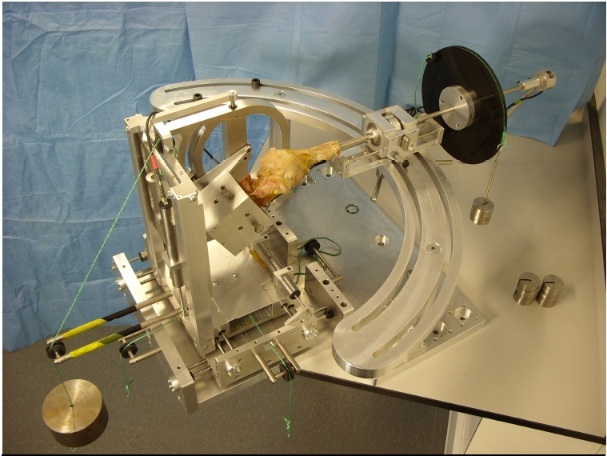
Cadaveric Testing
Intersegmental Finite Element Cadaveric Testing

Slide 55
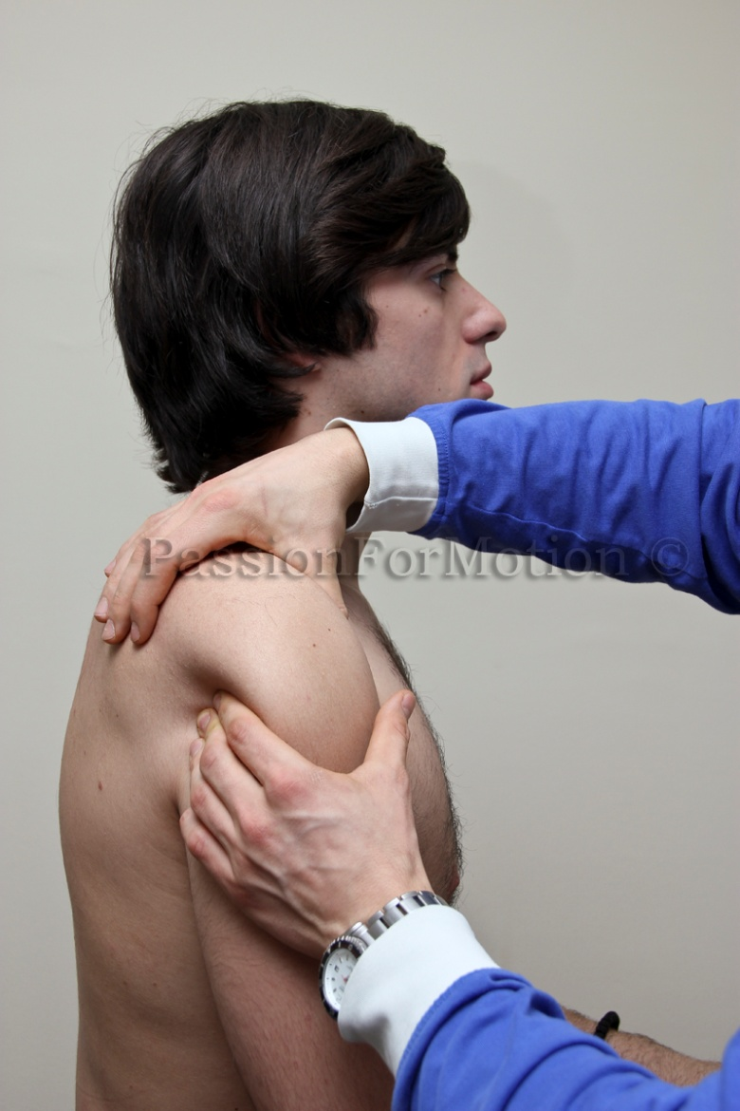
Simulating Clinical Motions
Anterior drawer test
Example studies:
Southgate et al., 2009, J Biomech.
Alexander et al., 2013, J Shoulder Elbow Surg
Intersegmental Finite Element Cadaveric Testing

Slide 56
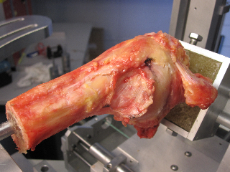
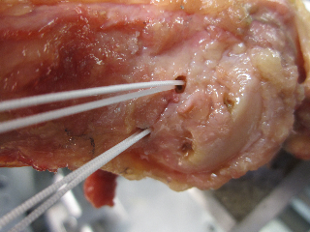
Cadaveric Testing
Humeral Avulsion of the Glenohumeral Ligament (HAGL) lesions
Southgate et al., Arthroscopy (In Review).
Intersegmental Finite Element Cadaveric Testing

Slide 57
Cadaveric Testing
Intersegmental Finite Element Cadaveric Testing

Slide 58
Cadaveric Testing Limitations
Specimens may have existing pathology
Variability in anatomy between specimens
Material properties can change if not kept in physiological environment
Reproducing in-vivo loading is challenging
Isolating structures can also be difficult
Often single experiment per specimen only
…Expensive!
Intersegmental Finite Element Cadaveric Testing

Slide 59
Cadaveric Testing Summary
Useful for investigating material properties, whole joint motion and effects of surgery
Need to be aware of complex loading environments
Limitations of cadaveric testing may prevent direct translation into clinical practice
Intersegmental Finite Element Cadaveric Testing

Slide 60
Types of Biomechanical Model
Intersegmental models
Each bone/muscle/ligament treated as a single element
Calculates joint reaction forces and predicts muscle tension
Finite Element models
Each bone/muscle/ligament divided into many small elements
Calculates distribution of stress/strain within the tissues
Intersegmental Finite Element Cadaveric Testing

Slide 61
Intersegmental Modelling
Kinematics
Movements (position, velocity, acceleration, joint angles)
Kinetics
Forces during movements (joint torque, GRF)
Forward Dynamics
How forces cause movements. Estimate the movement resulting from forces and moments
Inverse Dynamics
How movements require forces. Estimate the forces that cause the motions we measure
Intersegmental Finite Element Cadaveric Testing

Slide 62
Intersegmental Modelling
F
W
R
1 unit
10 units
Intersegmental Finite Element Cadaveric Testing

Slide 63
Intersegmental Moments
M = 50(0.3cos(θ-90))
θ
0.3m
50 N
Intersegmental Finite Element Cadaveric Testing

Slide 64
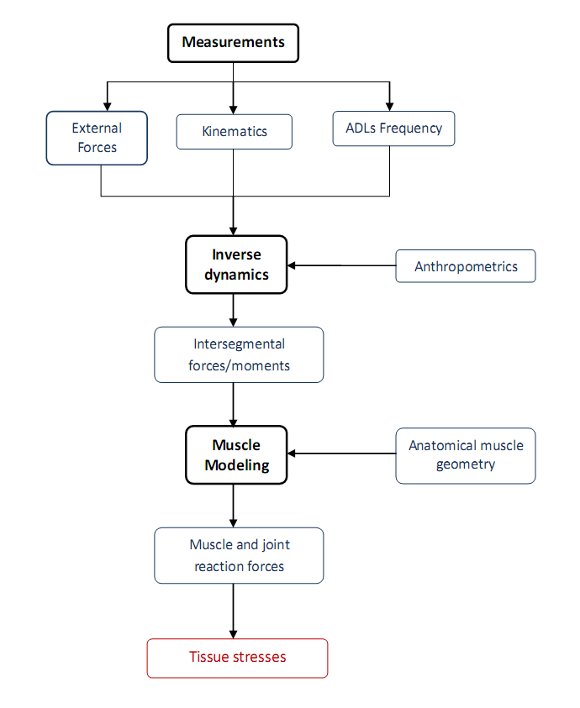
Intersegmental Modelling
Intersegmental Finite Element Cadaveric Testing

Slide 65
Intersegmental Modelling
Motion Capture
Kinematic analysis
Intersegmental Finite Element Cadaveric Testing

Slide 66
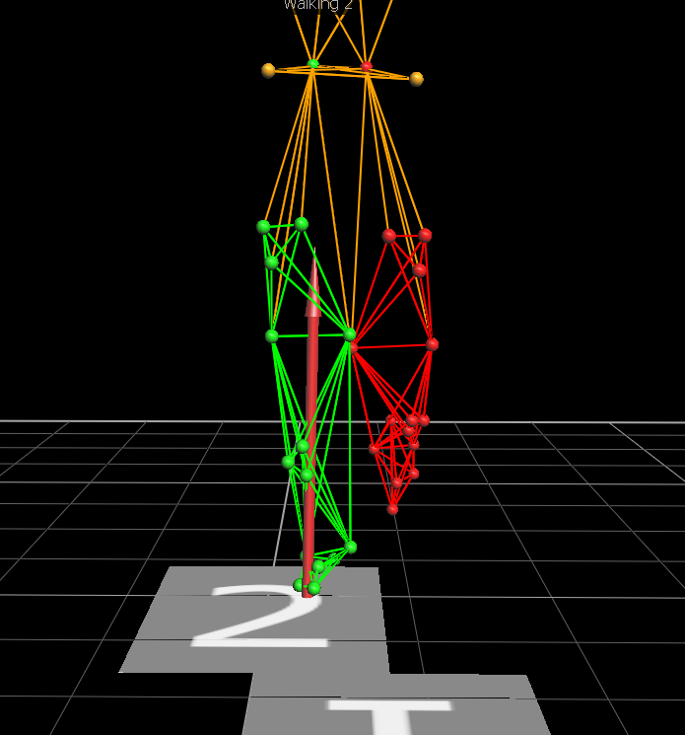
Intersegmental Modelling
Motion Capture
Kinematic/kinetic analysis can be used directly…
Example studies:
Duffell et al., Gait and Posture (In Review).
Intersegmental Finite Element Cadaveric Testing

Slide 67
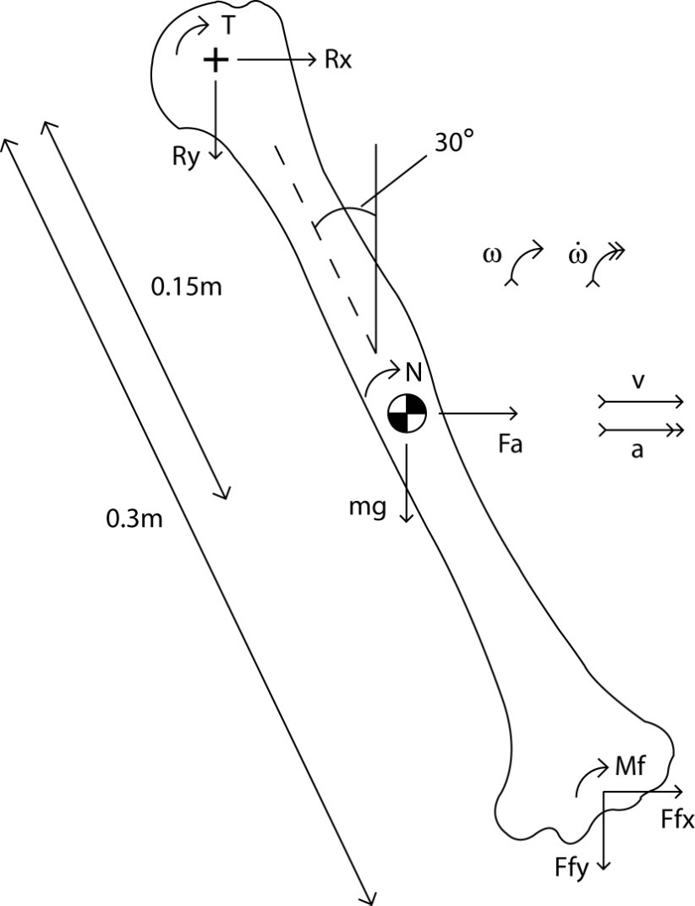
Intersegmental Modelling
Inverse Dynamics
Joint force and torque calculation
Intersegmental Finite Element Cadaveric Testing

Slide 68
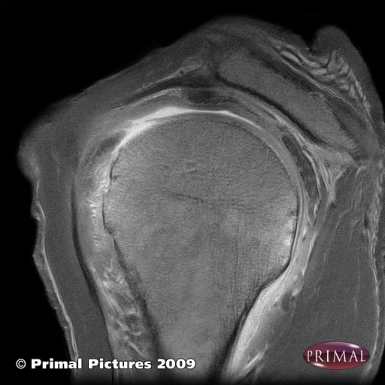
Intersegmental Modelling
Anatomical geometry
Segmentation
MRI/CT etc.
Example studies:
Klein Horsman et al., 2007, Clin Biomech.
Intersegmental Finite Element Cadaveric Testing

Slide 69
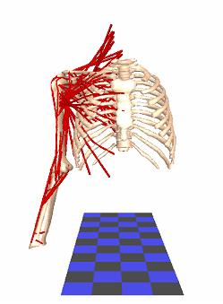
Intersegmental Modelling
Optimisation Algorithms
‘Cost function’ to minimise muscle stress
Written (coded) in Matlab/C++
Newcastle Shoulder Model
Intersegmental Finite Element Cadaveric Testing

Slide 70
Intersegmental Modelling
Output Muscle Forces
Intersegmental Finite Element Cadaveric Testing

Slide 71
Intersegmental Modelling
Uses
Analysing joint motions
  Diagnosing abnormal patterns
Estimating muscle and joint forces
  Improving implant design etc.
Effects on muscle moment arms
  Changes following surgery
Intersegmental Finite Element Cadaveric Testing

Slide 72
Intersegmental Modelling
Example studies:
...sensitivity to lower limb kinematics
  Southgate et al., 2012, Proc Inst Mech Eng [H]
...patellofemoral forces during weightlifting and vertical jumping
  Cleather & Bull, 2010, Proc Inst Mech Eng [H]
...biomechanics of reverse shoulder replacement
  Kontaxis and Johnson, 2009, Clin Biomech.
Intersegmental Finite Element Cadaveric Testing

Slide 73
Finite Element Modelling
Anatomical geometry
Segmentation
MRI/CT etc.
Intersegmental Finite Element Cadaveric Testing

Slide 74
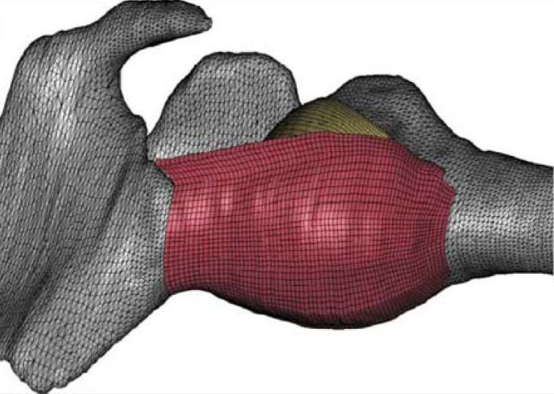
Finite Element Modelling
Mesh Generation
Element type
No. of elements
Example studies:
Weiss et al., 2005, Med Eng Phys.
Inferior Glenohumeral Ligament Model – Weiss Group
Intersegmental Finite Element Cadaveric Testing

Slide 75
Finite Element Modelling
Inputs
Material Properties
Loading Conditions
Example studies:
Masouros, 2009, PhD Thesis, Imperial College
Masouros Knee Model
Intersegmental Finite Element Cadaveric Testing

Slide 76

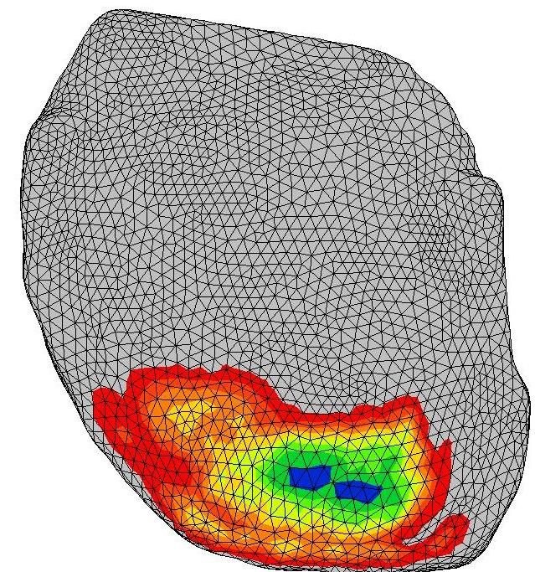
Finite Element Modelling
Outputs
Stress/Strain patterns
Glenoid cartilage
Intersegmental Finite Element Cadaveric Testing

Slide 77
Finite Element Modelling
Uses
Estimating joint contact stress
  Improving implant design etc.
Simulating surgery
  Effects of meniscectomy, for example
Intersegmental Finite Element Cadaveric Testing

Slide 78
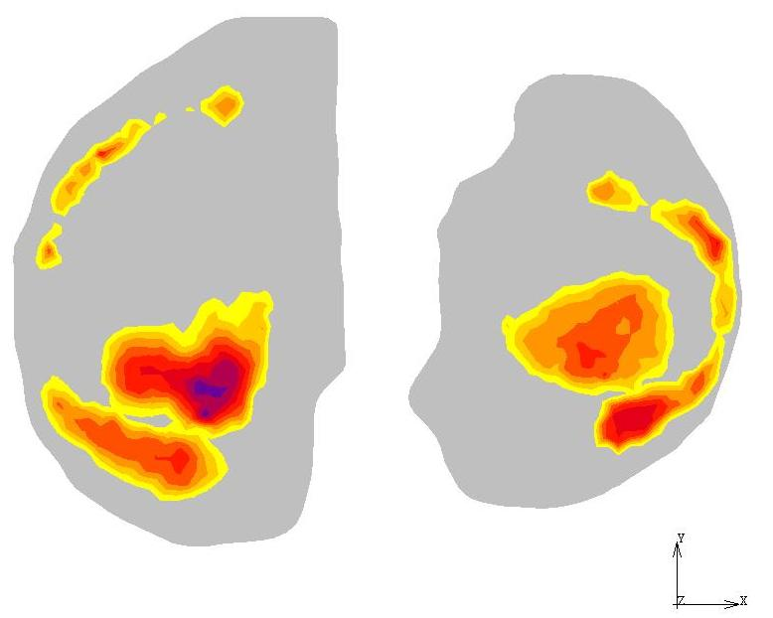
Finite Element Modelling
30° flexion
Normal stresses
in articular cartilage
Max. principal stresses
in menisci
Masouros Knee Model
Intersegmental Finite Element Cadaveric Testing

Slide 79
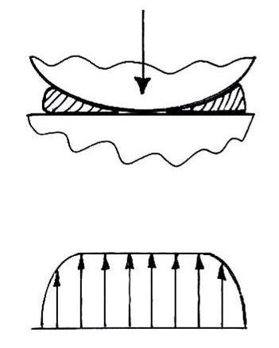
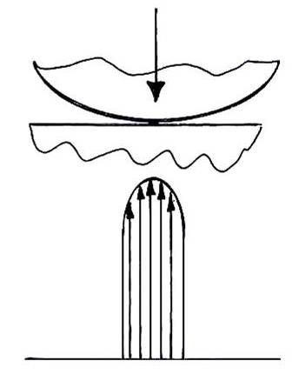
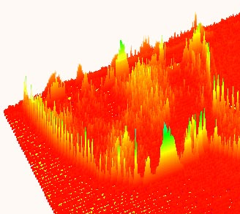
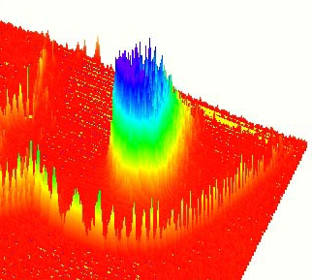
Finite Element Modelling
Meniscectomy results in:
Cartilage to cartilage contact
Less conformity
Decreased contact area
Increased contact stresses (up to 200%)¹
Increased shear stresses
McDermott et al, 2008, Curr Orthop.
Intact
Meniscectomised
Intersegmental Finite Element Cadaveric Testing

Slide 80
Modelling Limitations
Intersegmental models
Every aspect of a model needs verification and validation
  Verification – internal consistency
  Validation – it represents the human body
BUT...purpose of a model is always to simulate what can’t be measured directly
Intersegmental Finite Element Cadaveric Testing

Slide 81
Modelling Limitations
Motion capture: skin motion artifacts
Inverse dynamics: mass and inertial properties
Geometry: muscle modelling
Optimisation: relevant minimisation criteria
Intersegmental Finite Element Cadaveric Testing

Slide 82
Modelling Limitations
Finite element models
Computing power
Material properties/equations
Boundary conditions/interfaces
Intersegmental Finite Element Cadaveric Testing

Slide 83
Modelling Summary
Experimental Data
Input
Modelling
Validation
Output
Mechanical Behaviour
Clinical application
Intersegmental Finite Element Cadaveric Testing

Slide 84
Overall Summary
The human body and its structures are like any other solid object and obey Newton’s Laws of Motion
The human body can be simplified to allow investigation using basic mechanics and equations
Modelling is simply using these equations on a larger scale

Slide 85
Suggested reading
General background
Principles of Mechanics and Biomechanics, Frank Bell, Stanley Thornes publishing
Lower-limb biomechanics and modelling
Clinical Gait Analysis, Chris Kirtley, Elsevier publishing. Particularly chapter 4: Biomechanics of Standing.

